Slide 1
YBA
GUEST SPEAKER
Chris Garcia

Slide 2
INTRODUCTION
My name is Chris Garcia and I am 27 years old
I own a management consulting company, Chris Garcia & Associates LLC
We help startup companies grow and help existing businesses expand their customer base domestically and internationally
I’m a Delegate to Greece for the U.S. Department of State
I’m a Board Member for the Gates Millennium Scholars Alumni Association

Slide 3
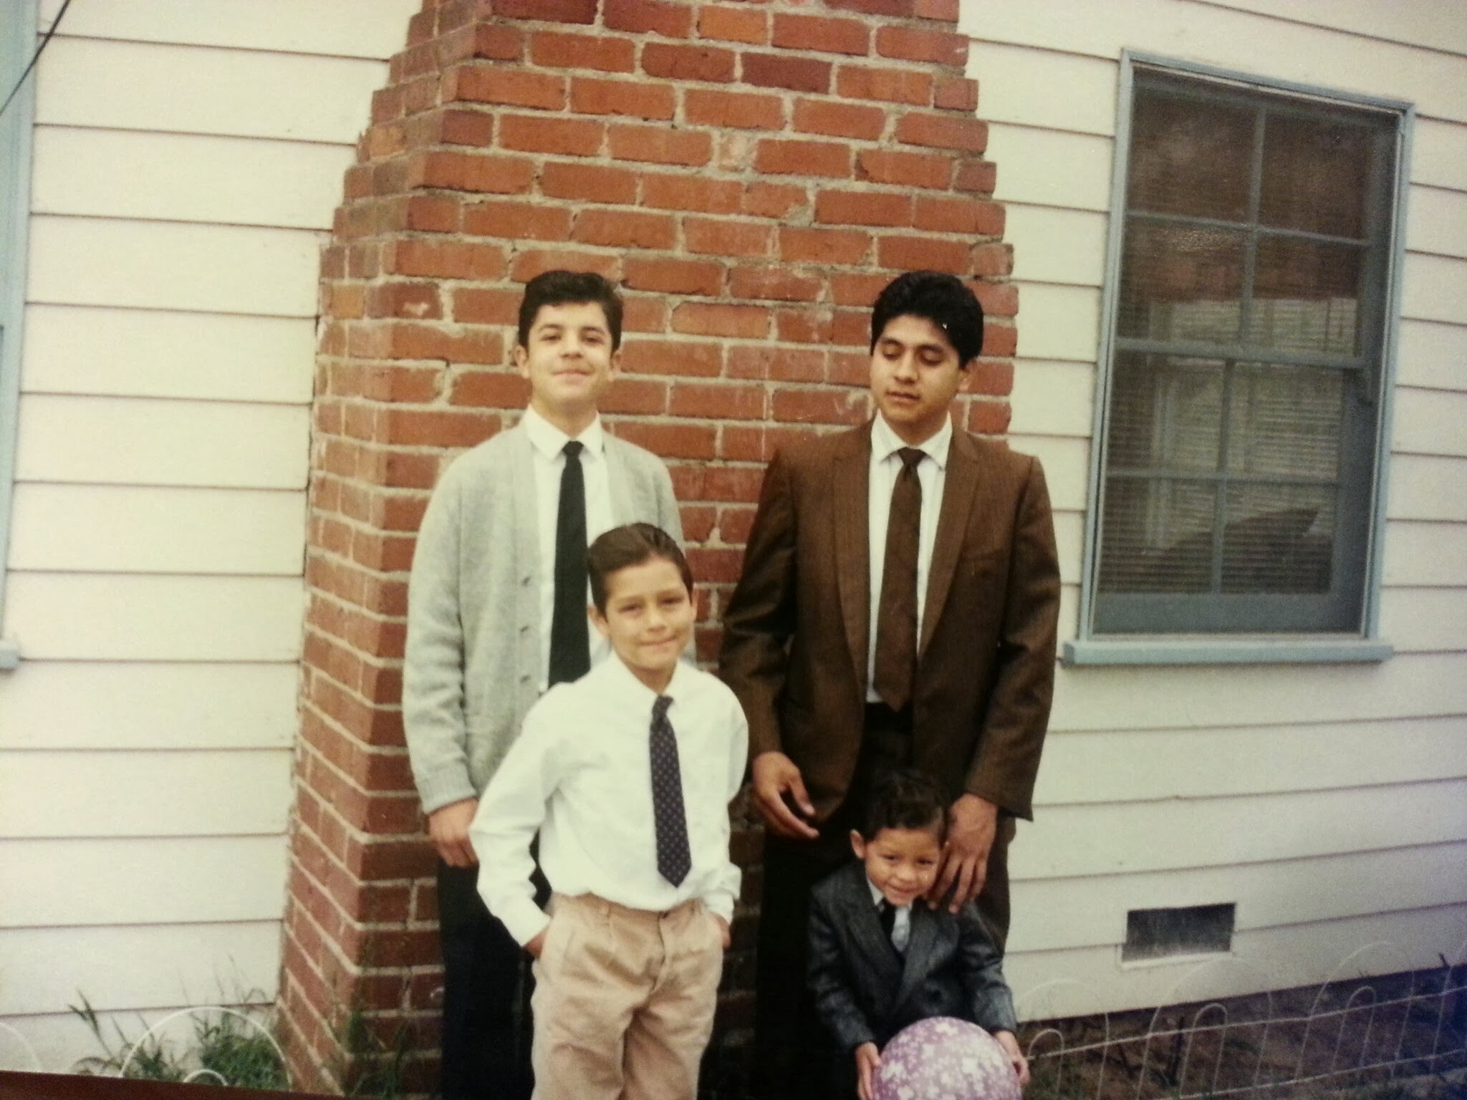
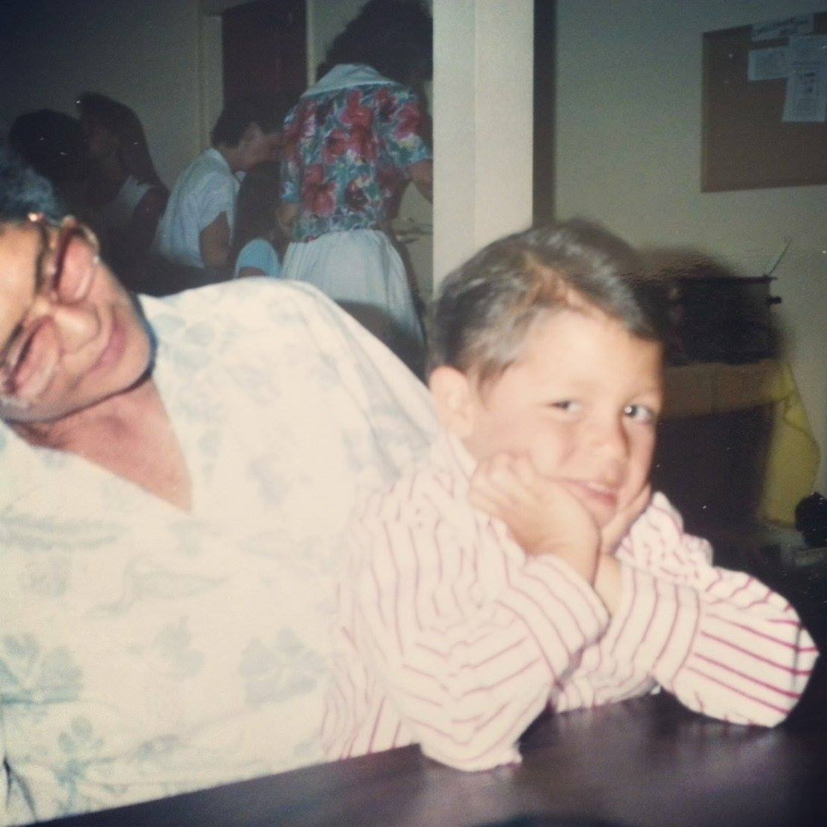
The Early Years…
I was born and raised in Pacoima, Los Angeles, California

Slide 4
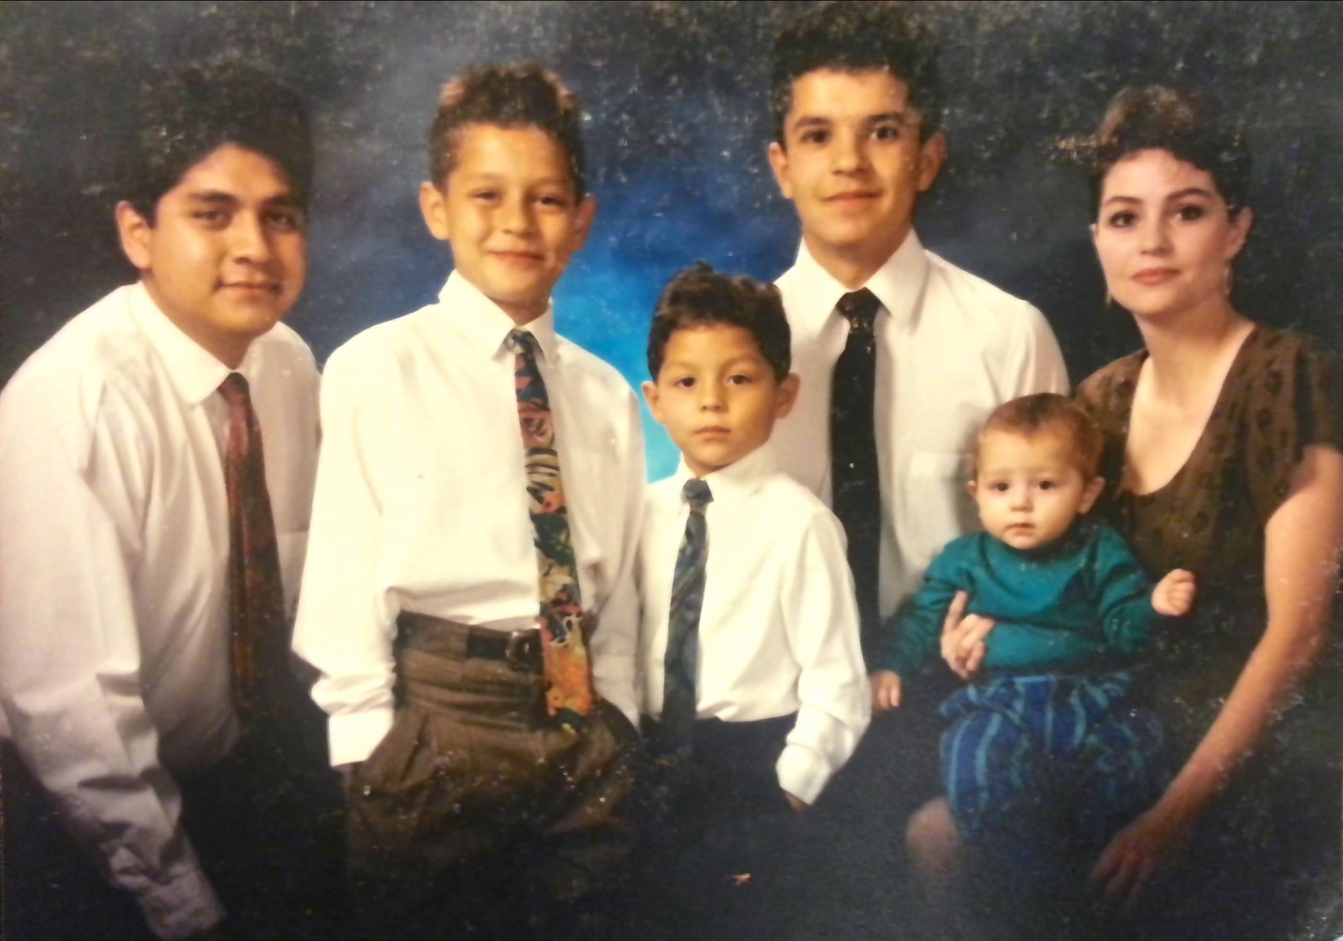
More Early Years…
A little about my family…

Slide 5
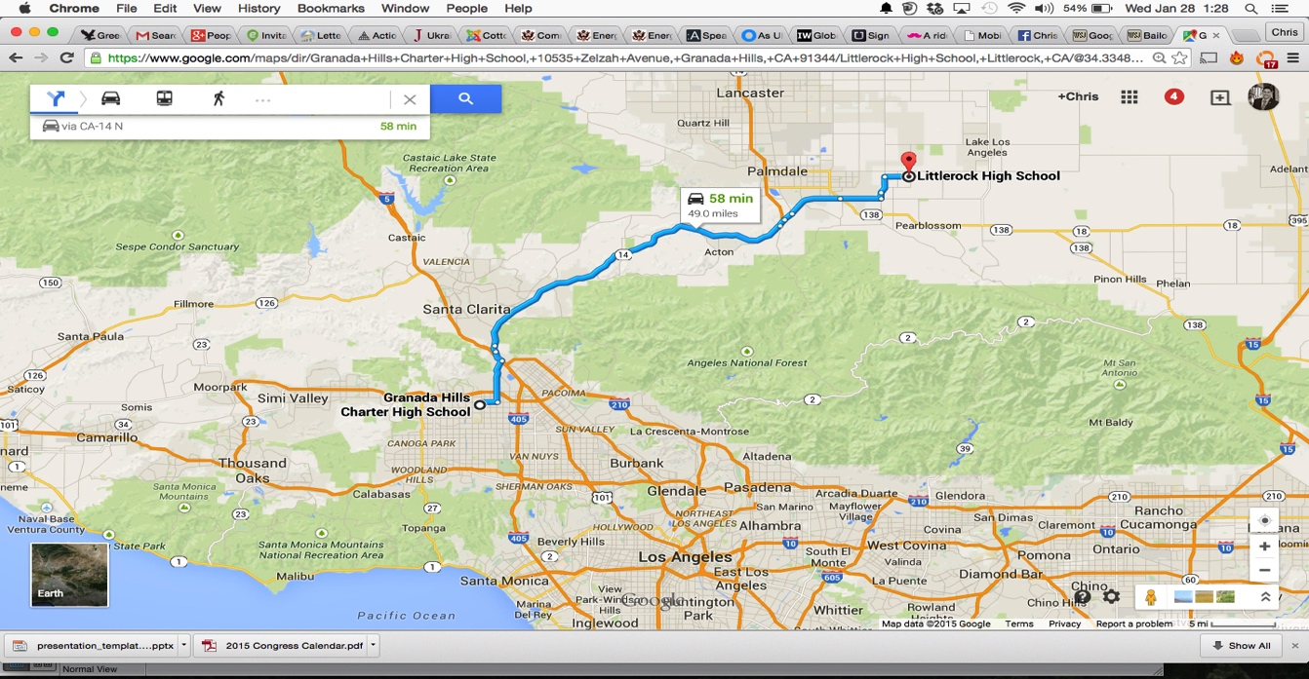
HIGH SCHOOL
I attended Granada Hills Charter High School in Granada Hills, CA and Littlerock High School in Littlerock, CA
\

Slide 6
HIGH SCHOOL
As a HS student I was involved in basketball, baseball, volleyball, cross country… and mathletes.
As a HS student I was outgoing, but not with many students.
I was also involved in local campaigns.
\

Slide 7
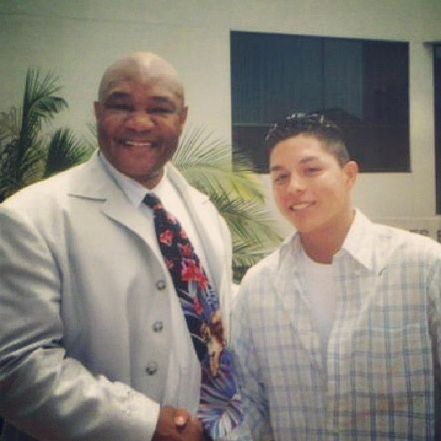
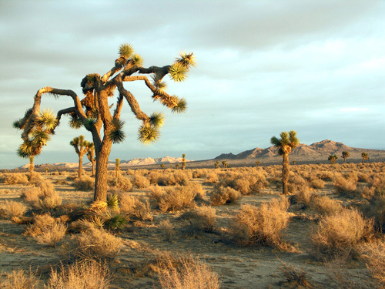
HIGH SCHOOL
Things I enjoyed in HS
Things I did not enjoy in HS
Pickup Basketball 24/7
Studying (is that weird?)
Pepperdine YCS
Struggling to fit in
Living in the desert

Slide 8
HIGH SCHOOL
Activities/Athletics in HS
Jobs I worked while in HS
Varsity Baseball
Varsity Basketball
Varsity Volleyball
Varsity Cross Country
Varsity Mathletes
Printing with my dad
Construction with my uncle
Sales associate at Big 5 Sporting Goods

Slide 9
HIGH SCHOOL
Fondest memories from HS
Obstacles/Adversity you had to overcome in HS
Road trips with my teammates
Being selected as a Bill Gates Millennium Scholar
Opinion piece in the school newspaper
Mr. Smith
Moving to a new high school sophomore year
Being alone with my little brother afterschool
Not having a lot of money

Slide 10


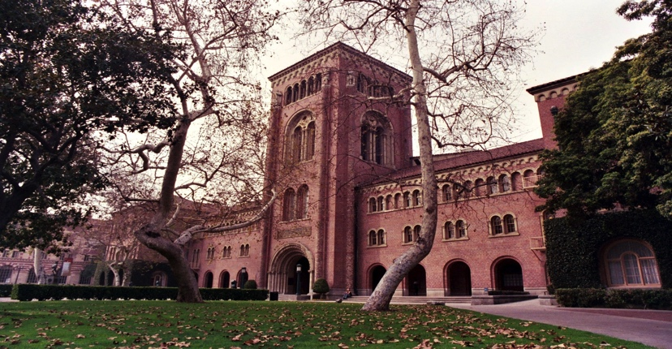
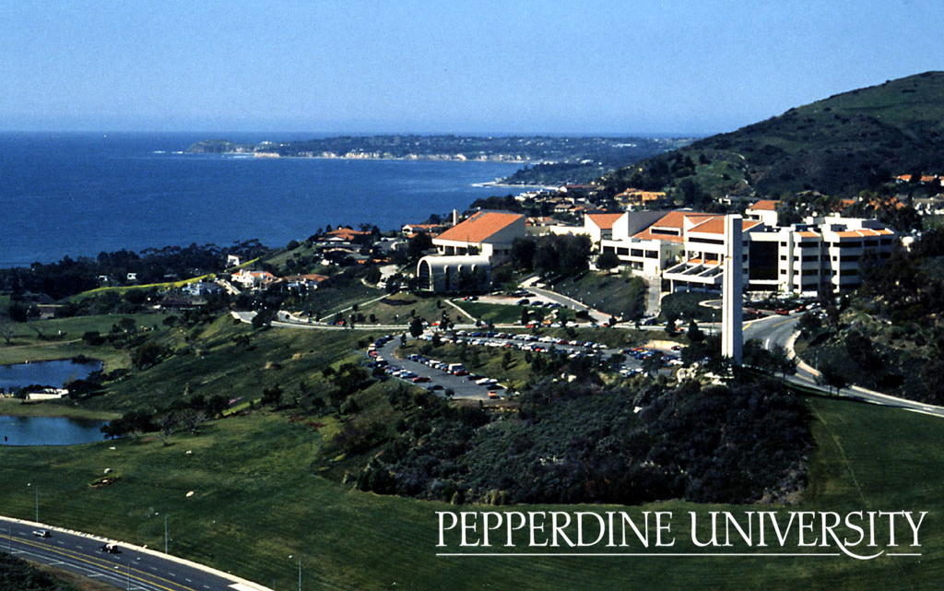
College
\

Slide 11
College
Activities/Athletics in College
Jobs I worked in College
Men’s Rugby
College Republicans
Young America’s Foundation
Malibu Veterans Day Ceremony
Personal Trainer
Lululemon
Political Consultant
Sales Analyst, Amber Hotel Company

Slide 12
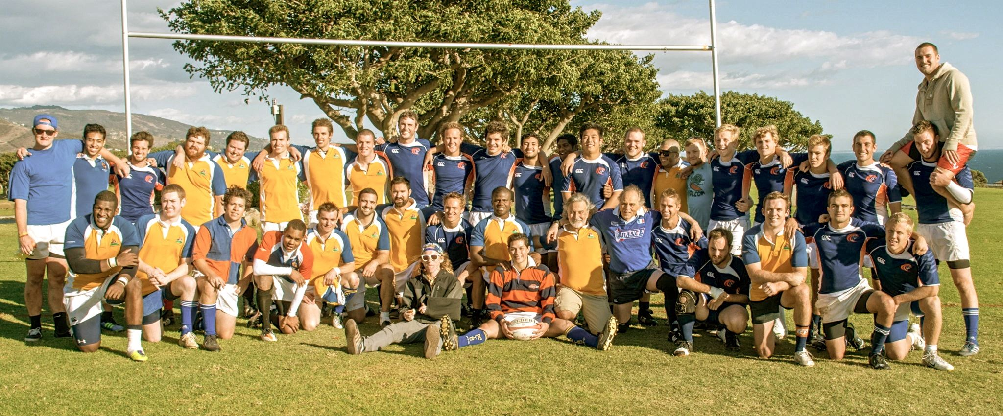
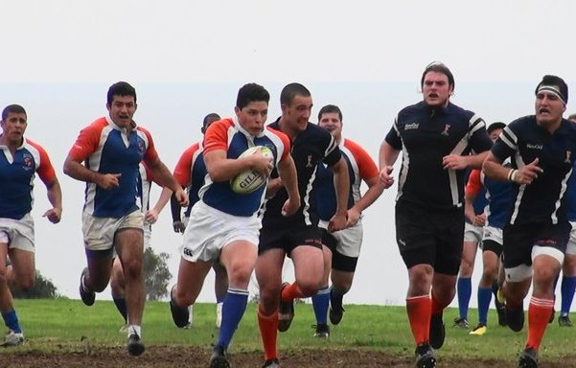
College

Slide 13
College
Favorite classes
Least favorite classes
Industrial Organization (Economics)
Marketing
Humanities
Calculus
Religion (required)

Slide 14
College
Fondest memories
Obstacles and Adversity
Winning the Men’s Rugby Division Championship
Appearing live on Fox News
9/11 Memorial: Waves of Flags
Mom and dad divorce
Grandma dying
Living in my car

Slide 15
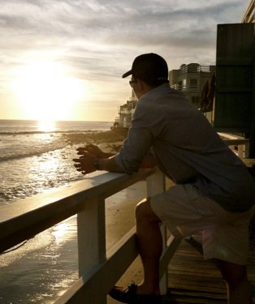
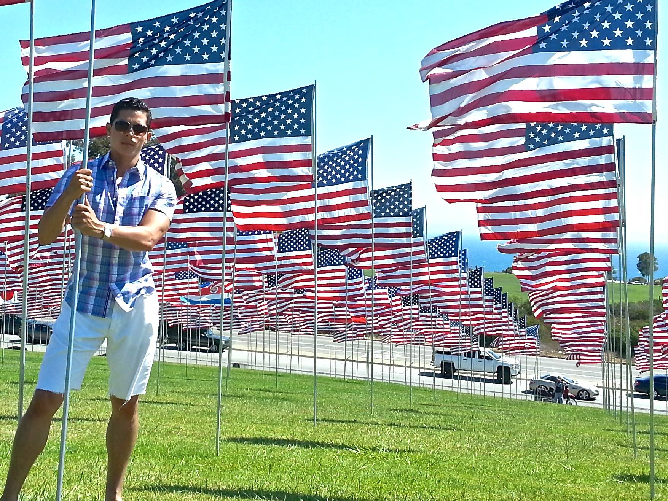
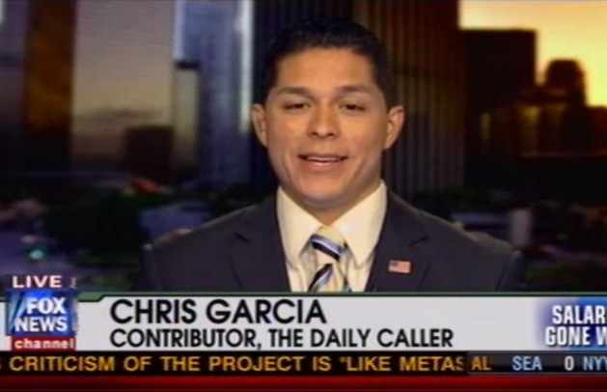
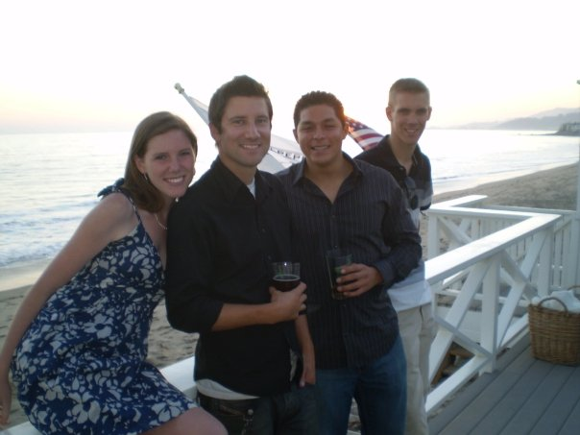
College

Slide 16
Career Path
2004
Grassroots Volunteer, George W. Bush for President
2006
Intern, Arnold Schwarzenegger for Governor (CA)
2008
Grassroots Volunteer, John McCain for President
Grassroots Volunteer, Tony Strickland for State Senate (CA-19)
Grassroots Volunteer, Audra Strickland for State Assembly (CA-19)
Grassroots Volunteer, Thomas Vidal for State Assembly (CA-53)
2009
Political Coordinator, California Republican Party
Pepperdine Randall Intern, LA County Republican Party
Vice President, Pepperdine University College Republicans
Notes:
You may use this chart to describe your journey to the current career

Slide 17
Career Path
2010
Co-Chair, Los Angeles Young Professionals (Gen-M), Meg Whitman for Governor (CA)
Grassroots Volunteer, Audra Strickland for Ventura County Supervisor
Grassroots Volunteer, Tony Strickland for Controller (CA)
Political Consultant, Mazza & Scheinkman for Malibu City Council
President, Pepperdine University College Republicans
2011
Grassroots Volunteer, Mitch Englander for Los Angeles City Council (CD-12)
2012
Grassroots Volunteer Leader, Tony Strickland for Congress (CA-26)
Grassroots Volunteer Leader, Todd Zink for State Senate (CA-19)
Grassroots Volunteer, Mitt Romney for President
Political Consultant, Skylar Peak for Malibu City Council
2014
Finance Committee Member, Tony Strickland for Congress (CA-25)
Political Consultant, Craig Foster for SMMUSD School Board
Notes:
You may use this chart to describe your journey to the current career

Slide 18
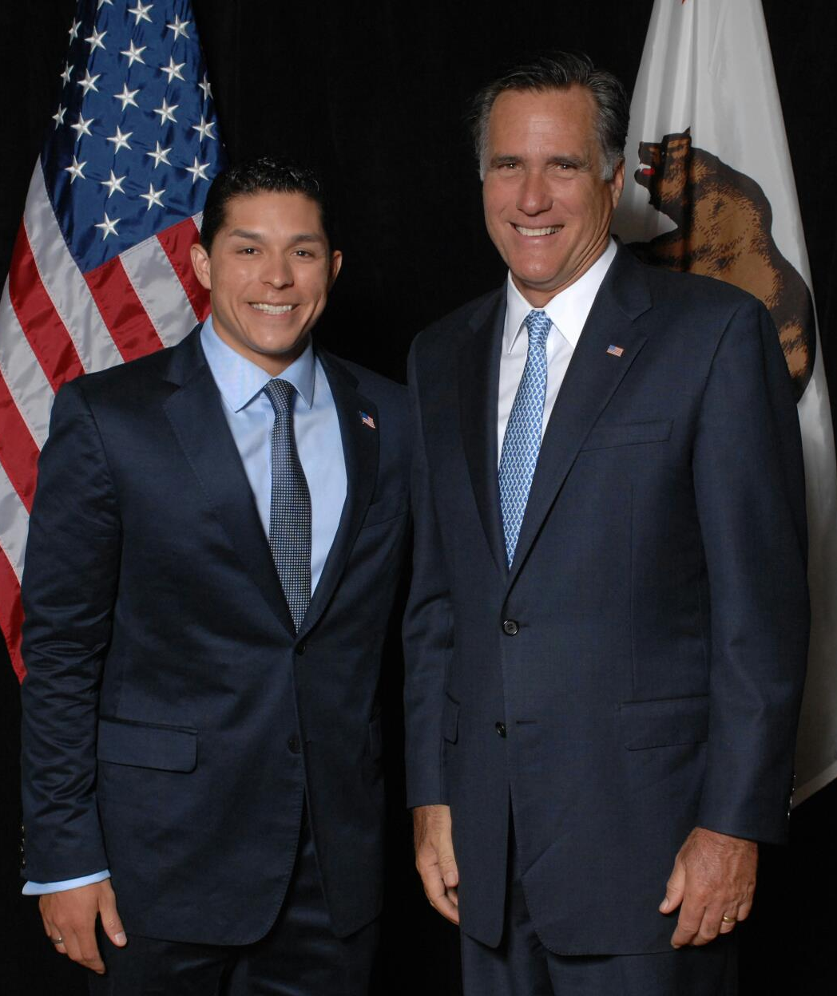
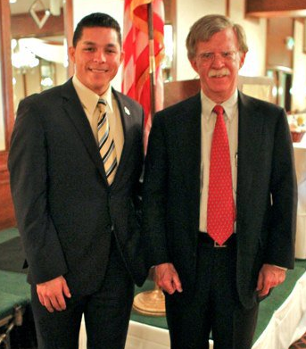

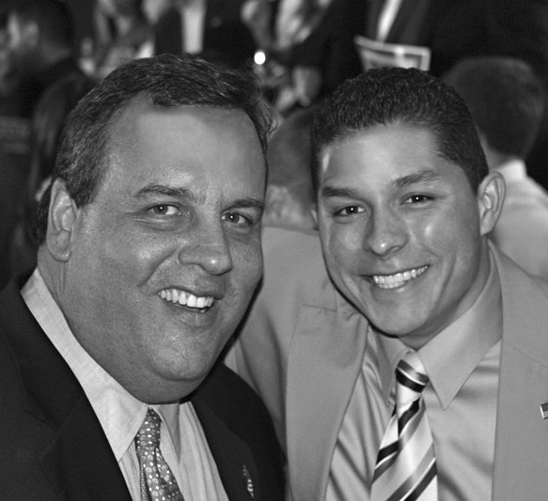
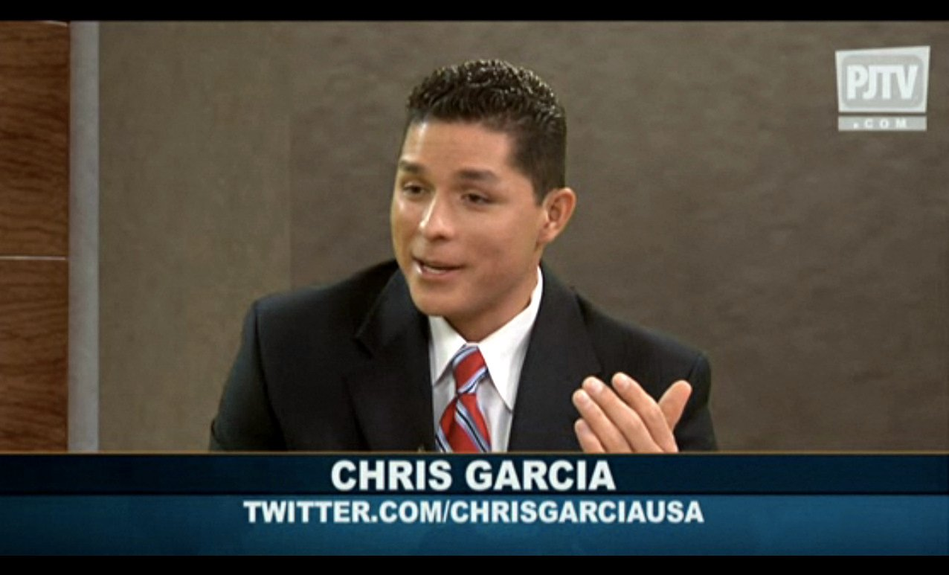
Career

Slide 19





Career

Slide 20


Slide 21
Career
Some challenges I had to overcome in my career

Slide 22
CURRENT ROLE
History
Chris Garcia & Associates LLC - founded in 2010
Began with political consulting, expanded to businesses
Size
3 partners
Location
Offices in Malibu, California and San Francisco, California
Services
Services
Startup consulting, capital formation, business planning & strategy
Marketing, Business Development, & Customer Acquisition
Notes:
Use this graph to give more description of your current company (history, size, location, products and services, etc.)

Slide 23
ACADEMIC EXERCISE
We will now spend several minutes discussing the day’s academic module and how it is relevant in the ‘real world’

Slide 24

QUESTION AND ANSWER

