Slide 1
YBA: Sara Stringfellow

Slide 2
INTRODUCTION
My name is Sara Stringfellow and I am 29 years old.
I work for March Capital Partners.
My company invests money into start up companies.
My role at March Capital is very varied!
Every day I look at pitch decks, help start ups with their marketing and UX, work the calendar, and oversee office operations.

Slide 3
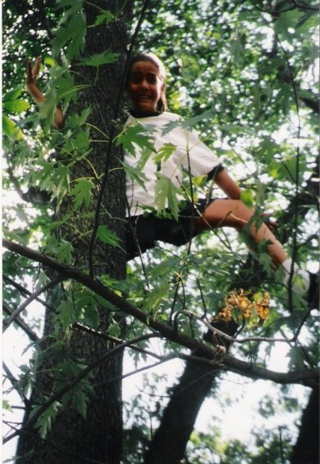
My childhood
I was born in Clearwater Florida and raised in Georgia, Delaware, Florida, etc.

Slide 4
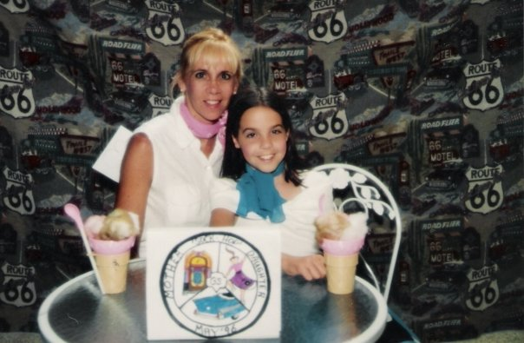
My family
A little about my family
My dad was a pilot, and my mother was an Office Manager

Slide 5
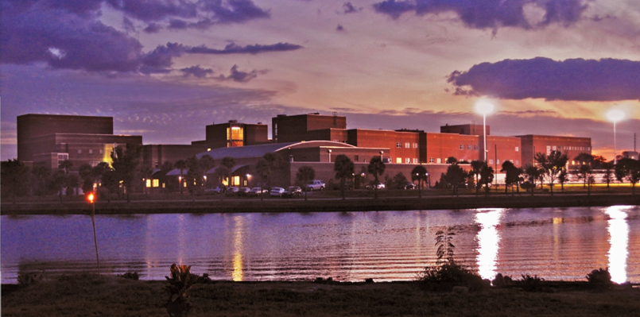
MY HIGH SCHOOL
I attended Howard W. Blake HS in Tampa, Florida

Slide 6
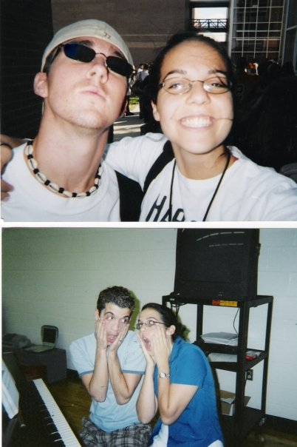
High School
As a HS student I was involved in Musical Theatre, Soccer, Drama Team, GSA, Chorus, Youth Group, etc.

Slide 7
High School
Things that felt difficult or challenging for me while I was in High School were:
Going to all my activities without a car, until the day I got one.
Doing everything. “More is better”
Feeling good enough at anything. “Better is better”

Slide 8
High School
Jobs I worked while I was in High School were:
Working as an Administrative Assistant at my Mom’s work
Running flyers around the neighborhood
Babysitting

Slide 9
Getting in to College
The top few things I did to ensure I got into college were:
Auditioned for everything, even if I didn’t think I wanted it.
Had a few top notch essays ready to send to anywhere.
Offered my guidance counselor doughnuts to expedite a transcript.

Slide 10
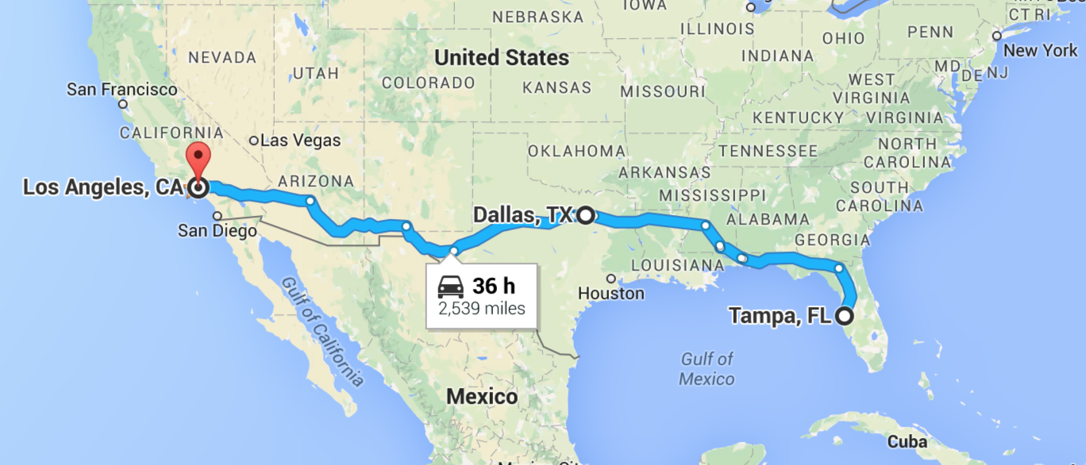
College
I attended college at SMU in Dallas, TX

Slide 11
College
Things I enjoyed in College
Things I didn’t enjoy in College
Living on my own
Making great friendships and connections
Having my eyes opened
Being empowered by negative to charge head first into positive
Making great connections in a city I had no intention of ever living in again.
Constant exposure to alcohol

Slide 12
College
Favorite classes
Least favorite classes
Poetry and creative writing
Oceanography
Tech theatre
Calculus for business
Retaking a math course easier than the one I chose to challenge myself with.

Slide 13
College
Jobs I worked while I was in College were:
Hostess
Nanny
Ran a child care organization
Professional Organizer
Administrative Assistant

Slide 14
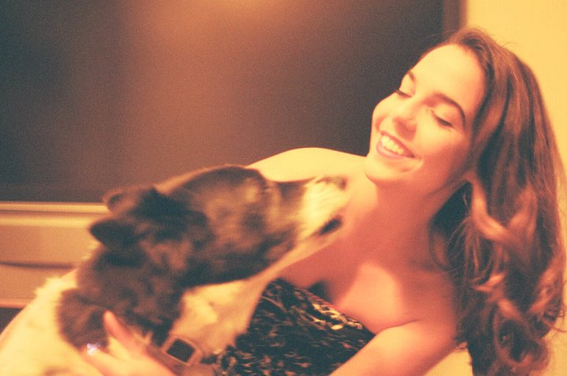
College
Things that felt difficult or challenging for me while I was in College were:
Missing the ocean. Missing the wilderness. Missing my pup back home.

Slide 15
Getting a job after College
The top few things I did to ensure I got a good job after college were:
Move to Africa.
https://youtu.be/JMH0wYFLcko

Slide 16
This is My Company
Every day at my company:
We meet with Investors to talk about how we are going to invest their money, into what kinds of start ups, and why we think that is the future of technology.
We meet with Start Ups to talk about how would use money we invest in them, and how their business is doing.

Slide 17
My Career Path
I then oversaw two office moves and hired a receptionist.
I was the Executive Assistant
I am now the Marketing Manager, Office manager, Executive Assistant.
Notes:
You may use this chart to describe your journey to the current career

Slide 18
My Career
The first job I had after college was:
A live in Executive Assistant/Nanny for a financial executive.
The worst job I have ever had was:
Working for someone who was not a healthy boss.

Slide 19
My Career
Challenges I have had to overcome throughout my career are:
Escaping the downstream position
Being seen as more than the girl who makes coffee
Taking action when not given any direction

Slide 20
More than just work
When I am not at work I like to:
Go to the gym
Go to the beach or snowboarding
Read
Write

Slide 21
Do it all over again?
If I could talk to my high school self, what would I say?
Keep track of what you love.
Everything gets hard at a certain level, choose what you want to care enough about to be frustrated by.
Plan your bad days.
Choose a college in a city you want to make connections in.

Slide 22
To you at 17 and half, from me at 27 and a half;
Don’t freak out about being so close to turning 18. I know it feels like an ending, and well, it is, but in the best possible way. Like in the way that there is such a rad beginning now starting and, oh man, you just don’t even know…

Slide 23
QUESTION AND ANSWER

