Slide 1
Scott Trevena
Chief Technologist WPAS

Slide 2
INTRODUCTION
My name is Scott Trevena and I am ?? years old.
I work for Wipro Promax Analytics Solutions (WPAS).
My company does:
Develops and sells software for Consumer Goods companies to enable them to plan their promotional calendars
My role at WPAS is Chief Technologist
Oversee the ongoing design and development of the application
Develop prototype functionality

Slide 3
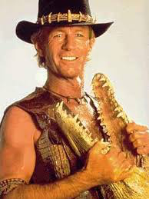
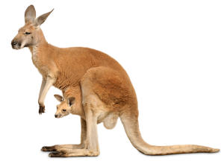
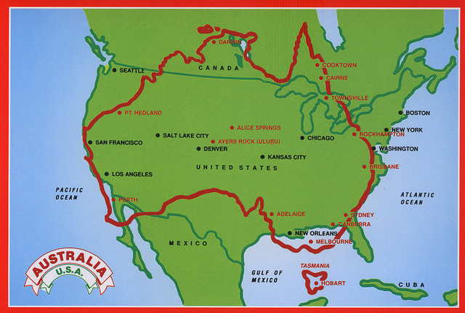
Australia

Slide 4
My childhood
I was born and raised in Sydney, Australia
This is a picture of me at a young age

Slide 5
My family
A little about my family
My dad was a Veterinarian and my mum stayed at home and looked after the three of us boys
This is a picture of my mum Rae, dad Graham and two younger brothers, Brett and Mark

Slide 6
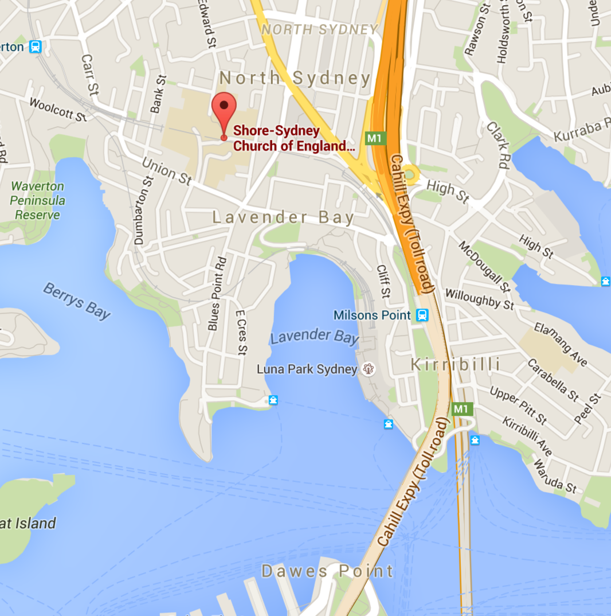
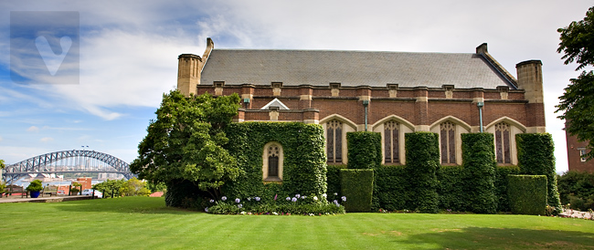
MY HIGH SCHOOL
I attended SCEGS in North Sydney, NSW, Australia

Slide 7
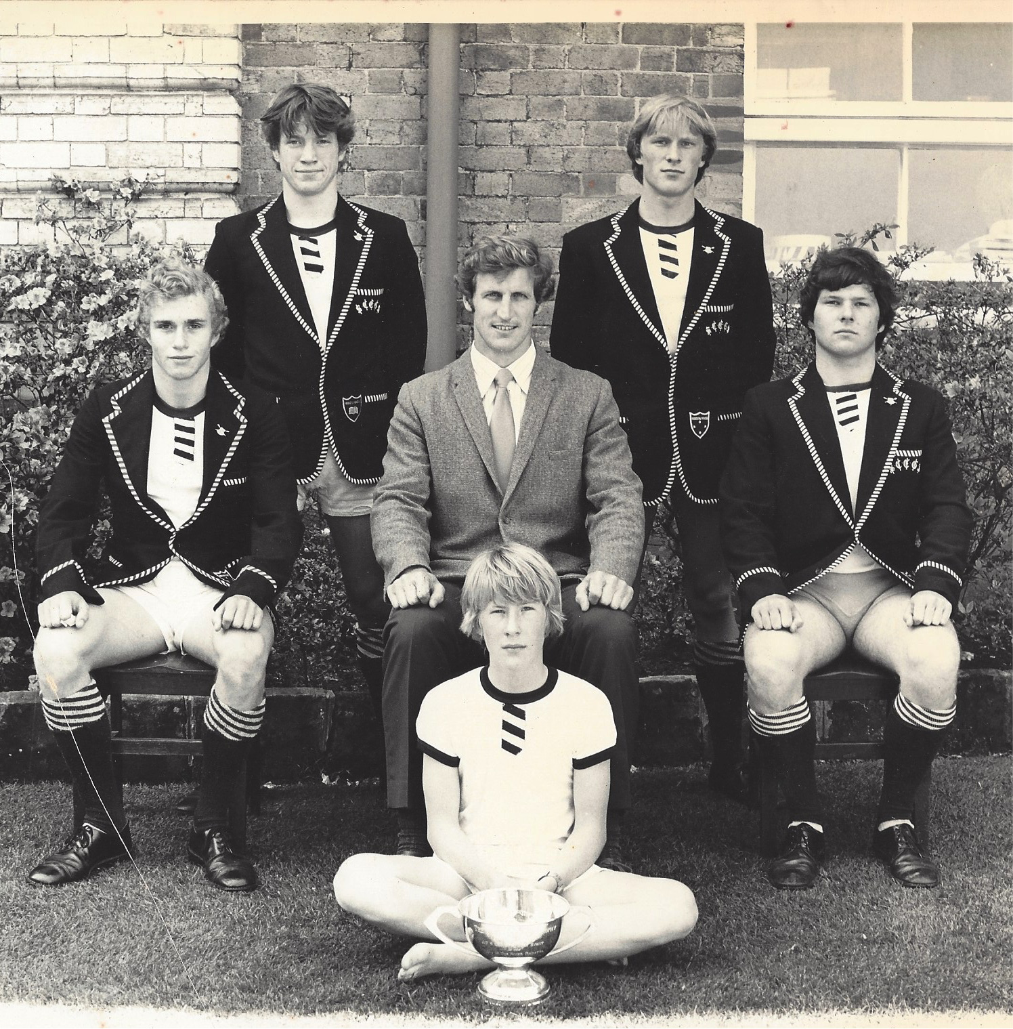
High School
As a HS student I was reasonably outgoing but was never really in the popular groups
Here is a picture of me in HS with my Rowing Crew

Slide 8
High School
Things that I really liked in High School were:
Maths / Physics / Chemistry / Economics
Playing Rugby, Rowing and Cricket
Cadets
Spending time with mates
Chatting to the girls on the train station

Slide 9
High School
Things that felt difficult or challenging for me while I was in High School were:
English / General Studies
My parents separating
Dealing with general boredom

Slide 10
High School
Jobs I worked while I was in High School were:
Shell Service Station Attendant
McDonalds
Veterinary “Nurse”

Slide 11
Getting in to College
The top few things I did to ensure I got into college were:
The process in Australia was different
Entry was based on HSC results (last 2 years of HS)
You applied and the entry marks were scaled to meet demand

Slide 12
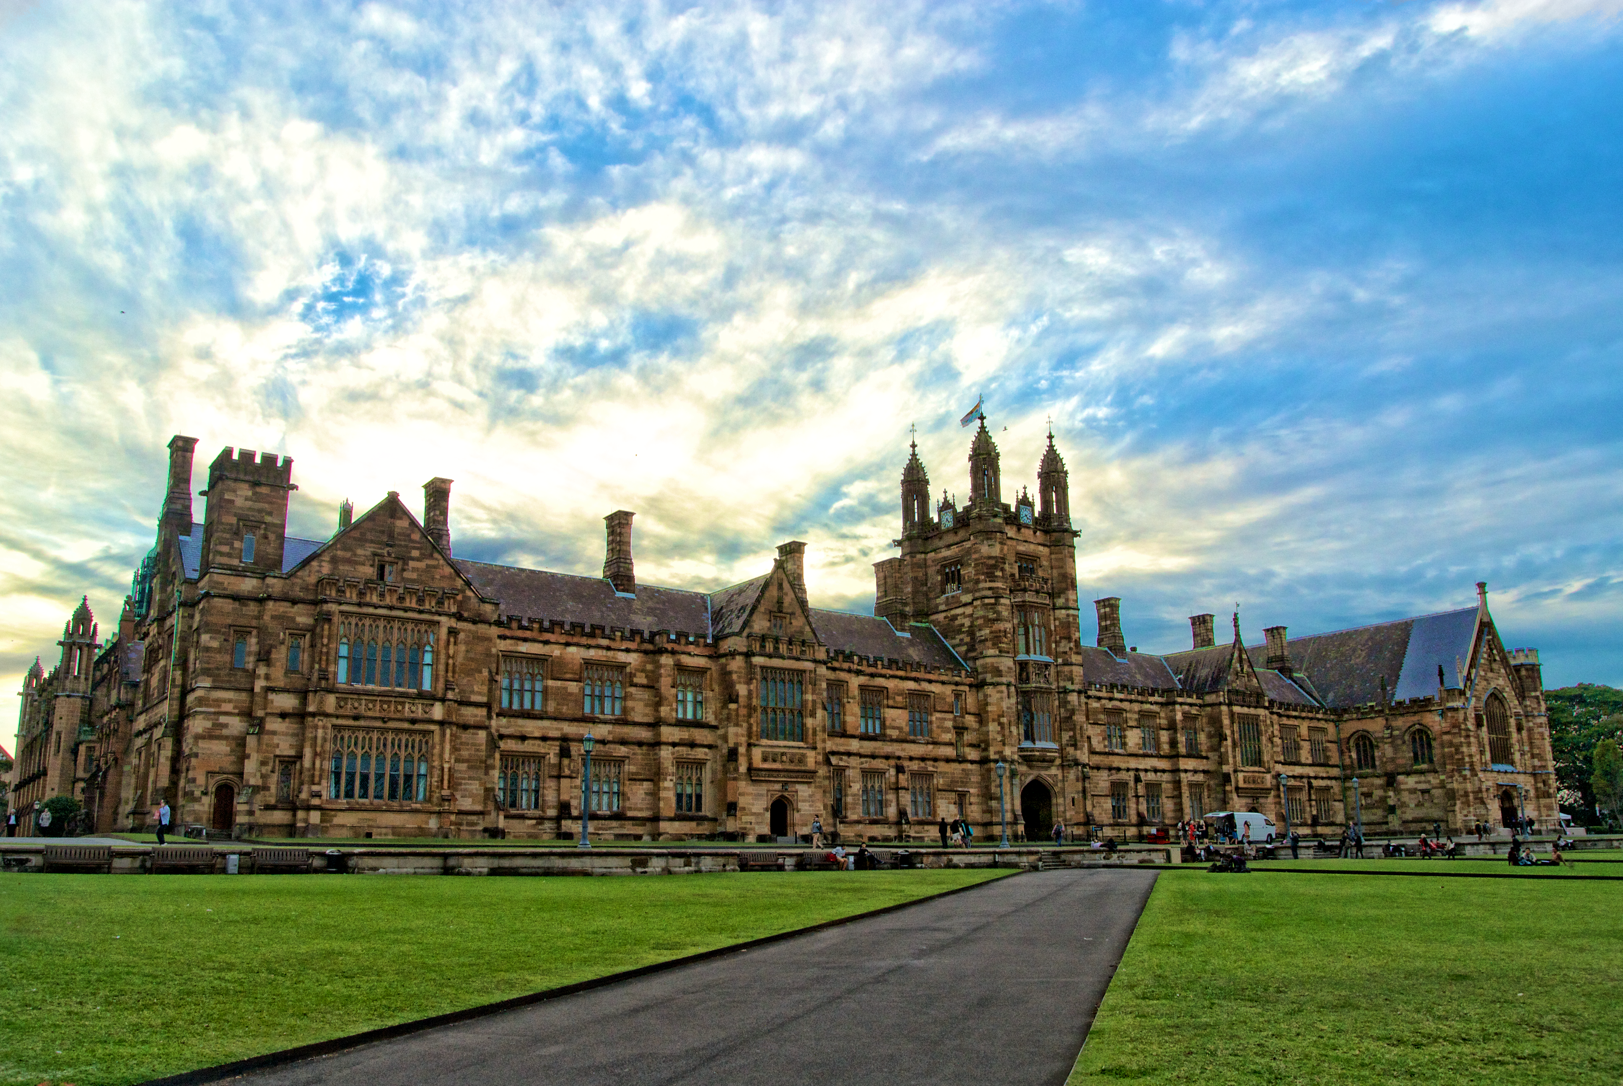
College
I attended Sydney University, NSW
Founded in 1850
(52,789 Students in 2014)
Insert map shot here

Slide 13
College
Things I enjoyed in College
Things I didn’t enjoy in College
Freedom
Friends
Bar & Coffee shops
Girls
First year exams
Girls

Slide 14
College
Favorite classes
Least favorite classes
Introduction to Programming
Foundations of Computer Systems
Data Structures
Differential Calculus
Linear Algebra

Slide 15
College
Jobs I worked while I was in College were:
Continued at Shell Service Station including opening or closing responsibilities
Learnt how to deal with customers and provide great service
Appreciate manual work
At times could do study etc whilst it was quite

Slide 16
College
Things that felt difficult or challenging for me while I was in College were:
My biggest challenge was balancing the new freedoms with the self discipline required for my academic success
Failing my first year exams
Having the courage to withdraw and pursue employment at the start of my second year

Slide 17
Getting a job after College
The top few things I did to ensure I got a good job after college were:
Was prepared to work hard
I had set an objective of achieving a similar level of success via working my way up
Looked for a job that provided opportunity for thinking outside the square
Was focusing on larger organizations, preferably International

Slide 18
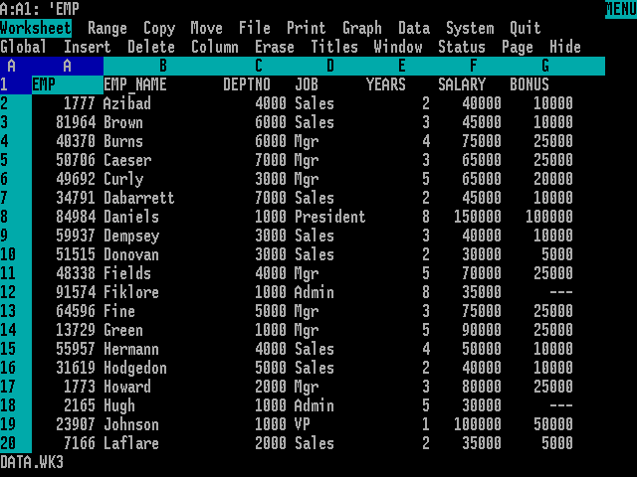
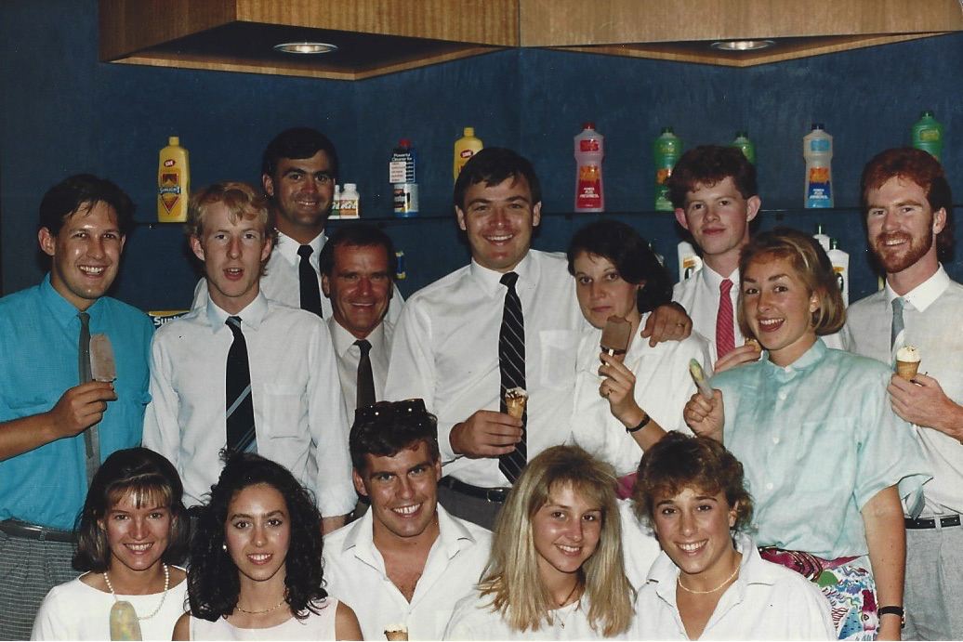
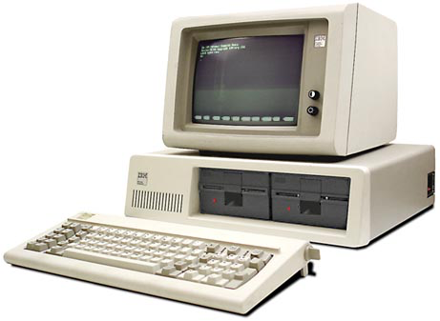
The job after College
What I learnt at Lever and Kitchen (L&K)
PCs in Business (Lotus 123/Excel/Windows)
Sales
Hard Work and being part of a Team
L&K Head Office Team around 1985 ☹

Slide 19
My Career Path in L&K
Trade Systems Manager
Distribution Clerk
Sales Representative
Account Manager
State Sales Manager
Notes:
You may use this chart to describe your journey to the current career

Slide 20
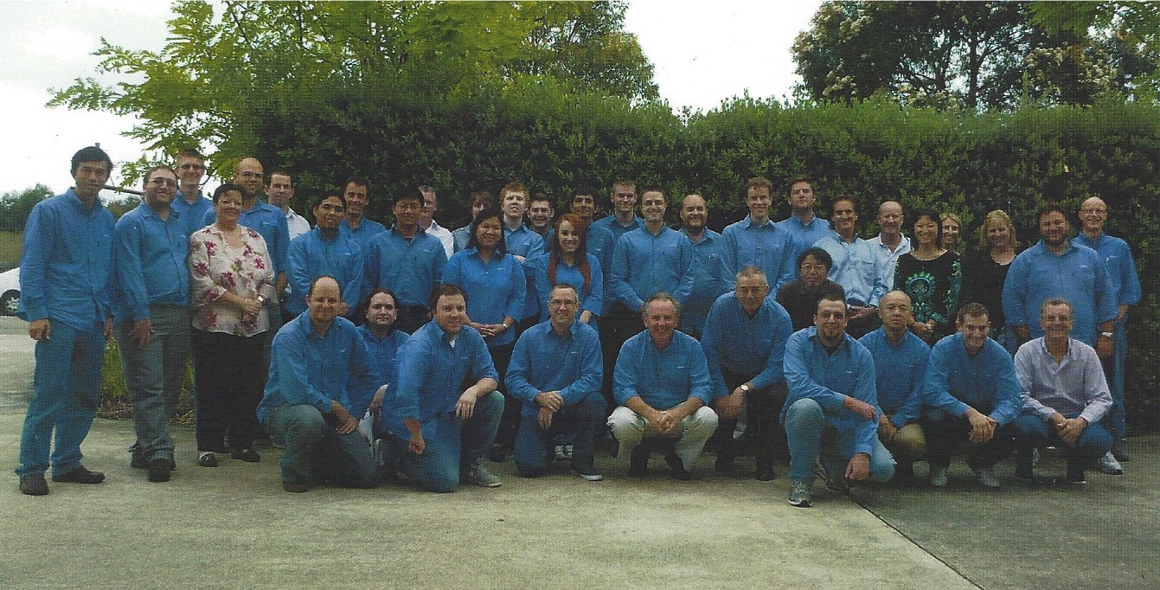
This is My Company
Every day at my company:
We develop, maintain and sell a sophisticated Trade Promotion Management and Optimization solution to Consumer Goods Companies
Customers across the world
Australian Promax Team maybe 5 years ago

Slide 21
My Career
The first job I had after college was:
(insert here with a little description of what you did and how you got hired)
The worst job I have ever had was:
(give a funny anecdote and what you learned from that experience if possible)

Slide 22
My COMPANY
Challenges I have had to overcome building my company are:
LOTS

Slide 23
More than just work
When I am not at work I like to:
Spending time with family and friends
Reading for Improvement and Entertainment (Audible)
Travel
Driving cars really fast
Play golf
Directorships (non profits)

Slide 24
Do it all over again?
If I could talk to my high school self, what would I say?
Maybe take a year off to travel the world when you are younger
It is okay to be a dreamer
Believe in and Trust yourself
Build partnerships / look for synergy
You don’t know it all (learn)

Slide 25
QUESTION AND ANSWER

