Slide 1
Britt Hysen
Editor-in-Chief

Slide 2
INTRODUCTION
My name is Britt Hysen and I am 27 years old.
I work for MiLLENNiAL magazine.
My company is a lifestyle media brand that highlights the heroes of the generation.
My role at MiLLENNiAL is the Editor-in-Chief
I oversee all editorial.

Slide 3
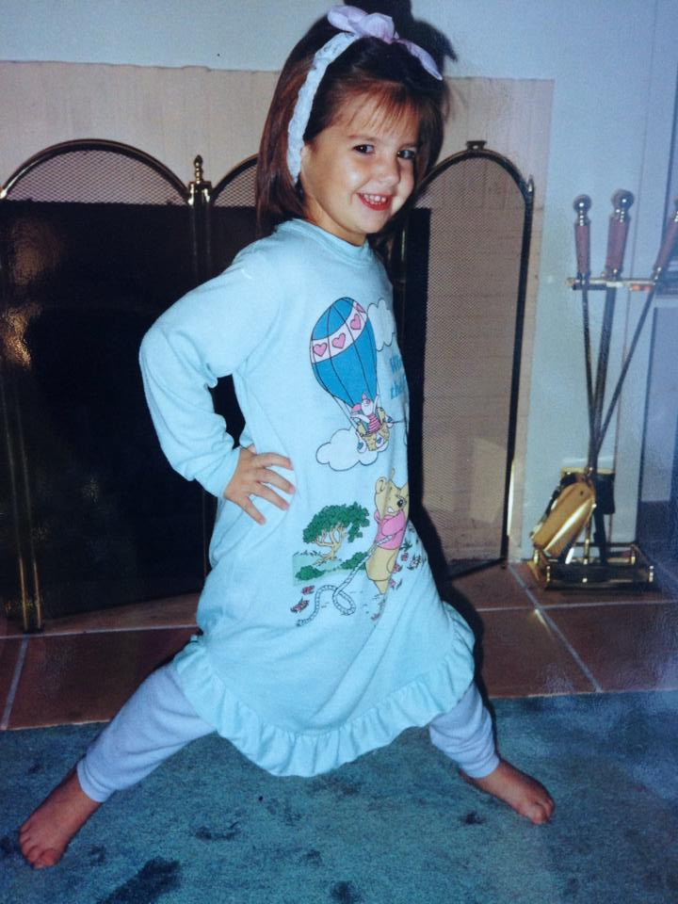
My Childhood
I was born and raised in Burbank, California.
This is a picture of me at age 4.

Slide 4
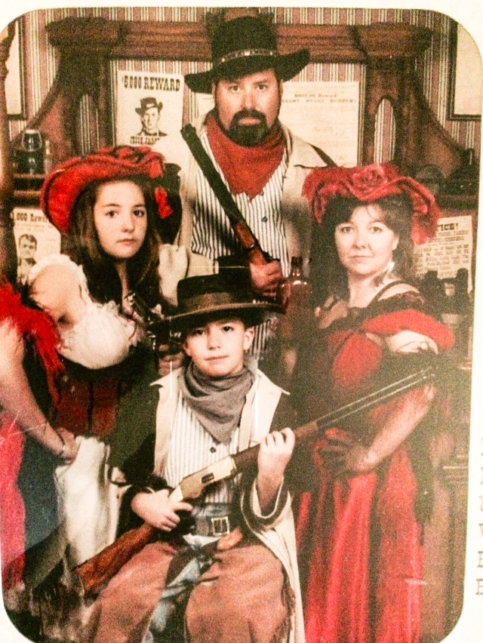
My family
A little about my family
My family is really close. Parents have been together for 30+ years and my brother and I are 4 years apart.
This is a picture of us in 1998. We dressed up in a photo booth at Six Flags.

Slide 5
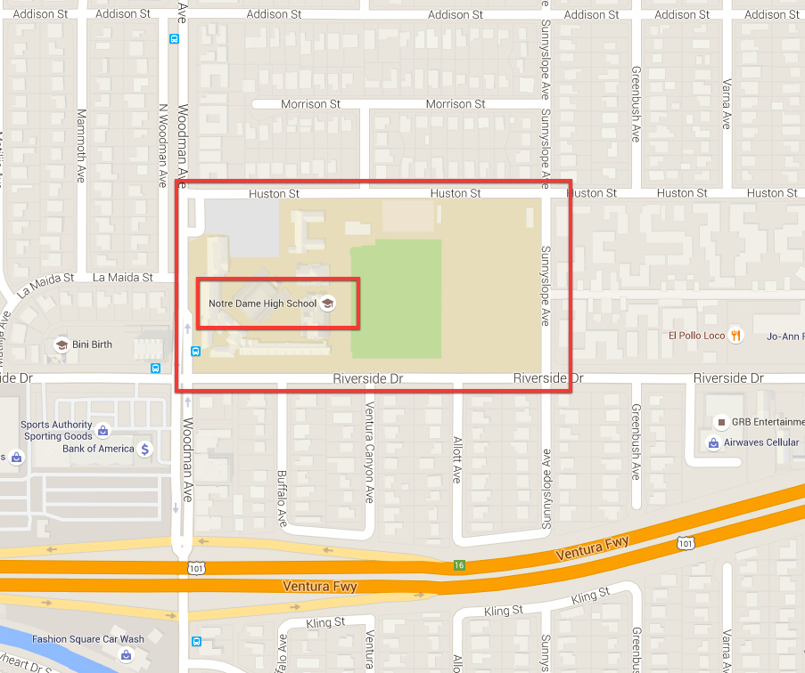
My high school
I attended Notre Dame HS in Sherman Oaks, CA

Slide 6
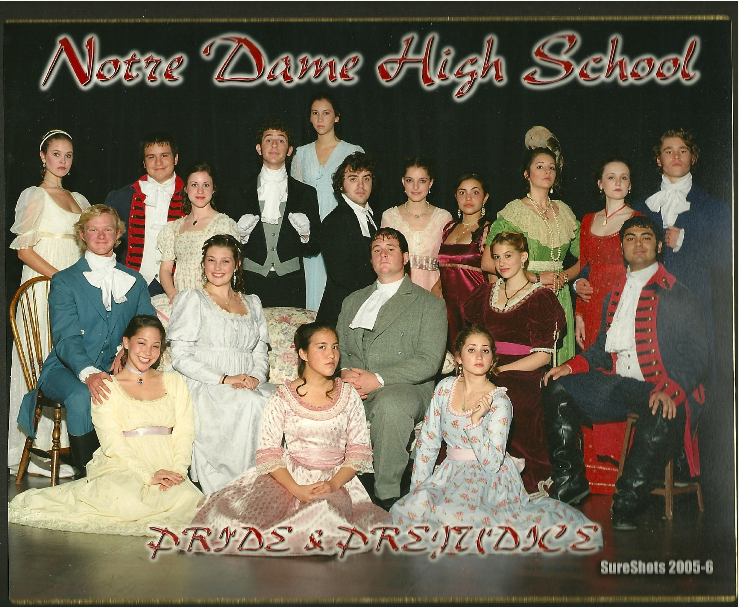
High school
As a HS student I was a bit of a loner until I got involved in theatre. ……………………………………………………………….
me
Here is a picture of me in the school play “Pride & Prejudice

Slide 7
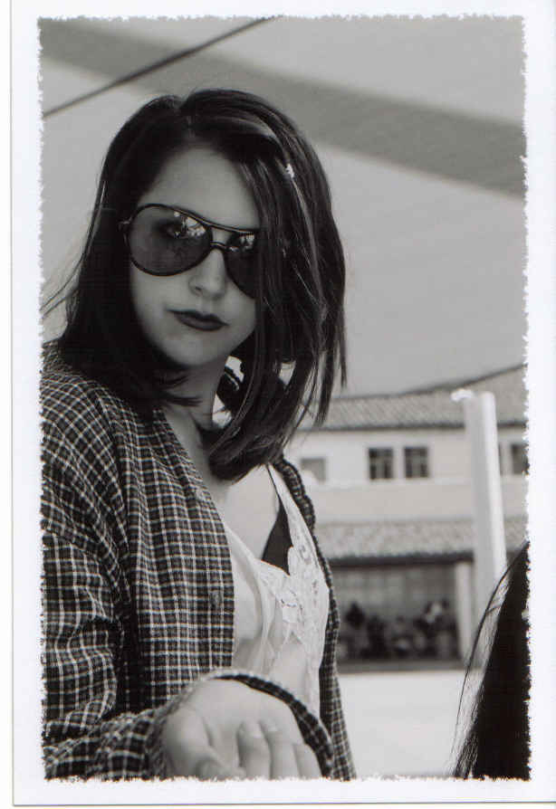
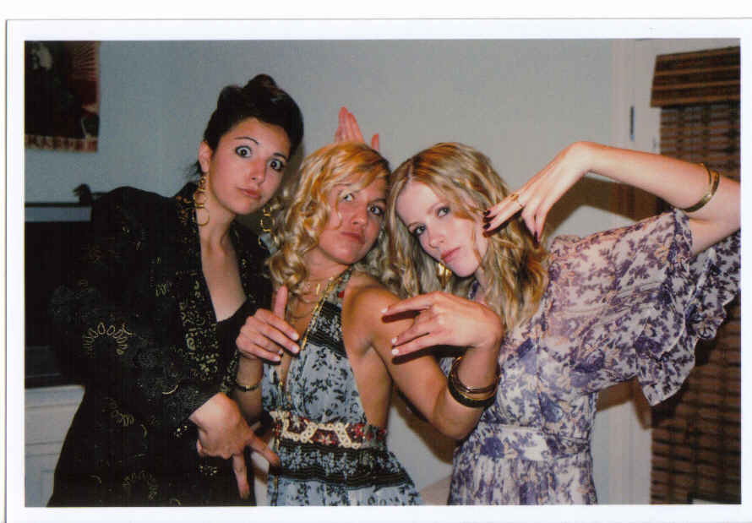
High school
Things that I really liked in High School were:
Hosting the improv shows and being cast in the plays
My photography class and developing my own film
Hanging out with my friends

Slide 8
High school
Things that felt difficult or challenging for me while I was in High School were:
Making friends
Being an artist in a sports school
Confining to the rules
Trying to “fit in” – I was always authentic to myself

Slide 9
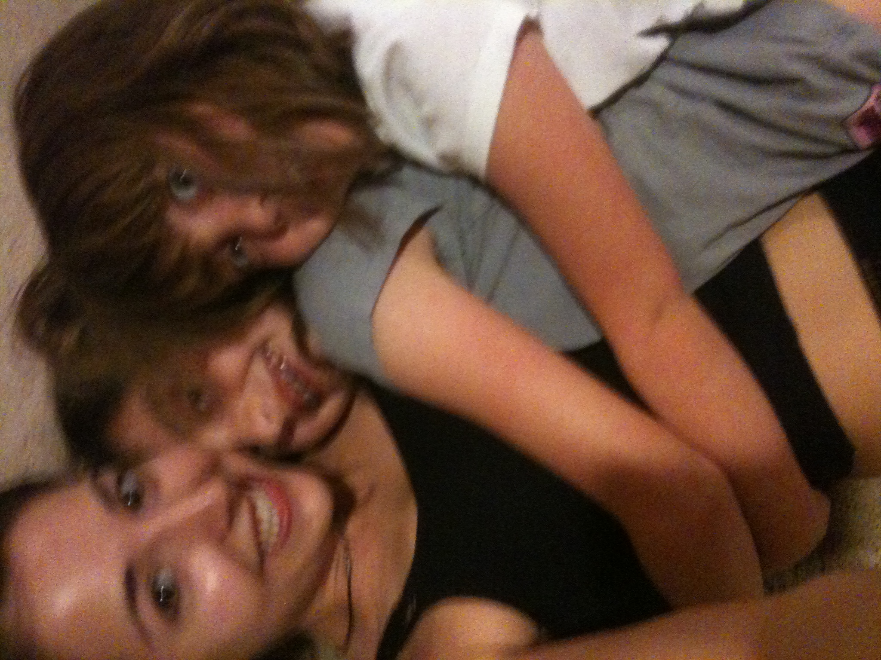
High school
Jobs I worked while I was in High School were:
Babysitting
Halloween Horror Nights “Scare-actor”

Slide 10
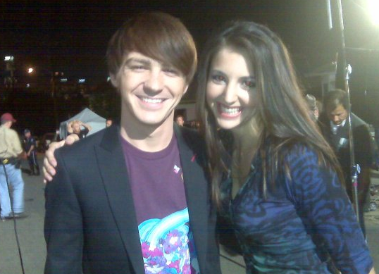
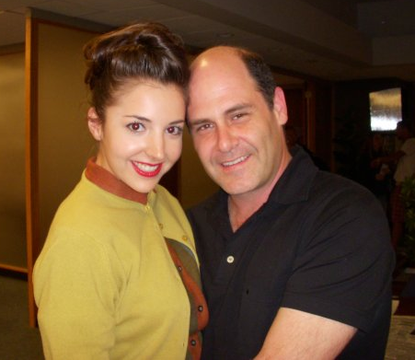
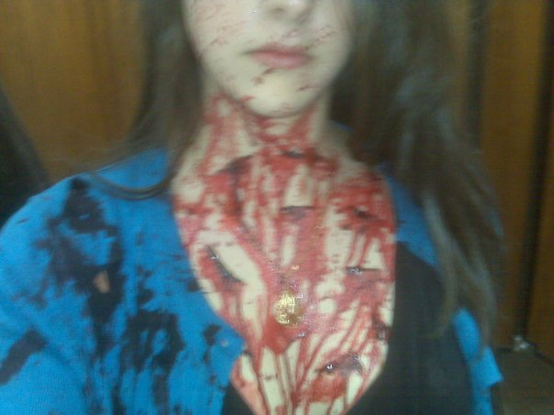
College years
Acting career
Business Marketing & Management
Criminal Minds
Merry Xmas Drake & Josh
Mad Men

Slide 11
college
Cal State Northridge then transferred to Penn State
Business Marketing and Management degree online
Took classes that would expand my interests and knowledge
Started my acting and journalism career while attending school
Always a go-getter; never let school prolong the start of my career

Slide 12
college
Things I enjoyed
Expanding my interest
Working as an actor
Jumpstarting my journalism career
Gaining real world experience
Things I didn’t enjoy
Having to do homework on set
Not being able to create a network of college friends
Never seeing my college campus

Slide 13
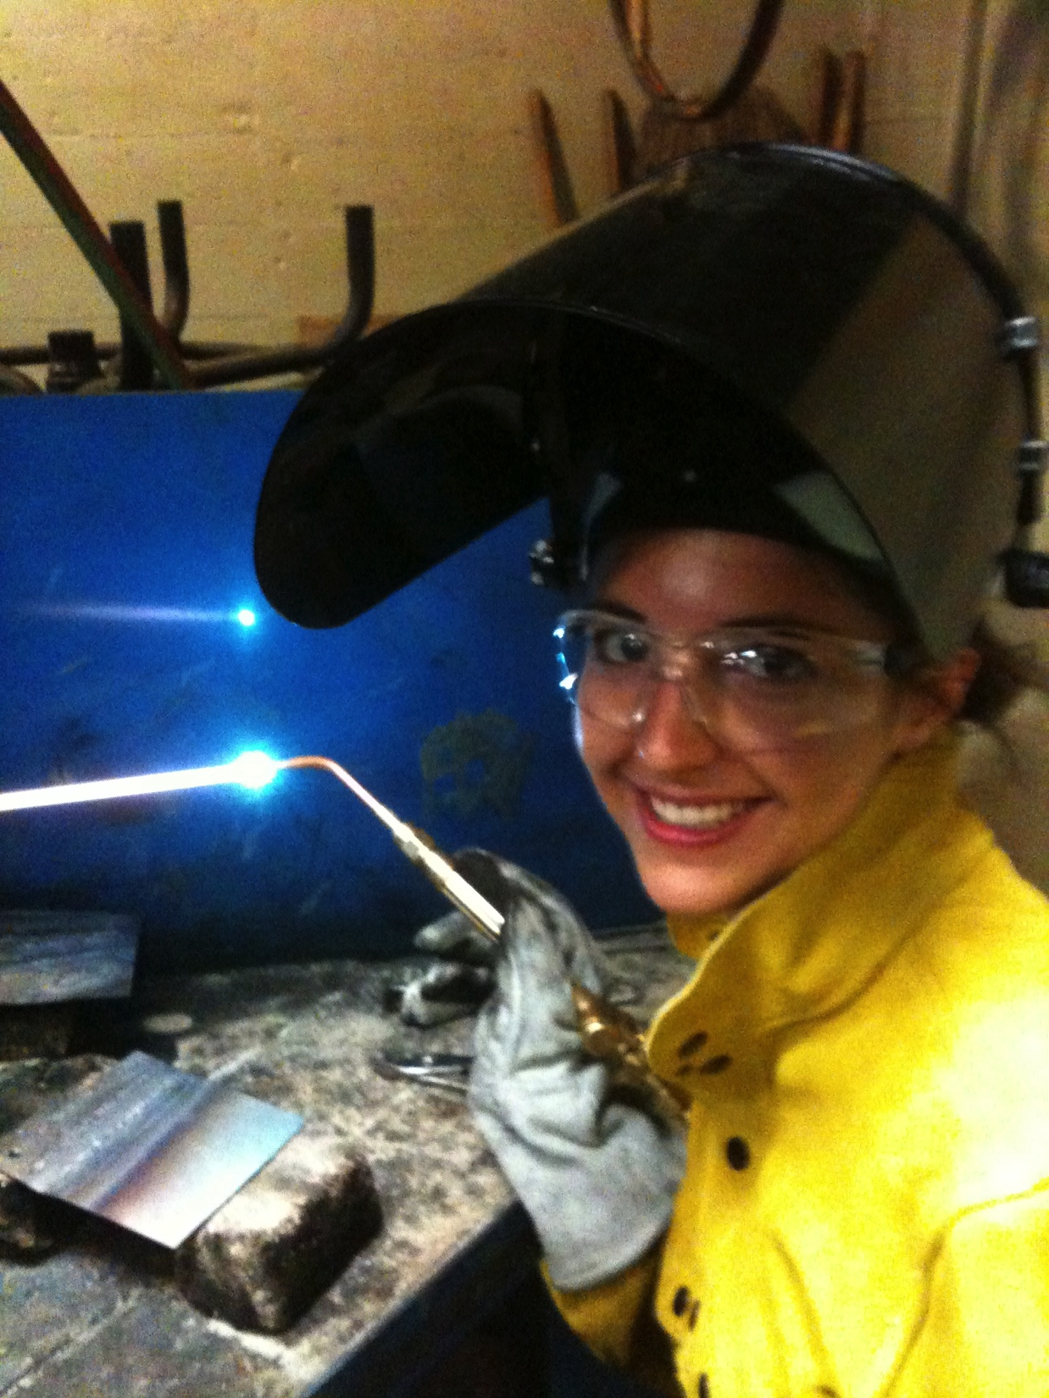
college
Favorite classes
Welding
Photography
Business Law
Least favorite classes
Statistics
Economics

Slide 14
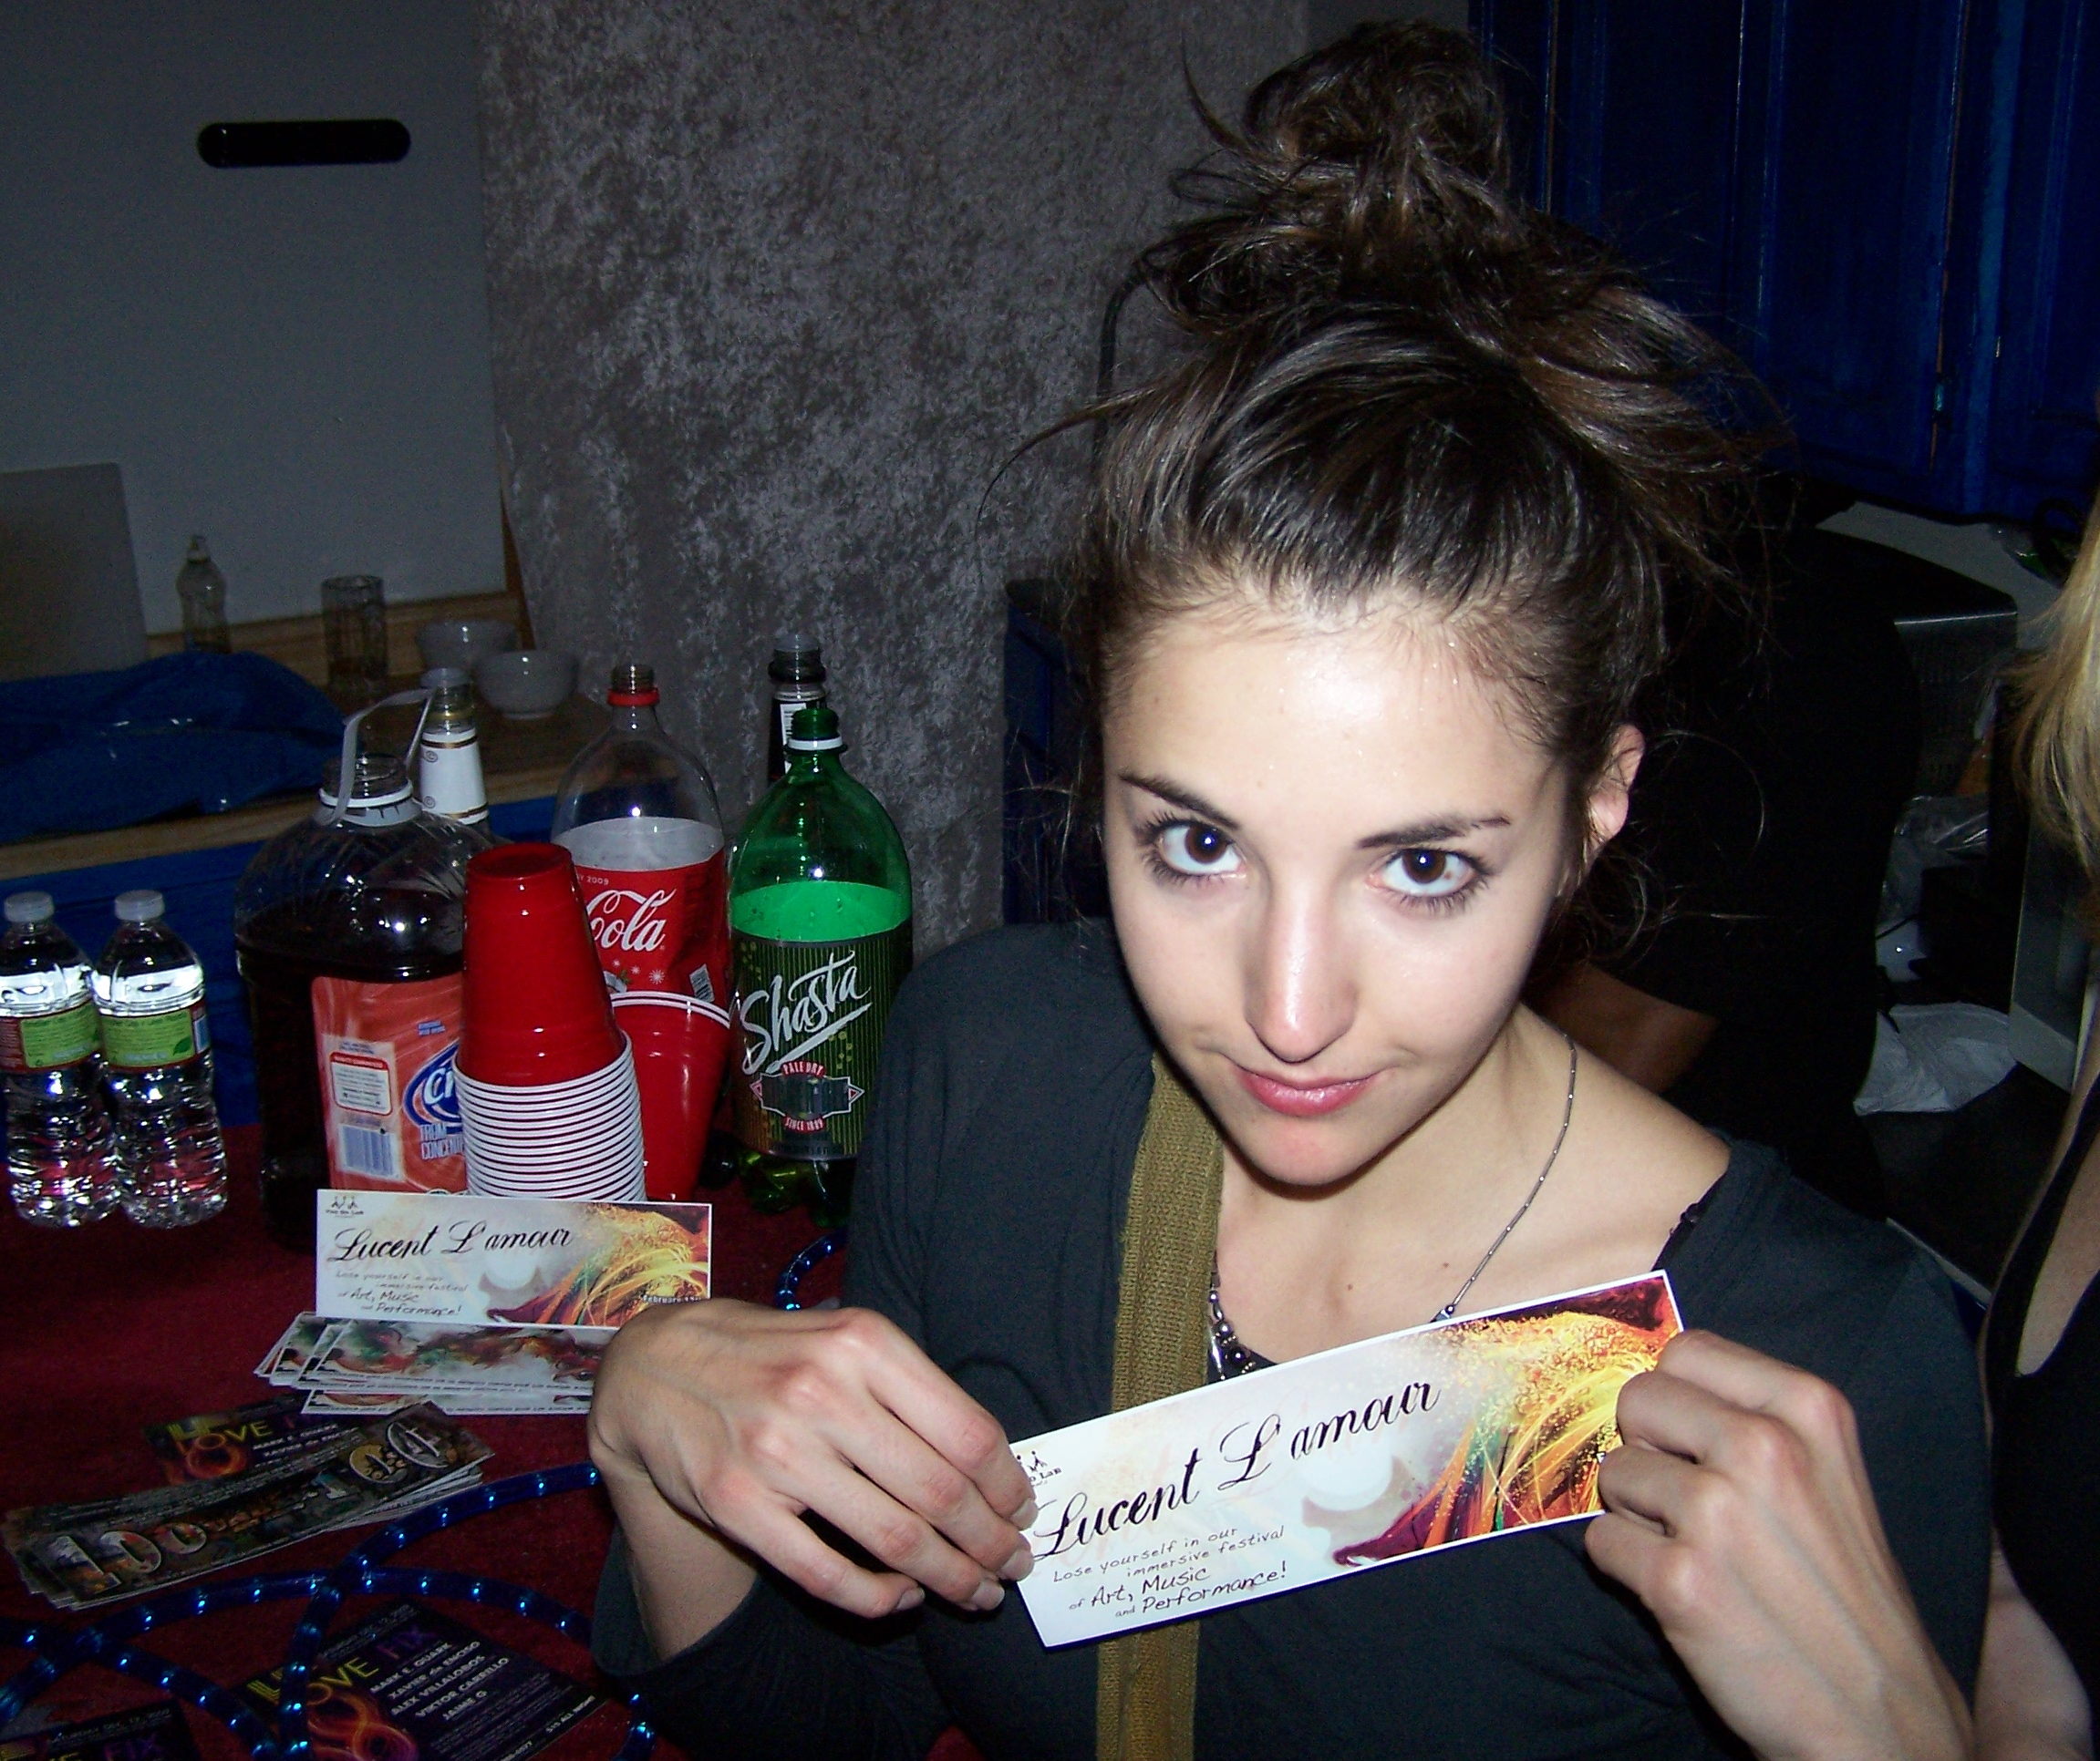
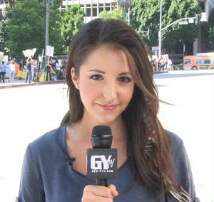
college
Jobs I worked while I was in College were:
Actor
Event promoter for The Do LaB
Reporter/Journalist

Slide 15
college
Things that were challenging in College:
Obtaining a business major online
Lack of peer interaction
Building a college network
Starting a business
Working independently

Slide 16
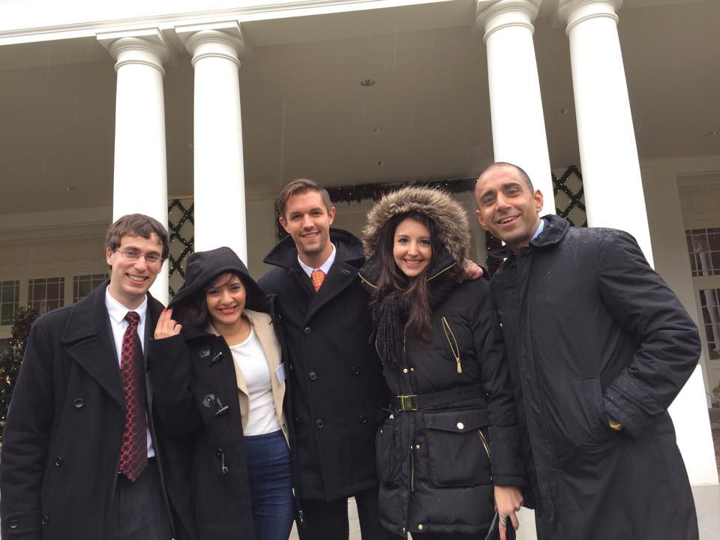
Post college
Launched a career on my terms
Built a business from the experience I created
Leveraged skills and resources
MiLLENNiAL is invited
to The White House

Slide 17
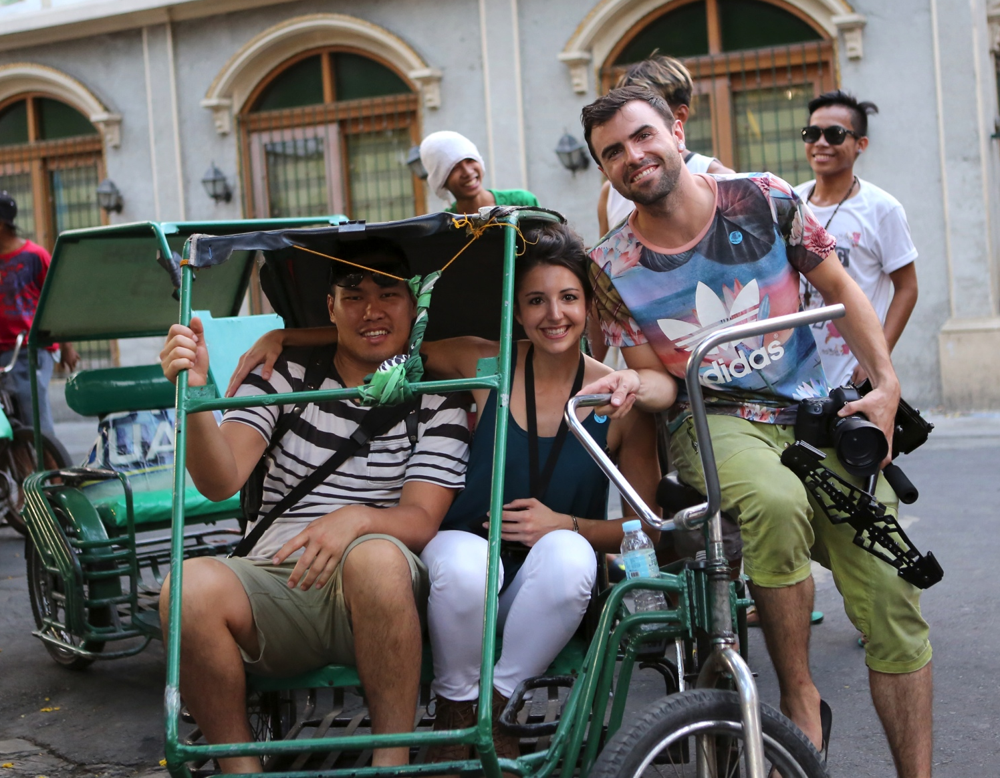
My company
Every day at my company:
MiLLENNiAL launched in June of 2014
Recognized by the White House as one of the most influential digital media companies for millennials
Produced more than 45 issues in 1 year
Operate a team of 20
Travel the world
Work with brands
April/May 2015
Film crew in Manila, Philippines
Creating content for the MIT of Asia

Slide 18
My career path
Became a freelance reporter/journalist
2010 - 13
Started as an actor
2007-10
Started building MiLLENNiAL in 2013 – officially launched in 2014
Notes:
You may use this chart to describe your journey to the current career

Slide 19
My career
Challenges I have had to overcome throughout my career are:
Following your passion even when it felt like it was working against me
Working for no pay to build a resume
Sacrificing weekends to put as many hours into building my company
Creating a product that was financially secure
Gaining support from the community
Finding the right partners to work with

Slide 20
My role within the organization
Editor in Chief
Managing Editor
Writer
Producer
Photographer
Notes:
Use this graph to give more description of your role specifically (responsibilities, typical work week, direct reports, etc.)

Slide 21
compensation
Editor in Chief
($55k)
Management
($50k)
Photographer
($40k)
Writer
($35k)
Notes:
Use this graph to show general compensation ranges for people in various roles in your company

Slide 22
More than just work
When I am not at work I like to:
Go dancing
Listen to music
Travel and sight see
Go hiking and be in nature
Do yoga and exercise
Go out with friends

Slide 23
Do it all over again?
If I could talk to my high school self, what would I say?
Pay more attention in class
Everything is going to work out
Believe in yourself
Follow your passions and see where they lead

Slide 24
Q & A
10 minutes

Slide 25
Activity
Interactive Q & A with prizes…

Slide 26
CLUE #1
Started by 2 Stanford University students, this social media app amassed over 700 million daily video and photo messages by May 2014.

Slide 27
CLUE #2
It was the first disappearing messaging service to hit the market.

Slide 28
ANSWER
SNAPCHAT

Slide 29
Bonus question
What are the names of the 2 founders?

Slide 30
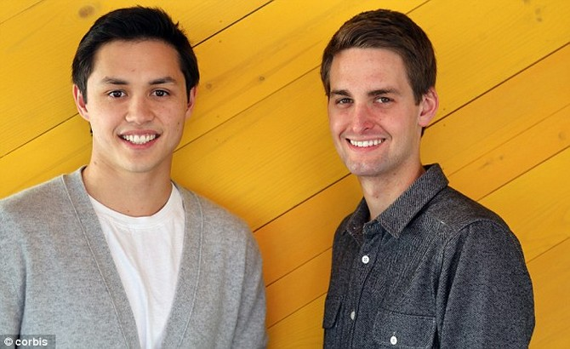
ANSWER
Bobby Murphy
Evan Spiegel

Slide 31
CLUE #1
This actress launched a baby product company that was recently valued at over $1 billion.

Slide 32
CLUE #2
Some of the movies that she has starred in include Fantastic Four, Sin City, and Into the Blue.

Slide 33
ANSWER
Jessica Alba

Slide 34
Bonus question
What is the name of her billion-dollar company?

Slide 35
Answer
The Honest Company

Slide 36
Clue #1
This Shark Tank billionaire investor made his first million in the early 90s when he sold his company MicroSolutions to CompuServe.

Slide 37
Clue #2
He currently owns the Dallas Mavericks.

Slide 38
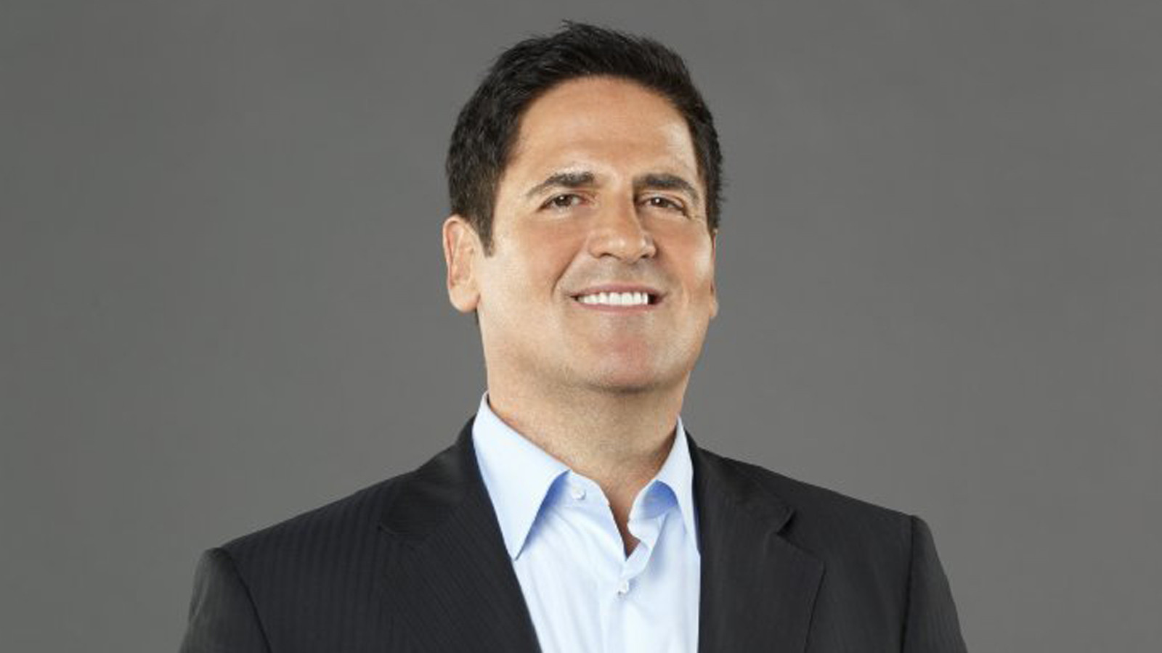
Answer
Mark Cuban

Slide 39
Clue #1
This is the largest social media site in the world with over 1.5 billion active users.

Slide 40
Clue #2
It originally launched under another name in 2004.

Slide 41
Answer
Facebook

Slide 42
Bonus question
Who is the the founder of Facebook?

Slide 43
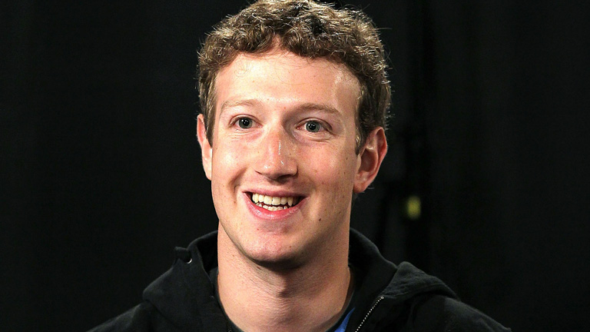
Answer
Mark Zuckerberg

Slide 44
Clue #1
This new social app allows anyone to post and respond anonymously to personal messages.

Slide 45
Clue #2
As of April 2015, the app reached over 10 million monthly active users.

Slide 46
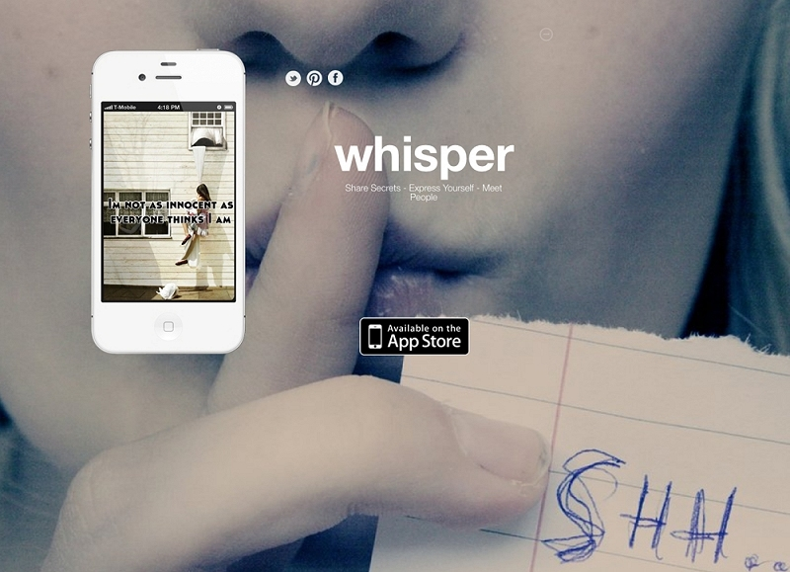
Answer
Whisper

Slide 47
Clue #1
This Canadian singer songwriter became one of the richest kids in the world before reaching his 18th birthday.

Slide 48
Clue #2
His current single “What Do You Mean” has over 213 million views on YouTube.

Slide 49
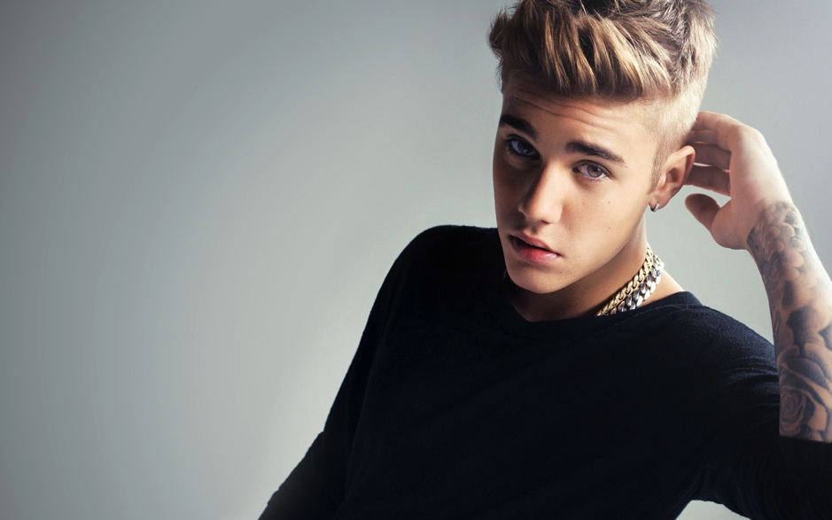
Answer
Justin Bieber

Slide 50
Bonus question
What is his current net worth?

Slide 51
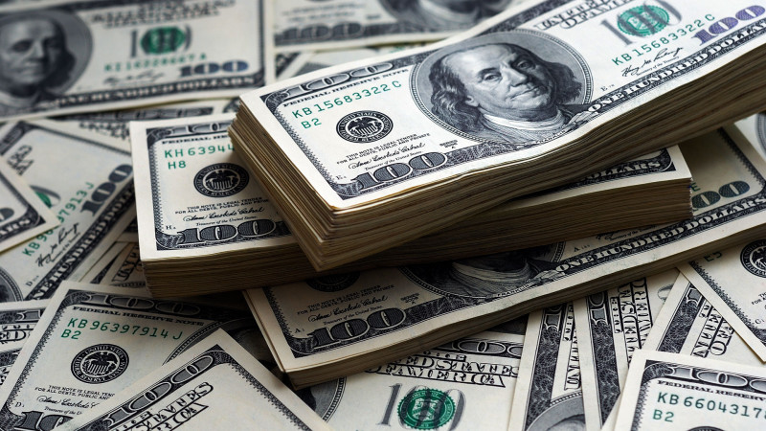
Answer
$200 million

Slide 52
Clue #1
This teen pop star admitted suffering from depression, bipolar disorder, and bulimia.

Slide 53
Clue #2
Her new album “Confident” debuted this month on Oct. 15, 2015.

Slide 54
Answer
Demi Lovato

Slide 55
Clue #1
This virtual reality headset was invented by a teenager and is set to hit the market in 2016.

Slide 56
Clue #2
The company was acquired by Facebook for $2 billion in the summer of 2014.

Slide 57
Answer
Oculus Rift

Slide 58
Bonus Question
Who is the founder of Oculus Rift?

Slide 59
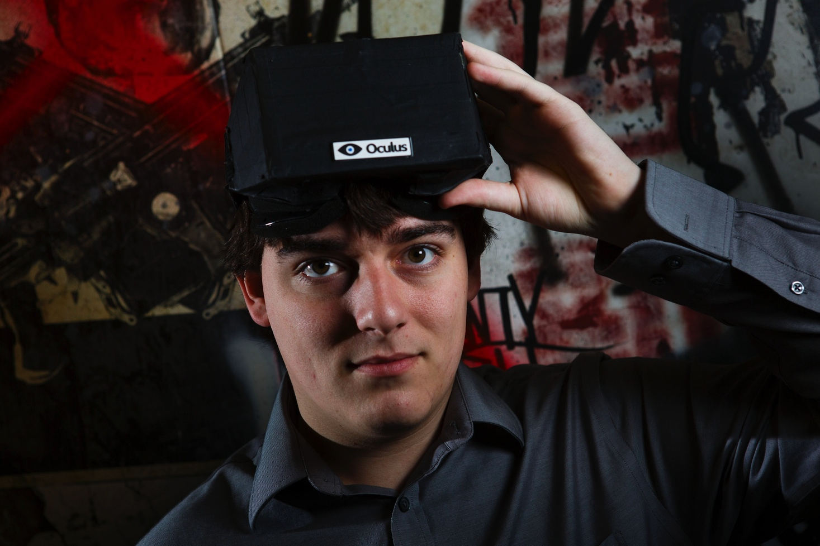
Answer
Palmer Luckey

