Slide 1
WHO AM I
Christopher Maravilla, 25 Years Old
Senior Associate at Ernst & Young
I love to play Tennis, Chess, and Drink Coffee!
From a Family of 8 siblings (Unbelievable I know)
Motivated Always to have the best Mindset

Slide 2
The Young Puppy on the Block
…Crazy Family…

Slide 3
GROWN-UPS!
…Still Crazy Family…

Slide 4
Role Model

Slide 5
Growing Up
Grew up without many possessions
Shared Everything!
3 Bed Room House for 8 kids and two parents felt like

Slide 6
High School
1st HIGH SCHOOL
2nd HIGH SCHOOL
Newbury Park Adventist Academy
Soccer Captain
Flag Football
Choir (Base!)
The Cool Kid
Littlerock High School
Soccer Captain
Tennis Team
AP History & Geometry
The Cool Kid
Importance of Involvement

Slide 7
Challenges Growing Up
Worked to pay for my education
Worked to help support my family
Difficult to make good friends
Not enough time for sleep
Not being able to do what everyone else was doing

Slide 8
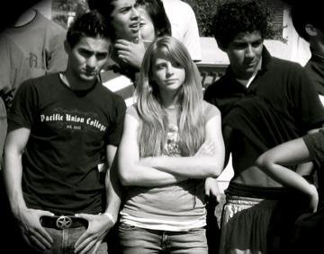
Best High School Memories

Slide 9
MY JOURNEY

Slide 10
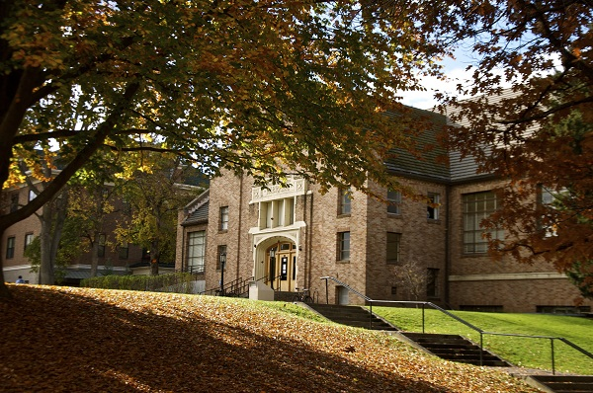
COLLEGE!- Good Bye Cali!
Walla Walla University (or Western Wedding University)
Located in Washington State

Slide 11
College Life
Worked full-time for 4 years to pay for education
JOBS WORKED
Janitor
Student Desk Worker (Grave Yard Shifts)
Grounds Supervisor
Resident Assistant
Student Body Advertising Manager
Student Body Controller

Slide 12
College Memories
Volunteer Work
Business Club President
Senior Class Vice President
Tax Competition at Washington State University
Involvement
Soccer Team member
Freshman Mentor
Dorm Event Planner
Whitman Tennis Team

Slide 13
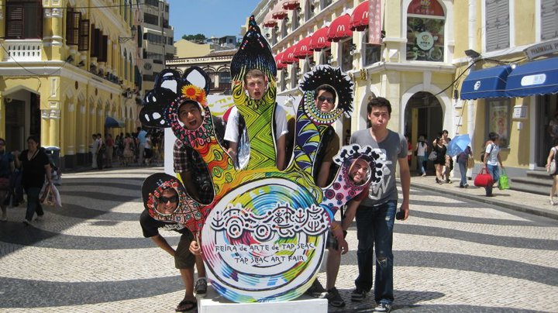
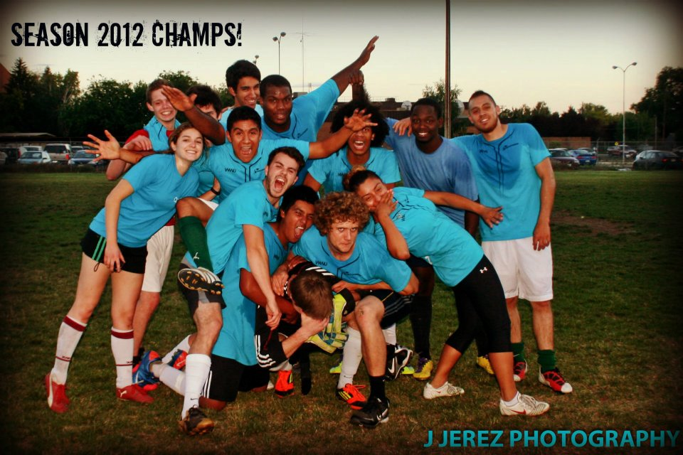
Best College Memories

Slide 14
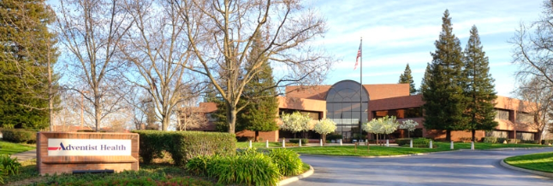
Career
Graduated with a BBA in Accounting
First real job was as an auditor for a healthcare system called Adventist Health in Sacramento California
Traveled to Hawaii, Oregon, Washington State

Slide 15
Career Advancement
????!
Senior Associate at EY
Senior Auditor at Adventist Health
Staff Auditor at Adventist Health
Student Body Controller/Marketing Manager
Dorm Resident Assistant
Grounds Worker/Manager
Janitor

Slide 16
Entrepreneur of the Year Volunteer
Work with hundreds of different people in our service line with many different clients (Smart & Final, Cedar’s Sinai, Hospitals)
Mentoring future professionals
Recruiting top Talent
Elements of Success Program
USC, UCLA Recruiting Events

Slide 17
Challenges
Dealing with different personalities
Work-Life Balance
Not Enough time in a day
Too many opportunities to choose from!

Slide 18
Additional Involvement
Mentor for Network for Teaching Entrepreneurialship
Coaching students to structure their business ideas into a reality.

Slide 19
FUTURE PLANS & GOALS
Go to coding school in June 2016.
Start a coding school for elementary and high school students
Consult for hospitals & healthcare clients
Open my own coffee shop
Start my own companies
Consulting Group
Education/School Mentorship Program
Create Websites/Apps!

Slide 20
WORDS TO LIVE BY
Be Restless for Success
Mindset is what sets the pace for Success
You miss 100% of the shots you never take
Be the change you want to see in the World

Slide 21
ACADEMIC EXERCISE
We will now spend several minutes discussing the day’s academic module and how it is relevant in the “real world”

Slide 22
QUESTIONS & ANSWERS

