Slide 1



Slide 2
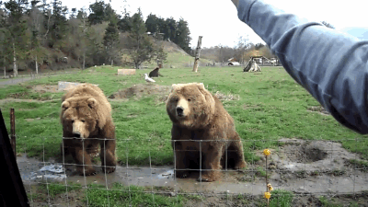
Hello!
  My name is Loren (ler-Rin)
  I’m the co-founder & CEO of a Startup called Not Ordinary Media - NOM for short
  NOM is a video technology company that is responsible for promoting branded videos across YouTube, Facebook, Twitter, and Instagram
  As Cofounder of a company I have a lot of different roles; from Sales, to Marketing, hiring, Business Development, fundraising, the list goes on…

Slide 3
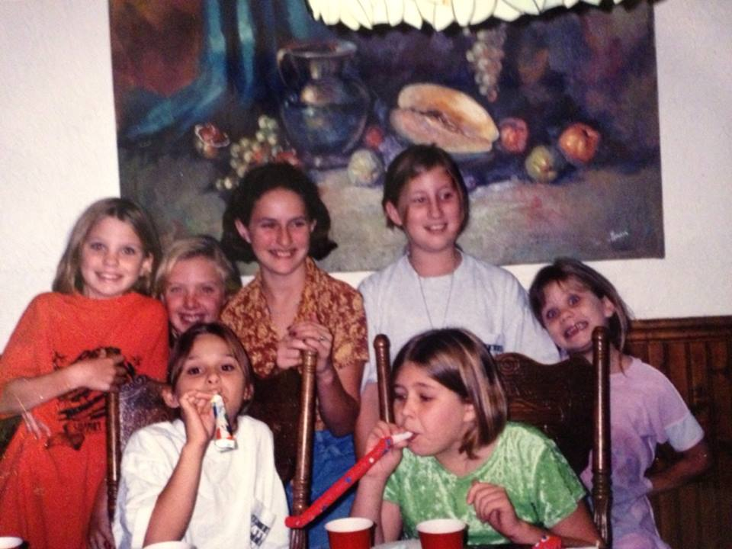
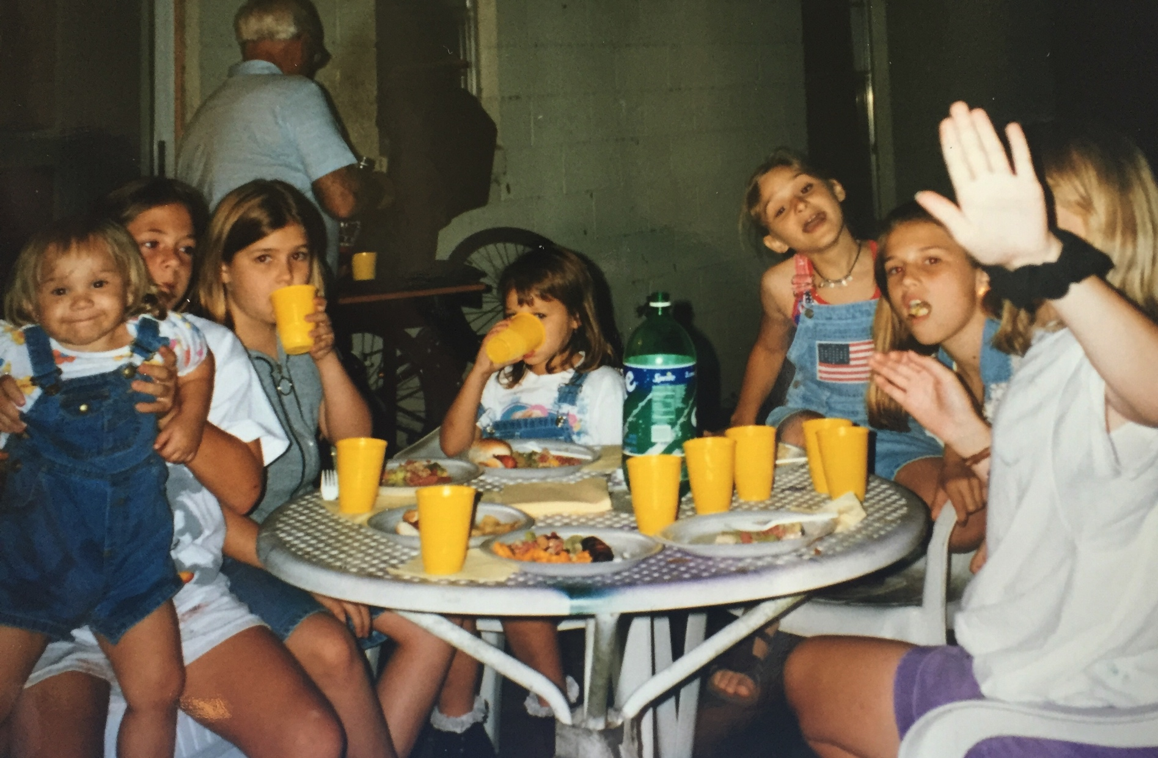
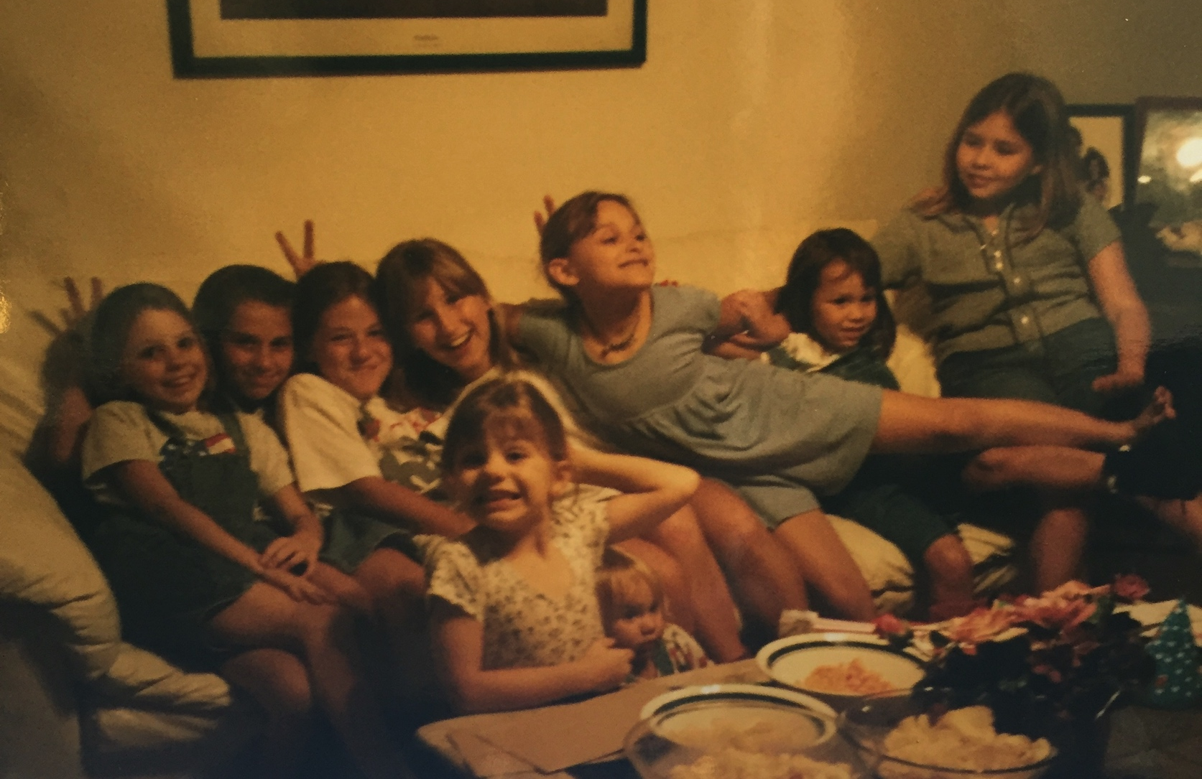
Hello!
  Raised in Florida
  Great group of friends
  Tee-ball, Gymnastics, Girl Scouts, Acting
  But then…

Slide 4

Be open to change, and adapt.

Slide 5
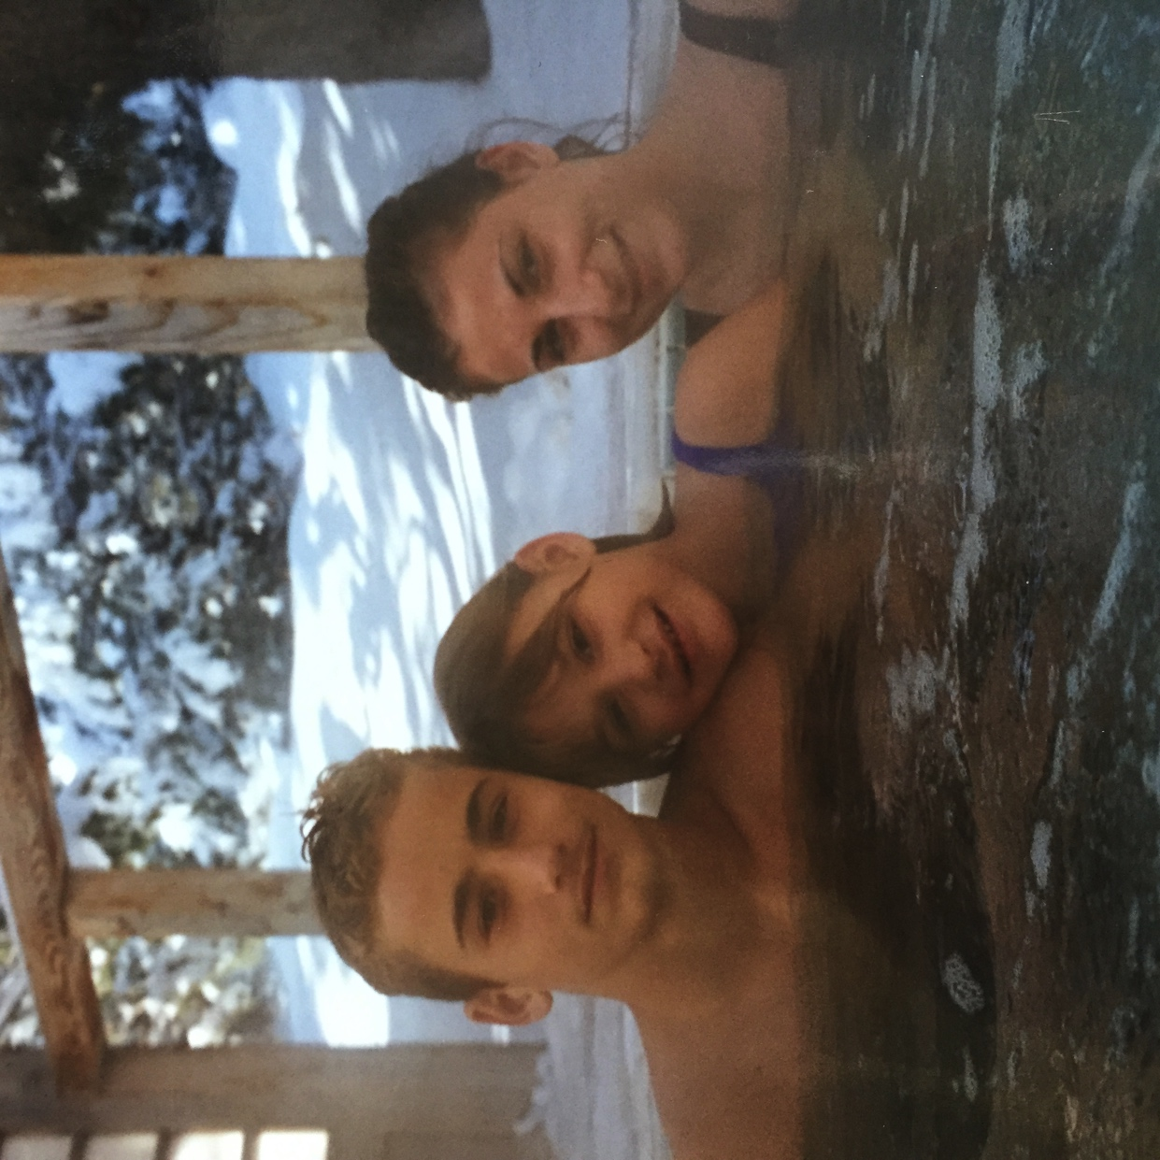
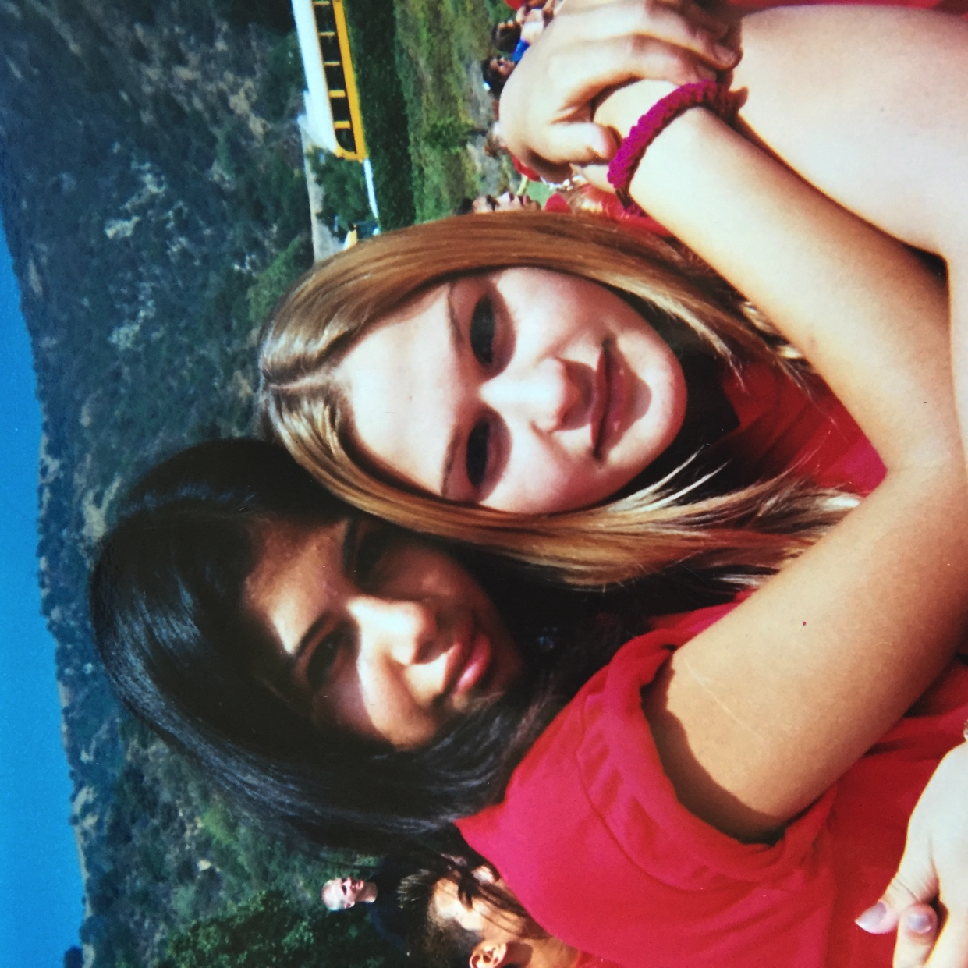
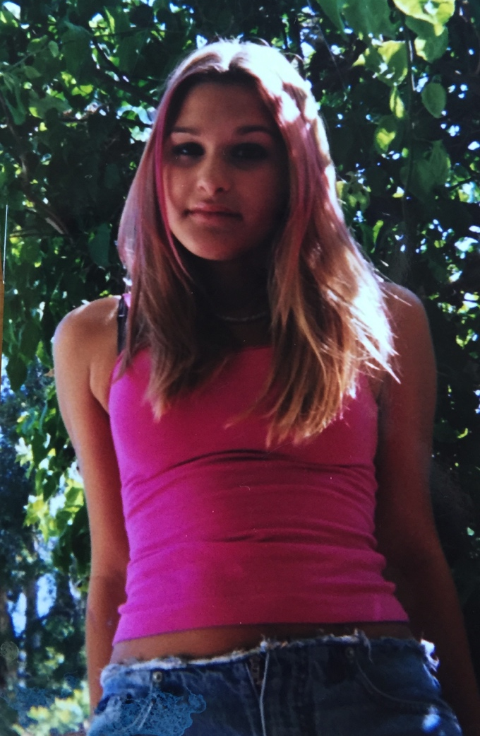
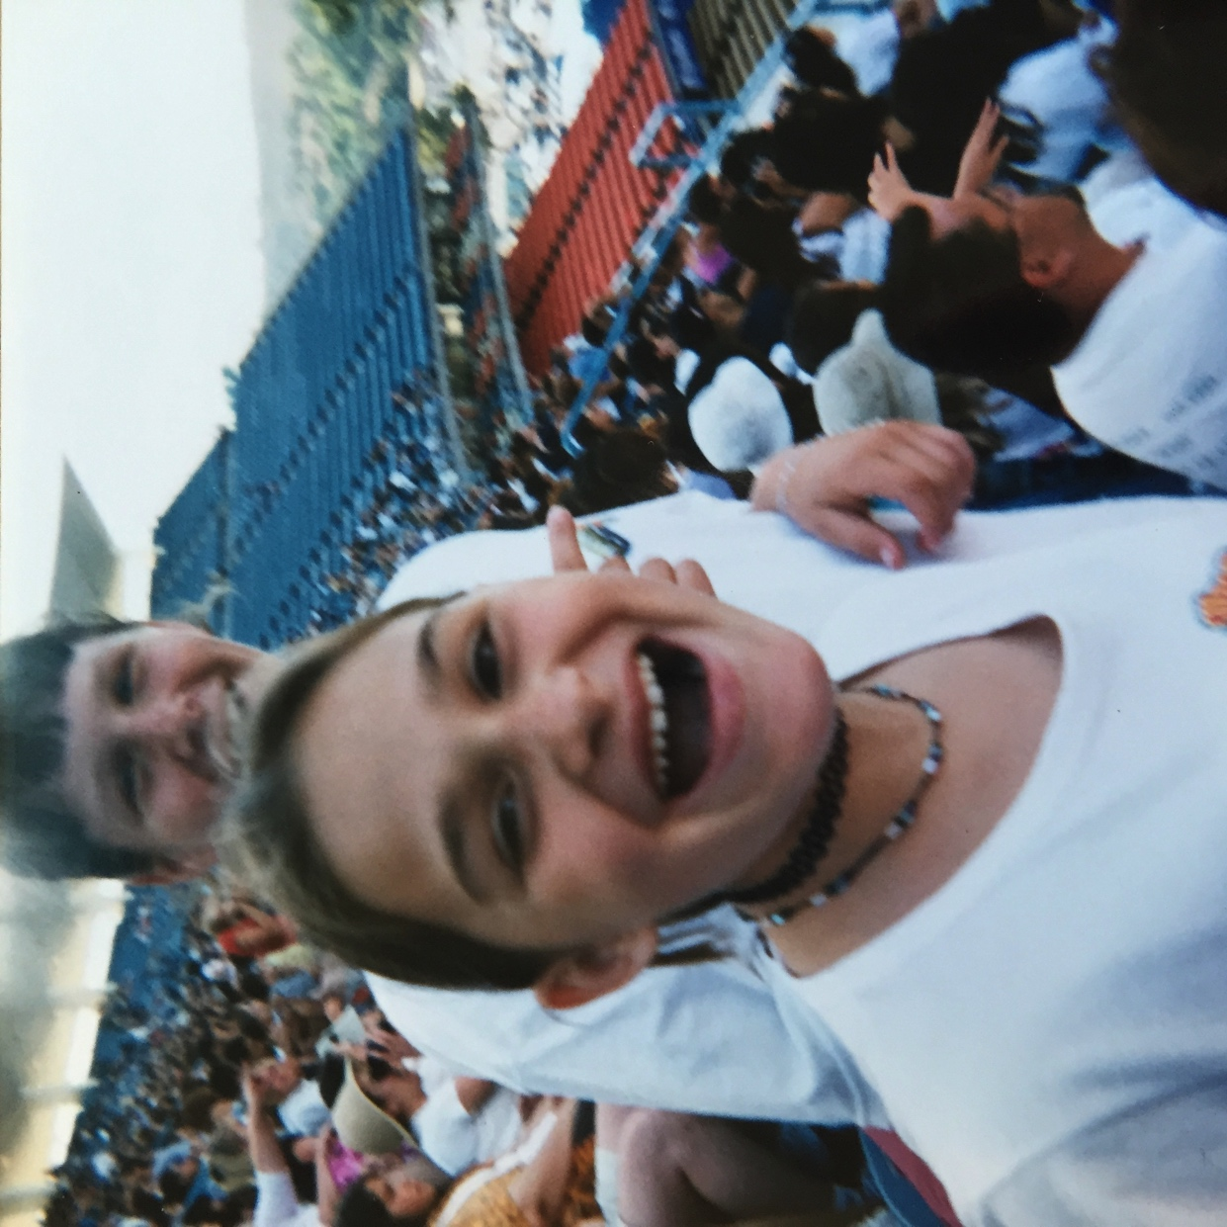
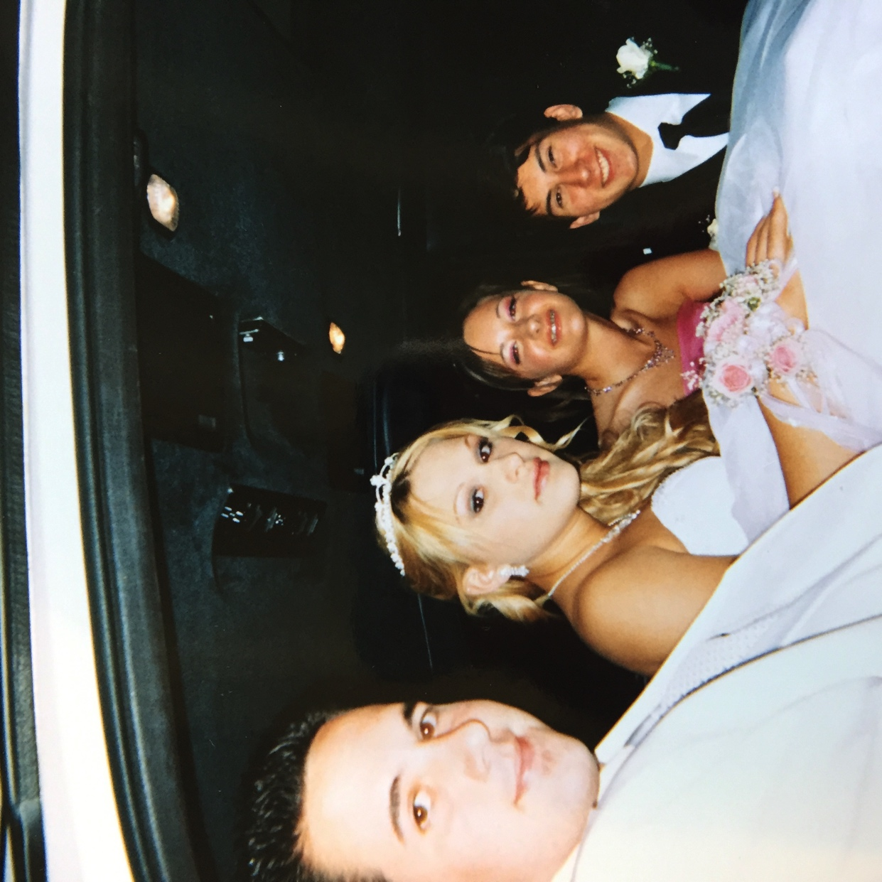
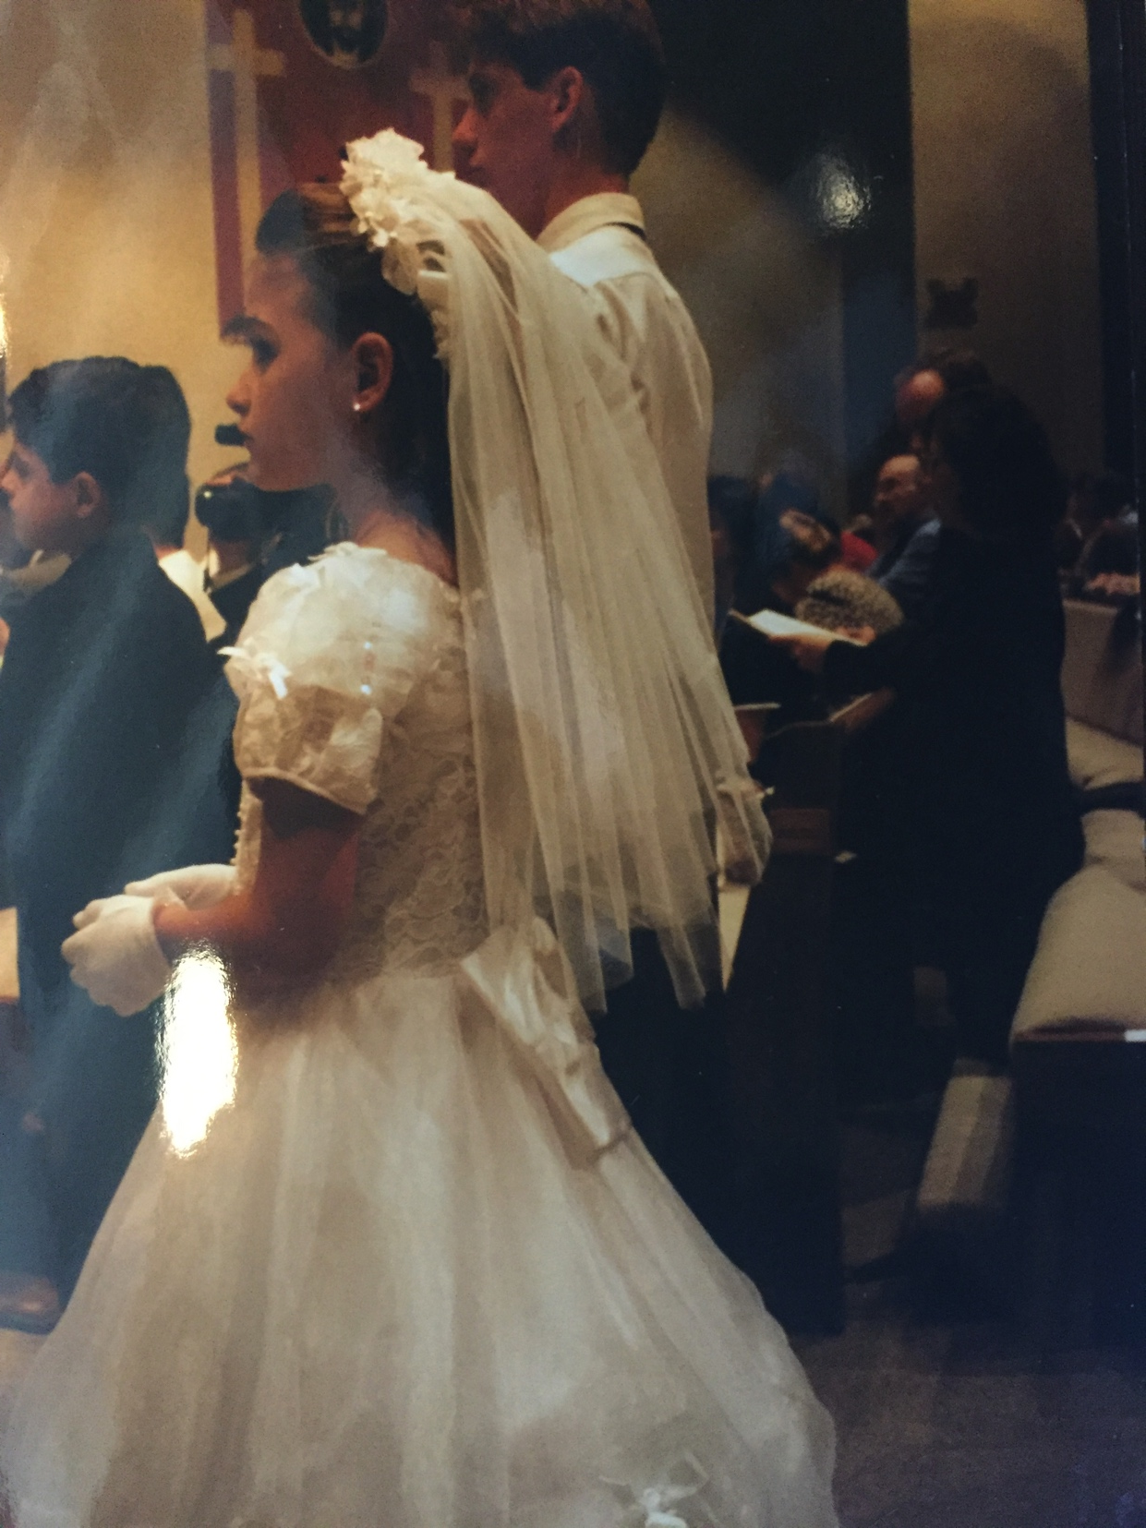

Slide 6

Challenge yourself, but don’t overwhelm.

Slide 7

There are likely two things you’ll attribute your success to as an adult – your teachers and your parents.
Don’t take them for granted.

Slide 8

There’s no shame in not knowing everything!
- take your time thinking about what you like to do

Slide 9

Find something you love and make it your life.

Slide 10

Set goals - short term & long term
“This baby Panda is cheering for you because you can do ANYTHING!”

Slide 11

Share your knowledge and expertise
1. Engrain what you know.
2. Expand what you know.
3. Establish yourself as a thoughtleader.
4. Increases your value.

Slide 12

Stay Curious!
1. The smartest thing you can do is constantly ask questions.
2. Take an interest in others – you may meet a mentor.

Slide 13

Be Courageous (take calculated risks)

Slide 14
THANK YOU!
Loren Rochelle // Business Development
m: 310.926.3413
e: loren@thisisnom.co

