Slide 1
Guest Speaker, Ben Pouladian
Youth Business Alliance

Slide 2
Introduction
My name is Ben Pouladian and I am 33 years old.
I work for Deco Lighting.
Deco Lighting is a leading provider of lighting solutions and applications for professional markets.
My roles at Deco Lighting are Co-founder and President.
I co-founded Deco Lighting about 10 years ago with my cousin Sam.

Slide 3
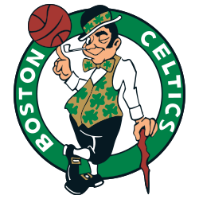
The Early Years…
I was born in Boston, Massachusetts and raised in Los Angeles, California.

Slide 4
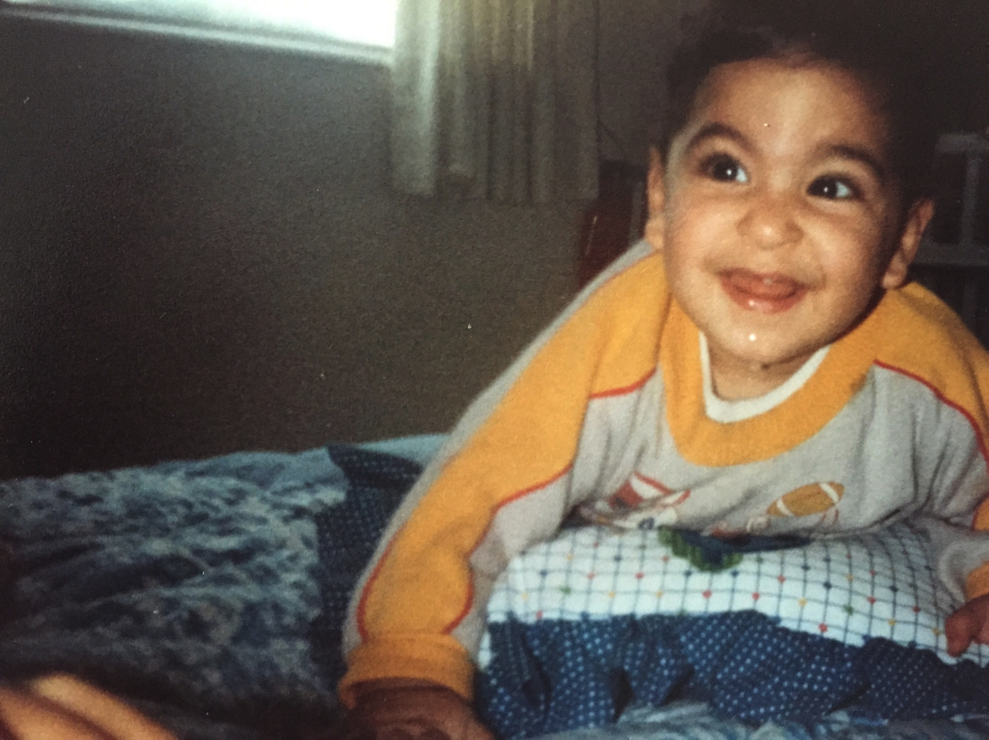
The Early Years…
This is me as a baby.
This is my 5th grade class picture

Slide 5
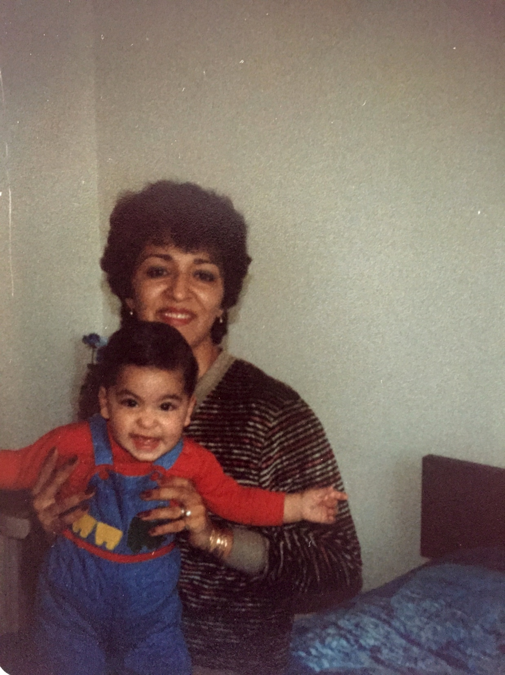
More Early Years…
A little about my family…

Slide 6
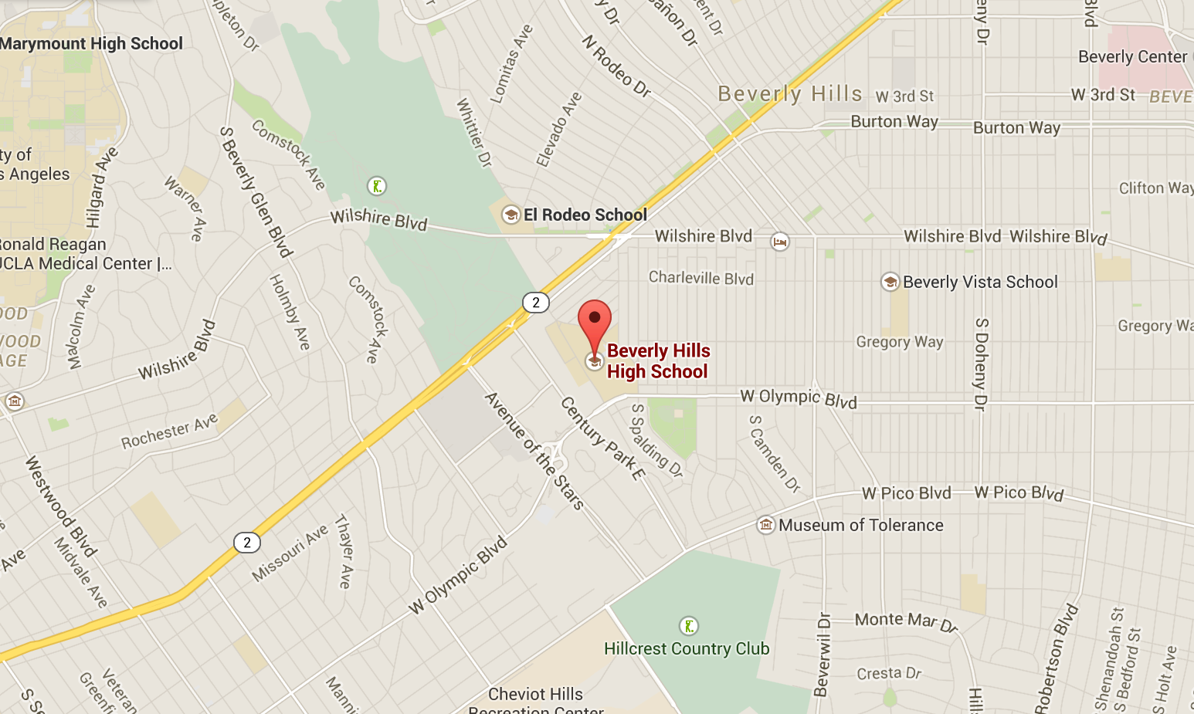
High School
I attended Beverly Hills High School in Beverly Hills, California.
\

Slide 7
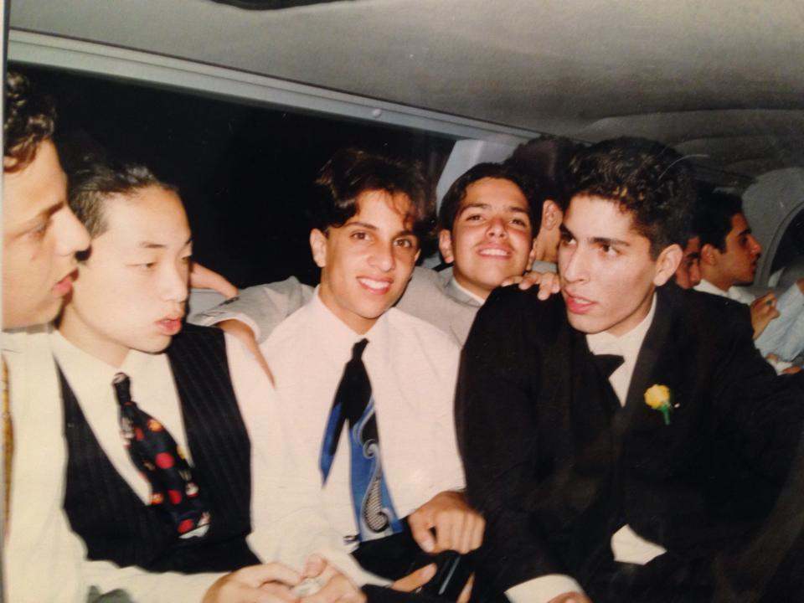
High School
As a HS student I was involved in football and many honors and AP classes. As a HS student I was shy and a little nerdy
Here is a shot of me in HS

Slide 8
High School
Things I enjoyed in HS:
Things I did not enjoy in HS:
Football
Computer Class
Semi-Independence
Meeting new friends
Prom Night
Harder classes
Studying for SATs
PE Class

Slide 9
High School
Activities/Athletics in HS:
Jobs I worked while in HS:
Football
Track
Volunteering
Doing a lot of studying and homework!
Cashier at Williams Sonoma
Busboy / Cashier at Jonny Rockets

Slide 10
High School
Fondest memories from High School:
Obstacles/Adversity I had to overcome in High School:
Some teachers taught with passion, those were the teachers I remembered and the material I still hold today
In High School my guidance counselor told me I wouldn’t make it into any engineering program.
I applied anyway and got accepted to USC, UC Irvine, UC Santa Barbara, and UCSD.

Slide 11
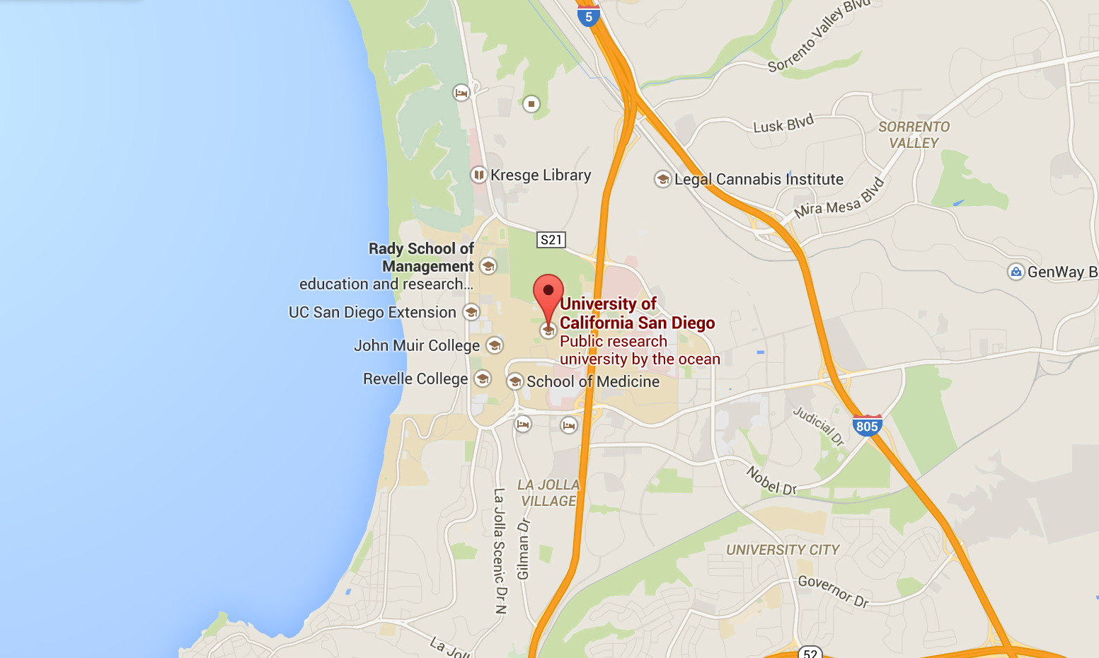
College
I attended college at UCSD in San Diego, California.

Slide 12
College
Activities in College:
Jobs I worked while in College:
The Ultrafast and Nanoscale Optics Group studies applied optics-photonics and nanoscale devices and systems.
My senior year I worked as an intern at Cymer, a company that develops extreme ultraviolet radiation (EUV) light sources which pattern advanced semiconductor chips that power several notable chip makers such as Intel and Samsung.

Slide 13
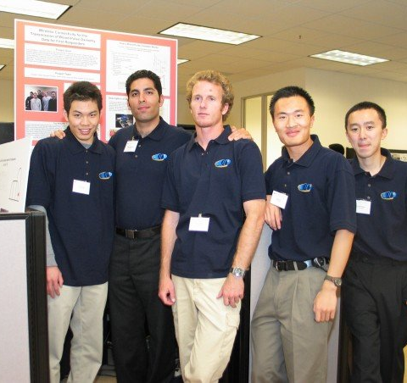
College
Favorite classes:
Least favorite classes:
International Politics
Group Engineering Project
Optics and Lasers
Logic semiconductors
Entrepreneurship 101
History of Reggae Music
Java Programming
General humanities
Differential equations
This is my senior year of college engineering team

Slide 14
College
Fondest memories:
Obstacles or adversity that I had to overcome:
Start from a clean slate, you are new just like everyone else, no history for anyone to judge you by
Make new friends
No parents to tell you to study or do your own homework, you are in charge of your own destiny!
Spending my weekends in the library
You think you are smart when you enter in college, but you realize many of your colleagues are just as smart or smarter than you
First quarter I went from being a straight A student in High school to a D average in college
You need to work extra hard to succeed in college

Slide 15
Career Path
I studied Electrical Engineering in college, a very math intensive degree. Graduated in 2004
In 2004, I moved to San Francisco, and worked for several technology companies. I left to go start my own!
In 2005 I co-founded Deco Lighting with my cousin, Sam.
Notes:
You may use this chart to describe your journey to the current career

Slide 16
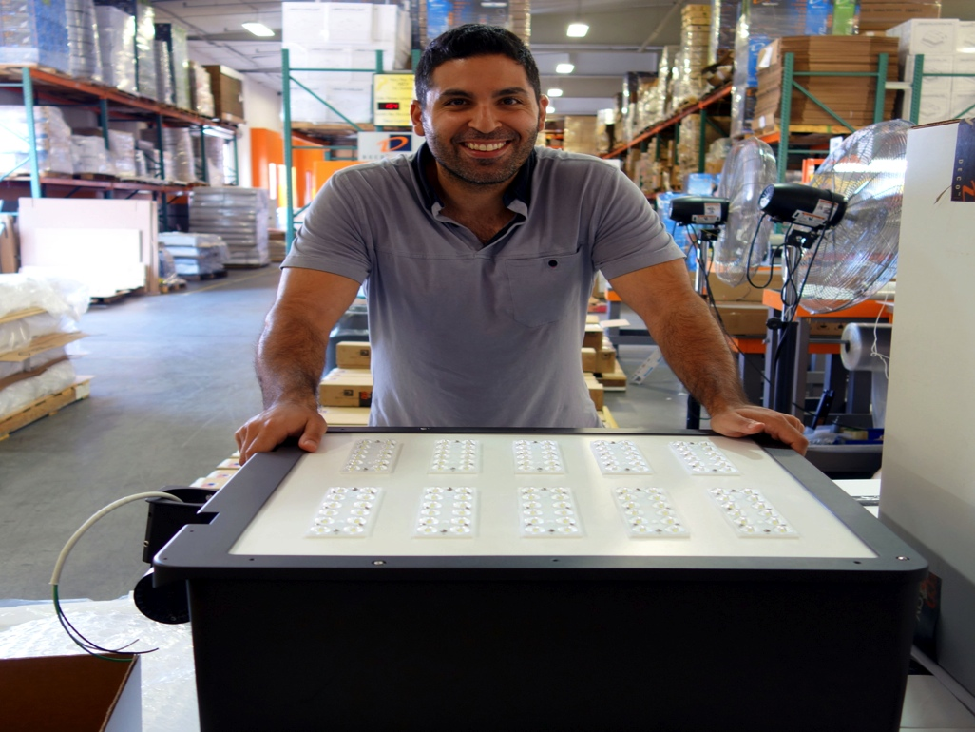
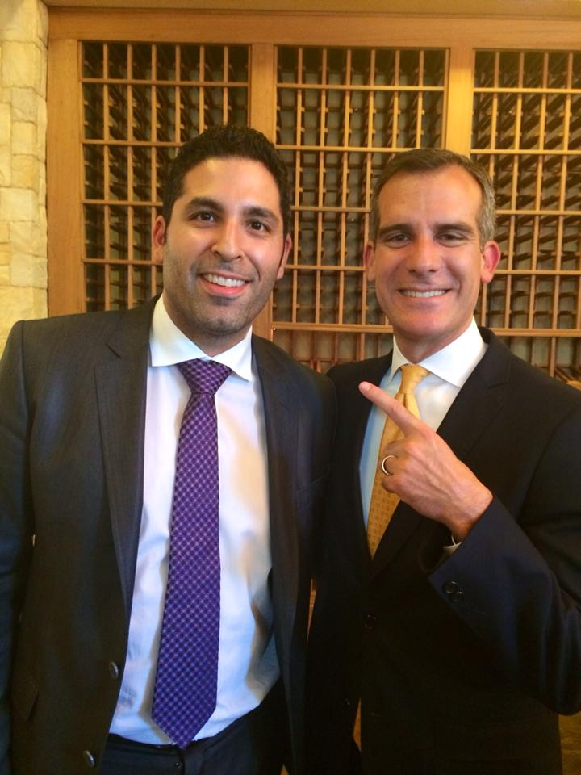
Career
Halloween at Deco Lighting
This is me standing with some of our new LED technology
This is me and Mayor Garcetti

Slide 17
Career
My first job:
My worst job:
I got my first job when I was ten years old delivering flowers in Boston.
When I was 16 years old I worked as a cashier at Williams Sonoma.
I soon left to work at Johnny Rockets.

Slide 18
Career
Some challenges I had to overcome in my career:
Started a company at age 23
Didn’t know where to begin, made many many mistakes and I learned a lot
Nothing comes easy, I wanted to give up many times
Perseverance is key
A positive attitude is a necessity for the tough times in life

Slide 19
Current Role
History
Deco Lighting was founded in 2005.
Size
Deco Lighting has about 100 associates.
Location
Deco Lighting is based in Commerce, California.
Products
Services
Smart LED Lighting fixtures that you can turn off and on with your computer or mobile phone
We provider lighting solutions and applications to professional markets.
We’re located a few miles from downtown Los Angeles.
N/A
Notes:
Use this graph to give more description of your current company (history, size, location, products and services, etc.)

Slide 20
Current Role
President
Sales
Customer Service
Engineering
Marketing
Notes:
Use this graph to give more description of your role specifically (responsibilities, typical work week, direct reports, etc.)

Slide 21
Career Compensation
Management
$120k
Sales
$100k
Customer Service
$50k
Administrative
$25k
Notes:
Use this graph to show general compensation ranges for people in various roles in your company

Slide 22
Academic Exercise
We will now spend several minutes discussing the day’s academic module and how it is relevant in the ‘real world’

Slide 23
Question and Answer

