Slide 1
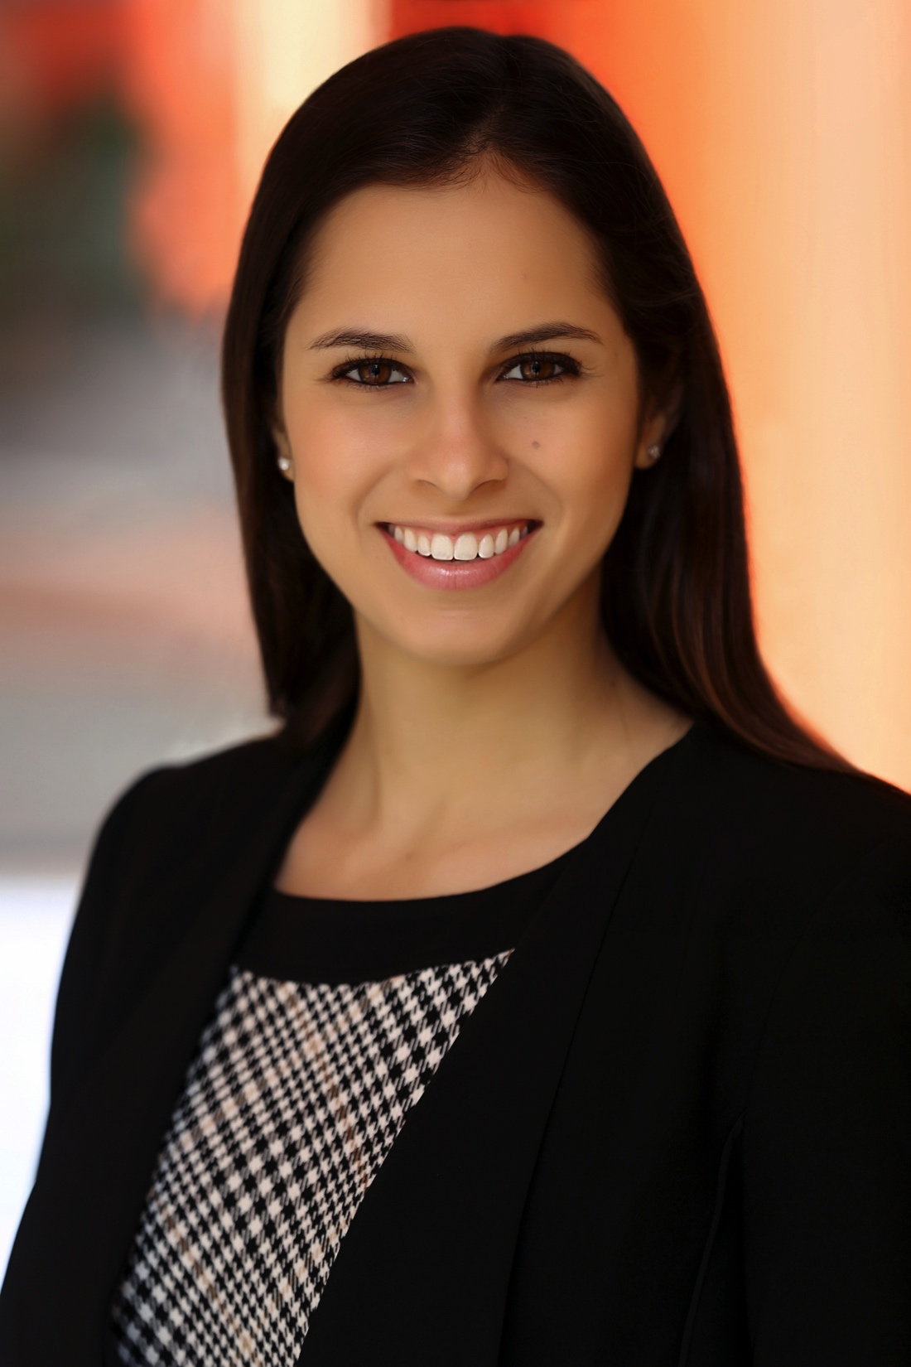
Rebecca Sadwick
Director of Marketing, GoGuardian, Inc.

Slide 2
INTRODUCTION
My name is Rebecca Sadwick and I am 23 years old.
I work for GoGuardian as Director of Marketing.
My company makes software that helps schools protect students online and use the technology in their classroom more effectively.
I work on raising awareness for our company by creating articles and directing video content that helps inform people about important topics in online safety and classroom technology use.

Slide 3
My childhood
This is me when I was 4, my youngest sister Kayla when she was 1, and our mom.
This is my middle sister Ari’s first Halloween. She was 8 months old, I was 2.5 years old.

Slide 4
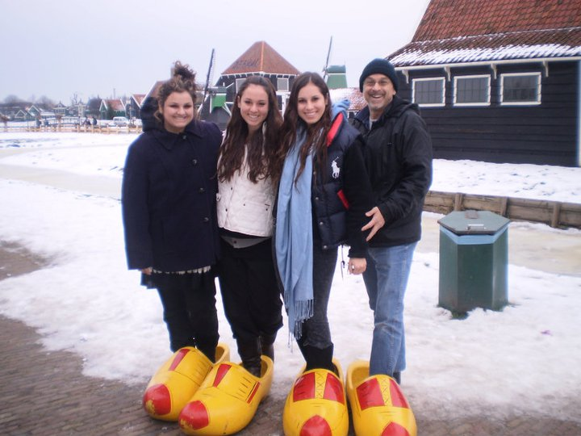
My family
I’m the oldest of 3 girls. My sisters are 2 years and 3.5 years younger than I. We grew up in Thousand Oaks, CA.

Slide 5
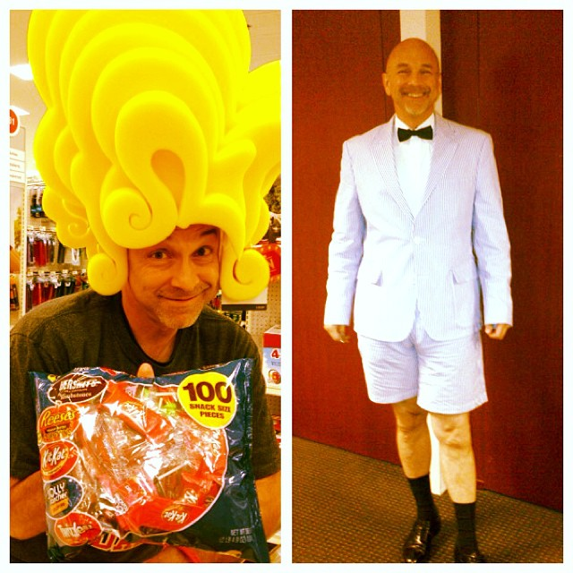
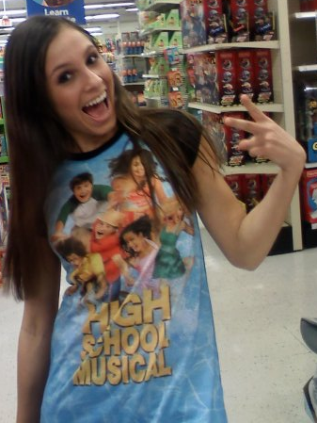
no idea where my goofiness came from…
Notes:
My mom is goofy too but doesn’t tend to pose for photos when she’s acting like it.

Slide 6
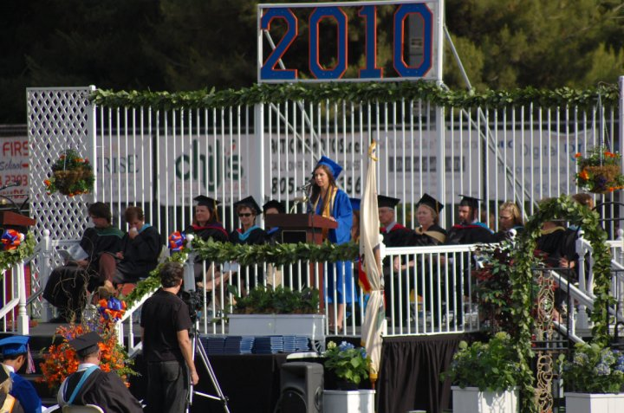
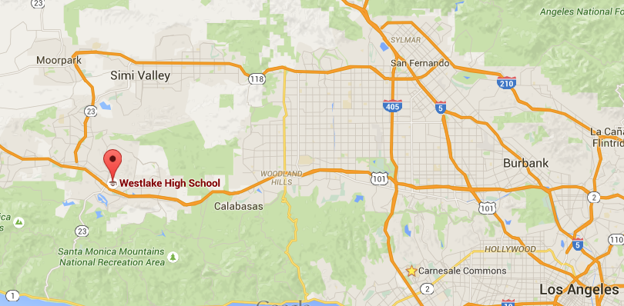
MY HIGH SCHOOL
I attended Westlake High School in Westlake Village, CA
()

Slide 7
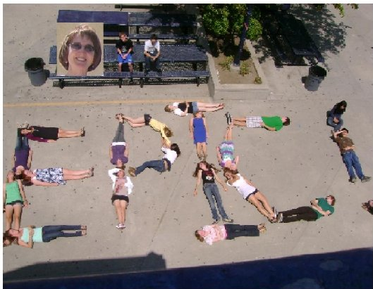
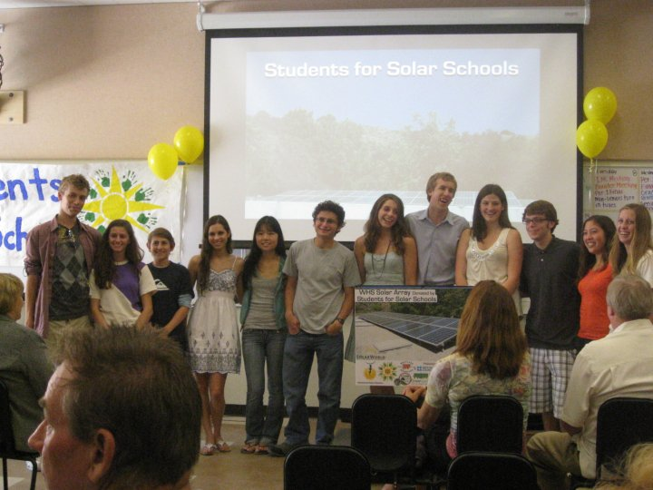
High School
As a HS student I was very focused on academics and giving myself lots of options for college. Some people would definitely call me nerdy.
This is my 10th grade English class on the last day of school.

Slide 8
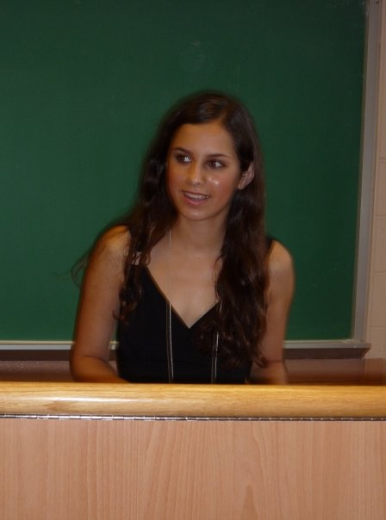
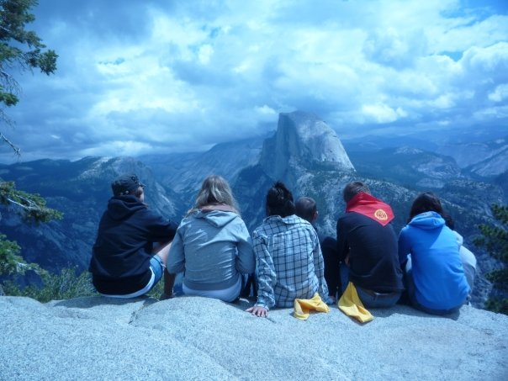
High School
Things that I really liked in High School were:
Politics and debate
Hiking and camping
Track and cross country
With some friends in Yosemite. I was already wearing a UCLA sweatshirt even though I didn’t know I was going there until 2 years later.
This is me at debate camp. Like I said, some people would call me nerdy.

Slide 9
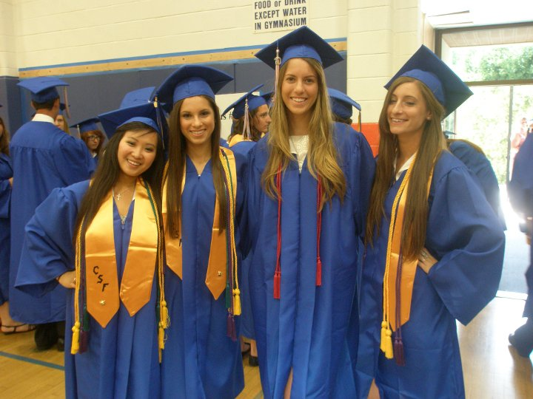
High School
Things that felt difficult or challenging for me while I was in High School were:
Staying true to my interests and values when they weren’t popular.
Chemistry.
Spanish.

Slide 10
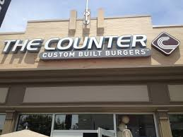
High School
Jobs I worked while I was in High School were:
Office Aide at my temple
Hostess at The Counter
Babysitting occasionally

Slide 11
Getting in to College
Took as many challenging courses as I could, and got the best grades possible in them.
Worth adding an extra class, even if you have to stay longer;
Become really involved with a small number of extracurricular activities
Youth Commission
JSA
Track and cross country

Slide 12
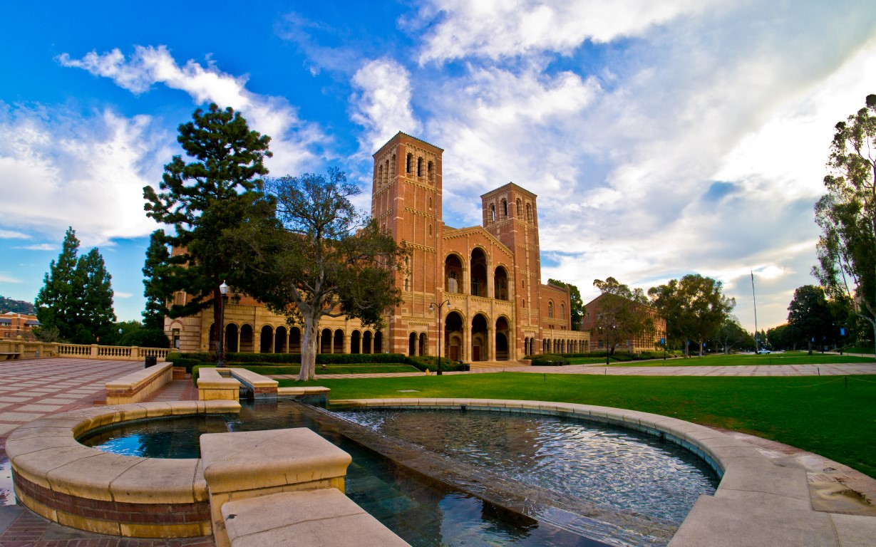
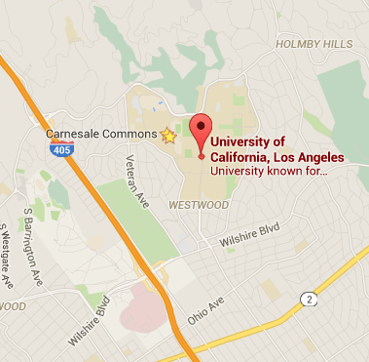
College
I attended college in Los Angeles.

Slide 13
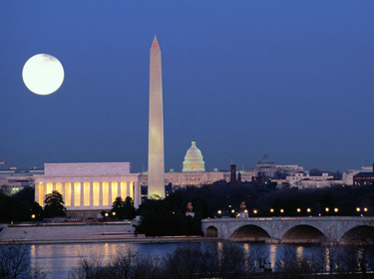
College
Things I enjoyed in College
Things I didn’t enjoy in College
Interning in Washington DC
Trying new sports and clubs
Making new friends
Reading
Political and debate clubs
Finals and midterms
Constant distractions
Constant moving
Every 9 months

Slide 14
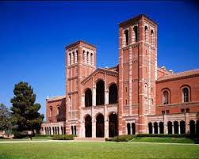
College
Favorite classes
Least favorite classes
Science, Technology and Public Policy
Social Welfare
Statistics
Political Philosophy
Physiological Science
Theatre
Earth Science
Atmospheric Science

Slide 15
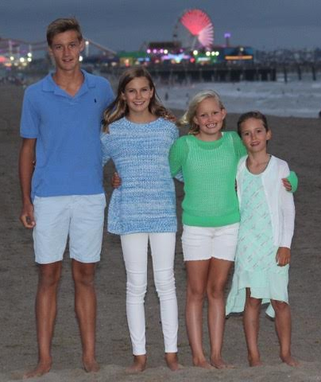
College
Jobs I worked while I was in College:
UCLA academic peer counselor
Babysitting

Slide 16
College
Things that felt difficult or challenging for me while I was in College were:
Balancing my obligations and interests
Always an activity or distraction
Juggling work and academics
Learned to block off time and make the best use of it

Slide 17
Getting a job after College
Maintain good relationships with friends, colleagues and professors
Impress them with your reliability and work product
Intern in fields related to my interests
Seek mentors and advice
Apply to programs, fellowships and internships while in college

Slide 18
GoGuardian
I work with the Brand Director, Designer, and Social Media Manager to make sure our company’s message comes across
We do planks and push-ups at 2:45 to keep our energy up
Our office coordinator brings her dog Huxley into the office
We play soccer on Mondays and Wednesdays and rock climb on Tuesdays together

Slide 19
My Career Path
I was offered to lead the Digital Technologies Initiative at UCLA
I worked on a report about youth Internet safety my senior year of college
I now direct the marketing efforts for a company that works to keep kids safer and more engaged online
Notes:
You may use this chart to describe your journey to the current career

Slide 20
My Career
Challenges I have had to overcome throughout my career are:
Realizing that it’s ok not to have everything figured out
Everyone figures things out as they go along. No one has it more together than you do, even if it looks like it.

Slide 21
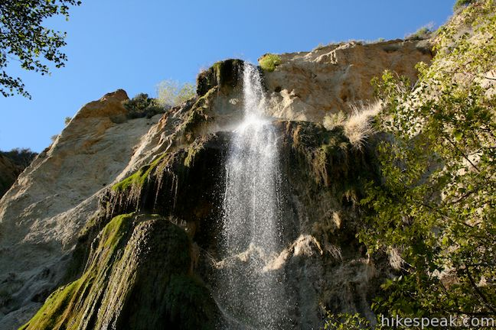
More than just work
When I am not at work I like to:
Paddleboarding
Hiking
Indoor rock climbing
Biking

Slide 22
Do it all over again?
I’d realize sooner that everything is temporary. Absolutely everything.
If it’s hard now, turn it into something that’ll set you up for where you want to be later.
If it’s great now, don’t take it for granted.

Slide 23
QUESTION AND ANSWER

