Slide 1
Chris Manderson YBA Guest October 2015

Slide 2
INTRODUCTION
My name is Chris Manderson and I am 46 years old.
I am Managing Director for Mergers & Acquisitions for Franklin Data Ventures, Inc.
My primary role is managing mergers and acquisitions.
I also run the legal department, managing litigation and other legal and business affairs

Slide 3
What You Really Need to Know!

Slide 4
What you should know about me?
I grew up in San Diego, California
After college, and before law school, I lived in Japan and traveled all over Asia: China, Thailand, Indonesia, Korea, Hong Kong etc.
At different stages in high school and college I thought about being an investment banker, a lawyer and a diplomat.
I have 3 kids, a son age 17 who in college, and daughters ages 15 and 8. They live in Vancouver, Canada
My parents were teachers: my dad taught high school history, my mom taught 4th grade

Slide 5
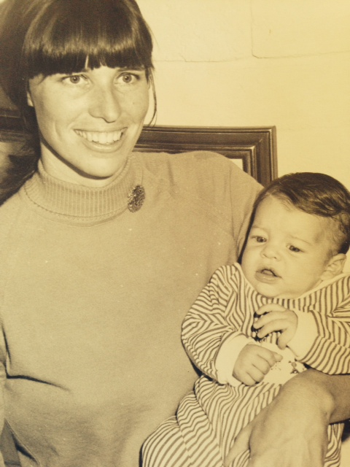
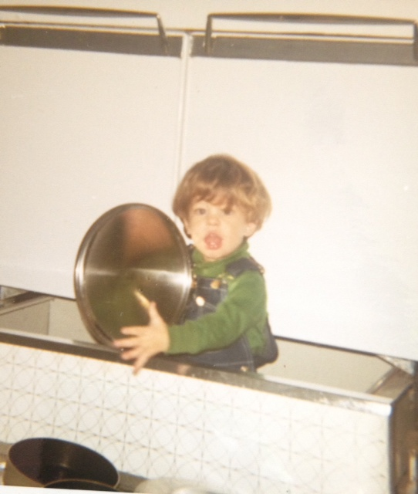
The Early Years…
I was born and raised in San Diego, CA.
This is a picture of me
at about 4 months.
Around age 5

Slide 6
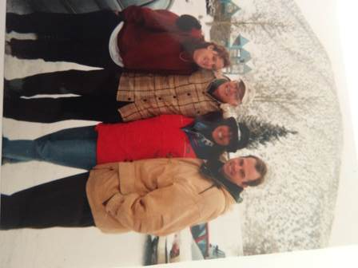
Family
A little about my family…
Bill
Bill. Age73.
Retired High School
History Teacher
Carole.
Age 72.
Retired elementary school teacher.
Aimee.
Elementary school assistant.

Slide 7
The Next Generation
Isabella
Age 13
Nicholas
Age 16
Coco
Age 7

Slide 8
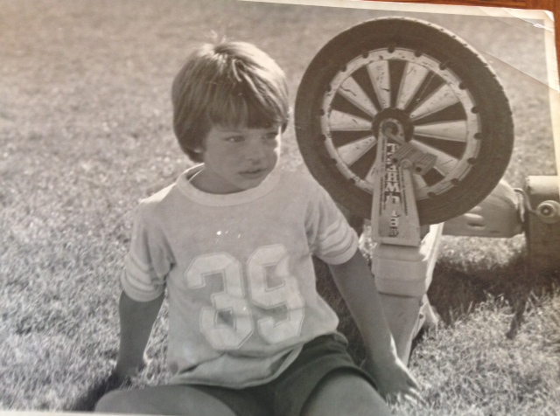
My neighborhood
I grew up in an area of San Diego called La Mesa/Mt. Helix.
It was a suburban mountain area with lots of boulders, trails, bushes, skunks and citrus and avocado trees
I loved sports, especially baseball
I had a golden retriever dog. Every afternoon I would hit tennis balls with a baseball bat for her to chase. She would charge into the bushes and bring them back, wet with slobber.

Slide 9
HIGH SCHOOL
I attended Grossmont High School in La Mesa, CA.
I was a lazy student and did not study very hard. I got decent grades but could have done much better
I was very good at standardized tests, and got into UC Santa Barbara, and later UCLA Law School, mainly due to good SAT and LSAT scores.
As a result, I did not develop good study habits until college.
I was an editor of an excellent school newspaper. We won best high school newspaper in San Diego county 4 years in a row, including my Junior year and Senior year.
Learning how to write well in journalism class has been an important professional skill

Slide 10
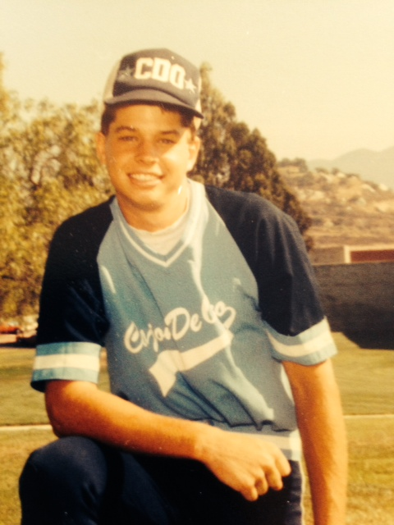
HIGH SCHOOL
Things I enjoyed in HS
Things I did not enjoy in HS
Sports
Journalism
Social activities
Working
Cars
Studying

Slide 11
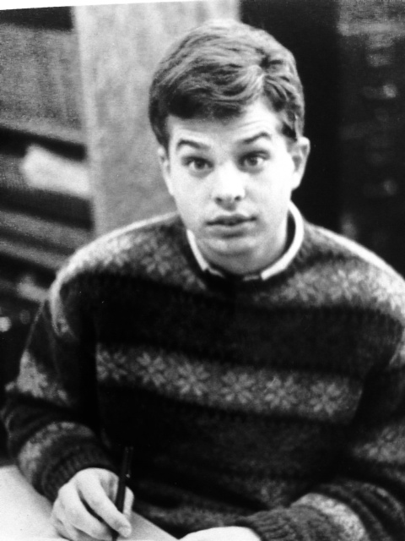
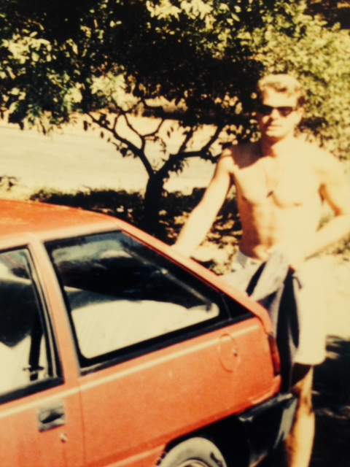
HIGH SCHOOL
Activities/Athletics in HS
Jobs I worked while in HS
Played baseball
Editor of school newspaper
Cars, girls, social activities
Bagged groceries at supermarkets

Slide 12
Early Jobs—High School
My first Job
My worst Job
Gemco Supermarket
Bagged groceries, loaded them in customers’ cars, cleaned up spills, swept floors.
Lessons learned:
Importance of good leadership
Professionalism
Teamwork
Business models—how does your employer make money?
KMP Plumbing
Summer construction job at Industrial plumbing company
No job is beneath you.
You can learn something from every job.

Slide 13
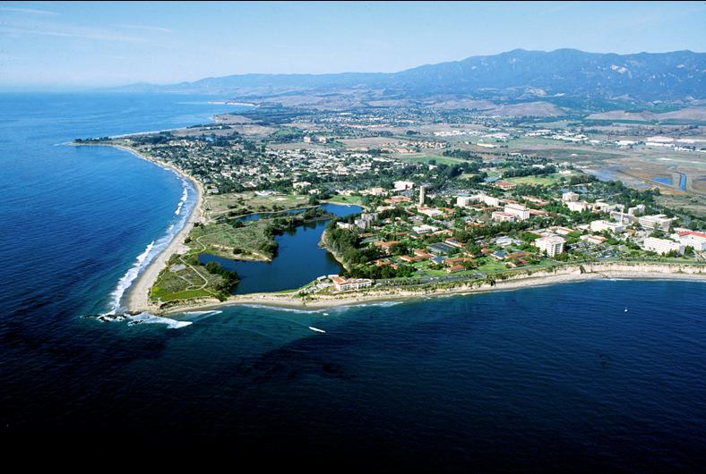
UC Santa Barbara
Gauchos
Graduated 1991
B.A., Political Science
Studied Japanese language
Worked in Washington, D.C. just before 1991 Iraq War
Moved to Japan after graduation

Slide 14
What I wanted to be when I grew up!
Diplomat
Studied international politics and languagesIn reality, a bureaucratic administrative job
Investment Banker
1980s
Mergers and acquisitions Seemed glamorous, lucrative and exciting
Wall Street movie/Gordon Gekko

Slide 15
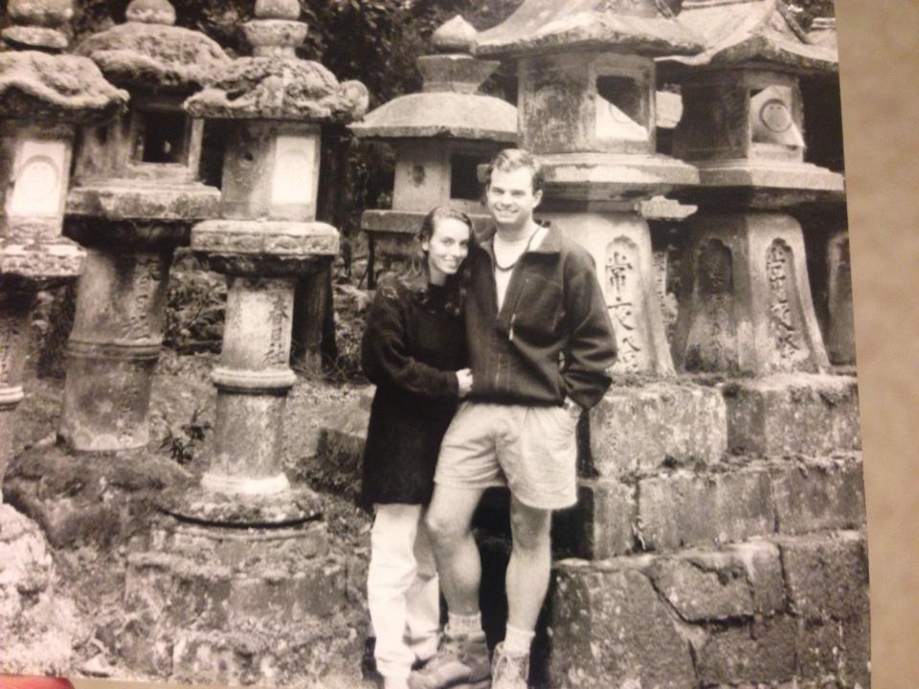
Japan 1991-1994
Sold my sister’s 1967 Mustang for $2,500 and bought a ticket to Japan
Worked for the Princeton Review of Japan in Tokyo
Taught GMAT, LSAT, TOEFL,
Got interested in business

Slide 16
Asia 1991-1994
Japan
China

Slide 17
Import business 1994-1996
Imported furniture from Indonesia and Thailand
Sold wholesale to furniture stores and other retailers
Customers included Costco, Nordstrom
Retail store on La Brea Avenue

Slide 18
Traveling in Southeast Asia
Nyepi Festival
Bali, Indonesia 1995

Slide 19
Lessons Learned
The Good
The Bad
Learned core business skills
Being your own boss is exhilarating but risky
Accounting is vital
Business travel is not fun
You always need more capital
You pay employees and the business before yourself
Choose partners and employees carefully

Slide 20
UCLA School of Law
Law school, 1997-2000
Graduation, May 2000
Returned to law school to forge a career (not a job)
Considered MBA and JD/MBA
Studied business law
Worked as LSAT instructor

Slide 21
Career
What I became…
A corporate lawyer
Worked at Skadden, Arps and Paul Hastings, 2 major international law firms
Specialized in mergers & acquisitions and business transactions
Advised corporations and private equity funds
Never went to court
Why?
Learned how businesses operate in many industries
Every deal is different—you have to understand how the client will grow its business thru the transaction
Resume builder

Slide 22
Legal Entrepreneurship
In 2009, founded Manderson, Schafer & McKinlay LLP
Goals:
develop my own clients
Run a business
Freedom & autonomy
A law firm is a business, facing the same issues as startups

Slide 23
Lessons Learned
Tyler and Lance
Get experience!
Developed new skills in bankruptcy, litigation and real estate.
Lance Armstrong investigation
Media relations; 60 Minutes story
The truth will always come out

Slide 24
Career Path
Associate at Skadden, Paul Hastings, 2000-2009
Founded Manderson, Schafer & McKinlay LLP
2009
Executive Vice President & General Counsel of Signature Group Holdings, Inc., 2012-2015
Notes:
You may use this chart to describe your journey to the current career

Slide 25
Mergers and Acquisitions
Why do companies merge and acquire?
Growth
Enter new businesses
Enter new markets
Easier to “buy it” than “build it”

Slide 26
Why become a Corporate Lawyer?
Gain an overall understanding of how businesses run and how to operate them efficiently.
Opportunity to work with several different types of businesses and clients.
Great foundation – limitless opportunities for growth

Slide 27
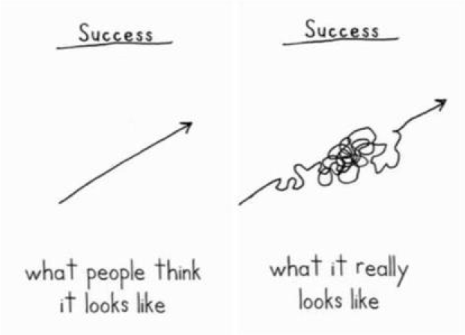
Words of wisdom
Your career path is unpredictable.

Slide 28
More Words of Wisdom
Choose your partners carefully. Partnerships are easy to get into, and difficult and destructive to exit.
Take risks. You will create growth opportunities, both personal and professional.
Entrepreneurs and risk takers can earn real wealth. Employees earn paychecks.
Controlling your own destiny in life is empowering
The truth will always come out. (Lance Armstrong case.) Before or during a crisis, you need to tell your story, your way. If you don’t, someone will tell it for you.
All careers look more exciting on TV.

Slide 29
Careers You Can Pursue
Lawyer (outside counsel in a law firm)
Government Lawyer or Regulator
Securities and Exchange Commission
Department of Justice—Antitrust Division
Regulatory: NASDAQ, NYSE, FINRA
Business Executive
Business Owner / Entrepreneur
Investment Banker

Slide 30
What You Really Need to Know!

Slide 31
QUESTION AND ANSWER

