Slide 1
Presentation by Valon Xharra

Slide 3
Who am I?
I am originally from Kosovo
BA in Political Science – Bard College
MA in International Affairs – Columbia University
MBA Business Strategy – Boston University
Current Job – Managing Director, Control Risks
Avid amateur competitive marathoner

Slide 4
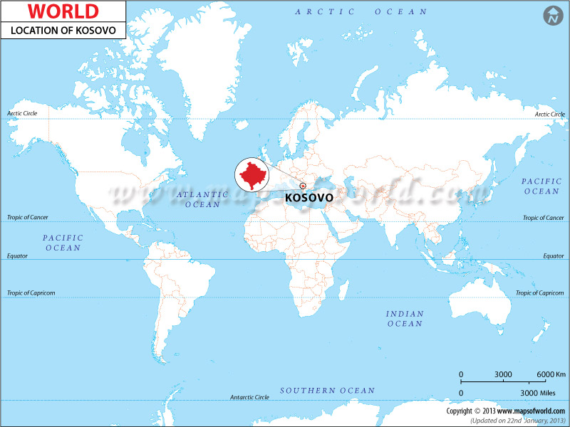

Slide 5
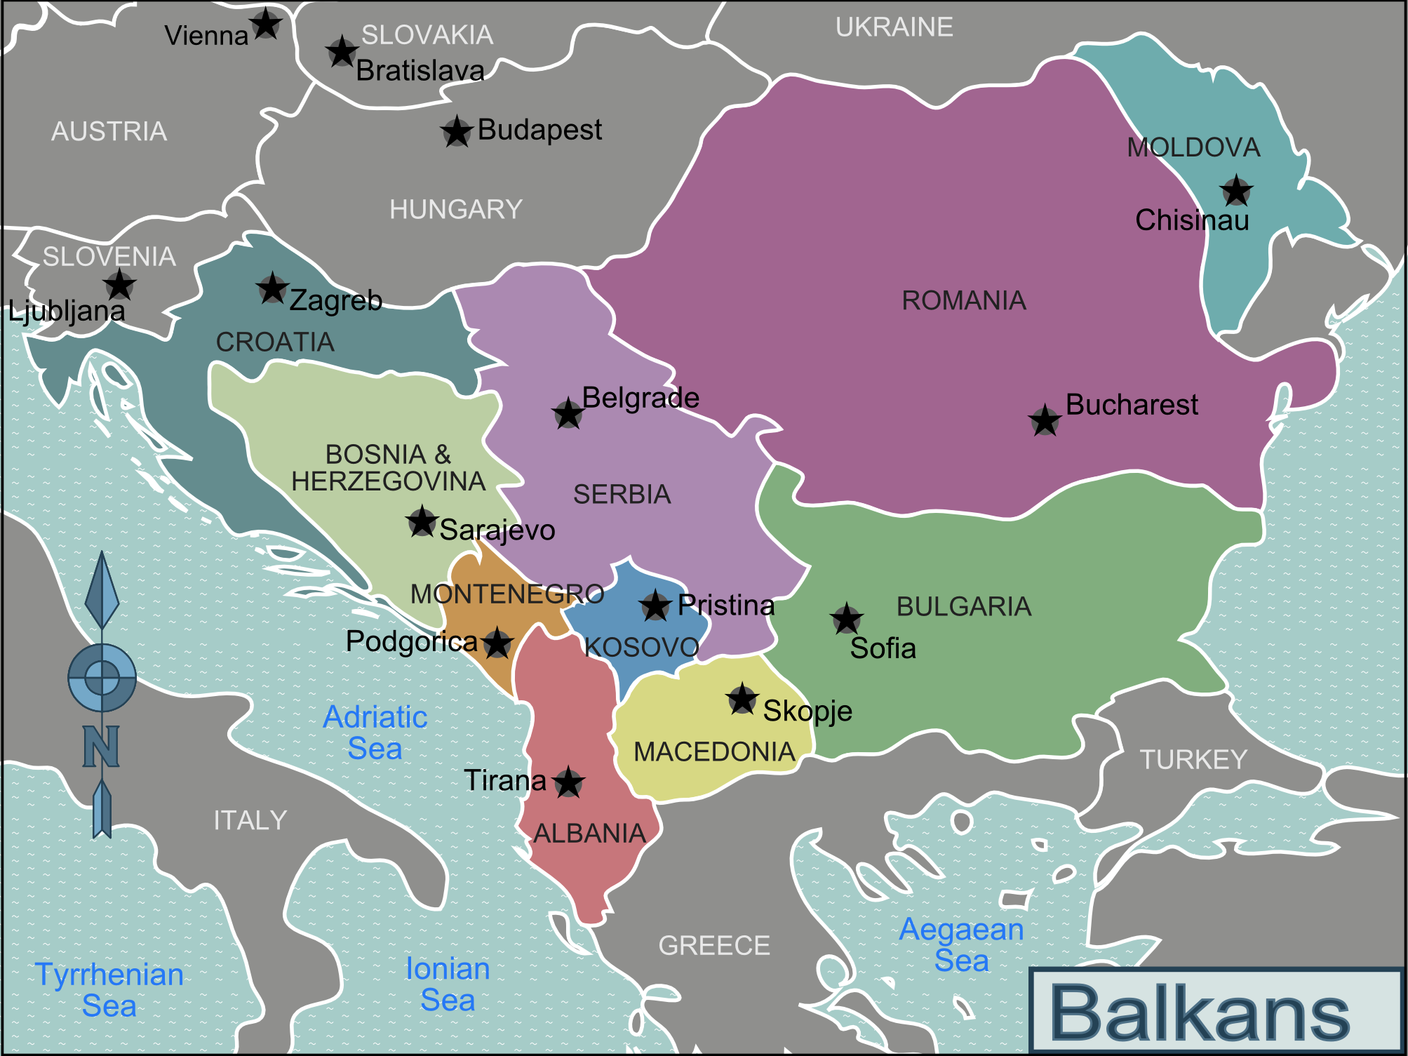

Slide 20
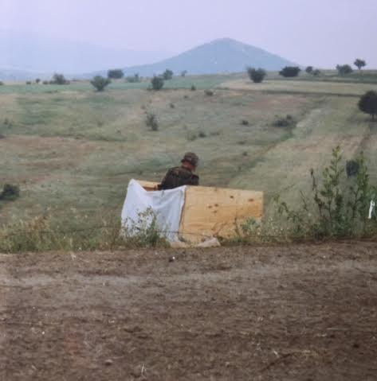

Slide 23
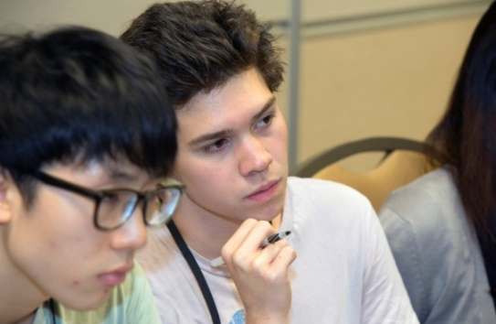
Jack Kent Cooke Foundation
College Scholarship Program

Slide 24
College Scholarship Program Overview
College Scholarship Program
Program Benefits
Program Eligibility
Application Timeline

Slide 25
What is the College Scholarship Program?
The Jack Kent Cooke Foundation College Scholarship Program is the nation’s largest undergraduate scholarship program through providing up to $40,000 per year available to high-achieving high school seniors with financial need who seek to attend the nation’s best 4-year colleges and universities.

Slide 26
Program Benefits
Receive up to $40,000 per year to attend a 4-year accredited undergraduate institution for tuition, living expenses, books and other required fees
Have access to one-on-one advising about selecting a college, navigating financial aid, transitioning to college, and maximizing the college experience

Slide 27
Program Benefits (cont.)
Have a pathway to the Cooke Foundation’s up to $50,000 per year Graduate Scholarship
The opportunity to network with the larger JKCF Scholar community
Scholars Weekend
Jack Kent Cooke Scholar Association

Slide 28
Program Eligibility
Plan to graduate from
a United States’ high school in
Spring 2016
Full-time enrollment
in accredited four-
year college
fall 2016

Slide 29
Program Eligibility (cont.)
Cumulative unweighted
GPA of 3.5 or better
Receive standardized test scores in the top 15% (SAT critical reading/math 1200+; ACT composite 26+)

Slide 30
Program Eligibility (cont.)
Demonstrate unmet financial need

Slide 31
Selection Criteria
Exceptional academic ability and achievement
Significant financial need
Persistence
Desire to help others
Leadership

Slide 32
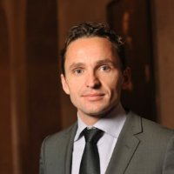
Control Risks?
What do I do now?
What’s Control Risks?
Control Risks is an independent, global risk consultancy specializing in helping organizations manage political, operational and security risks in complex and hostile environments.
I help clients identify risks and opportunities of investing abroad

Slide 33
Consultancy in the design and implementation of corporate- and project-level security strategies and the protection of client investments, assets, and personnel
Analysis and forecasting of political, security and operational risks to investments and operations
Due diligence, fraud, anti-corruption and business intelligence in support of transactions, investments, and overall business integrity
Global response capability to insured instances of kidnap, ransom, and extortion cases within 24 hours
Crisis & Security Consulting
Global Risk Analysis
Corporate Investigations
Kidnap/Extortion Response

Slide 34
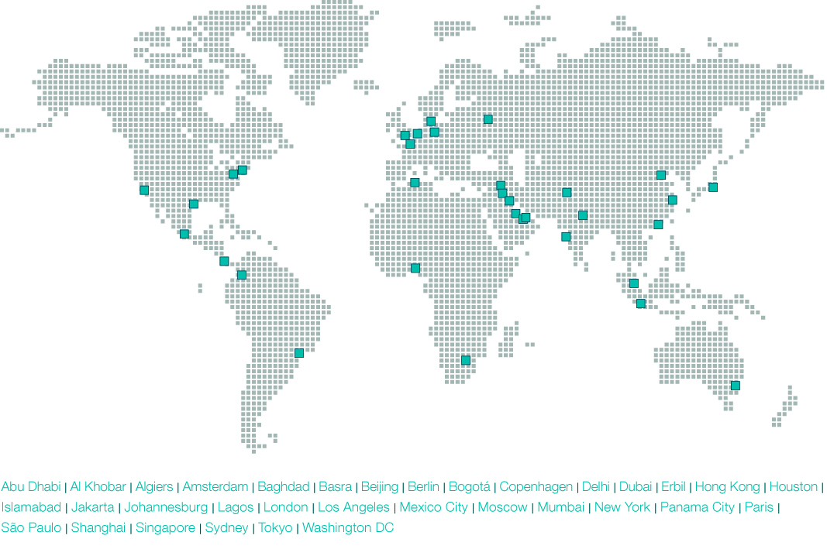
Control Risks office locations

Slide 35
Final thoughts and questions:

