Slide 1
YBA PROGRAM Alliance Collins Family High School
Rick Levy
ICM Partners

Slide 2
INTRODUCTION
My name is Rick Levy and I am 47 years old.
I work for ICM Partners.
We are a talent agency that represents artists in all parts of the entertainment industry including film, television, books, theatre, music, digital and commercials. We represent actors, authors, play writes, screenwriters, directors, producers, technical artists such a cinematographers, costume designers, and art directors.
My role at ICM Partners is Managing Member and General Counsel and I serve as a member of our Board of Directors.
Every day I do something different within my various capacities. I wear numerous hats which run the gamut from managing all of the legal affairs of the company, to overseeing the finances of the company, to working on business opportunities such as acquiring other companies, and I also get very involved with managing our employees including their compensation.

Slide 3
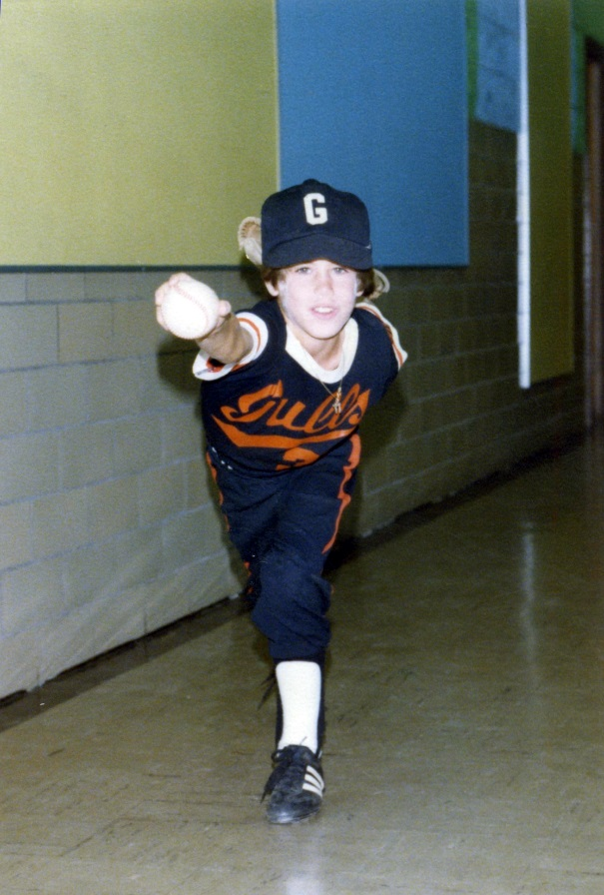
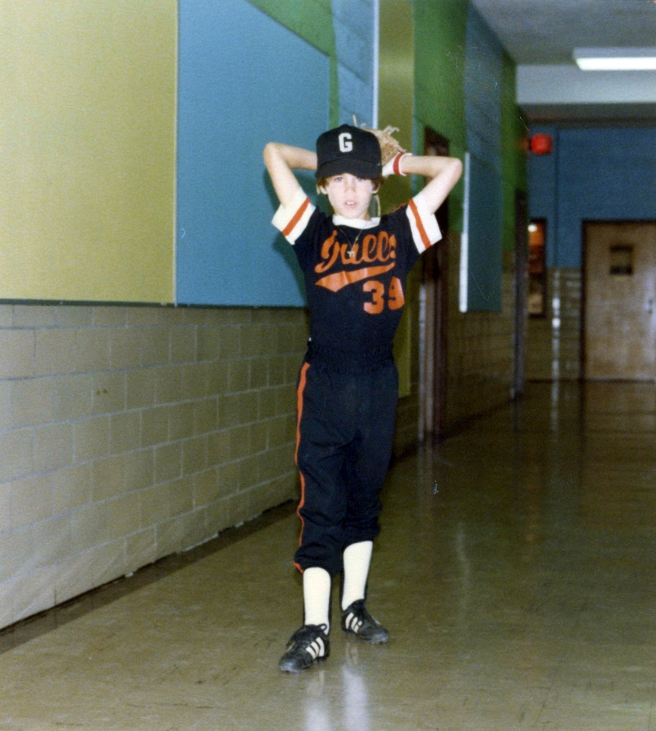
My childhood
I was born in New York on Long Island and was raised in a town in New York called Chappaqua which became famous because it is where the Clintons moved after Bill left the White House. By then, I had already been living in Los Angeles for more than 8 years.
These are pictures of me at 10 years of age doing what I loved to do best – playing baseball.

Slide 4
My family
A little about my family
I am the oldest of two boys. My brother Jared is three years younger than me and although we have not lived in the same city in 30 years, he is still my best friend.
My parents Robert and Andee divorced when I was in middle school, and both have since remarried. I also have two step-sisters named Nicole and Lisa.
This is a picture of me and (insert family member names)

Slide 5
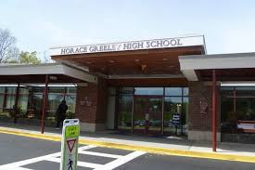
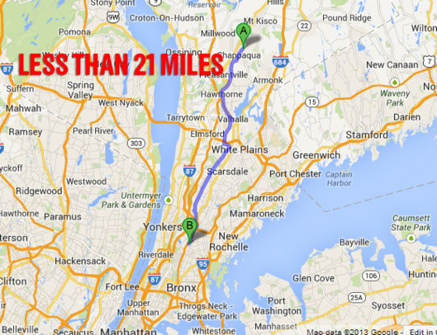
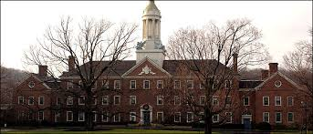
MY HIGH SCHOOL
I attended Horace Greeley High School, a public high school in Chappaqua, New York, which was located across the street from the famous Reader’s Digest headquarters.
The most famous person to graduate from my high school is actress and former Miss America Vanessa Williams, who graduated just a few years before me.
Reader’s Digest HQ

Slide 6
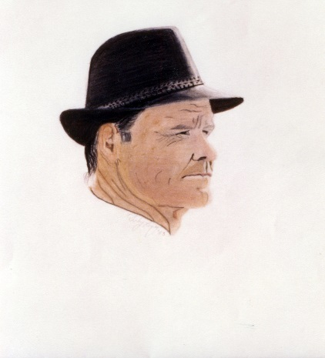
High School
Things that I really liked in High School were:
Student Government
Wrestling and working out with my friends on the team
Hanging out with my friends
Playing poker with my friends
Listening to music, especially Bruce Springsteen
Playing and watching baseball
History classes, which I later majored in in college
Art – I liked to draw in my spare time

Slide 7
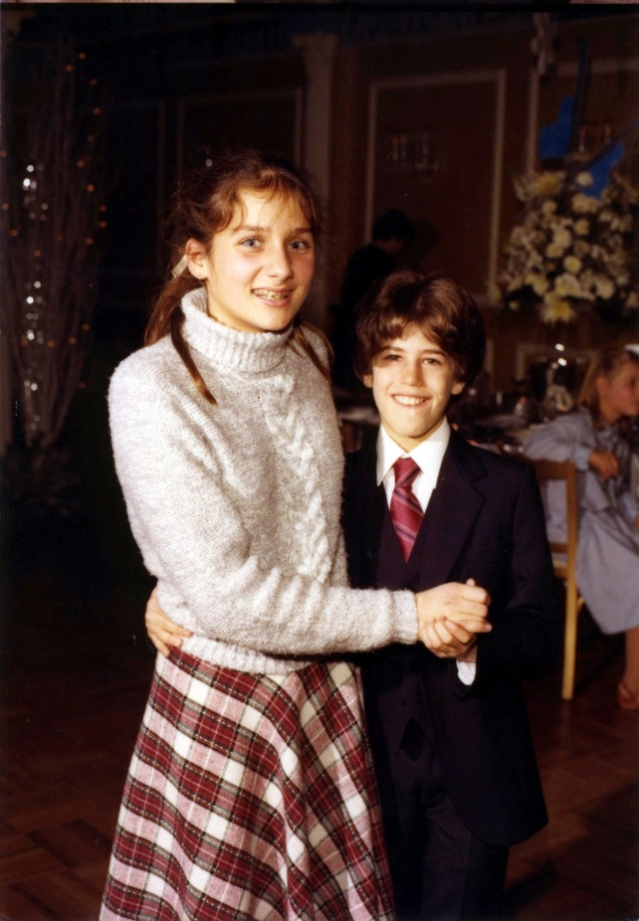
High School
Things that felt difficult or challenging for me while I was in High School were:
Calculus
Conversational French
Cutting weight for wrestling
Figuring out how to afford college
Dating my Freshman and Sophomore years because I grew really really late

Slide 8
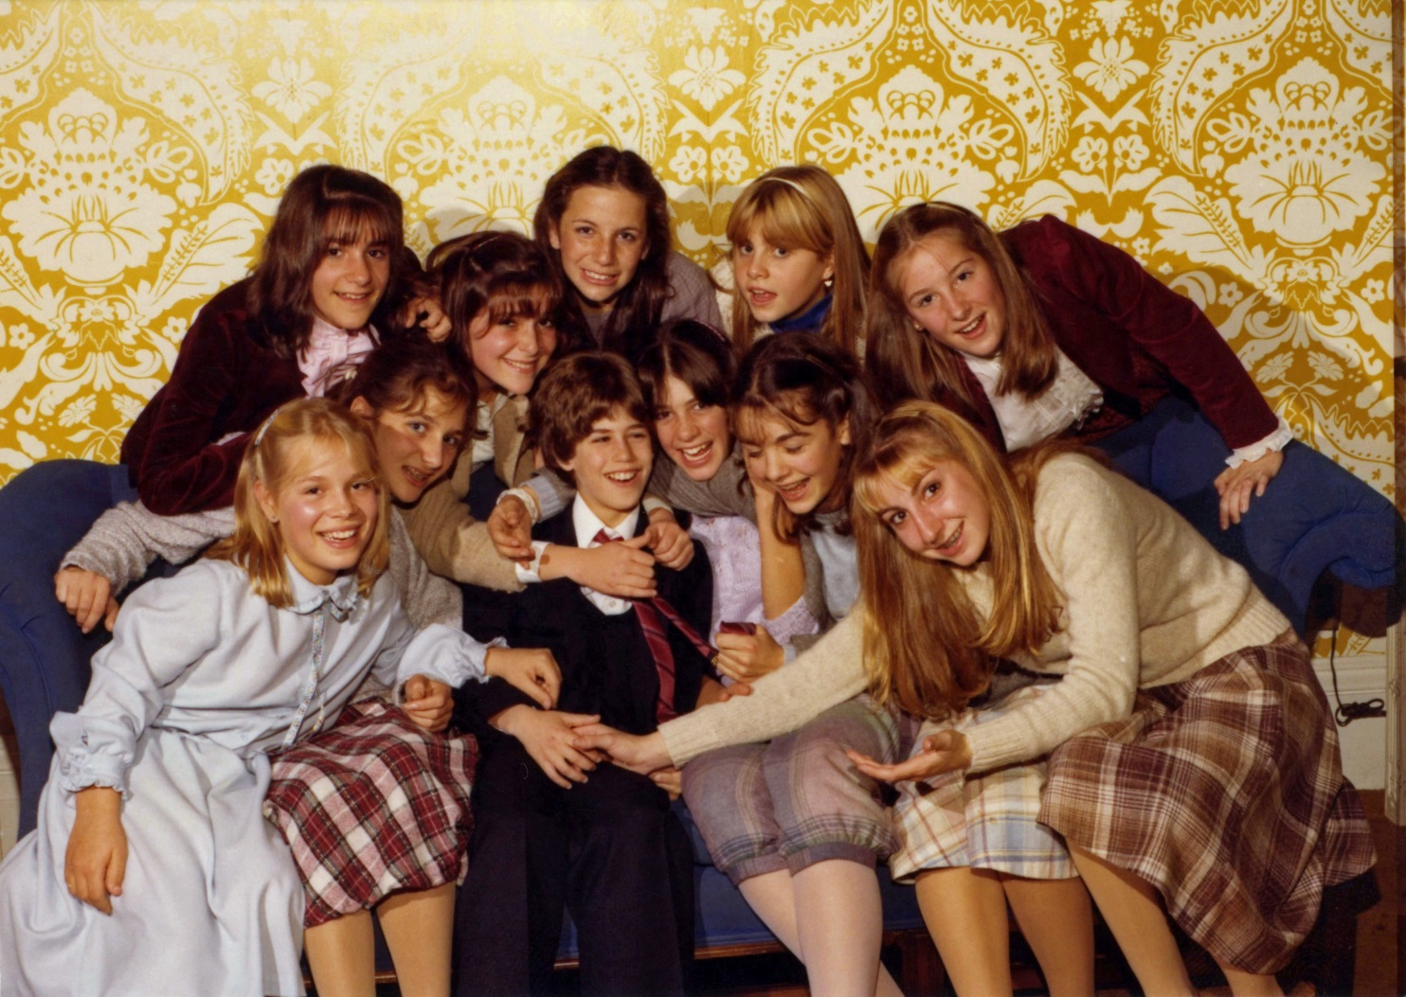
Middle School
Somehow dating seemed much easier in Middle School.

Slide 9
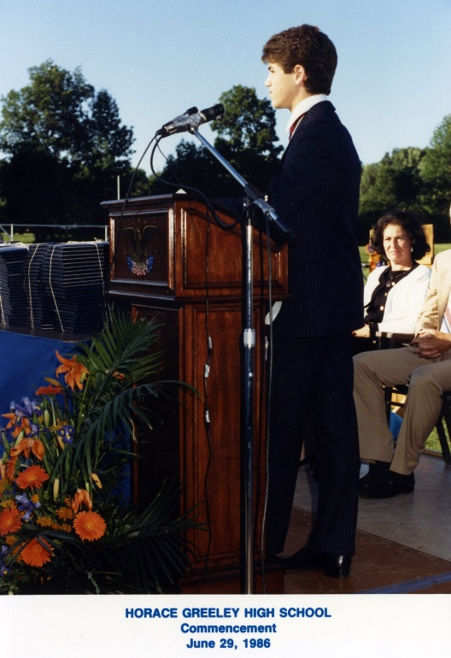
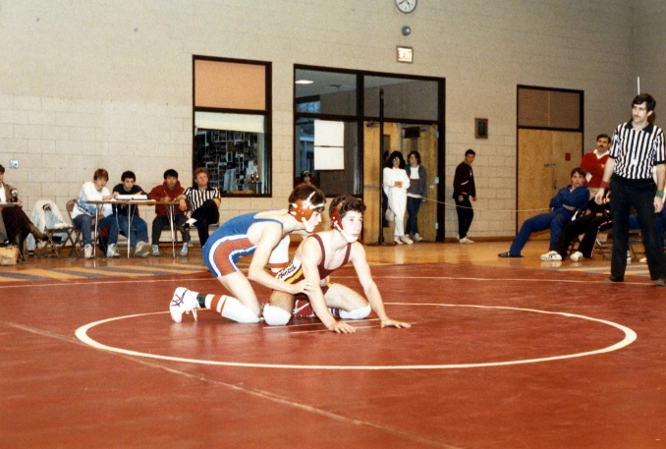
Horace greeley High School
As a HS student I was a member of our baseball and wrestling teams, and was President of my Freshman and Senior classes. (I lost elections in my Sophomore and Junior years.) I was a very good student, but did not graduate anywhere near the very top of my class, which was highly competitive academically.
Here is a picture of me on the right giving a commencement speech at my HS graduation, and below squaring off at a wrestling meet (which I ended up losing).

Slide 10
High School
Jobs I worked while I was in High School were:
I volunteered at a nearby hospital (we used to call it candy striping because of the uniforms);
I worked for a window and siding company called Acme Window;
I worked as a baby sitter for neighbors;
I worked as a bus boy for Pizza Hut; and
I worked as a waiter at a Kosher delicatessen (by far my favorite job).

Slide 11
Getting into College
The top few things I did to ensure I got into college were:
First and foremost to get good grades and good scores on my SATs;
Second, I really was focused on student government and getting involved so I could win elections;
Third, I did a lot of community activity and volunteer work; and
Fourth, I got involved in school athletics, and particularly wrestling which I did not start until the summer between my Sophomore and Junior year of HS; and
I also spent my Junior year of HS at Cornell University at a summer college program getting college credits.

Slide 12
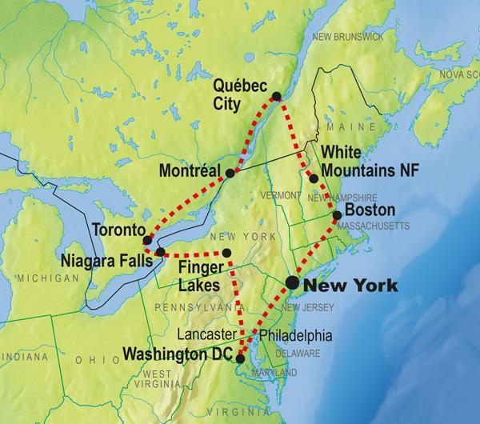
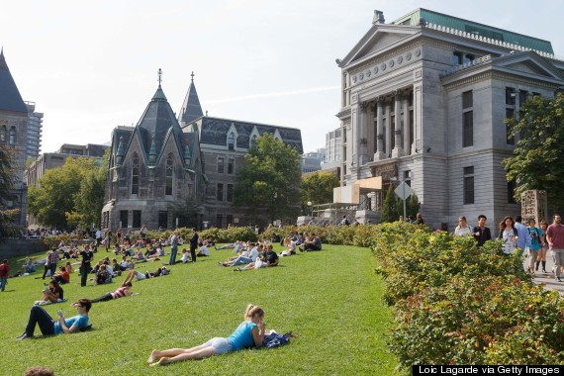
College & LAW SCHOOL
I attended college at McGill University in Montreal Canada and law school at NYU in New York City.

Slide 13
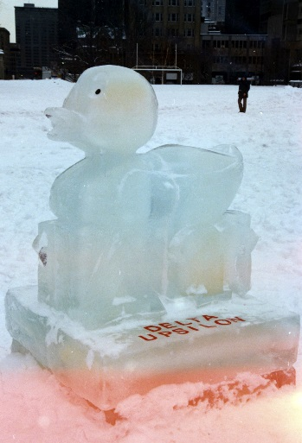
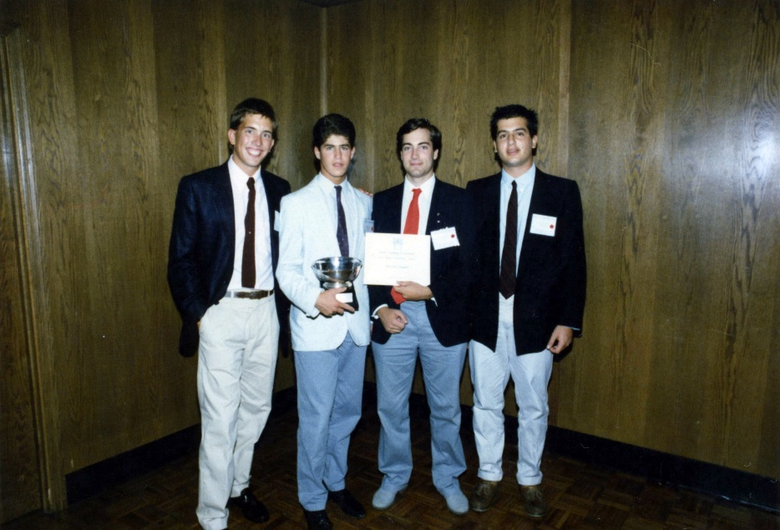
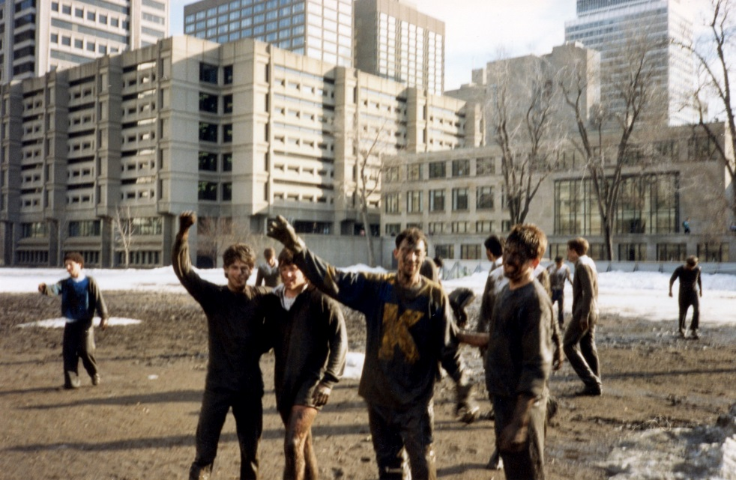
McGill university
Things I enjoyed in College
Things I didn’t enjoy in College:
My fraternity and my academic classes
The city of Montreal
The cold . . .

Slide 14
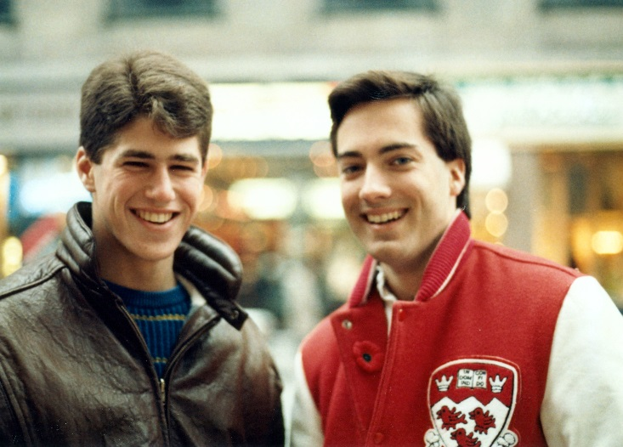
McGill university
Favorite classes
Least favorite classes
-Classical Philosophy -Comparative Religions
-Marxist Philosophy -Macroeconomic Theory
-WWII History -Intro to Marketing
-Comparative Governments

Slide 15
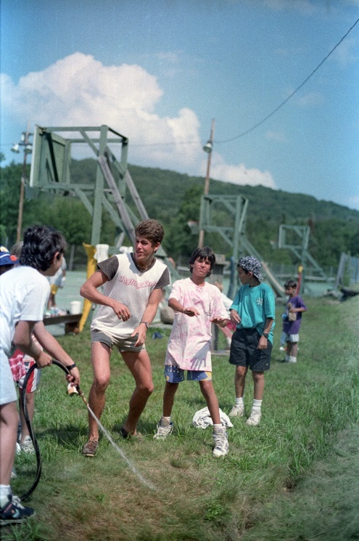
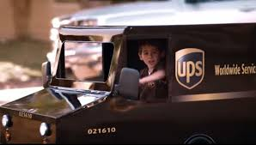
McGill university
Jobs I worked while I was in College were:
Valet parking cars at a Country Club;
Working as a waiter at that same Kosher delicatessen;
Working in the Safety Department at UPS;
Working as a summer counselor at a sleep away camp in upstate New York; and
Working as a paralegal at a Wall Street
law firm.

Slide 16
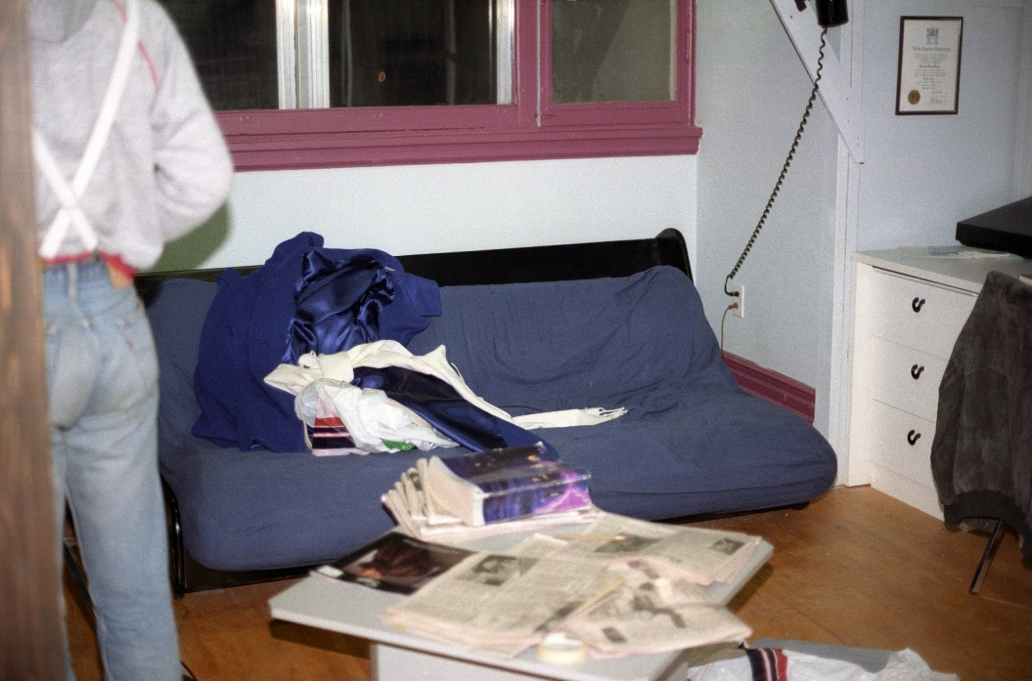
McGill university
Things that felt difficult or challenging for me while I was in College were:
Balancing my school work, social life, and commitments to my fraternity
Doing laundry
Living on a tight budget

Slide 17
Decision to go to Law School
Left McGill’s Faculty of Science and entered the Faculty of Arts
Enjoyed classes in history and political science
Uncle and Great Uncles were lawyers and judges
Applied to four law schools
Realized I wanted to be back in NYC with family at the “Center of the Universe” or so I thought
Was able to get a LOT of student loans to pay for it

Slide 18
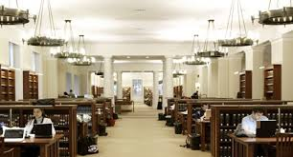
NYU LAW SCHOOL
Favorite classes
Least favorite classes
-Constitutional Law -Property
-The Law of the Supreme Court -Bankruptcy
-Civil Procedure -International Arbitration
-Entertainment Law

Slide 19
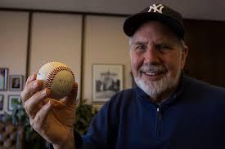
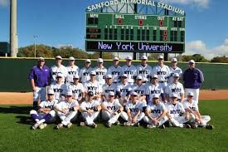
NYU LAW SCHOOL
Things I enjoyed in Law School
Things I didn’t enjoy in Law School
Law Review
Playing Baseball
Friends
NYC
Taking out student loans
Final Exams

Slide 20
MY FIRST JOBS
The first job I had after college was:
As a paralegal at the law firm at Cravath Swain & Moore in New York City.
The worst job I have ever had was:
Being a bus boy at Pizza Hut, and having to fill the all you can eat salad bar, which was always a mess, and I always had to go into the big walk in freezer to refill the salad dressings. I think I got paid $3.00/hour.

Slide 21
My Career Path
I was hired as the General Counsel of ICM in 1997
I started as an entry level associate at Gibson Dunn in 1992
I became ICM’s first Chief Operating Officer in 2005
I became ICM’s first Chief Business Development Officer in 2007
I became a Managing Member when we purchased the Company from a private equity firm in 2012
Notes:
You may use this chart to describe your journey to the current career

Slide 22
MY FIRST REAL JOB:
The top few things I did to ensure I got a good job after college were:
Got into a top law school;
Did very well with my grades, especially in my first year;
Made it on to Law Review;
Interviewed at a lot of top firms for summer associate positions (I didn’t get offers from quite a few of them); and
Worked hard at both of my summer associate jobs to secure offers for full-time employment when I graduated.

Slide 23
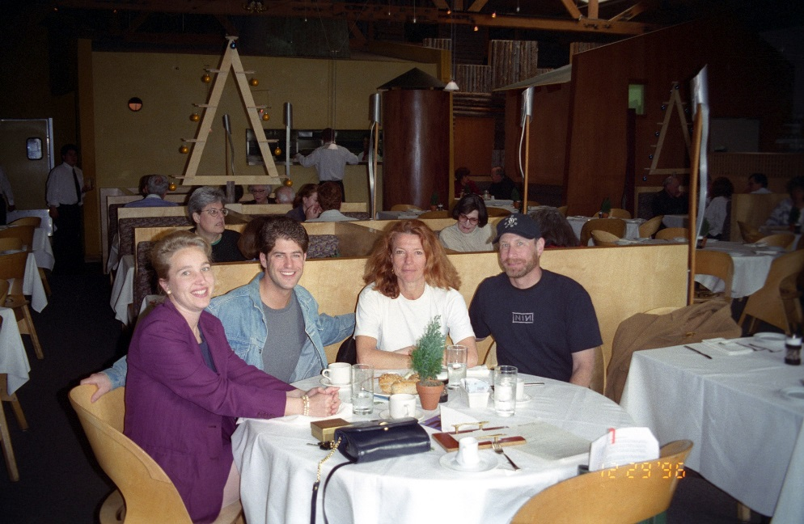
MY FIRST REAL JOB:
My job at Gibson Dunn consisted of:
I was primarily a labor and employment lawyer;
But I also did some entertainment litigation and a bit of entertainment transactional work;
I did a lot of legal research and writing; drafted motions, took depositions, argued motions in court, and occasionally tried cases;
I worked very long hours & weekends; and
Being new to Los Angeles,
this is where I made my first
friends, many of whom I am
still close to today almost 25 years later.
Celebrating a victory with
our client . . .

Slide 24
My SECOND REAL JOB:
I joined International Creative Management in 1997 as its General Counsel after almost five years at Gibson Dunn.
A General Counsel is the head lawyer for a company or organization.
ICM was and is a major talent agency that has been around for more than 40 years.
ICM was a client who I was doing a lot of work with at Gibson Dunn and who came to trust me and rely on my advice and expertise.
When I took the job, I was concerned that I was under-qualified because I had so little experience both as a lawyer and in the entertainment business.

Slide 25
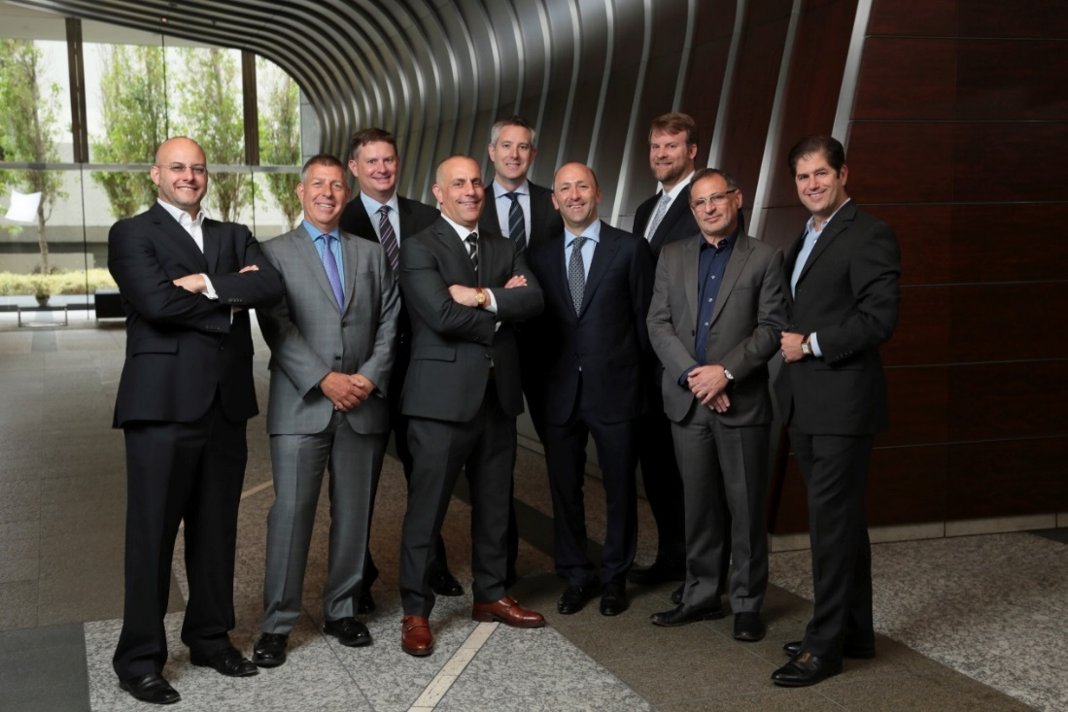
This is My Company NOW:
In 2005, we sold our company to a private equity firm for a lot of money.
In 2006, we bought another talent agency and merged management teams.
In 2012, a group of 10 of us bought our company back from the private equity firm and converted the company into a partnership where today the company is completely employee owned by about 40 partners.

Slide 32
My Career
Challenges I have had to overcome throughout my career are:
Mistakes I made as a young lawyer that my mentors forgave (I never made the same mistake twice);
A very steep learning curve coming into ICM both from a business, legal and internal political level;
A boss that was very difficult; and
Balancing a busy career with family life and being a father and husband.

Slide 33
My role within ICM PARTNERS
Board of Directors
PARTNERS
COO, CFO, CIO
Non-Partner Agents
Middle Management
Assistants
Notes:
Use this graph to give more description of your role specifically (responsibilities, typical work week, direct reports, etc.)

Slide 34
Compensation at my company
C-Suite
($300k-$2mm+)
Management
($150K-$275k)
Middle Manager
($80K-$150k)
Entry Level
($30K)
Notes:
Use this graph to show general compensation ranges for people in various roles in your company

Slide 35
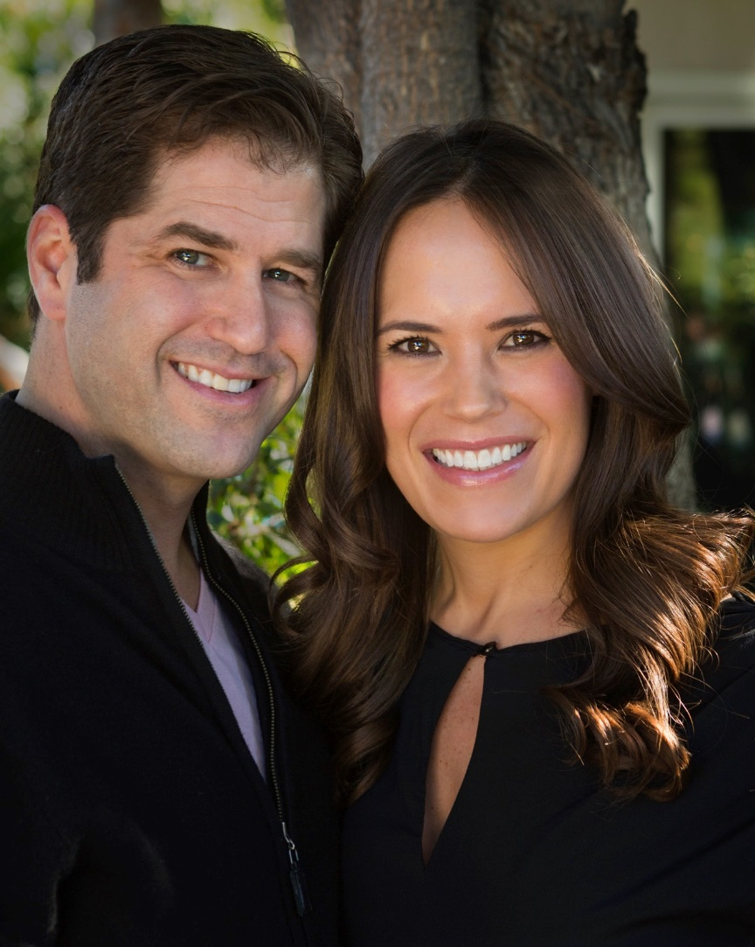
More than just work
The most important thing to me is family:
My wife Andrea ~

Slide 36
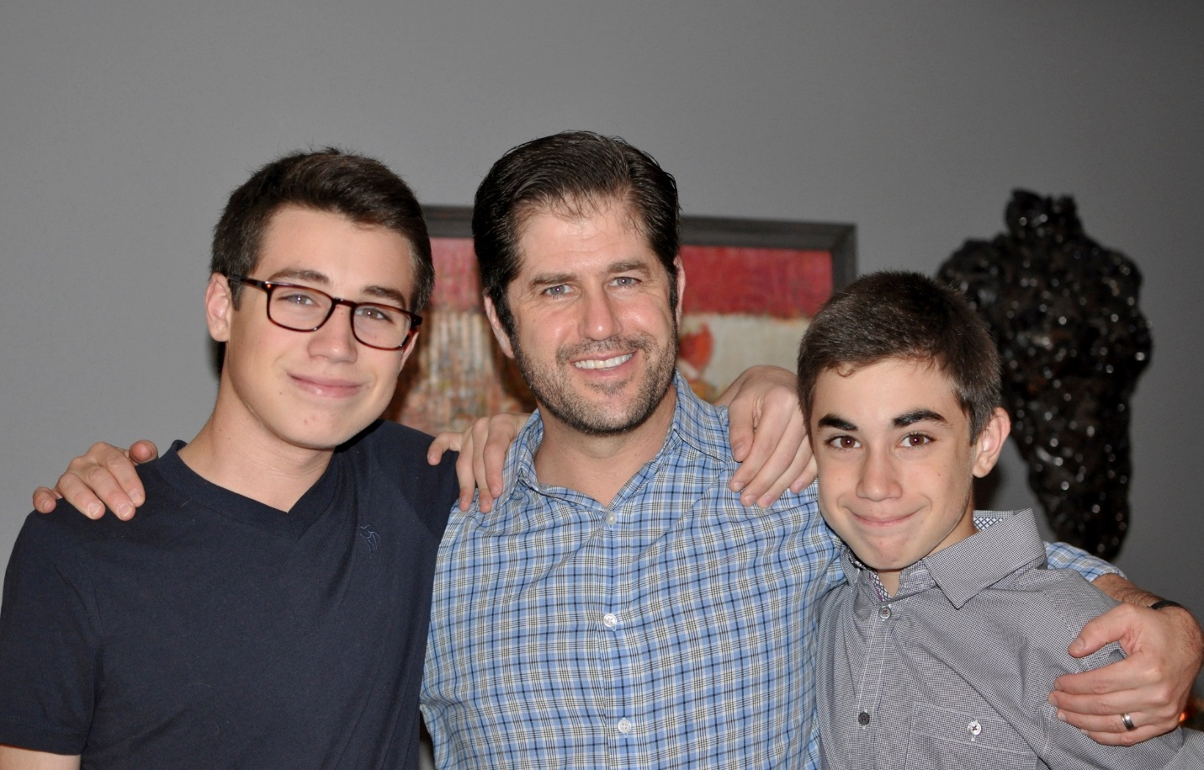
More than just work
My sons Sam (15) & Max (13):

Slide 37
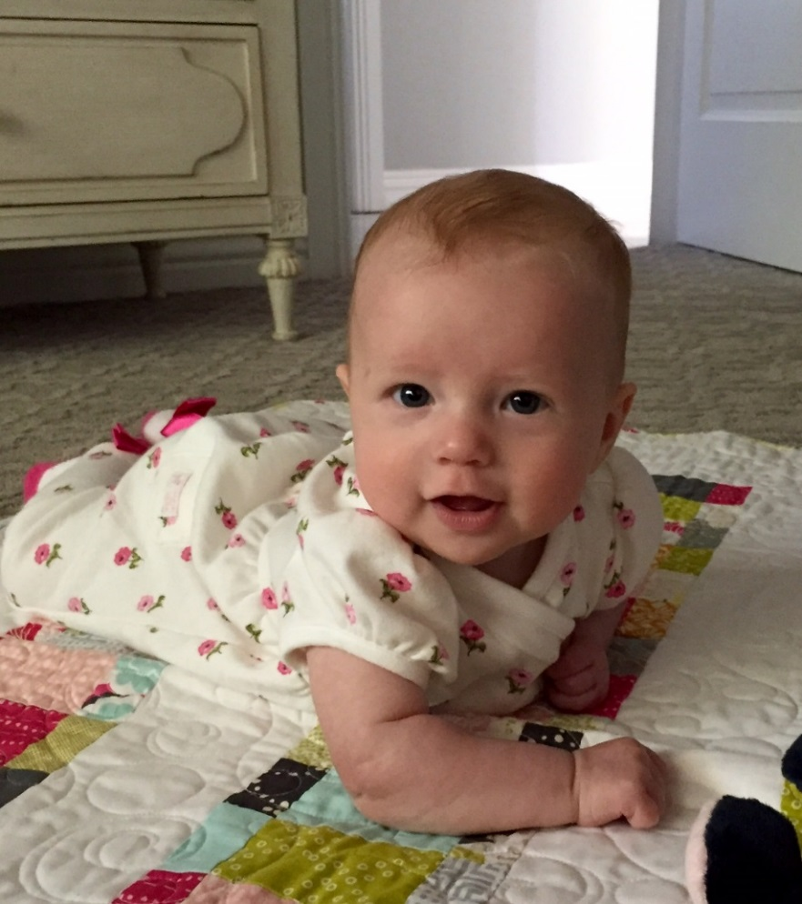
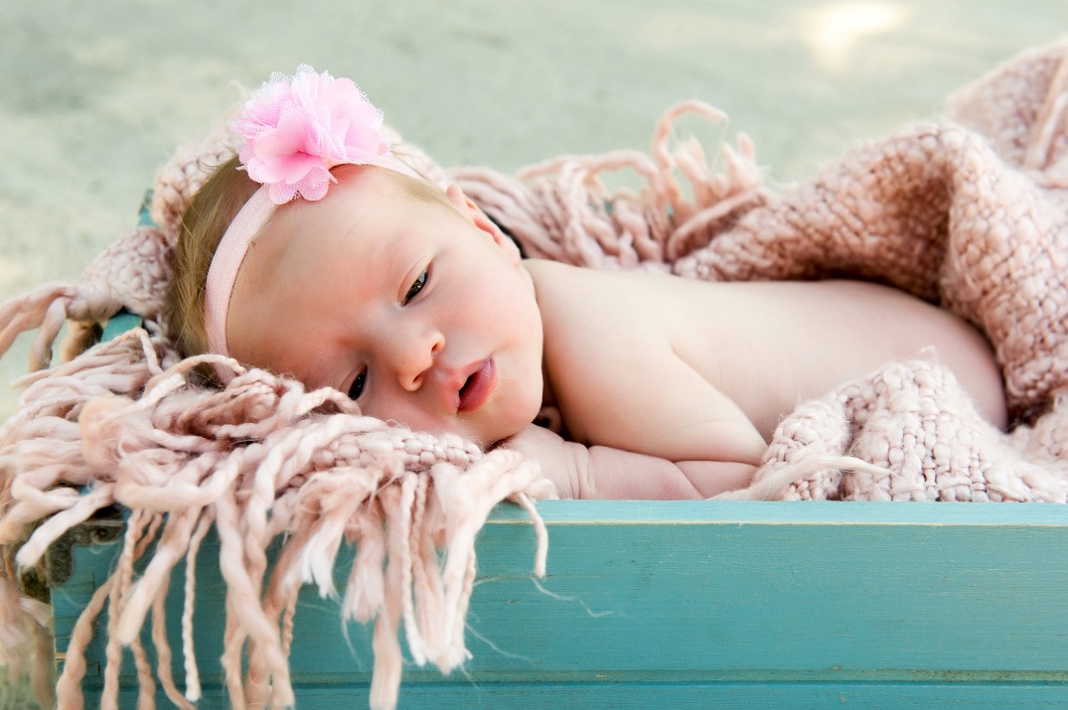
More than just work
. . . and my daughter Tabitha (4 months):

Slide 38
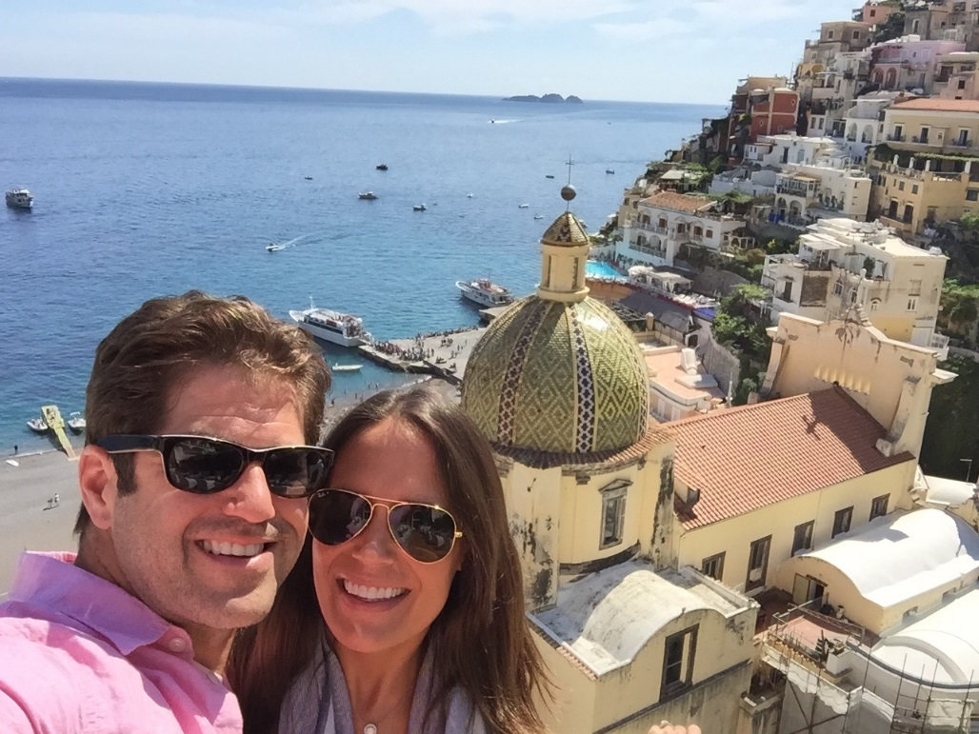
More than just work
When I am not at work I like to:
Travel

Slide 39
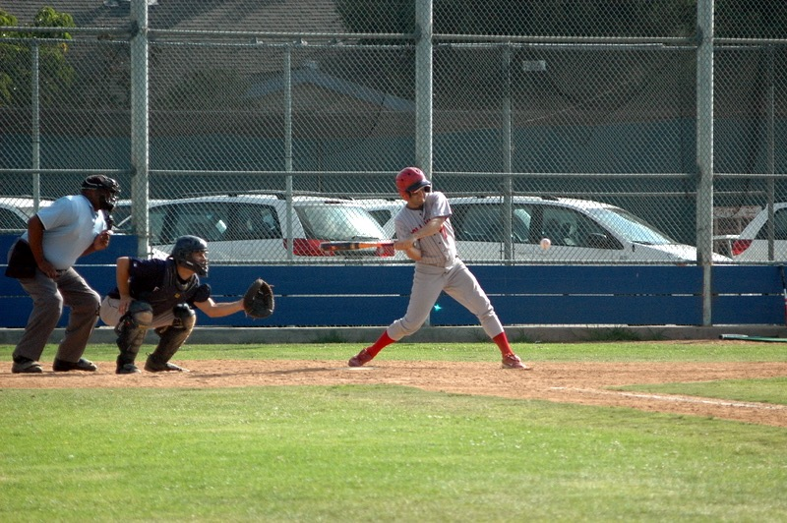
More than just work
Play baseball

Slide 40
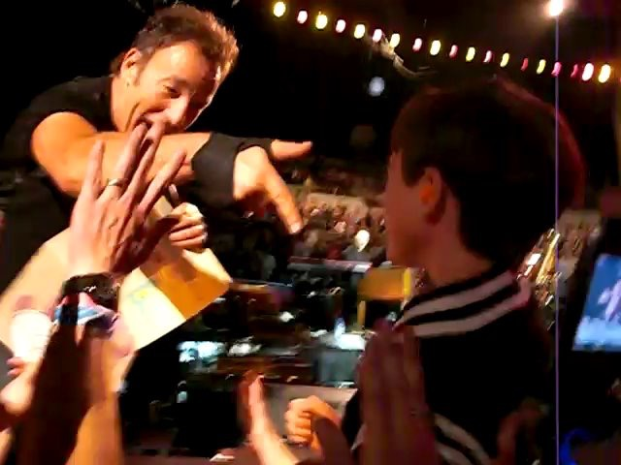
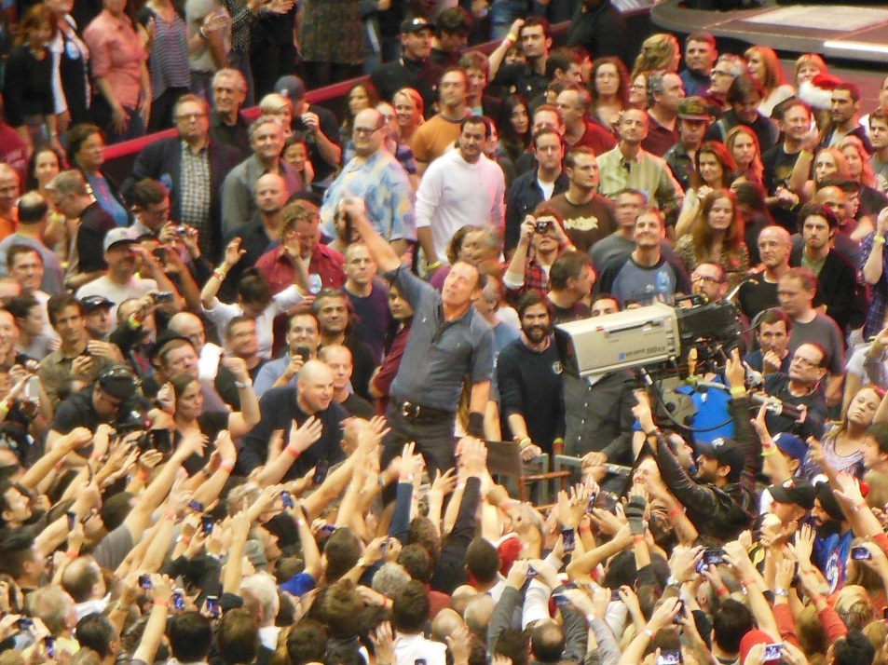
More than just work
Attend Concerts

Slide 41
Do it all over again?
If I could talk to my high school self, what would I say?
Enjoy every minute of it
Take advantage of every opportunity presented to you
Always give your best effort
Don’t be afraid to fail
Don’t ever give up on what you are passionate about
Relax, it is all going to end up okay

Slide 42
QUESTION AND ANSWER

