Slide 1
“show up Everyday with a smile”
- Percy Wood, President of United Airlines

Slide 2
What up!
My name is Cody Wood and I am 31 years old.
I work as a:
Songwriter
Actor
Private Music Teacher
Freelance Musician
Youth Business : ALLIANCE

Slide 3
lil Cody
I was born in Santa Fe, New Mexico and raised in Phoenix, Arizona and Weston, Massachusetts.
Age 13 on tour with the Phoenix Boys Choir in Beijing, China (Grammy Award Winner!)
Youth Business : ALLIANCE

Slide 4
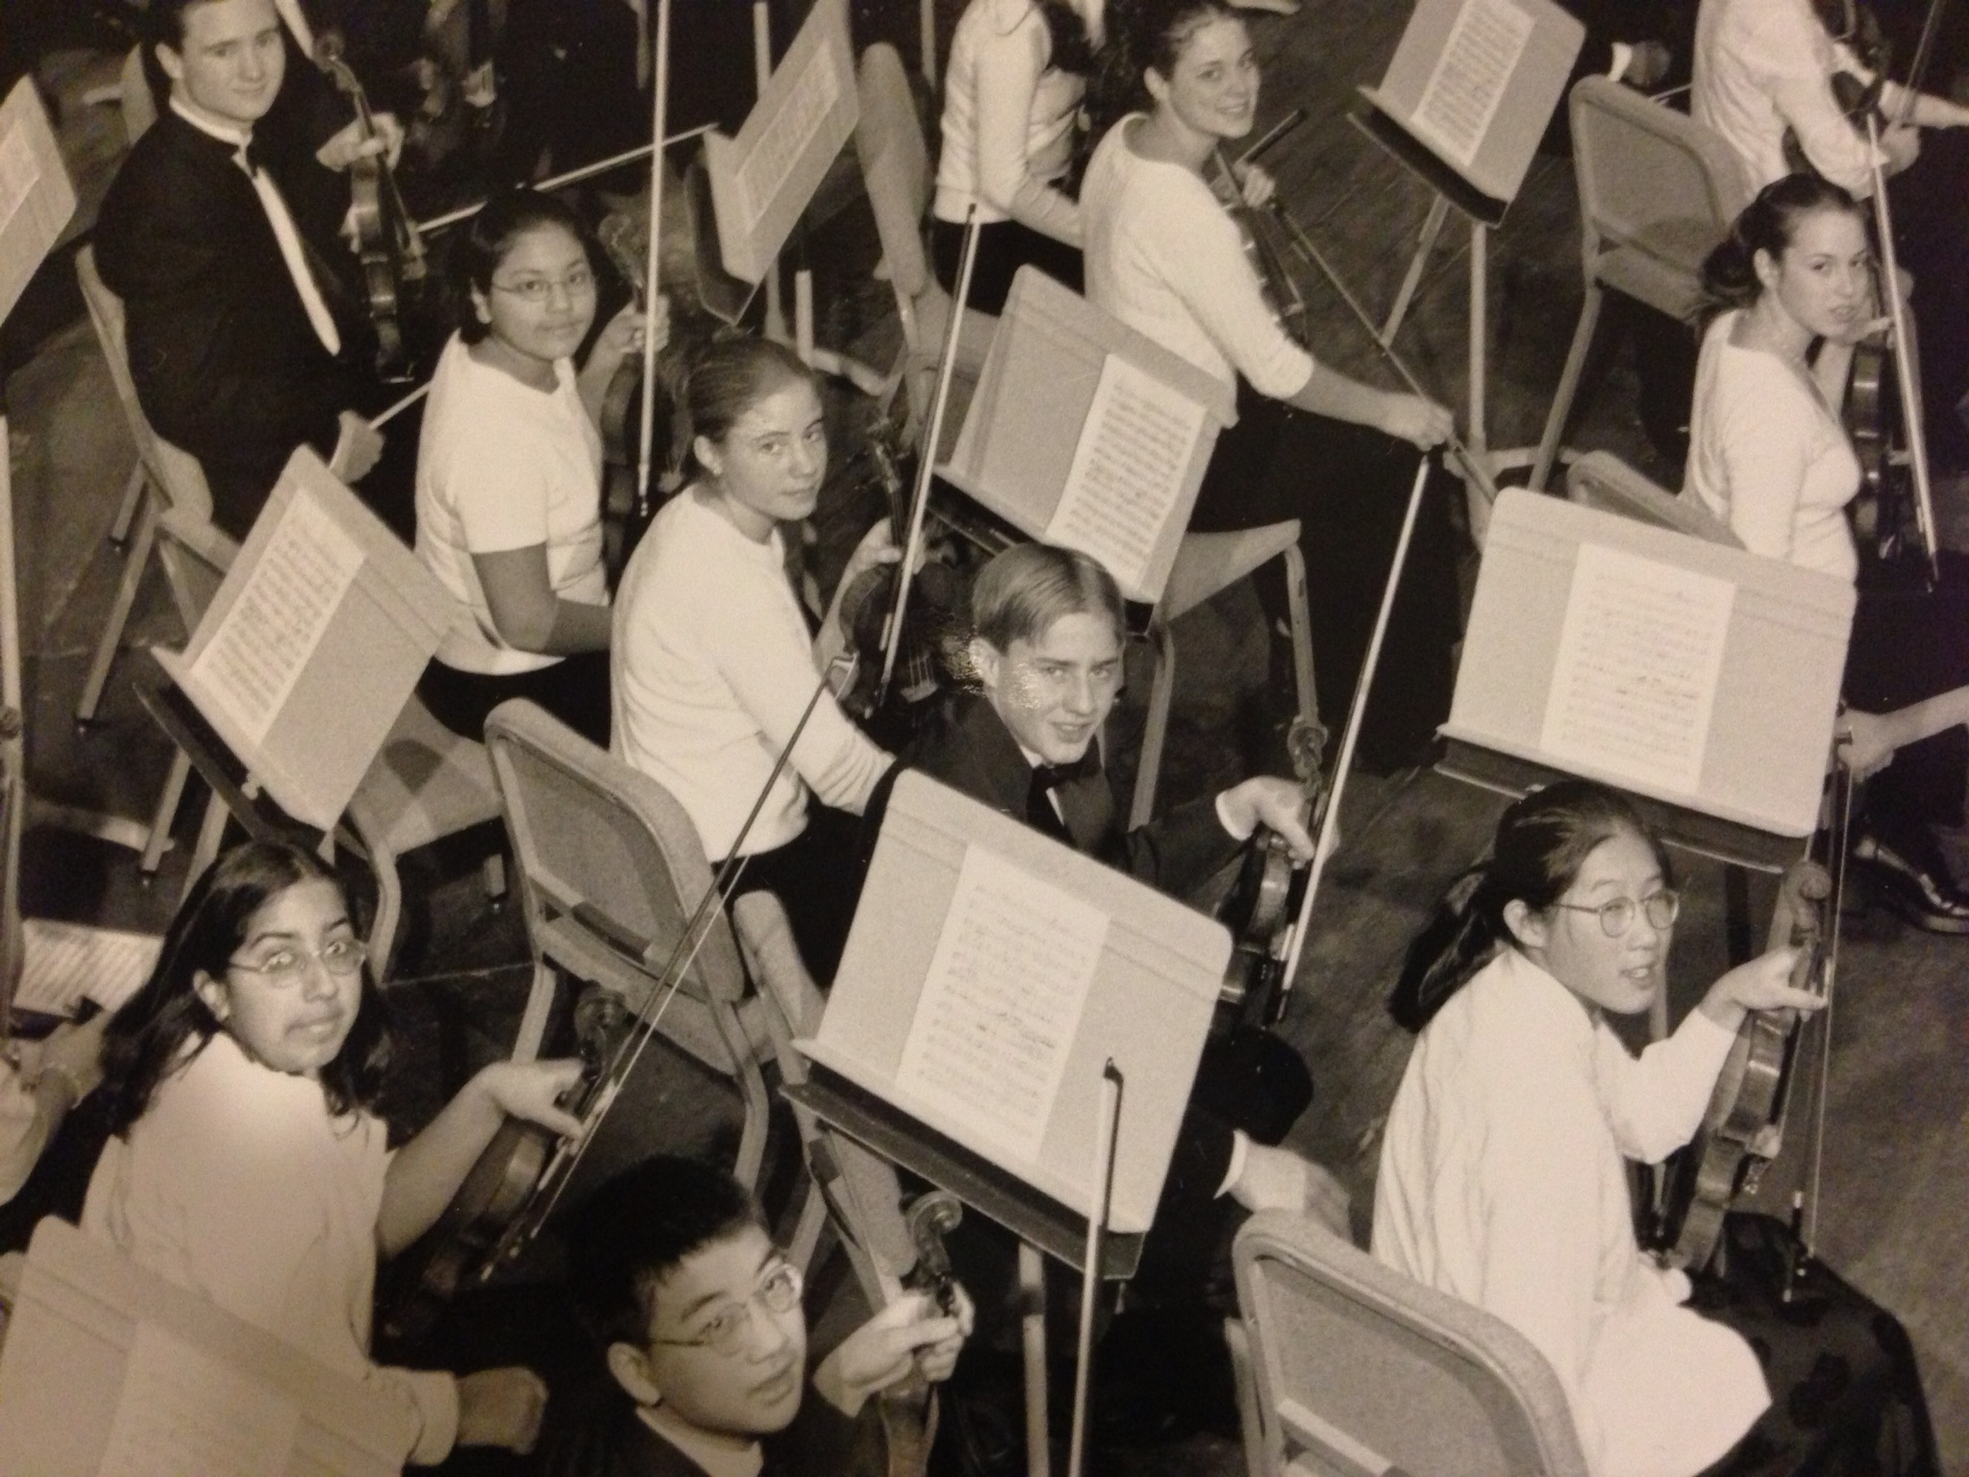
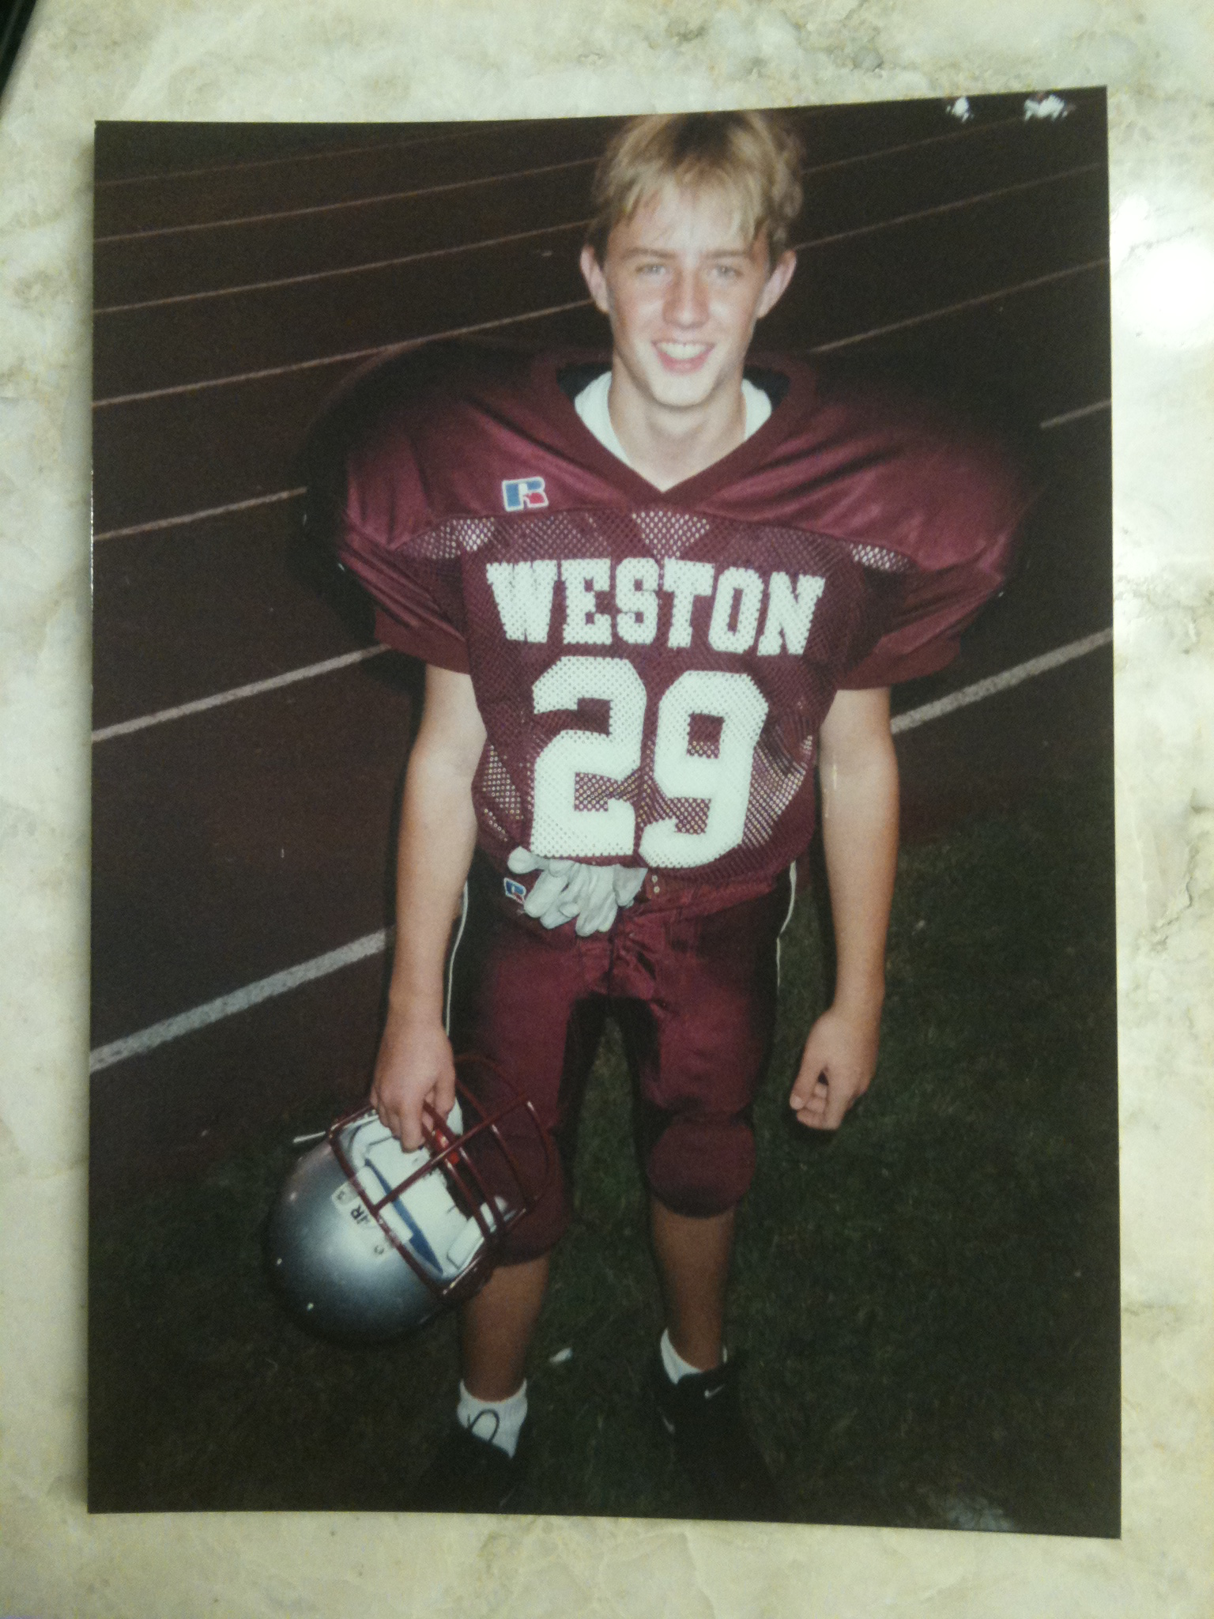
MY HIGH SCHOOLS
I attended Arizona School for the Arts in Phoenix, Arizona
and
Weston High School in Weston, Massachusetts
As a HS student I was (shy, outgoing, nerdy, popular, athletic, academic, etc.)
Youth Business : ALLIANCE

Slide 5
High School +
Things that I really liked in High School were:
Music Feeling Capable
Hanging with friends // Building Relationships
Sports
High School -
Things that felt difficult or challenging for me while I was in High School were:
Moving to a new community
Pressure and expectations
Staying focused on college
Youth Business : ALLIANCE

Slide 6
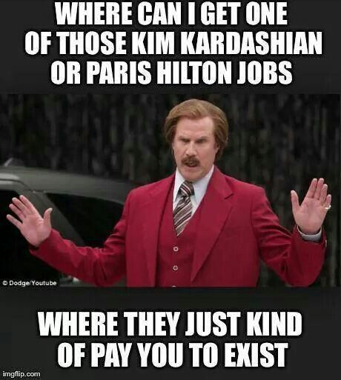
High School JOBS
Jobs I worked while I was in High School were:
Senator Ted Kennedy
Golf Caddy
Music Teacher
Data Entry
Youth Business : ALLIANCE

Slide 7
Getting in to College
Things I did to ensure I got into college were:
Grades
AP Classes
Extra curricular (Class Officers, National Honor Society)
Music
Sports
Test Prep Classes
Things I didn’t do: meeting alumni, writing letters, private tutoring
Youth Business : ALLIANCE

Slide 8
I earned two undergraduate degrees and graduated in 2008:
Bachelor of Science, Biomedical Engineering
Bachelor of Arts, Music
Anthony and Joe Russo, Movie Directors (Captain America)
Barry Meyer, CEO of Warner Bros.
Albert Michaelson, first American scientist to win a Nobel Prize
John Macleod, discovered Insulin
Frederick Robbins, developed Polio vaccine
Stephanie Tubbs Jones, Congresswoman
Don Shula, Head Coach of the Miami Dolphins
Youth Business : ALLIANCE

Slide 9
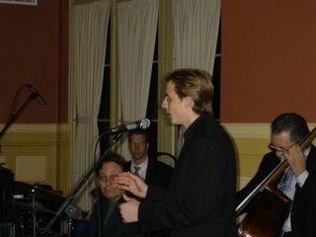
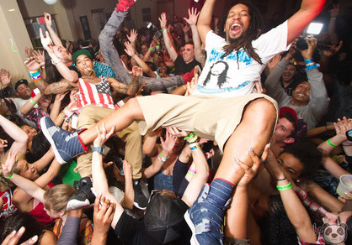
FREEDOM!!
Things I enjoyed in College:
Freedom of choice
Creating opportunities
Discovering new abilities
Developing relationships
Things I didn’t enjoy in College:
Freedom of choice
Missed opportunities
Realizing limitations
Youth Business : ALLIANCE

Slide 10
College JOBS
Jobs I worked while I was in College were:
Building Manager (Work/Study)
Deloitte (internship)
Research Assistant
Technical Writer
Youth Business : ALLIANCE

Slide 11
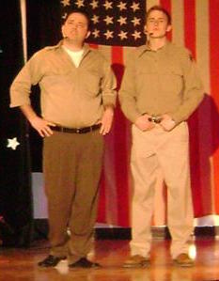
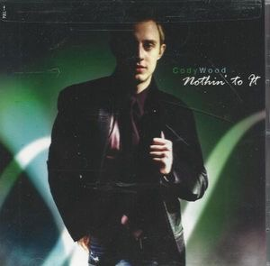
Getting a job
Offered a job at Deloitte Consulting
Made an album
Musical Theatre performance
Youth Business : ALLIANCE

Slide 12
My Career Path
LOS ANGELES
Played open mic
Server/Bartender
USC Films Scoring
First Booking
First Manager
Hired an intern
Booked a Musical
First Agent
Gen Art Emerging Artist Award
CURRENT
New agent/manager
Regular class and coaching
Consistent Auditioning
Collaboration with other producers and artists
Accepted to Recording Academy of Arts & Sci
Signed first Pub. deal
COLLEGE
Performed with Northcoast Jazz Collective
Met Sue Johnson, local arts promoter
Made an album at Cleveland Institute of Music
Mastered album in NYC
Indie Tour to LA
2003-2008
2008
2008 - 2011
2012-2015
Youth Business : ALLIANCE
Notes:
You may use this chart to describe your journey to the current career

Slide 13
This is My LIFE
15%
15%
15%
5%
Songwriter / Recording Artist
- Songwriting
- Production
- Contracts
Actor
- Getting Started
- Auditions
- Workshops
Private Music Teacher
- Variety of Levels
- Recitals
Freelance Musician
- Craigslist
- Network
~50% of my time is spent looking for new work

Slide 14
MUSIC
FANS
LABEL
ARTIST
BOOKING
AGENT
MANAGER
PUBLICIST
CONTRACTORS
LAWYER
Youth Business : ALLIANCE
Notes:
Use this graph to give more description of your role specifically (responsibilities, typical work week, direct reports, etc.)

Slide 15
ACTING
ACTOR
STUDIO EXECUTIVE
DIRECTOR
PRODUCER
CASTING DIRECTOR
ACTOR
MANAGER
AGENT
PHOTO-GRAPHER
PUBLICIST
LAWYER
Youth Business : ALLIANCE
Notes:
Use this graph to give more description of your role specifically (responsibilities, typical work week, direct reports, etc.)

Slide 16
Compensation In the ARTS
Independent Artist
$20K
Established Artist
$100K
C-Suite
($350K)
Local Star
$300K
Management
($150K)
Middle Manager
($75K)
International Star
5M
Youth Business : ALLIANCE
Notes:
Use this graph to show general compensation ranges for people in various roles in your company

Slide 17
My Career CHALLENGES
Challenges I have had to overcome throughout my career are:
1. Recovering from rejection and failure
“Success is going from failure to failure without losing enthusiasm” - Winston Churchill
2. Impostor syndrome
Impostor syndrome can be defined as a collection of feelings of inadequacy that persist even in face of information that indicates that the opposite is true. It is experienced internally as chronic self-doubt, and feelings of intellectual fraudulence.
Youth Business : ALLIANCE

Slide 18
More than just work
When I am not at work I like to:
Exercise
Travel
Spend time with Family
Read/Listen (Autobiographies, Biographies, Brain Pickings, TED)
Youth Business : ALLIANCE

Slide 19
Do it all over again?
“Show Up every Day with a smile”
Be Present, both in body and mind
Develop awareness
Contribute translates to value
Find joy in your work translates into fulfillment
Find joy in working with others
Intent
Work to overcome fear
Seek answers
Define success
Take Action
Youth Business : ALLIANCE

Slide 20
Good luck!
Cody Wood
cody@codywood.net
Youth Business : ALLIANCE

