Slide 1
INTRODUCTION
I work for Thomas Safran & Associates (TSA).
Thomas Safran & Associates develops and manages affordable rental housing in Southern California.
My title at TSA is President.
I oversee our Management company which includes on-site property managers, maintenance staff, regional supervisors, compliance, and resident services – about 150 employees.

Slide 2
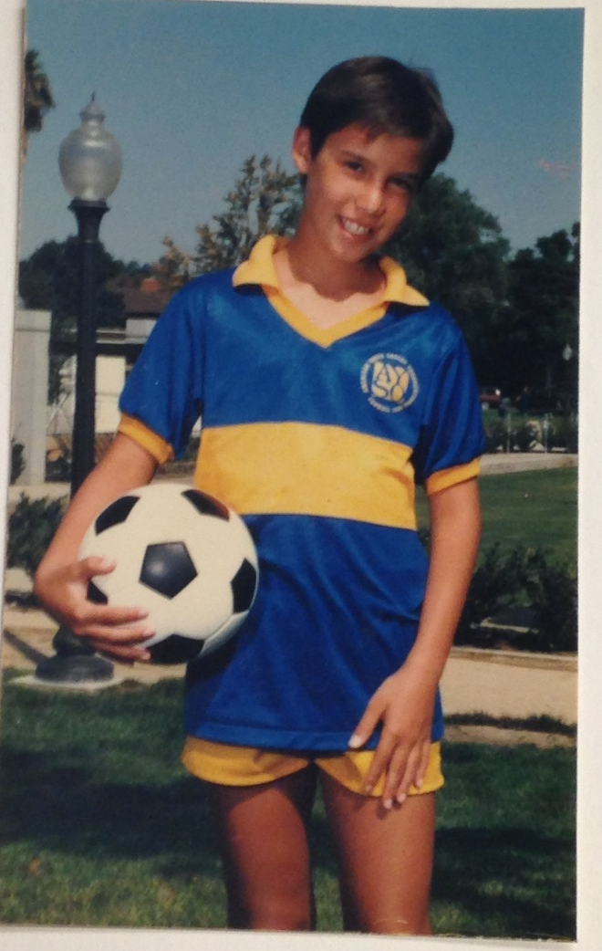
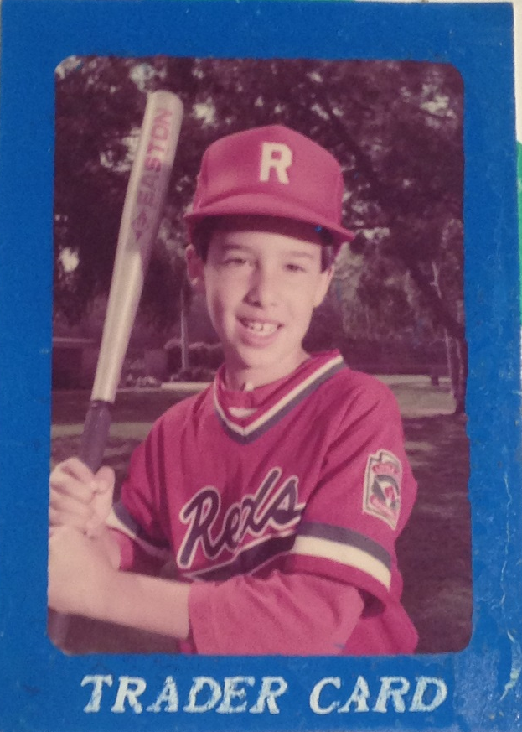
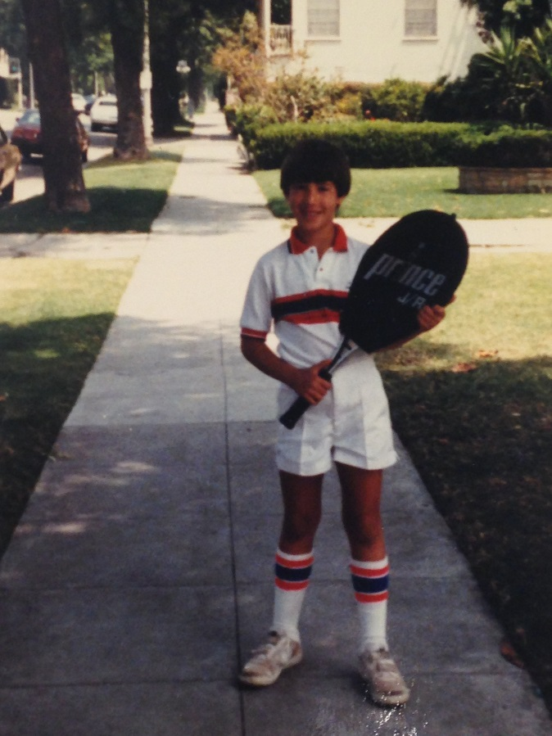
The Early Years…
I was born and raised in Los Angeles, CA.

Slide 3
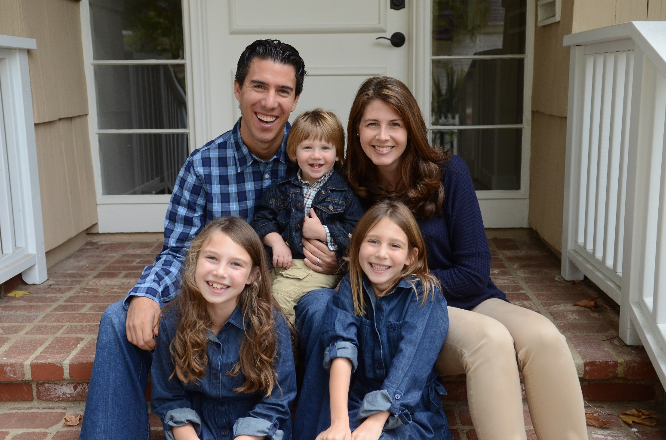
My Family
A little about my family…

Slide 4
HIGH SCHOOL
I attended high school in Los Angeles, CA

Slide 5
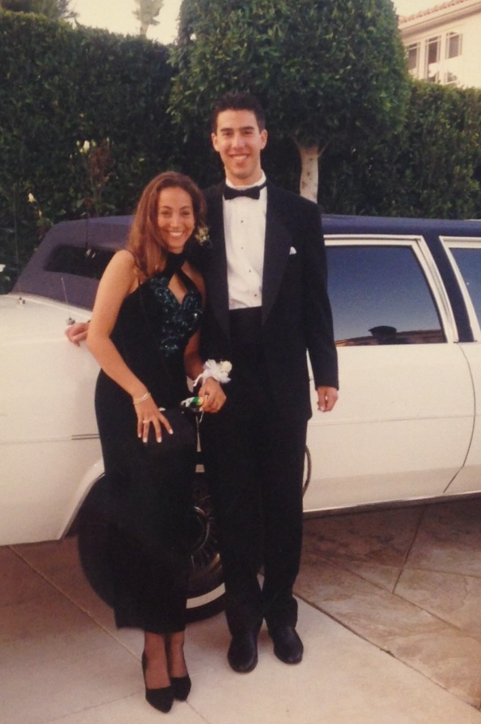
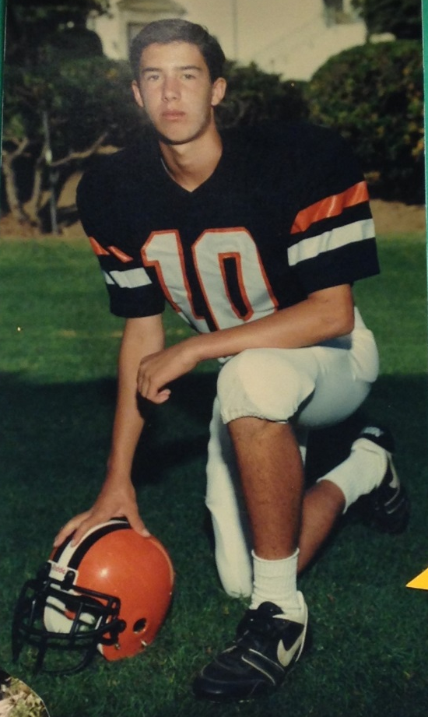
HIGH SCHOOL
As a HS student I was really involved in sports. I played football, basketball, and volleyball. I was captain of both the football and basketball teams.
I was a pretty outgoing kid, but playing sports made it easy to make friends.
Prom
Football Team

Slide 6
HIGH SCHOOL
Things I enjoyed in HS:
Things I did NOT enjoy in HS:
Classes:
English was my favorite class. I liked doing book reports.
Teachers:
My English and math teachers
Sports:
Football
Basketball
Volleyball
Interest in politicians:
I’ve met 3 presidents: Reagan, Clinton and Obama
Science classes:
I did not do well in biology, chemistry or physiology – my brain did not comprehend them.
Peer pressure

Slide 7
HIGH SCHOOL
Jobs I worked while in HS:
I always worked from as far back as I can remember. I liked to make money.
Fun jobs in HS were: babysitting for kids in the neighborhood and being a camp counselor at local day camps.
Awful jobs included working at an ice cream store with fancy desserts and coffee orders (I didn’t know a latte from an espresso). I also worked at a copy store like Kinkos. I was terrible and stapled presentations in all the wrong places.

Slide 8
HIGH SCHOOL
Fondest memories from HS:
I was selected to the under 16 junior basketball team and represented Los Angeles. There were over 80 teams and we won silver medal. We lost to a really good team from New Jersey.
I also traveled abroad my senior year and explored parts of Scandinavia in Europe.

Slide 9
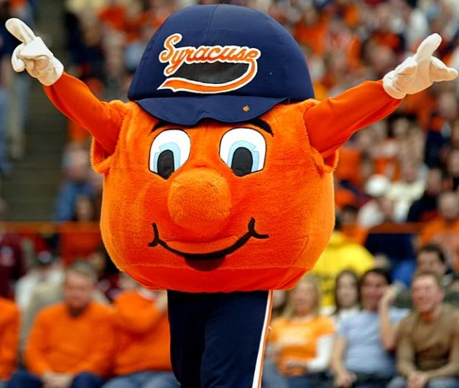
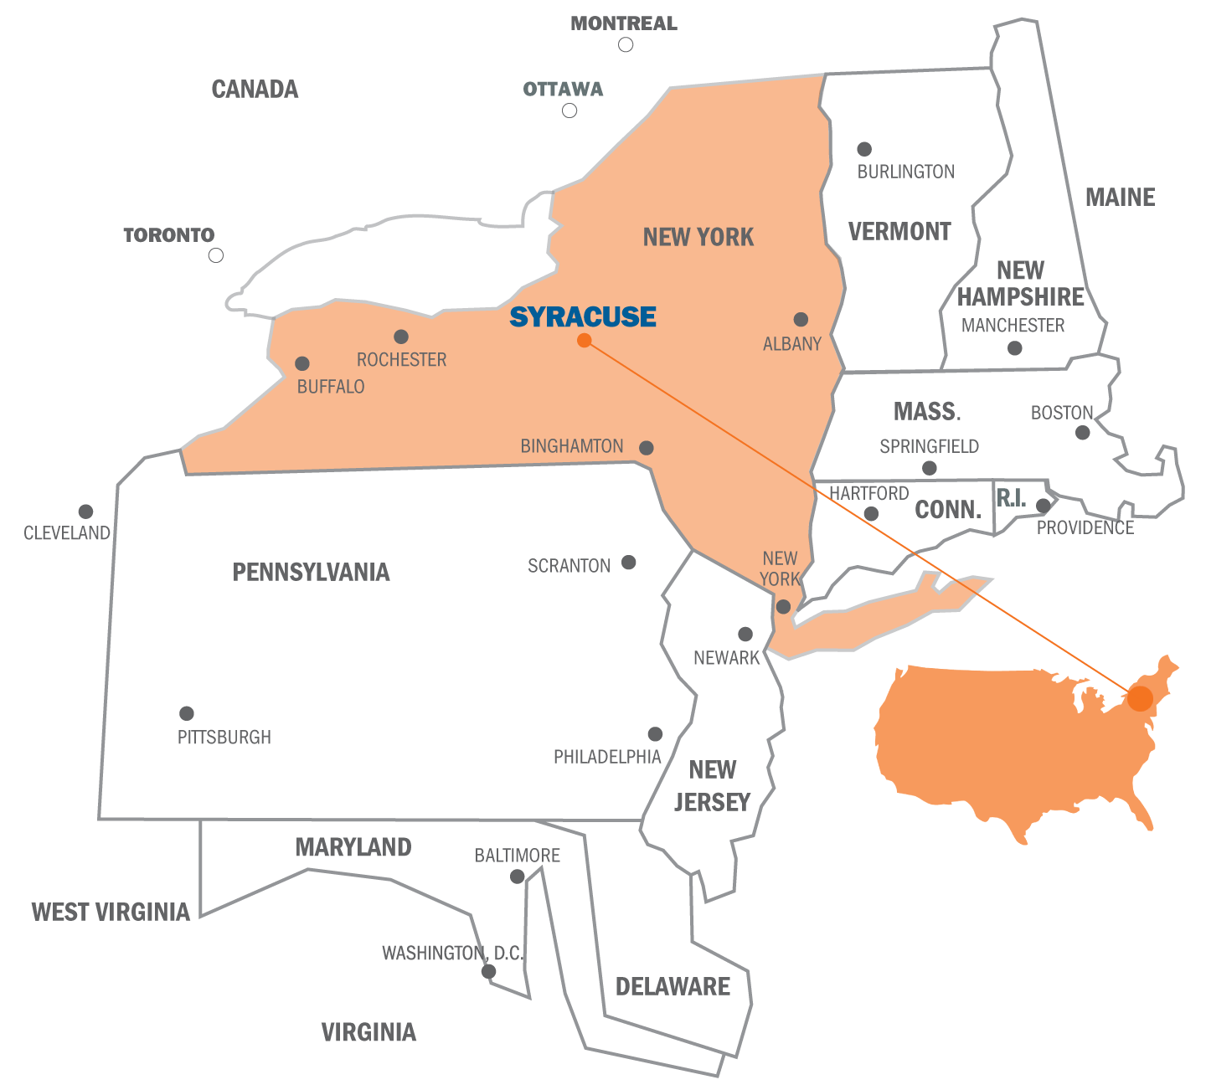
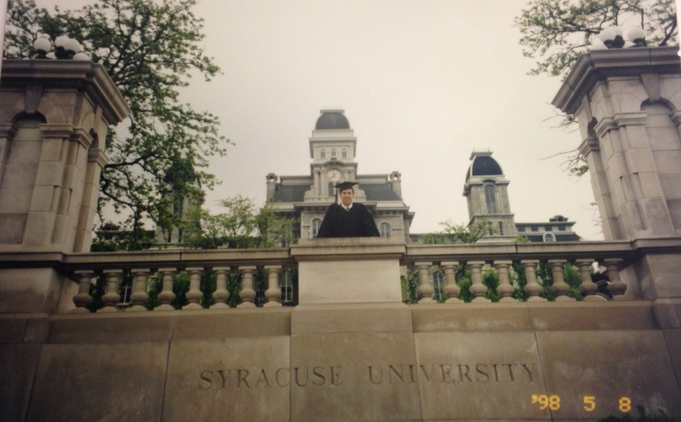
College
I attended college at Syracuse University in Syracuse, NY.
Graduation

Slide 10
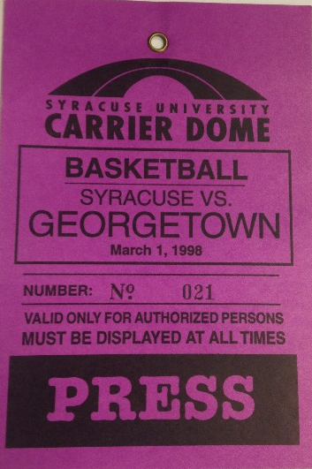
College
Activities/Athletics in College:
Jobs I worked while in College:
Basketball
I got involved in their office the first week of school
Manager of the basketball team my sophomore year
Fraternity – Delta Tau Delta
Community service – Cupid Week
I double majored in Communications & Political Science
I was paid to work for the basketball team.
I also worked for the Sports Information office which provided press releases and info prior to the games.

Slide 11
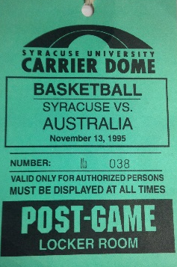
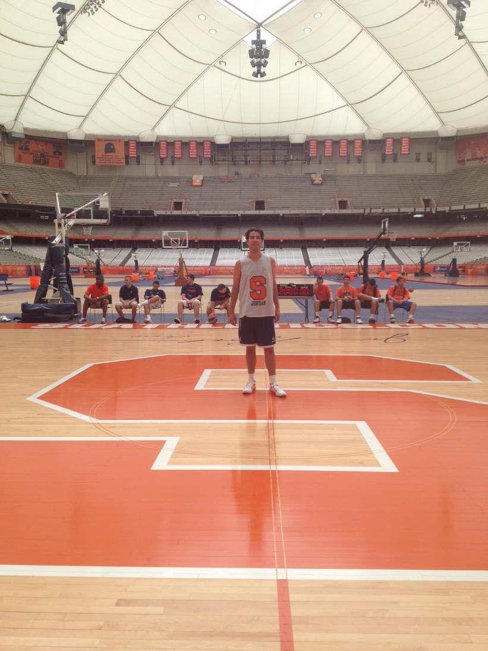
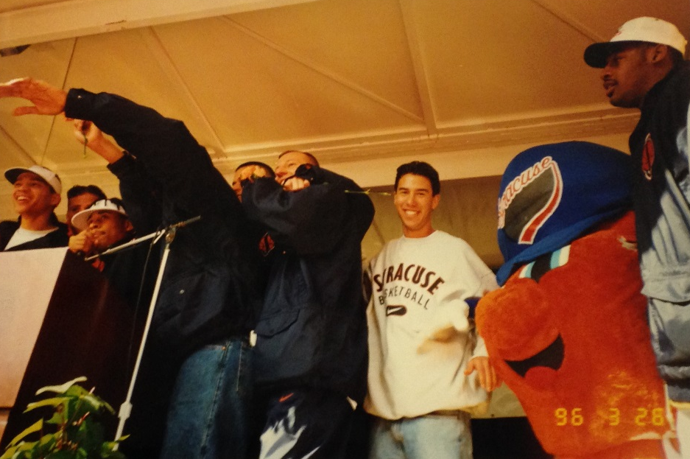
College

Slide 12
College
Favorite classes
Least favorite classes
Communications
Public Speaking
*Take as many literature, English and grammar classes as you can because you have to speak and write well to be successful in any field.
Science
Math

Slide 13
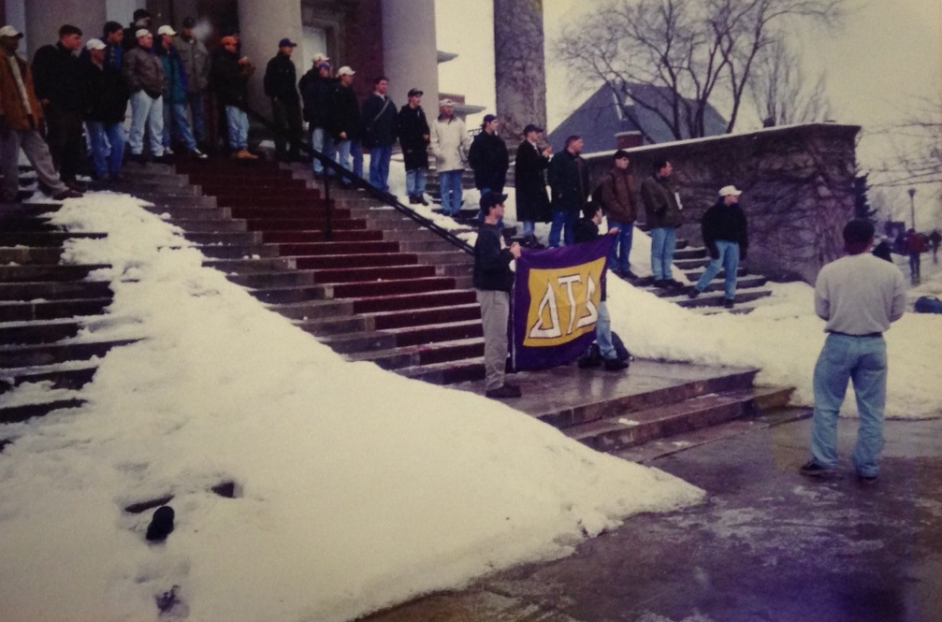
College
Fondest memories:
Obstacles or adversity that you had to overcome:
Basketball team
Meeting new friends
Traveling to new places like Niagara Falls, Pennsylvania, New York City, Montreal, Toronto…
Studying abroad
Semester in Spain
Semester in London
Living in a great college town
Experiencing the seasons
Adjusting to the cold! It snowed 180 inches my sophomore year and did not get above zero the entire month of February.

Slide 14
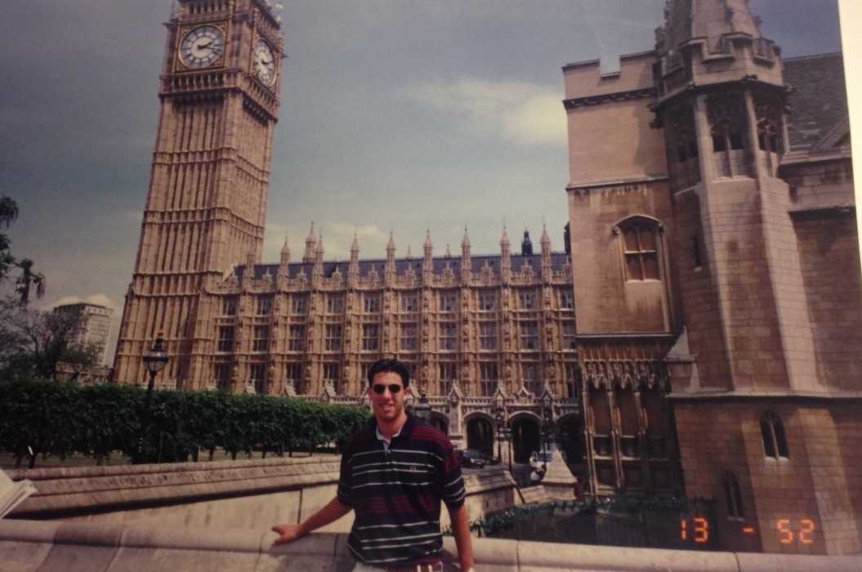
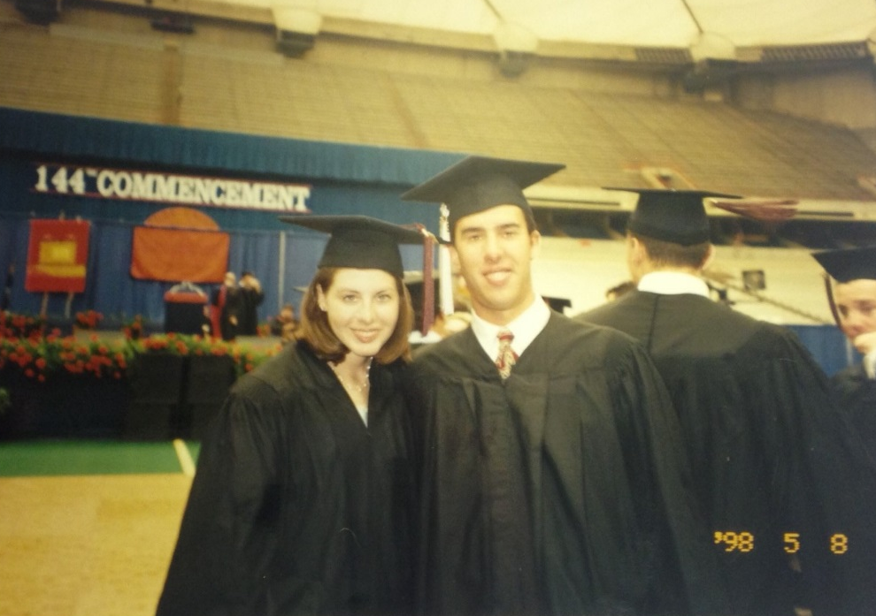
College
Studying abroad in London
Graduation

Slide 15
Career Path
I began my career in NY working in PR/Marketing
I got my MBA in Real Estate/ Finance at Fordham University in NY
I am now the President of Thomas Safran & Associates, an affordable housing developer
Notes:
You may use this chart to describe your journey to the current career

Slide 16
Career
My first job:
My worst job:
I worked a lot of jobs in high school:
Ice cream shop
Copy store
Camp counselor
I hated working in the ice cream shop even though it sounds fun.

Slide 17
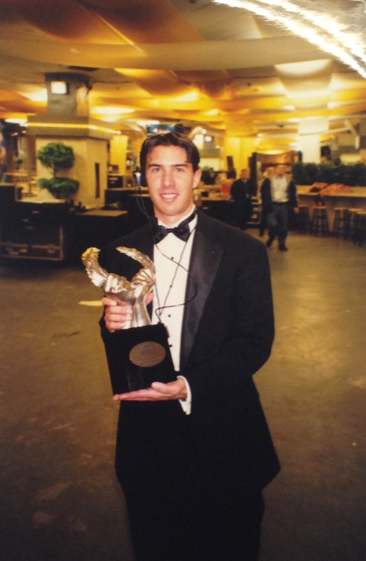
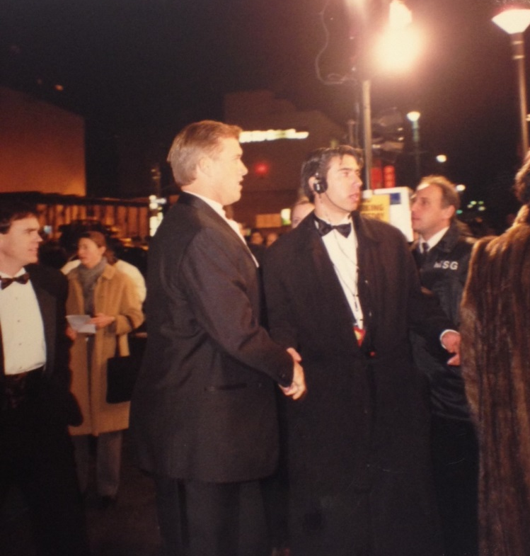
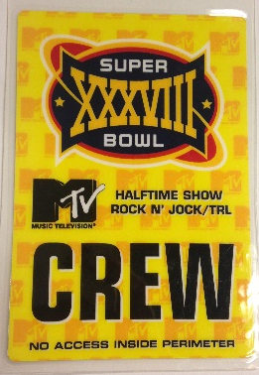
Career
My career in PR/Marketing:
Right after college I worked for a PR company for 3 years.
Fun brands: Levi’s, Sony, Sports Illustrated
Ability to be very creative
Then I worked at MTV for 4 years.

Slide 18
Grad School
I got my MBA in Real Estate/Finance at Fordham University in New York.

Slide 19
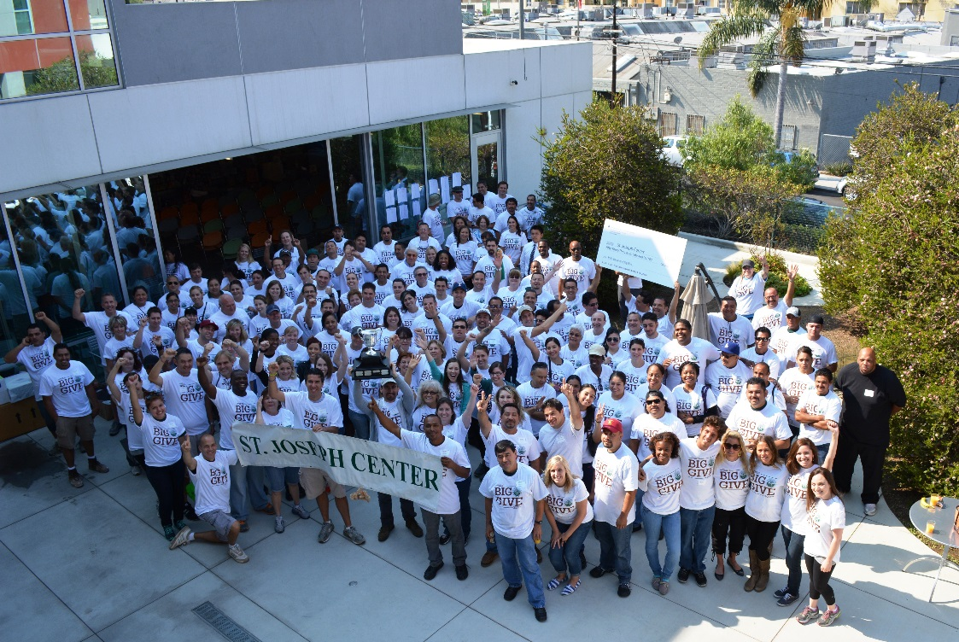
Career
I moved back to LA in 2005 and started working for Thomas Safran & Associates as a Regional Property Supervisor.
In 2008, I became President, which is my current role.
TSA staff at our annual community service day

Slide 20
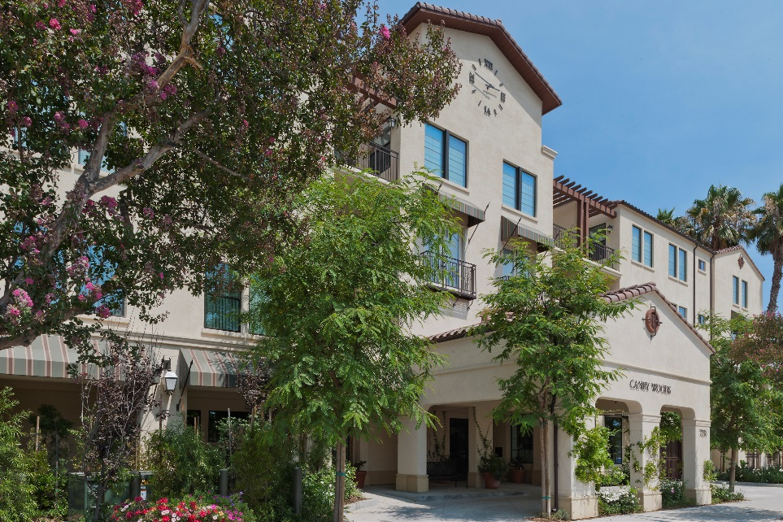
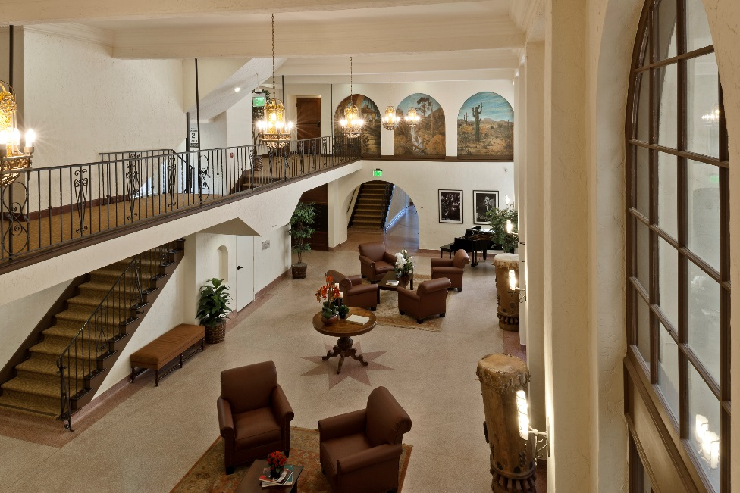
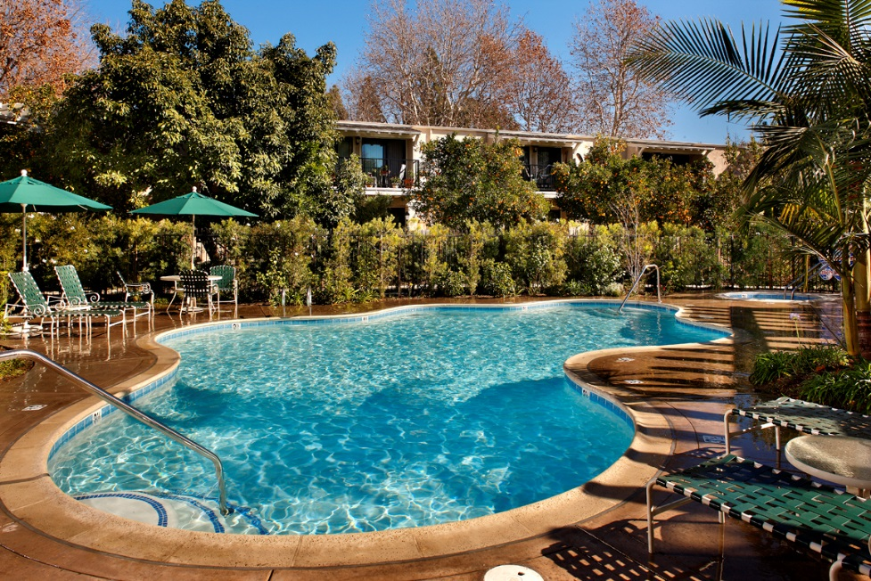
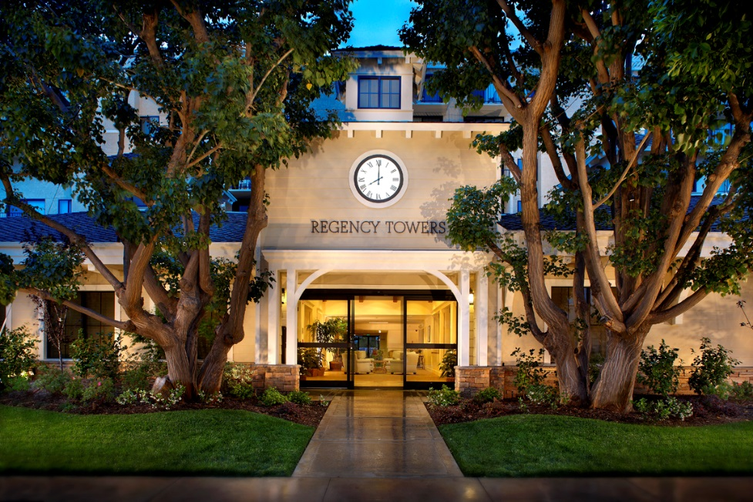
Some of our properties…

Slide 21
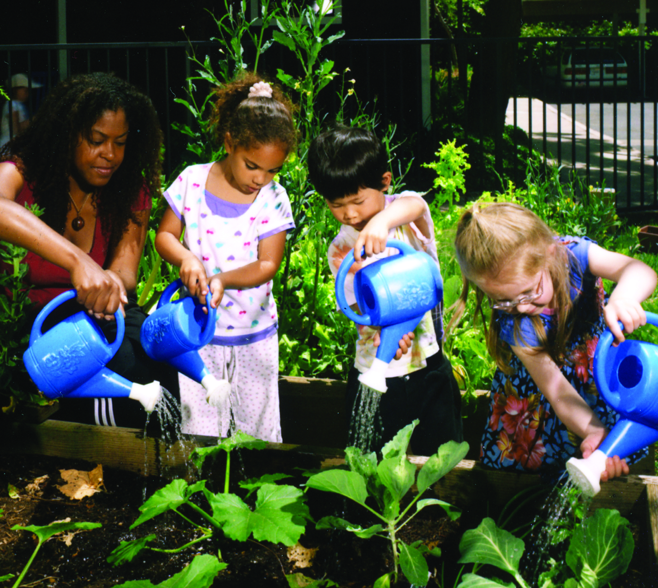
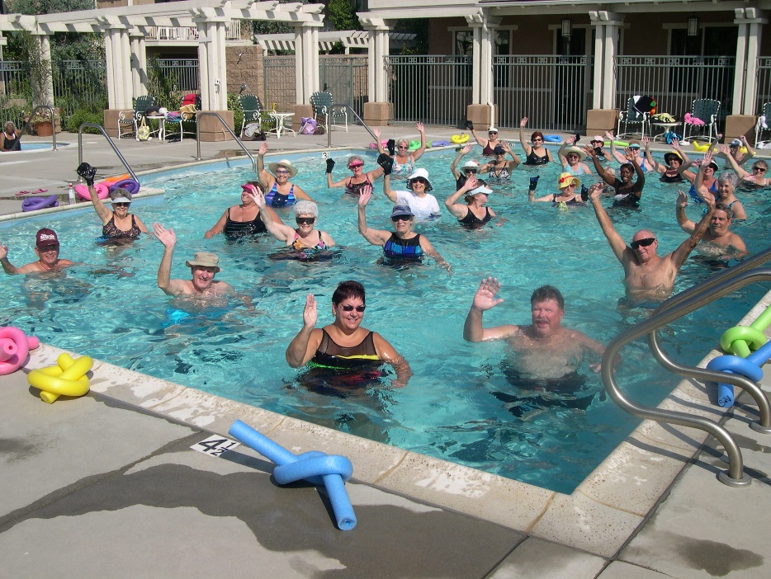
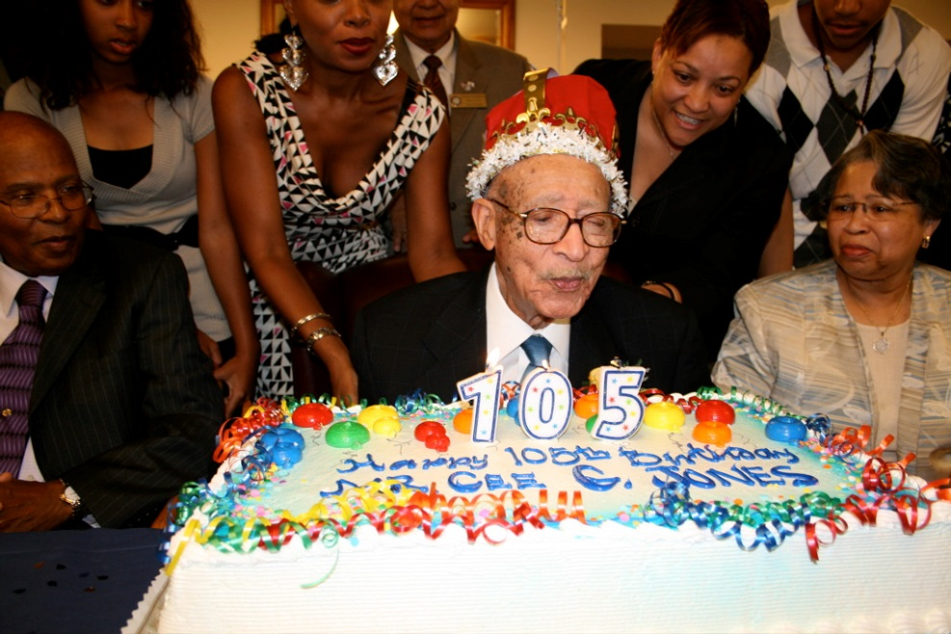
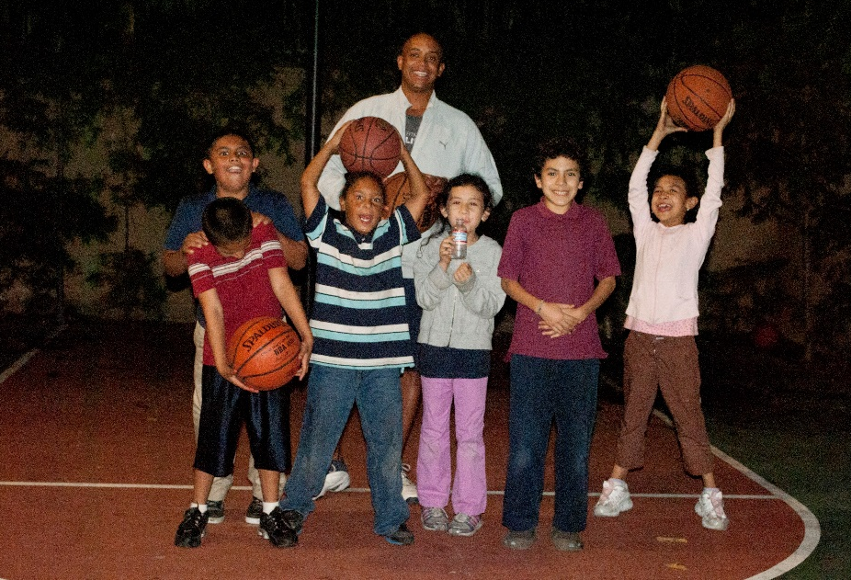
Resident Services:

Slide 22
CURRENT ROLE
History
Thomas Safran & Associates was established in 1974.
We specialize in the development and management of affordable housing.
Size
TSA has approximately 175 employees.
We have around 30 people in our corporate office.
Location
Our corporate office is located in West LA.
Products
Services
Beautiful properties throughout Southern California.
TSA provides high quality, low income housing to individuals and families.
Notes:
Use this graph to give more description of your current company (history, size, location, products and services, etc.)

Slide 23
CURRENT ROLE
President of Management Company
HR
Compliance
Resident
Services
Operations
Notes:
Use this graph to give more description of your role specifically (responsibilities, typical work week, direct reports, etc.)

Slide 24
Career Compensation
Leadership Positions $100k +
Project Manager
$60-$100k
Supervisor $70 -$90k
Manager:
$35-$50k plus apartment
Maintenance:
$15 - $28 hour
Notes:
Use this graph to show general compensation ranges for people in various roles in your company

Slide 25
QUESTION AND ANSWER

