Slide 1
YBA MR ELISHA HALL

Slide 2
INTRODUCTION
My name is Mr. ELISHA HALL and I am 34 years old.
I am the owner of Hall To Success.
I invest in PEOPLE, BUSINESSES and REAL ESTATE!
My company Hall To Success is a training company that focuses on:
1- Bettering the lives of people.
2- Growing Businesses.
3- Giving back to community.
Every day I seek to develop, learn and grow!
Youth Business : ALLIANCE

Slide 3
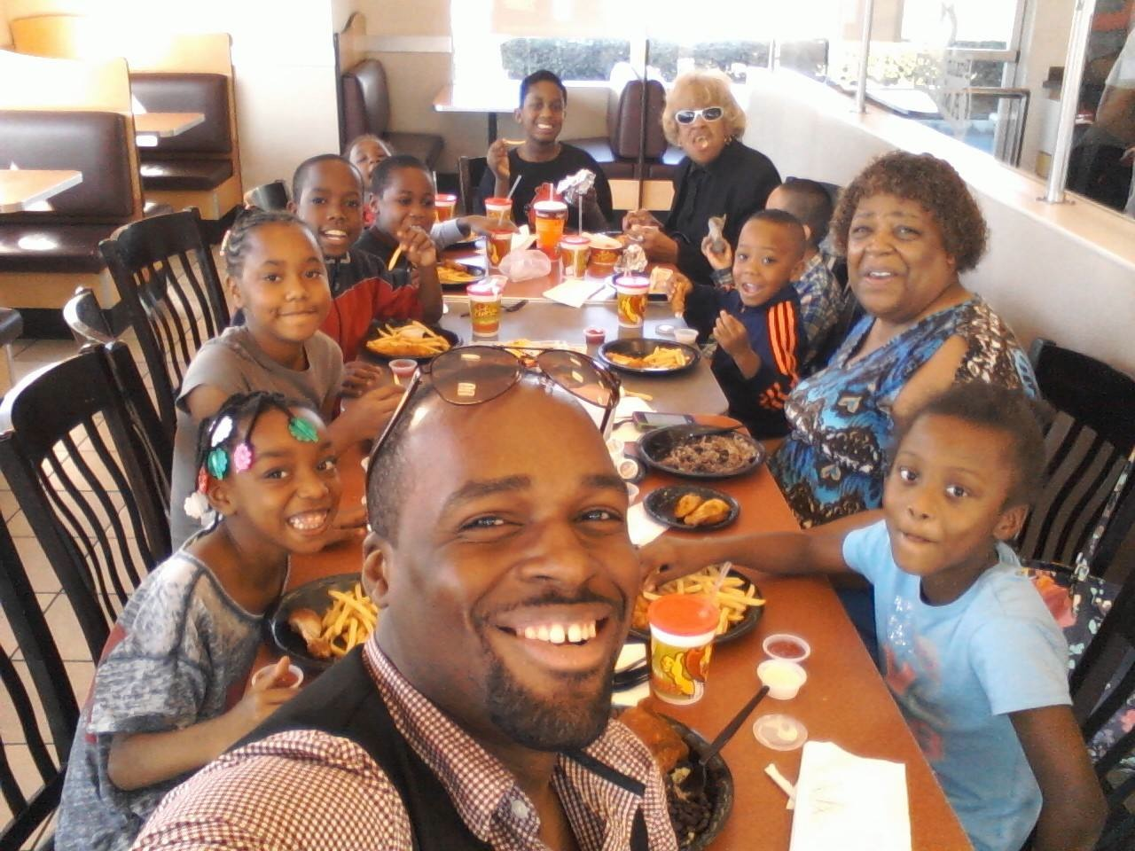
MY FAMILY
Youth Business : ALLIANCE

Slide 4
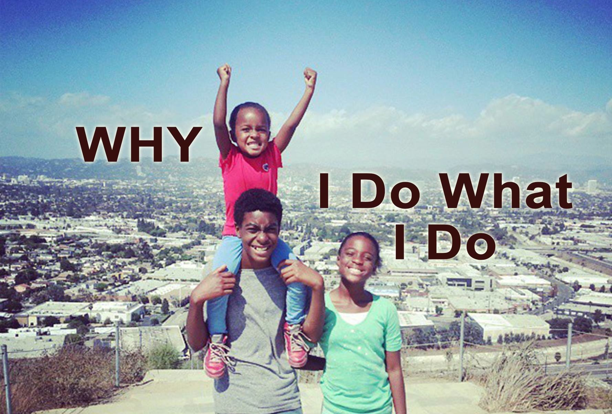
MY LITTLE ONES
Youth Business : ALLIANCE

Slide 5
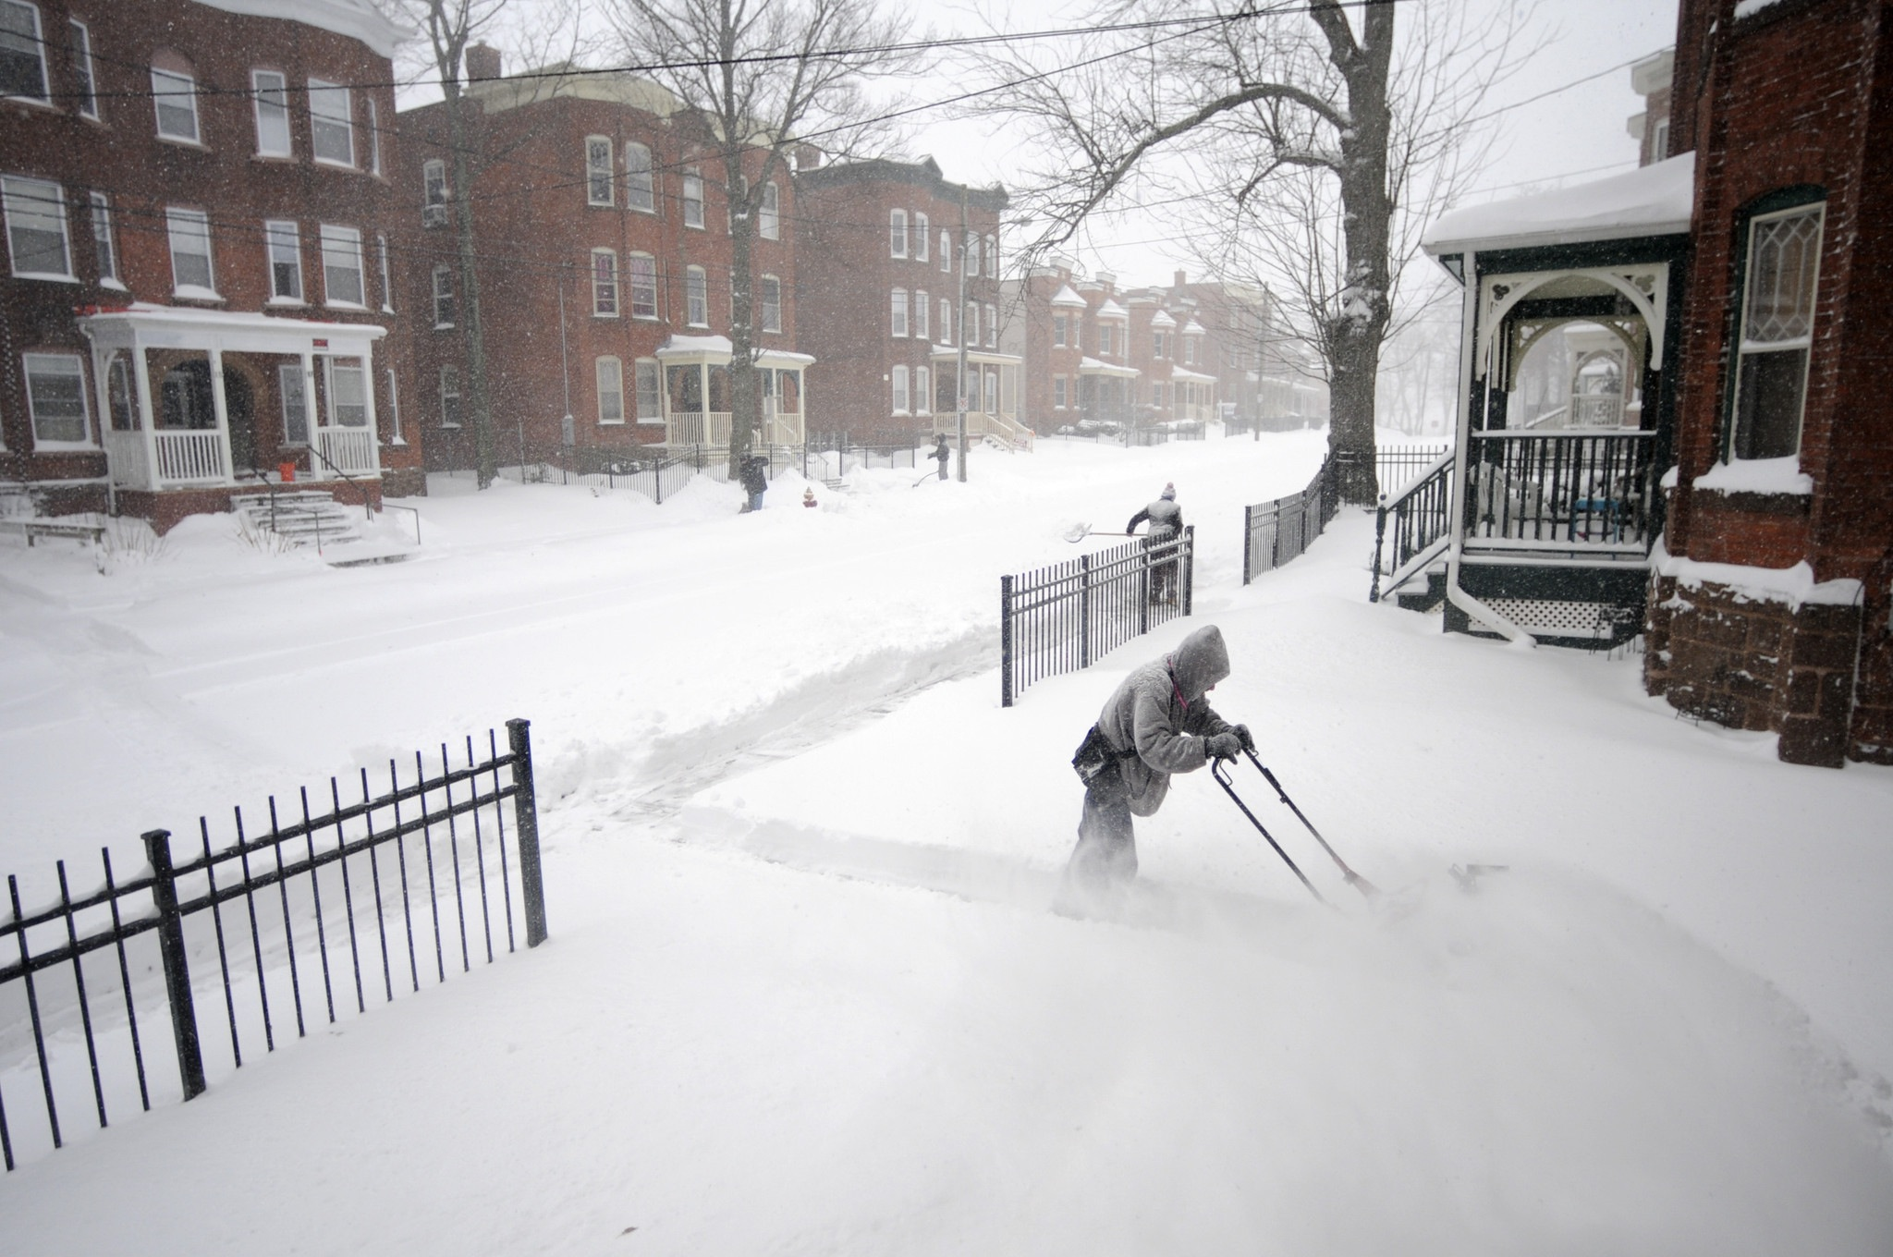
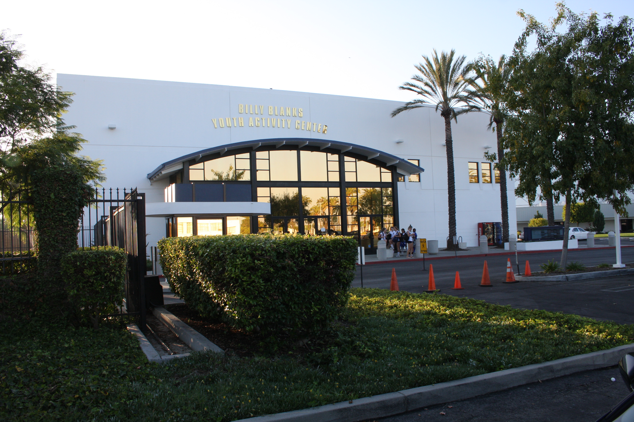
MY HIGH SCHOOL
I attended High School on the East Coast and on the West Coast.
Youth Business : ALLIANCE

Slide 6
HIGH SCHOOL
Jobs I worked while I was in High School were:
Sears
Youth Unity
Volunteered: United Way
Youth Business : ALLIANCE

Slide 7
HIGH SCHOOL
As a HS student I was shy and athletic. Crazy Combo! ……………………………………………………………….
Things that I really liked in High School were:
Sports: Football
Activities: Hanging Out With Friends
Classes: Chemistry ……………………………………………………………….
The thing that was the most challenging for me while I was in High School was:
Fitting In
Youth Business : ALLIANCE

Slide 8
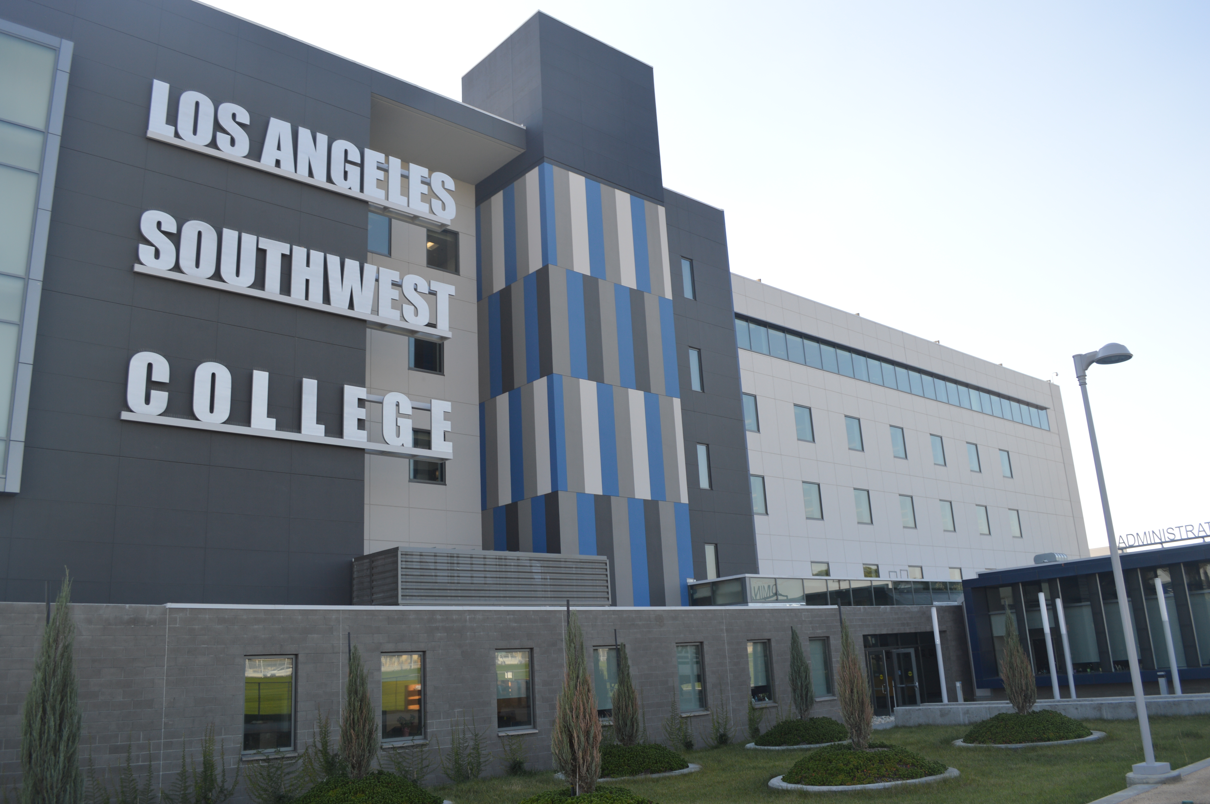
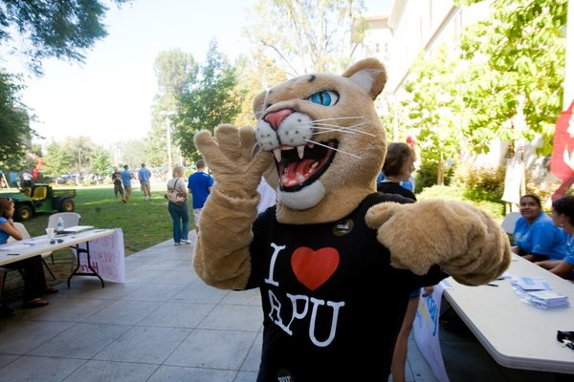
COLLEGE
LA Southwest College
Azusa Pacific University
Youth Business : ALLIANCE

Slide 9
COLLEGE
Things I enjoyed in College:
Time Freedom
Being away from home
Things I didn’t enjoy in College:
Time Freedom
Being away from home
Youth Business : ALLIANCE

Slide 10
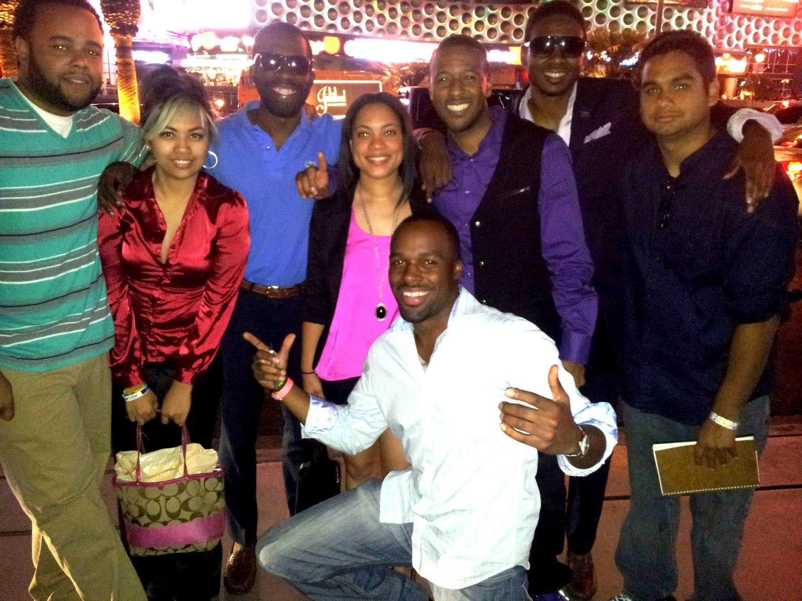
GETTING A JOB AFTER COLLEGE
The top few things I did to ensure I got a good job after college were:
Internships
Ask people in my network
Youth Business : ALLIANCE

Slide 11
COMPENSATION AT MOST COMPANIES
VP - Level
($120k-$160k)
Upper Management
($85K-$115)
HEALTH BENEFITS
Middle Management
($50K-$75)
401K / RETIREMENT
C-Suite
($350K)
Management
($150K)
STOCK OPTIONS / BONUSES
Middle Manager
($75K)
Entry Level
($20K-$40k)
Youth Business : ALLIANCE
Notes:
Use this graph to show general compensation ranges for people in various roles in your company

Slide 12
THIS IS MY COMPANY
Every day at my company:
I inspire people
I empower people
I PUSH people!!!
Youth Business : ALLIANCE

Slide 13
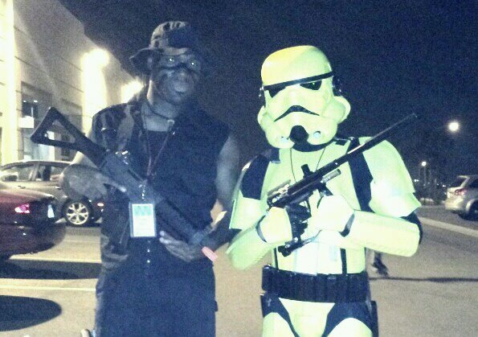
MY CAREER
The first job I had after college was:
Maxim Healthcare
I just need to money to pay bills
The worst job I have ever had was:
Lowes Warehouse.
I learned the importance of finding what makes you happy
Youth Business : ALLIANCE

Slide 14
MY CAREER
Challenges I have had to overcome throughout my career are:
ME
ME
ME
Youth Business : ALLIANCE

Slide 16
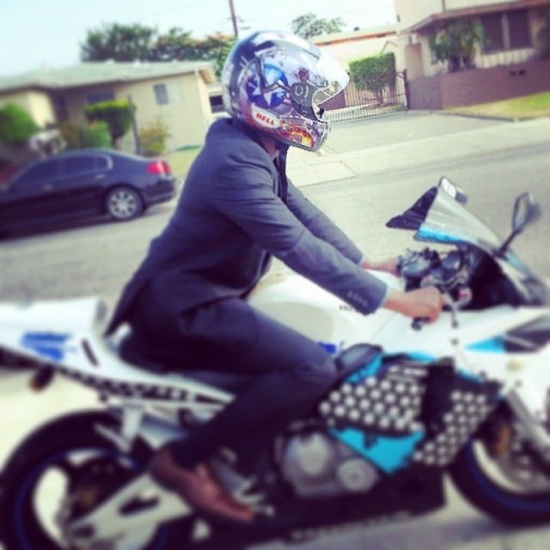
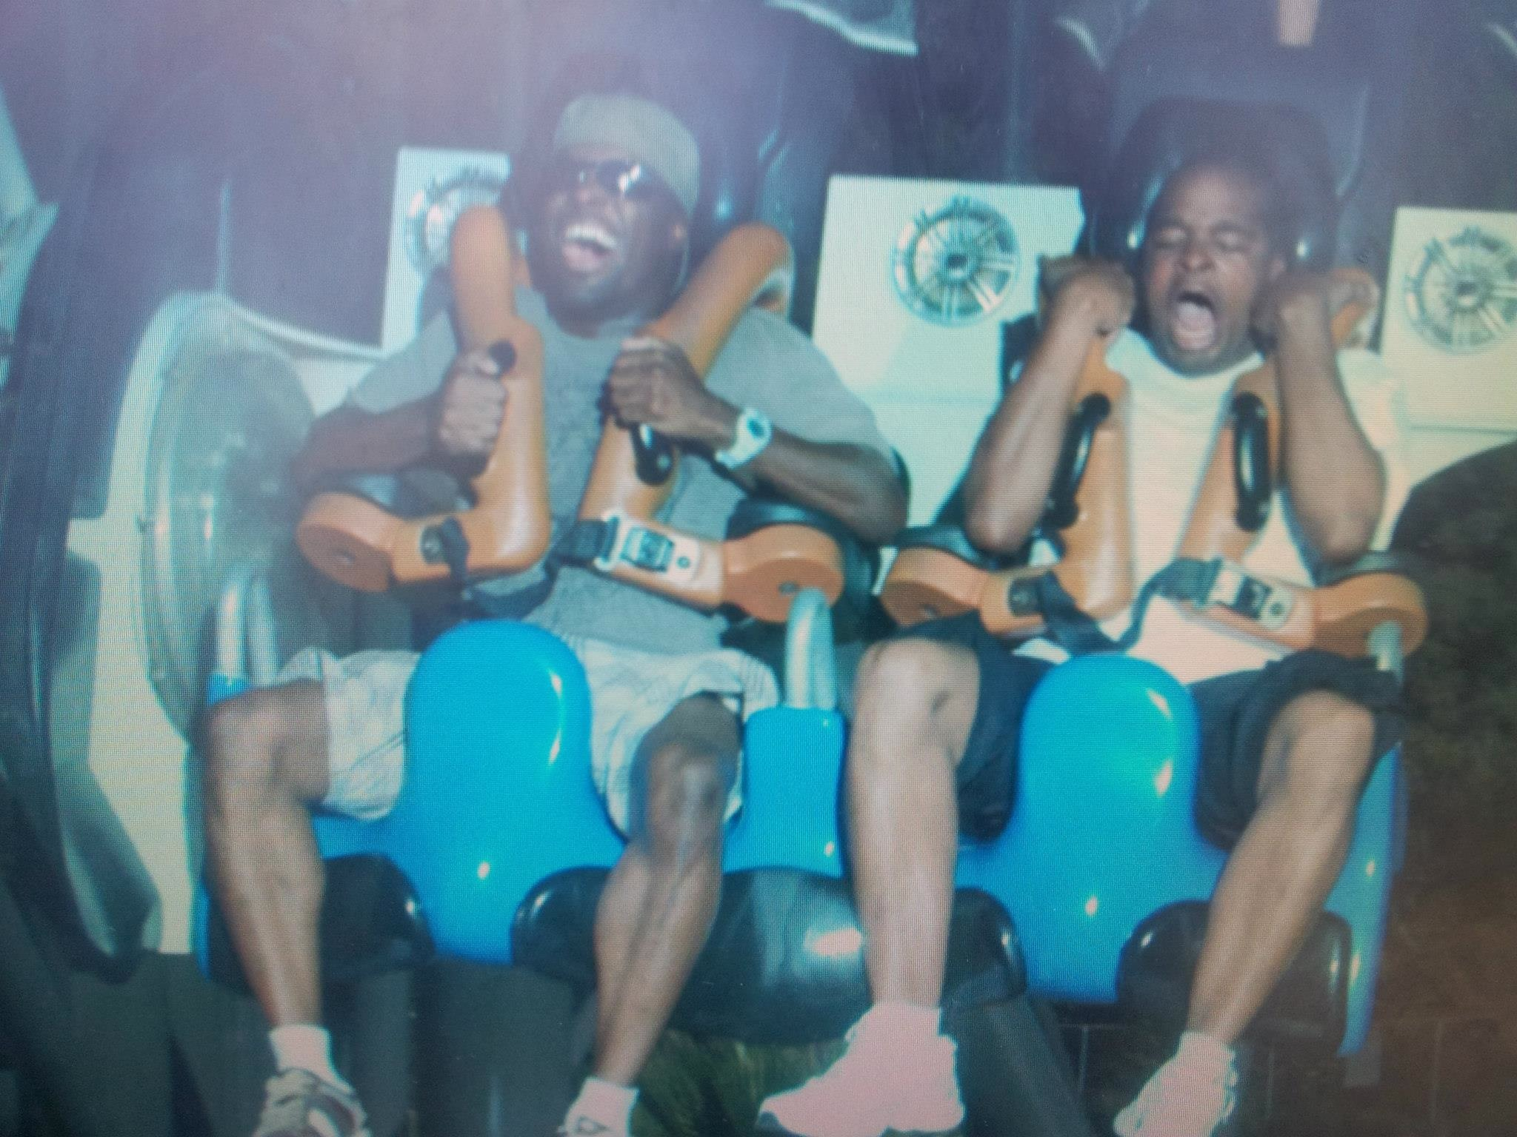
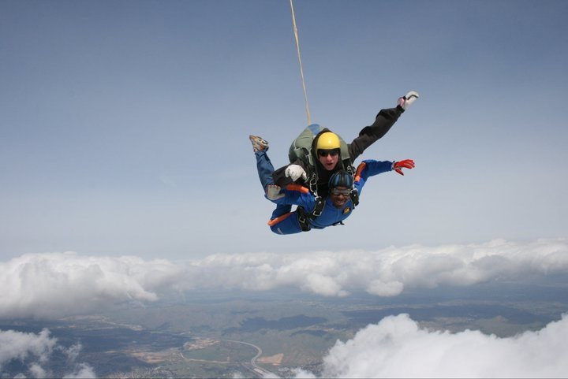
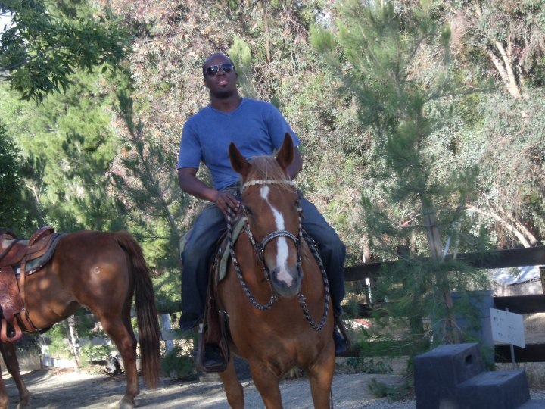
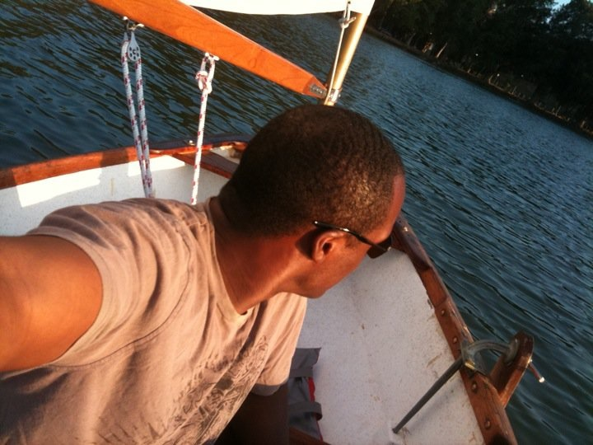
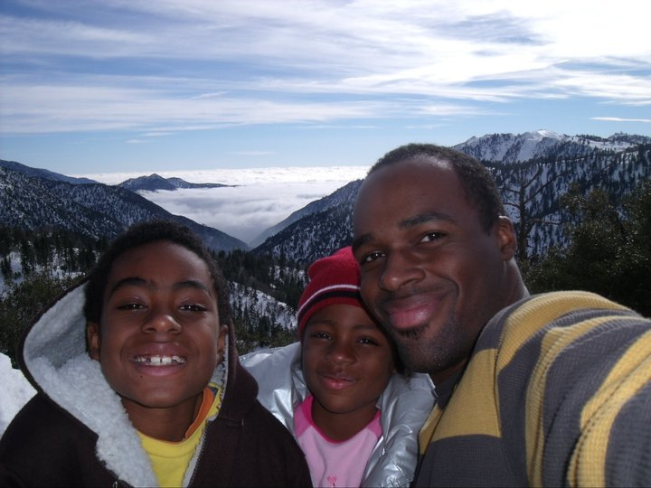
MORE THAN JUST WORK
When I am not at work I like to:
Youth Business : ALLIANCE

Slide 17
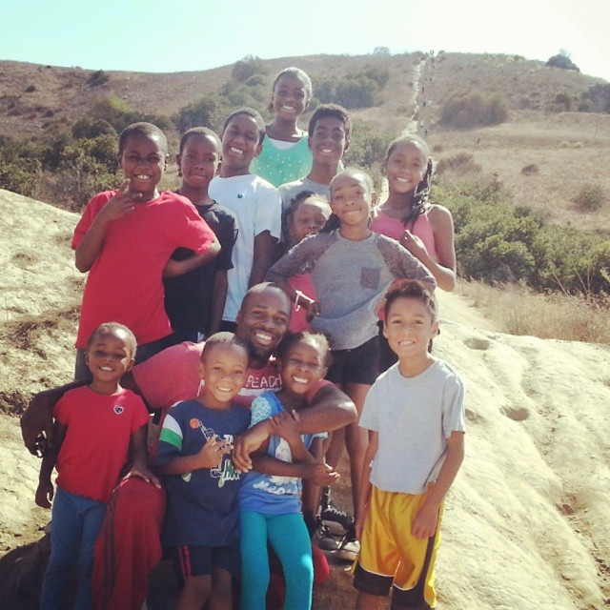
DO IT ALL OVER AGAIN?
If I could talk to my high school self, what would I say?
It all turns out ok
Be you, be creative, be happy
Never give up on you and keep dreaming BIG
Youth Business : ALLIANCE

Slide 18
QUESTION AND ANSWER
Youth Business : ALLIANCE

