Slide 1
Mindful Leadership
www.LauraLinden.com
as seen on

Slide 2
copyright 2015 Laura Linden
www.LauraLinden.com

Slide 3
SUCCESSFUL LEADERS:
Hold a BIG vision
Live outside their comfort zone
Act with certainty
Get creative
Make a lot of decisions quickly
Maintain uniqueness
Always have mentors
copyright 2015 Laura Linden
www.LauraLinden.com

Slide 4
copyright 2015 Laura Linden
www.LauraLinden.com

Slide 5
Most people make decisions the HARD way
and miss the opportunity to lead:
No system
Reactionary
Logic Only
Stuff Down Emotion
Push past physical
Skip or nod to Spiritual
Ignore Intuition
copyright 2015 Laura Linden
www.LauraLinden.com

Slide 6
If you’re not using your intuition
leadership and success will elude you
copyright 2015 Laura Linden
www.LauraLinden.com

Slide 7
How do you make decisions?
copyright 2015 Laura Linden
www.LauraLinden.com

Slide 8
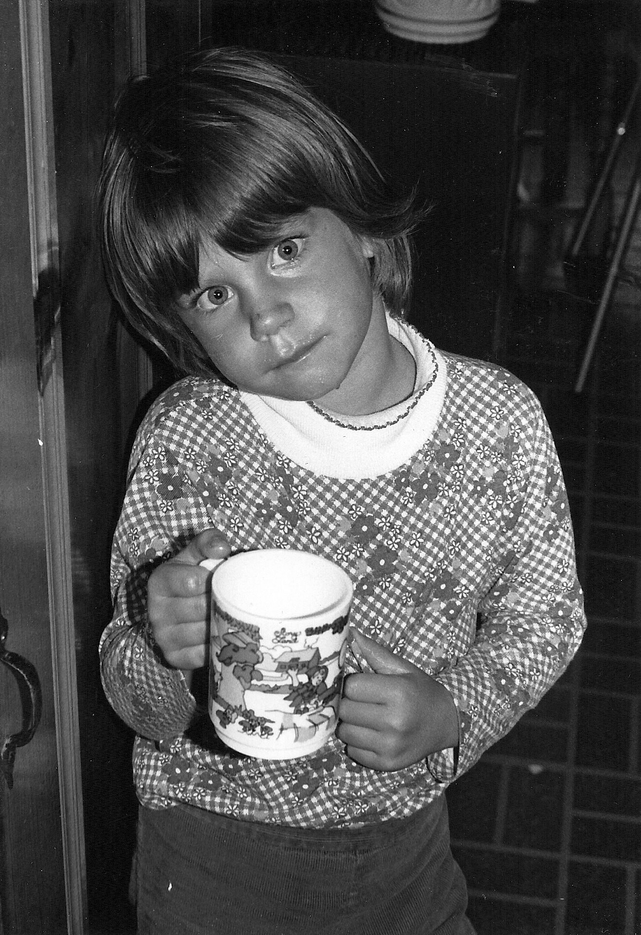
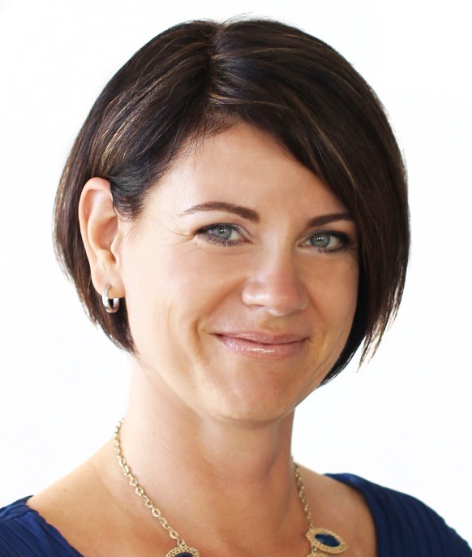
copyright 2015 Laura Linden
www.LauraLinden.com

Slide 9
How do you talk about intuition?
copyright 2015 Laura Linden
www.LauraLinden.com

Slide 10
strange
“twilight zone-y”
funny
odd
wild
weird
freaky
creepy
“woo woo”
copyright 2015 Laura Linden
www.LauraLinden.com

Slide 11
just know
“twilight zone-y”
imagination
gut instinct
instinct
intuition
“just had a feeling”
spine tingling
frog sense
spidey-sense
copyright 2015 Laura Linden
www.LauraLinden.com

Slide 12
What has it been like for you with your intuition?
not listening
listening
copyright 2015 Laura Linden
www.LauraLinden.com

Slide 13
Life without intuition is a
very expensive lifestyle
copyright 2015 Laura Linden
www.LauraLinden.com

Slide 14
What has it cost you?
copyright 2015 Laura Linden
www.LauraLinden.com

Slide 15
energy wasted
no self-trust
frustration
time wasted
no language
no community
money wasted
copyright 2015 Laura Linden
www.LauraLinden.com

Slide 16
Who is the best person to dictate
your direction of growth?
copyright 2015 Laura Linden
www.LauraLinden.com

Slide 17
YOU are!
copyright 2015 Laura Linden
www.LauraLinden.com

Slide 18
"If one advances confidently in the direction of his dreams, and endeavors to live the life which he has imagined, he will meet with success unexpected in common hours."
- Henry David Thoreau
copyright 2015 Laura Linden
www.LauraLinden.com

Slide 19
If you don’t get what you want
you get what you need.
copyright 2015 Laura Linden
www.LauraLinden.com

Slide 20
“Determine that the thing can and shall be done
and then
we shall find the way.”
-Abraham Lincoln
copyright 2015 Laura Linden
www.LauraLinden.com

Slide 21
“The significant problems we face cannot be solved
at the same level of thinking we were at when
we created them.”
-Albert Einstein
copyright 2015 Laura Linden
www.LauraLinden.com

Slide 22
“The significant problems we face cannot be solved
at the same level of thinking we were at when
we created them.”
-Albert Einstein
copyright 2015 Laura Linden
www.LauraLinden.com

Slide 23
You’ve got “it” ...
copyright 2015 Laura Linden
www.LauraLinden.com

Slide 24
... so why aren’t you using it?
copyright 2015 Laura Linden
www.LauraLinden.com

Slide 25
What can my intuition do for me?
(and others)
copyright 2015 Laura Linden
www.LauraLinden.com

Slide 26
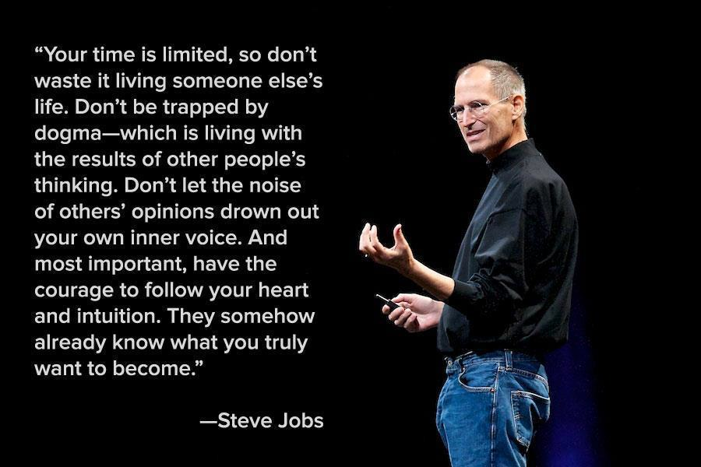
copyright 2015 Laura Linden
www.LauraLinden.com

Slide 27
“...(the sixth sense is) a power that will enable you to throw off discouragement, master fear, overcome procrastination and draw freely upon your imagination.”
-Napolean Hill
“Think and Grow Rich”
copyright 2015 Laura Linden
www.LauraLinden.com

Slide 28
“I’ve built a multi-billion dollar empire
by relying on my gut instinct.”
- Donald Trump
copyright 2015 Laura Linden
www.LauraLinden.com

Slide 29
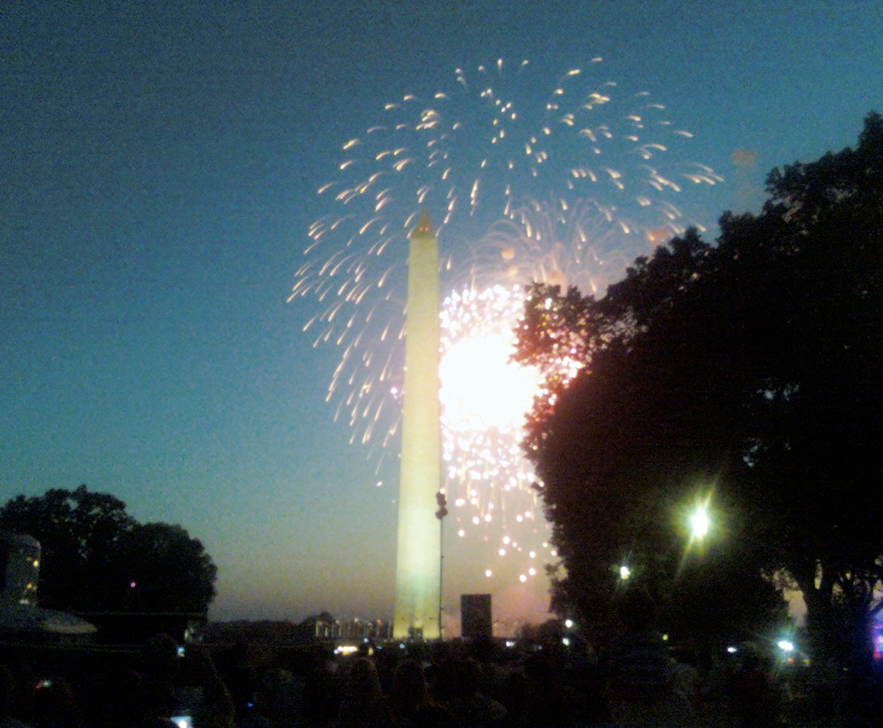
copyright 2015 Laura Linden
www.LauraLinden.com

Slide 30
What Can My Intuition Do For Me? (and Others)
Creativity
Solutions that result in the best for all involved
Relaxed Expansion
Direction / Clarity
Safety (Freedom, Peace, Joy) no matter what
copyright 2015 Laura Linden
www.LauraLinden.com

Slide 31
copyright 2015 Laura Linden
www.LauraLinden.com

Slide 32
copyright 2015 Laura Linden
www.LauraLinden.com

Slide 33
copyright 2015 Laura Linden
www.LauraLinden.com

Slide 34
copyright 2015 Laura Linden
www.LauraLinden.com

Slide 35
Logic and intuition walk hand in hand
copyright 2015 Laura Linden
www.LauraLinden.com

Slide 36
"Dig up all the information you can, then go with your instincts. We all have a certain intuition, and the older we get, the more we trust it...I use my intellect to inform my instinct. Then I use my instinct to test all this data. Hey, instinct, does this sound right? Does it smell right, feel right, fit right?”
- Colin Powell
copyright 2015 Laura Linden
www.LauraLinden.com

Slide 37
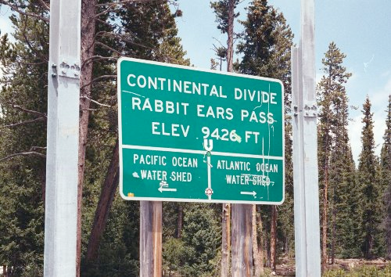
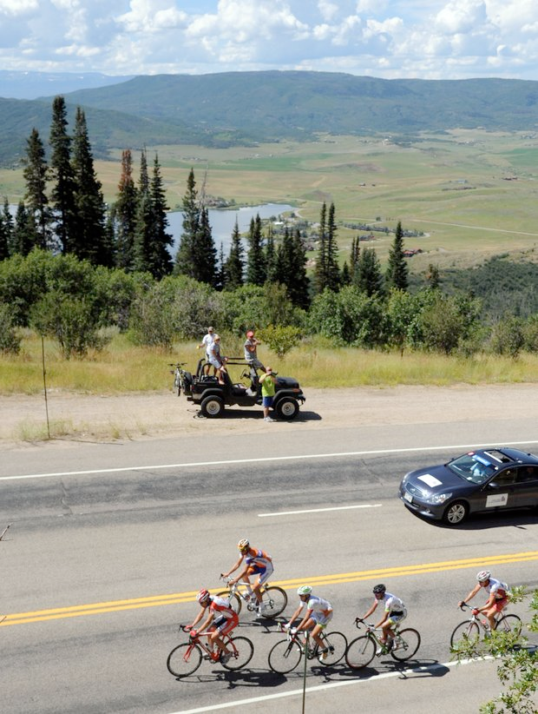

Slide 38
copyright 2015 Laura Linden
www.LauraLinden.com

Slide 39
X
copyright 2015 Laura Linden
www.LauraLinden.com

Slide 40
innate but must be developed
complements reason
is unemotional
requires action
mistake free
Michael Ray, Ph.D. - Creativity Stanford’s MBA program
copyright 2015 Laura Linden
www.LauraLinden.com

Slide 41
The Solution is simple
but not easy …
copyright 2015 Laura Linden
www.LauraLinden.com

Slide 42
… hone your Intuition!
copyright 2015 Laura Linden
www.LauraLinden.com

Slide 43
Have you ever felt certain?
copyright 2015 Laura Linden
www.LauraLinden.com

Slide 44
What do I DO when I can’t “hear” my intuition?
copyright 2015 Laura Linden
www.LauraLinden.com

Slide 45
Hydrate
Be present ... notice
Get outside
Get grounded
Meditate
Breathe
Laugh!
Gratitude
copyright 2015 Laura Linden
www.LauraLinden.com

Slide 46
Some Suggestions …
See it as a game with no expectations
Do not edit the information
Do not judge the information
Remember logic and intuition walk hand in hand
copyright 2015 Laura Linden
www.LauraLinden.com

Slide 47
Intuition Often Appears …
As a “little idea” that is easy to dismiss
While doing “other” things rather than focusing on it
When you are falling asleep (soft mind)
copyright 2015 Laura Linden
www.LauraLinden.com

Slide 48
What Do I Do When I “Hear” It?
Acknowledge it to yourself (imagine)
Write it, draw it, text it to someone ... get it out (first action)
Take the next step
Wait for clear feeling (if it’s urgent it’s not important, if it’s important it’s not urgent)
copyright 2015 Laura Linden
www.LauraLinden.com

Slide 49
Be a Successful Leader …
Use ALL the resources at your disposal
Use your intuition
Ask for help from trusted mentor
copyright 2015 Laura Linden
www.LauraLinden.com

Slide 50
What are you feeling about this?
And where?
copyright 2015 Laura Linden
www.LauraLinden.com

Slide 51
What questions do you have? (If any)
copyright 2015 Laura Linden
www.LauraLinden.com

Slide 52
If not You, then who would stand in your place?
What one action will you take this week?
copyright 2015 Laura Linden
www.LauraLinden.com

Slide 53
Thank You!
laura@LauraLinden.com
copyright 2015 Laura Linden
www.LauraLinden.com

