Slide 1
Introduction
My name is Chris Ott.
I am a Freelance Producer of broadcast TV commercials and other advertising related content for the web and other mediums.
I currently work on a freelance project basis for advertising agencies. My role is to produce TV commercials and short films for advertising clients.
My area of expertise is in the luxury automotive category, although over the years, I have produced commercials for just about everything. This includes but is not limited to, financial, consumer products, fast-food, insurance, fashion, beauty products, toys and beverages.

Slide 2
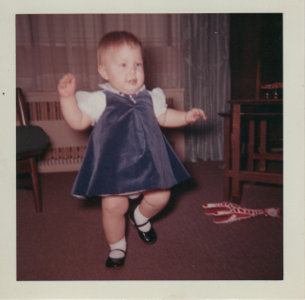
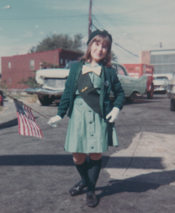
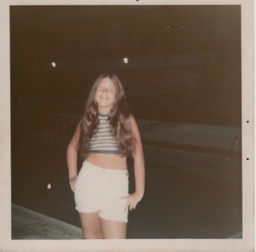
The Early Years…
I was born and raised in the New York metropolitan area
10 Months Old
10 Years Old
13 Years old

Slide 3
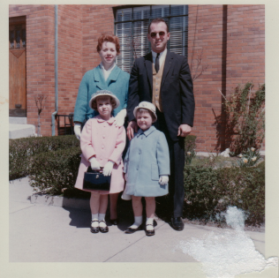
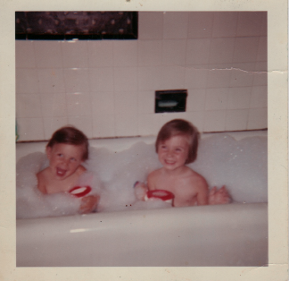
More Early Years…
This is me, in blue, with my core family (older sister, mom, and dad)
This is me with my core family (sister, mom, and dad)
Me, at 3, on right, having some fun with my sis at bath time

Slide 4
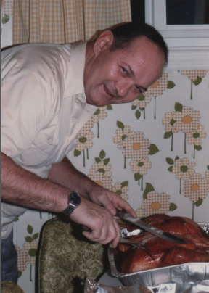
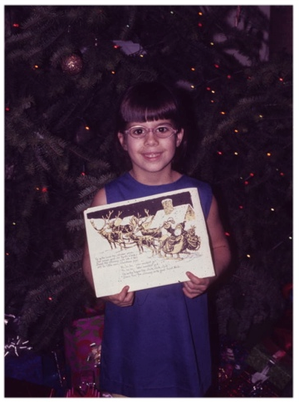
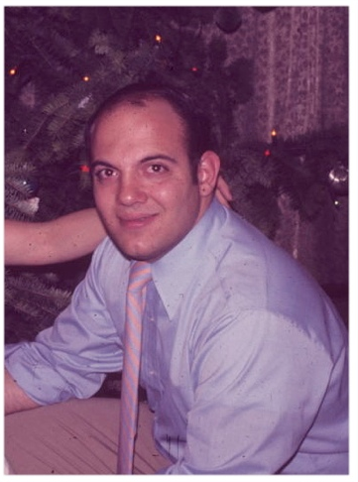
and More Early Years…
When I was 12, my mother remarried and I got a step-dad, and a new sister and brother.

Slide 5
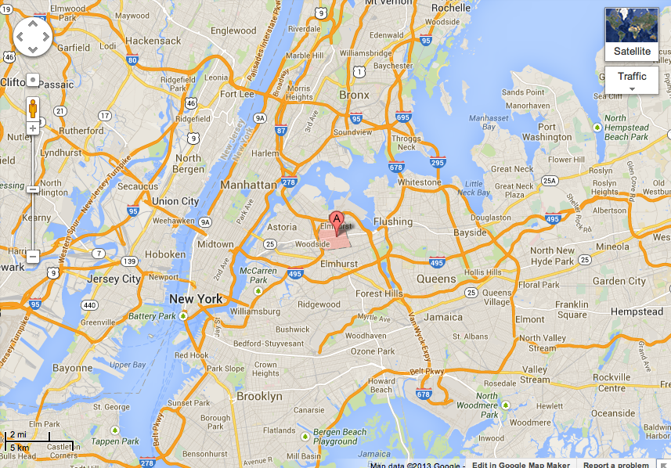
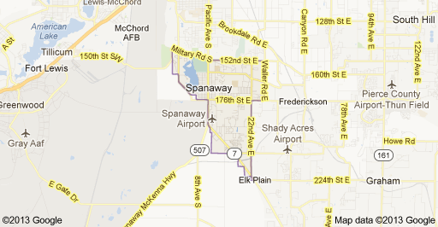
High School
I attended Garden Day School in Jackson Heights, NY
Insert map shot here
\

Slide 6
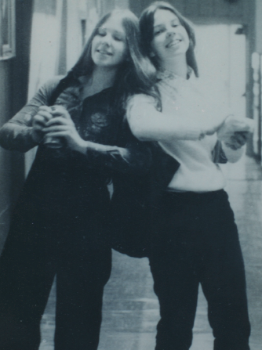
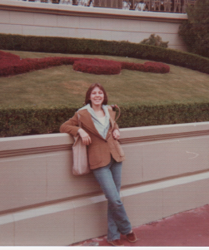
High School
As a HS student I was involved with the Theatre club and the Speech team, and I was the editor of my High School’s yearbook.
As a HS student I was outgoing and felt popular. I made friends easily, and liked to have fun and be busy all the time. I played tennis and rode my bike a lot, until I was able to get my driver’s license.
\
Me, on left, with my best friend
Me, after graduation, at Disney

Slide 7
High School
Things I enjoyed in HS
Things I did not enjoy in HS
Subjects I liked:
Geometry
English
Italian
Being in the HS theatre productions
Editing the HS yearbook
Spending time in Manhattan with friends
The long commute from home to school
Cliques that made me feel excluded
Classes that were not relevant to my life – TRIG !
Standardized tests

Slide 8
High School
Activities/Athletics in HS
Jobs I worked while in HS
Soccer
Tennis
Speech Team
Theatre Club
Babysitting
Receptionist
Tax Preparer

Slide 9
High School
Fondest memories from HS
Obstacles/Adversity you had to overcome in HS
Being elected Editor of the yearbook
Changing to a more progressive school in my Sophomore year
Auditioning and making it into in my first school play
My worse year ever was Freshman year in a school I didn’t like. My parents agreed I could change schools in my Sophomore year
We relocated so I missed all of the friends I grew up with. I felt isolated.

Slide 10
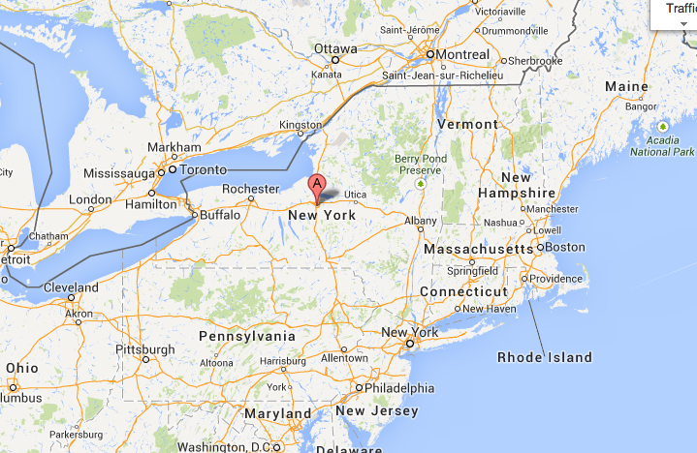
College
I attended Syracuse University in Syracuse, NY. I was an Advertising major in the Communications School. I also spent a semester abroad in London.
Insert map shot here
\

Slide 11
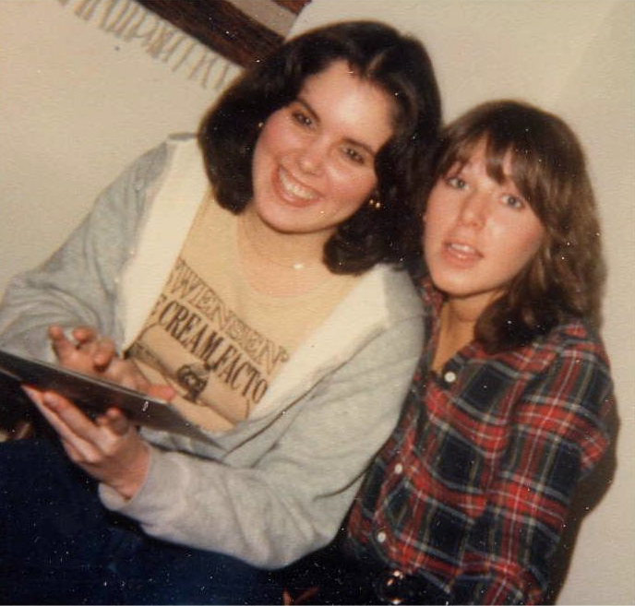
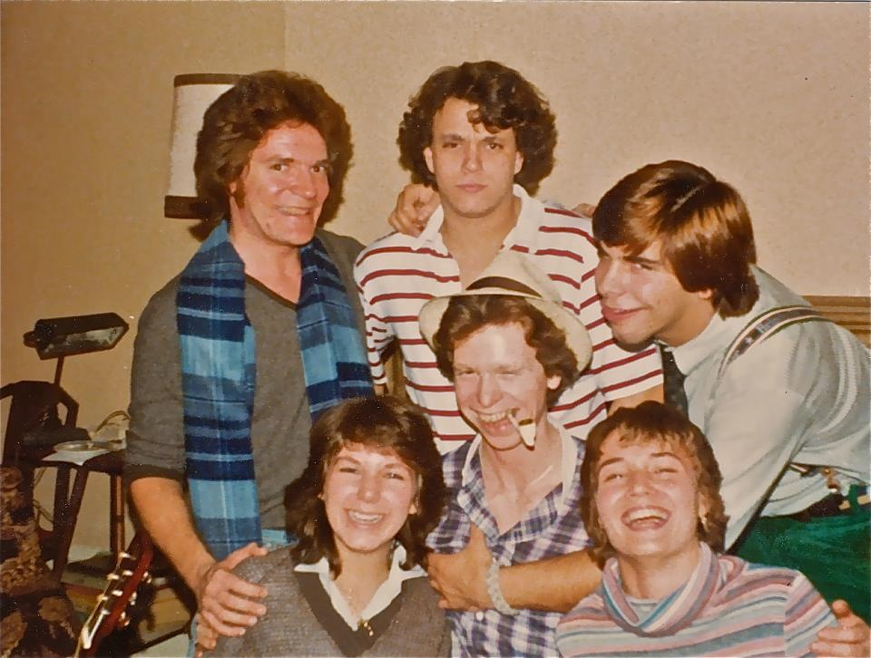
College
Me, on right, in Sophomore year with my friend Pam.
Me, bottom left, in Junior year with my roommates in London

Slide 12
College
Activities/Athletics in College
I was active in fundraising for Muscular Dystrophy
I belonged to a sorority
I played tennis and skied
I went camping
I joined the theatre for non-majors club and made lots of new friends

Slide 13
College
Least favorite classes
Favorite classes
The Philosophy of Logic
Copywriting
Advertising classes taken in London
Photography
Women in Literature
Communications 101
Advertising Media
Geology

Slide 14
College
Fondest memories
Obstacles or adversity that you had to overcome
Going to concerts with friends
Going skiing locally at night
Going to London for an eye opening semester !
Being on a beautiful campus and being absorbed in college life
Timing for swim team at meets
Being without a car in senior year – don’t ask

Slide 15
Career Path
I started as a Post-production Coordinator
I got my first job in advertising as an Assistant Producer after 4 years working in post-production
I am now a top level Producer working on world class advertising as an independent contractor
Notes:
You may use this chart to describe your journey to the current career

Slide 16
Career Perks
As a producer I get to travel all over the world to make commercials.
I get to work with interesting people, sometimes athletes and celebrities.
I have to research each project, since each idea is unique, so I become a mini expert on lots of topics.
I am always on the move, to a shoot, to casting, location scouting, to the editor, or the visual effects house.
I get to be creative and and to have a lot of input which influences how the end product turns out
I have a reel, with the work I am most proud of, that I can show people.
Notes:
You may use this chart to describe your journey to the current career

Slide 17
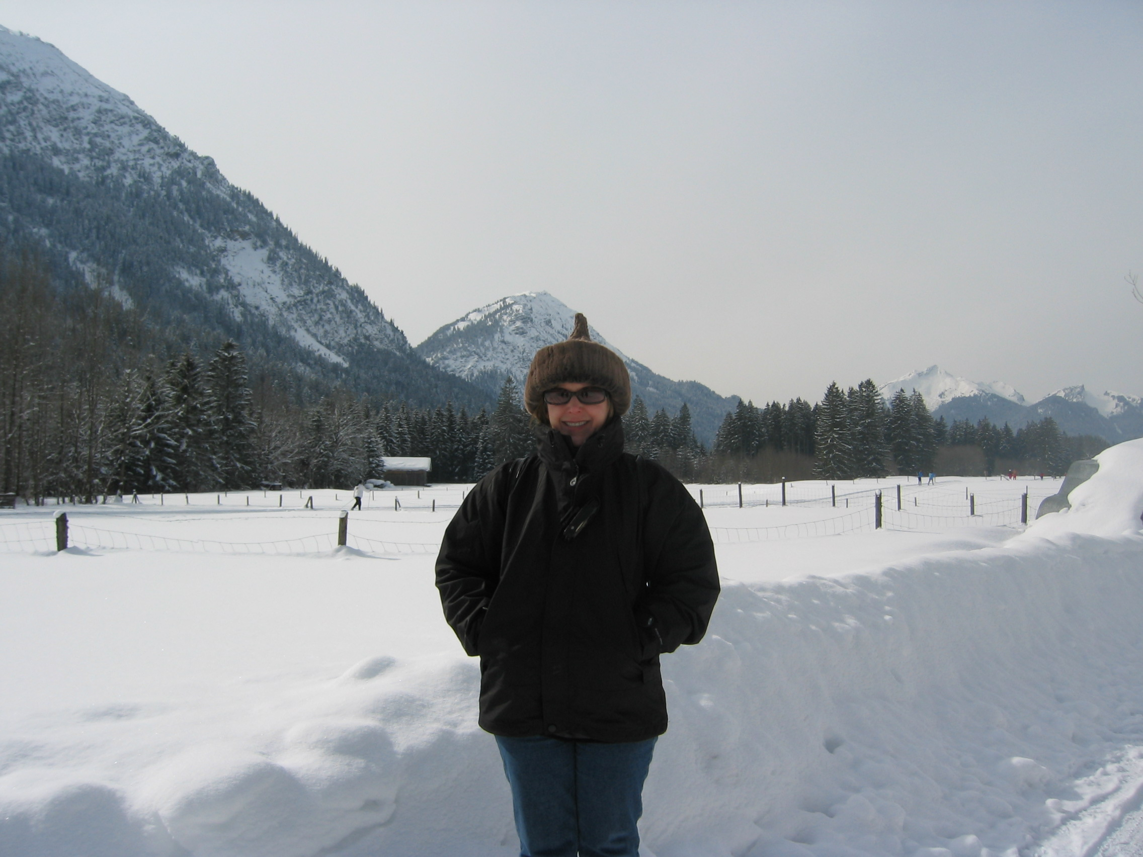
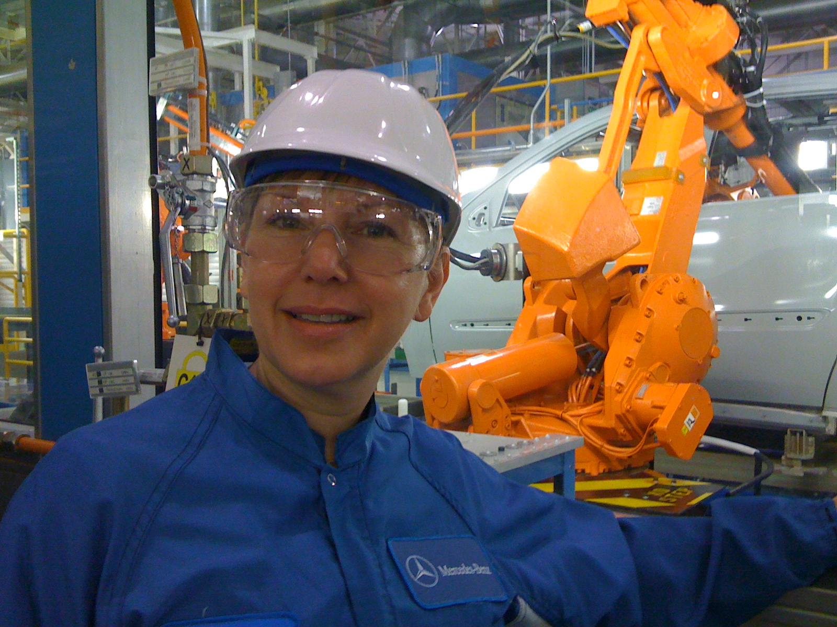
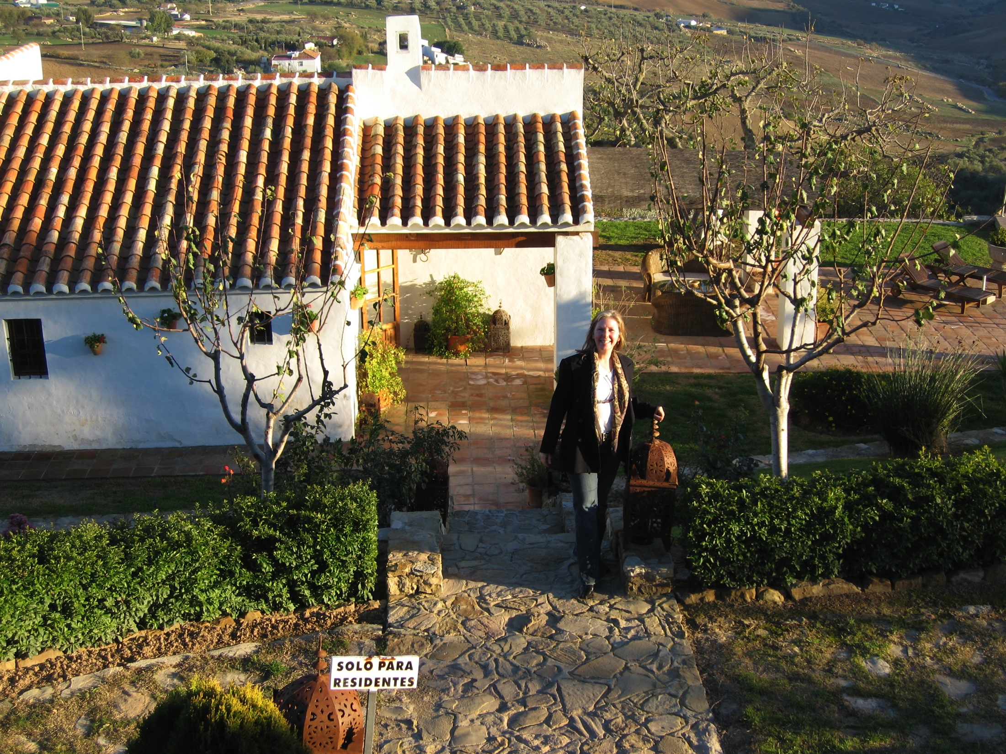
Career Pix
Company pic
Company pic #2

Slide 18
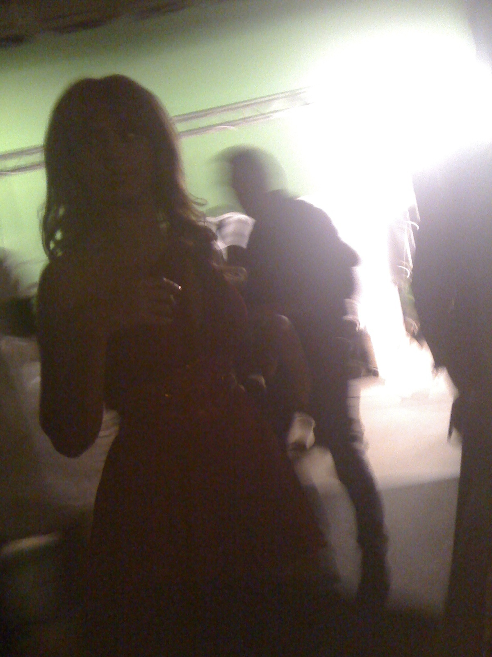
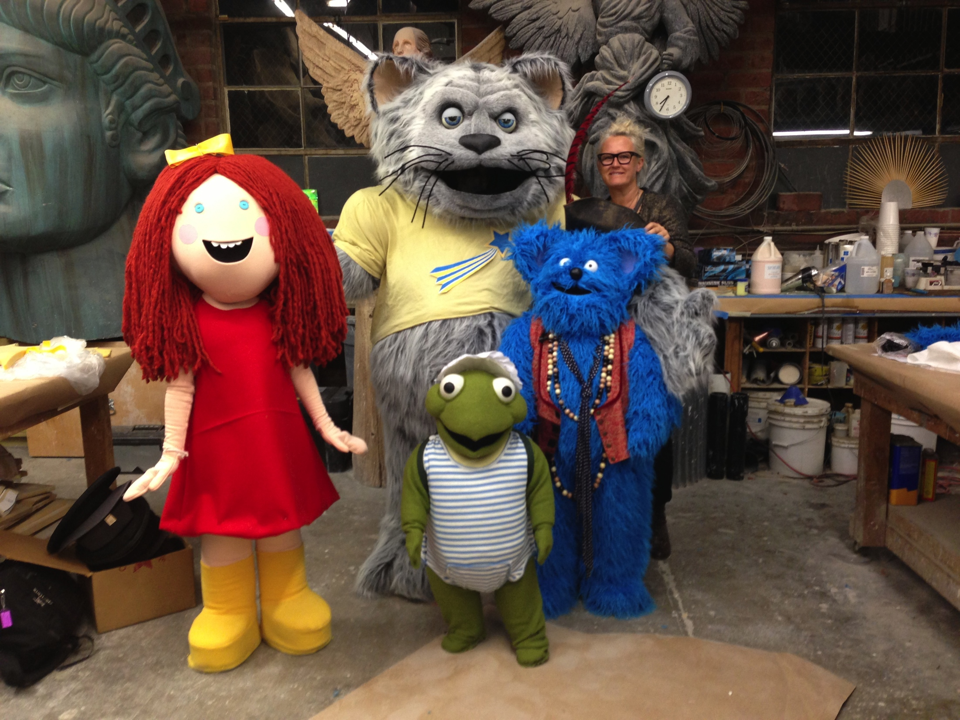
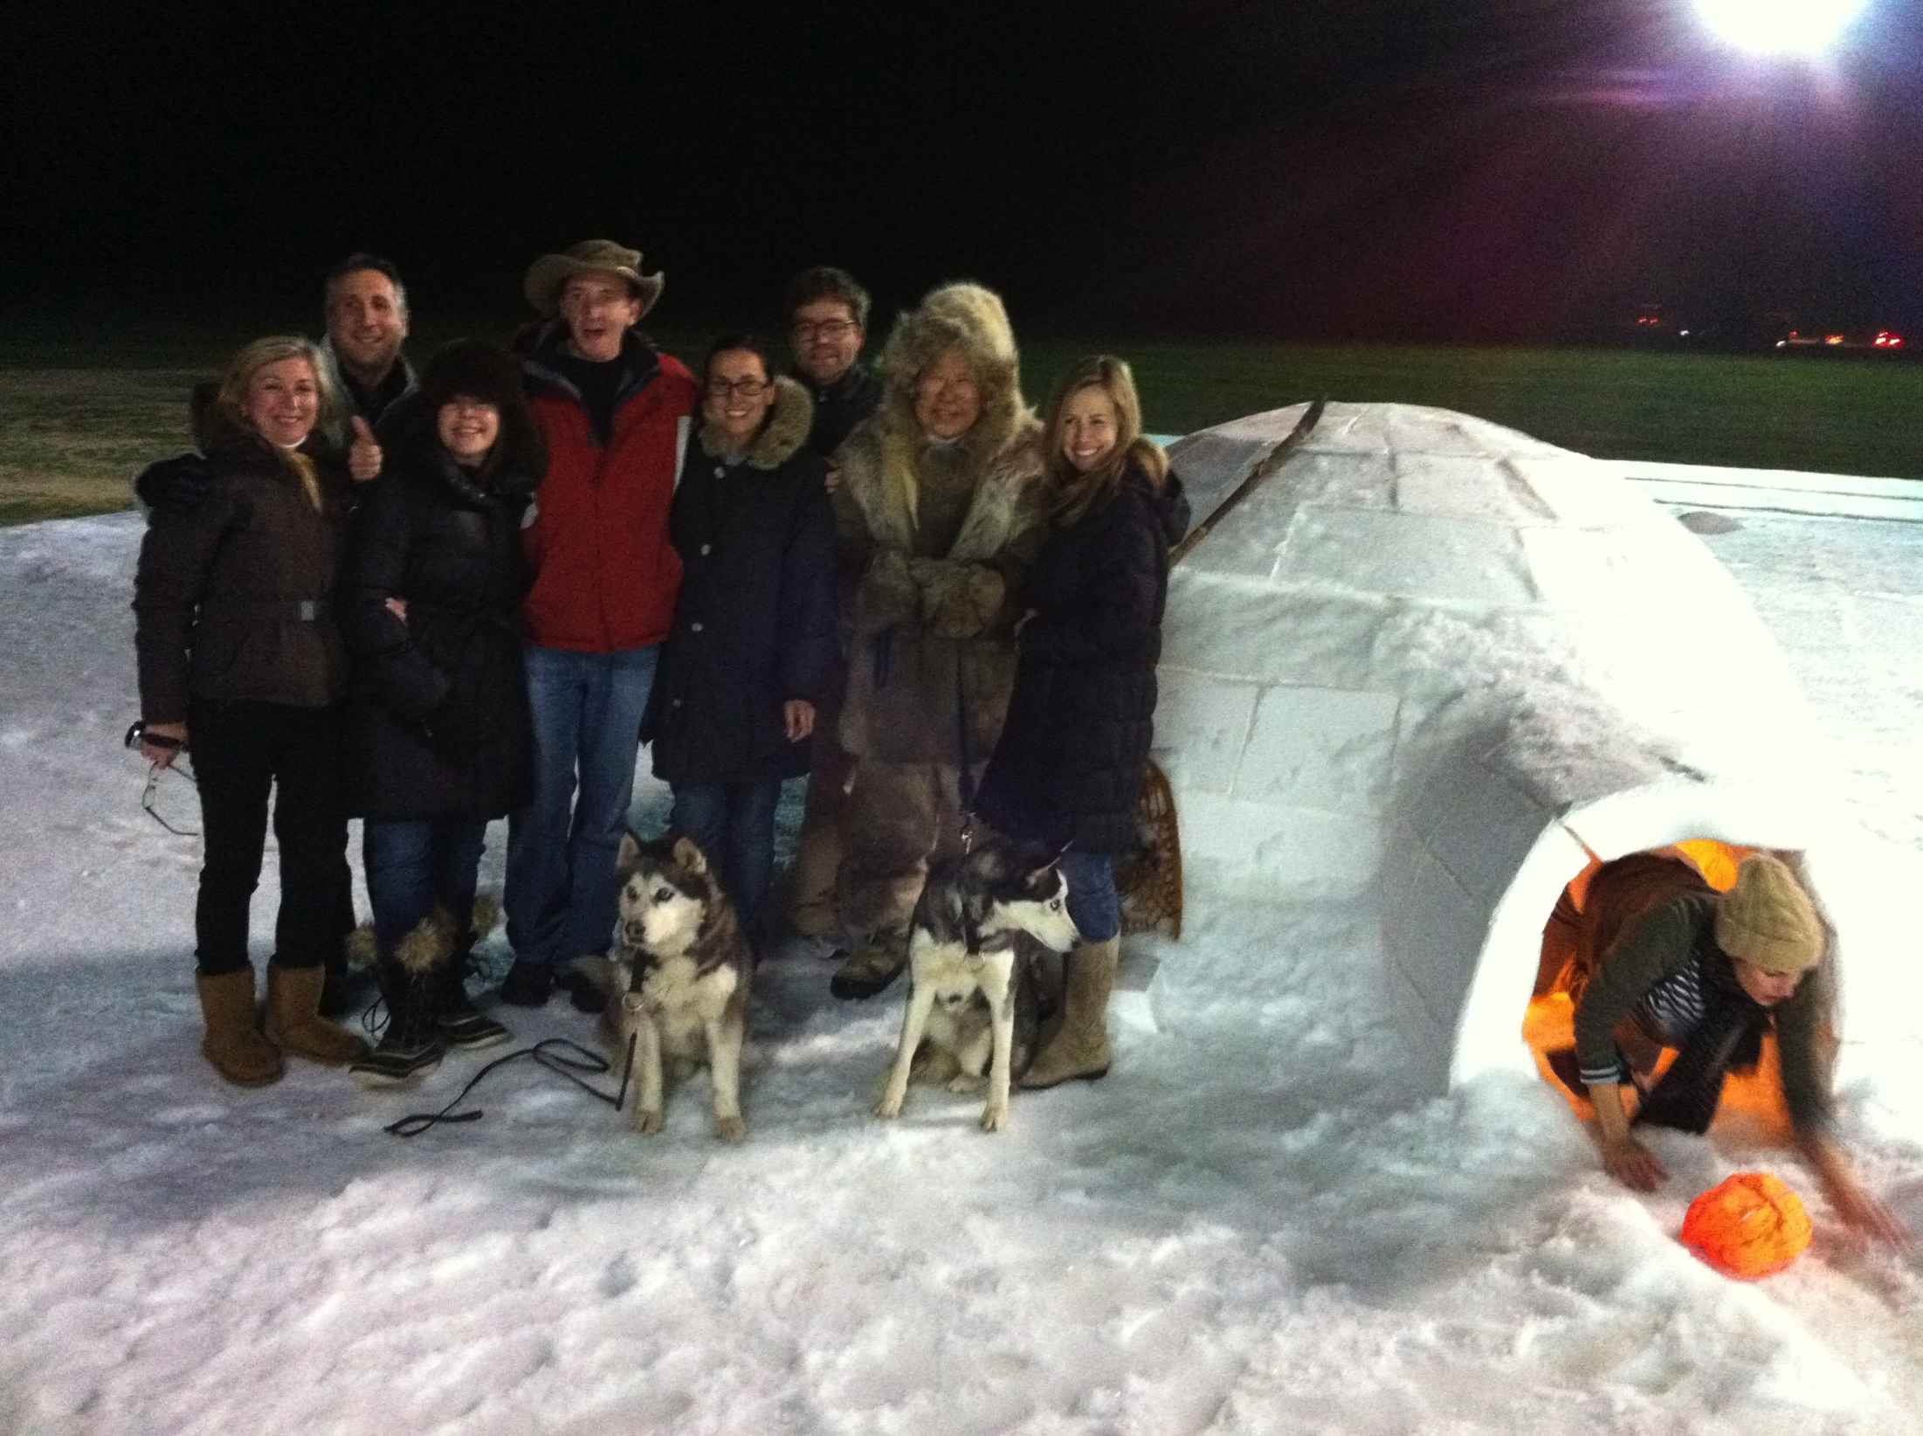
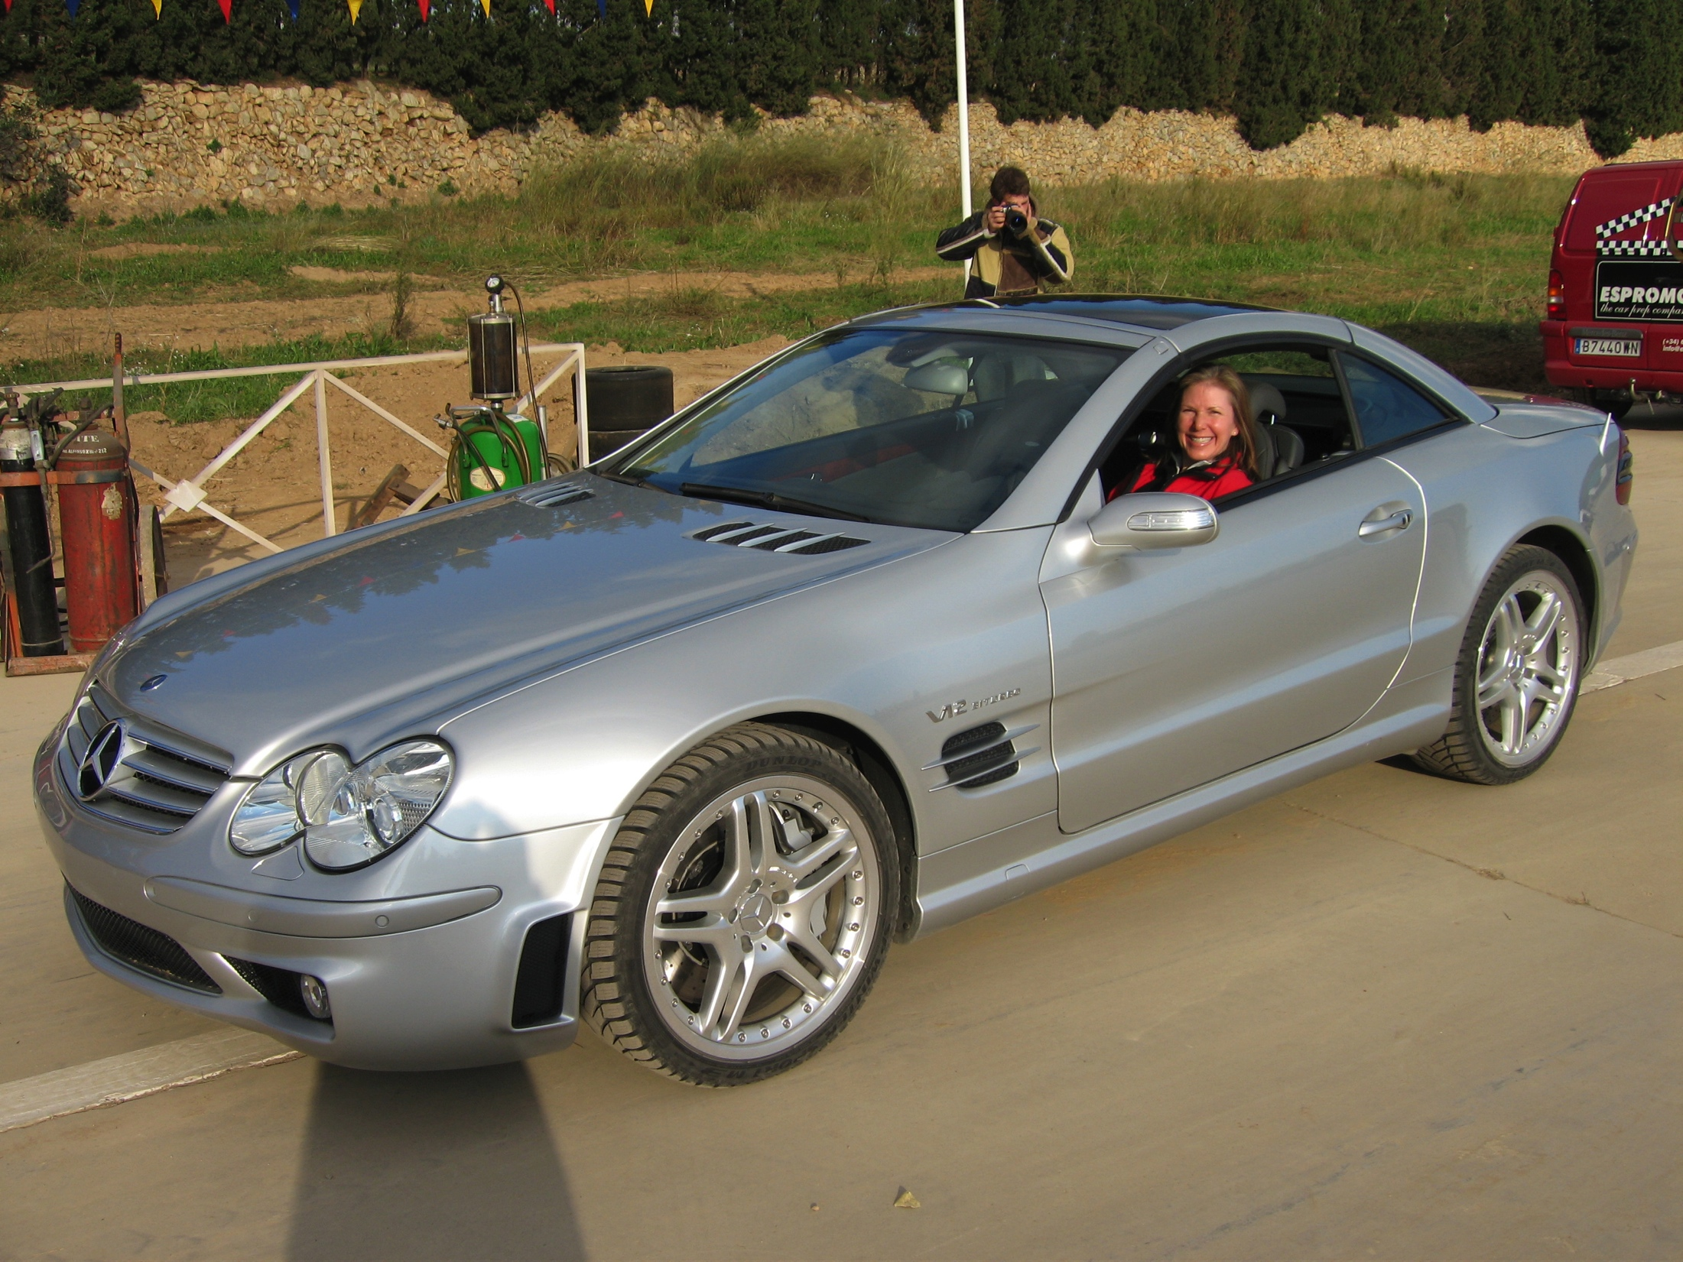
Company pic
Company pic #2

Slide 19
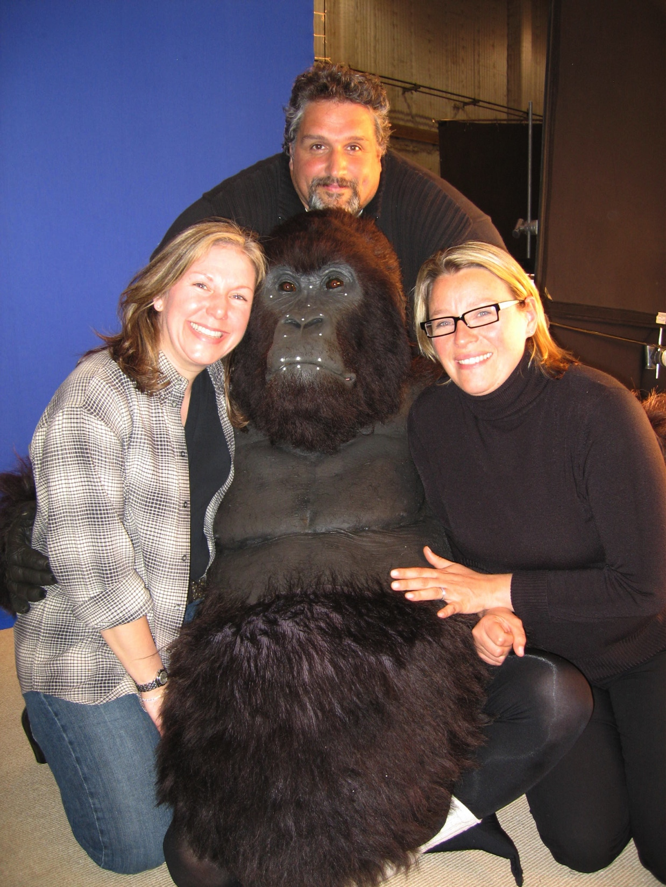
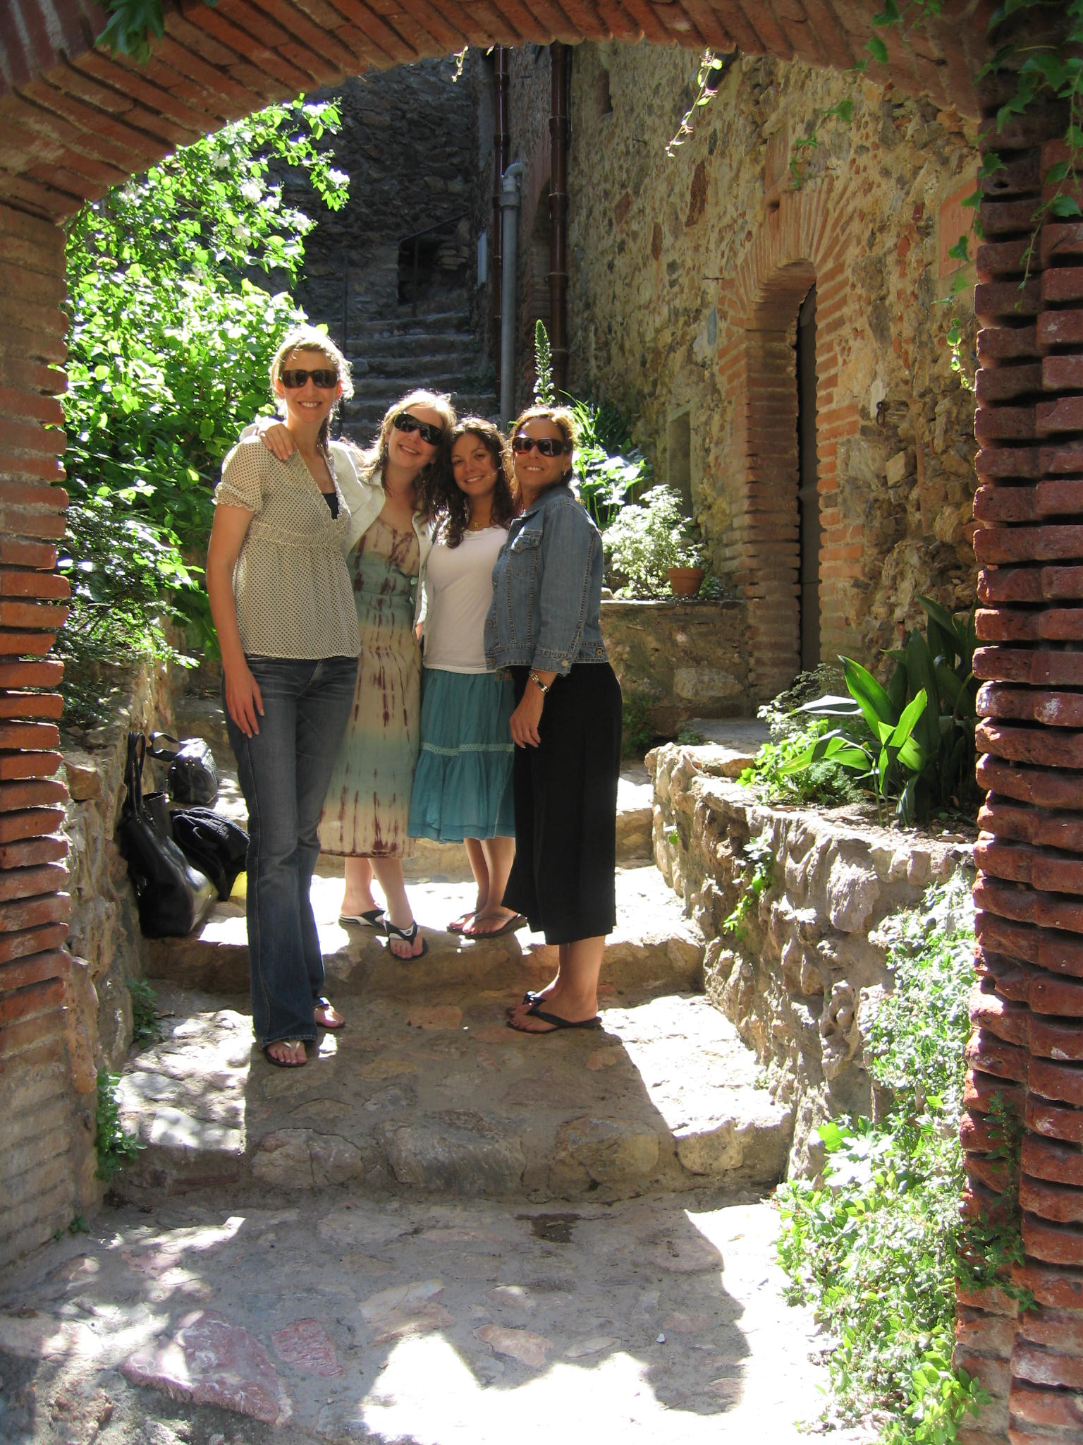
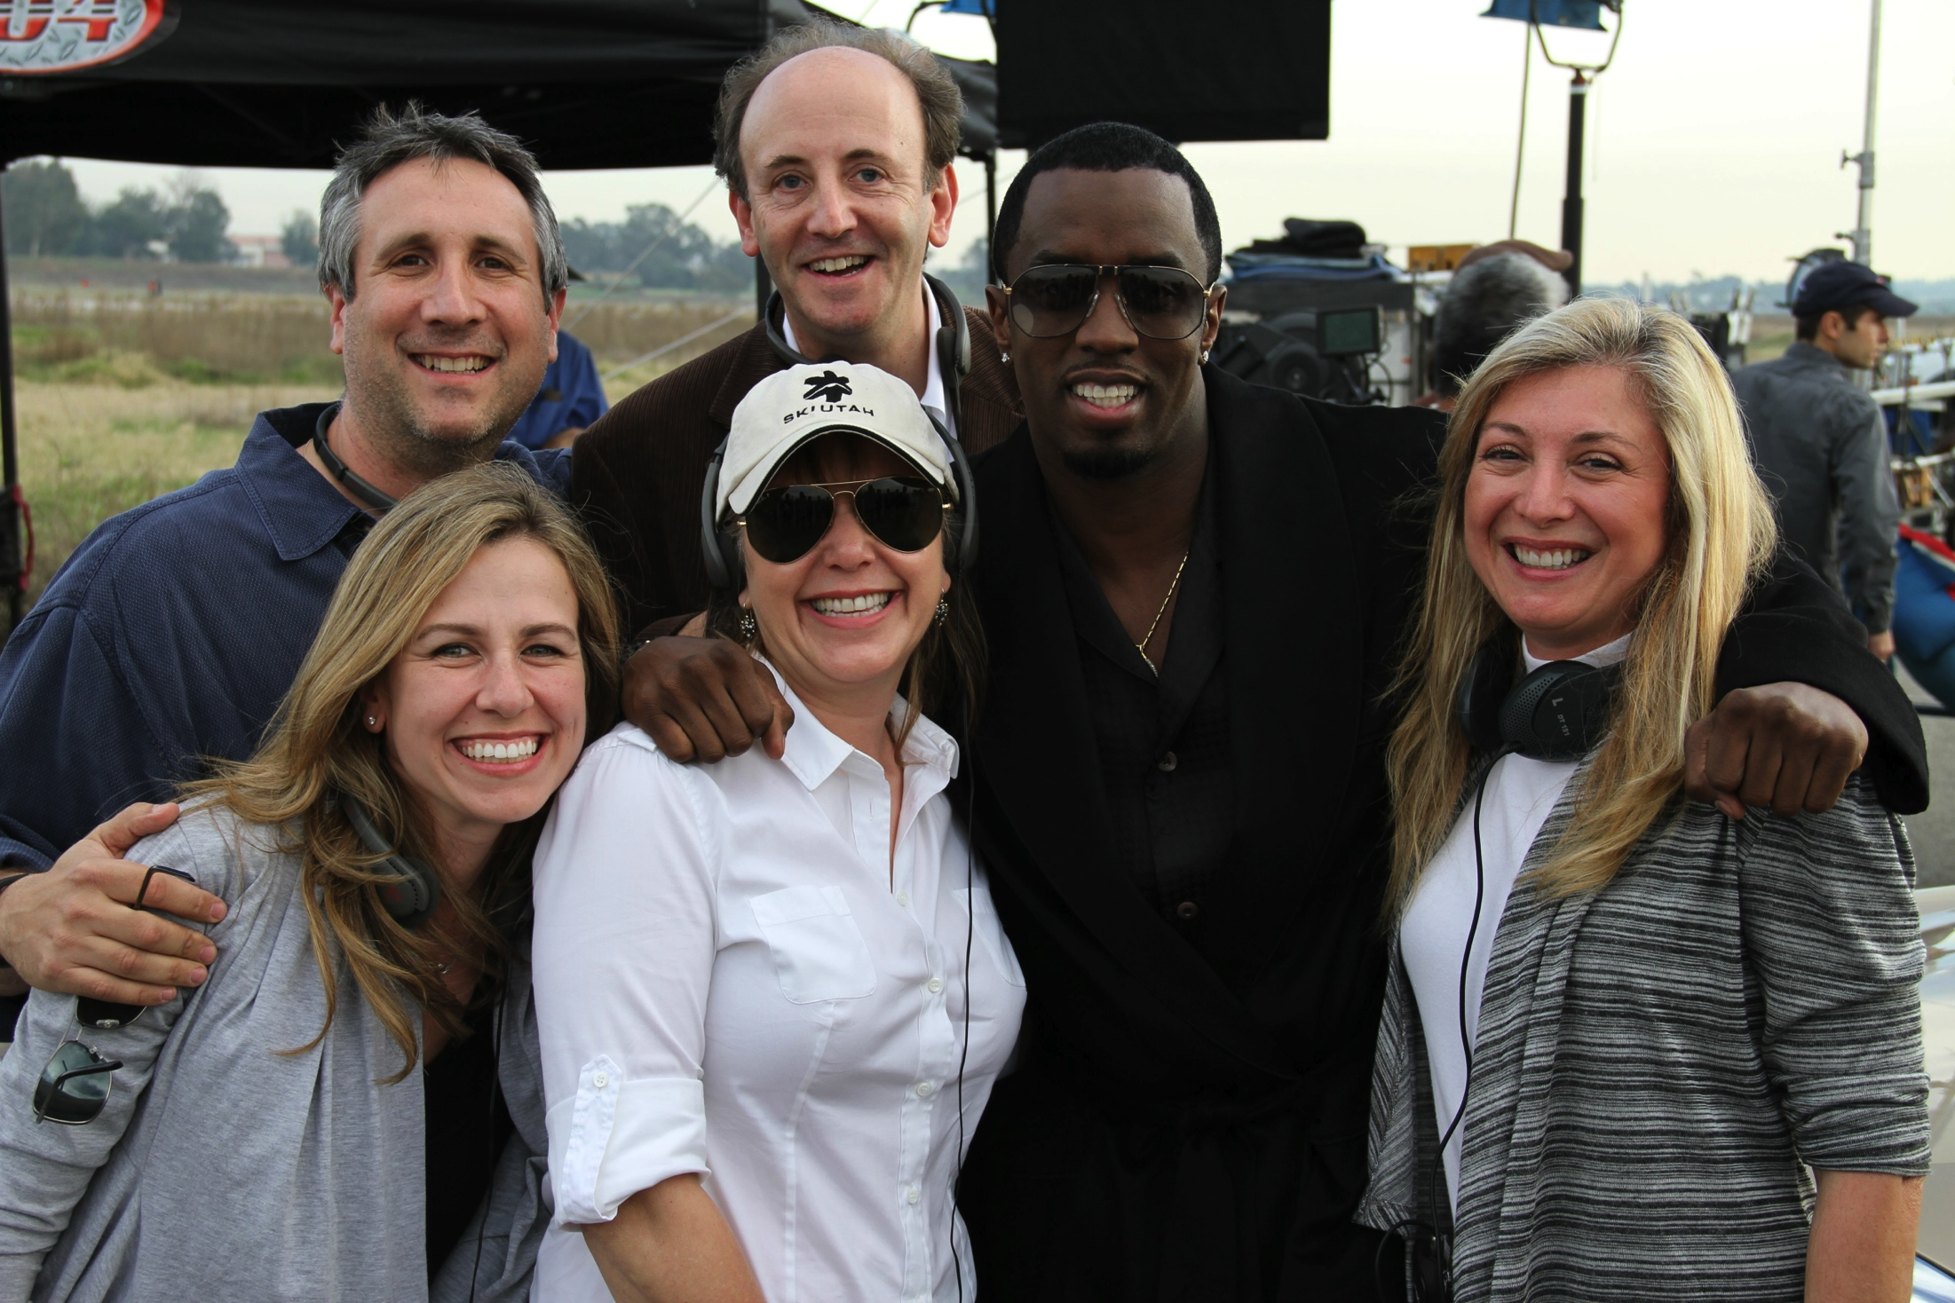
Company pic #2

Slide 20
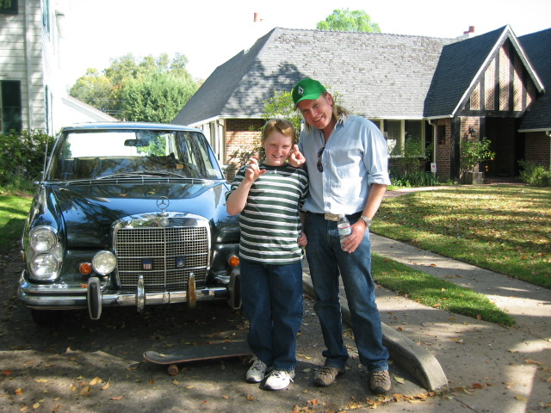
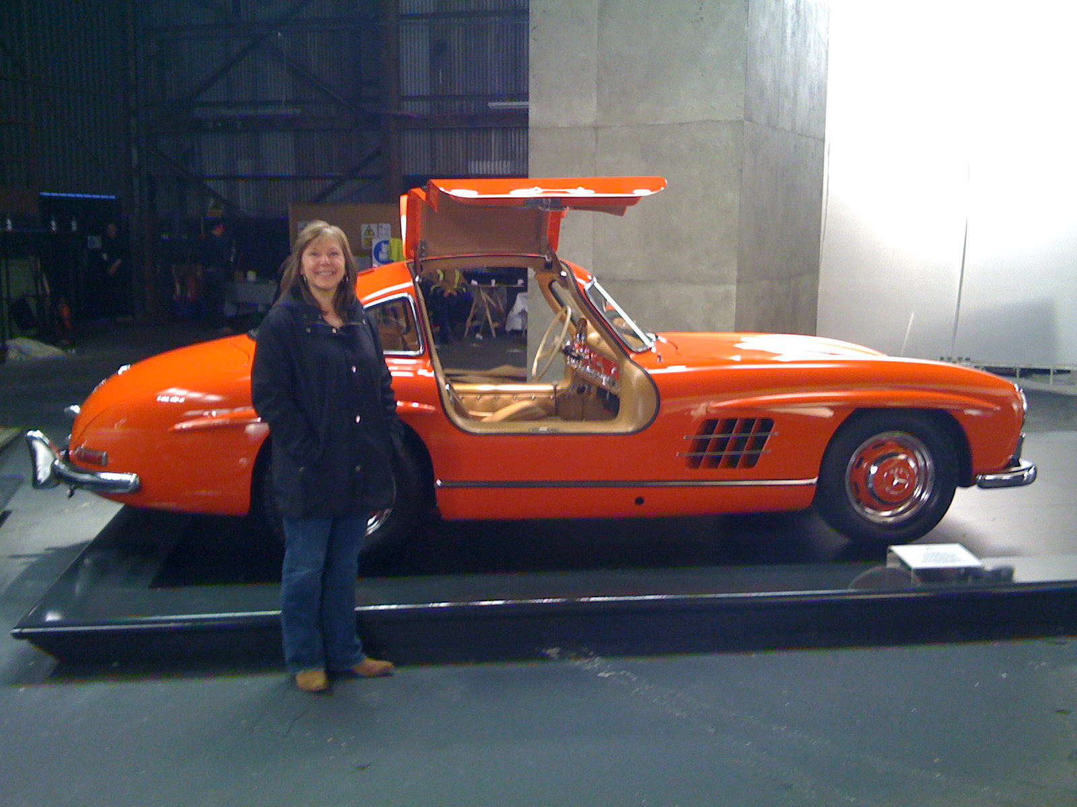
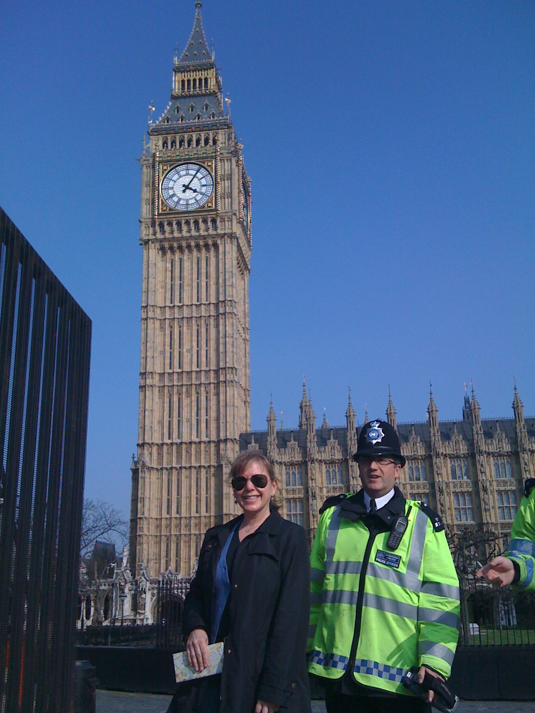
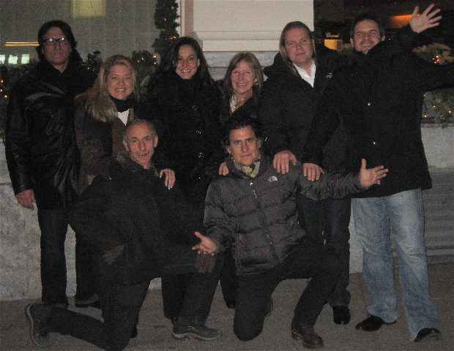
Company pic #2

Slide 21
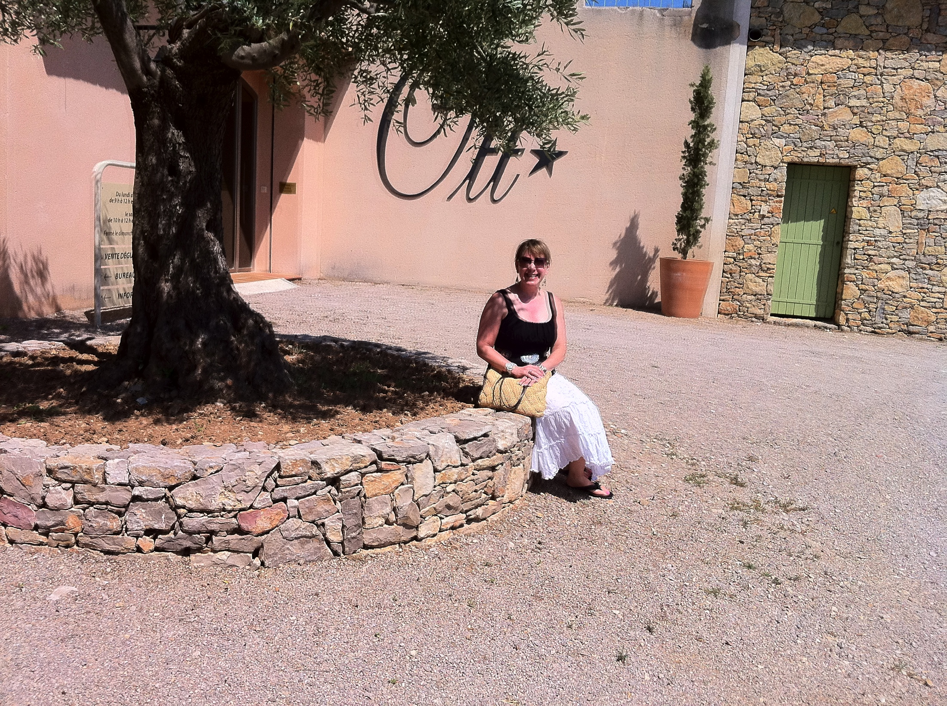
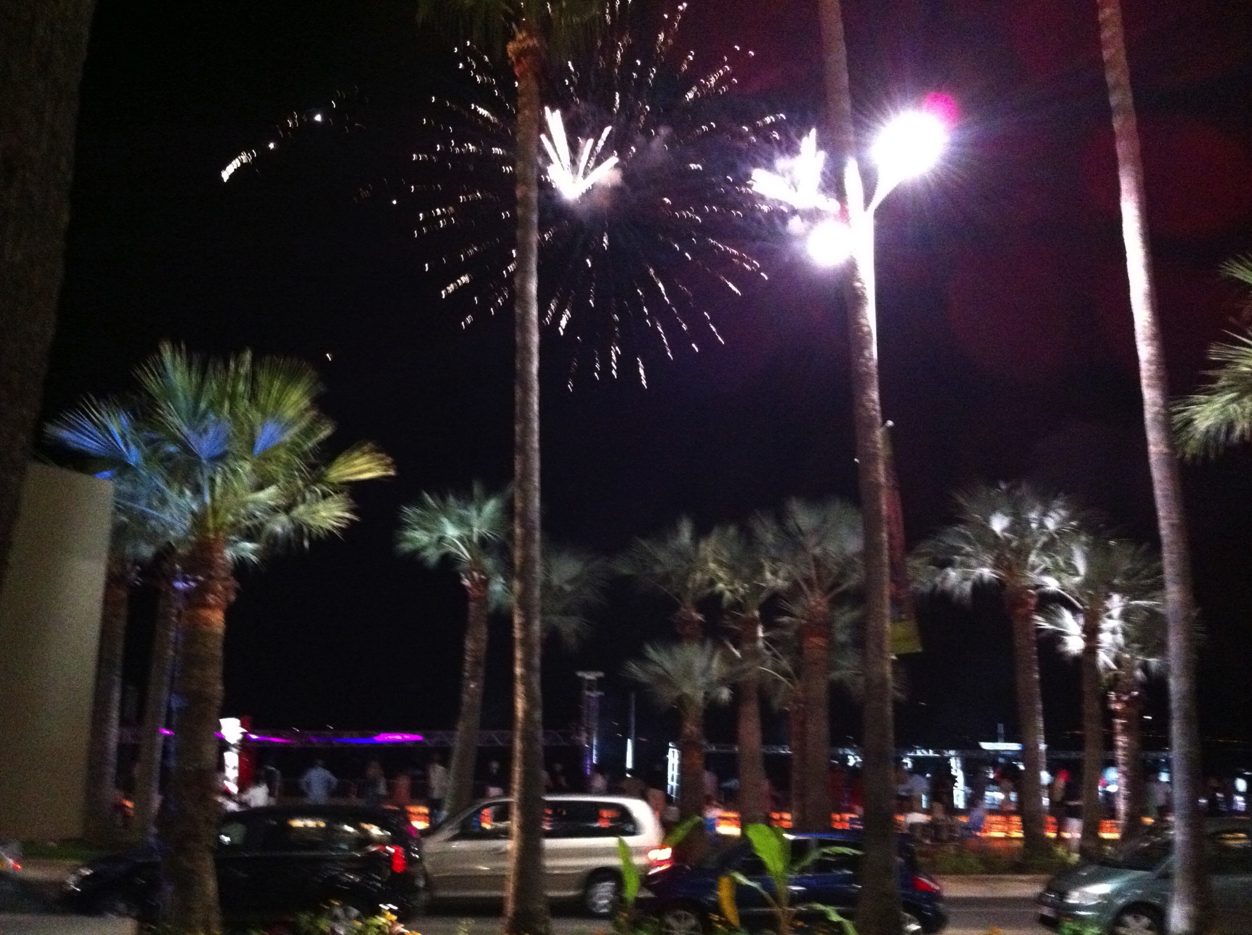
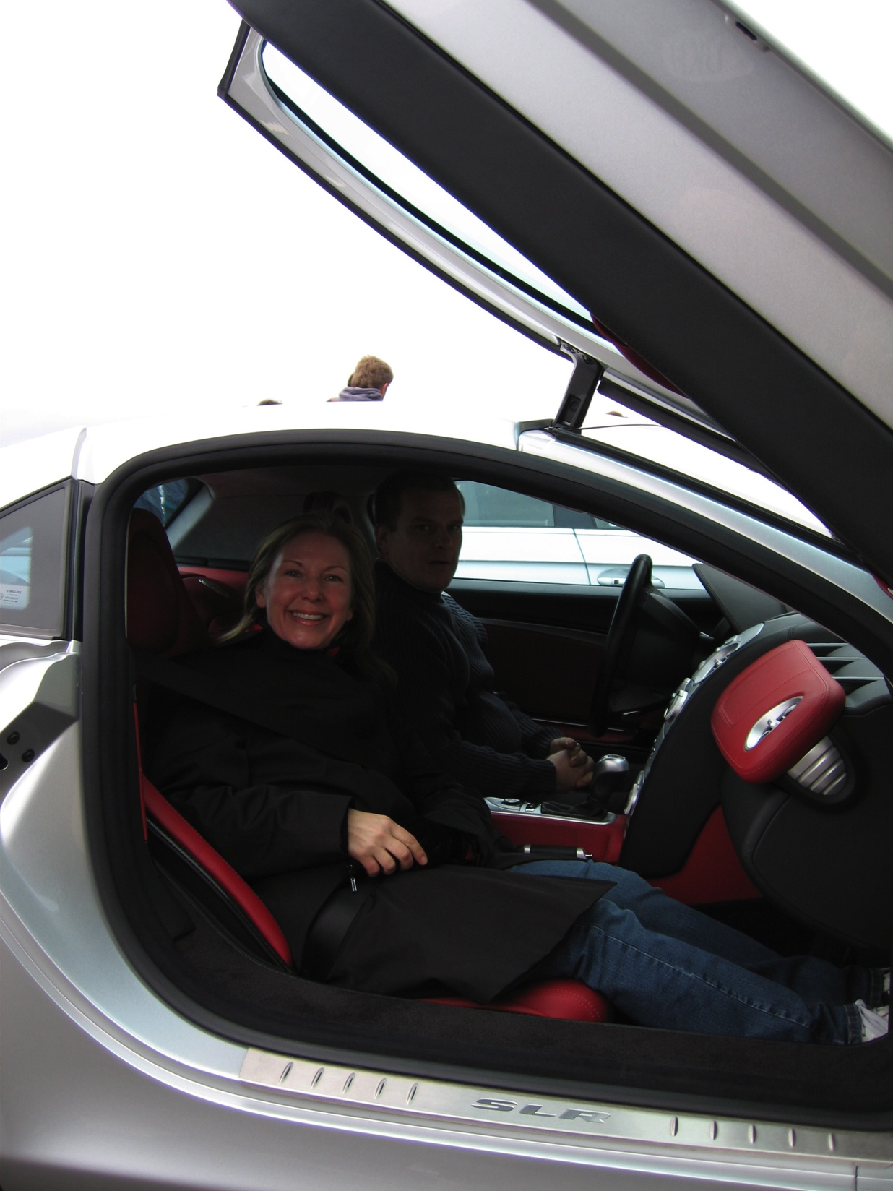
Company pic #2

Slide 22
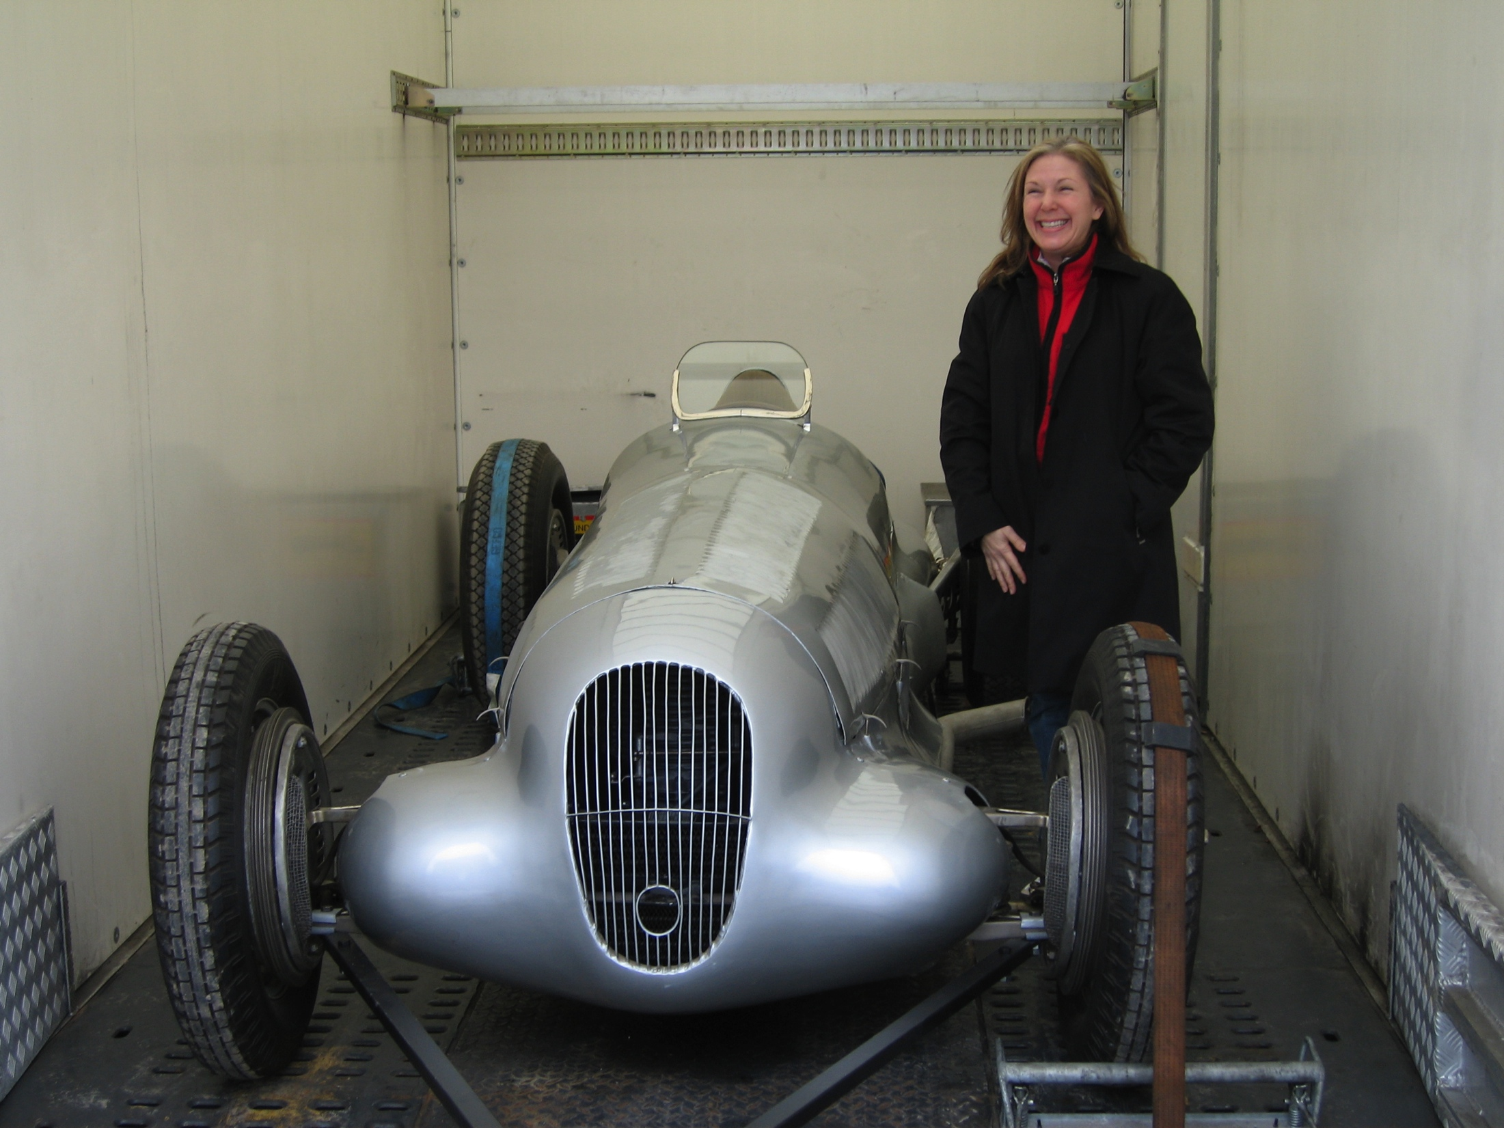
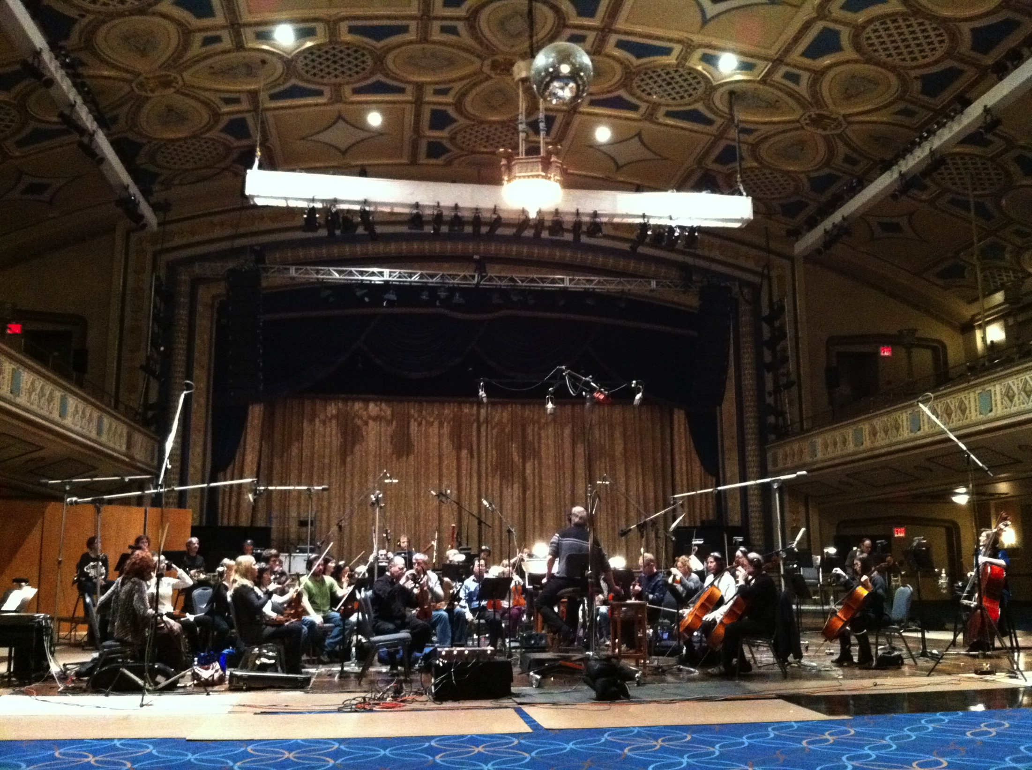
Company pic #2

Slide 23
Career
My first Job
My worst Job
In 1980, I worked in post-production as the coordinator for all of the editing of the commercials for Ronald Reagan’s presidential campaign. He was elected and became president, and the post production facility hired me as a staff coordinator. That is what we call a win win.
Never had a bad one, just bad projects. When life gives you lemons, make lemonade.

Slide 24
Career
Some challenges I had to overcome in my career
I was a woman in a man’s world. Not always a bad thing but challenging at times.
Because of my gender, at times I felt like I had to prove myself that much more to get people to take me more seriously.

Slide 25
Current Role this is the chronology of events
Receive idea approved by client for production
Consult with creatives, who created the idea, to discuss all facets of production.
Recommend, director, location/set, casting director, proposed schedule, editor, visual effects company, music company, etc. Coordinate all digital components with production of the assets.
Create budget and schedule, based on competitive bidding in all categories, to be approved by client
Once budget is approved follow through, with all listed above, until shipping of all assets is complete and deadlines are met.
Notes:
Use this graph to give more description of your role specifically (responsibilities, typical work week, direct reports, etc.)

Slide 26
Career Compensation
Head of Production / Exec. Producer 200-350k
Senior Producer 100-250k
Producer 60-100k
Associate/Assistant Producer 40-65k
Notes:
Use this graph to show general compensation ranges for people in various roles in your company

Slide 27
Examples of My Work
Mercedes
Mercedes Decay
Mercedes
Mercedes Reincarnation
http://youtu.be/uNmZVwOyeMw
Mercedes
Mercedes Aaaaoooga
http://youtu.be/ex6MqrcH2t8
Mercedes
Mercedes Welcome
http://youtu.be/Vie2fplRf5M
https://www.youtube.com/watch?v=7TMM0HA2lKI&list=UUIH943PRFjSqj1qvFLj5VYQ
Chevrolet
A New Journey
https://www.youtube.com/watch?v=xdGBLqROwlc&list=UUIH943PRFjSqj1qvFLj5VYQ
Notes:
Use this graph to give more description of your current company (history, size, location, products and services, etc.)

Slide 28
Academic Exercise
We will now spend several minutes discussing the day’s academic module and how it is relevant in the ‘real world’

Slide 29
Question and Answer

