Slide 1
Youth business Alliance
Guest speaker: Nitin Thakor

Slide 2
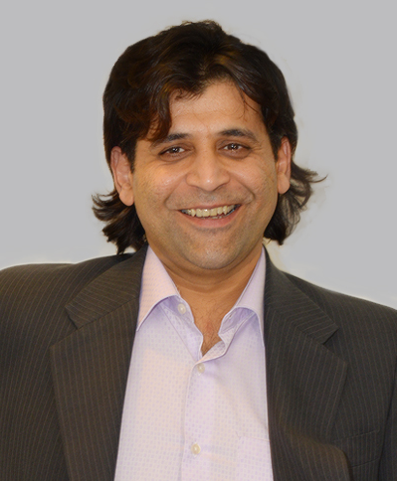
INTRODUCTION
My name is Nitin Thakor and I am 41 years old.
I am CEO of GeBBS Healthcare Solutions.
GeBBS provides Revenue Cycle Management solutions to hospitals and physician groups (doctors).
My wife Edith and I have four children: Gabriel (11), Giselle (9), Jay (4) and Nicholas (5 months).

Slide 3
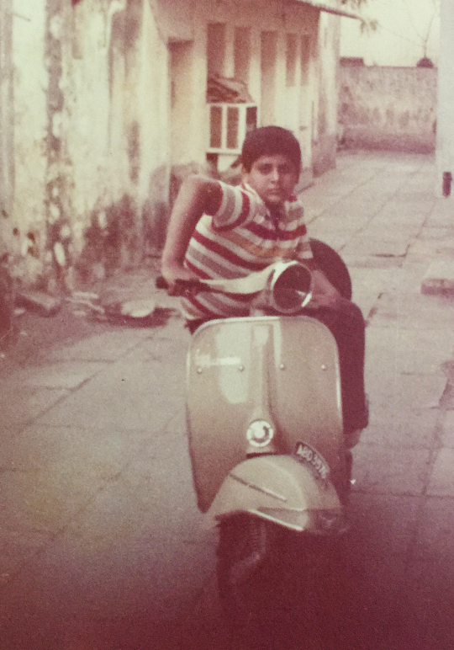
The Early Years
I was born in Hyderabad, India and raised in Mumbai, India.
Fun fact: Until the year 1995 Mumbai was called Bombay.
This is me at age 11.
Notes:
Dad was in the Army
Shy kid

Slide 4
HIGH SCHOOL
I attended Jamnabai Narsee School in Mumbai, India.
Notes:
6 schools

Slide 5
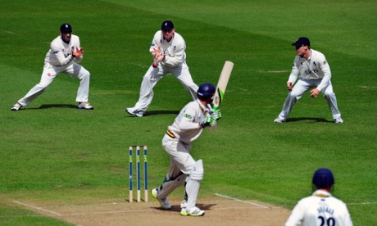
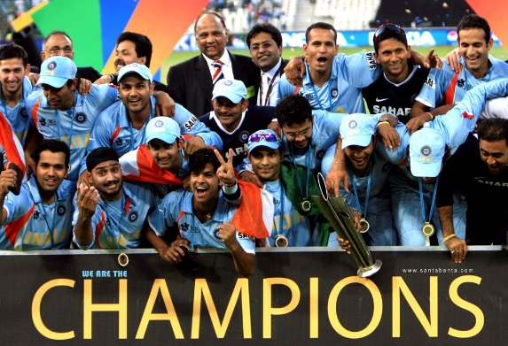
High School, cont.
I liked Cricket and HEAVY METAL!!!
I disliked school & studying
…. because I never felt challenged.
Notes:
Got into a lot of trouble
Band
Shy with the ladies
Amazed my parents let me go to the US

Slide 6
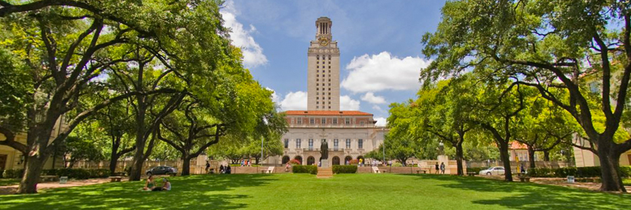
College
I attended the University of Texas at Austin in Austin, Texas.
Earned a B.A. in Economics and a B.B.A. in Finance and Economics
Notes:
Wasted time

Slide 7
Things I would have done differently…

Slide 8
Career
Turned down an analyst position with Goldman Sachs in NYC and returned to India for three years. From India I moved to New Jersey to start a software business.

Slide 9
Career, cont.
After 5 years in New Jersey I moved to the Big Apple … then to sunny California!
Empire State of Mind

Slide 10
Career Path
2000-2005 Started a software business and was CEO for 5 years.
2005-present Became CEO of GeBBS in 2005.
1997 Returned to India.

Slide 11
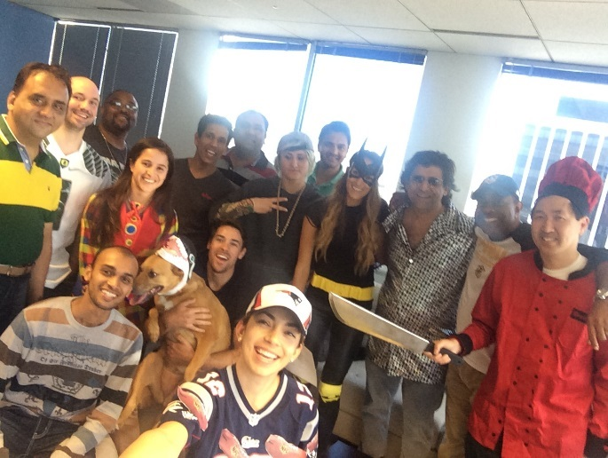
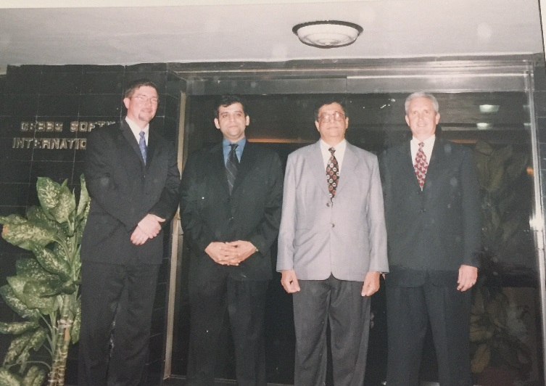
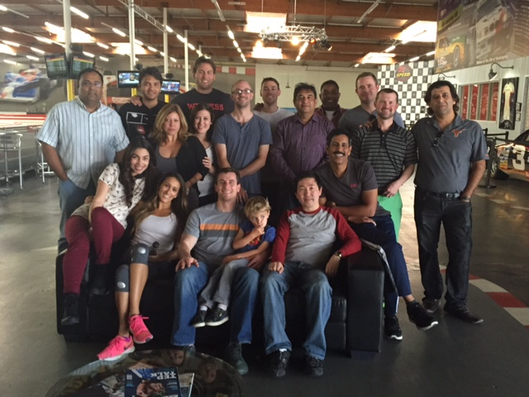
GeBBS Healthcare Solutions
Founded in 2005
Over 4,000 employees
Offices in the U.S., India and Philippines
HQ in Marina del Rey, CA
Halloween ‘15
Executive Team in 2005
K-1 Racing Team Event

Slide 12
My role within GeBBS
CEO (ME)
Marketing
Sales
Client Relations
HR & Operations
Business Development
Recruitment
Accounting & Admin
Notes:
Use this graph to give more description of your role specifically (responsibilities, typical work week, direct reports, etc.)

Slide 13
Compensation at GeBBS
C-Suite
($350K)
Management
($100K)
Middle Manager
($55K)
Entry Level
($35K)
Notes:
Use this graph to show general compensation ranges for people in various roles in your company

Slide 14
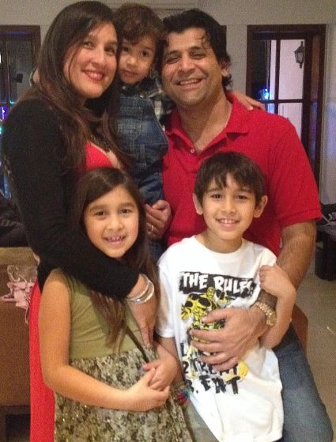
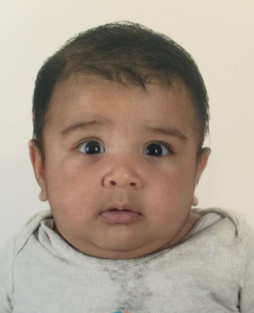
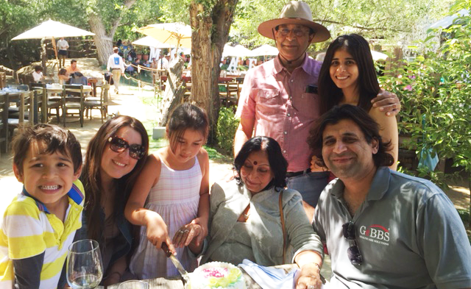
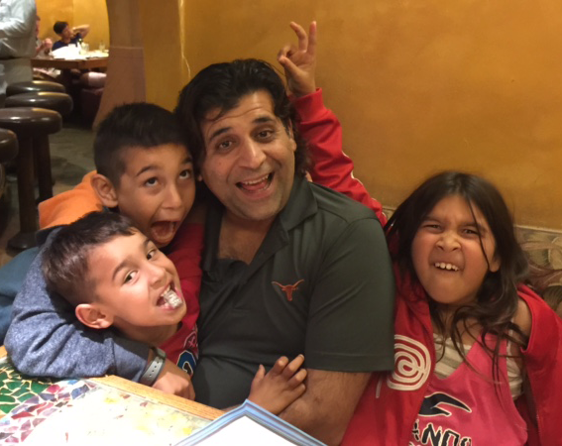
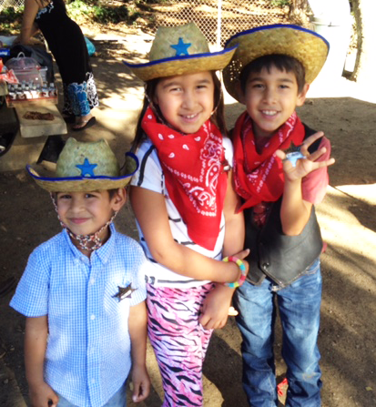
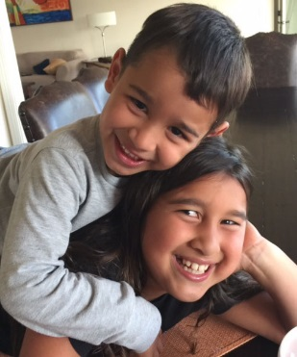
Beyond Work
FAMILY

Slide 15
Do it all over again?
Take the initiative to experience new things.
Make the most of my time in college.
Hire people that are smarter than me.

Slide 16
Academic Exercise
We will now spend several minutes discussing the day’s academic module and how it is relevant in the ‘real world’.

Slide 17
QUESTION & ANSWER

