Slide 1

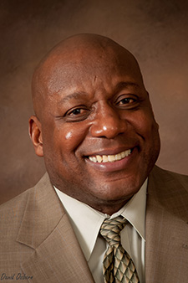
YOUTH BUSINESS ALLIANCE
(YBA)
ALLIANCE COLLINS FAMILY HIGH SCHOOL
Organizational Leadership for the
21st Century
(Preparing Today’s Youth for Tomorrow’s Challenges)

Slide 2
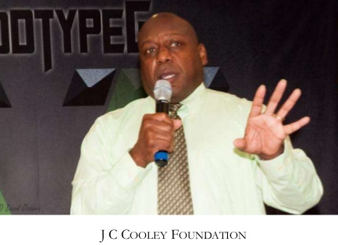
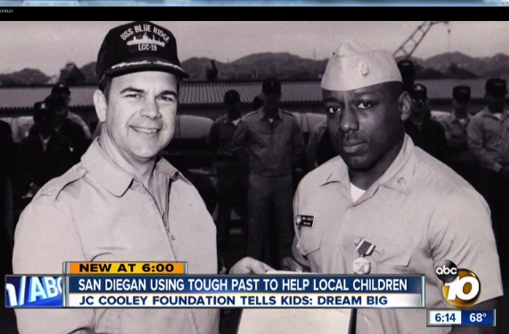
About JC
Cooley
    I am a Business Owner, Teacher, Writer, and Parent
    President/CEO of JC Cooley Innovation Solutions, LLC
    CEO/Founder JC Cooley Options & Opportunities / the Choice Program,
    Naval JROTC Senior Military Science Instructor Certified
    Retired Navy Officer, Community Activist, Speaker, Husband and Father
    Author - My Path 2014 and The Book of Knowledge: “Your Pathway to Enlightenment 2015
    Recipient of the ABC Channel 10 Salute to America Military Hero Award
      Awarded - May 2015 w/ special airing on ABC
      NEXT UP - VIDEO

Slide 3

VIDEO CLIP

Slide 4

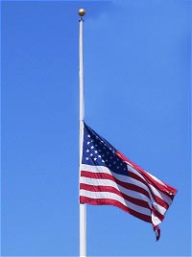
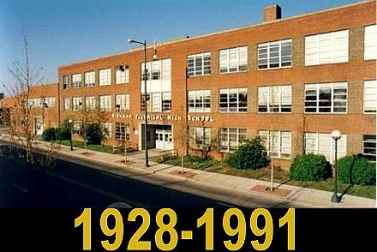
High School
Kirkman Vocational Tech HS – Chattanooga, Tennessee
  Focus on Electronic Engineering
  Computers
  Management

Slide 5
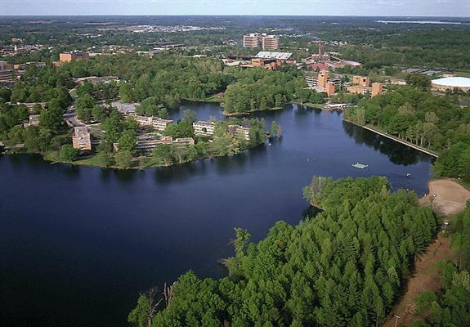
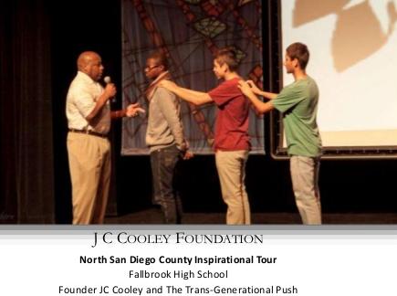
Colleges
Southern Illinois University
  Dual Bachelors in Education and Human Resource Management
Central Michigan University
    Dual Masters in Public Administration/Human Resource Management
  Villanova University
    Various Masters Certificates
University of Notre Dame
  Executive Masters Certificate MBA in Executive Leadership and Management

Slide 6
The JC Cooley
Innovations Solutions, LLC
  Disabled Veteran Minority owned business
  Provide consulting to D.O.D. in services in Information Assurance Type 1 Security Certification and Accreditation
  Consultant to US Navy, US Army, Air Force and other branches of D.O.D.
Security Matters

Slide 7

The JC Cooley Foundation
  Provide youth life skills and mentorship programs to young adults
  Promote a positive relationship between the youth and professional mentor
  Allow the youth to create his/her own successful learning environment
  Train youth to obtain life-long skills sets reinforcing personal responsibility
  Educate on life skills and goal setting.
  Belief in helping our youth focus on;
    A meaningful personal change
    Enhancement of their opportunities for success in society.
DREAM BIG-THINK BIG-BE BIG

Slide 8

AGENDA – The Road to success
Birth Rights (Confident, Courage, Hope Belief, and Faith)
Our Great Country [87% 10% and 3% = 100% (The World’s Views)]
Attitude (Visual, Understanding, Focus (VUF)
L.I.F.E (Love, Investment, Family, Empowerment)
The Four Cs (Create, Collaborate, Commit, CONFIDENCE)
A PLAN (for continued success to discover Your Destination to achieve your Destiny
Dream Big, Think Big, Be Big (JC Cooley Foundation Motto)
  Yesterday, Today, & Tomorrow
Current Behavior + Vision = Change
  Current Behavior + Intolerable Pain = Change
Options, Opportunity, The Choice (My Life Short Story)
Closing (A.I.P.)
QUESTIONS

Slide 9

Birth Rights
Confident
Courage
Hope
Belief
Faith

Slide 10

Our Great Country – World View
What is 87/10/3?
Today’s World’s Leadership (THE GREAT U.S.A)
87% + 10% + 3% = 100%
87 %
  What will this group do?
10%
  What will this group do?
3 %
  What will this group do?

Slide 11

Attitude
Vision, Understanding, Focus (VUF)
I Believe + Control CONVICTION = Perseverance (GOALS)
MY SUGGESTION ON HOW WE MEET OUR GOALS
  Must Change Our Focus and Our Youths Focus
NO - I, ME or MY
Instead – It should be the WE, US
and OURS = TEAM (and) WORK
How Do We Get THERE?
Main Topic to follow……

Slide 12

L.I.F.E.
Love
Investment
Family
Empowerment

Slide 13
The Four Cs
The 4 Cs are the building Blocks that prepare our youth for the challenges of tomorrow
Create
Collaborate
Commit
CONFIDENCE

Slide 14

Change must happen
Current Behavior + Vision = Change
Current Behavior + Intolerable Pain = Change

Slide 15


The Plan
Thought
Write
Commit
Focus

Slide 16

A.I.P.
Aspire
Inspire
Perspire

Slide 17

Where’s your focus?
Dream Big
Think Big
Be Big
Give 100% effort in all you do!!!

Slide 18

Questions?
Give 100% effort in all you do!!!

