Slide 1
YBA GUEST Presentation
Pervez P. Delawalla

Slide 2
INTRODUCTION
Pervez Delawalla and I’m 41
Founded Net Data Centers 13 years ago FMK as Net2EZ
Net Data Centers provides data center, cloud and managed services to business looking to outsource their data center or IT services.
I’m currently the President & CEO at Net Data Centers
In my current role I oversee many different aspects of my business including sales, operations and finance.

Slide 3
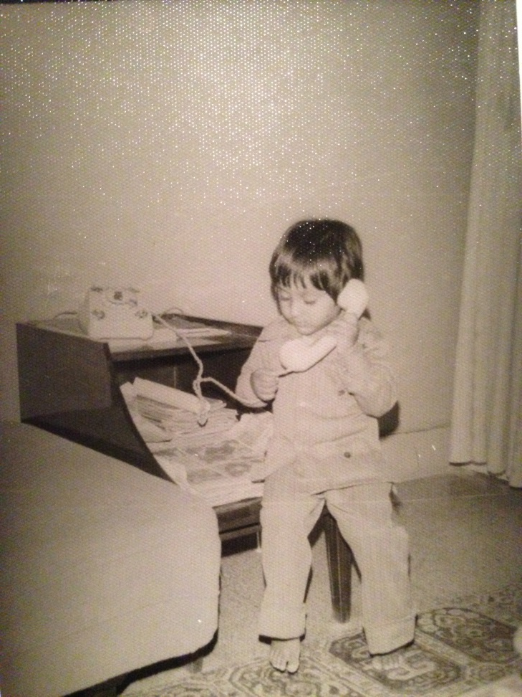
The Early Years…
I was born in Karachi, Pakistan and I moved to US when I was 13. My first two years in US was spent in North Carolina and then I moved to Los Angeles.

Slide 4
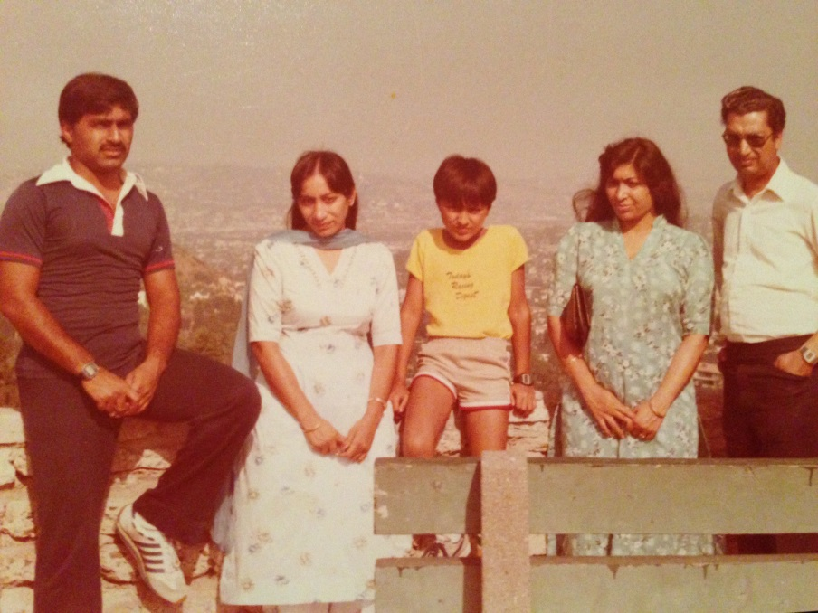
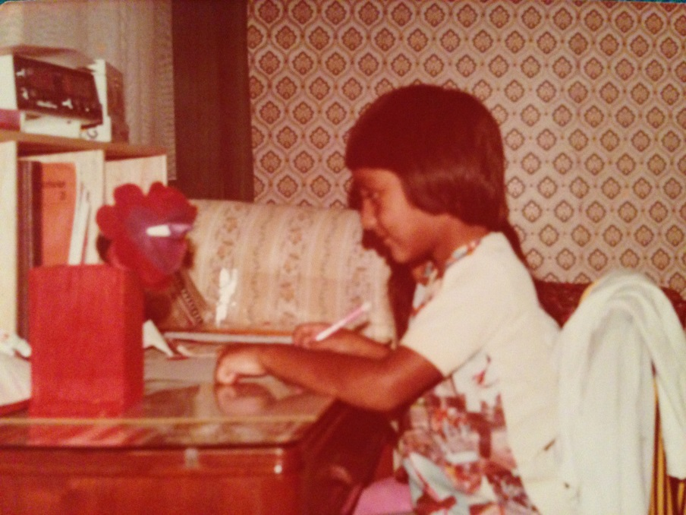
More Early Years…
A little about my family…

Slide 5
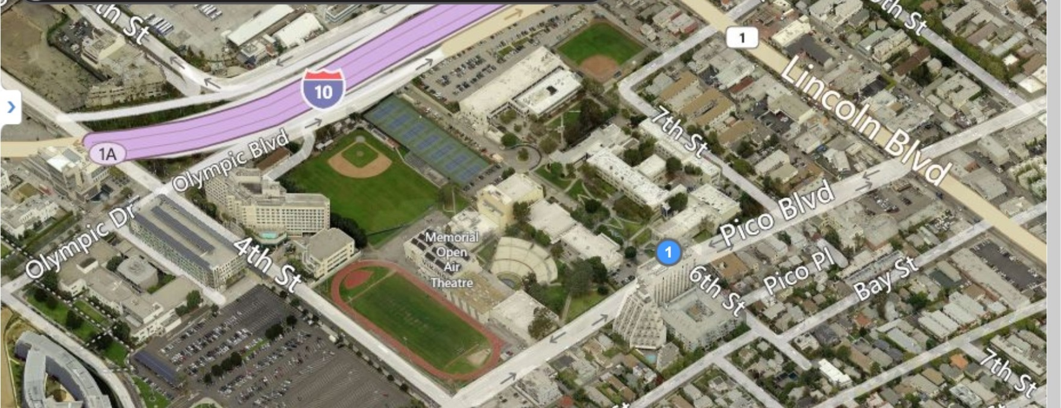
HIGH SCHOOL
I attended Santa Monica High in Santa Monica, CA
\

Slide 6
HIGH SCHOOL
At my high school I engrossed myself at Computer Lab
As a HS student I was semi-nerdy and semi-popular, took part in track & field and played basketball every chance I got
Until my sophomore year I was honor student.
\

Slide 7
HIGH SCHOOL
Things I enjoyed in HS
Things I did not enjoy in HS
Being in Computer Lab
Math
Science
Arts
English
History

Slide 8
College or Graduate School
I attended technical college called Mt. Sierra College in Pasadena, CA
Second year @ Mt. Sierra College I taught high school students Novell networking classes in exchange for full scholarship to classes I wanted to attend.
\

Slide 9
Career Path
I started as a intern for printing company
I started my consulting business when I was in High School
I am now the CEO of Net Data Centers which I founded 13 years ago
Consulted for many fortune 500 companies and worked for Data Center Companies
Notes:
You may use this chart to describe your journey to the current career

Slide 10
Career

Slide 11
Current Role
President & CEO
Ops
Finance
Board
Sales
Notes:
Use this graph to give more description of your role specifically (responsibilities, typical work week, direct reports, etc.)

Slide 12
Career Compensation
Over 100K
$80K
$50K
Started
$20k
Notes:
Use this graph to show general compensation ranges for people in various roles in your company

Slide 13
QUESTION AND ANSWER

