Slide 1

Ben Sheehan
Supervising Producer,
Talent & Artist Relations
BEN SHEEHAN
SUPERVISING PRODUCER, TALENT & ARTIST RELATIONS

Slide 2
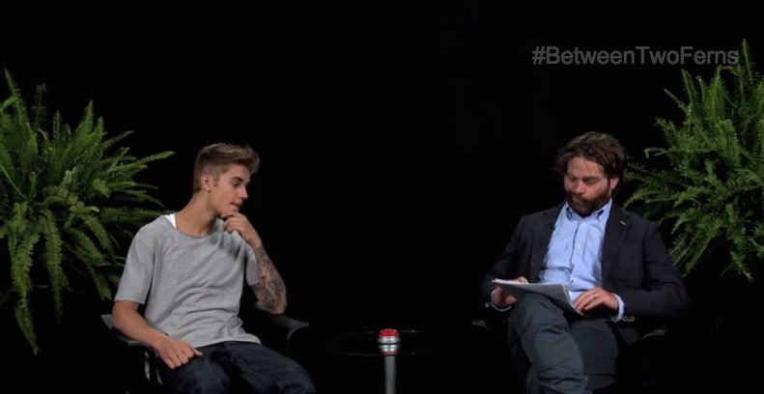
Hi.
I’m Ben
I’m 30 years old
I work for Funny Or Die
My company produces short-form digital content for the Internet (such as comedic videos and articles)
We also produce television shows and live events
My role at Funny Or Die is ‘Supervising Producer’
I handle projects related to either music or politics, and I also oversee talent outreach (actors, musicians, athletes, etc.)

Slide 3

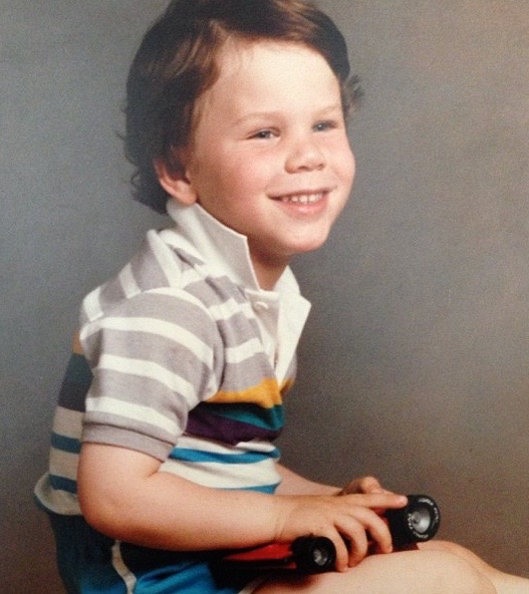
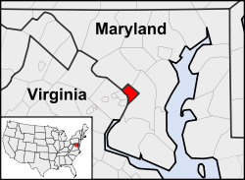
Where I’m from.
I was born in Washington, D.C. and raised in Bethesda, MD

Slide 4

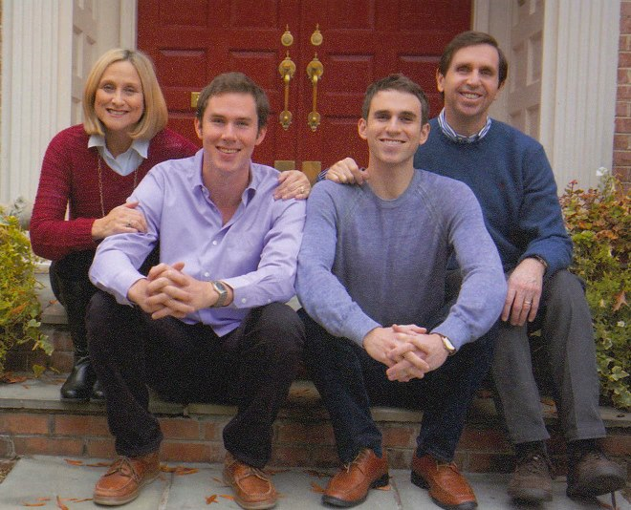
This is my family.
My mom worked in the United States Senate
My dad trains politicians and executives in public speaking
My brother works at the Dept. of Education in New York

Slide 5
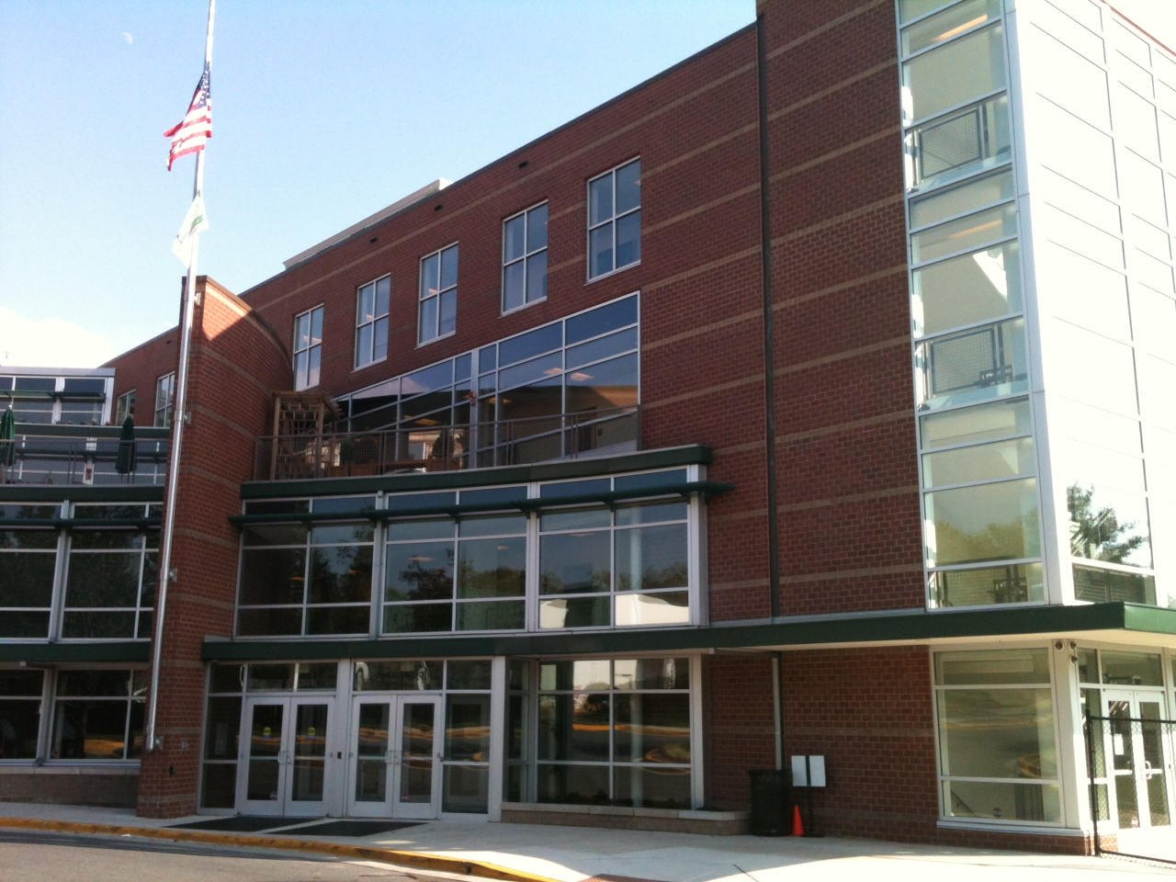

My high school.
Georgetown Day School in Washington, D.C.

Slide 6
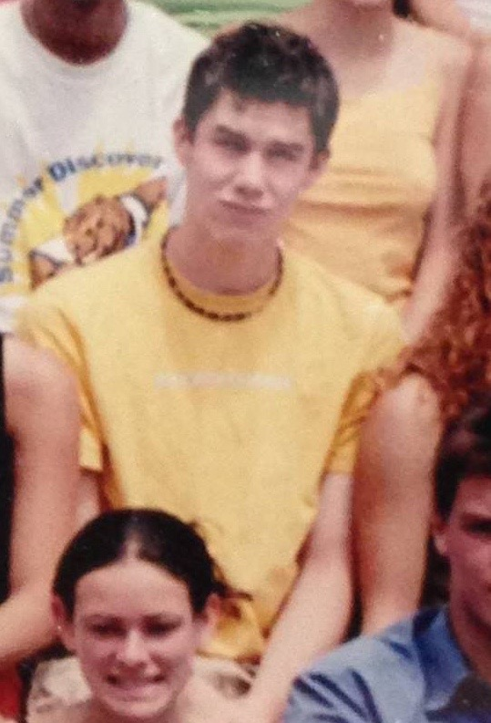
Me in high school.
(I got made fun of during most of it)

Slide 7
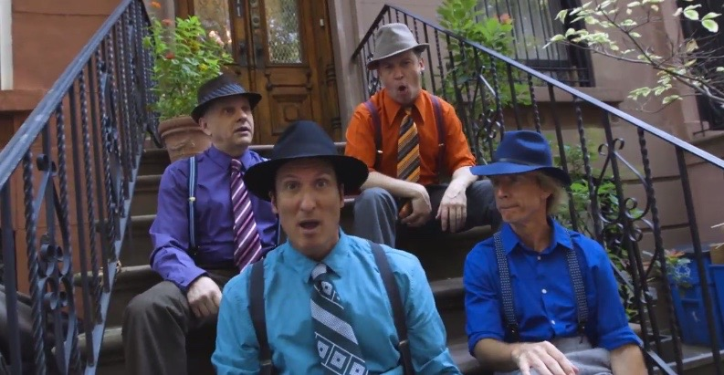
Activities in high school.
Played varsity baseball and basketball
Sang in the a cappella group
Played guitar and piano in bands

Slide 8
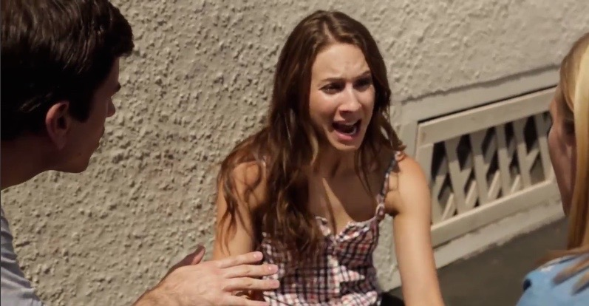
Challenges in high school.
Fitting in – was very shy until end of junior year
Acne which made me really introverted
Struggled with Science and Spanish

Slide 9
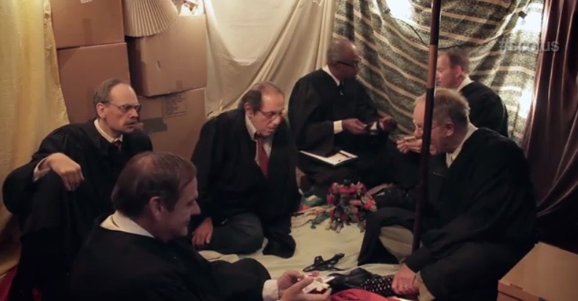
High school jobs.
Summer camp counselor
Intern at a political polling firm
Intern at the Democratic National Convention in Los Angeles

Slide 10
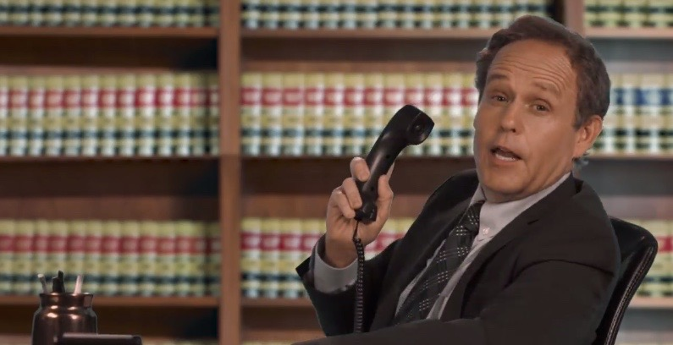
Things that helped me get into college.
Going out of my comfort zone and trying new things, regardless of whether or not people thought it was ‘cool’
  Math competitions, poetry, stage managing

Slide 11
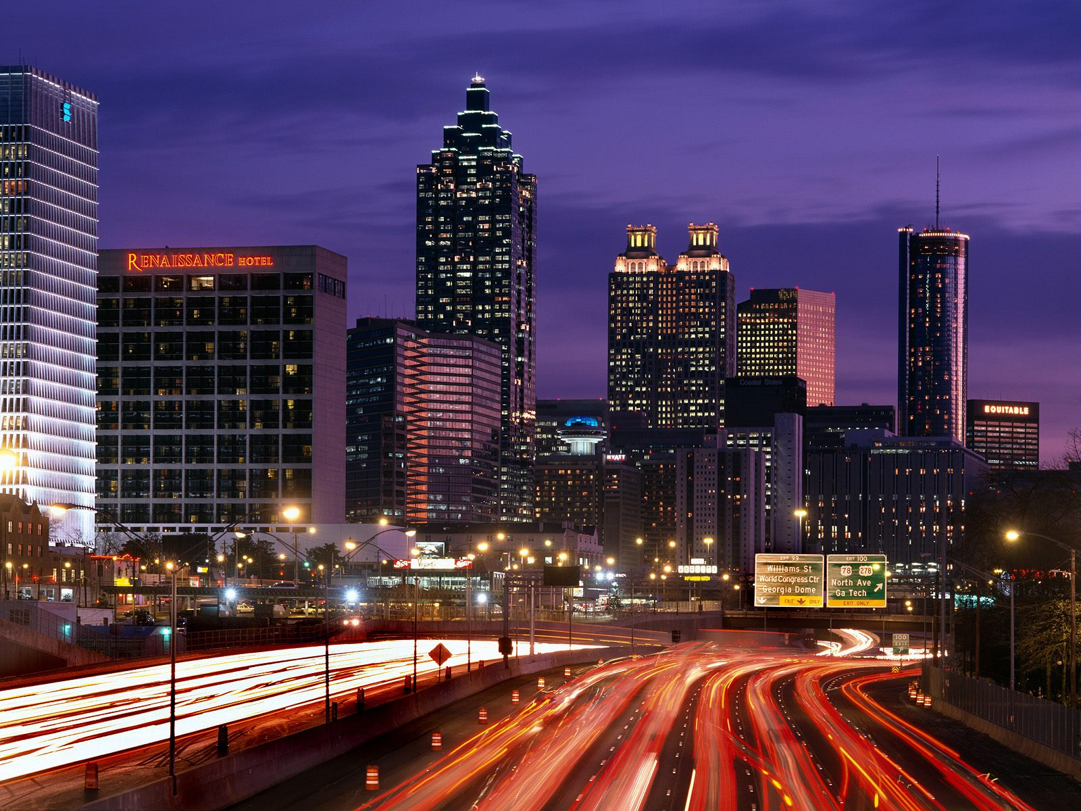
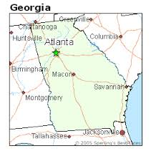

I went Emory University.
In Atlanta, Georgia

Slide 12
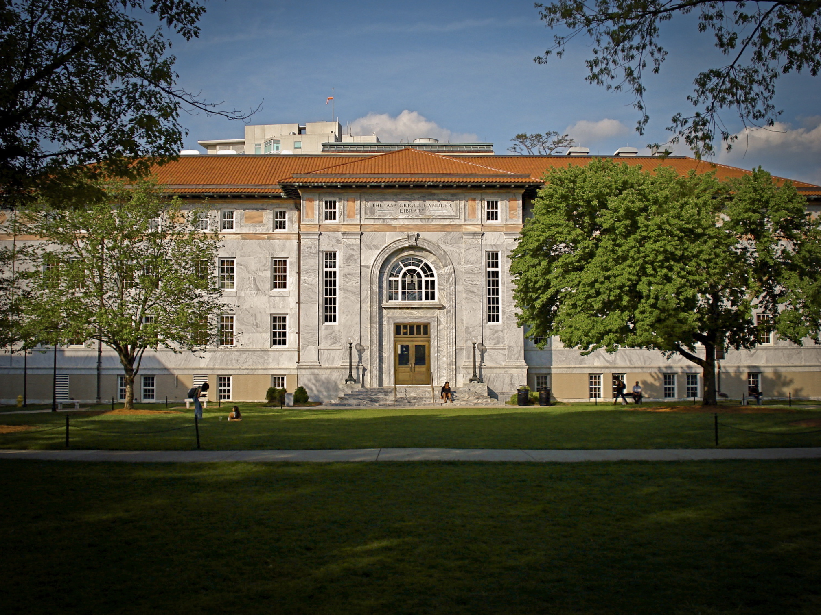
College likes/dislikes.
Likes
Dislikes
Club baseball
A cappella
Taking classes I wanted
Having independence
Going to parties
Not making varsity baseball
Pulling all-nighters
Loud neighbors
Not having school spirit

Slide 13
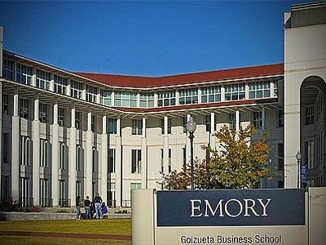
College classes.
Favorite
Least Favorite
Political philosophy
Music theory for majors
Racquetball
Financial accounting

Slide 14
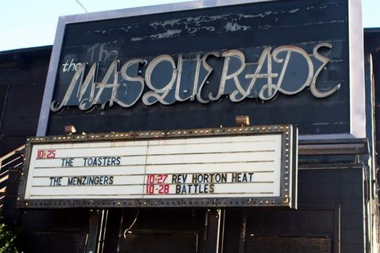
College jobs.
Performer at bars and on-campus social events
Summer internships
  RIAA
  AOL Music

Slide 15
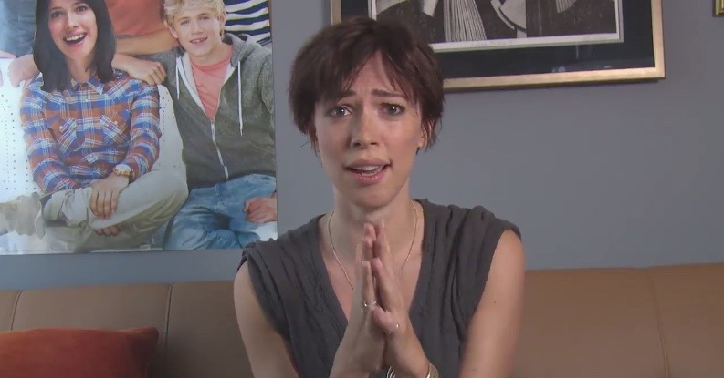
College challenges.
Balancing work with newfound independence
Getting up for early classes
Not procrastinating

Slide 16

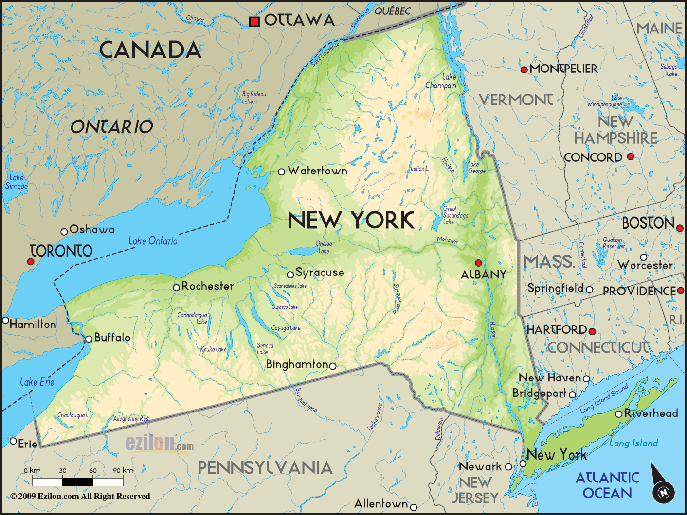

After college.
Worked hard during my internships
Had a job, lost it to financial crisis
Performed music for a year
Went back to grad school
  Studied music business at New York University

Slide 17
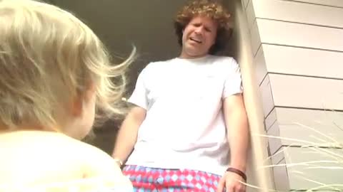
My current company.
Funny Or Die launched in 2007
Founded by Will Ferrell, Judd Apatow, CAA, etc.
We produce web videos, TV shows, live events
  Mix of editorial content and branded content
  100+ employees in Los Angeles, San Mateo, New York, D.C.

Slide 18
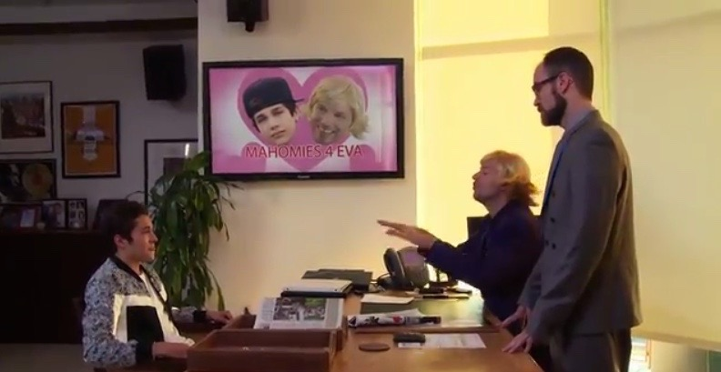

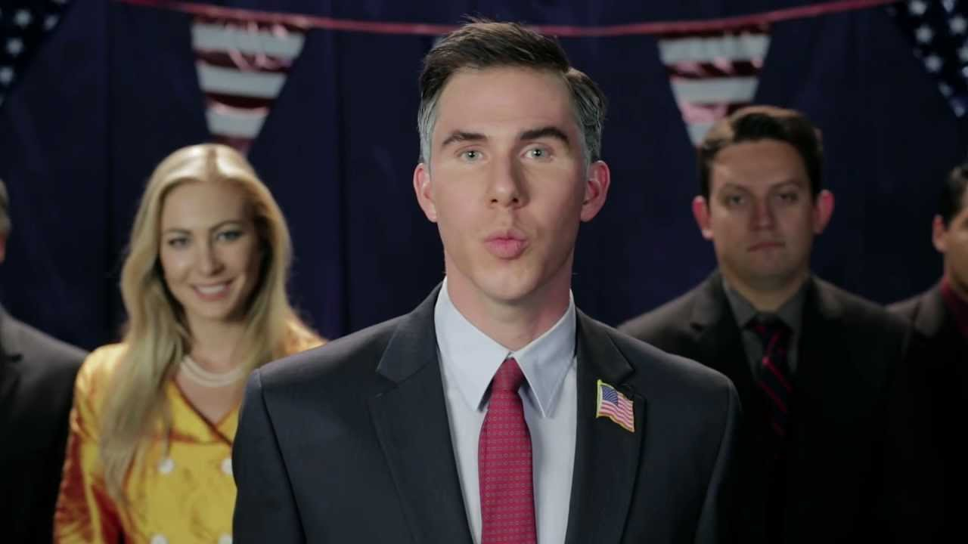

Career path.
Left and made videos on my own
Moved to L.A. to work at a music startup
Started at Funny Or Die almost 3 years ago
Notes:
You may use this chart to describe your journey to the current career

Slide 19
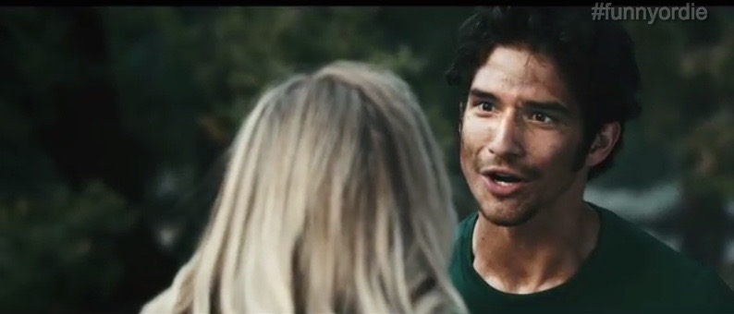
Career challenges.
Self-doubt
Learning to get along with difficult people
Knowing when to take risks and speak up
Making a career switch

Slide 20
Where I am now.
EXECUTIVE PRODUCER
SUPERVISING PRODUCER
PRODUCER
PRODUCER
PRODUCER
Notes:
Use this graph to give more description of your role specifically (responsibilities, typical work week, direct reports, etc.)

Slide 21
Compensation.
CEO
($400K)
President
($250K)
Senior Level
($70K)
Entry Level
($30K)
Notes:
Use this graph to show general compensation ranges for people in various roles in your company

Slide 22
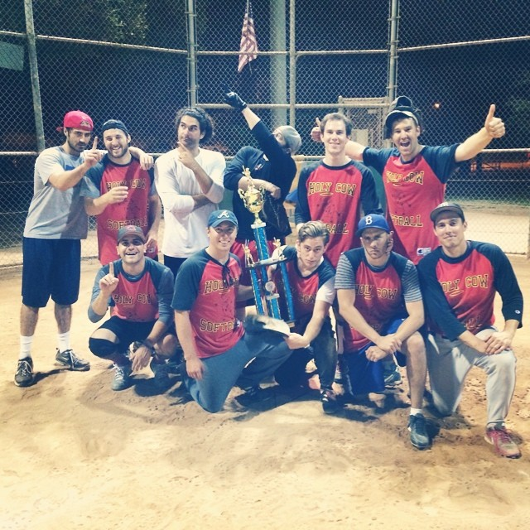
Beyond work.
Practice guitar, piano, sing, write songs
Go out with friends, to dinners and concerts
Play softball on 4 teams
  Work, city league, pickup game, Temple team

Slide 23
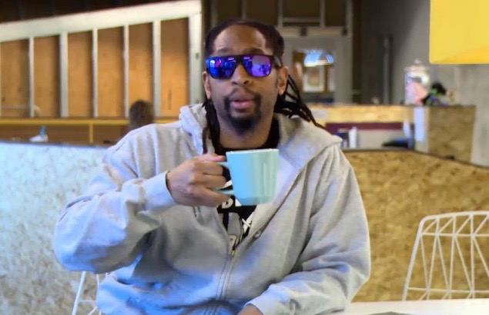
Things to remember.
Bullies are people who are unhappy with themselves
You’ll work the hardest at the things you love
There’s a practical application for your interests
Things that make you unique = Things that make you cool
Keep a journal; it’ll be fun to read later in life
Be nice to people
  It’s the right thing to do
  You never know where people will end up

Slide 24
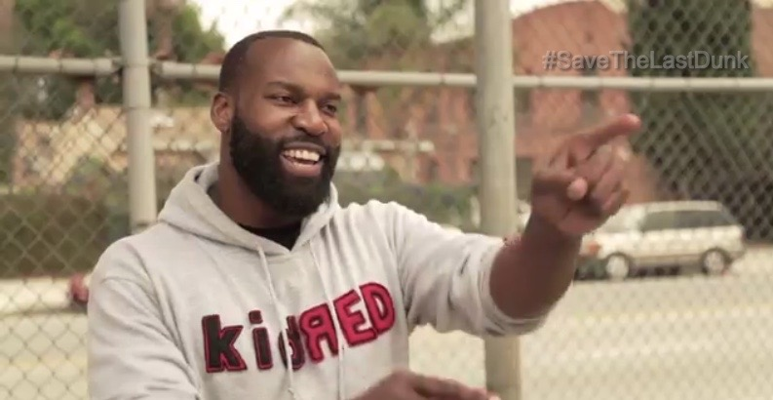
Questions?

