Slide 1
MY NAME IS CONSTANCE ENDELICATO
I AM A LAWYER. I AM A PARTNER IN THE LAW OFFICES OF WOOD, SMITH, HENNING & BERMAN, LLC
I DEFEND DOCTORS, HOSPITALS, AND OTHER HEALTH CARE PROVIDERS WHO HAVE BEEN SUED IN MEDICAL MALPRACTICE ACTIONS.

Slide 2
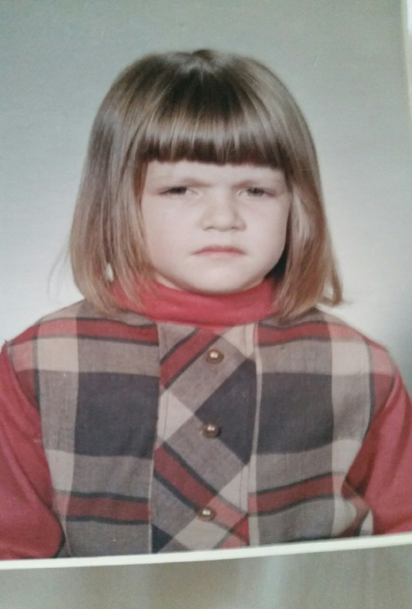
THIS WAS MY SCHOOL PHOTO WHEN I WAS IN KINDERGARTEN
THIS IS A STORY OF HOW I OVERCAME SHYNESS, FEAR, AND INSECURITY TO BECOME A TRIAL LAWYER (AND ALLOW MY PHOTO TO BE TAKEN !)

Slide 3
MY CHILDHOOD
I GREW UP IN NEBRASKA IN A SMALL TOWN OF 6,000
I WAS THE YOUNGEST OF FIVE CHILDREN
ME BROTHER BROTHER BROTHER SISTER
0 5 12 13 14

Slide 4
THIS IS WHAT NEBRASKA LOOKS LIKE

Slide 5
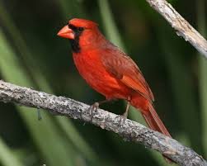
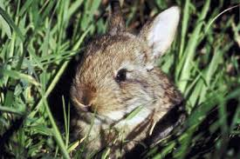
THIS IS IN MY BACKYARD

Slide 6
NEBRASKA HAS CORN

Slide 7
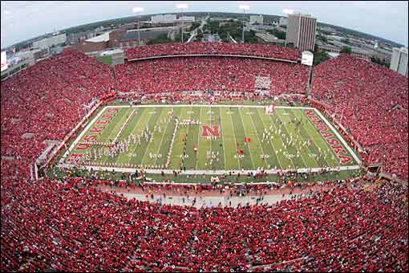
NEBRASKA HAS FOOTBALL

Slide 8
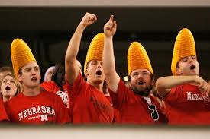
SOMETIMES THE TWO COLLIDE

Slide 9
NEBRASKA HAS COWS

Slide 10
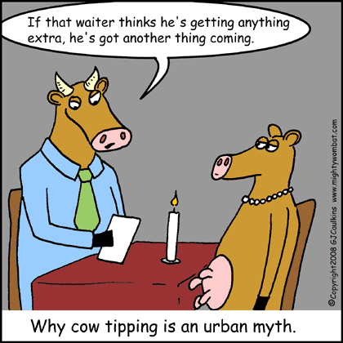
COW TIPPING: FACT OR FICTION?

Slide 11
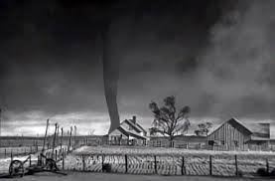
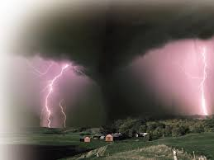
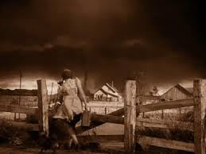
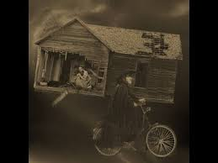
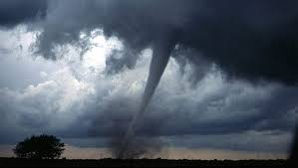
NEBRASKA HAS THUNDERSTORMS AND TORNADOS

Slide 12
BACK TO MY CHILDHOOD
WHY I AM SCOWLING IN THE KINDERGARTEN PHOTO

Slide 13
LIFE LESSON NUMBER ONE
WORK HARD
TAKE PRIDE
BE SELF-SUFFICIENT
I WANTED TO DO IT ON MY OWN

Slide 14
MY FIRST JOB: DETASSELING CORN

Slide 15
LIFE LESSON NUMBER TWO
FACE YOUR FEARS
I WANTED TO STOP BEING AFRAID

Slide 16
HOW I TOOK A LEAP OF FAITH (LITERALLY)

Slide 17
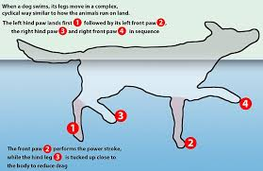
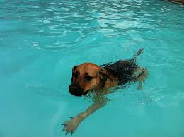
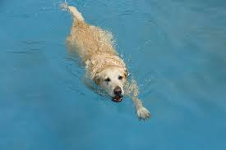
THE DOG PADDLE

Slide 18
THIS IS WHAT I LOOKED LIKE

Slide 19
MORE PADDLING
CAT PADDLE
MONKEY PADDLE

Slide 20
LIFE LESSON NUMBER THREE
BELIEVE IN YOURSELF
BE CONFIDENT
DO WHAT IS RIGHT FOR YOU
I WANTED TO BE WORTHY

Slide 21
HOW I GAVE UP ONE CAREER CHOICE FOR ANOTHER

Slide 22
LIFE LESSON NUMBER FOUR
BE A GOOD PERSON
DO UNTO OTHERS
I WANTED TO BE BETTER

Slide 23
HOW A BAD SITUATION CAN LEAD TO A POSITIVE CHANGE

Slide 24
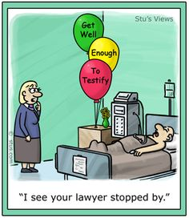
MY CAREER AS A LITIGATOR
MEETINGS
DEPOSITIONS
COURT
WRITING EVALUATION REPORTS
DRAFTING AND ARGUING MOTIONS
WRITING LETTERS
RESEARCH AND INVESTIGATION
MEDIATION
MARKETING

Slide 25
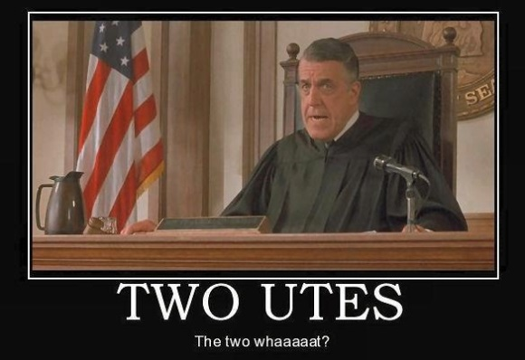
A CAREER IN LAW
LAWYER 4 YRS UNDERGRAD/3 YRS LAW + BAR
PARALEGAL 2 YRS UNDERGRAD +CERTIFICATION
LEGAL SECRETARY H.S. GRAD +VOCATIONAL TRAINING
RESEARCH CLERK H.S. GRAD + COMPUTER TRAINING
LITIGATION ASSISTANT H.S. GRAD + OTJ TRAINING
FILE CLERK H.S. GRAD + OTJ TRAINING
COURT REPORTER H.S. GRAD + CERTIFICATION
JUDGE 4 YRS UNDERGRAD/3 YRS LAW + BAR+
PRACTICE LAW + APPOINTMENT/ELECTION

Slide 26
KEYS TO OBTAINING THE CAREER OF YOUR CHOICE
GPA
SCORES ON ENTRANCE EXAMS
PREPARE FOR INTERVIEWS
RESEARCH
RESUME
BE PROACTIVE
SET GOALS
WORK HARD/TAKE PRIDE
FACE YOUR FEARS
BELIEVE IN YOURSELF
BE A GOOD PERSON

