Slide 1
INTRODUCTION
My name is Miriam Diwan and I am 33 years old.
I am Co-Founder of my company, NowMoveMe
NowMoveMe helps people who are moving find the right neighborhood for them, based on personality fit
My role at NowMoveMe is…CEO!!
Since we are a startup, every day is different. One day I will be coding (programming), another day I will be looking through cool photo options for our Instagram

Slide 2
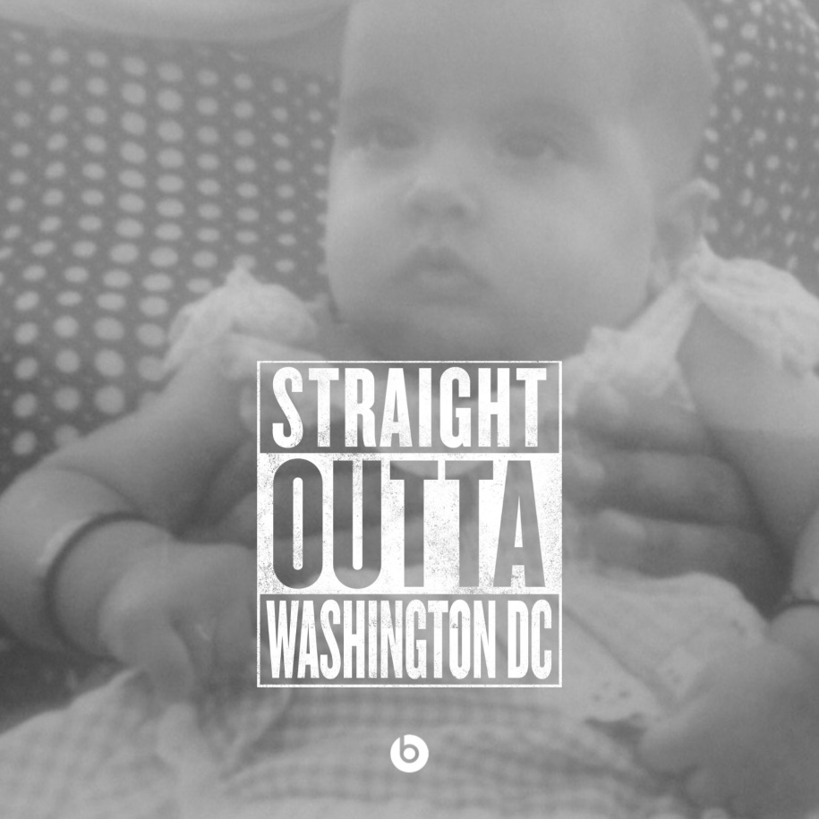
My childhood
I was born in Washington, D.C. and raised in a suburb in Maryland

Slide 3
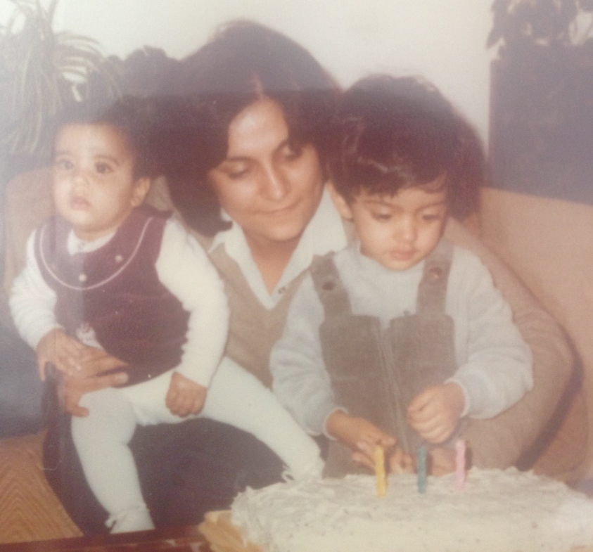
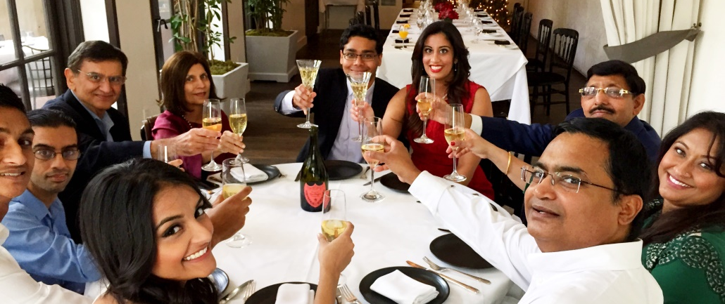
My family
My childhood was very wonderful, I was extremely fortunate to have loving parents, an older brother, and many opportunities. I am lucky to now have 2 loving families!

Slide 4
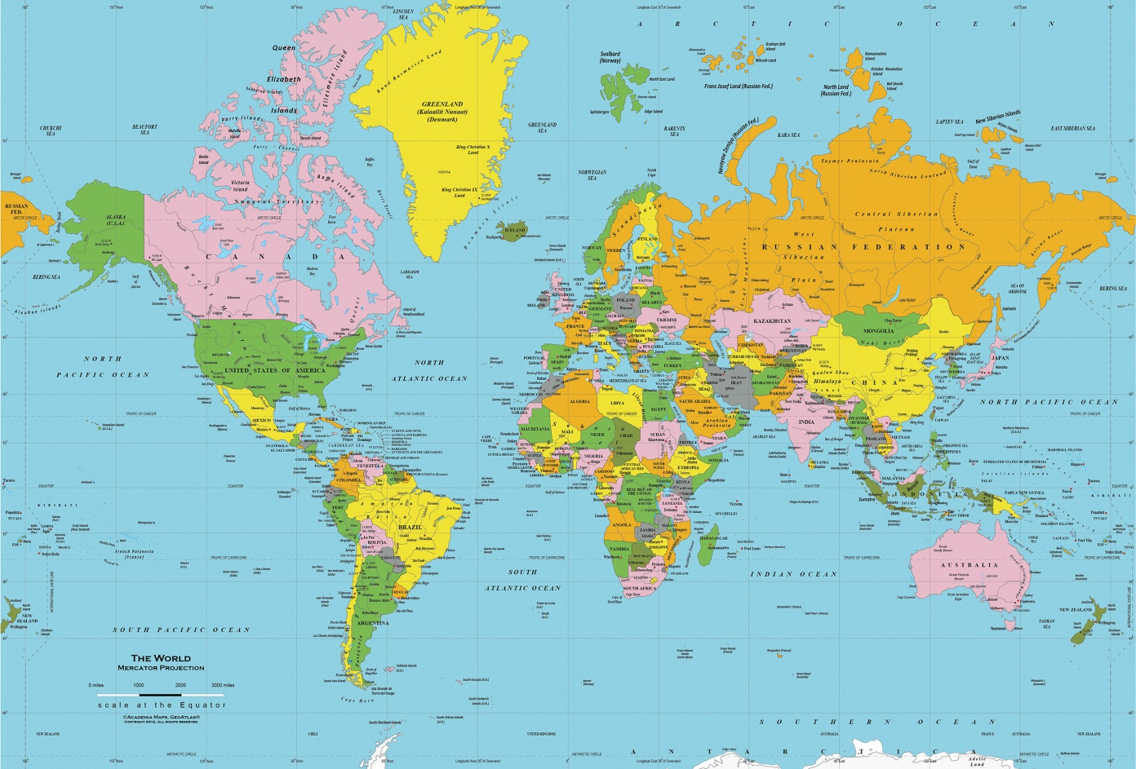
My family
I have moved a lot! Both while growing up & after college.

Slide 5
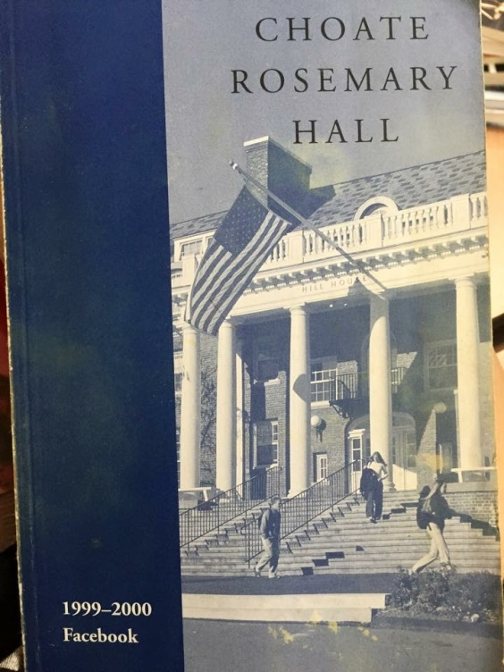
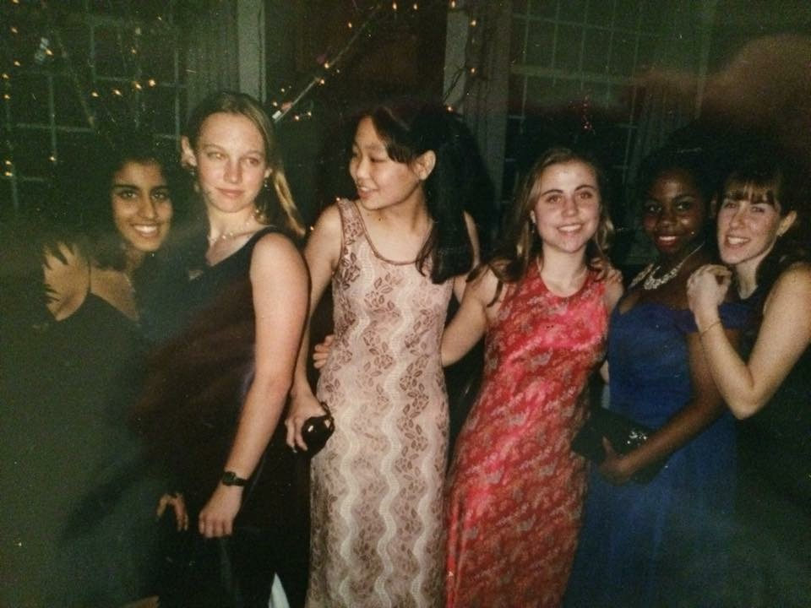
MY HIGH SCHOOL
I attended Choate Rosemary Hall in Wallingford, Connecticut. It was a boarding school (my parents lived in Singapore at the time!)

Slide 6
High School
As a HS student I was pretty academic, but also was on the varsity crew team and very involved in photography (was the head photographer for the newspaper and the yearbook!)
[INSERT CREW PHOTO]

Slide 7
High School
Things that I really liked in High School were:
My English & Art classes
Doing tons of different extracurriculars
Living with my friends in the dorms! So fun!

Slide 8
High School
Things that felt difficult or challenging for me while I was in High School were:
Not enough time in the day for everything!
I took all AP classes junior & senior year = very little sleep
Being away from home was difficult, although we usually got to go home every month (for me, my parents would be back in DC during my vacations so I could see them!)

Slide 9
High School
Jobs I worked while I was in High School were:
During the summers, I took more classes. Some fun (art at the Rhode Island School of Design!)
I didn’t work any jobs until college, when I did 2-3 internships a summer

Slide 10
Getting in to College
The top few things I did to ensure I got into college were:
Getting into college was a lot of work!
I made sure to take advanced classes and ace them
Extracurriculars and sports were also extremely important – I had crew, the yearbook, and the newspaper
I think my college essays set me apart (in a good way), as I wrote about my experience living in Pakistan, which was quite a unique and eye opening experience
SATs (& lots of practice tests!) were also very important

Slide 11
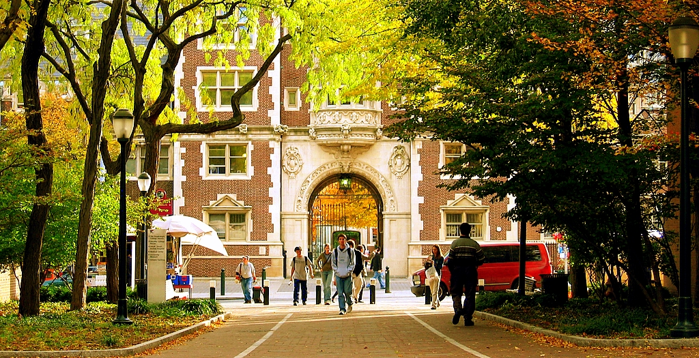
College
I attended college at the University of Pennsylvania in Philadelphia, PA

Slide 12
College
Things I enjoyed in College
Things I didn’t enjoy in College
So many new opportunities!
I got two degrees (business & communications)
New friends, from all over the world
I did crew my freshman year, but then decided college sports were not for me

Slide 13
College
Favorite classes
Least favorite classes
Communications
Finance
Marketing
Economics
Accounting
Anthropology

Slide 14
College
Jobs I worked while I was in College were:
I worked every summer in college, with internships
After my freshman year, I interned at a PR firm, Edelman Public Relations
Sophomore year, I did back-to-back internships. I interned again at Edelman, but also did internships at a finance company that helped fund environmental projects. It was a great way to figure out what I wanted to do after college.
Junior year, I pursued finance and interned at Morgan Stanley in New York City

Slide 15
College
Things that felt difficult or challenging for me while I was in College were:
Like high school, I piled on a lot of social activities and difficult classes, so I just didn’t get much sleep!
College was much, much bigger than my high school, and it was tough at the beginning to make friends, even though I am pretty outgoing!

Slide 16
Getting a job after College
The top few things I did to ensure I got a good job after college were:
Grades were the most important
I think my many internships / summer jobs also really helped, because I knew exactly what I was interested in, and why. Hands-on experience is really the best
I studied a lot for interviews, and talked to a lot of people at the places I was interviewing at (or in the same careers) – current employees, past employees. Any insight is good.

Slide 17
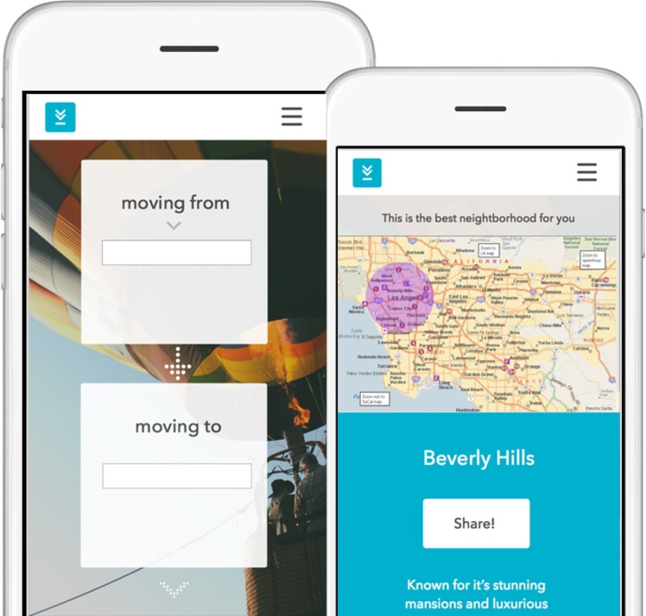
This is My Company
My company started from my experience moving so many times. When I moved to LA, my friend & I came up with the idea, so we co-founded our own company!

Slide 18
My Career Path
I moved from Investment Banking to a Hedge Fund, where I became a portfolio manager by 27
I started off in Investment Banking, which I did for 2 years
I had to take a 3-4 year break from my career, since my mom was sick. She is now better! And I am back to work, as CEO of my own company
Notes:
You may use this chart to describe your journey to the current career

Slide 19
My Career
The first job I had after college was:
Investment Banking Analyst at JPMorgan. I worked as part of a team to help very large companies (like General Motors) raise money
It was a lot of putting together presentations and excel spreadsheets, but very exciting because you got to sit in meetings with CEOs and learn about their businesses
The worst job I have ever had was:
I never had a worst job, but investment banking was pretty difficult. My typical day was 9am – 2am, and usually had 1 all-nighter a week! Twice I worked for 48 hours straight (not recommended)

Slide 20
My Career
Challenges I have had to overcome throughout my career are:
Being a woman in a male-dominated field was difficult, but you just have to keep working hard & stay confident
Balancing the work hours with family & personal life – family is very important!
Starting your own business is not easy, but it is exciting to build something from scratch

Slide 21
My role within organization
Co-Founders
(CEO & CMO)
TECH
MARKETING
PhDs
Web Developer
Social Media
Notes:
Use this graph to give more description of your role specifically (responsibilities, typical work week, direct reports, etc.)

Slide 22
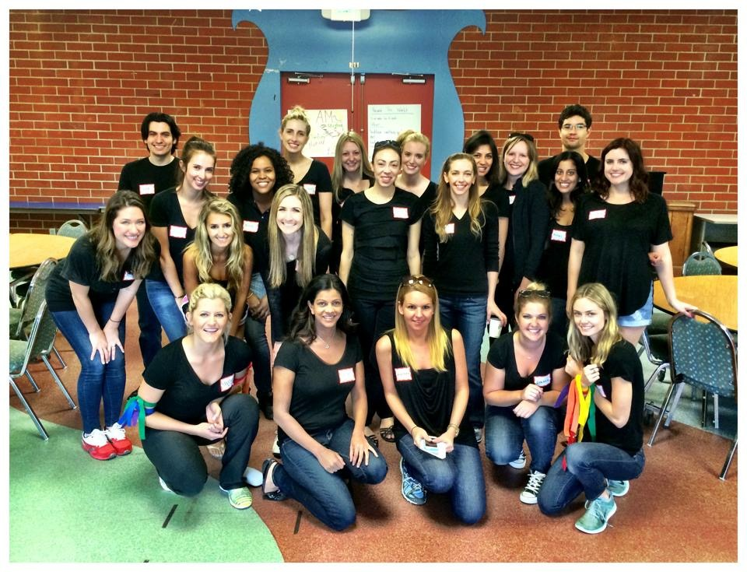
More than just work
When I am not at work I like to:
Spend time with my family, cook, volunteer (Junior League, Getty Museum, LACMA)

Slide 23
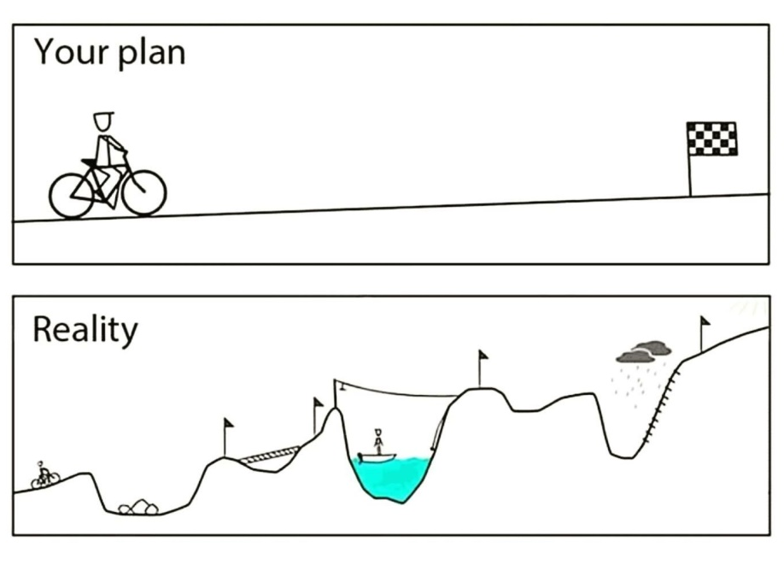
Do it all over again?
If I could talk to my high school self, what would I say?
I always saw the future as one straight path where I had to connect all the dots, and if I didn’t, I would be in trouble
In reality, life is much more like this! With hard work and a good attitude, it works out in the end, but it is not always a straight line up

Slide 24
Question & Answer
We would love your feedback on our site! http://54.148.143.106/

