Slide 1
INTRODUCTION
My name is T.K. Pillan and I am 45 years old
I work for Veggie Grill
Veggie Grill is a restaurant chain serving amazing vegetarian burgers, salads, wings, etc.
My role at Veggie Grill is Co-Chairman and Co-President
When we started 7 years ago I was involved with every facet of Veggie Grill, but now I focus on marketing and strategic growth planning
Before Veggie Grill, I co-founded a technology company

Slide 2
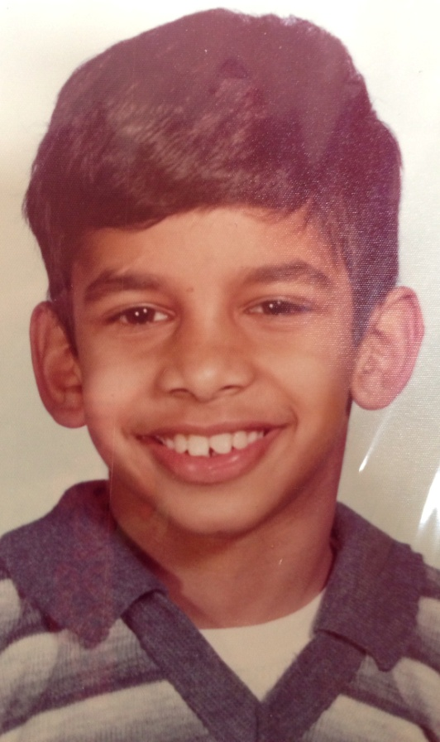
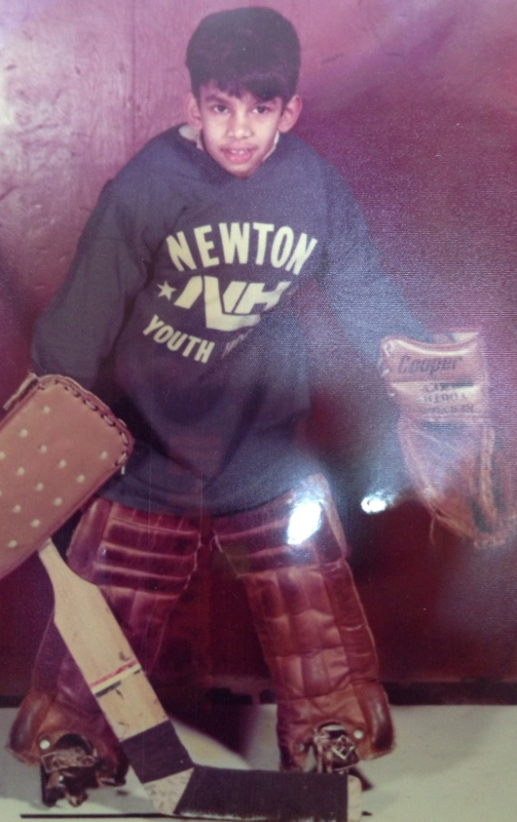
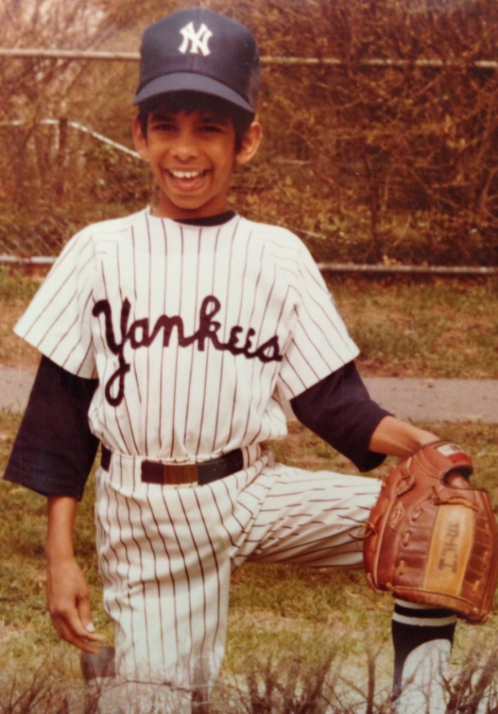
The Early Years…
I was born in New Jersey and grew up in Boston, MA
3rd Grade Class Photo 3rd Grade Hockey 5th Grade Little League

Slide 3
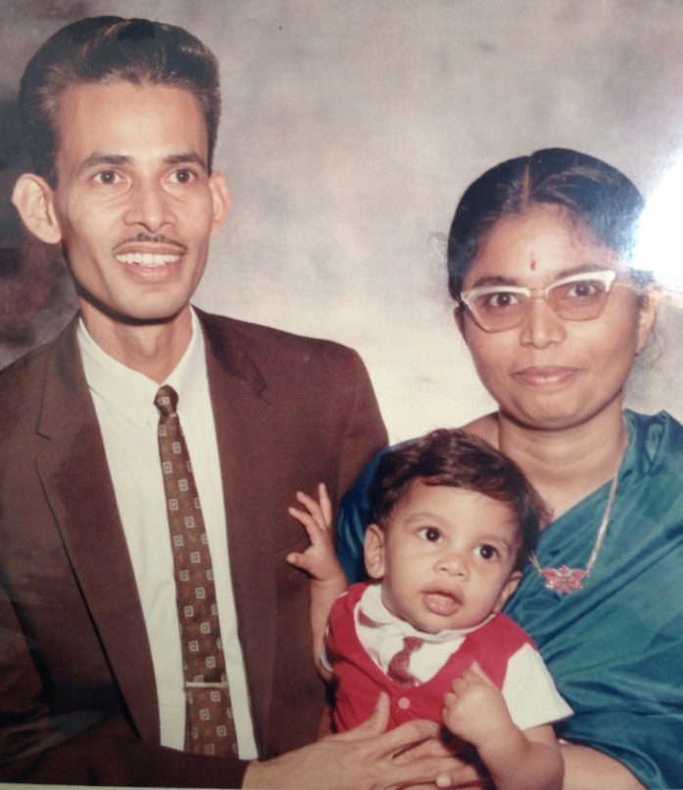
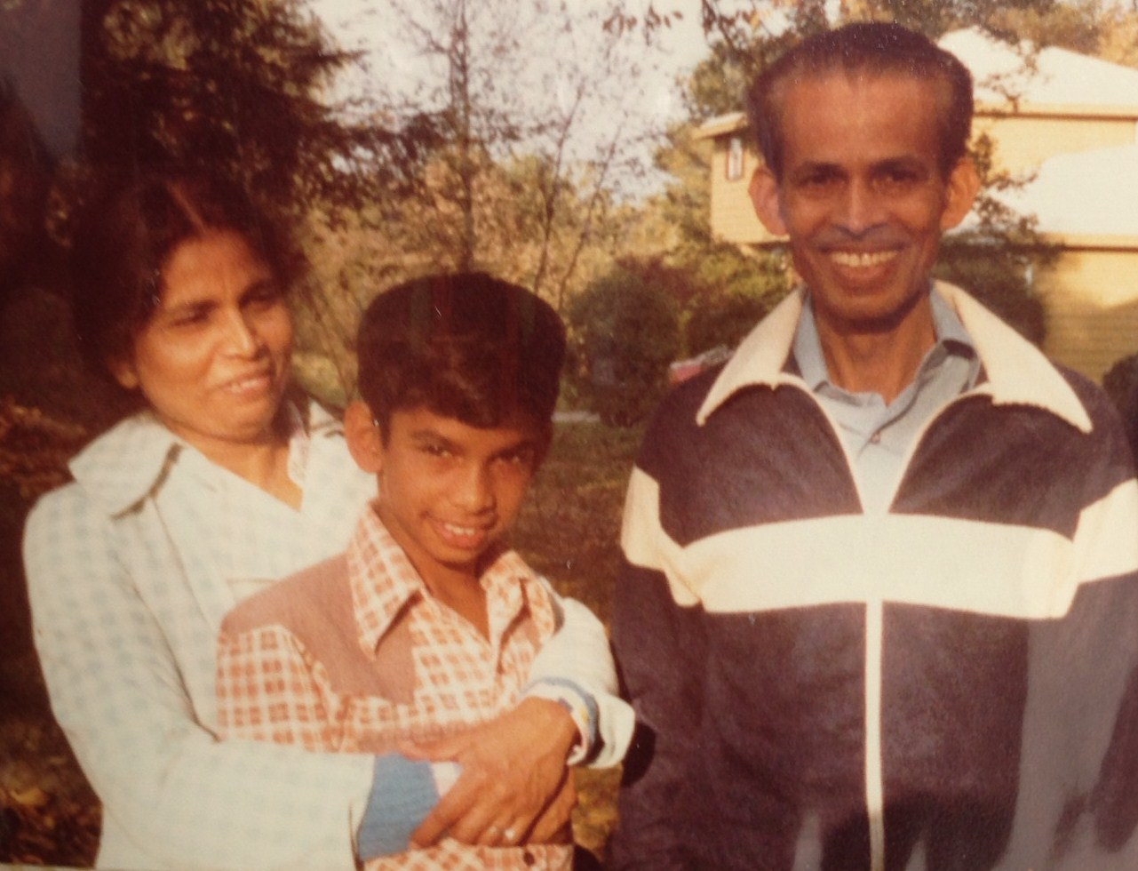
More Early Years…
My parents immigrated from India. I didn’t have any other family around and was the only Indian kid in my neighborhood.

Slide 4
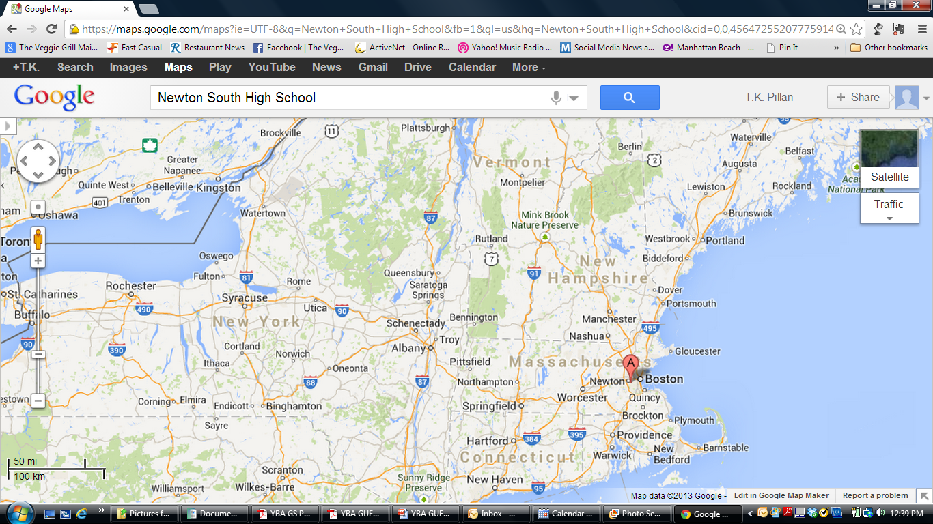
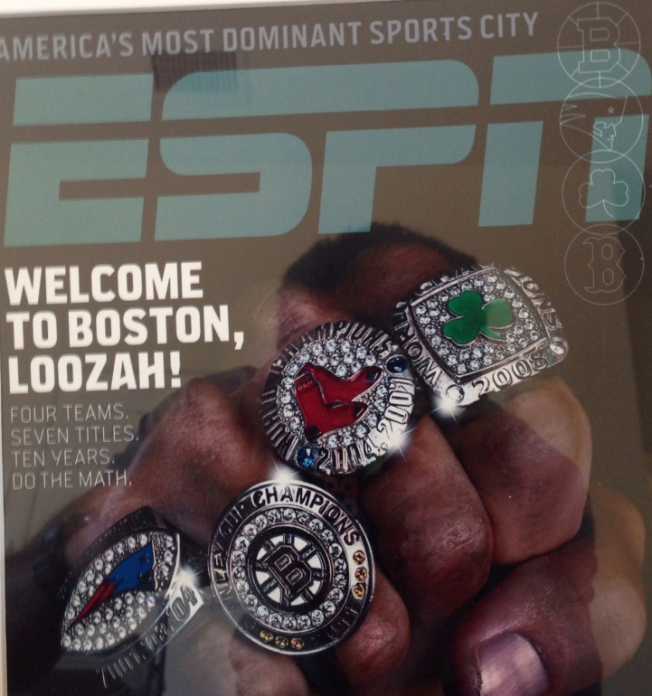
HIGH SCHOOL
I attended Newton South HS in Newton, MA
Insert map shot here
\

Slide 5
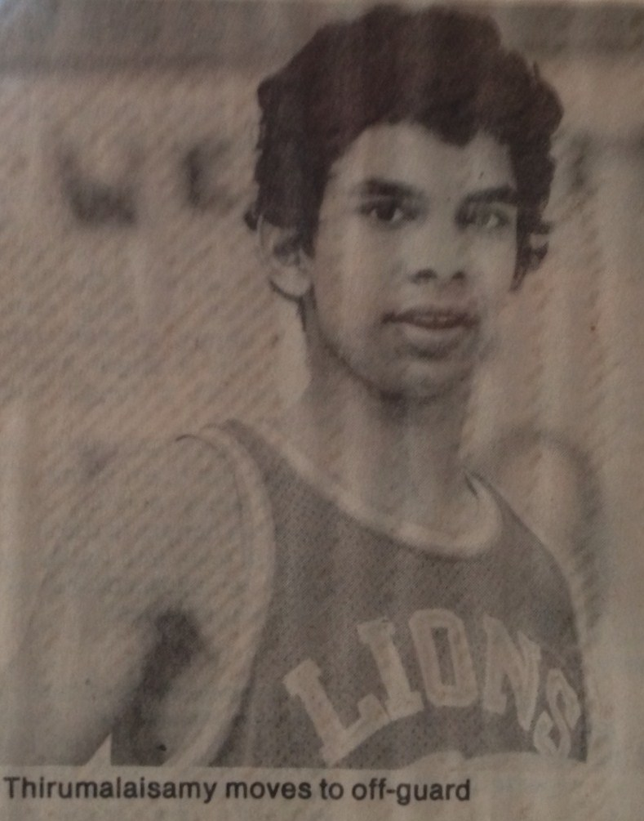

HIGH SCHOOL
As a HS student I was a jock and a nerd
I was captain of the baseball, basketball and soccer teams
I was shy around girls and didn’t have any girlfriends
I was in the top 10% of the class
I was very skinny and had a lot of hair!
\

Slide 6
HIGH SCHOOL
Things I enjoyed in HS
Things I did not enjoy in HS
Sports!!!
  Baseball
  Basketball
  Soccer
Practicing sports
Studying hard and getting good grades so I could practice sports
Trying to fit in with the popular cliques
Being skinny

Slide 7
HIGH SCHOOL
Jobs
I caddied at the local golf-course and had a weekly paper-route my freshmen and sophomore year
My sophomore and junior year I was an usher at a movie theatre … it was great because my friends worked there and we got to watch movies for free
My senior year I got a job with the Newton recreation department at the local gym … that was even better because I got to play basketball and study while I worked!

Slide 8
HIGH SCHOOL
Fondest memories from HS
Obstacles/Adversity in HS
Working hard, having fun and bonding with my teammates on all the sports teams
Summers playing sports, working and hanging out with friends
Being the skinny kid who looked different
Trying to fit in socially when dating & parties became popular because my parents were very strict

Slide 9
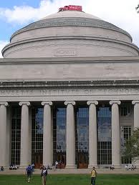
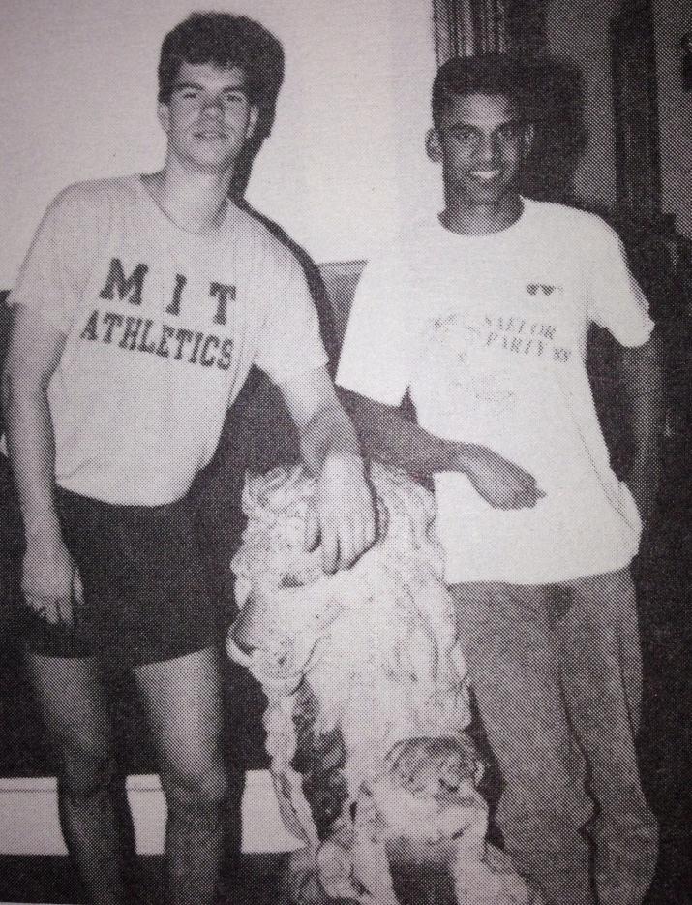
College
I attended college at MIT in Cambridge, MA
\
The famous dome (and prank)
My junior year

Slide 10
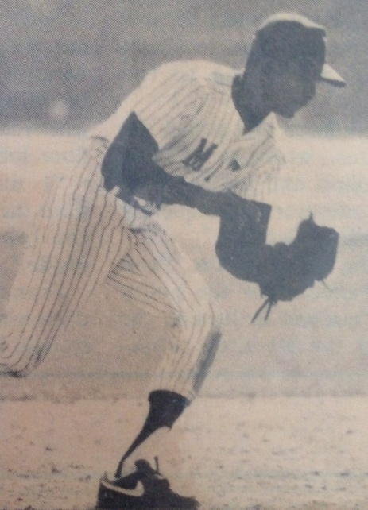
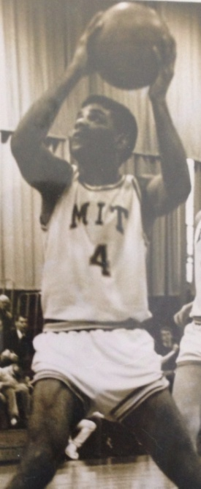
College
Activities/Athletics in College
Jobs in College
Fraternity President
Varsity Baseball
Varsity Basketball
Selling children’s books
Laboratory research
Engineering internship

Slide 11
College
Favorite classes
Least favorite classes
Economics
Accounting
Engineering ---unfortunately I was an Engineering major!

Slide 12
College
Fondest memories
Obstacles or adversity
Learning how to relax and enjoy myself with my fraternity brothers
Baseball and basketball road trips
Getting decent grades in engineering courses where I was just keeping my head above water
Getting little to no sleep and then playing baseball/basketball games

Slide 13
Career Path
I started as a computer systems consultant & programmer
I went to business school and then started an Internet systems company
I am now Co-Chairman and Co-President of Veggie Grill
Notes:
You may use this chart to describe your journey to the current career

Slide 14


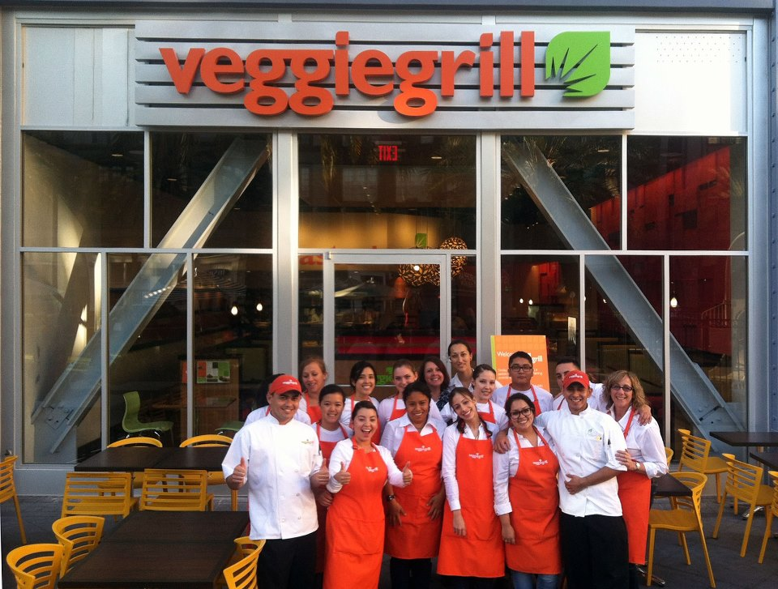
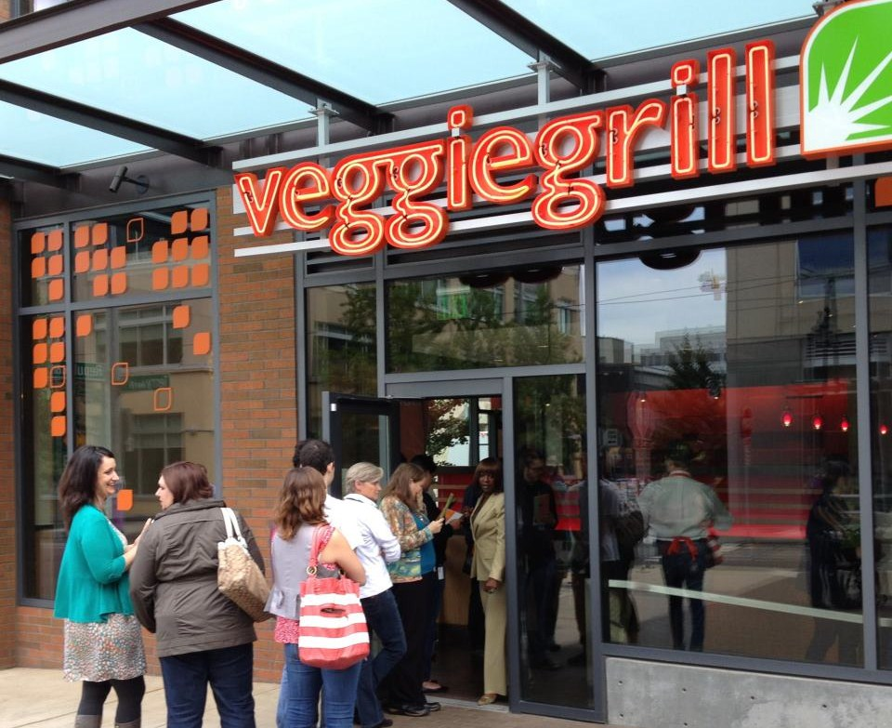
Career

Slide 15
Career
My first Job
My worst Job
My first job was a paper-route when I was in 6th grade
My worst job was working in the shoe department of a sporting goods store. I thought it would be fun working in a sports store, but it wasn’t having to neel down and keep putting different shoes on people. I went back to my job at the movie theatre after a few weeks.

Slide 16
Career
Some challenges I had to overcome
When I started my Internet company, I had to explain to people what the Internet was. I also encountered a lot of doubters about the feasibility of a vegan restaurant chain. If you passionately believe in something, that is the first and most important step in starting a company.

Slide 17
CURRENT ROLE
History
Veggie Grill opened its first location in Nov 2006 in Irvine, CA
Size
Today we have 20 restaurants
We employ over 500 people
Location
We are in LA, Orange County, San Diego, Bay Area, Seattle, Portland
Products
Our main office is in Santa Monica
Santa Fe Crispy Chickin’ Sandwich, VG-Cheeseburger, All Hail Kale Salad, Buffalo Chickin’ Wings, Sweetheart Fries
Notes:
Use this graph to give more description of your current company (history, size, location, products and services, etc.)

Slide 18
Current Role
Chairman
Board
CEO
Strategic Planning
Marketing
Notes:
Use this graph to give more description of your role specifically (responsibilities, typical work week, direct reports, etc.)

Slide 19
Career Compensation
Corporate Management $50-200k
Regional Management $55-100k
Restaurant Management $30-55k
Restaurant Staff
$18-30k
Notes:
Use this graph to show general compensation ranges for people in various roles in your company

Slide 20
ACADEMIC EXERCISE
We will now spend several minutes discussing the day’s academic module and how it is relevant in the ‘real world’

Slide 21

QUESTION AND ANSWER

