Slide 1
Sanford “Sandy” Weinberg YBA GUEST Presentation

Slide 2
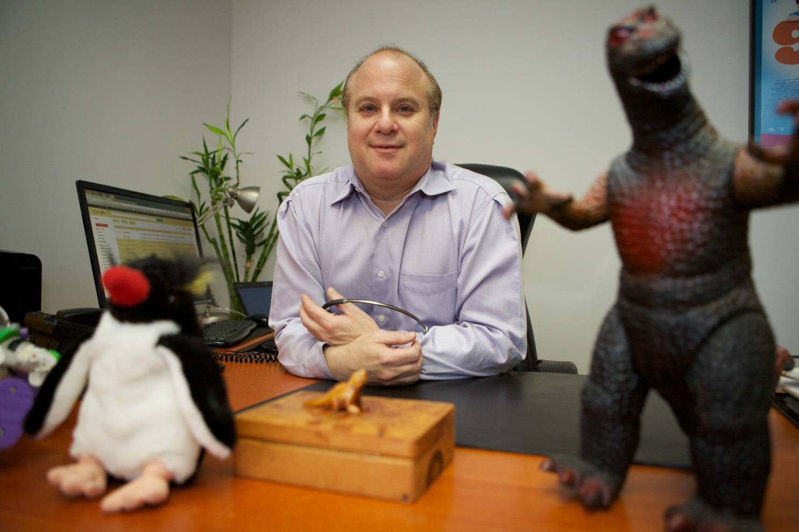
INTRODUCTION
My name is Sandy Weinberg.
I work for the SUMMIT TALENT & LITERARY AGENCY
I am the owner.

Slide 3
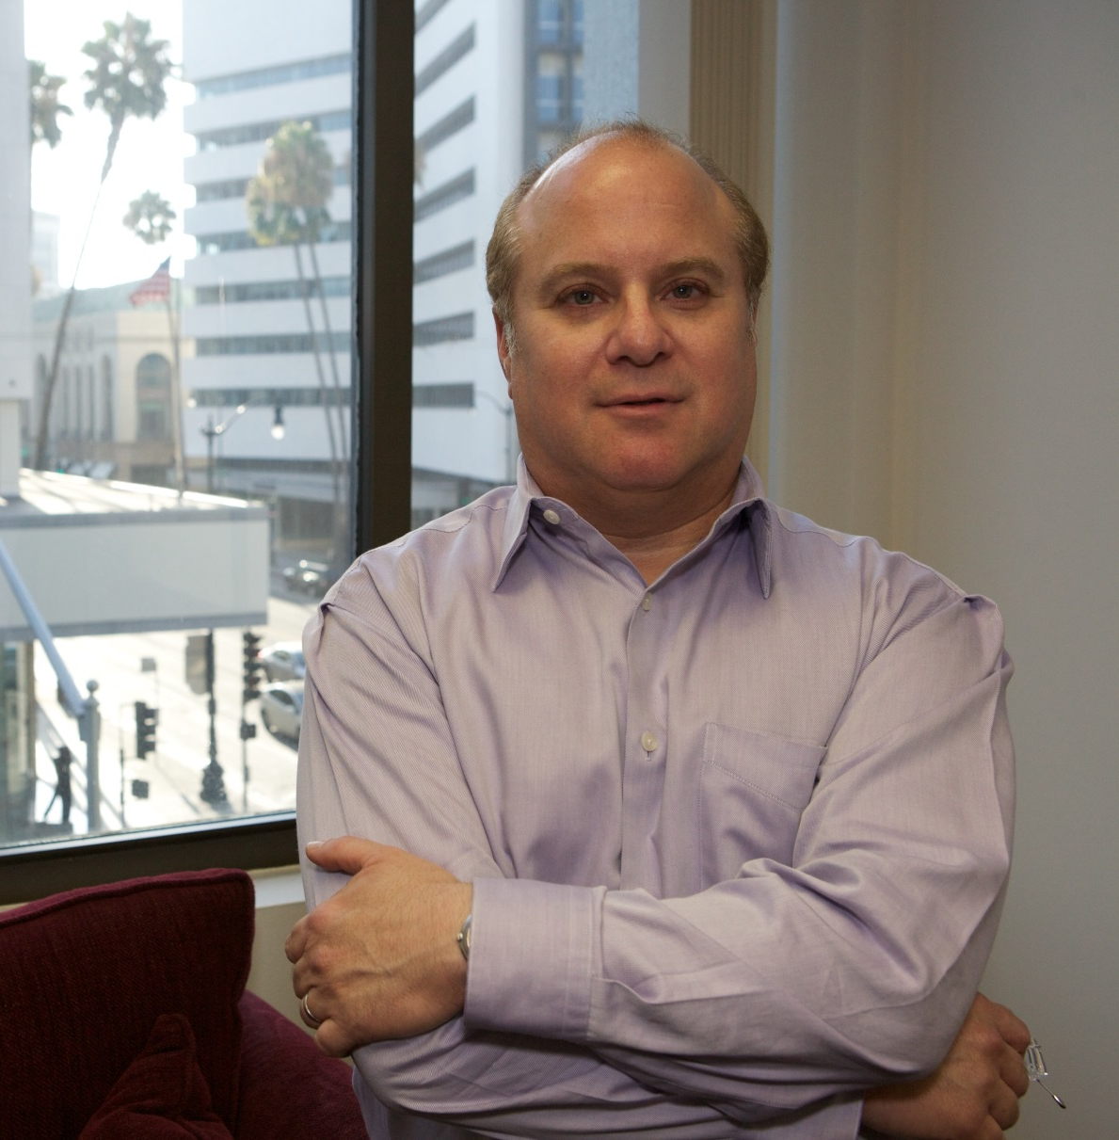
My Company and my role
Summit Talent represents
writers, directors, authors and
animators in film, television
and theater.
As a literary agent, my role
at Summit Talent is to help
clients build their careers by
finding them job opportunities.
I also sell their scripts for
development in film and
television.

Slide 4
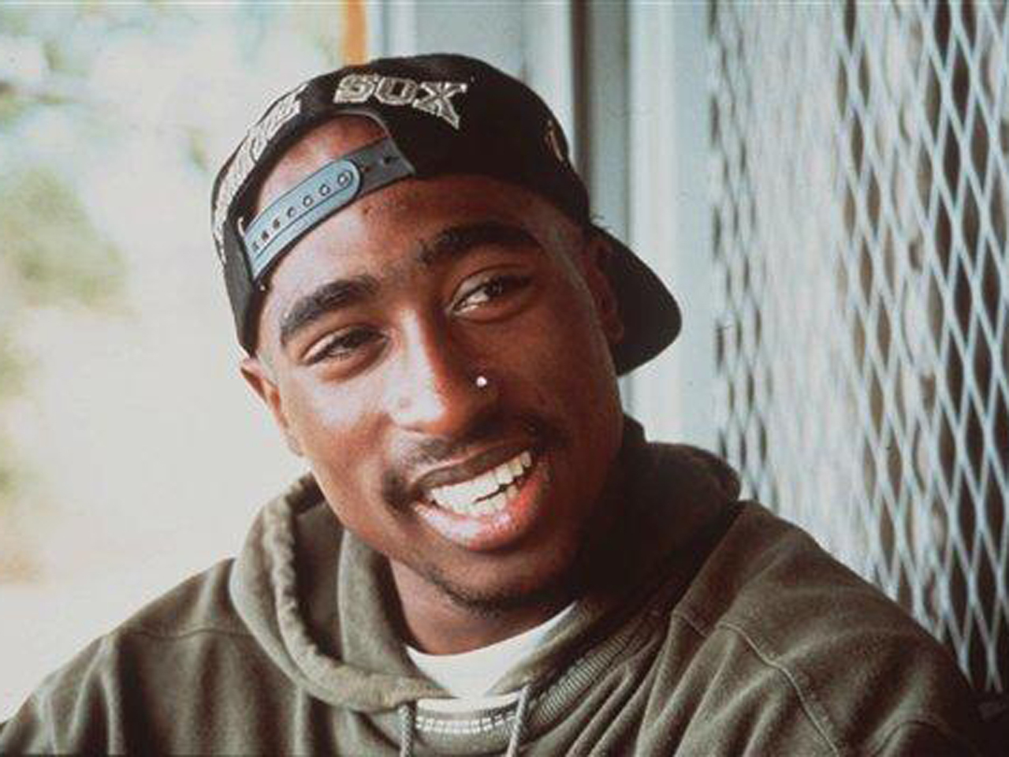
Here are just some of the projects
that my clients are involved with:
Upcoming
Tupac Movie

Slide 5
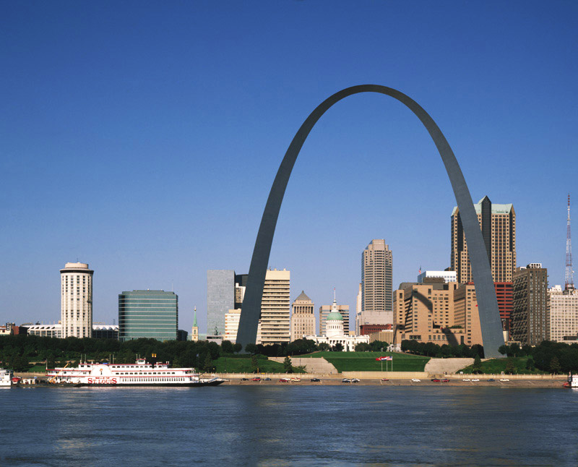
My childhood
I was born in St. Louis, MO and raised in the suburbs.

Slide 6
My family
My father sold restaurant equipment and my mother was a bookkeeper. Neither of my parents attended college.
My parents divorced when I was 14 years old and I lived with my mother. My 2 older sisters were already in college. I started working when I was 11 years old.
My grandmother, Blanche Sievers, was the first person in our family to graduate from college. In 1921, she graduated from Washington University in St. Louis with a music degree. She then married my grandfather, Saul Cohen, who was a classical violinist.
My sibling and I, and our 3 first cousins, all played musical instruments. We all graduated from college.

Slide 7
I attended Horton Watkins High School in Ladue, MO
This is a public high school. I graduated with a 3.8 GPA (out of 4.0)
At the time, Ladue was very “white”. There were only 4 African-Americans in my graduating class and no Hispanics.

Slide 8
Ladue High School
Ladue offered many classes in the arts and our teams competed in all sports. It also offered advanced placement courses. I attended AP classes in English and Calculus. Most of the graduates attended college.
I participated in marching band, theater and choir. In my free time, I studied piano and wrote music. I also participated in my temple’s youth group and I was elected to the regional board of the Missouri Valley Federation of Temple Youth. (MOVFTY)

Slide 9
Challenges in High School
Things that felt difficult or challenging for me while I was in High School were:
Gym (I was relatively small and a very slow runner).
Group sports. I played little league baseball (7 years), soccer (3 years) and ice hockey (3 years). I wasn’t very good at any of them.
I was often one of the last kids picked for sports teams.
Most of the kids in my school were wealthy, and I was not. I rode my bike everywhere because I didn’t have a car and my parents worked.

Slide 10
Jobs in High School
The neighborhood lawn mower guy.
Babysitter.
Waiter. I often worked night shifts during the school year.
Sealed plastic bags at a sportswear company for 6 months during my senior year.
Music director & accompanist for local children’s theatre.
Camp counselor at local theatre camp.
Children’s birthday party entertainer for 7 years beginning at age 11. I did this most weekends all the way through high school. I saved enough money to pay most of my own personal expenses during high school and college.

Slide 11
Getting to College
I made sure to save enough money to leave St. Louis to attend college.
Although I graduated with a very high GPA, I bombed my SAT’s. In grade school, I scored “C” level on multiple choice aptitude tests, but they were wrong, for I was always an “A” student.
I was accepted to several universities but I could only afford to go if I had a scholarship. The best scholarship was from Tulane University because my scholarship funds applied to the Junior Year Abroad program. Choosing a college that paid me to leave the country was one of the best decisions I ever made!
.

Slide 12
Tulane / london school of economics
I attended Tulane University in New Orleans, LA, and I spent my entire Junior Year at the London School of Economics in London, England. In London, I earned top scores in my classes which included health care, nuclear weapons proliferation and 20th century european history. I also traveled to Russia for 3 weeks by finding a grant and by selling 3 pairs of jeans on the Moscow streets. In the Spring, I traveled through western Europe for 3 weeks.
When I returned to Tulane my senior year, I realized I should have stayed in London.
Graduated Magna Cum Laude. I was 1 of 4 students who graduated at my level.

Slide 13
College activities
My first year I sang with the “Tulanians”, a school sponsored pop/jazz group that performed throughout the year. I had to quit after 1st year because I needed to raise my GPA to get into a good school for my Junior Year Abroad.
My freshman and sophomore years, I was a member of the Alpha Epsilon Pi Fraternity. I’m still friends with my fraternity roommate whom I see often.
I stayed up late at night, went to clubs and partied a lot.

Slide 14
Employment during College
For two years in New Orleans, I worked at a the Southern Prisoners’ Defense Committee, a public interest group which litigated class action suits against southern prisons and defended inmates in post-conviction death penalty appeals.
One summer in St. Louis, I worked on a factory assembly line assembling toaster ovens. I also welded filaments for popcorn poppers.
One summer in St. Louis, I worked for the St. Louis Planning Authority, a job I found by myself. I also received college credit for my work.
One summer in St. Louis, I worked for a law firm, another job I found for myself.
Every summer, I worked nights as a waiter.

Slide 15
CHOOSING A Law school
After college, I wanted to move to
L.A.
Because I didn’t know what
profession to pursue, I applied to
law schools. I bombed my LSAT.
I chose Southwestern University
School of Law over USC because Southwestern offered a full
scholarship.

Slide 16
Law school
I disliked law school, but I performed well earning many academic honors.
I was an editor for the Law Review. I published an article on the constitutional rights of Haitian refugees being held in Florida’s detention camps.
I supported myself working as a law clerk in several firms during the school term and during the summers in between.
Twice a month, I worked as a waiter for a catering company. This covered my gas and food bills.

Slide 17
Passing the bar – jobs after law school
I passed the California Bar the first time because I took a course that taught me how to succeed on a standardized, multiple choice test.
While studying for the Bar, I swam a mile every day.
At the small law firm where I worked, my first jury trial was defending a home care nurse whose patient left her over a million dollars. We won the case. The woman gave me a waterfall painting she made, which I still have.
At my second job as a lawyer, I tried my second case. We lost because our client was a fraud.
My boss treated everyone horribly, including me.

Slide 18
Starting over: Becoming A SECRETARY TO BECOME AN AGENT
Went into an agency mailroom and then, for 1 year, became a secretary to a successful literary agent.
Became an agent at a very old, established agency called H.N. Swanson.
1 year later, moved to Innovative Artists, and stayed 5 years.
Innovative offered a partnership which I declined because it didn’t include ownership. I loved working there, but I didn’t want to build a business for someone else to own.
Moved to Paradigm because I didn’t know what else to do. Big mistake.
In 2000, went out on my own to create the Summit Talent & Literary Agency. I own 100% of the company, and I get to “agent” the way I want. I built my own business for myself.

Slide 19
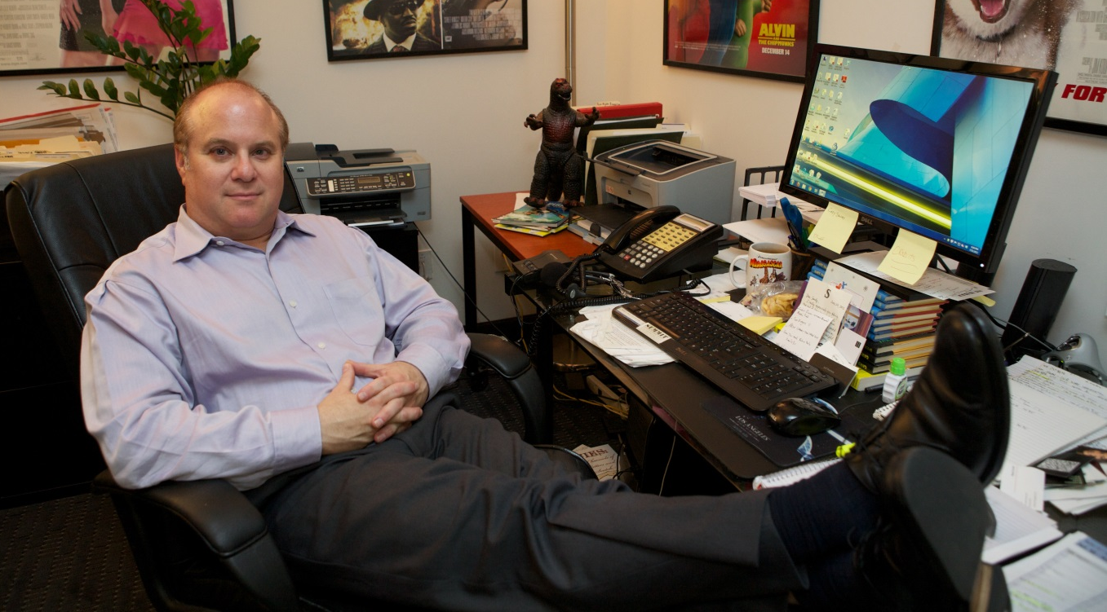
No staff meetings!!!
Balancing home life with work.
Learning new areas of the business.
Entrepreneurship is challenging and scary.
Time management.

Slide 20
My Career Path
Assistant
Lawyer
Agent
Owner / Entrepreneur
Notes:
You may use this chart to describe your journey to the current career

Slide 21
My Career
Summit Talent is comprised of myself and my assistant who is training to be an agent.
The agency’s 22 clients are writers and directors and animators in all media.
Film – “Tupac”, “Liar Liar”, “9 to 5”, “Alvin & The Chipmunks 1 & 2”
Television – “Gotti” for HBO, writers on “Empire”, many mini-series, cable movies, and animated series
Theme Parks – Universal Studios’ “Despicable Me” Ride
Theater – “9 to 5: The Broadway Musical”
Books – The Andy Carpenter Mysteries
Sell clients’ material to television and film companies.
Find clients jobs at television and film companies as writers and directors.
Paid consultant to Government of Taiwan.
Adjunct Producer at UCLA.

Slide 22
Challenges
Challenges I have had to overcome throughout my career:
I used my own money to launch my own company.
I do not receive a salary.
I earn what the company earns after all expenses are paid.
One studio blackballed me because the Head of Business Affairs was angry with me. It only lasted on week.
One network executive threatened to blackball myself and a client unless the client waived an $80,000 payment. We called her bluff – the client kept the money.
Some markets disappear while others emerge.
Pivot to help clients enter new markets.
My 3 largest expenses: Employee(s), Office Rent and Health Insurance.

Slide 23
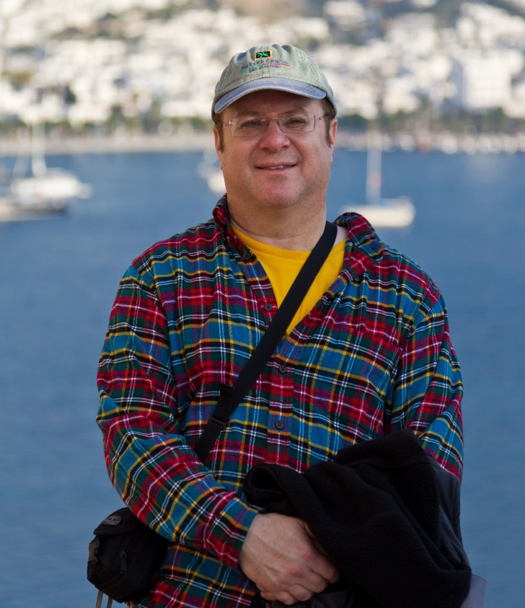
Beyond work
When I am not at work I like to:
Swim. (This year, for the first time, 3 miles)
Work out at the gym.
Travel around the world.
Garden.
Hang out with my friends.
Go to movies, the theater and concerts.
Barbecue in the backyard.
Go to the beach.
I am a fun uncle, and I help my nieces and nephew pay for college.
I talk to my mother every Sunday.
“Here I am in Ushuaia, Argentina. The southernmost city in the world.”

Slide 24
Do it all over again?
If I could talk to my high school self, what would I say?
Be brave – fear is not your friend, so leave fear outside the door.
You shall succeed.
Know that sometimes you will fail, but failure helps you succeed.
You are not what people judge you to be.
Always practice adapting to new challenges.
Standardized tests do not predict your success.
Become a good listener.
Do not offer an opinion unless you are asked.
Ascertain the agenda of the person you are meeting.
Destiny doesn’t make house calls.

