Slide 1
Maggie Oldham
YBA Presentation
Oscar De La Hoya Animo High School
August 19th, 2015

Slide 2
Introduction
My name is Maggie Oldham and I am 31 years old
I have a “day” job:
Goldco Precious Metals
We help people invest some of their savings into gold and silver. I work in the marketing department doing e-mail and Internet marketing.
And…. a “passion job”:
Modern Etiquette Coach
I help people put their best foot forward in business, social, and dating situations. I have a blog with articles and videos, and I teach individuals and groups.

Slide 3
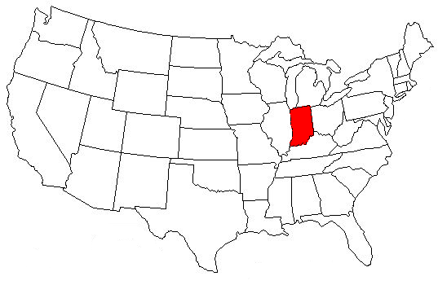
The Early Years
Born and raised in Indianapolis, Indiana

Slide 4
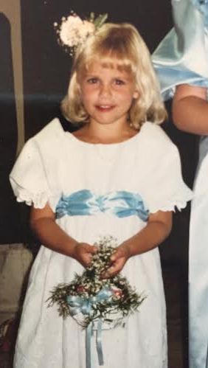
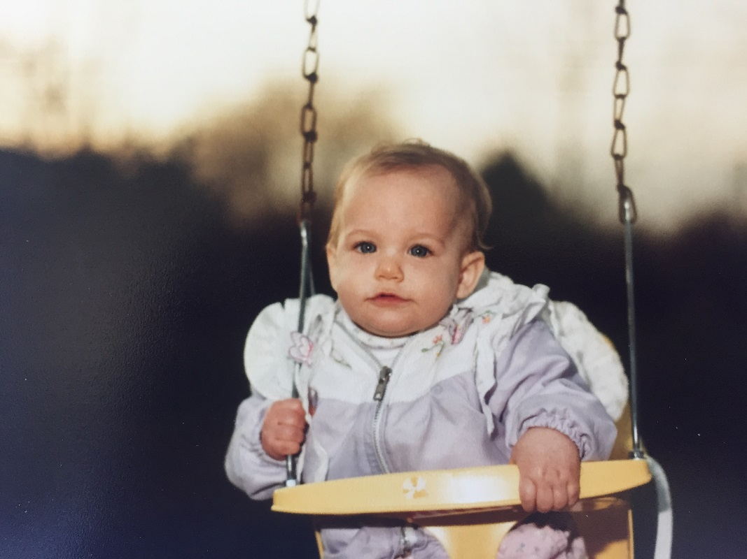
The Early Years
I was adopted and I’m an only child
I loved to play outside
Loved animals
Strong-willed child

Slide 5
The Early Years
Loved sleepovers
First boyfriend was in kindergarten
My dad was a principal at another elementary school in the district so I was “teacher’s pet”
Switched elementary schools in before 4th grade – very rough transition
Started to understand what a “clique” was

Slide 6
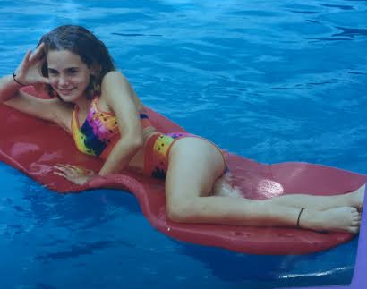
Middle School
Opened my eyes to other people’s realities
Late bloomer – braces and no boyfriend
My hair started to get curly and I didn’t know what to do with it
Cheerleading and volleyball

Slide 7
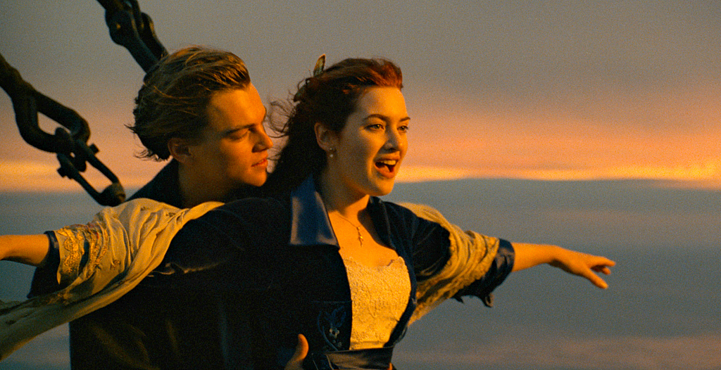
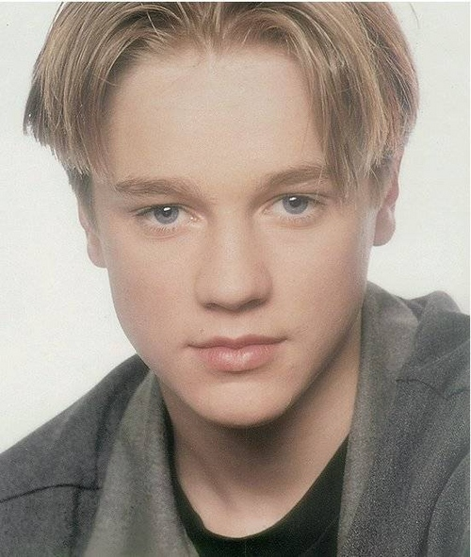
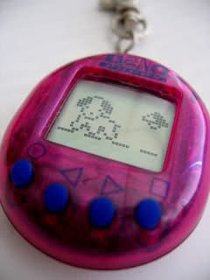
Middle School
Things that were popular in middle school (1996-1999):

Slide 8
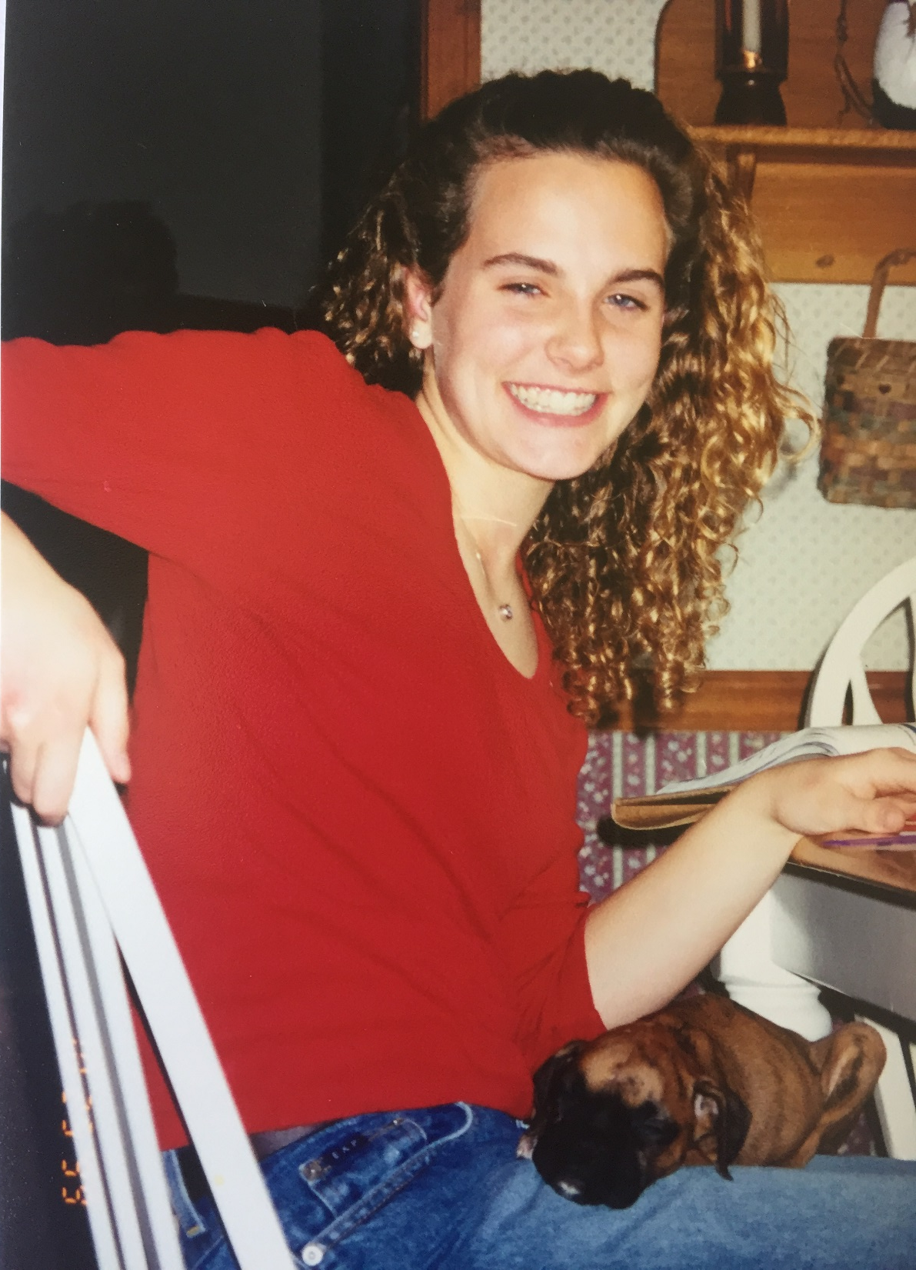
High School
Dad became the Assistant Superintendent, so the pressure was on to get straight A’s and to “keep my nose clean” (aka stay out of trouble)
Braces came off, but still in my “cocoon” phase
Took honors classes and studied very hard – stressed myself out
The only freshman without a date to the Homecoming dance

Slide 9
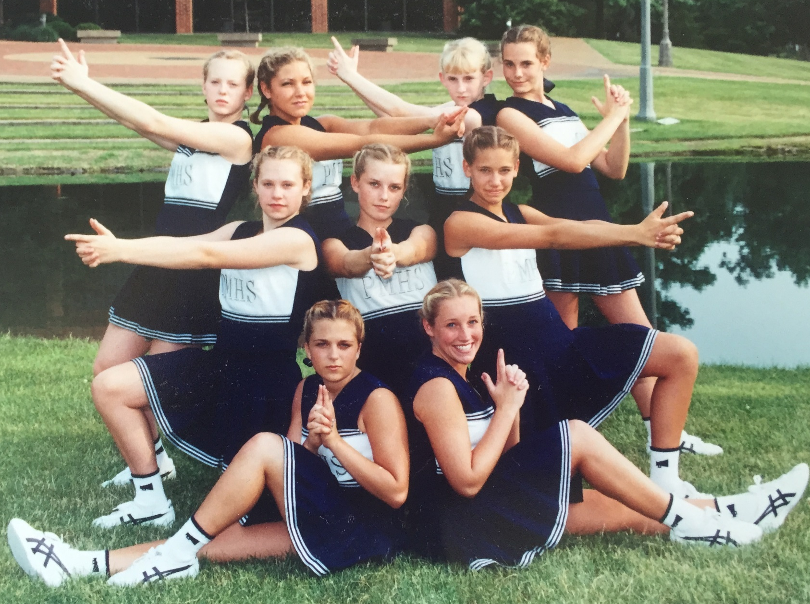
High School
Cheerleading was a big part of my life… but, it came with serious “highs” and “lows”

Slide 10
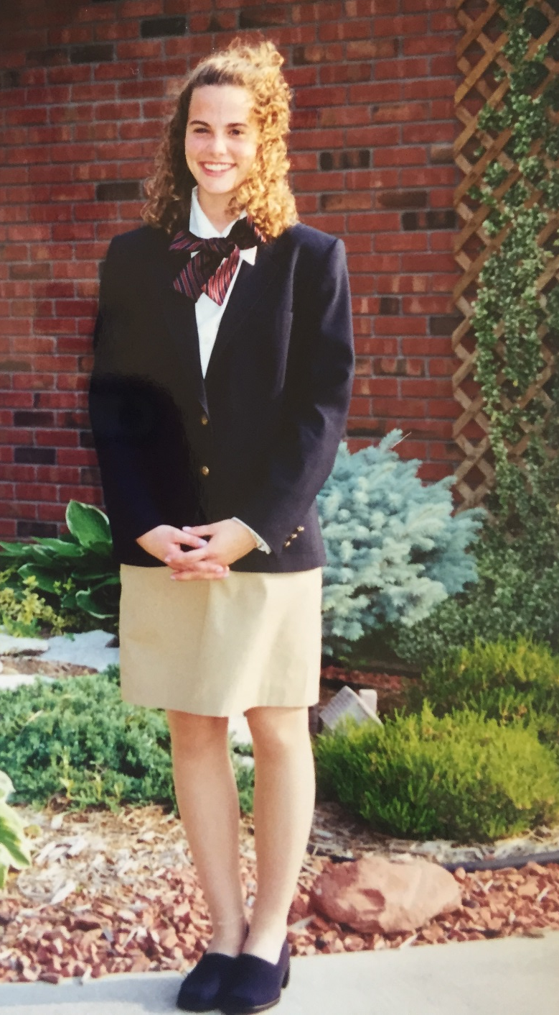
High School
Extracurricular activities:
Ambassador Corps
Mayor’s Youth Council
FalconTV
French Club
National Honor Society
Student newspaper
I was so focused being the “best” that it drove me to become a perfectionist
I never worked so hard as I did in high school

Slide 11
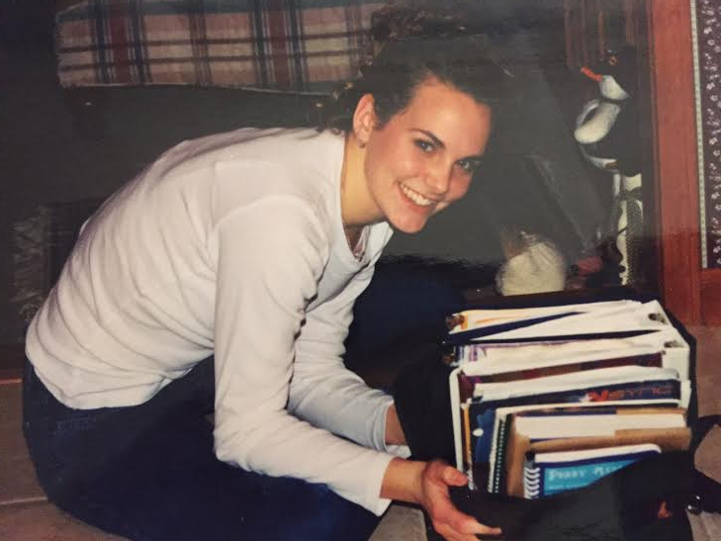

Slide 12
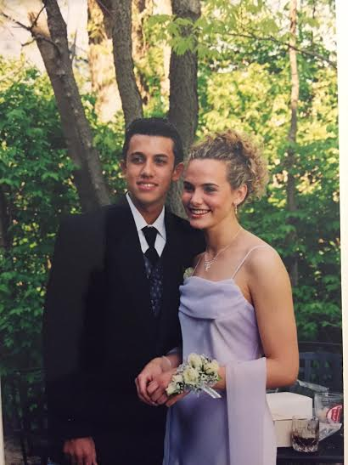
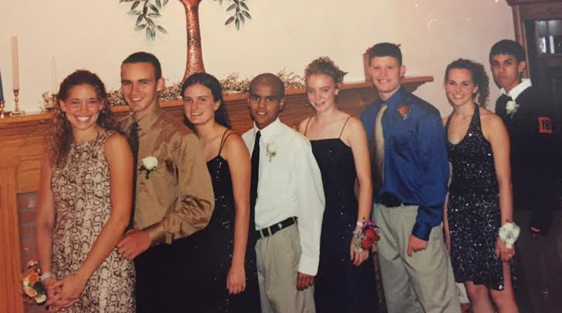
High School
I started to come out of my “cocoon” phase Junior year
Had a boyfriend during Junior and Senior year

Slide 13
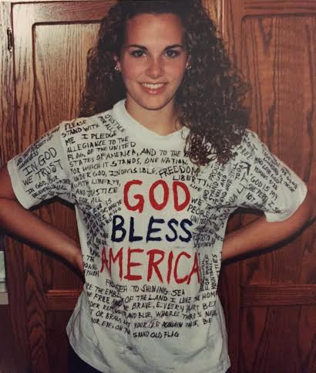
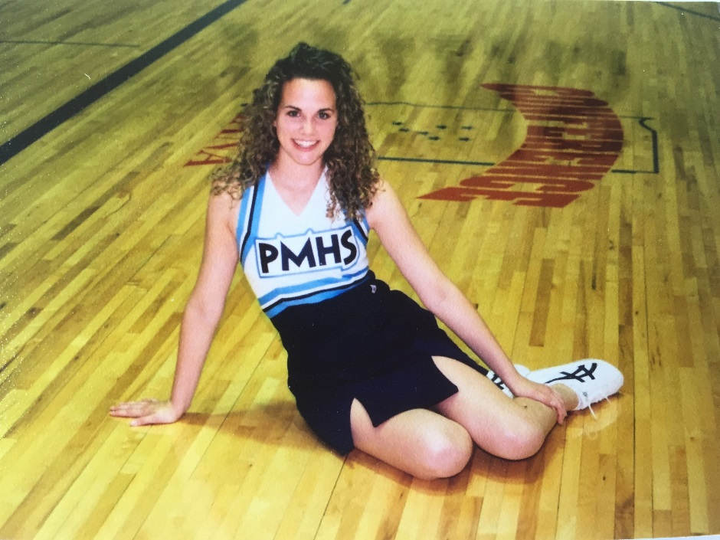
High School
September 11th, 2001 happened during my Junior year
I started doing college visits
Ran track during the spring of my Junior and Senior year
Decided not to do cheerleading for basketball Senior year

Slide 14
High School
On the weekends, we hung out in each other’s basements, went to Steak ‘n Shake and pizza king, the mall, movies, and hung out in parking lots trying to decide what to do
Senior year I was OVER the drama and started to drift away from high school friends
Graduated in May 2003 with honors
The one piece of advice I wish I knew and trusted….
IT WILL GET BETTER

Slide 15
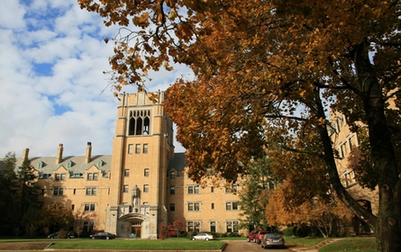
College

Slide 16
College
Went “pot luck” my Freshman year and met the girl who would become my roommate all four years of college and a lifelong best friend
I was so exhausted from the stress of extracurricular that I literally did nothing but study and have fun the first two years of college
I started out as a Communications major then switched to Business my Sophomore year
Facebook came out during fall 2004 (my Sophomore year of college)

Slide 17
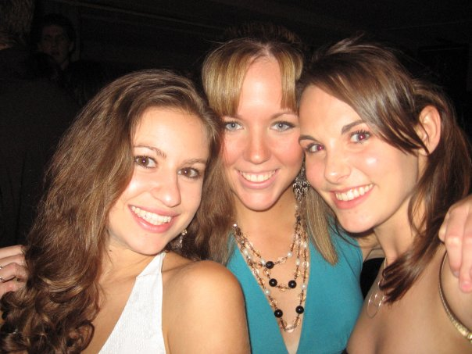
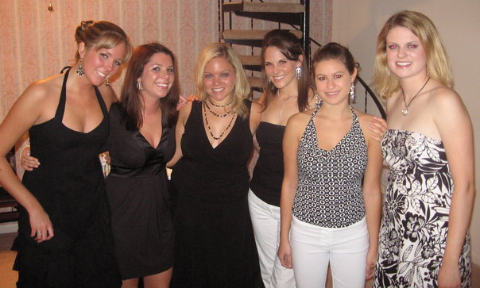
College

Slide 18
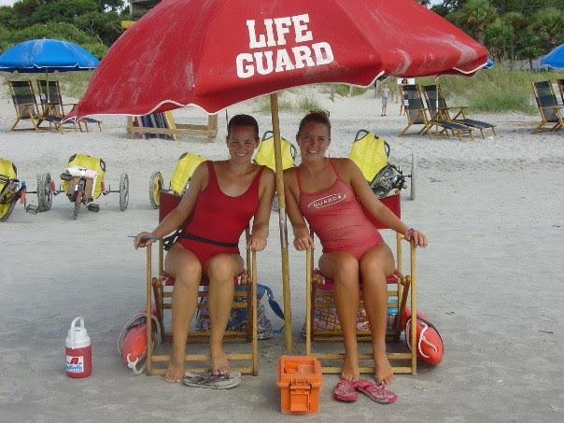
First Jobs
In high school, I was a lifeguard at the public pool
In college, I lifeguarded on the beach in Hilton Head, SC

Slide 19
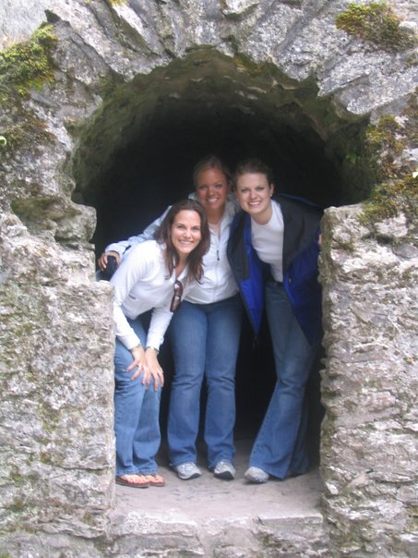
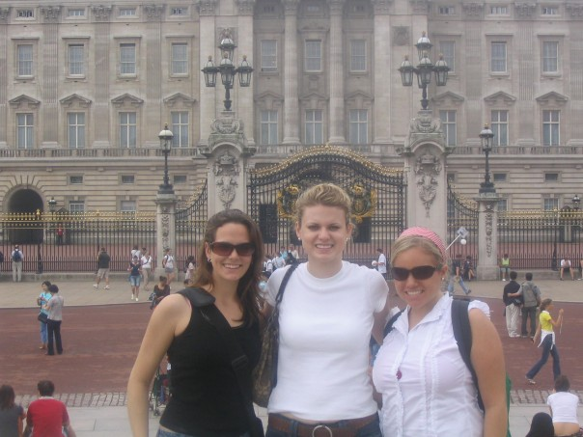
Internships
During the fall of my Junior year of college, I did a marketing internship with a restaurant company
During the summer between my Junior and Senior year of college, I did a marketing internship in Ireland

Slide 20
Jobs After College
I graduated from Saint Mary’s College in May 2007 and started working as an analyst for Huron Consulting Group in Chicago that September
Travel and a lot of spreadsheets
I LOVED living in the “big city” of Chicago
Worked in pricing for four years Cook Medical in Indiana
I tried to be happy but I wasn’t truly happy
My wake up call

Slide 21
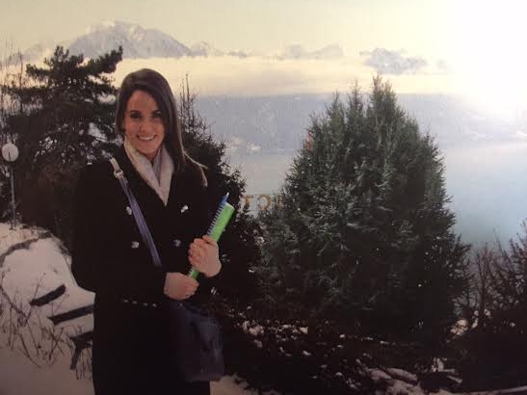
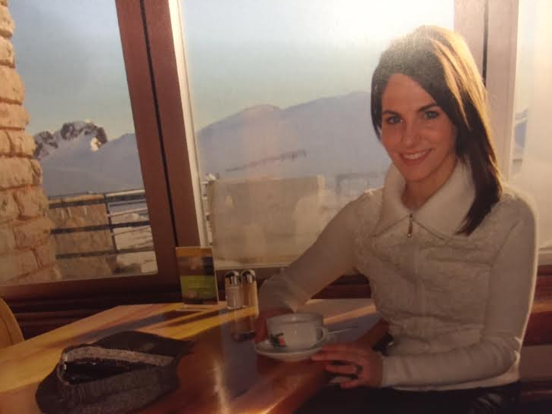
The Big Move
I made the decision to move in the fall of 2012
But first….. Switzerland!
The Insititut Villa Pierrefeu finishing school
Changed my life

Slide 22
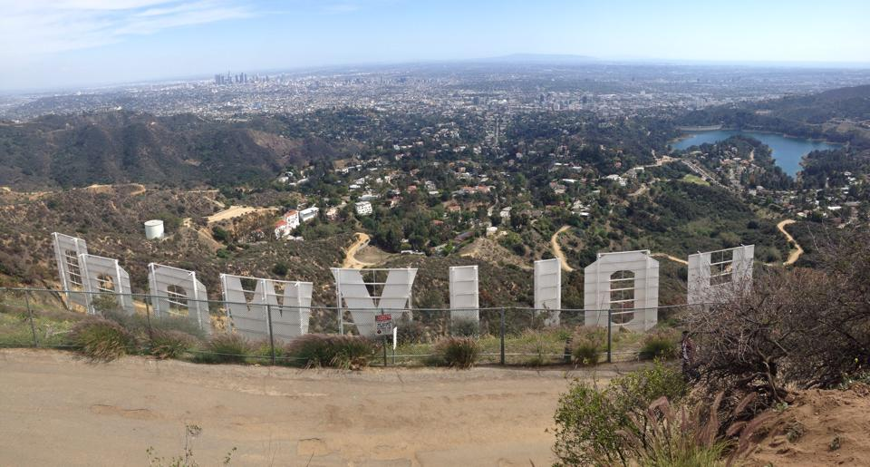
The Big Move
Packed two suitcases and moved to LA on March 11, 2013
I experienced an overwhelming sense of peace

Slide 23
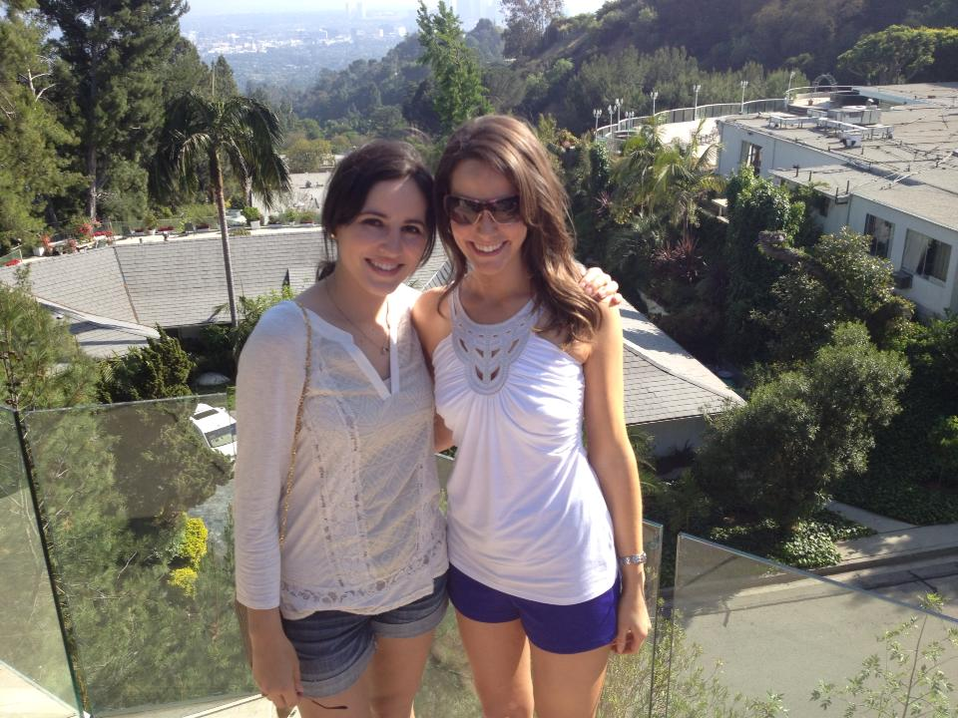
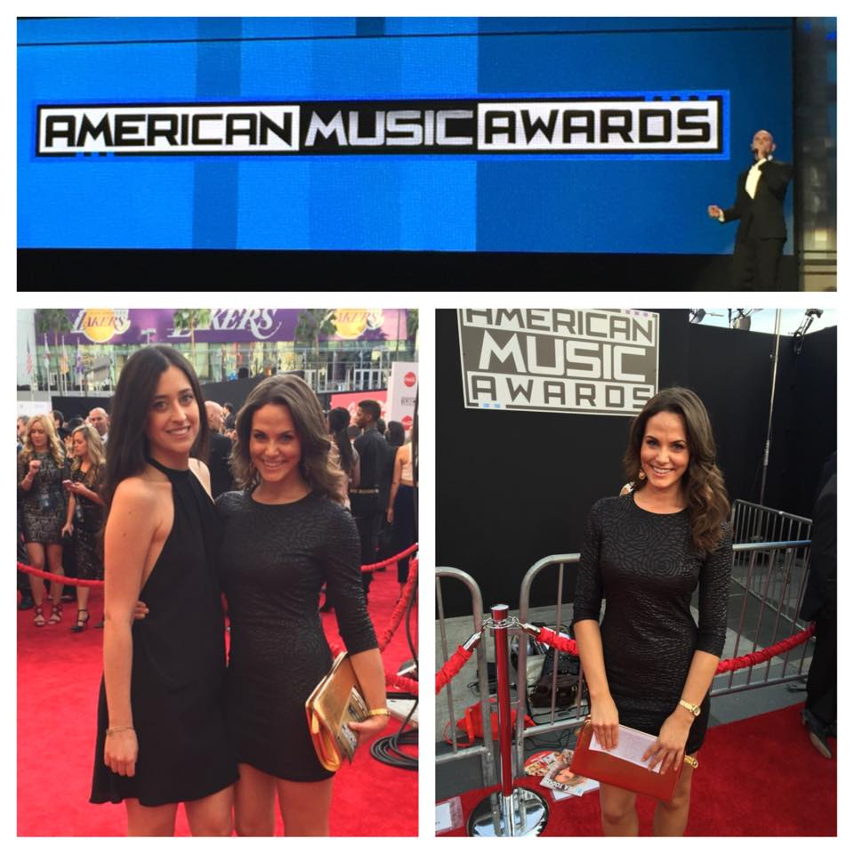
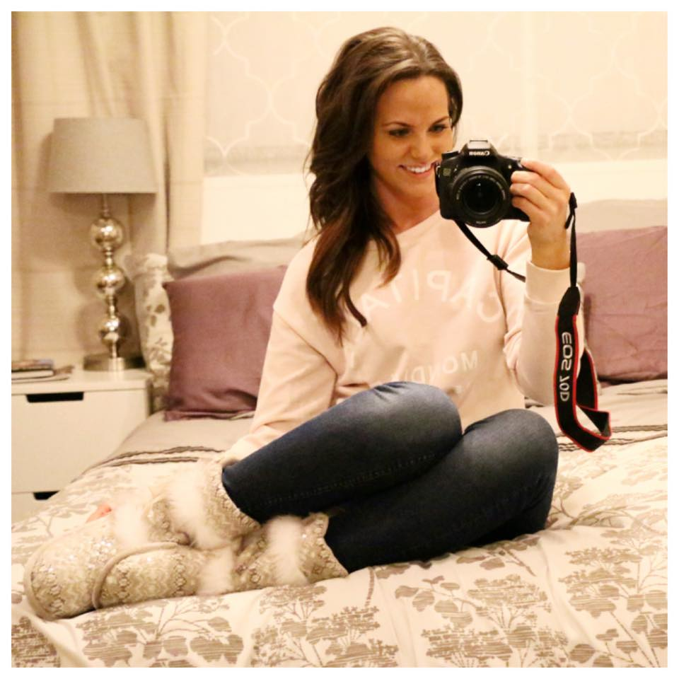
I love LA!!

Slide 24
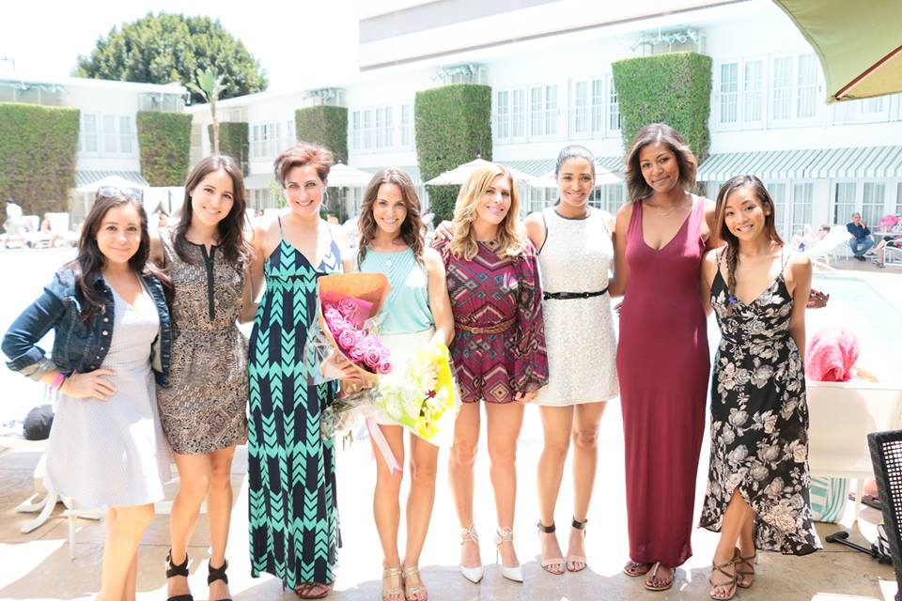
I love LA!!

Slide 25
Modern Etiquette Coach
What is etiquette?
Starting my own business
Website
Marketing
Content
Social media
Why it’s important to be smart about income

Slide 26
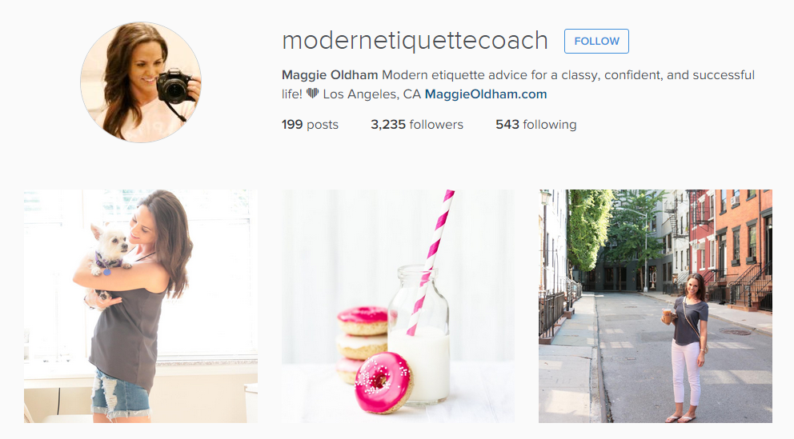
Modern Etiquette Coach

Slide 27
Final Thoughts
It’s great to have a plan, but it’s also important to trust the process
Work hard and be nice to people
Do your inner work
Books I recommend:
“How to Win Friends and Influence People” – Dale Carnegie
“The Secret” – Rhonda Byrne
“Men Are From Mars, Women Are From Venus” – John Gray

Slide 28
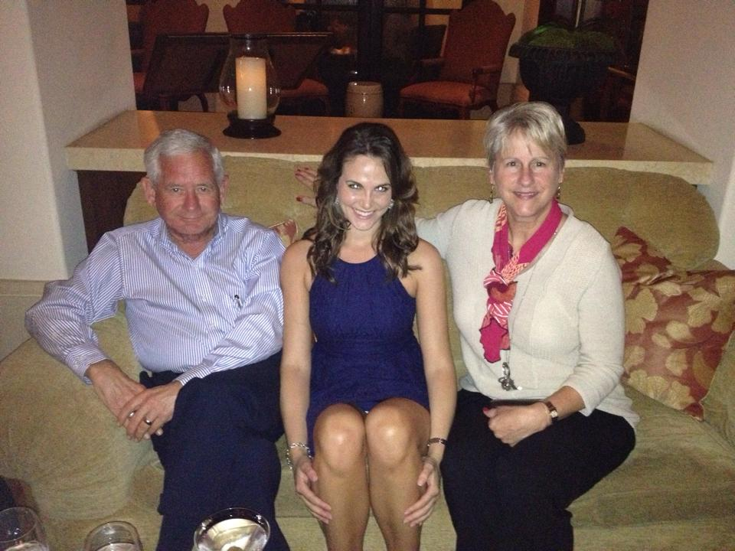
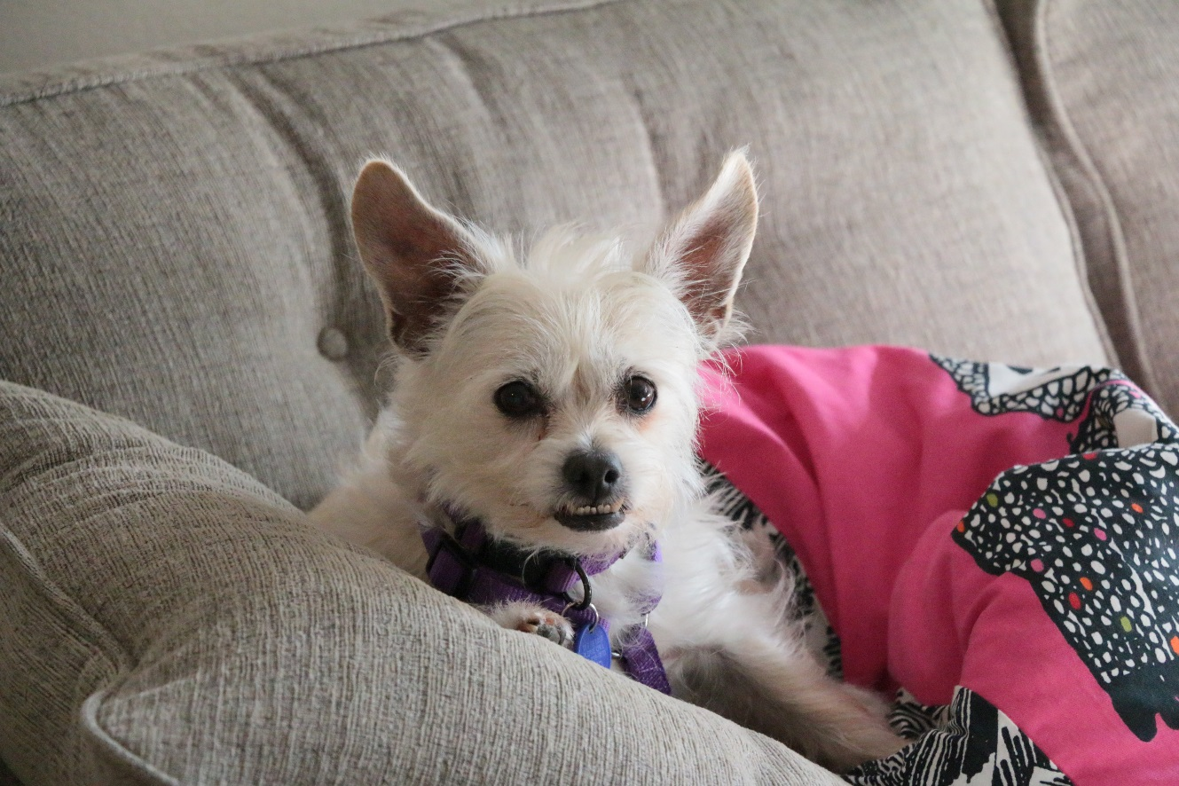
Questions

