Slide 1
YBA GUEST RESOURCE TEMPLATE

Slide 2
INTRODUCTION
My name is David Bogan and I am 54 years old.
I work for PC550 Holdings.
My company does:
Develop innovative dynamic approaches toward mitigating insurance fraud.
We engaged in both ground up and acquisition growth.
My role at PC550 Holdings is President/CEO
Every day I look for new and creative ways to reduce insurance fraud and develop a plan for implementing those plans or improving upon efforts already being made. I am responsible for the profitability of the company and all its subsidiaries.

Slide 3
My childhood
I was born in Sioux City and raised in Iowa and later Denver Colorado
This is a picture of me at age 6

Slide 4
My family
A little about my family - I have three sisters and had a twin brother. Unfortunately, he passed away when we were very young.
This is a picture of me and my Dad, Mom, and two younger sisters

Slide 5
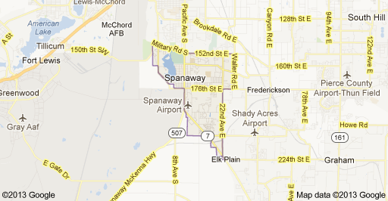
MY HIGH SCHOOL
I attended Arvada West High School in Arvada, Colorado
(Insert map or image of high school or mascot etc. here)

Slide 6
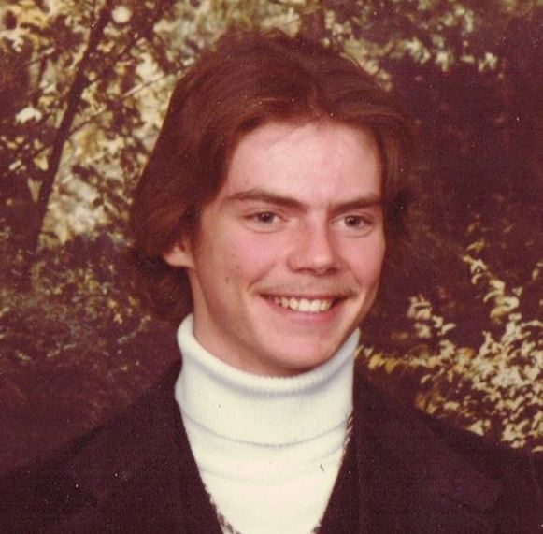
High School
As a HS student I was a little shy at school but worked as a Disc-Jockey at night and on the weekends. This was a great opportunity for me to gain self confidence……………………………………………………………….
Here is a picture of me in HS

Slide 7
High School
Things that I really liked in High School were:
Hiking and Camping whenever I could.
I loved the Mountains of Colorado.
Band
I was in the Marching Band.
Math
I really enjoyed math because I was able to view it as building blocks. Each new level of math simply built upon the last. I eventually took Calculus and then Math Analysis.

Slide 8
High School
Things that felt difficult or challenging for me while I was in High School were:
Making new friends was never easy.
Remember I was a little shy!
I was not very athletic in High School either.
I always wanted to be part of the “it crowd”.
Although I was never an out cast, there were plenty of other kids that did not know who I was.

Slide 9
High School
Jobs I worked while I was in High School were:
(My very first job was working for Kirby Vacuum Cleaner
I never sold a single vacuum clear!
But I then became a Disc Jockey and worked for a company named Sweetness and Company.
But the most exciting job I had was working for a company called Alpine Air Charter.

Slide 10
Getting in to College
The top few things I did to ensure I got into college were:
Grades
My English Teacher miss reported me as failing English my Senior Year
Extra-curricular Activities
Civil Air Patrol
Boy Scouts
Worked as a volunteer on a political Campaign
Writing letters

Slide 11
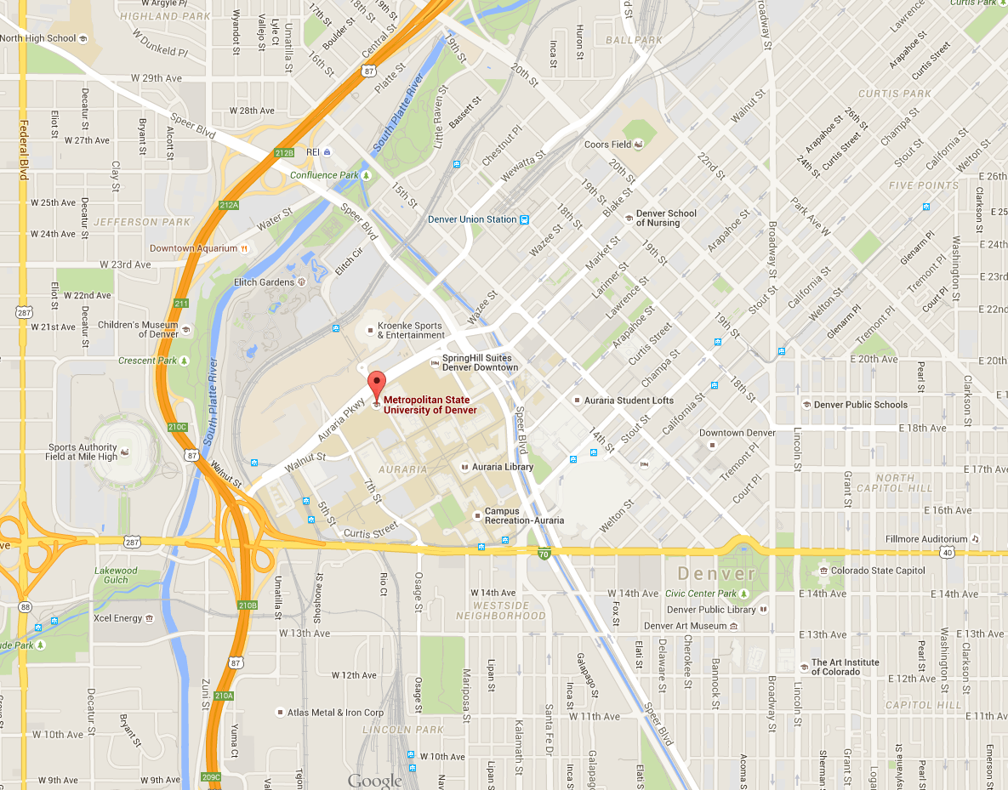
College
I attended college in Denver, Colorado
Insert map shot here

Slide 12
College
Things I enjoyed in College
Things I didn’t enjoy in College
LEARNING!!
Meeting people
Freedom
The respect shown by our professors
I also enjoyed rodeo / bull riding
It took awhile to get used to self study.
Long Hours

Slide 13
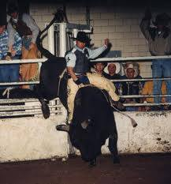
College
Things I enjoyed in College
I also enjoyed rodeo / bull riding

Slide 14
College
Favorite classes
Least favorite classes
Business
Business Law
Criminal Justice Courses
All History Classes
Calculus
Arts
English
English
English
And then English
Not necessarily in that order

Slide 15
College
Jobs I worked while I was in College were:
I continued working as a disc-jockey through College.
Great opportunity to meet people
I could go out without spending money
I learned the business side of night clubs
Developed great people skills
It made me realize the difference between my private and public self

Slide 16
College
Things that felt difficult or challenging for me while I was in College were:
My family did not have money; however, my friends did
Not having a car
Not living in the dorms, an apartment or Fraternity House
Focusing on a career

Slide 17
Getting a job after College
The top few things I did to ensure I got a good job after college were:
I worked hard on getting good grades.
My job helped me prepare for life after college on many levels
Positive Thinking
Focusing on Success

Slide 18
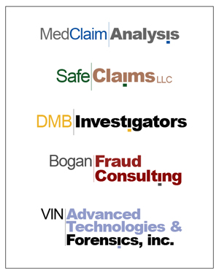
This is My COMPANY

Slide 19
This is My COMPANY
Every day at my company:
I am President and CEO of PC550 Holdings, Inc.
My Job is to insure the continued development and success of the business. We are a holdings company which owns a variety of insurance related, mostly anti-fraud, insurance service provider companies. It is also my responsibility to recognize new opportunities for the company and seize upon them.
I do this by insuring that we are hiring the best talent and working collaboratively with them to improve our services or a business process already being offered else-where.

Slide 20
My Career Path
I started as a an insurance investigator working for an insurance company.
I did a lot of networking
I was a police officer for 17 years and left after being seriously injured.
I am now the CEO of this organization.
I went through a lay off
My vendor, a forensic locksmith needed help
Notes:
You may use this chart to describe your journey to the current career

Slide 21
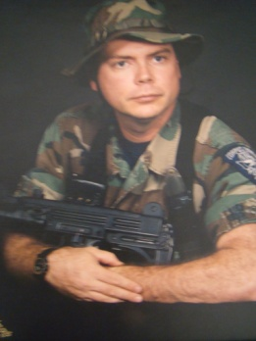
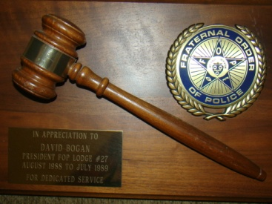
My Career
The first job I had after college was:
I was a SWAT Officer the City of Corpus Christi Police Department Texas
The worst job I have ever had was:
Selling Kirby vacuum cleaners door to door

Slide 22
My Career
Challenges I have had to overcome throughout my career are:
(list a few things that have made your career path difficult or that you have had to learn/change along the way)

Slide 23
Compensation at my company
C-Suite
($350K)
Management
($150K)
Middle Manager
($75K)
Entry Level
($40K)
Notes:
Use this graph to show general compensation ranges for people in various roles in your company

Slide 24
More than just work
When I am not at work I like to:
I am active with my family
Asst. Coach Middle School Debate Team
Asst Coach of Middle School Golf Team
Scoutmaster of my son’s Boy Scout Troop
Camping
Hiking
Outdoors activity
Reading
Golf
Cooking

Slide 25
Do it all over again?
If I could talk to my high school self, what would I say?
Stay Focused
Realize that there is a lot of life to follow
Be true to who you are
Life is short….Be Happy
Yes, I would absolutely do it all over again!

Slide 26
QUESTION AND ANSWER

