Slide 1
Nima Moayedi
Alliance - Collins Family
youthbusiness: ALLIANCE
April 26th, 2015

Slide 2
introduction
My name is Nima Moayedi and I’m 42 years old
I work for Razorgator
Razorgator sells tickets to sports, concert and theater events worldwide
My role at Razorgator is CEO
I’ve been with Razorgator since 2006 and have held various management roles. I took over as CEO at the end of 2010

Slide 3
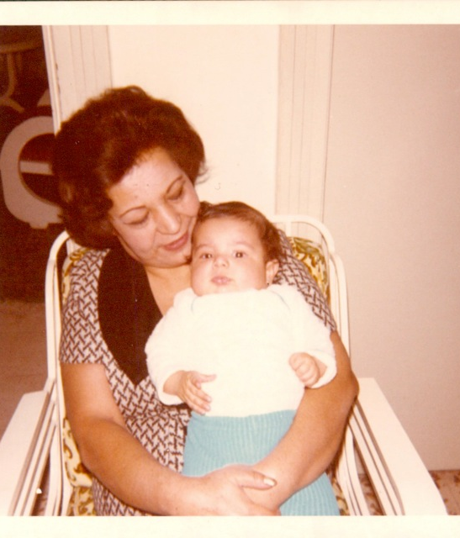
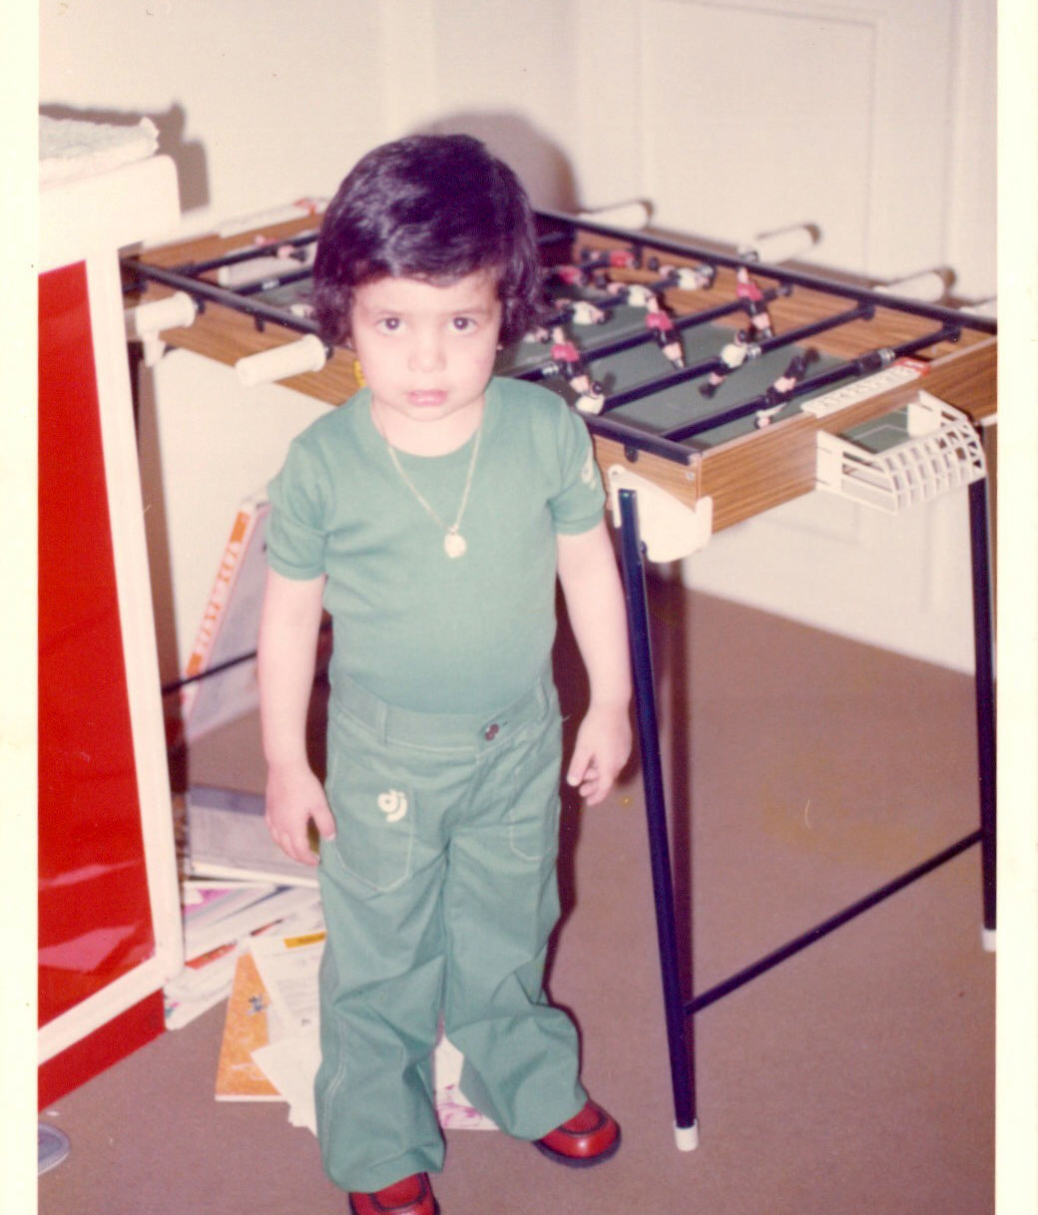
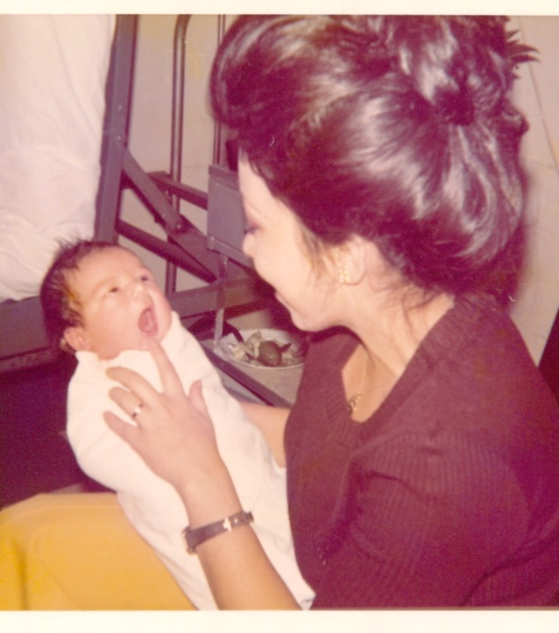
The early years
I was born in Tehran and moved to London when I was 5 (1978)
2 days old :)
with grandma
I miss the hair

Slide 4
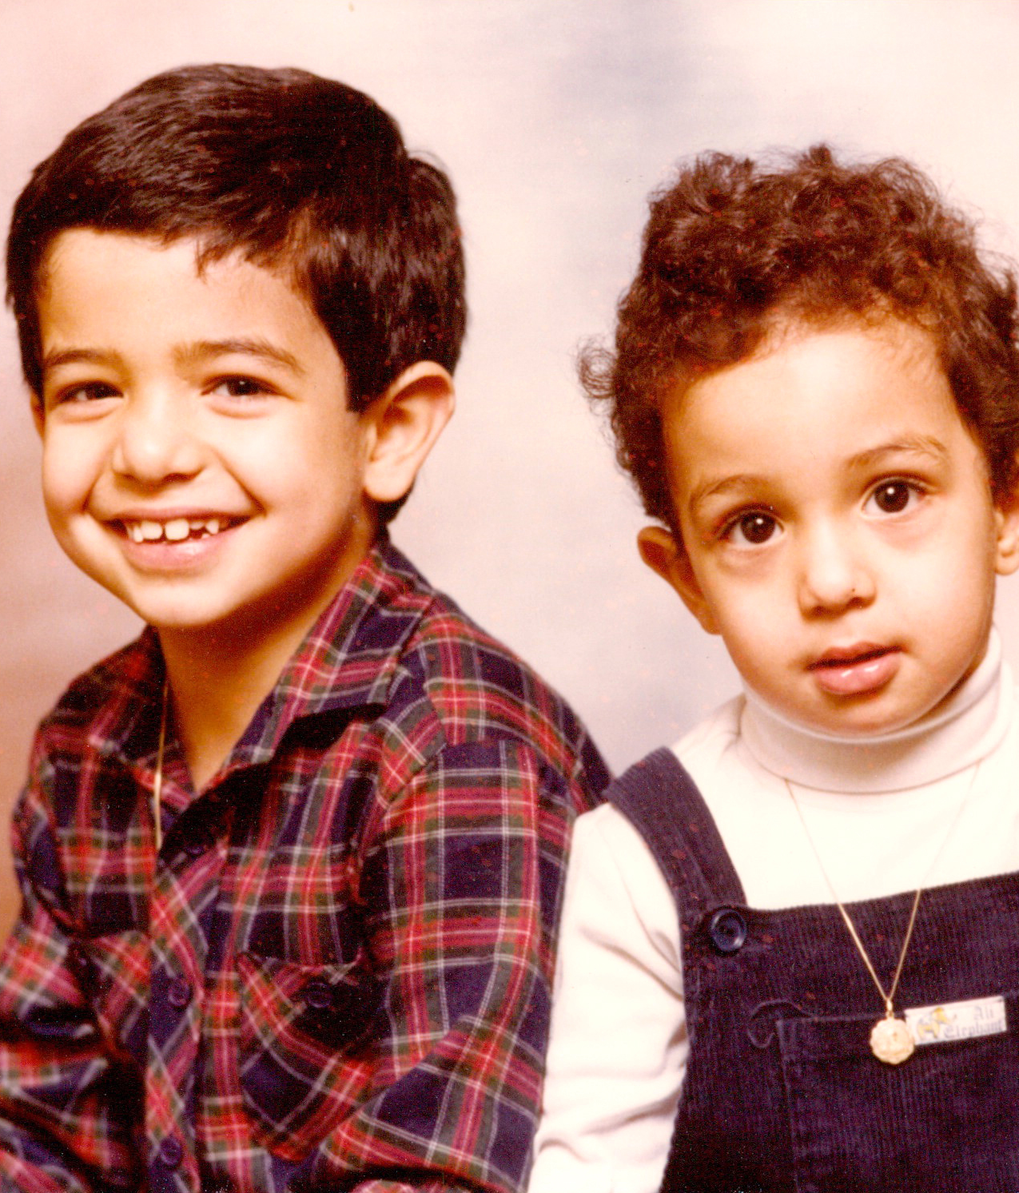
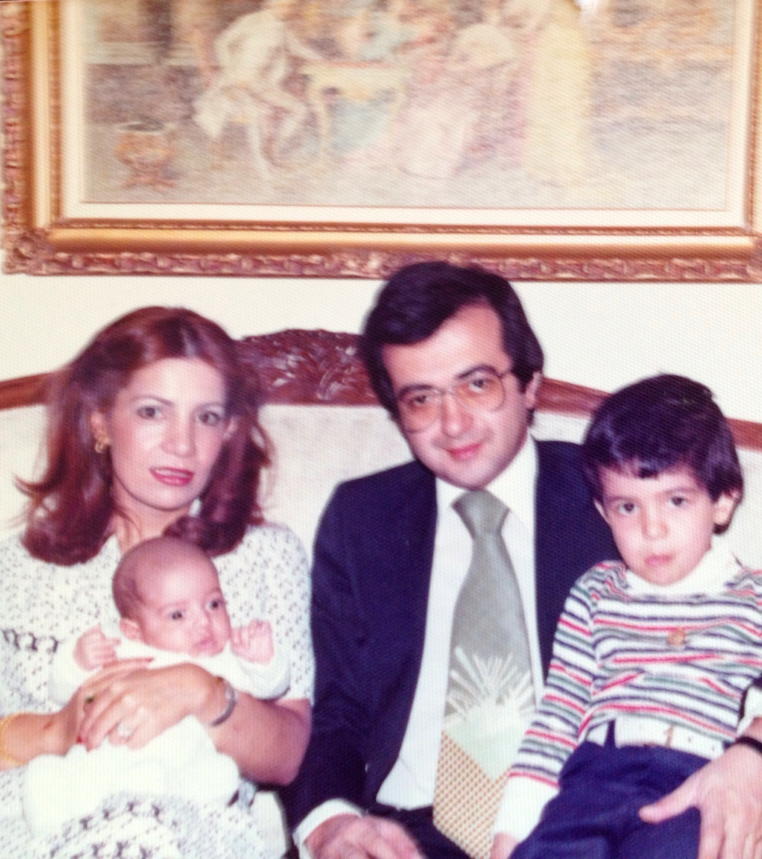
my family
I’m one of the lucky ones; a loving family…
My brother Kasra (Kaz)
with Mom and Dad

Slide 5
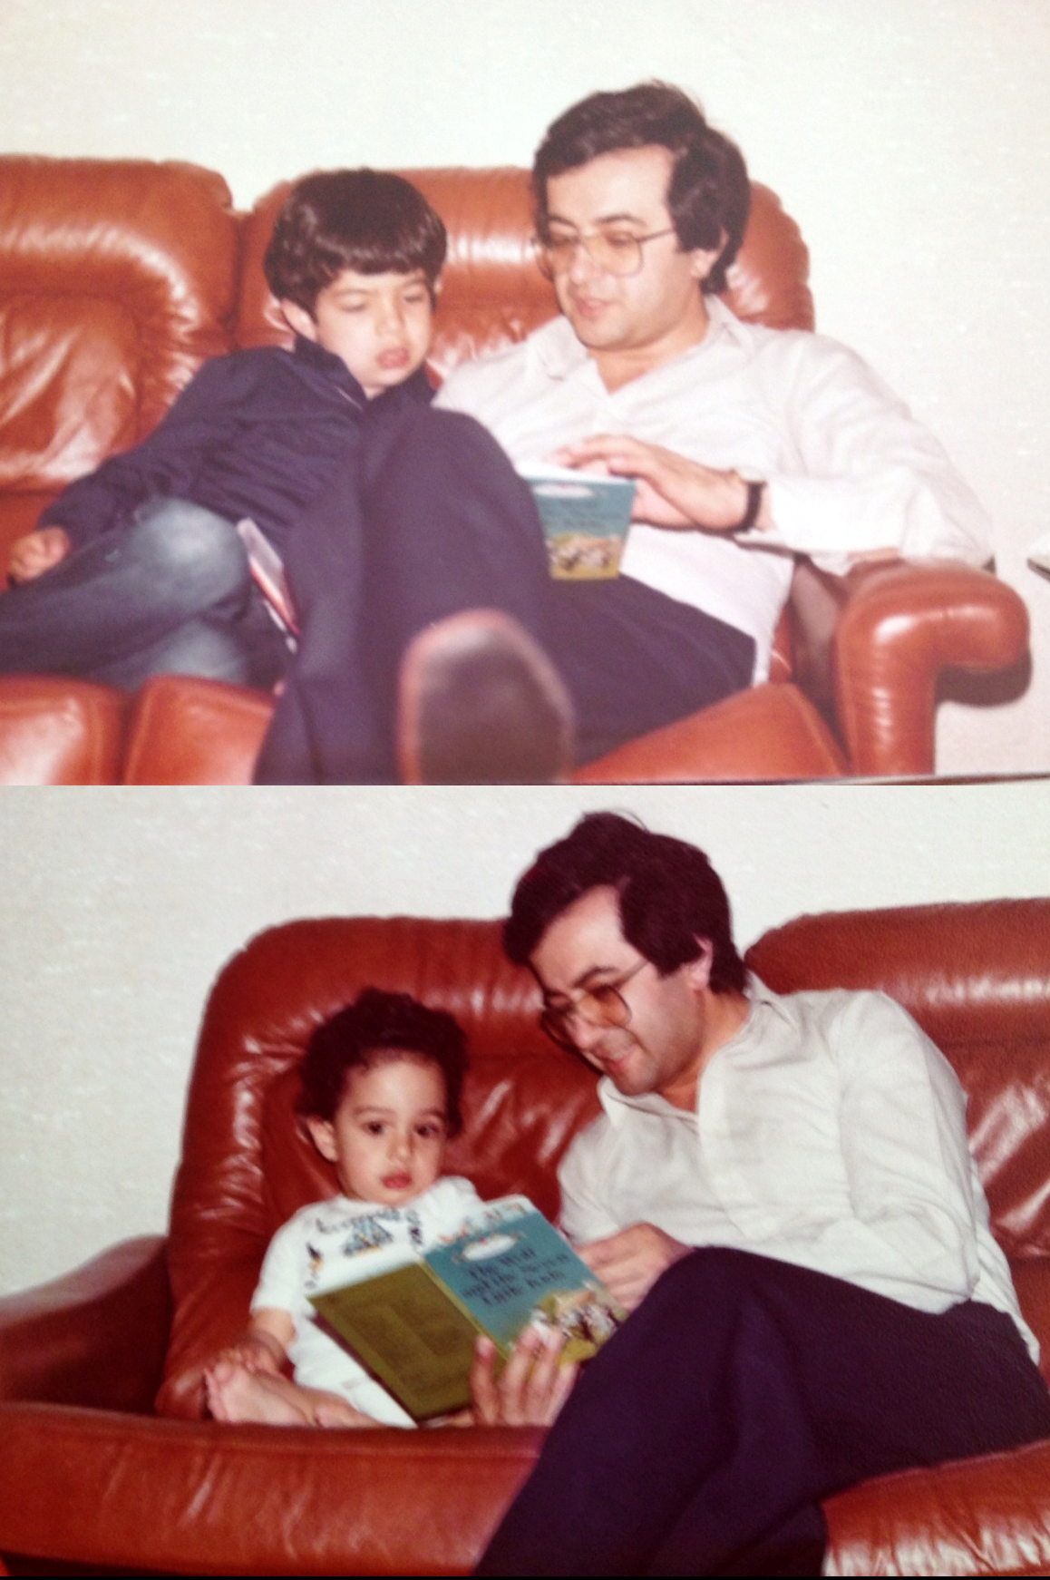
Still LOVE to read!
School in London was strict!
Still super close to my brother

Slide 6
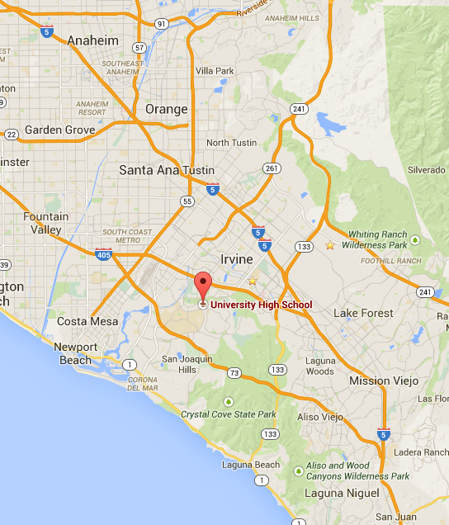
high school
I went to University High School in Irvine, CA
It was a huge cultural change from the boarding school I went to in London…

Slide 7
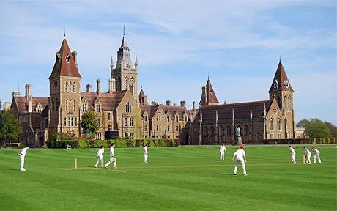
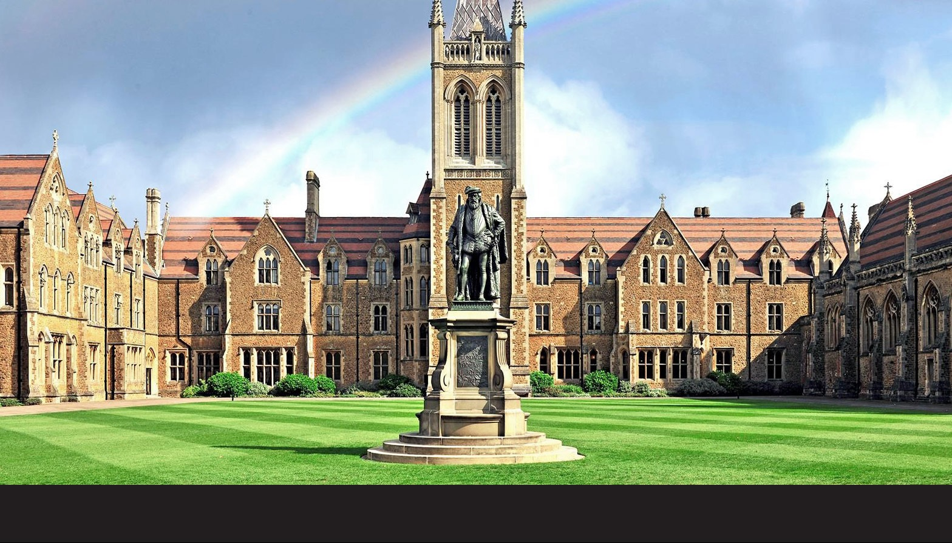
from UK to USA
Things were much more formal in the UK
High school here was a big change for me!
Language nuances, totally new atmosphere
My school there, Charterhouse, was a 500+yr old monastery! (very different from Irvine)

Slide 8
high school life
Despite the big change, I adjusted fairly well to high school life
I was always asked to read out loud in English class because of my thick British accent :)
Was pretty much a normal kid in every way. I tended to get along with everybody (I still do)
Kept myself busy with school work (I had a lot of AP classes because of my transfer) and I read a lot
Loved going to the arcade (do they even have those anymore?)

Slide 9
high school
Things I didn’t enjoy in HS
Classes
History, Biology, PE
Sports
Was never really into sports :-/
Things I enjoyed in HS
Classes
English, French, Chemistry, Physics, Photography
In-school activities
President of French and Persian clubs, Yearbook
Out of School Activities
Going to the movies, reading, hanging out with friends, computers

Slide 10
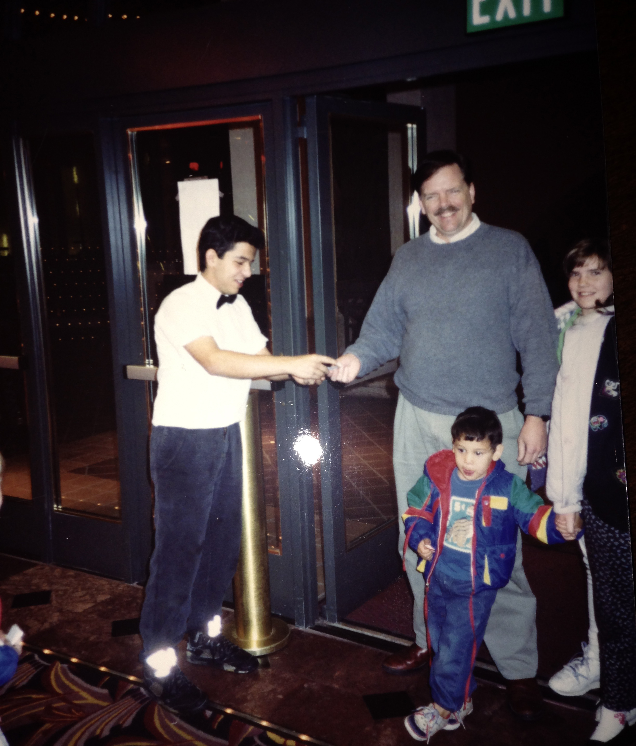
high school
I worked at the movie theater starting when I was 16 years old
Didn’t pay for movies! yeah!
I was hired to work concessions, but also cleaned the theater after shows and took tickets up front
Learned to deal with angry /impatient customers and learned to jump in and help wherever I could when things got crazy

Slide 11
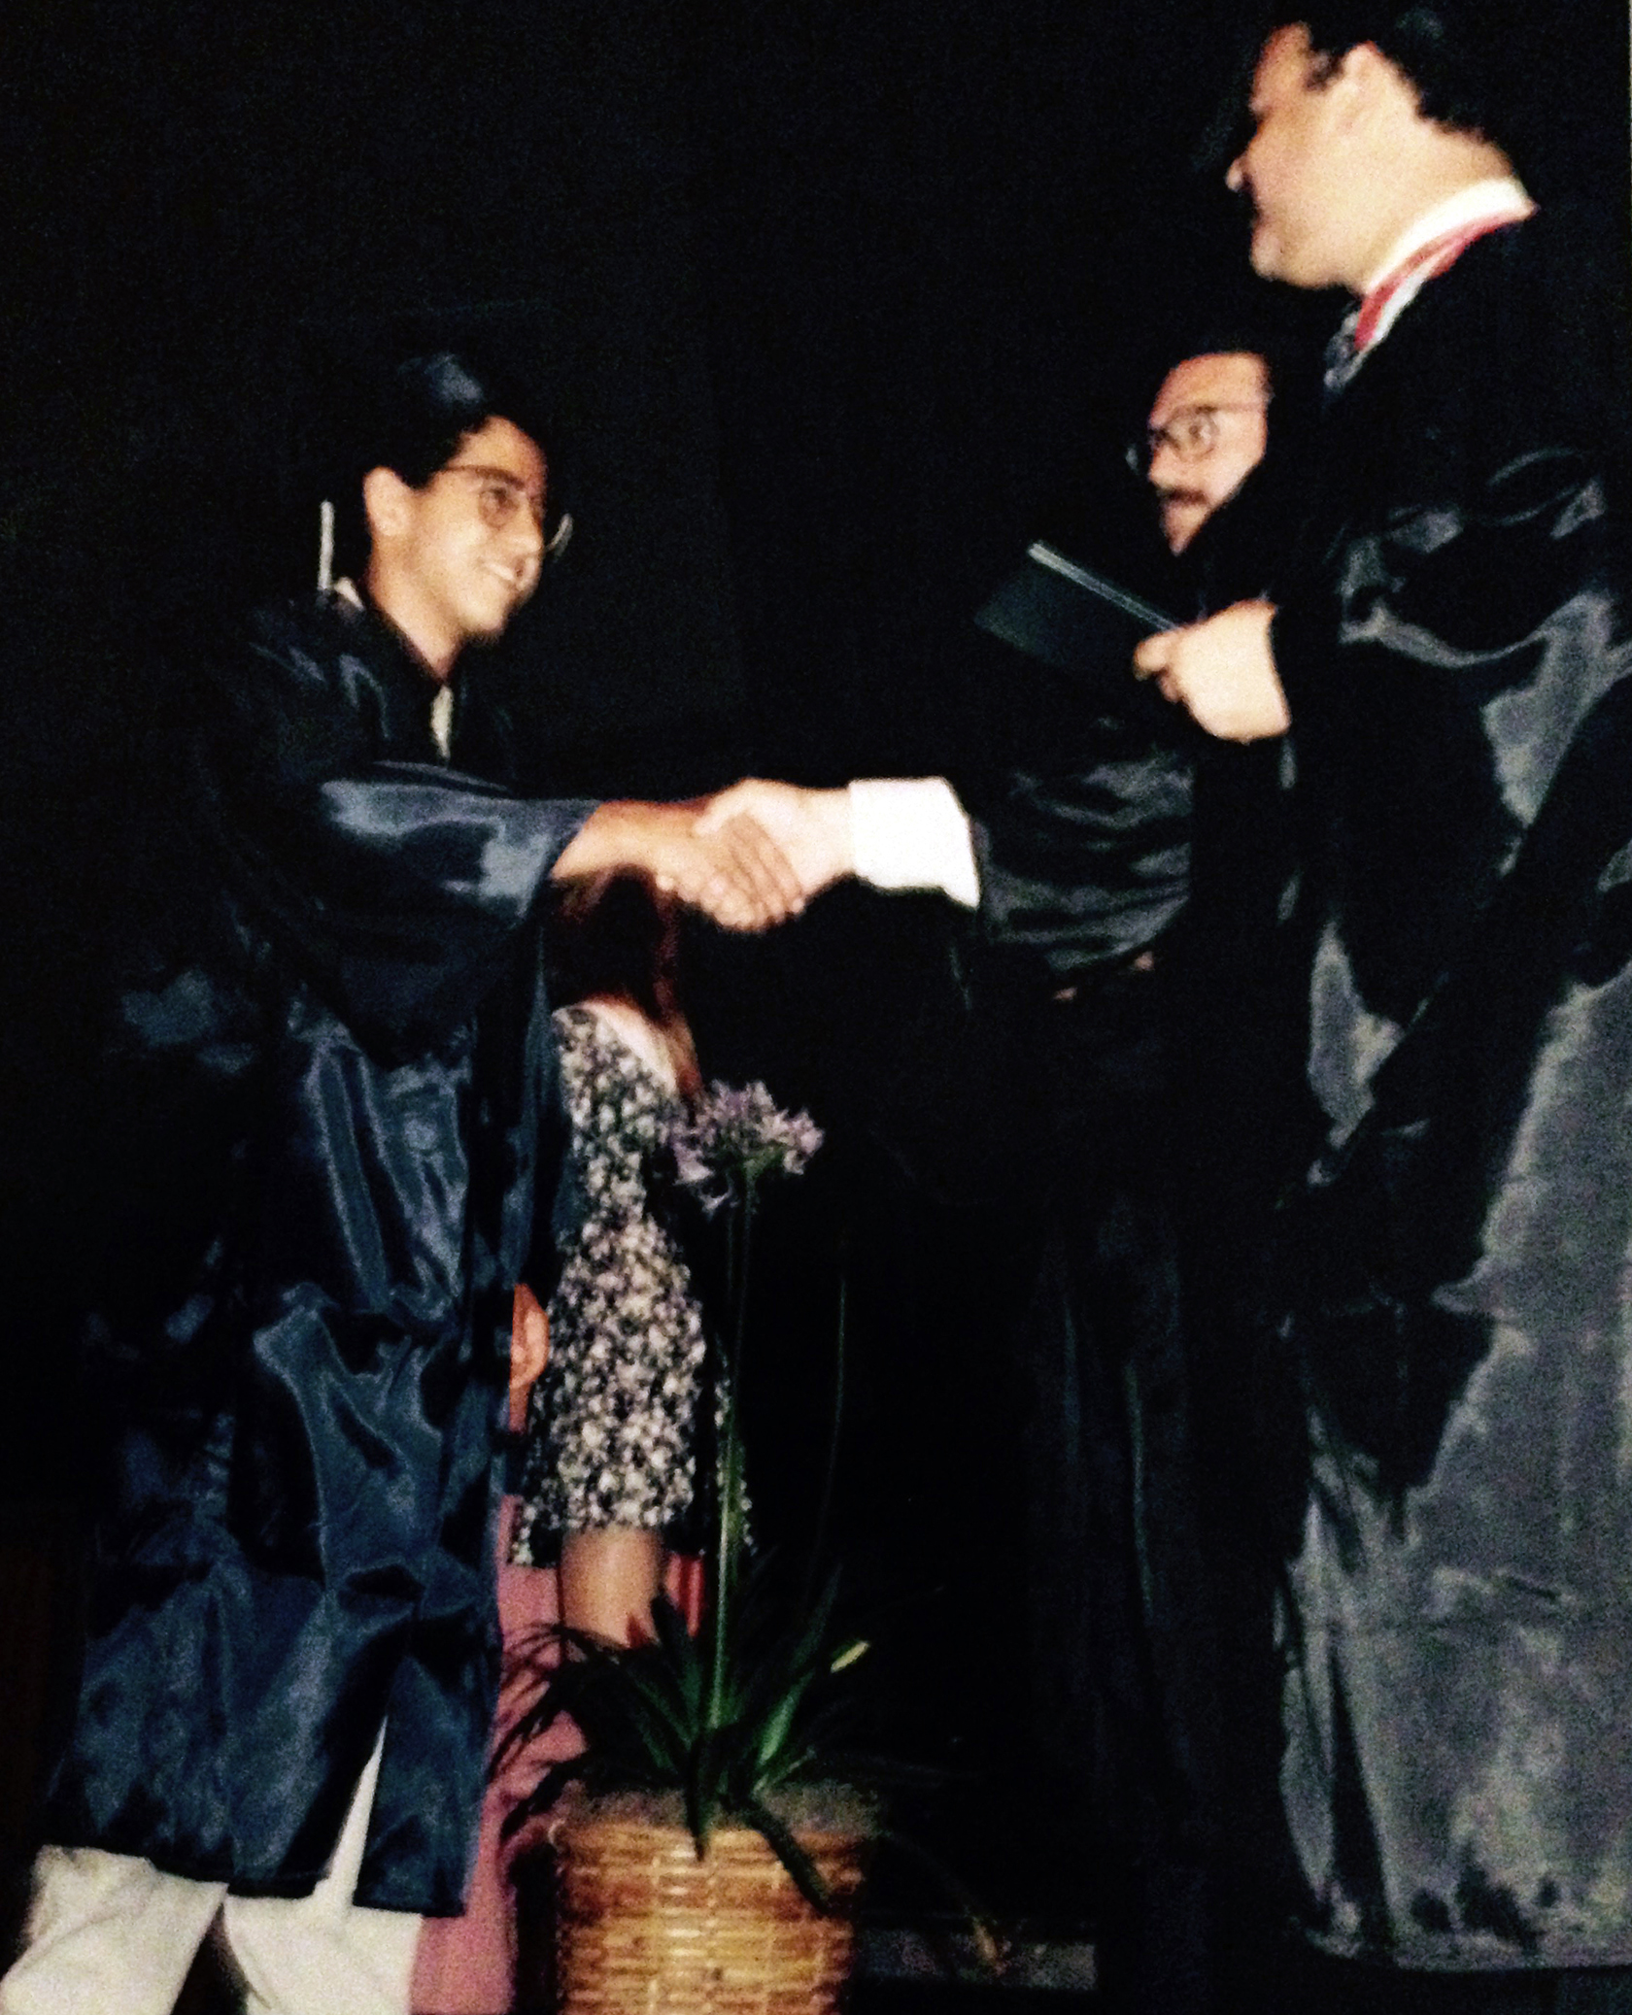
getting into college
I did well in most my classes and my parents were always on me about grades. No excuses!
I took an SAT course with the Princeton Review
My sore improved so much that I was asked to come back and teach once I graduated
Ended up becoming teacher of the year and taught SAT Math, English and the GRE for 4 years with them. Some of my fondest memories of that time

Slide 12
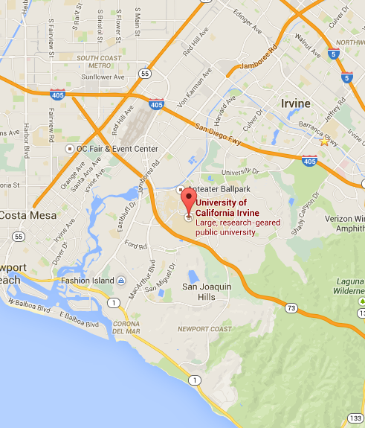
college
I went to University of California, Irvine (UCI)

Slide 13
college
I majored in Political Science and minored in Sociology: Law and Criminology
I had a pretty well balanced mix of school, work and personal life
At school I enjoyed statistics and did research with an incredible professor, Dr. Noviello. I also loved all my criminology classes
I worked at computer store, first at Computer City and then Computer Palace
I promoted parties under the brand “Mystery 4” :-) (still around, but I’m not involved)

Slide 14
college
Classes I enjoyed
Probability and Statistics
International Business
Macroeconomics
Anything Law/Criminology related (e.g. Organized Crime)
Classes I didn’t enjoy
Political Theory
Public Policy
US and Int’l politics and Government
Urban Policy

Slide 15
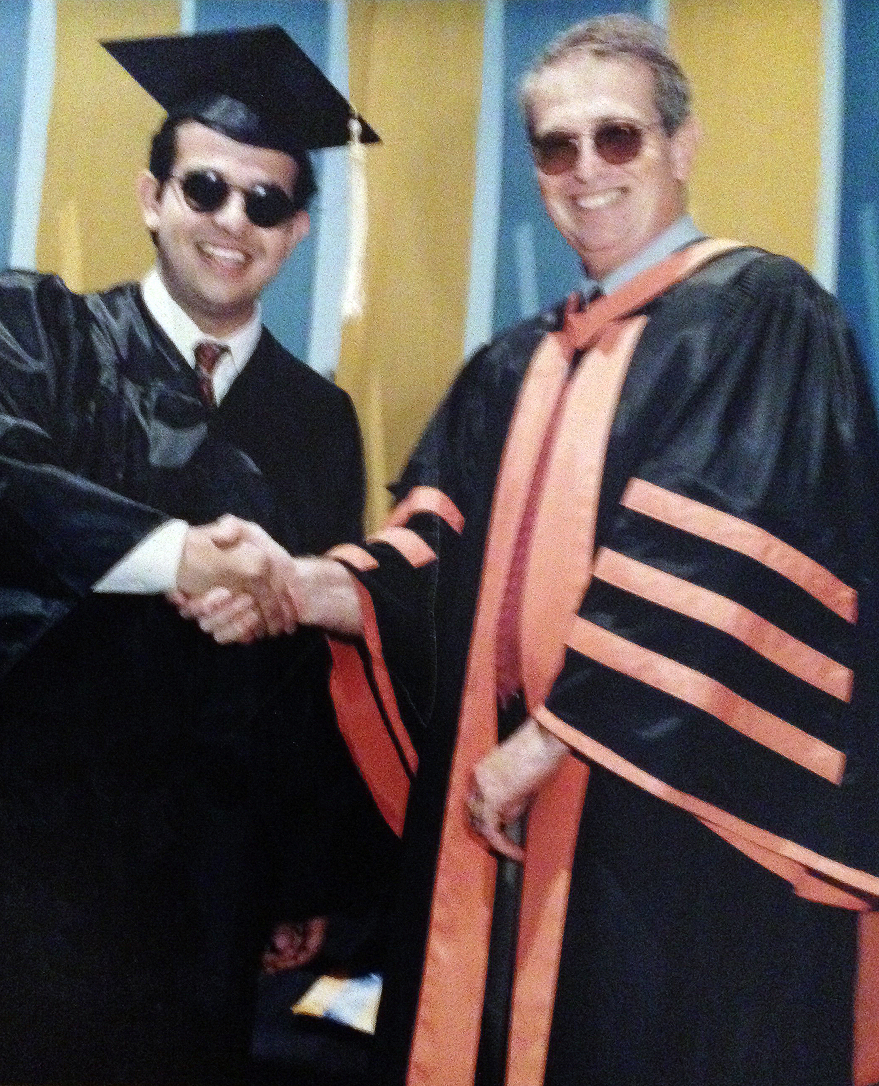
college
In college, I was bit by the entrepreneurial bug
I started Simple Web (we designed websites in the very early days)
I originally intended on going to law school (took the LSAT and did fairly well), but I ultimately took the GMAT and got into the MBA program at UCI
Regrets? I should have registered some domain names :)

Slide 16
grad school
I went to University of California, Irvine - Graduate School of Business
Now known as the Paul Merage Graduate School of Business

Slide 17
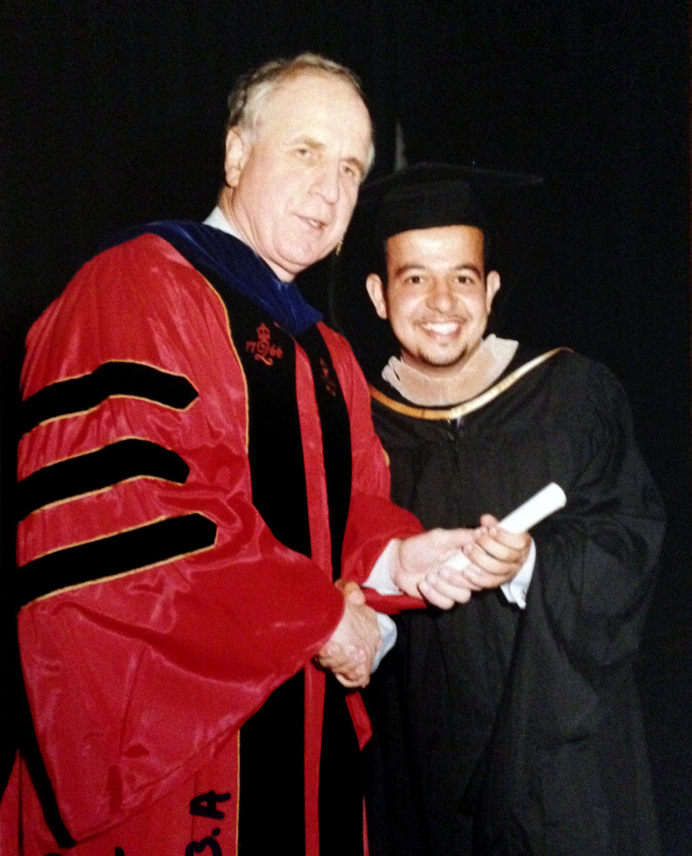
grad school
I worked full time (at Webzter) and I went to school in the evenings
It was a lot of work and some very long days!
I learned a lot about teamwork and working well in groups
My fondest memories (although I didn’t realize it at the time) were working until very late with my group and turning in some really great work I was proud of
Regrets? I should have paid more attention in Financial Accounting…ugh

Slide 18
career path
Worked at Edwards Theaters, Computer Palace, Computer City
Started Simple Web (we built websites for small companies)
Sold to Webzter (we built website for medium sized companies)
They went out of business in 1999 with the crash
Went to Capita as Director of Operations (we built websites for huge companies)
Went to Paciolan (a ticketing company, later sold to Ticketmaster)
Left Paciolan to start my own company, eWorldTones but it failed after about a year
Came to Razorgator in 2006 - and took over as CEO in late 2010

Slide 19
current role
We’re all about the live event experience! Sports, Concerts and Theater tickets
We also have a corporate division; a SaaS product to help huge companies manage their ticket assets
I actually don’t go to as many events as you might assume :)
As CEO I oversee Tech, Finance, Sales/Customer Service, Operations/IT, HR, Marketing…pretty much anything and everything
Since starting in 2006, we’ve been through a lot of changes
I’ve been in Customer Service, Ops, I’ve been a ‘turnaround CEO’ (2011-2014) and now a ‘growth CEO’

Slide 20
current role
Sales breakdown: 65% Sports, 30% Concerts and 5% Theater
1million+ customers, $1.5 billion of inventory, $60+mm from investors
Shift to mobile is happening super fast!
Over half our orders now include digital tickets
These last 2 areas are what we’re focusing on now

Slide 21
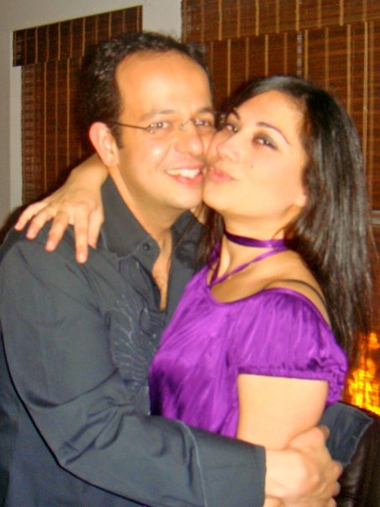
more than just work
I got married to Mariam in 2007; she’s amazing!!
We love to travel; and have been to 15 countries in the last 5 years
We love eat out and try new restaurants (Yelp = Favorite App)
No kids yet, but hopefully soon ;)

Slide 22
what i’ve learned
Hard work pays off and it’s OK to fail
Just don’t give up!
Keep learning - continue to stay curious
Think about Win-Wins! (not I win, you lose)
Learn how to network & connect with people. Be confident.
Be nice. As simple as it sounds :)

Slide 23
do it all over again?
If I could talk to my high school self, what would I say?
Start learning about how to save for your future! It’s never too early and never too little.
Your parents are right more often than you think
Life will start moving really fast as you get older - enjoy and cherish every second

Slide 24
The Stonecutters Credo
“When nothing seems to help, I go look at a stonecutter hammering away at his rock perhaps a hundred times without as much as a crack showing in it. Yet at the hundred and first blow it will split in two, and I know it was not that blow that did it, but all that had gone before.”
–Jacob Riis

Slide 25
questions and answers

Slide 26
THANK YOU!!
nima@razorgator.com

