Slide 1
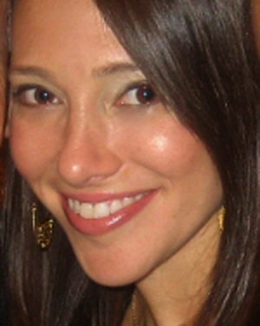
Jodi Redmond
Founder/Director
Subject Tutoring ★ Test Prep ★College Admissions
Every day I work with students, mainly to help them gain admissions to universities.

Slide 2
Film Producer

Slide 3
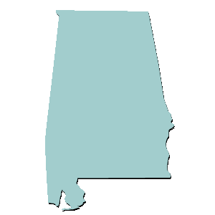
YOU’RE FROM WHERE?!
ALABAMA

Slide 4
JODI AS A CHILD

Slide 5
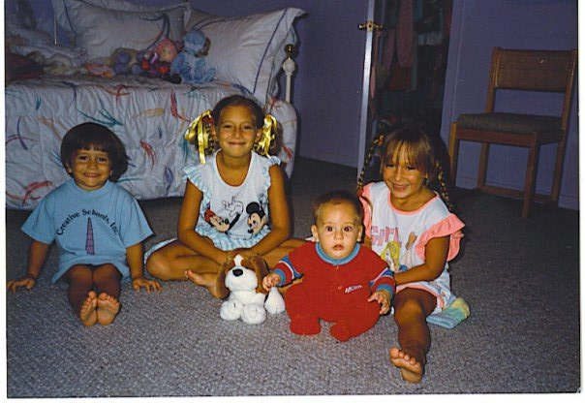
My Family

Slide 6
MY HIGH SCHOOL
I attended the Alabama School of Fine Arts
Birmingham, Alabama

Slide 7
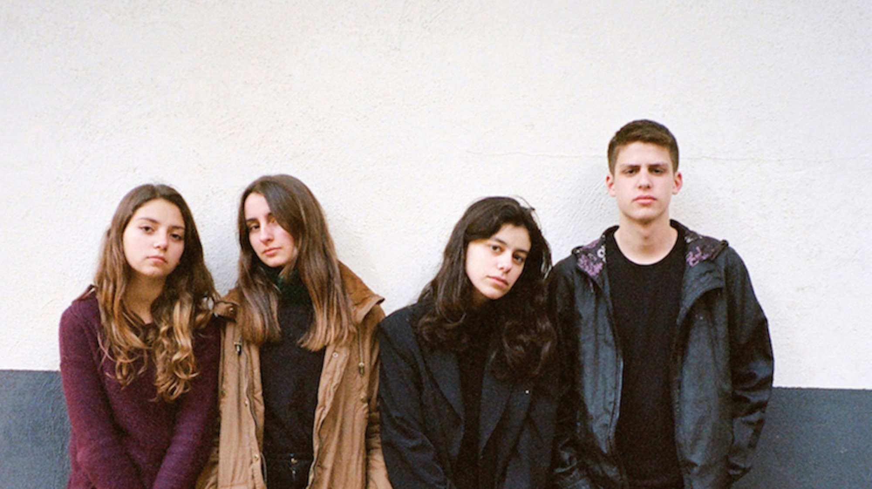
High School

Slide 8
CLASSES

Slide 9
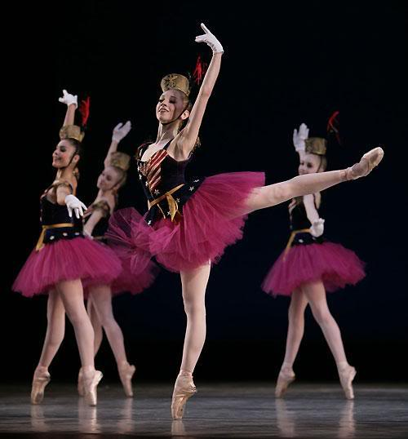
High School
Things that I really liked in High School were: DANCE, DANCE, AND DANCE. Also liked indie bands.

Slide 10
High School
Things that felt difficult or challenging for me while I was in High School were:
Family Life
Managing academics with art form (dance); touring
Wondering if/where I would dance professionally
My body
Injuries
Not feeling like part of society, but also not really wanting to be a part of it.

Slide 11
High School
Jobs I worked while I was in High School were:
My job was to dance and stay in school.
Summers: I worked for my father, who was a podiatrist.

Slide 12
Getting in to College
The top few things I did to ensure I got into college were:

Slide 13
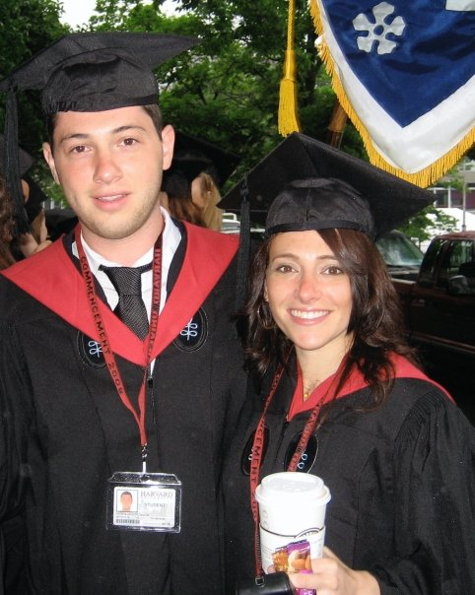
College
I attended college (and) grad school in Cambridge, Massachussetts (with a hiccup or two in between)

Slide 14
College
Things I enjoyed in College
Things I didn’t enjoy in College
Choosing which courses to study
Getting top grades (never in high school)
Being independent
Making friends that were different from my previous crowd.
Trying to juggle work and studying
Feeling like I was behind because my high school background was different
Large classes (freshman year)

Slide 15
College
Favorite classes
Least favorite classes
A History of Violence (Holocaust Studies)
A course on riots fueled by racism, inequality, police brutality
Developmental psychology
International Education

Slide 16
College
Jobs I worked while I was in College were:
Professional ballet dancer
Dance teacher at ballet school
Summers at my father’s office
Retail and waitress (summer)

Slide 17
College
Things that felt difficult or challenging for me while I was in College were:
I had focused only on dancing my entire life, so I had little idea as to what types of jobs were available or even what areas of study were options for me.
I was working, so wasn’t able to be as social as most others.

Slide 18
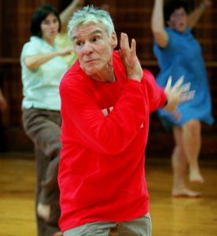
Getting a job (becoming a stalker) after College

Slide 19
NATIONAL DANCE INSTITUTE

Slide 20
SEOUL, KOREA

Slide 21
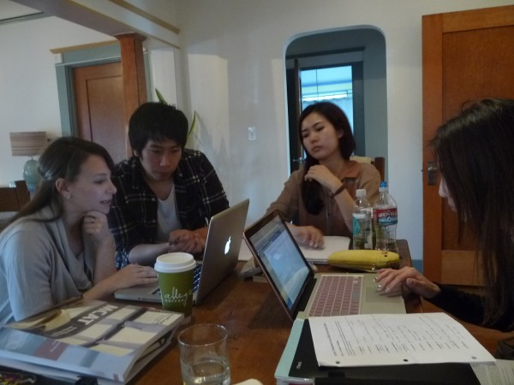
A Day at Aureus Prep
Started company on my own, from scratch.
Every day at my company, I work directly with students and parents, mostly on college admissions planning.
Based in Los Angeles, but have students around the globe.
Insert company picture

Slide 22
My Career Path
I began in arts-in-education for my dream organization.
I began my own company (the old-fashioned way), and am now in charge of my days.
Moved my way up to co-directing the organization.
Notes:
You may use this chart to describe your journey to the current career

Slide 23
My Career
The first job I had after college was:
New York City Opera Education (I had to apply successfully and go through 4 rounds of interviews)
The worst job I have ever had was:
Smelling feet

Slide 24
My Career
Challenges I have had to overcome throughout my career are:
Not having ability to practice my art form.
Not working for a company, so lacking stability = RISK
Figuring out how to juggle multiple interests

Slide 25
My role within organization
ME
TUTOR
TUTOR
TUTOR
Notes:
Use this graph to give more description of your role specifically (responsibilities, typical work week, direct reports, etc.)

Slide 26
Compensation at
Director/Owner
$200K - 350K
Management
Up to $150k
Tutor/Consultant
(Freelance)
Up to 75K
Entry Level
(Administrative)
($20K)
Notes:
Use this graph to show general compensation ranges for people in various roles in your company

Slide 27
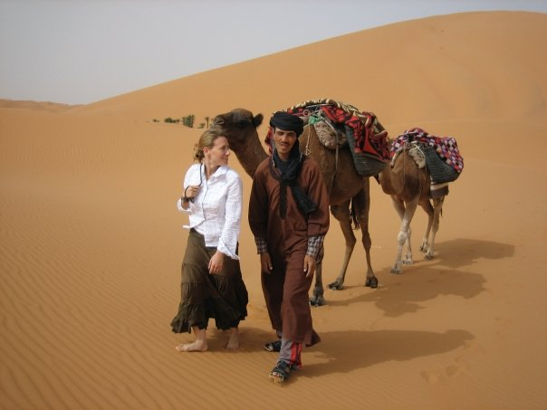
More than just work

Slide 28
Do it all over again?
If I could talk to my high school self, what would I say?
Learn for the sake of learning
Don’t focus so much on grades in college
Just do you.

