Slide 1
Mark Siegel

Slide 2
INTRODUCTION
My name is Mark Siegel and I am 46 years old.
I work for Emerald Health Services
Emerald Health is a staffing company that provides nurses to hospitals.
My role at Emerald Health is the President and Chief Operating Officer
In my role, I manage the daily operations of the business

Slide 3
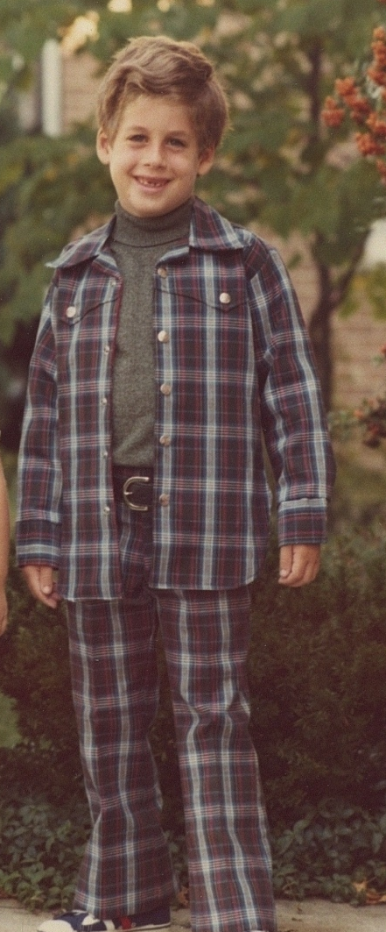
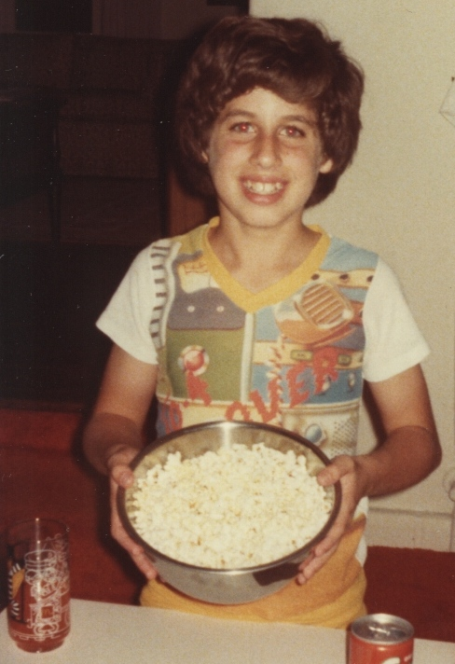
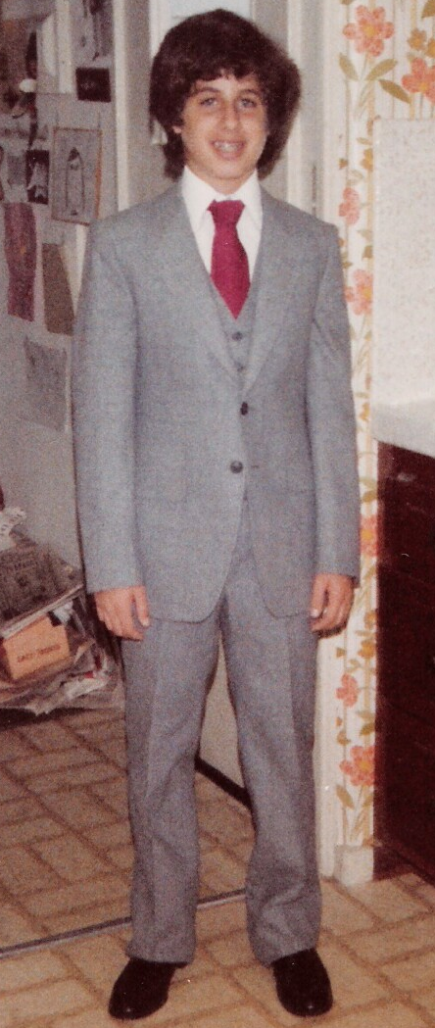
The Early Years…
I was born in Michigan and moved to Los Angeles when I was 9 years old.
This is a picture of me at age 7.
This is a picture of me at age 11.
This is a picture of me at age 13

Slide 4
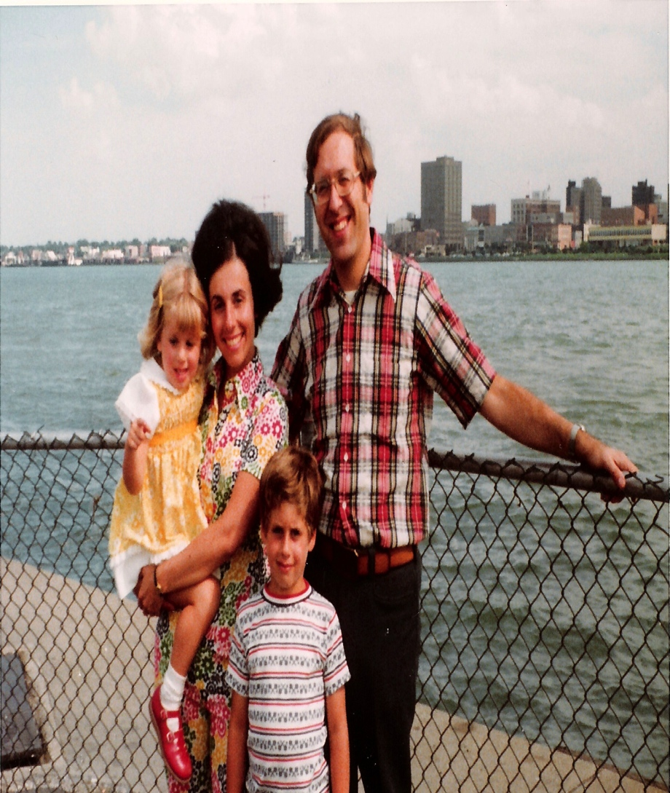
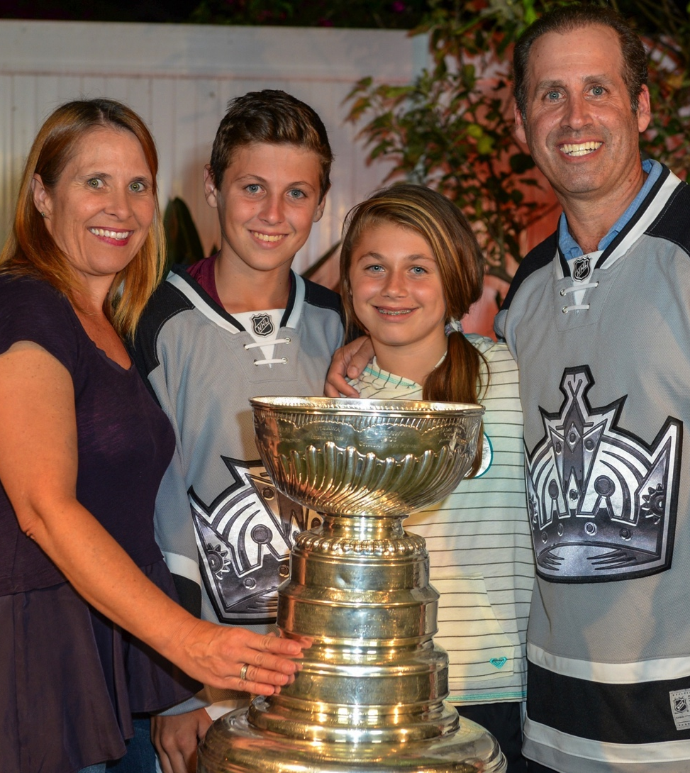
More Early Years…
A little about my family…Then & Now…
This is a picture of me with my mother Diane, Father Stan and sister Janet
This is a picture of me, my wife Tamara and my two kids, Justin and Amanda

Slide 5
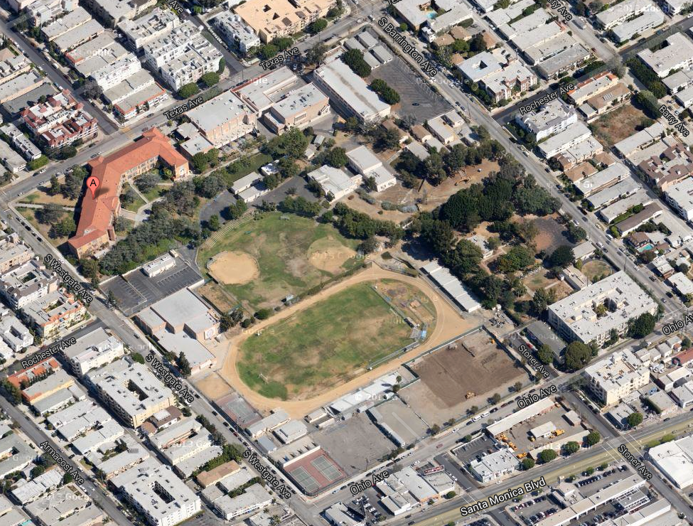
HIGH SCHOOL
I attended University High School in West LA and graduated in 1986

Slide 6
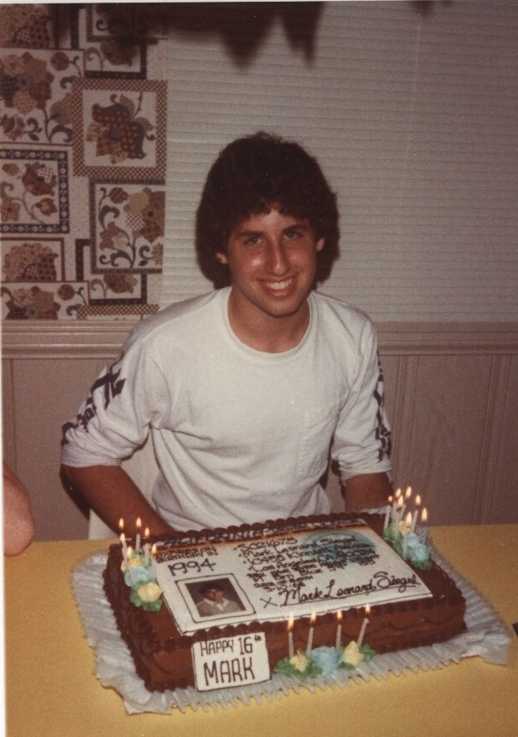
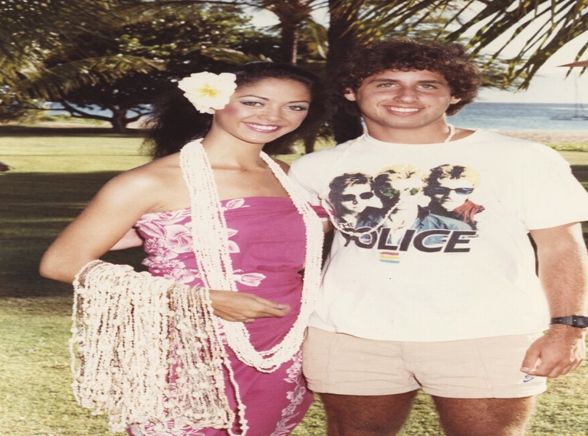
HIGH SCHOOL
As a HS student I was involved in a variety of activities. I played a lot of tennis and also played drums in school bands and bands with my friends
As a HS student I was a bit overwhelmed. I had good friends, enjoyed music and did well in school, but wasn’t sure of how I wanted to spend my time or with whom I wanted to spend it.
Summer trip 17 years old
16th Birthday

Slide 7
HIGH SCHOOL
Things I enjoyed in HS
Things I did not enjoy in HS
Music
  I love the drums!
Science
  “Hands on” experiments were my favorite
History
  I love learning about other time periods
Getting to school
  Long walk to a city bus that was always crowded.
“The grove kids”
  The “in” kids were not friendly, even though some were my friends since grade school
Language classes
  I don’t learn languages easily
Sitting still and paying attention
  It was very hard for me

Slide 8
HIGH SCHOOL
Activities/Athletics in HS
Jobs I worked while in HS
I hate getting up early, but got to school at 8.
Band practice or drum lessons were after school 2X per week.
Tennis after school 2 per week.
Homework would keep me up late at night. I rarely slept more than 7 hours a night.
My family didn’t have much money so I had to work for spending money.
Newspaper delivery boy, movie theater doorman, ice cream scooper, valet parking attendant, restaurant busboy, balloon delivery driver, phone telemarketer. I did it all!!!

Slide 9
HIGH SCHOOL
Fondest memories from HS
Obstacles/Adversity you had to overcome in HS
Playing with my band at clubs in Hollywood on weekends. Promoting the shows for the weeks leading up to the event.
Hanging out with my friends from my jobs.
My first girlfriend.
My dad moved away to New York and left the family.
My mom ran out of money and had to move houses.

Slide 10
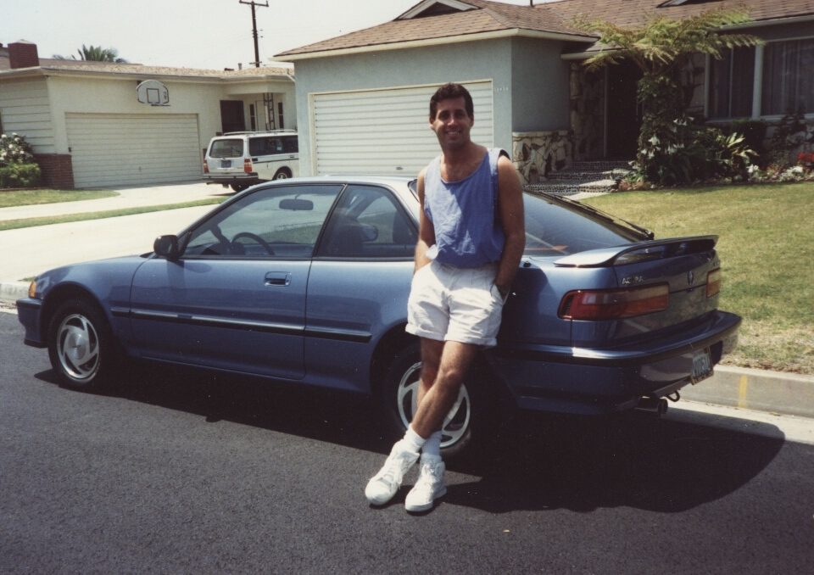
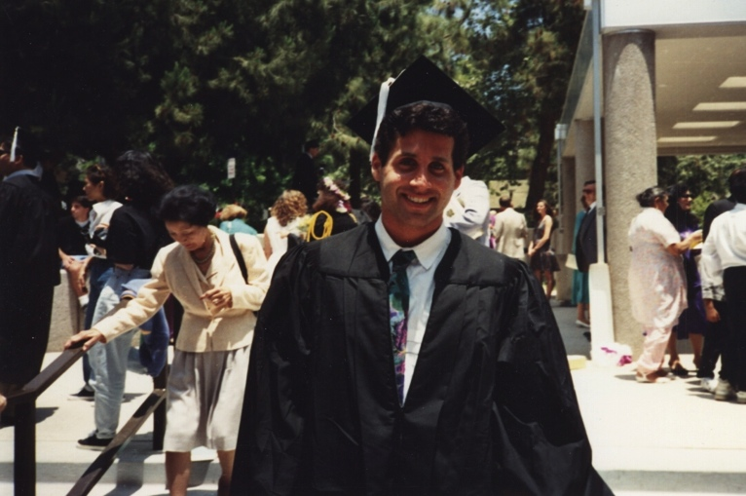
College
I attended college at UCLA.
My first “new” car
UCLA Graduation

Slide 11
College
Activities/Athletics in College
Jobs I worked while in College
I wasn’t good enough to play any school sports, so I did several intramural sports (my dorm, friends, etc.)
I kept playing music with my bands
I had financial aid, but had to work for spending money, so I continued to work through school. Waiting tables and bartending helped pay my tuition.

Slide 12
College
Favorite classes
Least favorite classes
Political Science
  I loved learning about other nations, especially Russia (the Soviet Union)
Sociology
  Learning about people’s behaviors was amazing
Economics
  UCLA didn’t have lots of business classes, so this was my focus
Microbiology
  Failed the class twice
Geology
  Rock, rocks and more rocks
English literature

Slide 13
College
Fondest memories
Obstacles or adversity that you had to overcome
Living in the dorms
  Tons of fun and made great friends
UCLA Sporting events
  Go Bruins!!
Being on my own
  I loved the independence
Money
  My grades suffered since I had to work.
My best friend and I had a big falling out
  His drug use tore apart our 15 year friendship
Shyness with girls
  Fear of rejection was a big deal for me

Slide 14
Career Path
I started in advertising
I am now the President of a healthcare company
I worked as a project manager at Mattel Toys
I joined an internet company called petsmart.com
I started running distressed turnaround companies
Notes:
You may use this chart to describe your journey to the current career

Slide 15

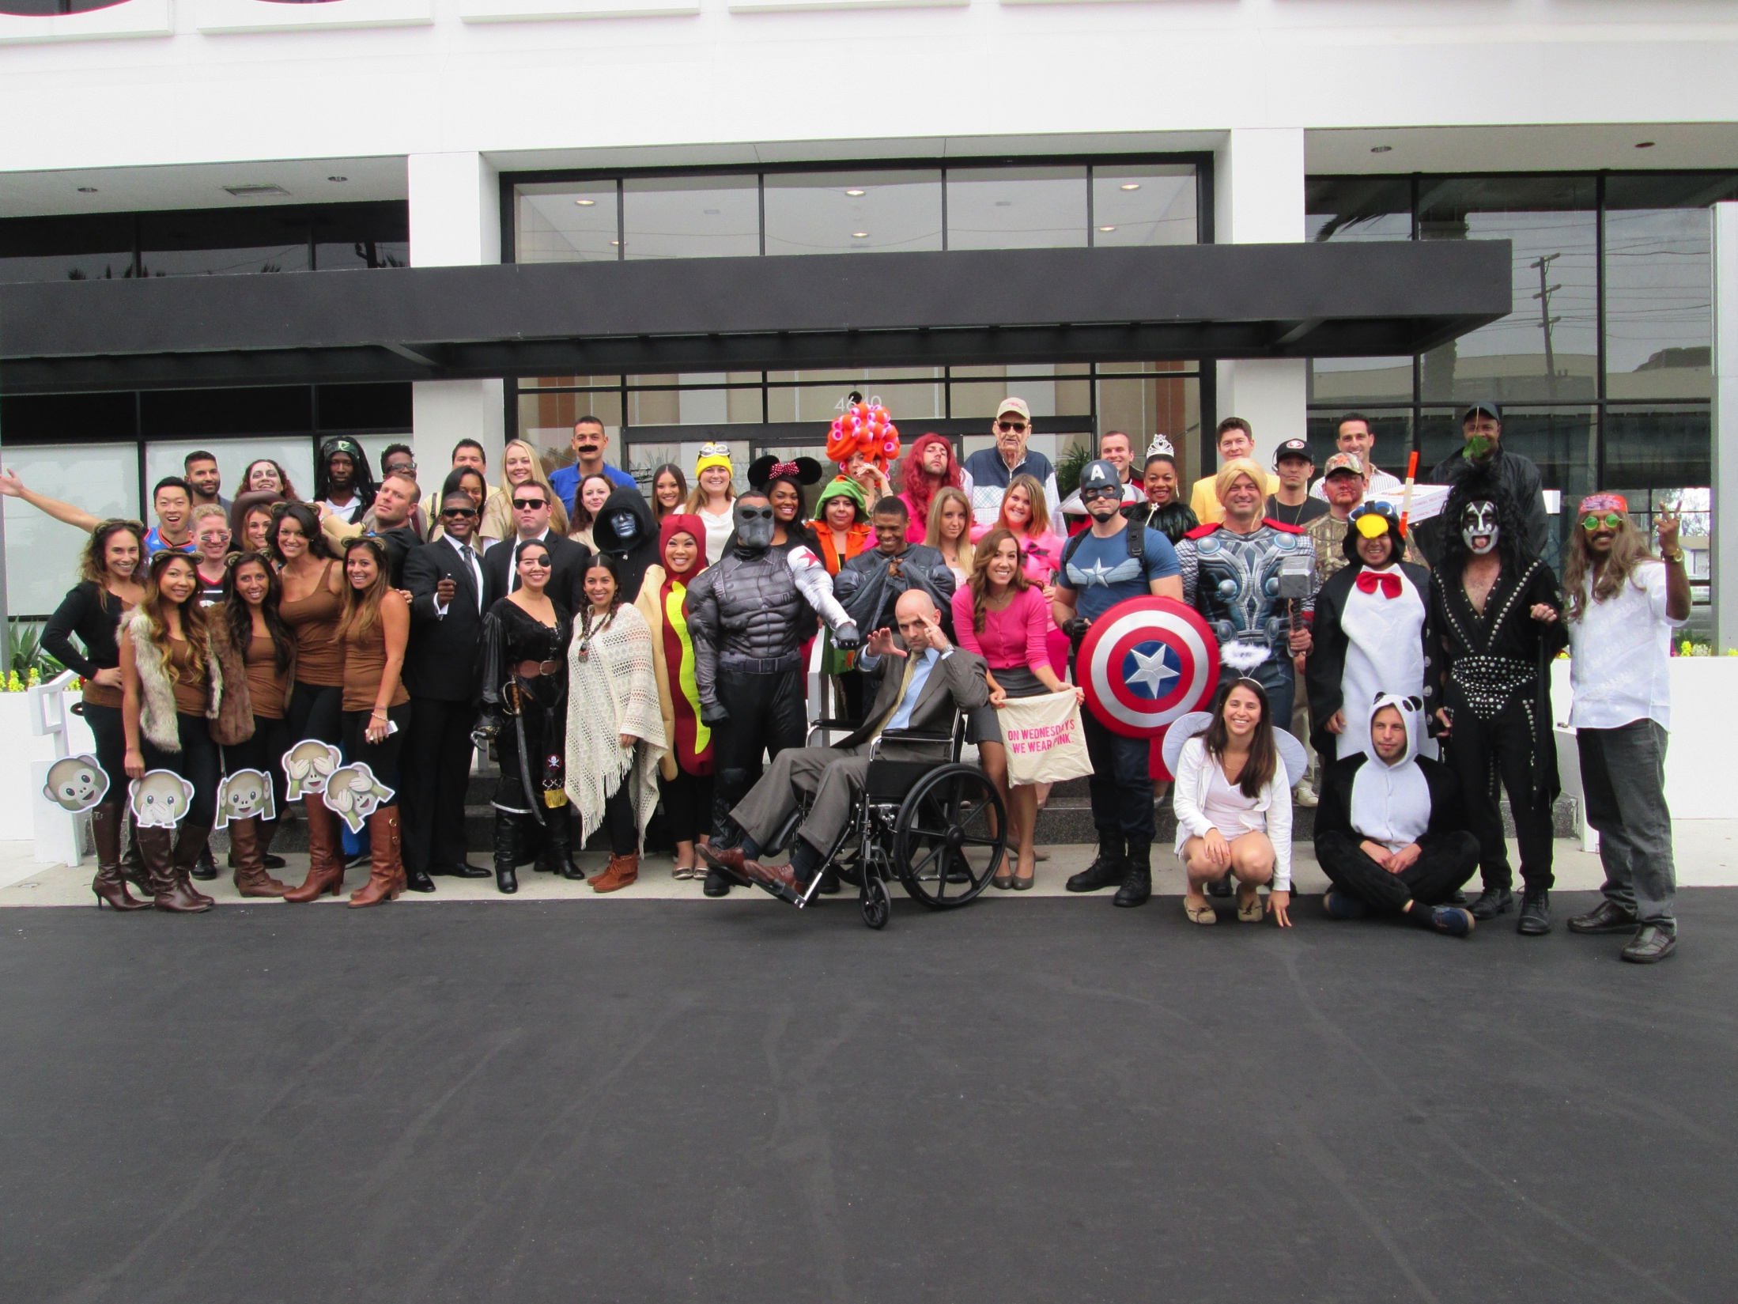
Career
We work hard and play hard

Slide 16
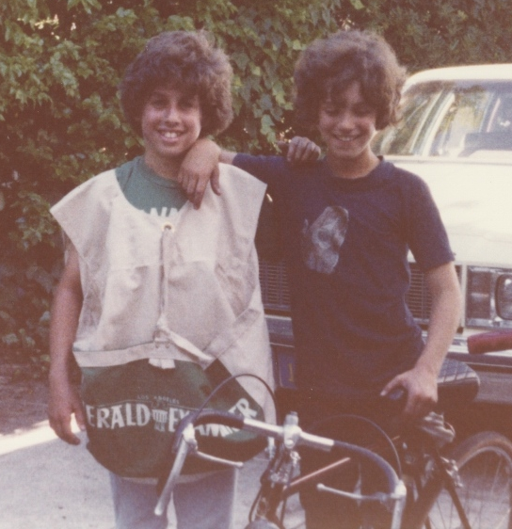
Career
My first Job
My first job was delivering newspapers on a beach cruiser through the hills of westwood. I made $30 per month and worked 6 days per week. Sunday mornings were the worst since the paper was huge!!
That’s me on the left

Slide 17
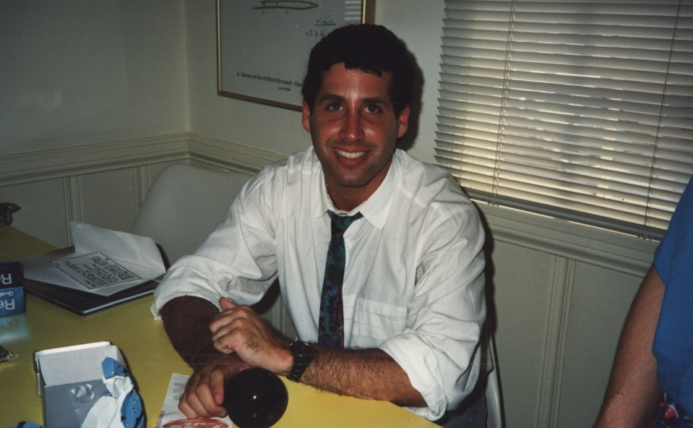
Career
My worst Job
Doing phone sales for a non-profit. You cannot even imagine the horrible things people call you when you call them at home asking for money!

Slide 18
Career
Some challenges I had to overcome in my career
I’ve worked for several companies that were in serious financial trouble and I needed to fix them quickly. I had to do very tough things like firing people, shutting offices and declaring bankruptcy. That was very tough on me.

Slide 19
CURRENT ROLE
History
Emerald was founded in 2002
Size
We have over 400 nurses and employees
Location
Our headquarters is in Marina Del Rey, but we place nurses all across the country
Products
Services
We support hospitals by placing Travel Nurses in critical nursing roles.
Notes:
Use this graph to give more description of your current company (history, size, location, products and services, etc.)

Slide 20
Current Role
President & COO
Finance
Operations
Human Resources
IT/Technology
Notes:
Use this graph to give more description of your role specifically (responsibilities, typical work week, direct reports, etc.)

Slide 21
Career Compensation
Company Management $100k-$200k
Department Manager $75k-$100k
Department Technical role $50k-$80k
Administrative $40k-$60k
Notes:
Use this graph to show general compensation ranges for people in various roles in your company

Slide 22
ACADEMIC EXERCISE
We will now spend several minutes discussing the day’s academic module and how it is relevant in the ‘real world’

Slide 23

QUESTION AND ANSWER

