Slide 1
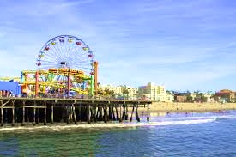
Youth business alliance guest presentation Dennis Wolfe

Slide 2
INTRODUCTION
My name is Dennis Wolfe and I am
44 years old.
I work for Tongal.com.
My company creates commercials and music videos for some of the biggest artists and brands in the world.
My role at Tongal is the Head of Music Content and Partnerships. Every day I work with major record companies, artists and brand marketing teams to create compelling video content for YouTube and TV.

Slide 3
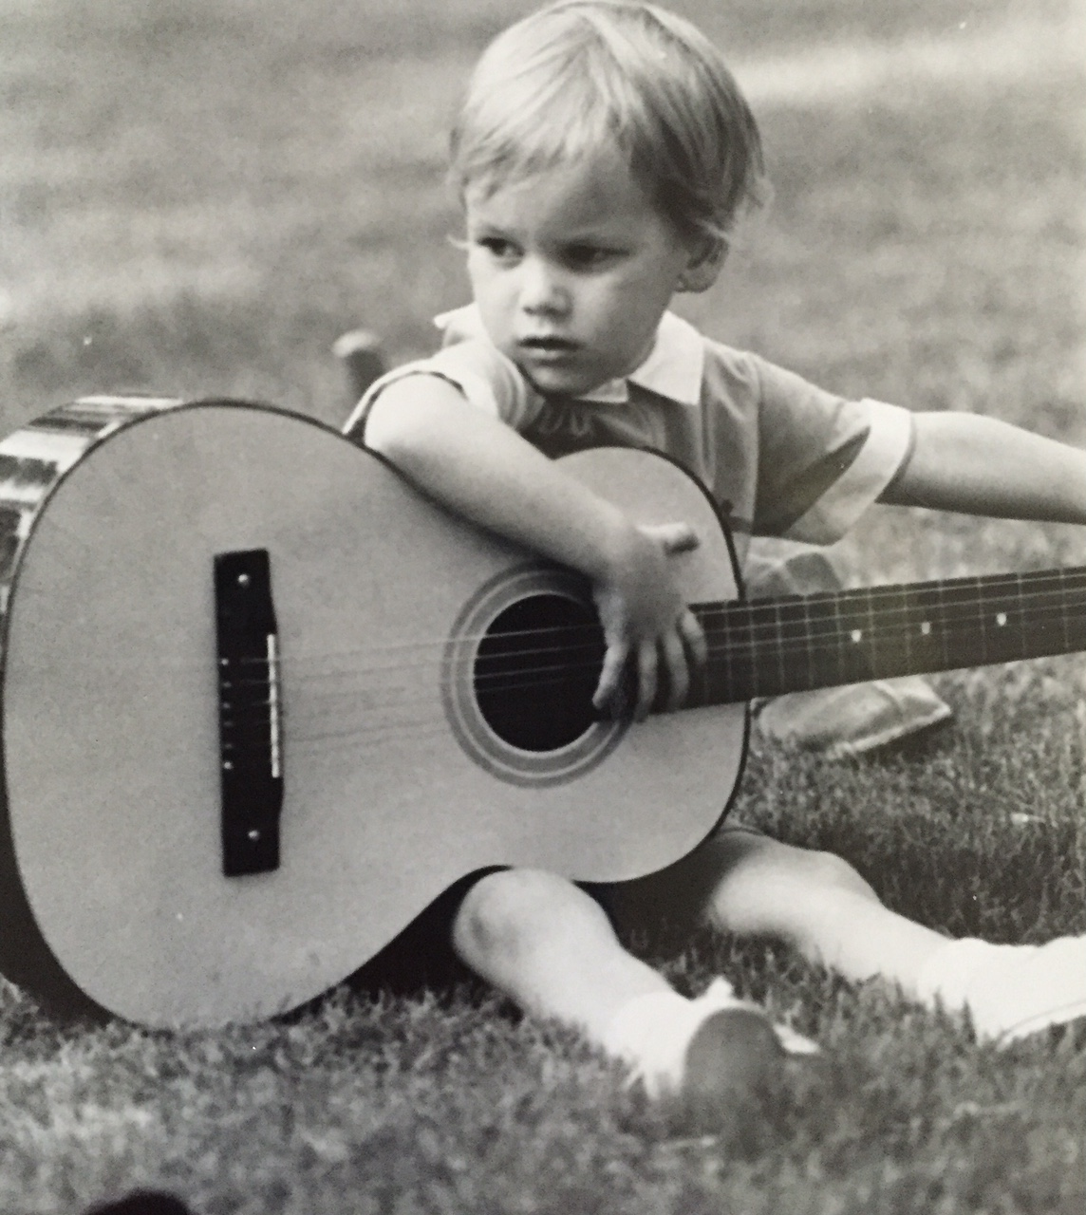
My childhood
I was born in Okinawa, Japan and raised in Orlando, Florida.
This is a picture of me at age 4.

Slide 4
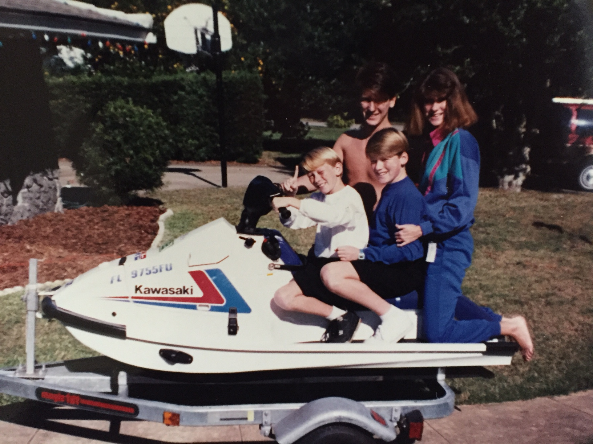
My family
I’m the oldest of 4 kids – 2 brothers and a sister. We did the usual stuff: little league, church, school, birthday parties, and lots of water sports.
This is a picture of me, my sister Lisa and brothers Sean & Ryan with our first jet ski.

Slide 5
MY HIGH SCHOOL
I attended Boone High School in Orlando, FL
Home of the Boone Braves

Slide 6
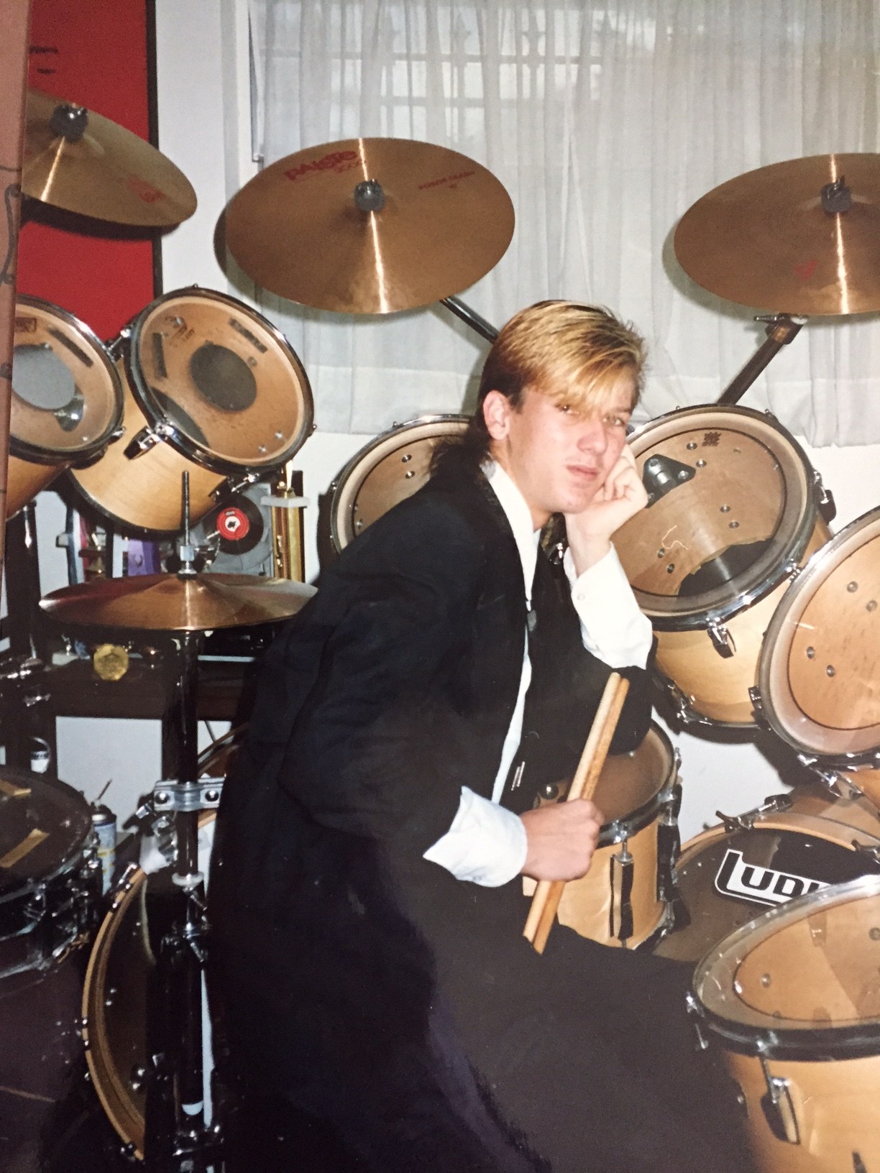
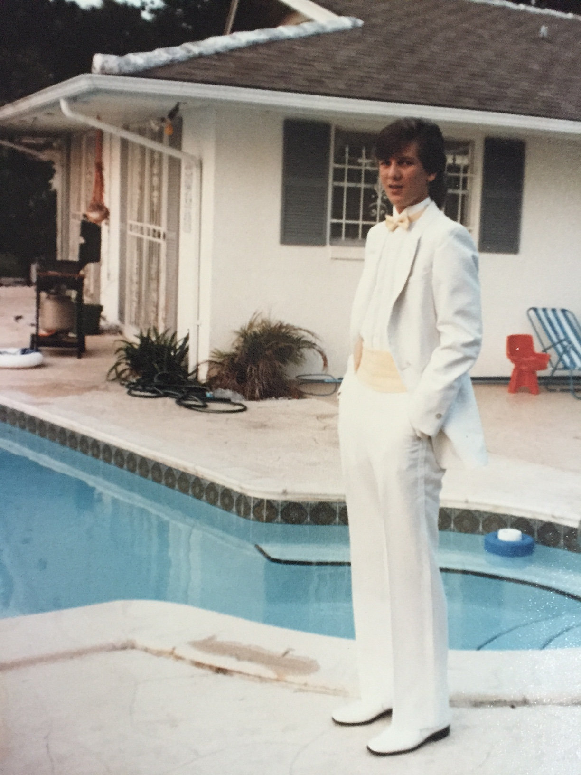
High School
As a HS student I cared about a few things:
Getting good grades so I could get into a good college
Being involved in lots of extracurriculars and playing drums
Having a good time while managing to stay out of trouble
Having ridiculous hair and fashion taste (it was the 80’s)

Slide 7
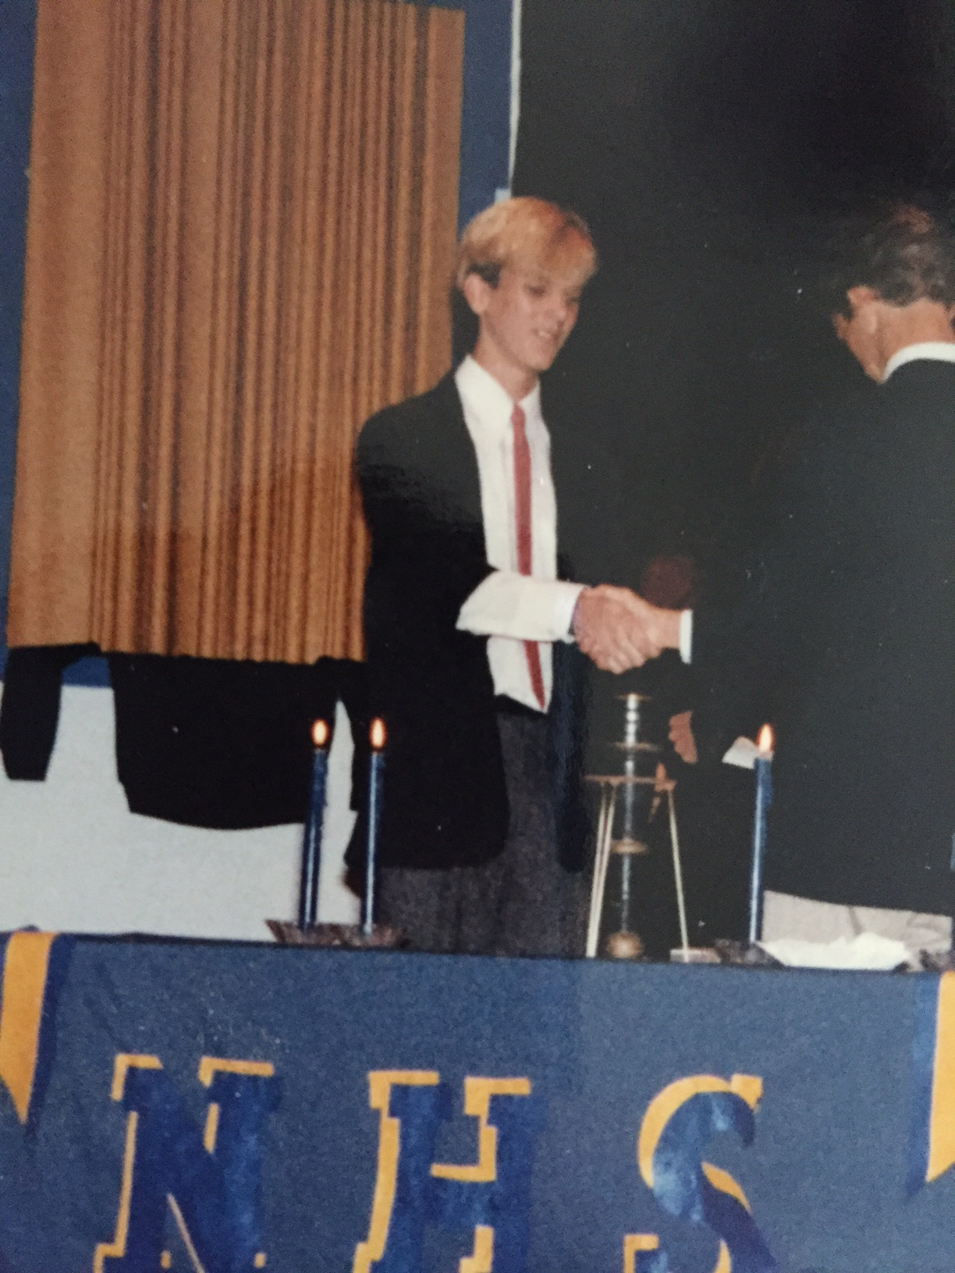
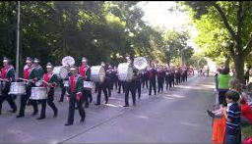
High School
Things that I really liked in High School were:
Marching Band
Clubs / Student Council
Having lots of friends

Slide 8
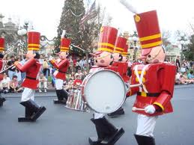
High School
Jobs I worked while I was in High School were:
McDonald’s
Grocery bagger
Disney World – Toy Soldier Band

Slide 9
Getting in to College
The top few things I did to ensure I got into college were:
Straight A’s, solid SAT scores
Leadership roles in clubs / extracurriculars (President of Student Council, President of Interact Club, Drum Captain in marching band, etc)
Community service through church
Developed good relationships with teachers / counselors

Slide 10
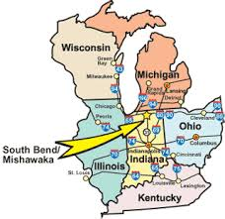
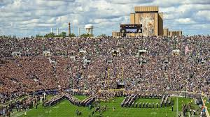
College
I attended the University of Notre Dame in South Bend, IN and majored in Business and Computers

Slide 11
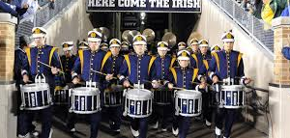
College
Things I enjoyed in College:
And maybe not so much…
Marching band
College athletics (as a fan)
Rigorous study
School spirit / camaraderie
The feeling this was going to lead to something great
Rigorous study
Too much freedom
Limited chances to get a good grade

Slide 12
College
Favorite classes:
Least favorite classes:
Philosophy
Psychology
Corporate Strategy
Finance and Investing
Composition and Literature
Religious studies
Physics
Statistics
Geology

Slide 13
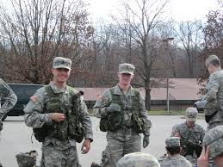
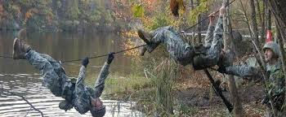
College
How I paid for college: Full Army ROTC Scholarship
Army classes twice a week (in uniform)
Physical training three times a week
Afternoon labs (in uniform)
“Boot camp” summer between Jr and Sr year, 3 weeks
4 year Active or 8 year Reserve option after graduation

Slide 14
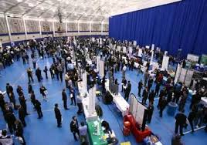
Getting a job after College
The top few things I did to ensure I got a good job after college were:
Summer jobs that meant something during college
Maintaining at least a 3.4 GPA
Using the career center for interview prep and actual interviews themselves
Utilizing alumni network after graduation – VERY IMPORTANT

Slide 15
My Career
After graduation, I utilized my degree and major for the first six years, working as a Tech Support Analyst for IBM and then as an Account Executive for National Computer Resources.
But I realized that I wasn’t really enjoying what I was doing, and music was always my passion, so off to Los Angeles I went…

Slide 16
My Career
Within 6 months I had my first music industry job at Capitol Records in the A&R Admin Dept, and within a year, landed my first record deal with the alt rock band The Exies.

Slide 17
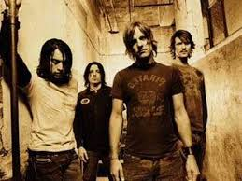
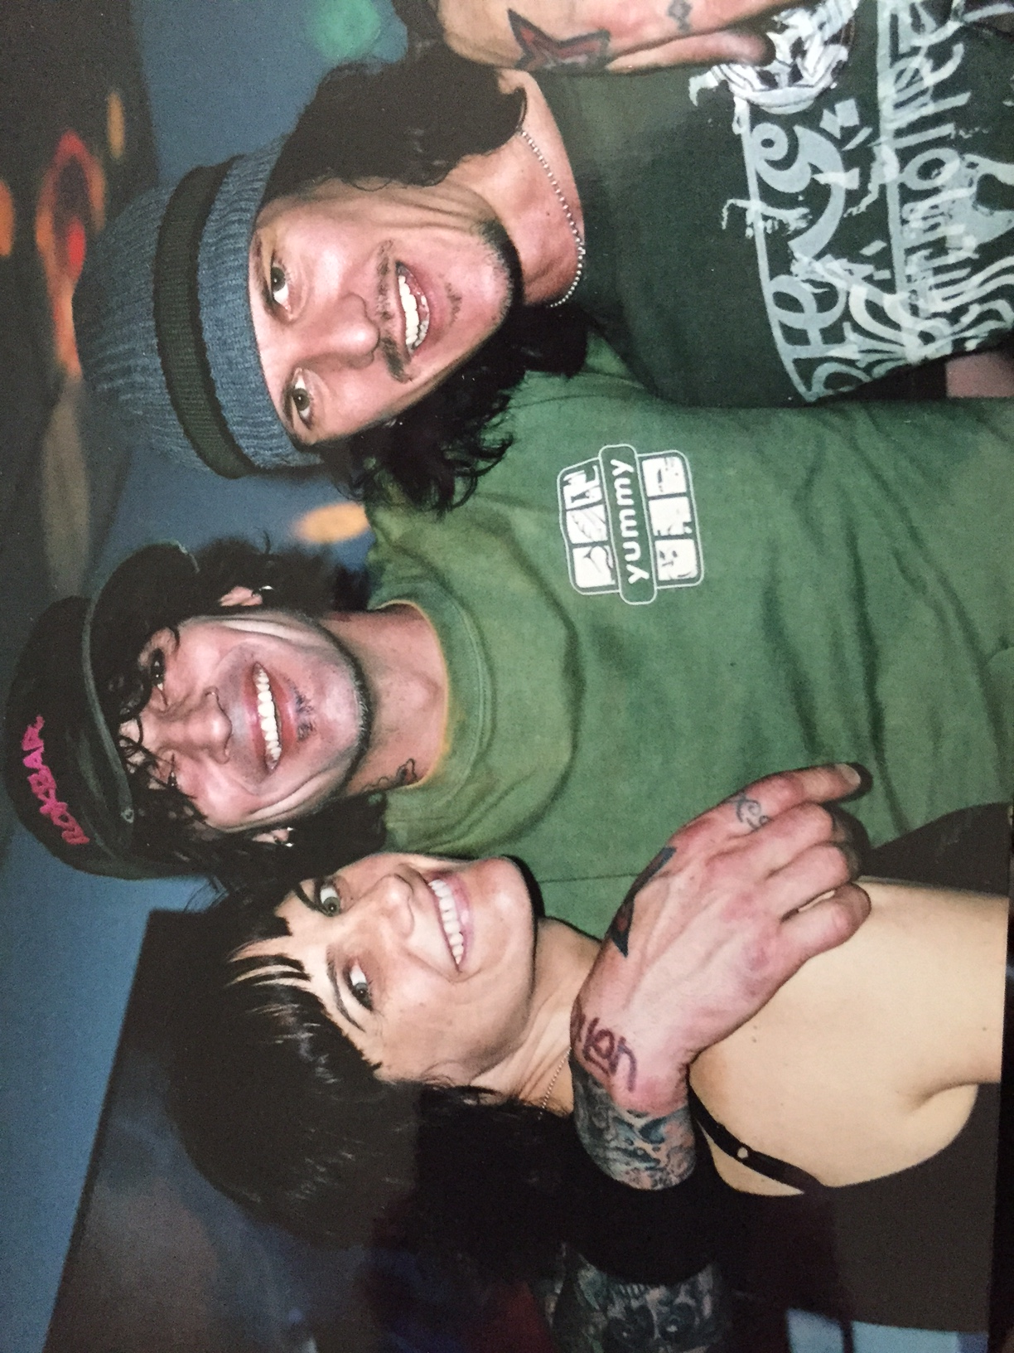
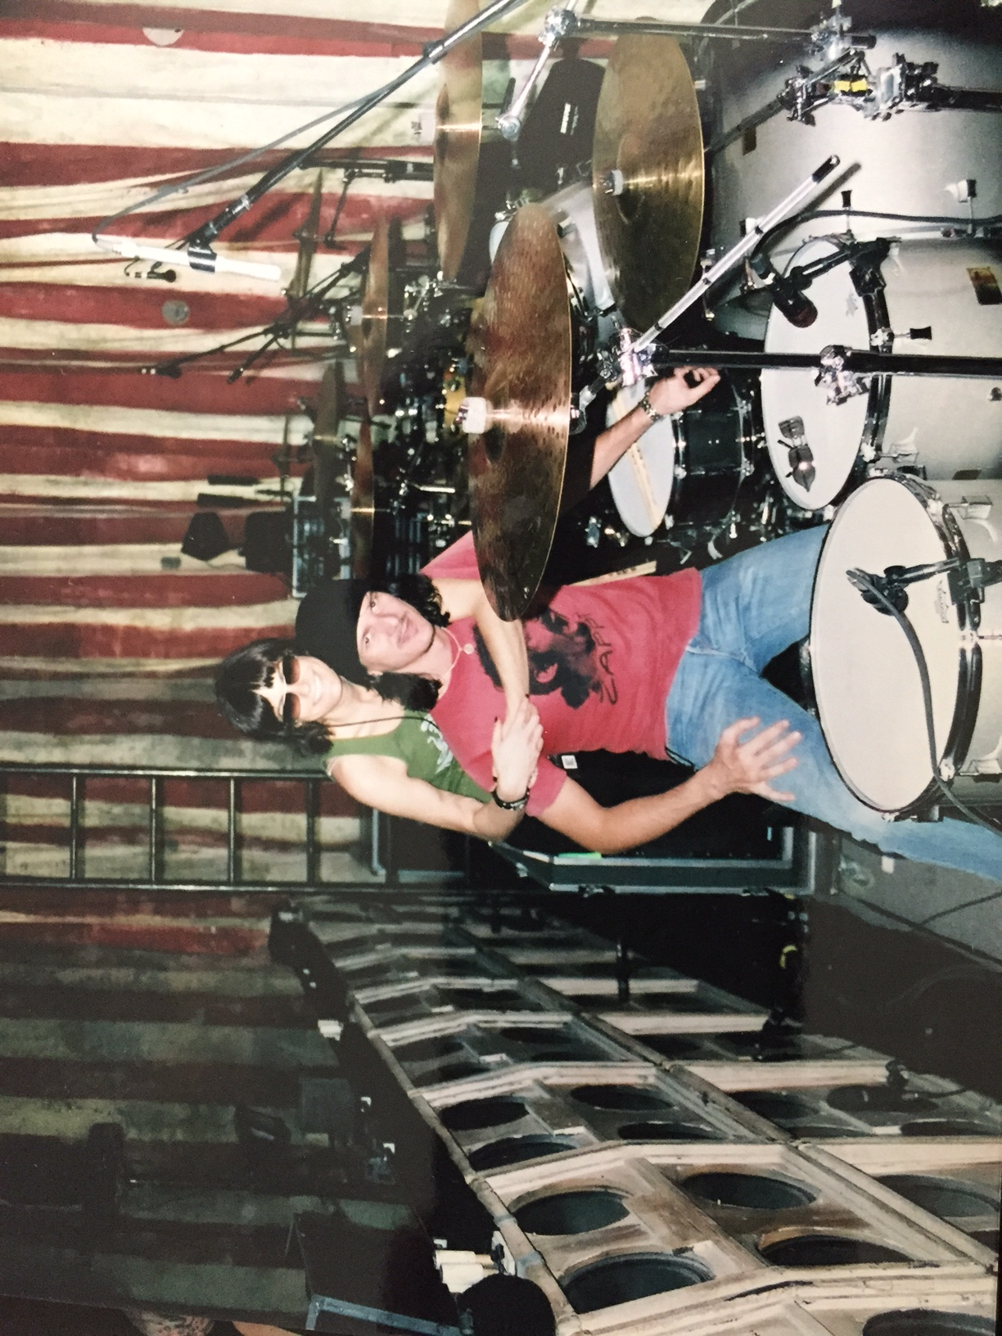
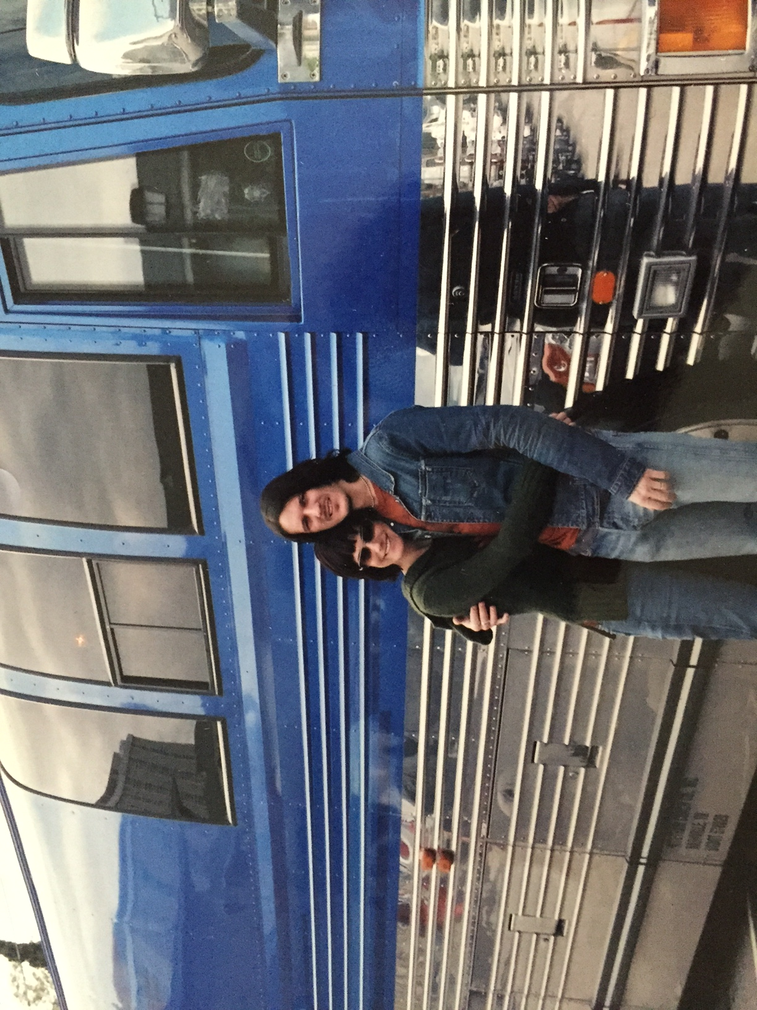
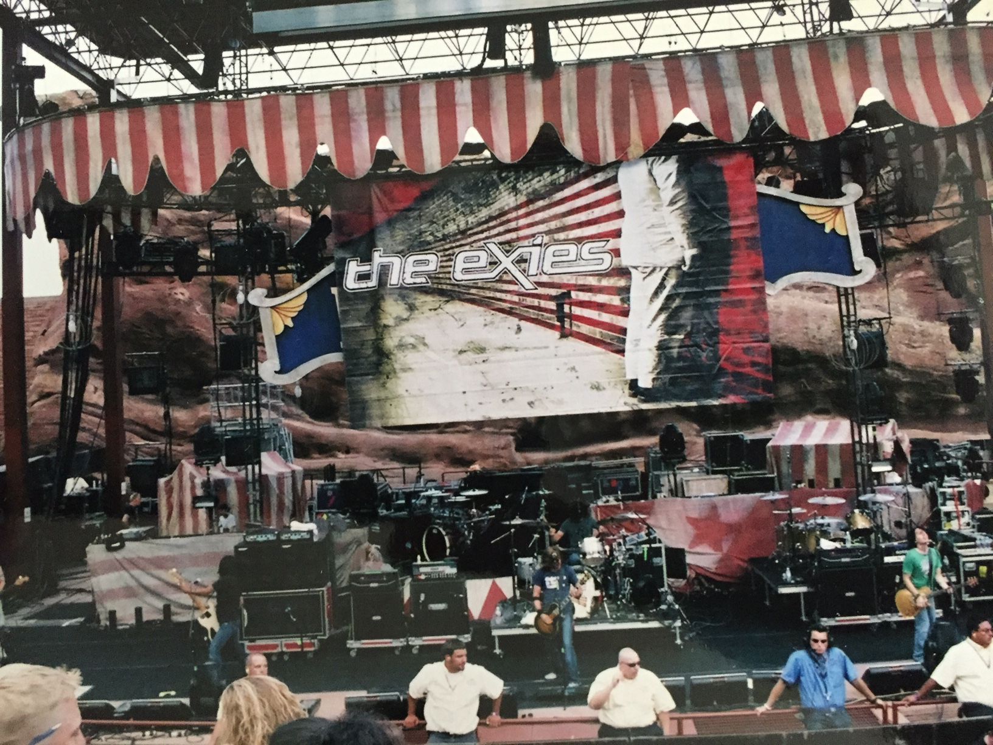

Slide 18
And back to capitol…

Slide 19
And the grammy goes to…

Slide 20
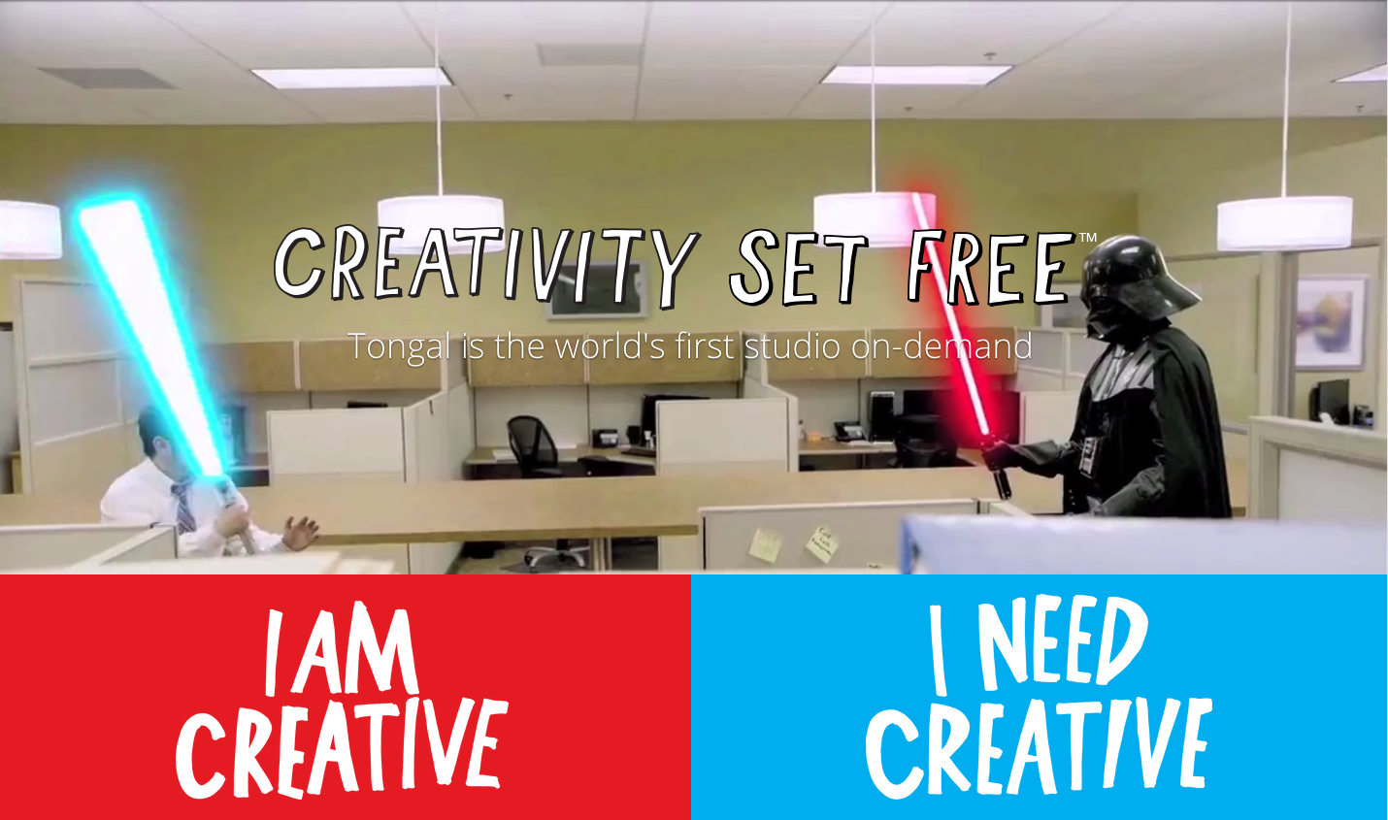
Music meets tech: tongal.com
Every day at my company:
(describe in more detail your company i.e. history of your company, what you sell/create/do, who your end client is, how many people work there, where it’s based, etc.)
Insert company picture

Slide 21
Head of music content and partnerships

Slide 22
My role within organization
President
Head of Marketing
Head Of Music Content
Head of Technology
Notes:
Use this graph to give more description of your role specifically (responsibilities, typical work week, direct reports, etc.)

Slide 23
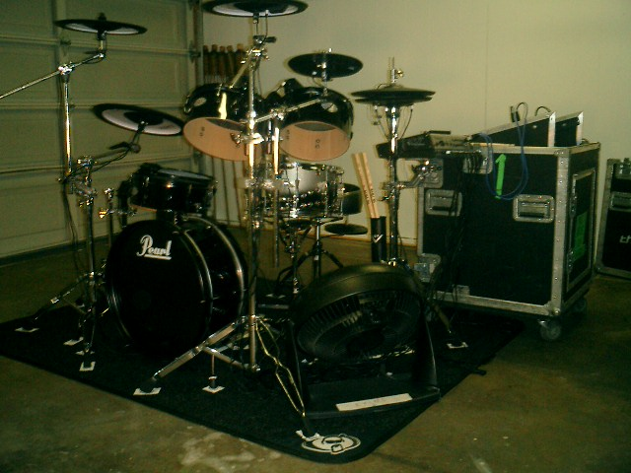
More than just work…

Slide 24
Do it all over again?
If I could talk to my high school self, what would I say?
Try not to go so nuts with the hair color and crazy clothes.
Pay better attention to the advice you get from teachers, counselors and parents. You do not know it all.
Be nicer to kids that are having a tougher time than you are.
Stay awake in class more.
This could be the last time you live in the same town with a bunch of your closest friends. Enjoy it.

Slide 25
QUESTION AND ANSWER

