Slide 1
INTRODUCTION
My name is Trinidad Winters and I am 31 years old for another week.. Yikes
I work for Rightech Inc.
What do we do?:
We put men and woman to work across the country
My role at Rightech Inc is Director of National Accounts

Slide 2
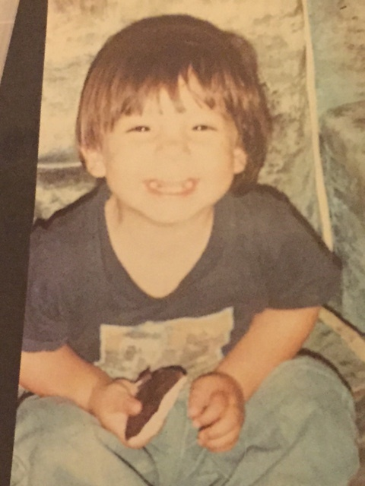
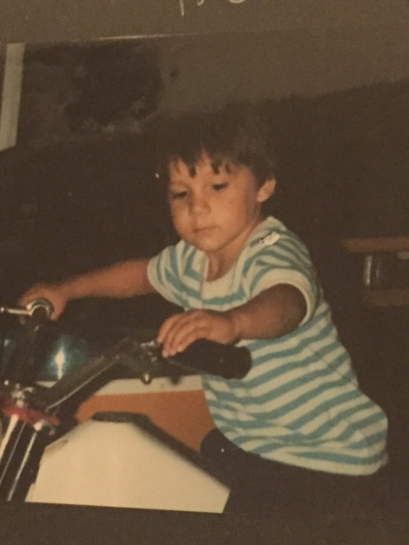
My Earlier Years
I was born in Torrance CA and raised in Lennox & Glendale CA
2 Years Old
4 Years Old

Slide 3
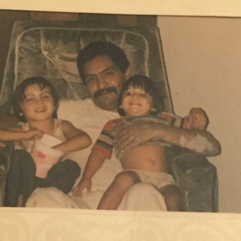
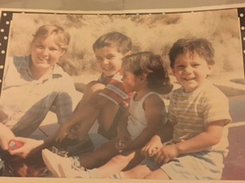
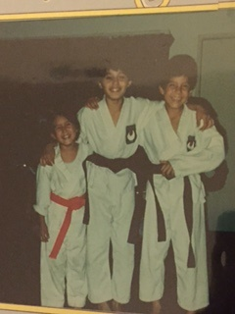
MY FAMILY
A little about my family growing up…
A lot of love, a lot of hardship…
Me with my Mom and siblings
Dad, my brother and I

Slide 4
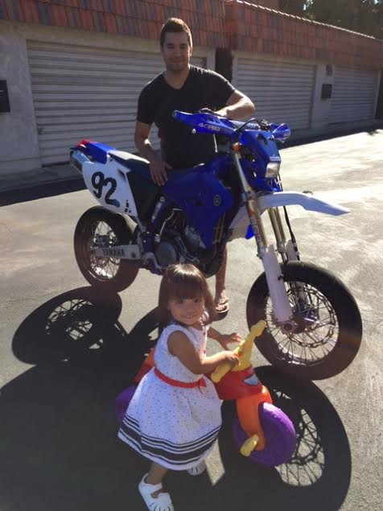
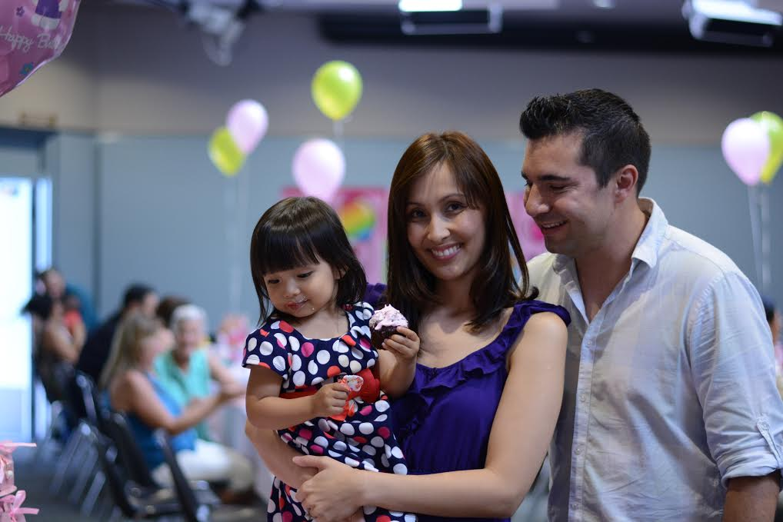
Family of my Own…

Slide 5
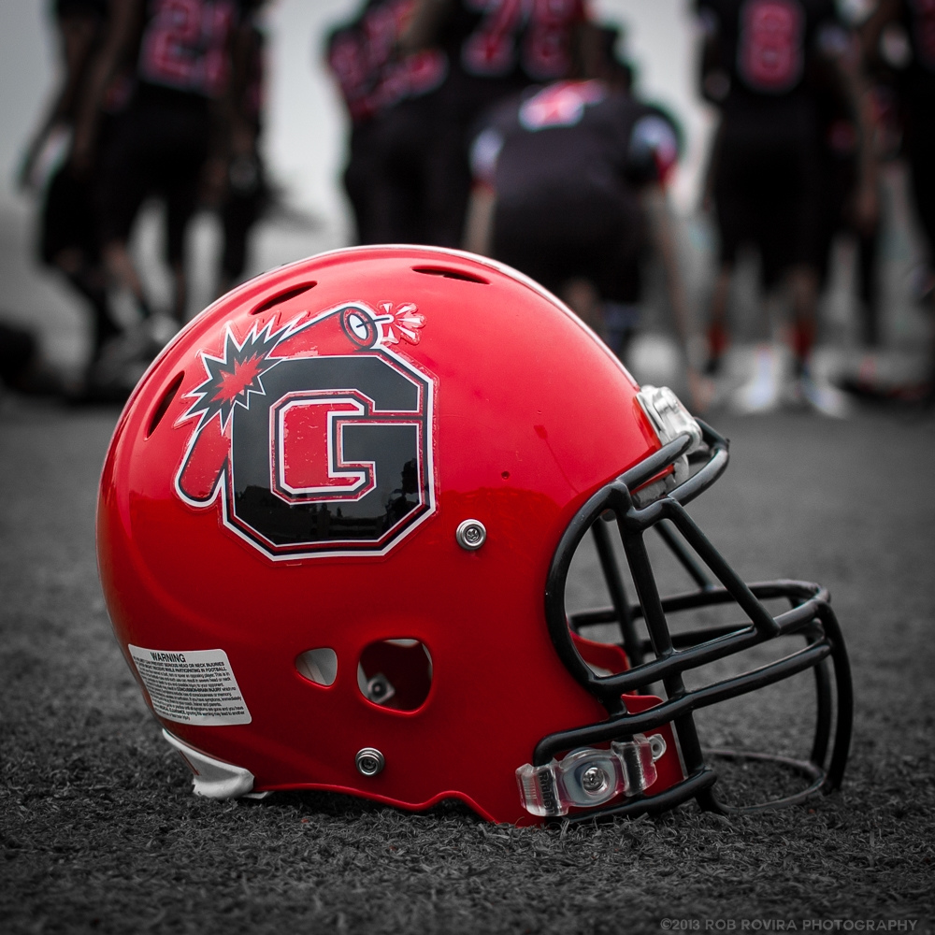
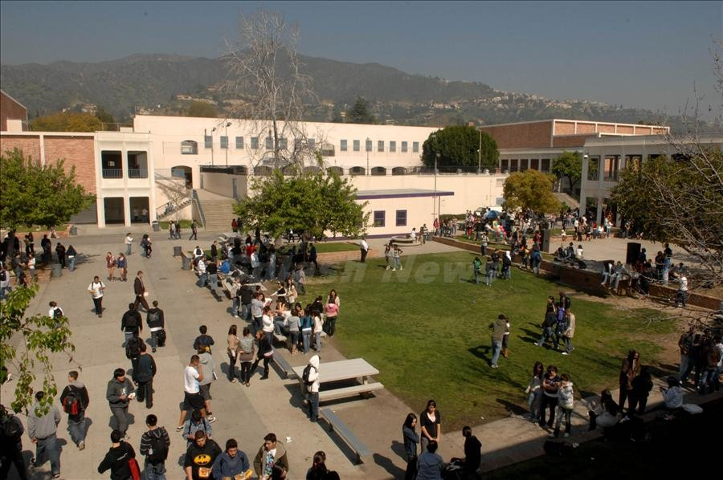
And…Allen F. Daily High School

Slide 6
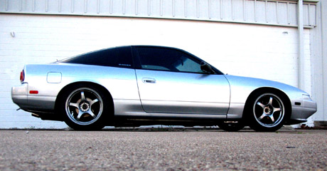
HIGH SCHOOL
As a HS student I felt invincible, I loved to tinker with cars, play football and was always up to something..

Slide 7
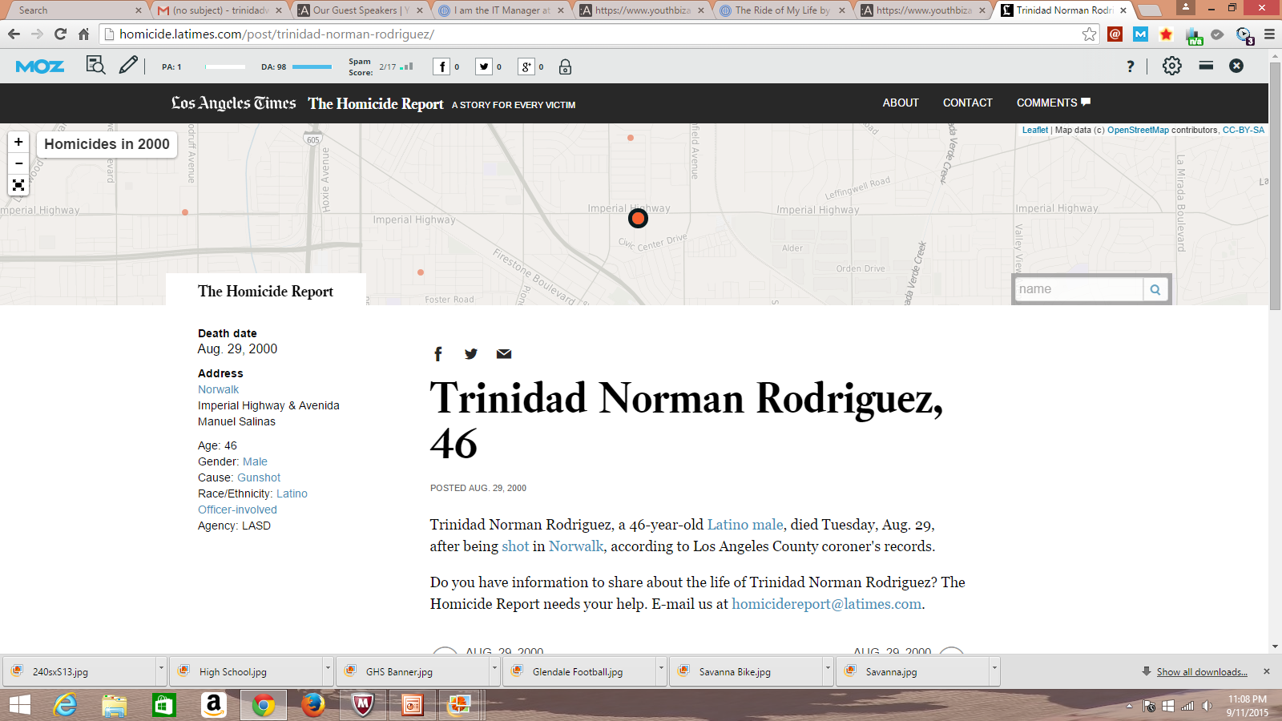
HIGH SCHOOL
An Unexpected tragedy…
Things that I really liked in High School were:
(list classes, sports, hanging with friends, activities, etc.)

Slide 8
HIGH SCHOOL
Things that felt difficult or challenging for me while I was in High School were many…
Things I didn’t like: Things I Liked:
-English -Math
-Art -Football
-Science -Getting my license and car
-History -Friends
-Auto Shop Class

Slide 9
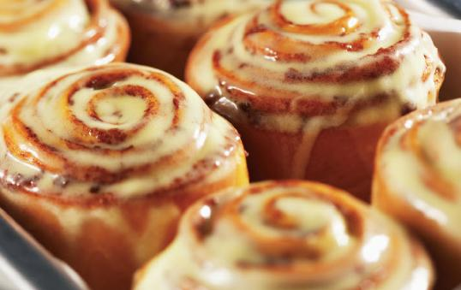
HIGH SCHOOL
Jobs while in High School
Cinnabon!!
Auto Mechanic

Slide 10
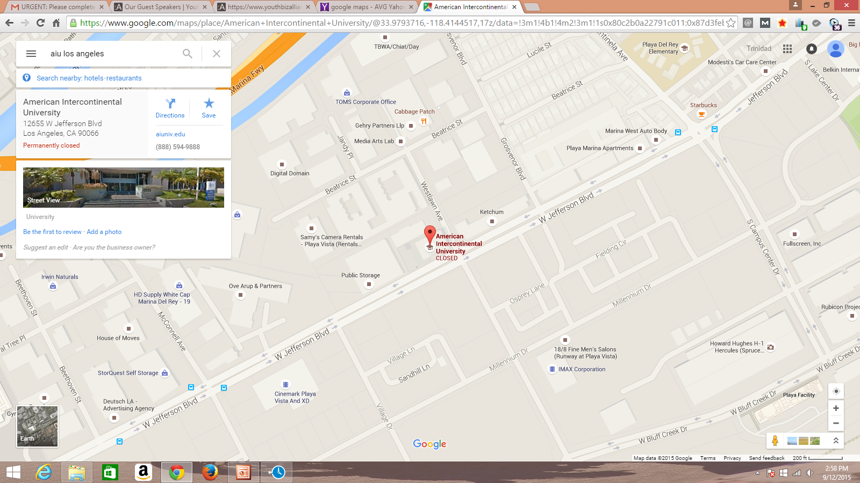
COLLEGE
I attended college at American Intercontinental University in Los Angeles

Slide 11
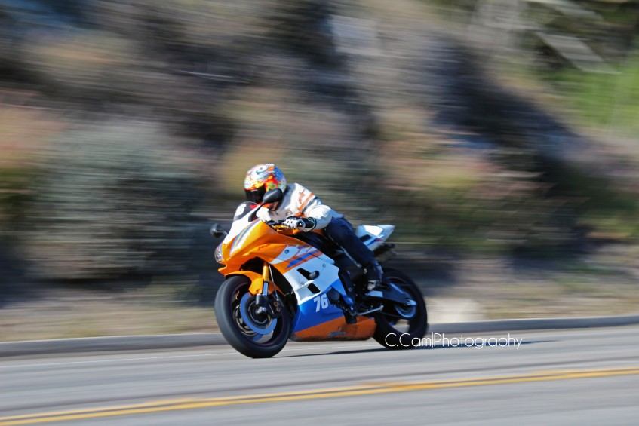
COLLEGE
My favorite activities in College
Jobs in College
-Motorcycles
-International Travel
-Spending time with the girlfriend
-Customer Service Representative
-Data Entry, Police Station
-Started a business
My Fourth Year in College

Slide 12
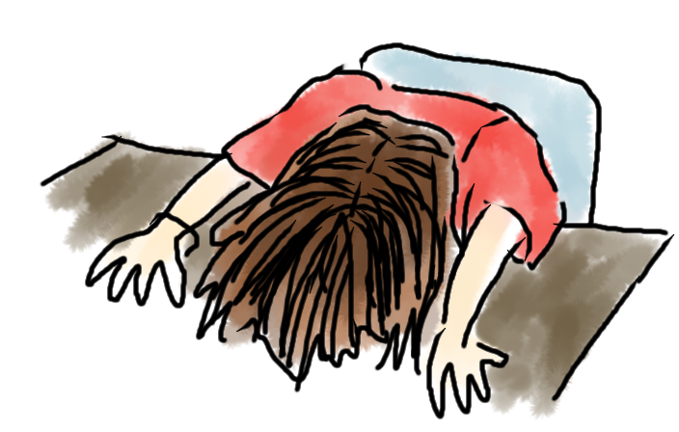
College
Favorite classes
Least favorite classes
-Entrepreneurship
-Psychology
-Public Relations
-Accounting
-Film
-English

Slide 13
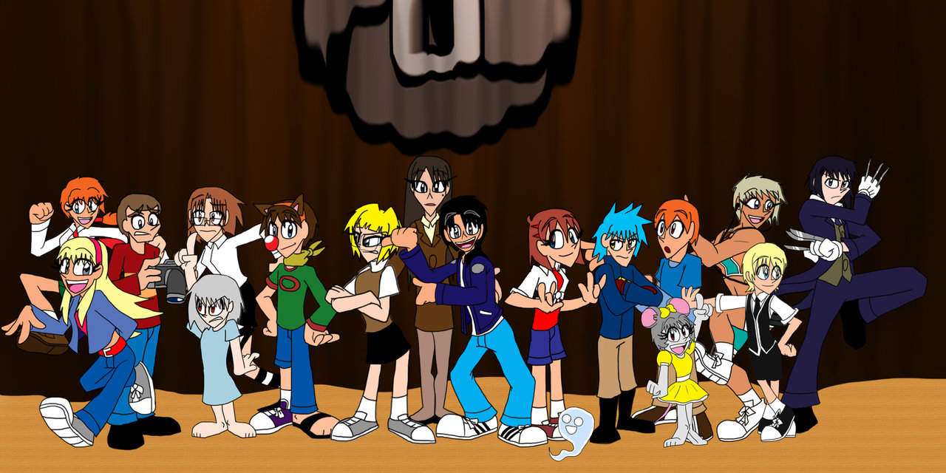
College
Fondest Memories:
-Started a business
-Got Engaged
-Met a lot of great friends and characters
Challenges I Faced:
-Teachers I didn’t like
-No support from parent
-Worked and attended school
Full time.

Slide 14
What does Rightech do?
Some of our clients: ADT, TYCO, Red Hawk Fire & Security

Slide 15
MY CAREER PATH

Slide 16
MY CAREER
The first job I had after college was:
Human Resources with an Aerospace Manufacturer
The worst job I have ever had was:
Data Entry for a company that manufactured bathroom products

Slide 17
MY CAREER
Biggest Career Challenge I have had to overcome throughout my career are:
Negative & dishonest people

Slide 18
MY ROLE WITHIN ORGANIZATION
CEO
National Director
(Me)
VP
Operations
Recruiting
Account Mgrs
Notes:
Use this graph to give more description of your role specifically (responsibilities, typical work week, direct reports, etc.)

Slide 19
COMPENSATION AT MY COMPANY
Vice President
($400K Annual )
Director
($100K Base)
$185K-$250K Annual
Account Manager
$50K-$75K Base)
$100-$200K Annual
Recruiter
($32-$45K) Base
$65-$80K annual
Notes:
Use this graph to show general compensation ranges for people in various roles in your company

Slide 20
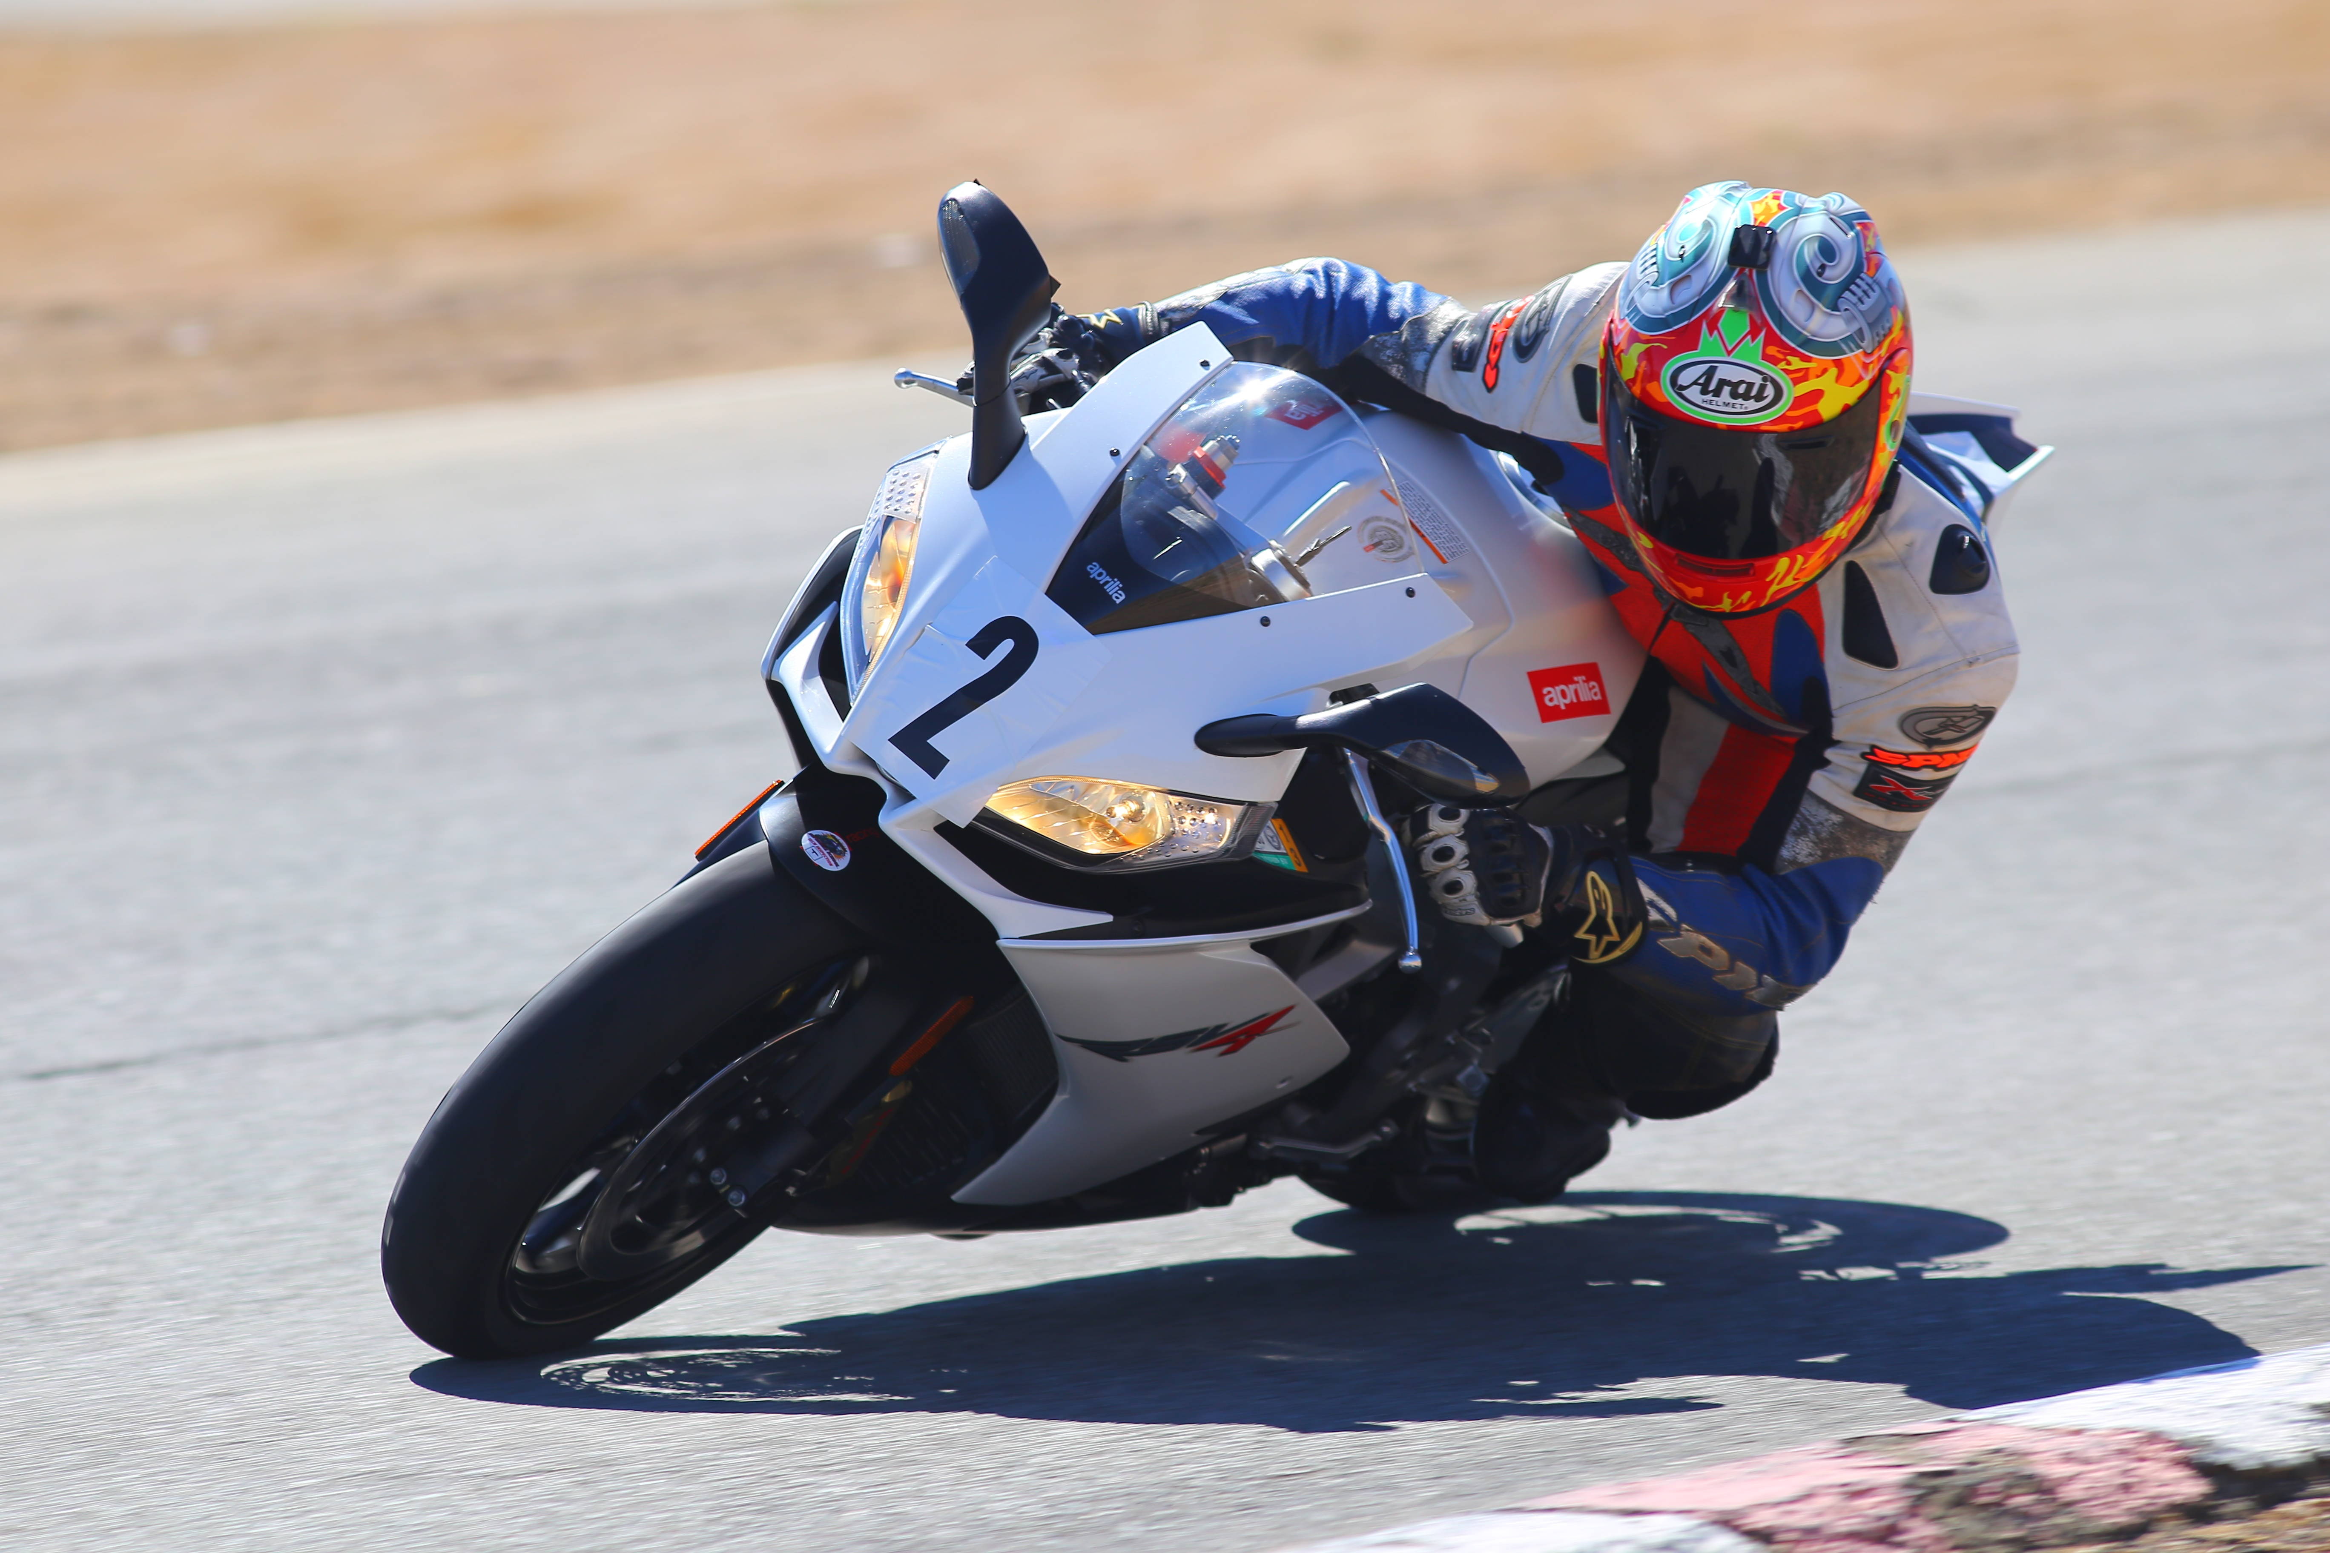
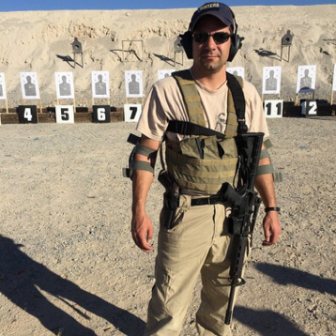
MORE THAN JUST WORK
When I am not at work I like to:
Spend time with my wife and daughter
Race Motorcycles
Outdoor activities such as shooting range

Slide 21
DO IT ALL OVER AGAIN?
If I could talk to my high school self, what would I say?
Life and business is not textbook, there is no one right way to do anything. Take different paths, you’re only limited by your own imaginations so be creative and have fun.
With each failure you can grow and still achieve your dreams
If you reach for the moon and miss you’ll still be amongst the stars

Slide 22
QUESTION AND ANSWER

