Slide 1
Jessa Santangelo
Activate.LA 501 (c) 3 Nonprofit

Slide 2
INTRODUCTION
My name is Jessa Santangelo and I am 26 years old.
I am the Executive Director at Activate.LA
Activate.LA is a nonprofit company in Fashion, Art & Entertainment. We exist to use Fashion, Art & the Entertainment Industry (media) to help other nonprofit charities, causes and companies.

Slide 3
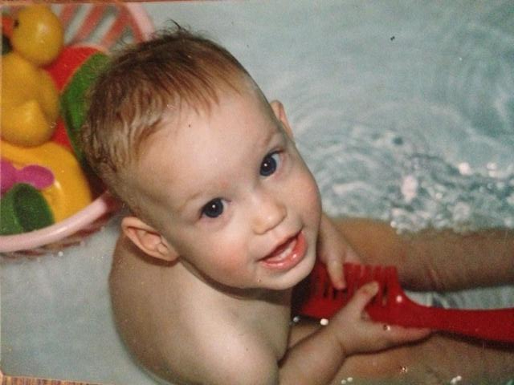
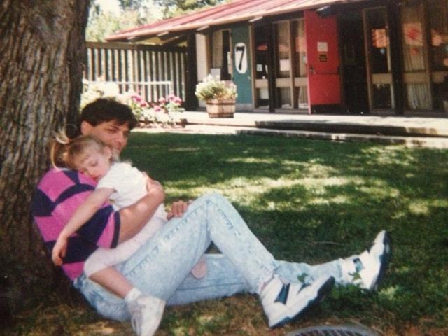
The Early Years…
I was born in Sacramento, Ca and raised in the Bay Area

Slide 4
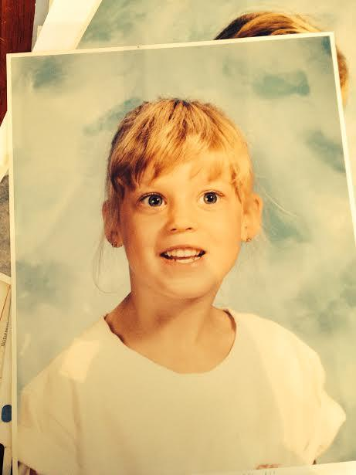
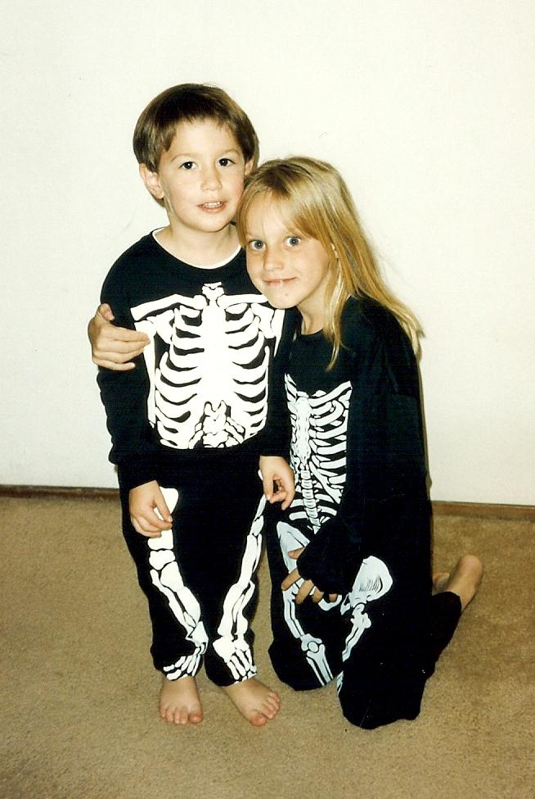
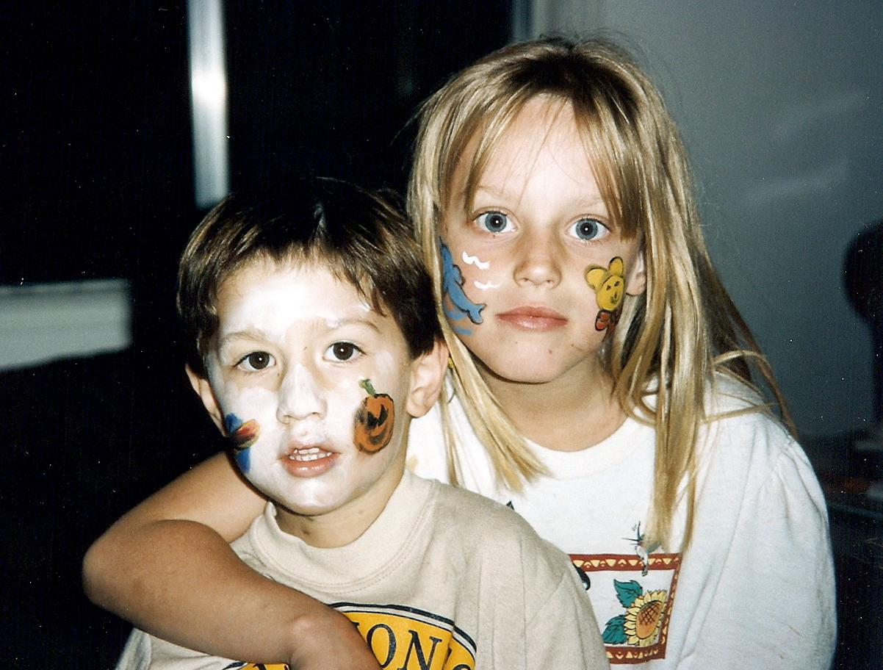
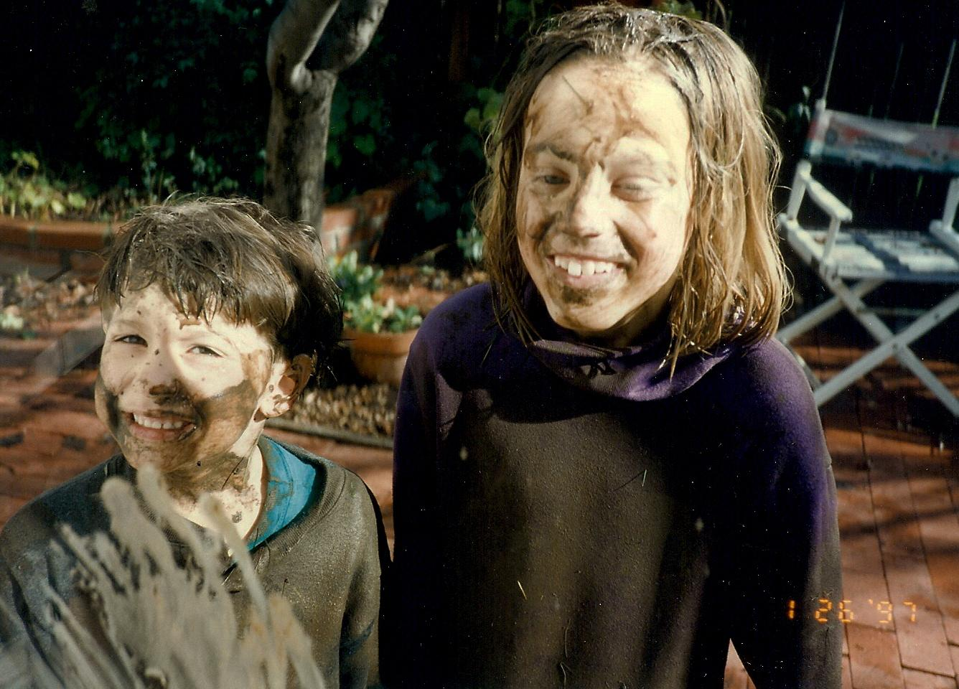
More Early Years…
I moved a lot in my early years which taught me to be outgoing and become good at making new friends.

Slide 5
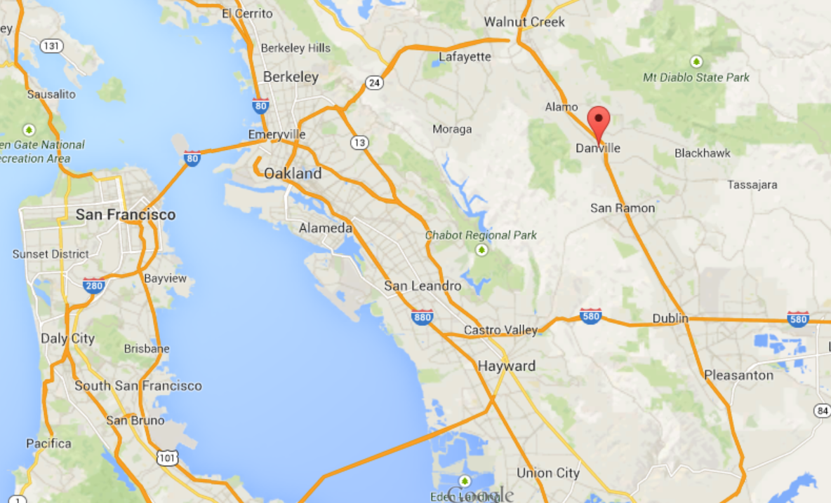
HIGH SCHOOL
I attended three high schools in the Bay Area and Graduated mid-year of my junior year
\

Slide 6
HIGH SCHOOL
As a HS student I was involved in theatre, Speech & debate, and dance
As a HS student I was always the “new girl”

Slide 7
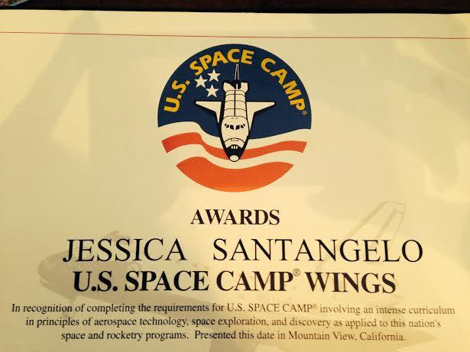
HIGH SCHOOL
Things I enjoyed in HS
Things I did not enjoy in HS
- Making new friends
- Speech & Debate
- Performing for a crowd
- Tests & quizzes
- Working in the “Special” day class
- Homework
- gossip
- Certain teaching styles

Slide 8
HIGH SCHOOL
Activities/Athletics in HS
Jobs I worked while in HS
- Theatre
- Dance
- Speech and Debate
- Lifeguard
- Swim instructor
- Worked with children with autism
- hostess at restaurant

Slide 9
HIGH SCHOOL
Fondest memories from HS
Obstacles/Adversity you had to overcome in HS
- Performing plays in theatre
- Being the “new girl”
- Making new friends
- Working with the special needs kids.. especially Christopher S.
- Moving between several schools
- Family life

Slide 10
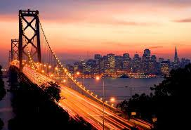
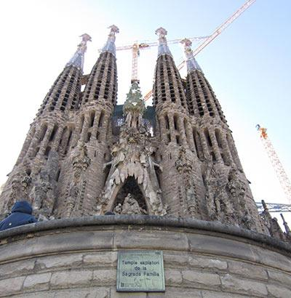
College...
I attended San Francisco State & The University of Barcelona
San Francisco State

Slide 11
College
Activities in College
Jobs I worked while in College
- C.A.R.C/J.J.M.P.
- Theatre
- Kaplan INC.
- Behavioral therapy
- A.B.A.
- S.O.T.A.

Slide 12
College
Favorite classes
Least favorite classes
- Neuropsychobiology
- Neuropsychology
- Sign language
- Industrial psychology
- I loved all my classes!!!

Slide 13
College
Fondest memories
Obstacles or adversity that you had to overcome
- Backpacking through europe
- Graduating in the top 3% in my field
- Making new friends
- Paying tuition while taking a full course load

Slide 14
Career Path
- Privately contracted therapy
- Working with celebrities
- Music industry opportunities
- Opened recording studio
- Then became involved with the tech start-up industry
- Began working with non-profits, and eventually opened my own called “Activate LA”
Notes:
You may use this chart to describe your journey to the current career

Slide 15
Career
Company pic
Company pic #2

Slide 16
Career
My first Job
My worst Job
-Swim instructor & lifeguard
- Working as hostess

Slide 17
Career
Some challenges I had to overcome in my career
- Deciding between making money, and doing what I am passionate about.
- People telling you “no” and continuing to persevere.
- Finding guidance in yourself.

Slide 18
CURRENT ROLE
Activate LA (non-profit)
- Started in 2013
- 37 employees/volunteers
- Upcycling fashion program
- Art program
Privately contracted Therapist
- Since 2007
- Northern & Southern California
- Specialized in:
traumatic brain injury
monozygotic (identical twins) with Autism
behavioral neurological or psychological conditions
Notes:
Use this graph to give more description of your current company (history, size, location, products and services, etc.)

Slide 19
Career Compensation
Activate LA (non-profit)
45k
Privately contracted therapy
$65-$300/per hour
Notes:
Use this graph to show general compensation ranges for people in various roles in your company

Slide 20
ACADEMIC EXERCISE
We will now spend several minutes discussing the day’s academic module and how it is relevant in the ‘real world’

Slide 21
QUESTION AND ANSWER

