Slide 1
Hillary gadsby
Gadsby Media Group
StilettoGal

Slide 2
INTRODUCTION
My name is Hillary Gadsby and I am 37 years old.
I work for Gadsby Media Group & StilettoGal
My company does:
  Marketing & Events
My role at Gadsby Media Group is Chief Executive Officer and my role at StilettoGal is Chief Visonary Officer and co-founder
  Every day I meet with clients for their event and marketing needs and build strategic relationships with vendors.

Slide 3
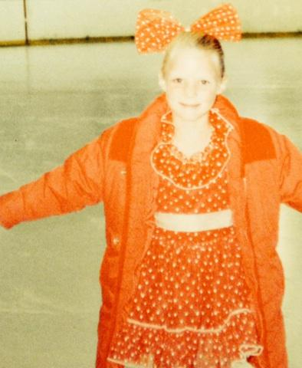
My childhood
I was born in Boise, Idaho and raised in Sun Valley, Idaho
This is a picture of me at age 6

Slide 4
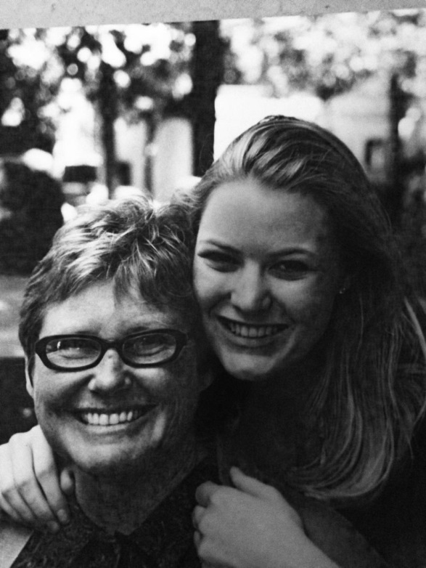
My family
  I grew up in a middle class family where my mother was a serial entrepreneur and my father was a carpenter in the summer and a ski instructor in the winter. My mother started and closed many businesses during my childhood. She taught me to never give up and to get back up even if I fell down.
This is a picture of my mom and I at my college graduation

Slide 5
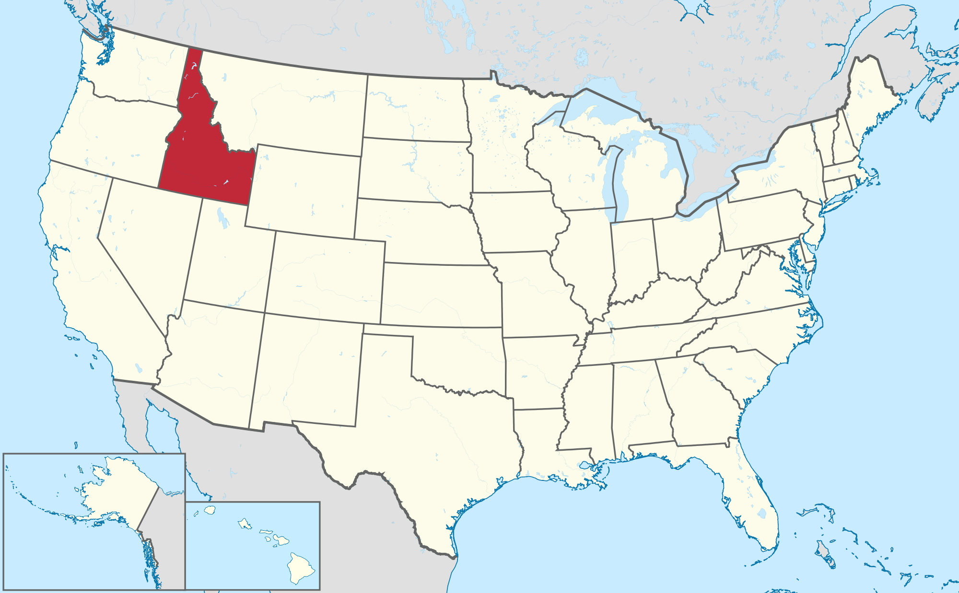
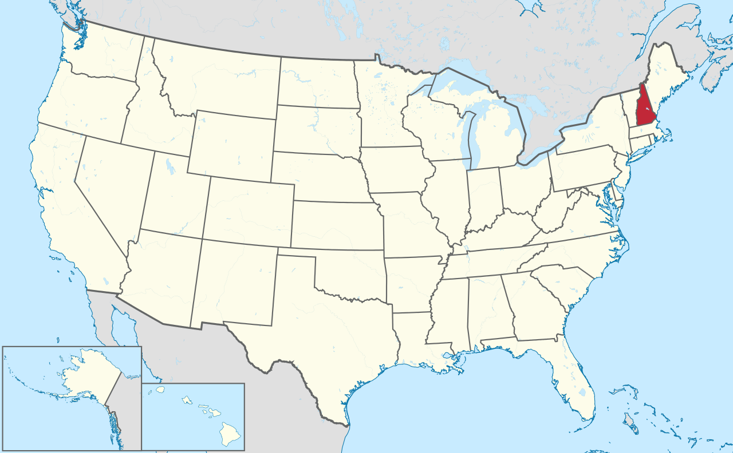
MY HIGH SCHOOL
I attended two high schools, one private and the other public. Private school was in New Hampshire and the public school was located in my home town.

Slide 6
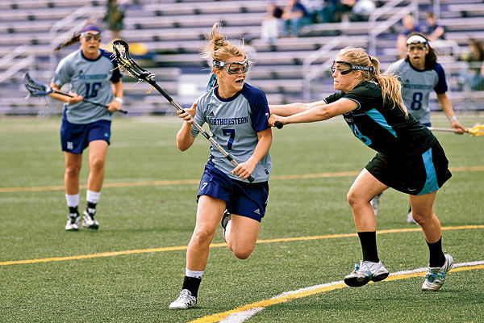
High School
As a high school student I was a bit of an introvert. I had a good group of friends but did not party with them. There wasn’t a whole lot to do in both schools. Both towns were small so we spent most of our time playing sports.

Slide 7
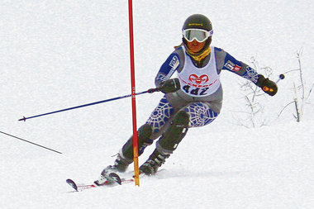
High School
Things that I really liked in High School were:
  Soccer and Lacrosse
  I loved to ski race for both high schools. We didn’t have afternoon classes because we ski raced for the schools. Most of my high school life was spent either training for skiing or ski racing.

Slide 8
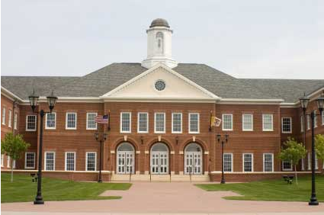
High School
Boarding school was not easy for me. Most of the kids were very wealthy and didn’t want to be there. I went to receive a better education because my school at home did not have the best program. Most of the kids there wanted to play and I wanted to study. I didn’t graduate from the private school. I went back to my hometown to graduate.

Slide 9
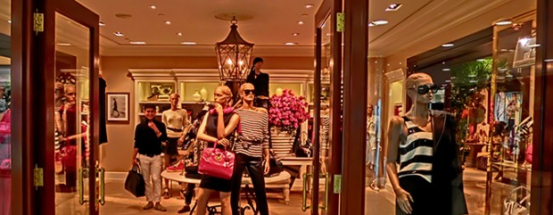
High School
Jobs I worked while I was in High School were:
  The Brass Ranch, a retail store that sold Ralph Lauren clothing. I spent my summer and winter vacations working here. It gave me a good sense of people and how to interact with them. Little did I know that I would meet the person who would change my life while working there.

Slide 10
Getting in to College
The top few things I did to ensure I got into college were:
  Graduate from high school with good grades
  Extra curricular activities
  Group organizations

Slide 11
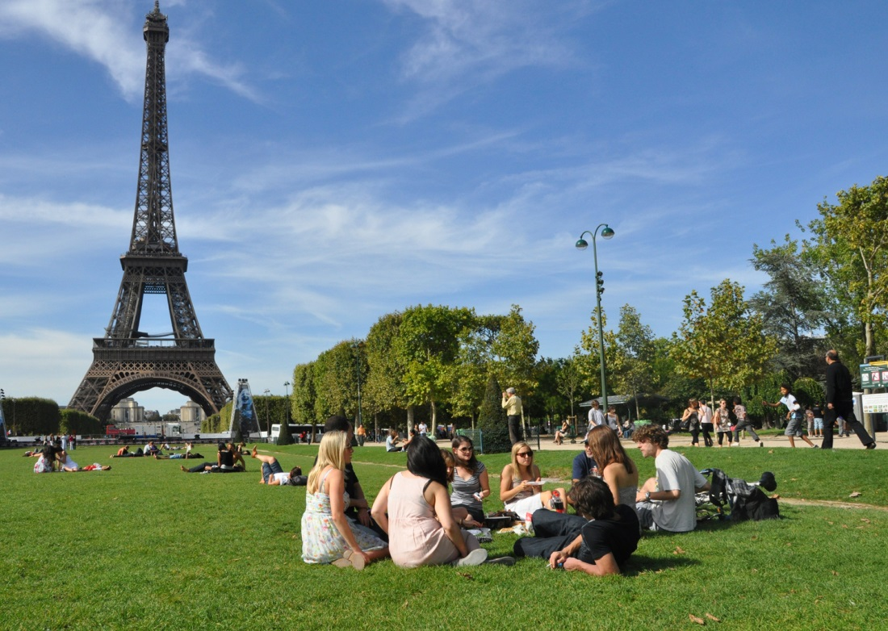
College
I attended at The American University of Paris in Paris France
Insert map shot here

Slide 12
College
Things I enjoyed in College
Things I didn’t enjoy in College
International students and relationships
Exploring the French culture
Diversity
Travel on the weekends
Far away from home
Difficult class schedule
Not having classes on one campus

Slide 13


College
Favorite classes
Least favorite classes
French language
Marketing
Math
Computer Science

Slide 14
Getting a job after College
The top few things I did to ensure I got a good job after college were:
  I started to build my connections early
  I applied for an internship during my final year

Slide 15
This is My Company
Every day at my company:

Slide 16
My Career Path
I was appointed Director of Marketing & Events for the Wedding Shop in London
I started as a retail sales girl
I am now the CEO of Gadsby Media Group and Chief Visionary Officer of StilettoGal
Notes:
You may use this chart to describe your journey to the current career

Slide 17
My Career
The first job I had after college was:
  An internship at Ralph Lauren in Paris
The worst job I have ever had was:
  In between jobs, to earn an income, I had to work at a tax law office. I spent my days filing and assembling tax papers. I hated it so much I made myself really sick.

Slide 18
My Career
Challenges I have had to overcome throughout my career are:
  Due to the nature of business that I was in and being an American it was difficult to stay in a job for a long time. I was able to meet all kinds of people in my work so that I could progress into finding another better job.

Slide 19
My role within organization
CEO
INDEPENDENT CONTRACTORS
Notes:
Use this graph to give more description of your role specifically (responsibilities, typical work week, direct reports, etc.)

Slide 20
More than just work
When I am not at work I like to:
  Spend time with friends and loved ones
  Exercise
  Come up with new business ideas

Slide 21
Do it all over again?
If I could talk to my high school self, what would I say?
  Don’t be so serious

Slide 22

Q & A

