Slide 1
YBA GUEST SPEAKER GAYLE DICKIE
KNOWING YOUR PATH
DOING WHAT YOU ENJOY

Slide 2
INTRODUCTION
My name is Gayle Dickie and I am way older than you think.
I work for my own company Hey Girl Hey Entertainment.
My company is an entertainment and media company specializing in film, TV, branding, social media content producers, live events and a multiple of entertainment projects.
My role at Hey Girl Hey is CEO and President
Every day I manage all the current projects in which we are participating and work a lot with investment capital and packaging them to reach our goals.

Slide 3
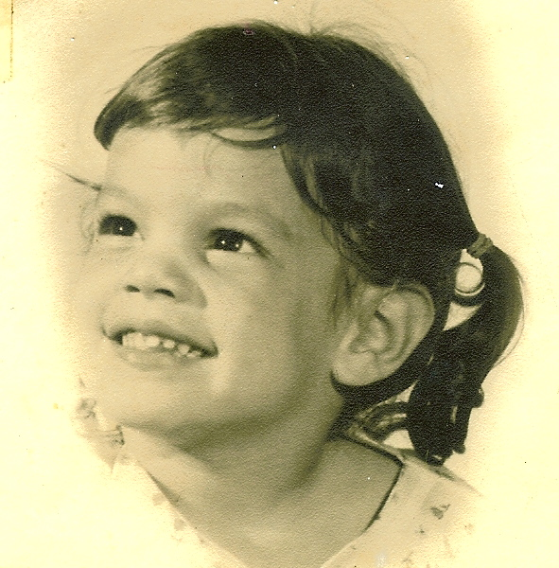
My childhood
I was born in Glendale, CA and raised in La Crescenta and La Canada.
We moved to Marina Del Rey when I was a Junior in High School.
This is a picture of me at 3 years of age

Slide 4
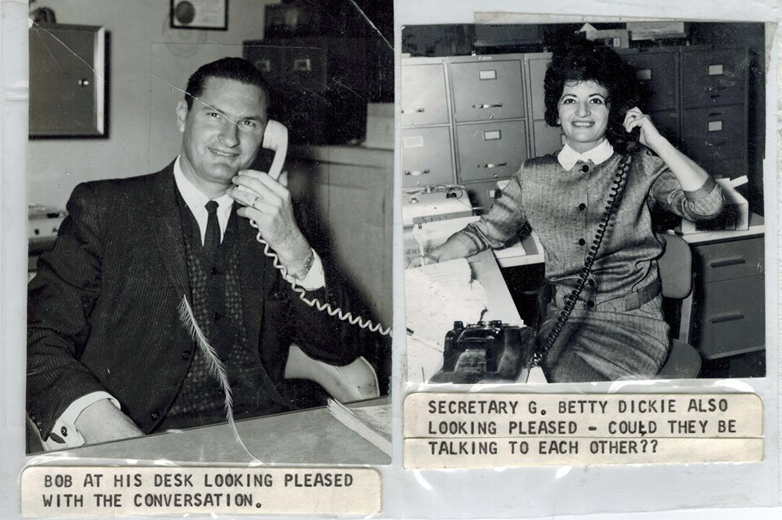
My family
Youngest daughter – older brother.
I had to learn very early to stand up for myself and catch either a fast football or baseball or get hit in the head.
One thing I never forgot is my mother making me sign a piece of paper that read, “I am having a happy childhood.” Signed, Gayle Dickie.
My Dad and Mom

Slide 5
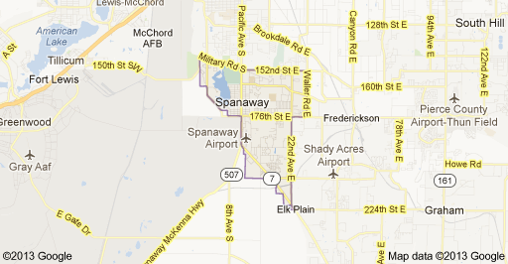
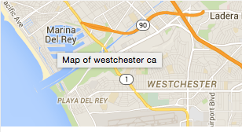
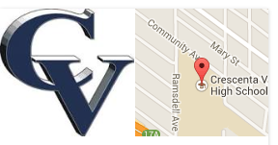
MY HIGH SCHOOL
I attended Crescenta Valley High and Westchester High School in Los Angeles, California

Slide 6
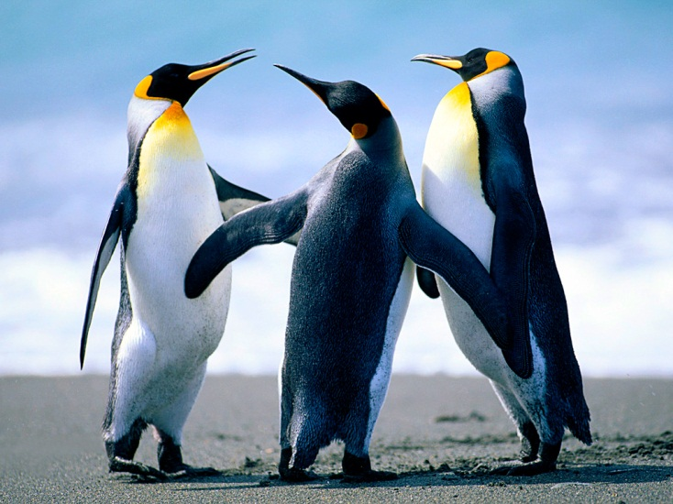
High School
As a HS student I was (shy, outgoing, nerdy, popular, athletic, academic, etc.) ……………………………………………………………….
Here is a picture of me in HS

Slide 7
High School
Things that I really liked in High School were:
Volleyball – All City All State All CIF
Softball League Championship
Basketball
Track
English
Geometry
Boys ☺

Slide 8
High School
Things that felt difficult or challenging for me while I was in High School were:
I changed High School’s in the middle of my Junior year which could have been a difficult transition. But within the first hour in admin bldg. I met a girl with whom I am still friends to this day. I had no expectations and yet everything happened for a reason. I met the High School quarterback and dated him until he left school☹
I really didn’t have the friendship base in the last year of school because it wasn’t kids I grew up with BUT the one friend I did meet has been lifelong over 35 years.

Slide 9
High School
Jobs I worked while I was in High School were:
I worked for one of my friends dad’s who was a lawyer every summer and learned essentially every aspect of the private law practice with the exception of entertainment. I did divorces, criminal cases, and real estate while he went to the beach every day at 11:30a☺
I worked for a movie theater selling tickets which was a job I couldn’t wait to go to in the evening weekends. I learned lines to every movie that played and had a great time counting the money.

Slide 10
Getting in to College
The top few things I did to ensure I got into college were:
I probably could have gone anywhere on an athletic scholarship but decided to stay close to home and went to Santa Monica College, then UCLA, the El Camino College and the my MBA program years later while I was employed by a global IT firm running their Media & Entertainment Practice.

Slide 11
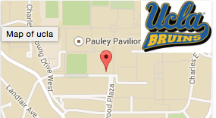
UCLA
I attended college in Los Angeles, CA
Insert map shot here

Slide 12
College
Things I enjoyed in College
Things I didn’t enjoy in College

Slide 13
College
Favorite classes
Least favorite classes

Slide 14
College
Jobs I worked while I was in College were:
(insert any paying and non-paying jobs and what you learned from doing that

Slide 15
College
Things that felt difficult or challenging for me while I was in College were:
(list and adversities you had to overcome and how you did it – keep it simple)

Slide 16
Getting a job after College
The top few things I did to ensure I got a good job after college were:
I went to the top agencies for placement in entertainment law firms.
Networked with everyone I knew to at least get in the door.
When I didn’t know the answers, I kept my mouth shut and went quickly to go find answers.

Slide 17
This is My Company
Every day at my company:
I package and develop our slate of projects for film, TV and Social Media Mgmt. and currently working on a Live Event with various partners and investment groups. At any one time, I am working on projects in the music business for various artists, getting a film ready for production and keeping my eye on the next project and various funding opportunities.
Insert company picture

Slide 18
My Career Path
I became a TV syndicator selling various network, off network and first run TV shows domestically.
I started as a paralegal in the music, film and TV businesses.
I am now the CEO of my own company creating my own TV projects, films and partnering in the social media monetization business for celebrity….
Notes:
You may use this chart to describe your journey to the current career

Slide 19
My Career
The first job I had after college was:
Ski Instructor – YES I TOOK A YEAR OFF!
The worst job I have ever had was:
Hughes Aircraft – Assistant – nothing was fun about it
And the people were boring.

Slide 20
My Career
Challenges I have had to overcome throughout my career are:
Being a girl in a guy-only business
Learned how to play golf and liked it to compete with the guys
Working with partners who didn’t contribute as much
Learning to find the right partners
Being a woman in a mainly male business
Trusting my instincts from the very first impression

Slide 21
My role within organization
CEO- ME
Producers
Assistants
Entry
Interns
Notes:
Use this graph to give more description of your role specifically (responsibilities, typical work week, direct reports, etc.)

Slide 22
Compensation at my company
C-Suite
($350K)
Management
($150K)
Middle Manager
($75K)
Entry Level
($20K)
Notes:
Use this graph to show general compensation ranges for people in various roles in your company

Slide 23
More than just work
When I am not at work I like to:
I run, swim, yoga, weights, and go and see as many movies as I can either in a theater or at home.
I watch every new TV show I can.

Slide 24
Do it all over again?
If I could talk to my high school self, what would I say?
Go to Law School….it won’t hurt… only a little☺

Slide 25
QUESTION AND ANSWER

