Slide 1
YBA GUEST Speaker
Catalina L. Manzano
Attorney at Law

Slide 2
INTRODUCTION
My name is Catalina L. Manzano and I am 43 years old.
I work for The Manzano Law Offices.
My company is a law firm and we provide legal services in the following areas of the law:
1. Family Law (divorces, child custody/support, restraining orders etc.);
2. Labor Law (for example when someone is discriminated against at work or not paid the money that they are owed)
3. Business Law (contracts and business disputes)
3. Immigration
My role at the Law Offices of Catalina Manzano is mostly managerial, although I do handle some cases personally.
Every day I check the calendar to find out what court appearances we have, client meetings etc. My favorite part of practicing law is going to court and arguing cases.

Slide 3
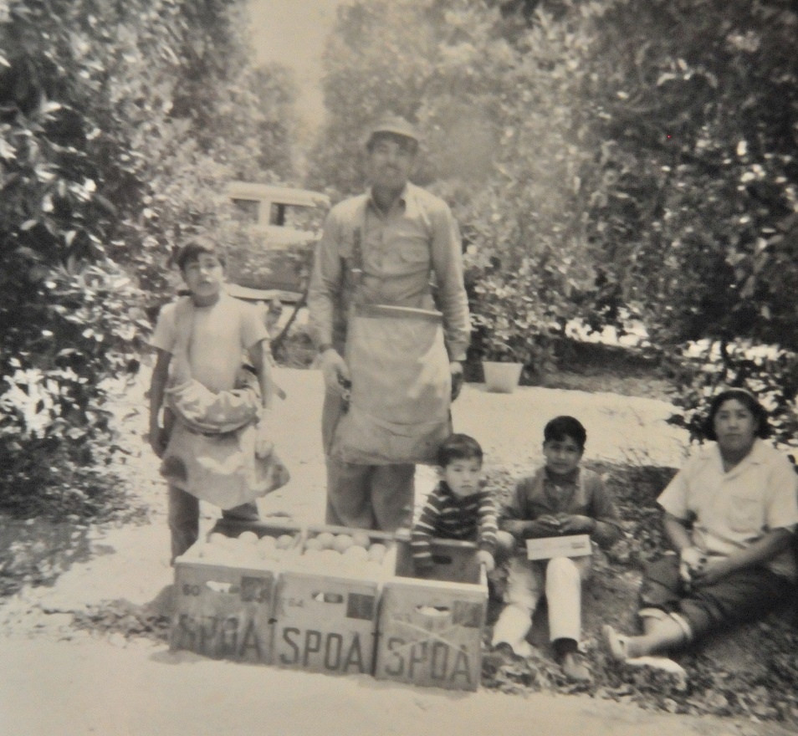
My childhood
I was born in Ventura, CA and raised in Santa Paula.
Notes:
My parents immigrated from Mexico and most of my older brothers and sisters were born in Mexico. When they first arrived in the United States they worked in the fields harvesting fruits and vegetables.

Slide 4
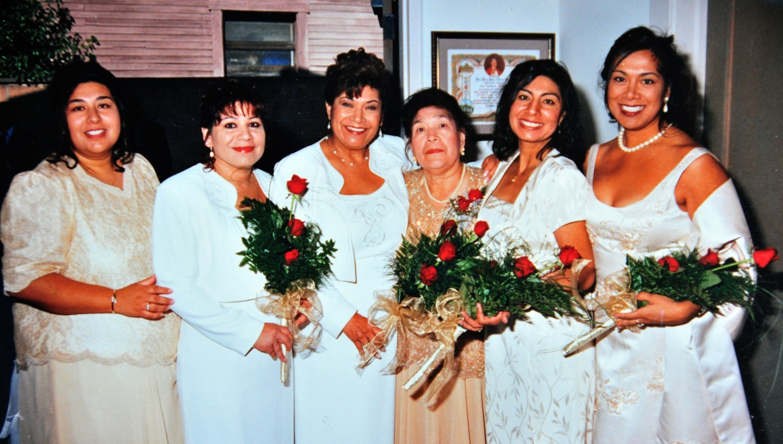
My family
I grew up in a very large family! I have 4 brothers and 4 sisters. I am the eighth child of nine. I was the second in the family to attend University.

Slide 5
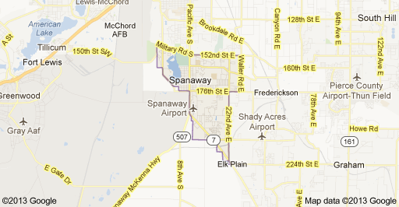
MY HIGH SCHOOL
I attended Santa Paula High School in Santa Paula, California which is located in Ventura County.
(Insert map or image of high school or mascot etc. here)

Slide 6
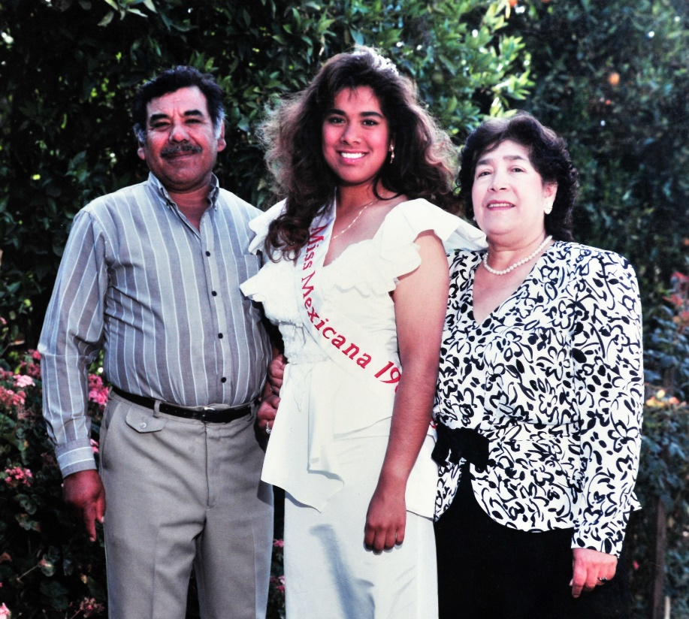
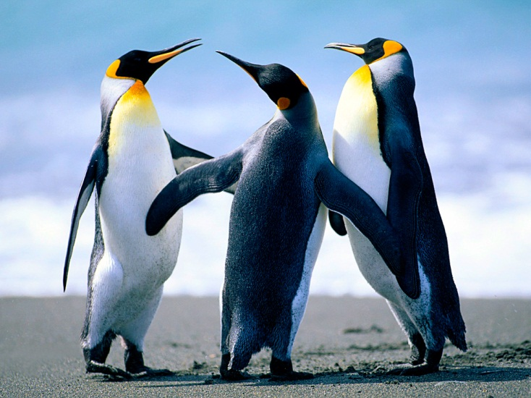
High School
As a HS student I was very outgoing, athletic and really interested in my classes. I competed in a “Miss Mexicana” pageant which I won and was given scholarship monies and a trip to Mexico.
…………………………………….
Here is a picture of me in HS

Slide 7
High School
Things that I really liked in High School were:
I really enjoyed playing tennis, cheerleading and going to proms.

Slide 8
High School
Things that felt difficult or challenging for me while I was in High School were:
Managing my time between academics, sports, work and family.
Also, Chemistry was particularly difficult for me.

Slide 9
High School
Jobs I worked while I was in High School were:
1. Delivering Pizza! My best friend and I worked for a company called Double Deal Pizza where you got two pizzas for the price of 1 and so they would send us out to deliver the pizzas together..get it?? Double Deal. Kind of silly but it was their marketing ploy.
2. I also worked as a front desk manager for a historical hotel called the Glen Tavern Inn. The hotel was built in 1934 and is known to be haunted by a ghost named “Cal” who was allegedly shot during a poker game. He is known to visit guests in room 307…the ghost room.
3. Doctor’s Assistant- one summer I worked for a clinic called “Clinicas Del Camino Real” for a great program that was created to assist high school students understand what doctors really did from day to day..at the time I wanted to be a doctor. It was a great experience and I got to watch a hip surgery at Santa Paula Hospital.

Slide 10
Getting in to College
The top few things I did to ensure I got into college were:
I always made sure that my grades were as strong as they could be. I used to take great pride in being Number 1 in my class. Getting B’s was not an option so I really focused on studying.
I knew that universities looked favorably on extracurricular and community/volunteer activities so I was President of the Keywanettes (a service organization) ; I was a cheerleader, on the tennis team, and played on the softball team one year.
Also I made sure to visit as many universities as possible during my freshman and sophomore years so that by junior year I knew exactly what the requirements were of each, had spoken to admissions counselors etc.

Slide 11
College
For my undergraduate work I attended the University of California in Santa Barbara. I did graduate work at California State University, San Jose, and then went to Law School at Pepperdine University in Malibu, California. I spent one summer at Yale University in a wonderful program called the Women’s Campaign School.
Insert map shot here

Slide 12
College
Things I enjoyed in College
Things I didn’t enjoy in College
New Friends
Living in the Dorms
Freedom to select classes
My Sorority (Alpha Chi Omega)
Formals (like prom)
Road Trips with my friends
Psychology
Chicano Studies
Having Cesar Chavez as a Professor (United Farm Workers)
I missed my mom’s cooking and my friends from home
Not having much spending money
Finals (stress)

Slide 13
College
Favorite classes
Least favorite classes
Psychology
Chicano Studies
Statistics

Slide 14
College
Jobs I worked while I was in College were:
Resident Assistant for a Summer Program for Underprivileged High School Students
ESL Instructor for One Stop Immigration and Education- I taught adults English in the evenings from 7-10 p.m. It was the best work experience I had during college.
Intern at California Rural Legal Assistance – worked on a Slavery case that involved indigent Mexican workers that were forced into slavery at Somis Ranch in Ventura County, California.
Intern for the President of Mexico (Carlos Salinas de Gortari Administration). I researched and documented human right violations along the Mexico-US border and provided reports to the government. I lived in Mexico City and on one ocassion had breakfast at the President’s house!

Slide 15
College
Things that felt difficult or challenging for me while I was in College were:
Finances!!! I never had enough money to do the things /activities that I wanted to do even though I worked throughout my college years.
Managing my time. I had to learn how to use my time wisely because it was my first experience with so much freedom.
Being away from my family and high school friends. We all went to different universities so I rarely got to see them.

Slide 16
Getting a job after College
The top few things I did to ensure I got a good job after college were:
Research;
Internships;
Networking

Slide 17
This is My Company
Every day at my company:
As a law firm, our first priority is our clients.
Much of the day is spent meeting with the clients and updating them on their cases or talking to new clients.
If there is a court appearance of course one of the attorneys will be assigned to “cover” the hearing.
When we have had high profile cases we sometimes hold press conferences to let the public know what is happening with the case. For example, we had press conferences for the “car wash” cases and the Miramonte Cases.
Insert company picture

Slide 18
My Career Path
I started as an associate at a law firm…)
I worked as a summer associate at various law firms
I am now the owner of my law firm ….
Notes:
You may use this chart to describe your journey to the current career

Slide 19
My Career
The first job I had after college was:
My first job after undergraduate school (UCSB) was teaching the 3rd grade at Winnetka Elementary School in the valley- Canoga Park, CA.
The first job after law school was at Sony Pictures Entertainment working on film credits. I then went to NBC where I worked on rights analysis for Saturday Night Live.
The worst job I have ever had was:
Mcdonalds… blue polyester! I worked there for one week while in High School.

Slide 20
My Career
Challenges I have had to overcome throughout my career are:
Juggling family with career. As a young lawyer you are expected to put in many hours and that leaves very little time for family.
Also, when I started practicing law it was predominantly men at the law firms.
I did not have many mentors within my inner circle so I had to develop relationships with older more seasoned attorneys who I could go to for advice and guidance.

Slide 21
My role within organization
Managing Partner (Me)
Associates
Support Staff
Paralegals
Administrative Assistants
Notes:
Use this graph to give more description of your role specifically (responsibilities, typical work week, direct reports, etc.)

Slide 22
Compensation at my company
Starting Salary for New Attorneys in the Los Angeles Area: $92,000.00
My first Year as an Associate for a Boutique Firm:
$48,000.00
Fifth Year Associate at mid size Insurance Defense Firm:
$80,000.00
Senior Associate at a Mid Size Firm (2008) $125,000.00

Slide 23
More than just work
When I am not at work I like to:
Mostly I like to spend time with my 6 year old daughter Isabella. We enjoy swimming, golf (yes she even has her own little golf clubs!), movies and spending time with our pets Charlie Bear and Gatito.
When I am not with my daughter I enjoy tennis, dining out, cooking, and reading.

Slide 24
Do it all over again?
If I could talk to my high school self, what would I say?
I would have considered more universities outside of California;
I would have spent less time with my high school boyfriend and more time with my friends and enjoying my extracurricular activities;

Slide 25
QUESTION AND ANSWER

