Slide 1
kimberly yang 2.17.15

Slide 2
introduction
My family calls me “Guang Guang”, my friends call me “Kim” and my professional colleagues call me “Kimberly”
I currently work for Proven Solutions Inc.
Proven is an exclusive staffing company involved with Executive Search, Contract and Direct Hire for Finance and Accounting, Information Technology, Operations and Administrative Support
I am a Sr. Partner here and started the LA Technology team

Slide 3
learning to crawl…
I was conceived in Guam, born in San Jose, CA and grew up predominantly in the bay area.

Slide 4
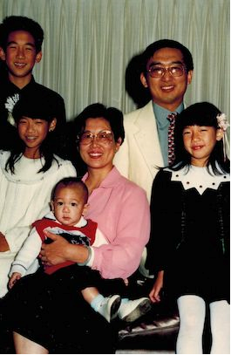
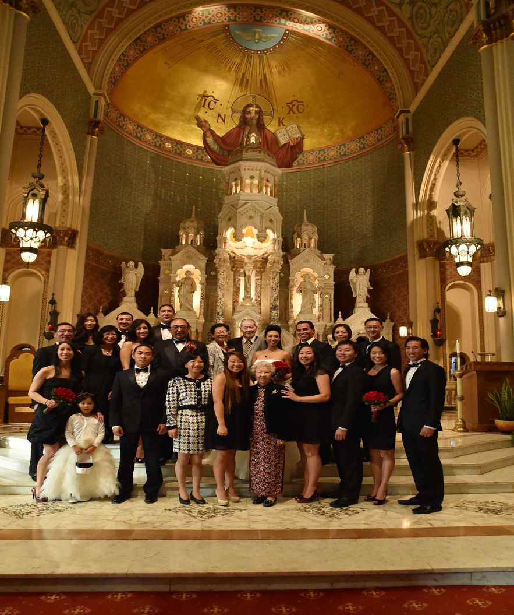
my roots…
Immediate and extended family

Slide 5
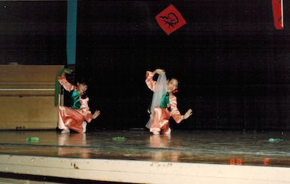
dance! (discipline)

Slide 6
Learning to run…
I attended Notre Dame High School in San Jose, CA

Slide 7
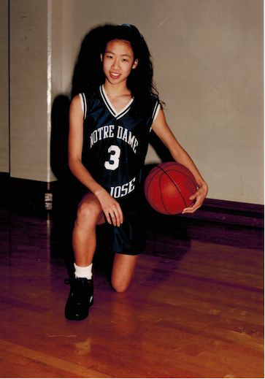
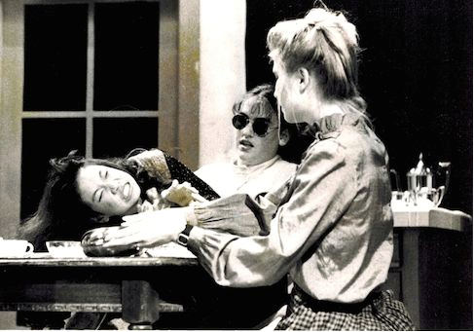
high school
As a HS student I was involved in ballet/ Chinese modern dance, volleyball, basketball, track, the school play and A LOT OF SCHOOL WORK
As a HS student I was athletic yet nerdy. I was shy but also involved. Danced ballet/Chinese modern but was not a cheerleader
First time I experienced a few of my most difficult years of my life…
\

Slide 8
high school
I was so cool…
Not so cool…
JV and Varsity for all sports – vball, bball, track
Top score game for bball was 23 points, MVP, back row specialist for volley
Rotary club speech: 1st place
Set 100 meter dash record time
4.0+ GPA
Played Helen Keller in school play
Moved up to Beaverton, OR for Jr. year
Parents separated → Divorce
Bell’s Palsy
Totaled my first car, day after I got my license

Slide 9
high school
1995 Graduation

Slide 10
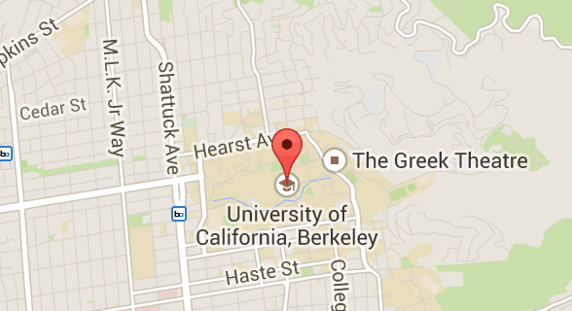
Learning to Run on my own… COLLEGE!
I attended UC Berkeley in Berkeley, CA
Go Bears!

Slide 11
Go Bears!
Activities
Extra $$$
Intramural volleyball, basketball, indoor soccer
Attended CAL football games, fraternity /sorority parties
PARTIED in SF
Volunteered to teach at year round school – 2nd graders
International House as admin
Promoted at clubs and go-go danced

Slide 12
Go Bears!
FUN! FUN! FUN!
YAWN…
FILM 173
Journalism/Broadcasting
Psychology
Sociology
Criminal Law
Political Science
Statistics 21
History

Slide 13
Go Bears!
Things remembered…
Things to learn from…
Meeting so many brilliant minds… feeling NOT as smart
Meeting so many different people from all walks of life
Naked/strange people on Telegraph
Living on my own
Responsibility – value of $$$
Easy to be caught up in activities outside of school
It’s important to attend classes (black lightening notes)

Slide 14
internships

Slide 15
career path…
1999: Started trying internships to figure out what I DIDN’T want to do
2001: Started at TEKsystems as an IT recruiter
2004: Packed my things, resigned from TEK and moved down to Los Angeles
2004: Started at Robert Half International as Division Director
2005: Started at Kforce as Market Manager -> Director -> Managing Director
2010: Started the LA Tech office for cPrime
2013: Started the LA Tech office for Proven Solutions

Slide 16
First Jobs

Slide 17
J-O-B

Slide 18
Friendly fire…
My Clients
The Walt Disney Company
DirecTV
Mattel
Sony Pictures
NBC Universal
Paramount
CBS Studios
AEG
Toyota
20th Century FOX
Charles Schwab
Paypal
Macys.com
Visa
Gap
Williams Sonoma
Verizon
Nextel
Activision Blizzard Entertainment

Slide 19
climbing the corporate Ladder
Challenges
Looking young (ish)
Being female
90% of my clients are males
High expectations
ABC

Slide 20
not a 9 to 5…
Sr. Partner
Biz Dev
Account Management
Management
Strategy
Notes:
Use this graph to give more description of your role specifically (responsibilities, typical work week, direct reports, etc.)

Slide 21
career breakdown for IT
In-demand skills sets: Project Management, Development, Analysis, Analytics
Data Management: BI Architect / Designer, BI Developer, Data Analyst, Data Warehouse Architect, DBA, DB Architect, DB Developer, ERP App Architect: 96K-150K
Functional & Business Management: Business Sytems Analyst, Business Analyst, Product Manager, Program Manager, MO, Project Coordinator, Quality Assurance, Business Process Engineer, Digital Media: 70K-310K
Infrastructure: Data Center Manager, DTS, HDS, Network Engineer/Admin, Systems Engineer, NOC, Operations Manager, Telco Engineer, UNIX/LINUX, Windows: 53K-130K
Appliction/Web Developers: Embedded Engineer, GUI/UI/UX, Front end developer, Mobile App, Web admin, 80K-155K

Slide 22
Live to work, work to live

Slide 23
live to work, work to live

Slide 24
ACADEMIC EXERCISE
We will now spend several minutes discussing the day’s academic module and how it is relevant in the ‘real world’

Slide 25
Inquisitive minds…

