Slide 1
YBA GUEST
Gene Massey
CEO MediaShares

Slide 2
INTRODUCTION
My name is Gene Massey and I am 66 years old.
I am the CEO of MediaShares.com.
My company does marketing for stocks using video and online articles:
My role at MediaShares is the owner of the company
Every day I work from 7 AM to 10 PM

Slide 3
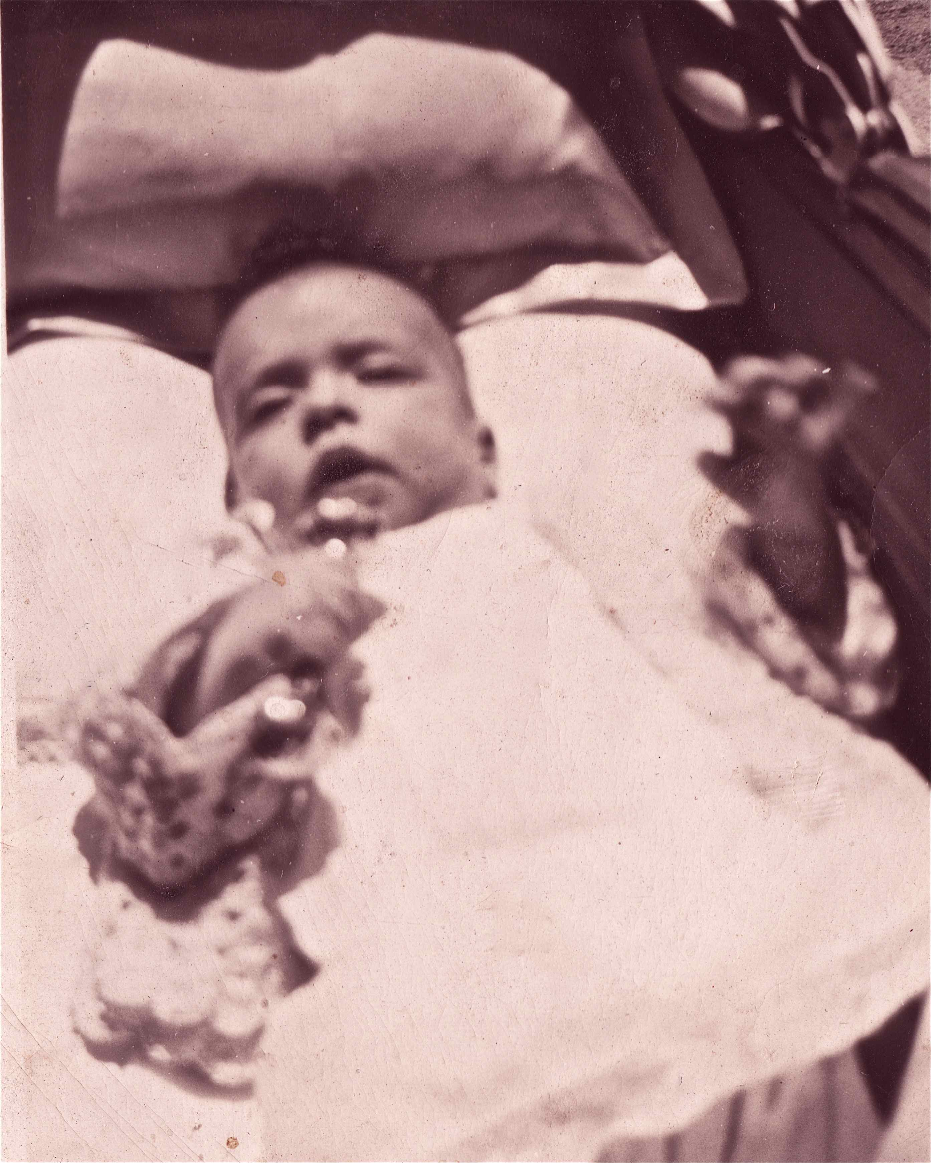
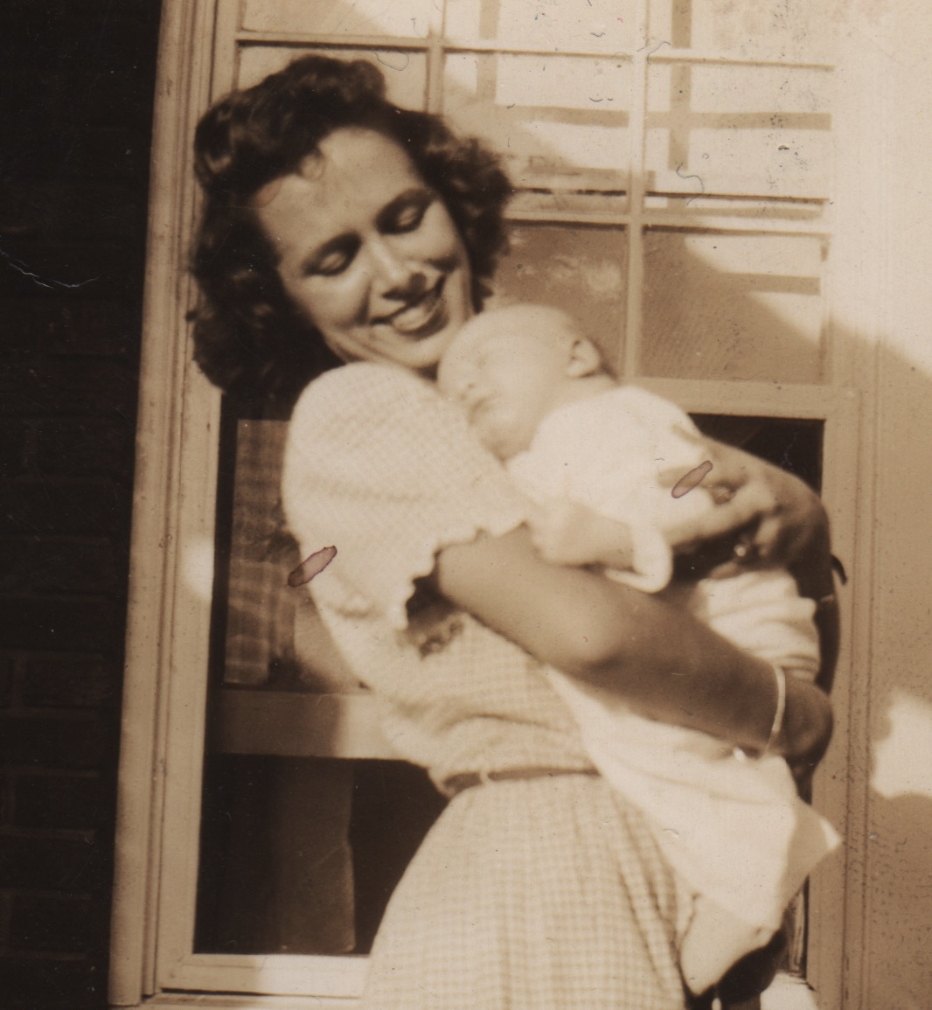
My childhood
I was born in Atlanta and raised in Macon, Georgia
These are pictures of me at 6 months

Slide 4
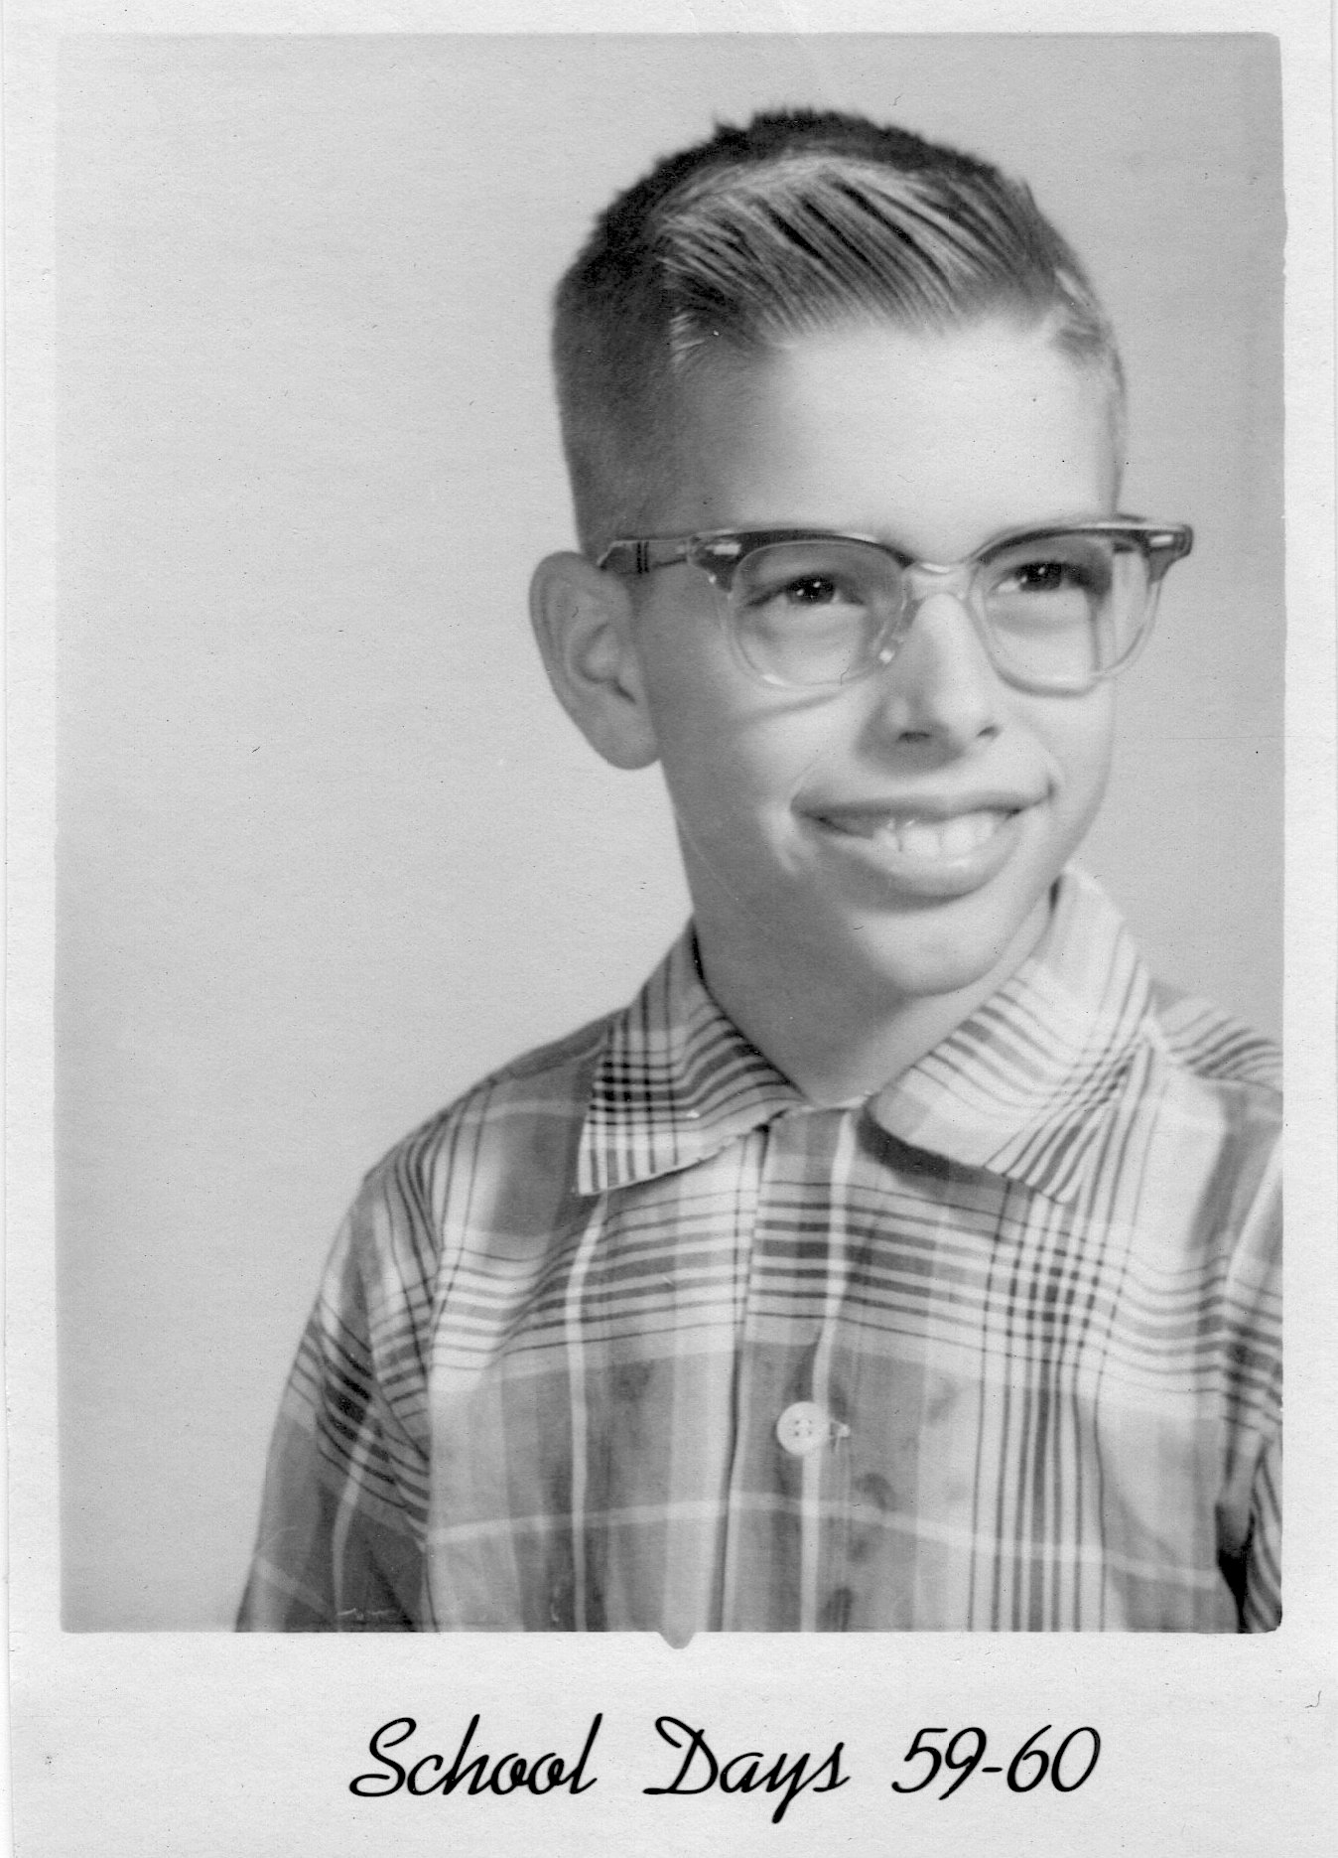
My childhood
I became a nerd:

Slide 5
My family
My father was an alcoholic
My Mother was in and out of mental institutions
I had one real sister, a half sister by my Mother’s second marriage, a sister and brother by my Father’s second marriage, and an unrelated sister by my Father’s third marriage. My Father asked me to leave home when I was 17.

Slide 6
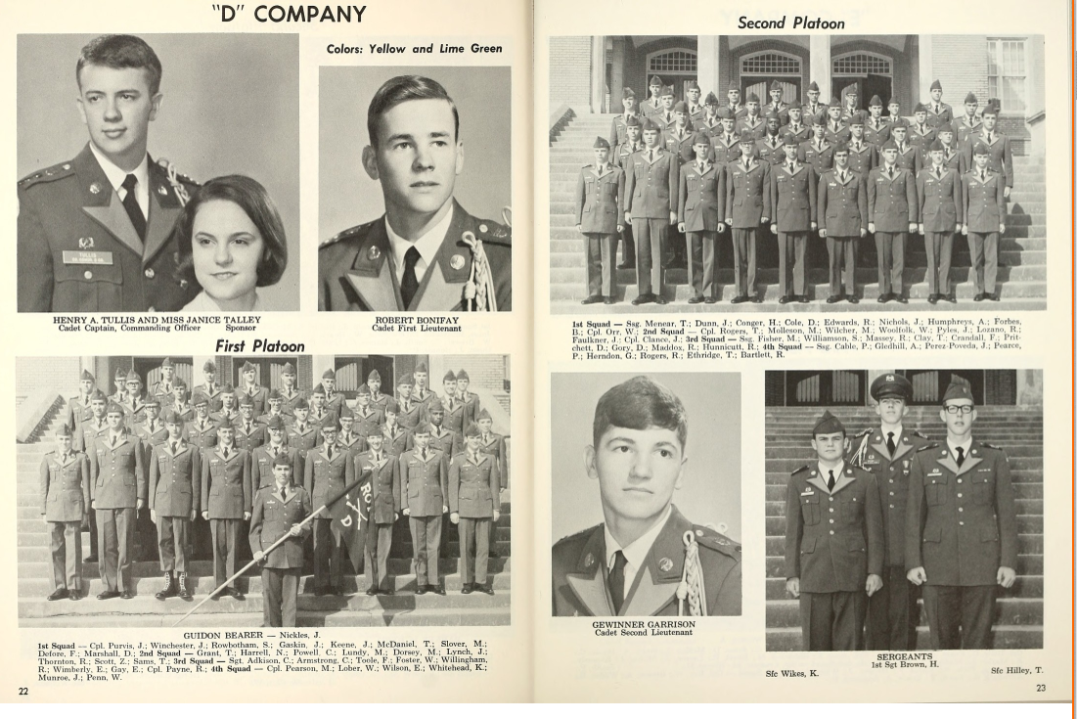
MY HIGH SCHOOL
I attended Lanier Sr. High for Boys in Macon Georgia
As you can see it was a boy’s military school
(Insert map or image of high school or mascot etc. here)

Slide 7
High School
As a HS student I was a Nerd
I went to a military school
I was not popular
However I did like acting classes
This led me to the University of Georgia where I studied acting and was in several big plays.
Here is a picture of me in HS

Slide 8
High School
Jobs I worked while I was in High School were:
I worked in a jewelry store and made $8-10 per week.
I bought gas and cigarettes and booze with the money

Slide 9
Getting in to College
I got into the University Of Ga., even with grades that were not great
I worked in College as a tech in the theatre department
My grandmother paid my tuition
I left college after 1 year to be an actor at a summer theatre
After a season of summer stock I came to California

Slide 10
Getting a job IN CALIFORNIA
I came to California to be an actor
I worked in restaurants as a waiter
I taught myself filmmaking
I started my own film production company making TV commercials

Slide 11
Play Gene’s commercial reel here

Slide 12
This is NOW My Company
Insert company picture

Slide 13
My Career Path
Notes:
You may use this chart to describe your journey to the current career

Slide 14
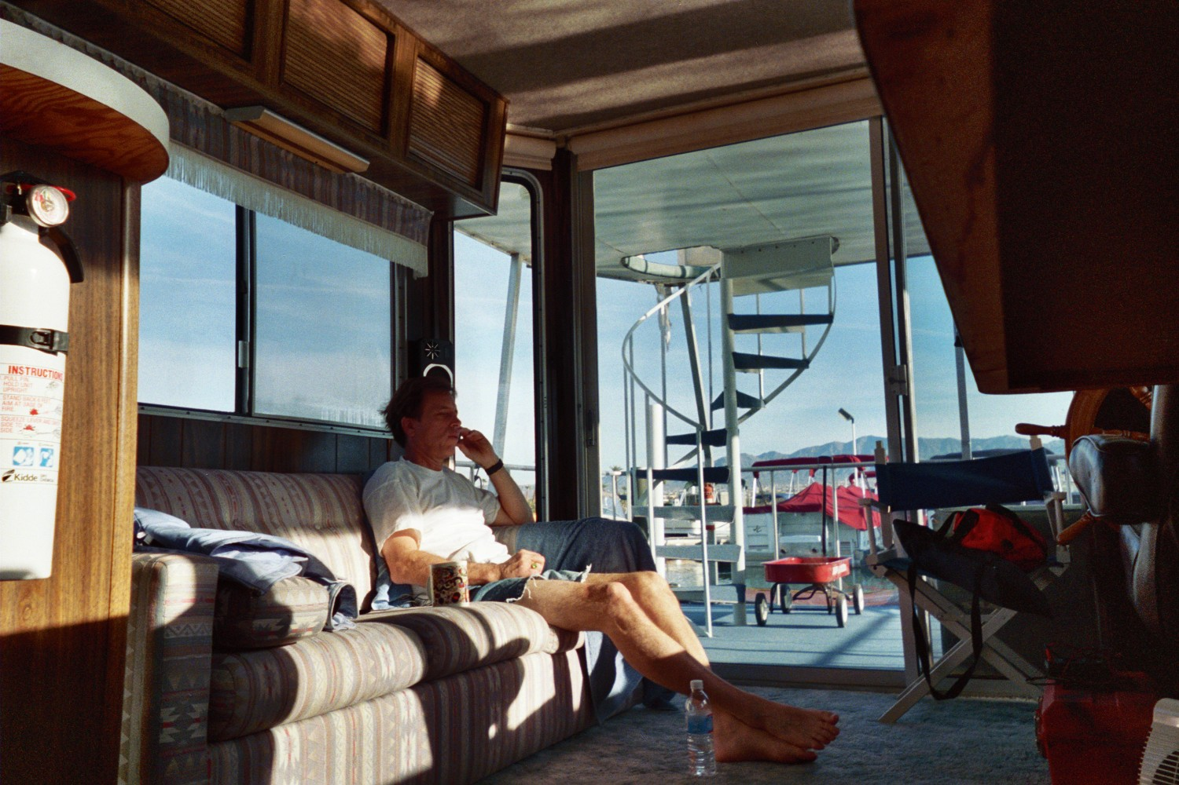
What I sold: My Houseboat

Slide 15
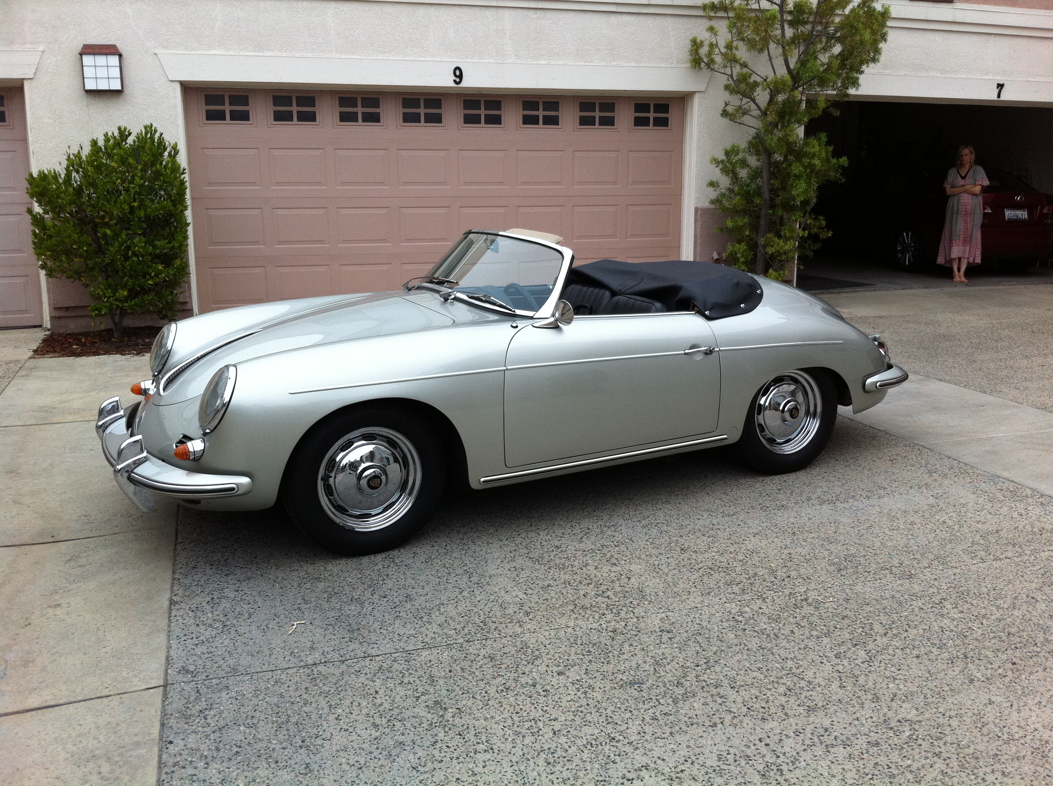
What I sold: 1961 Porsche Roadster that I had for 37 years

Slide 16
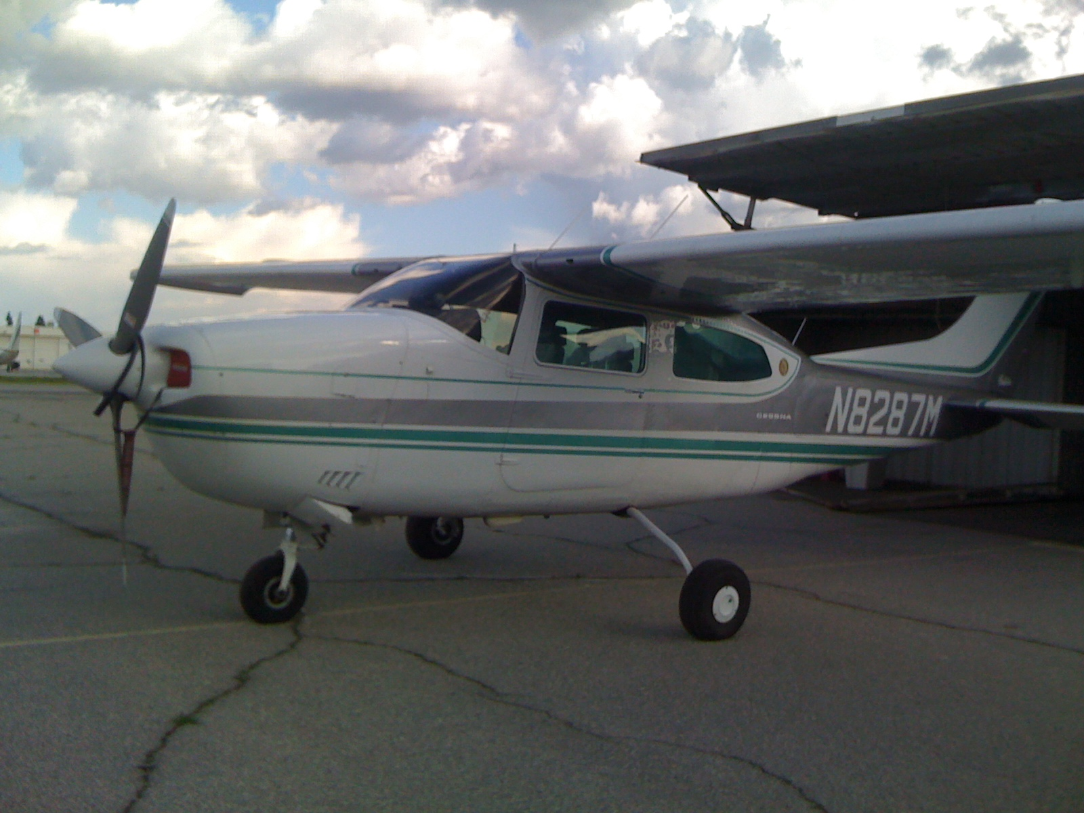
What I sold – My Airplane:

Slide 17
PLUS – I spent my life savings of almost $1 million
All to finance my business!

Slide 18
My Career
Challenges I have had to overcome throughout my career are:
Learn the importance of working in harmony with others
No drugs
Very little alcohol
Discipline to work when I would rather play
Concentrate even when there are many distractions

Slide 19
Compensation at my company
C-Suite
($350K)
Management
($150K)
Middle Manager
($75K)
Entry Level
($20K)
Notes:
Use this graph to show general compensation ranges for people in various roles in your company

Slide 20
More than just work
When I am not at work I like to:
Work at something else
Travel
Service to others

Slide 21
Play 2nd movie here

Slide 23
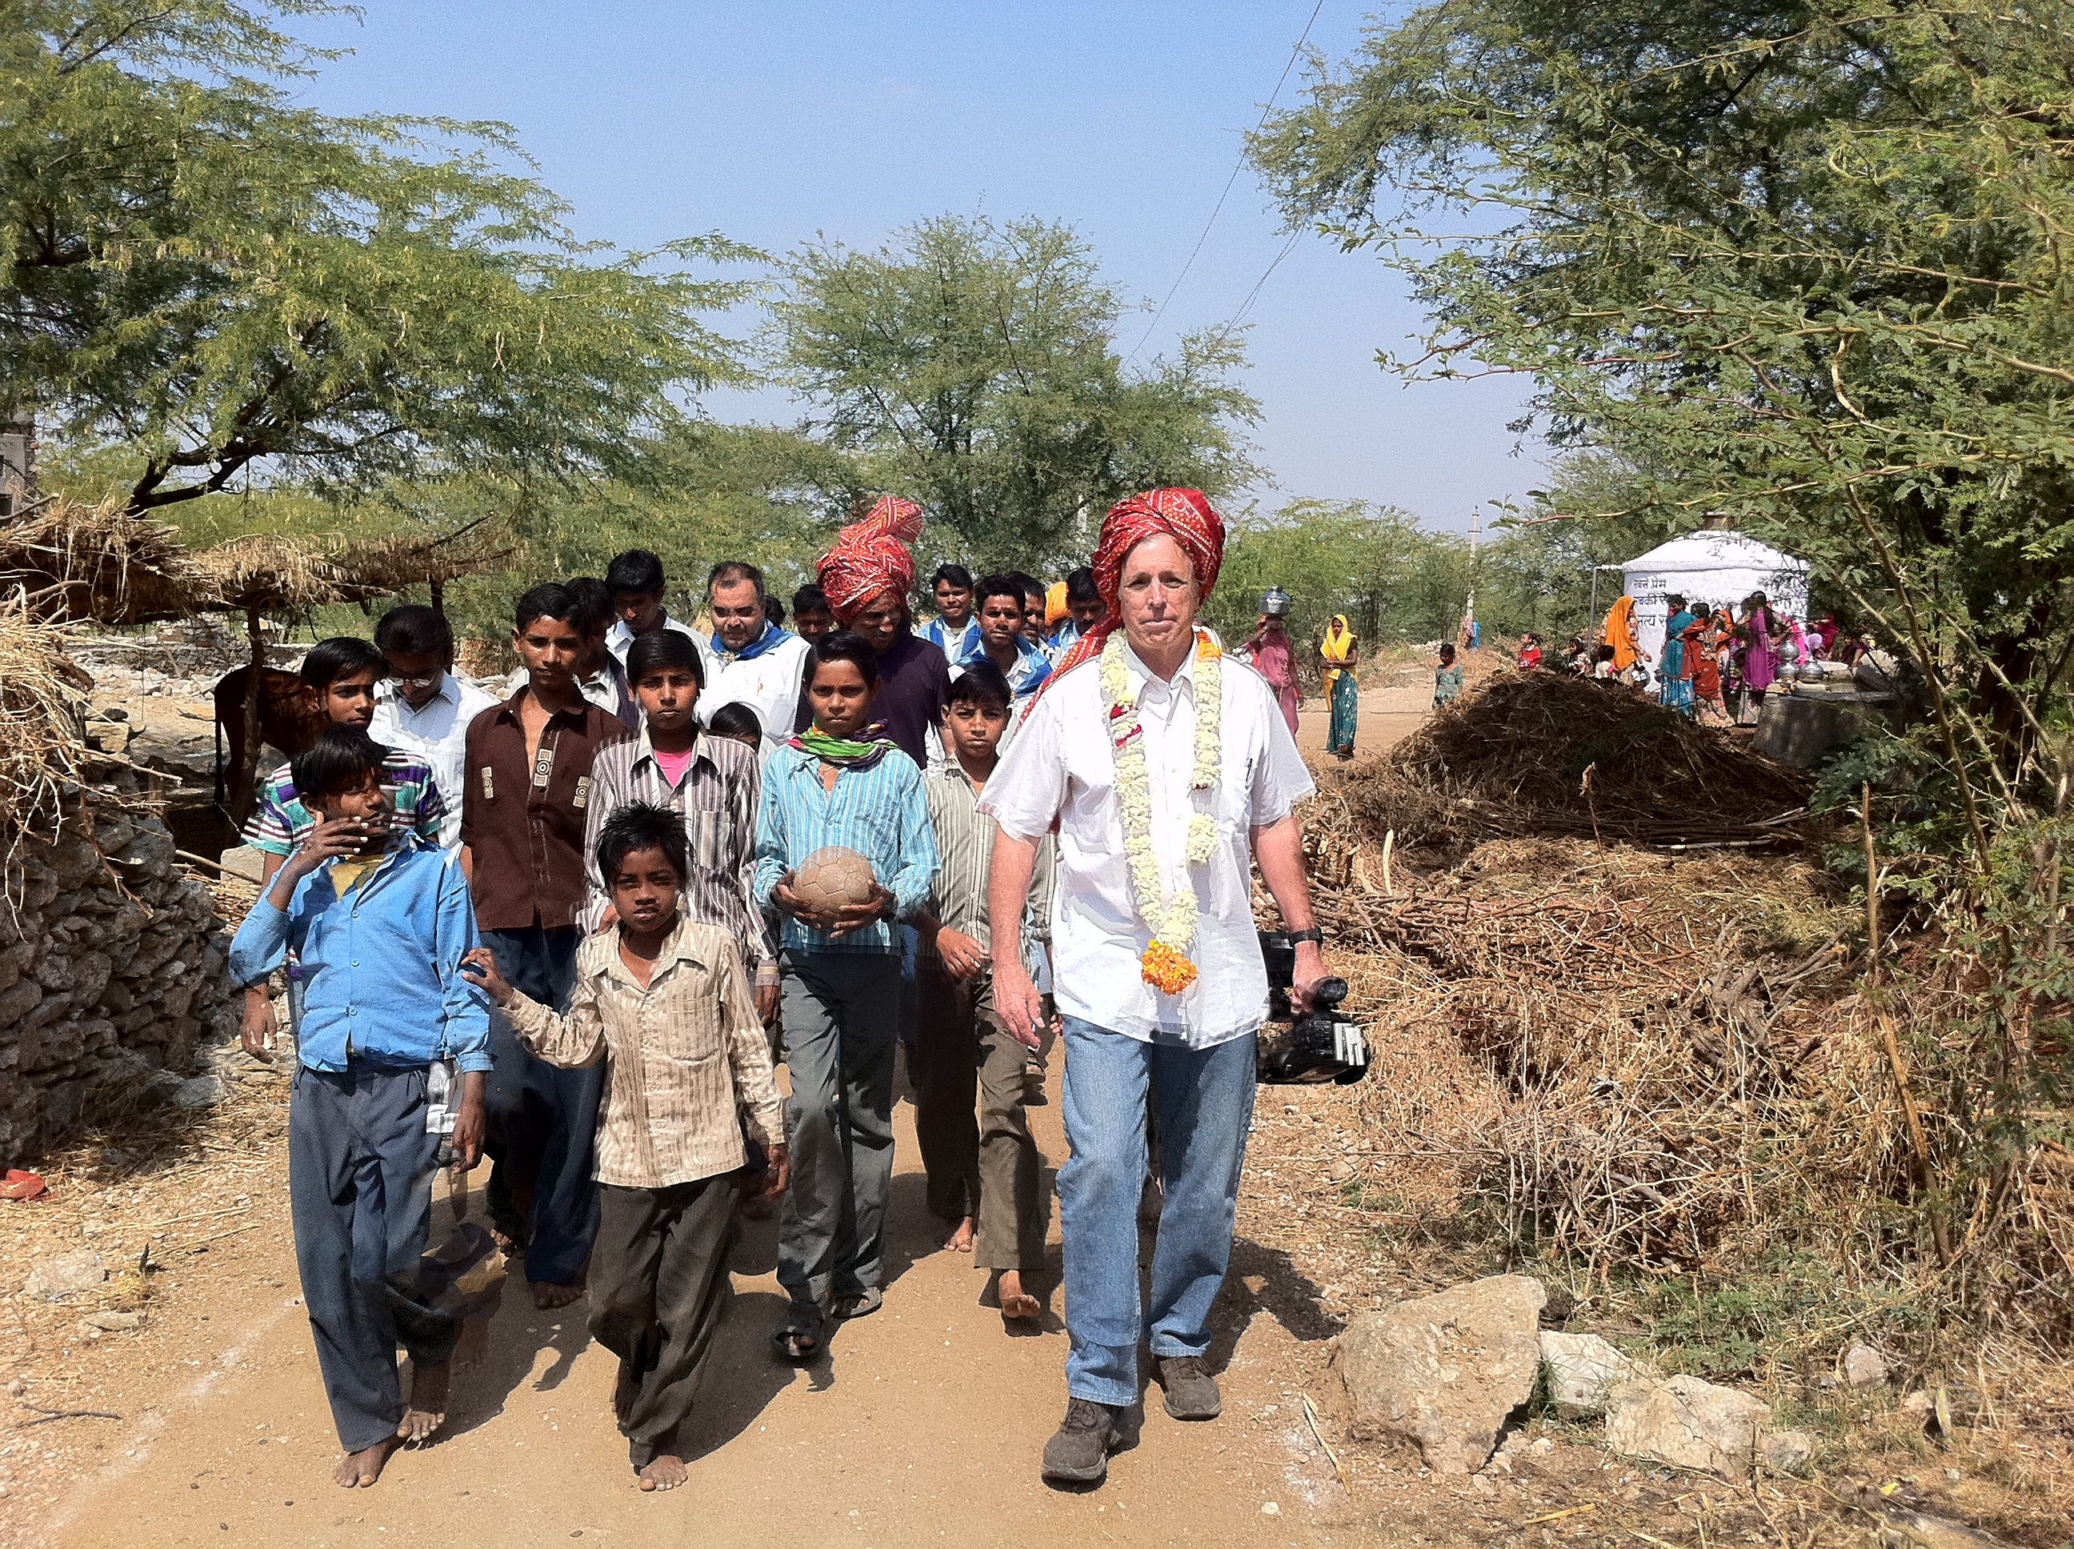

Slide 24
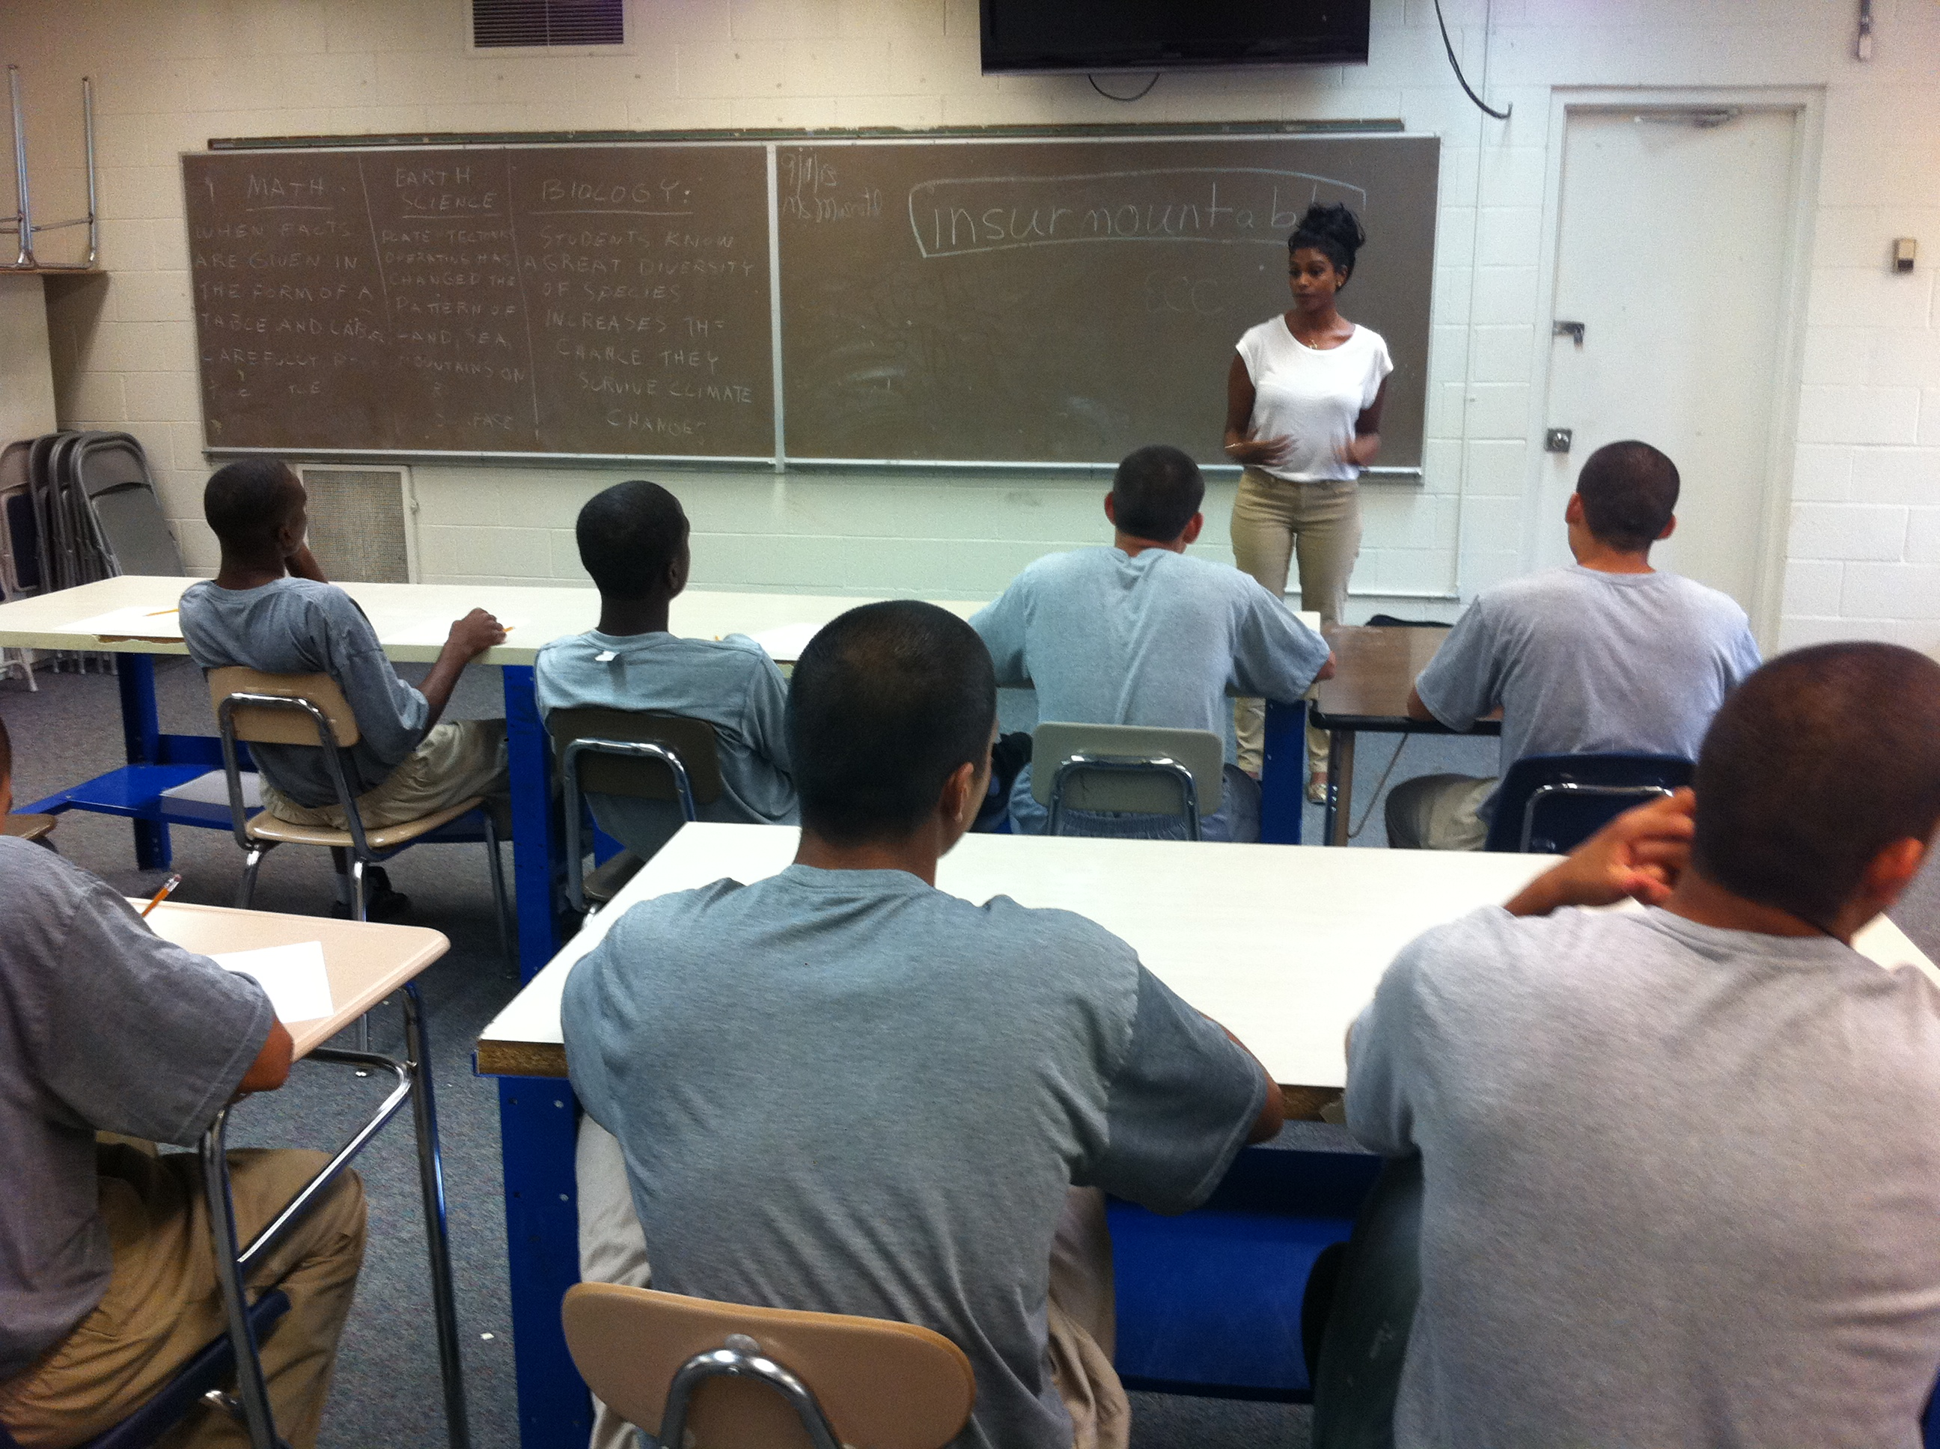

Slide 25
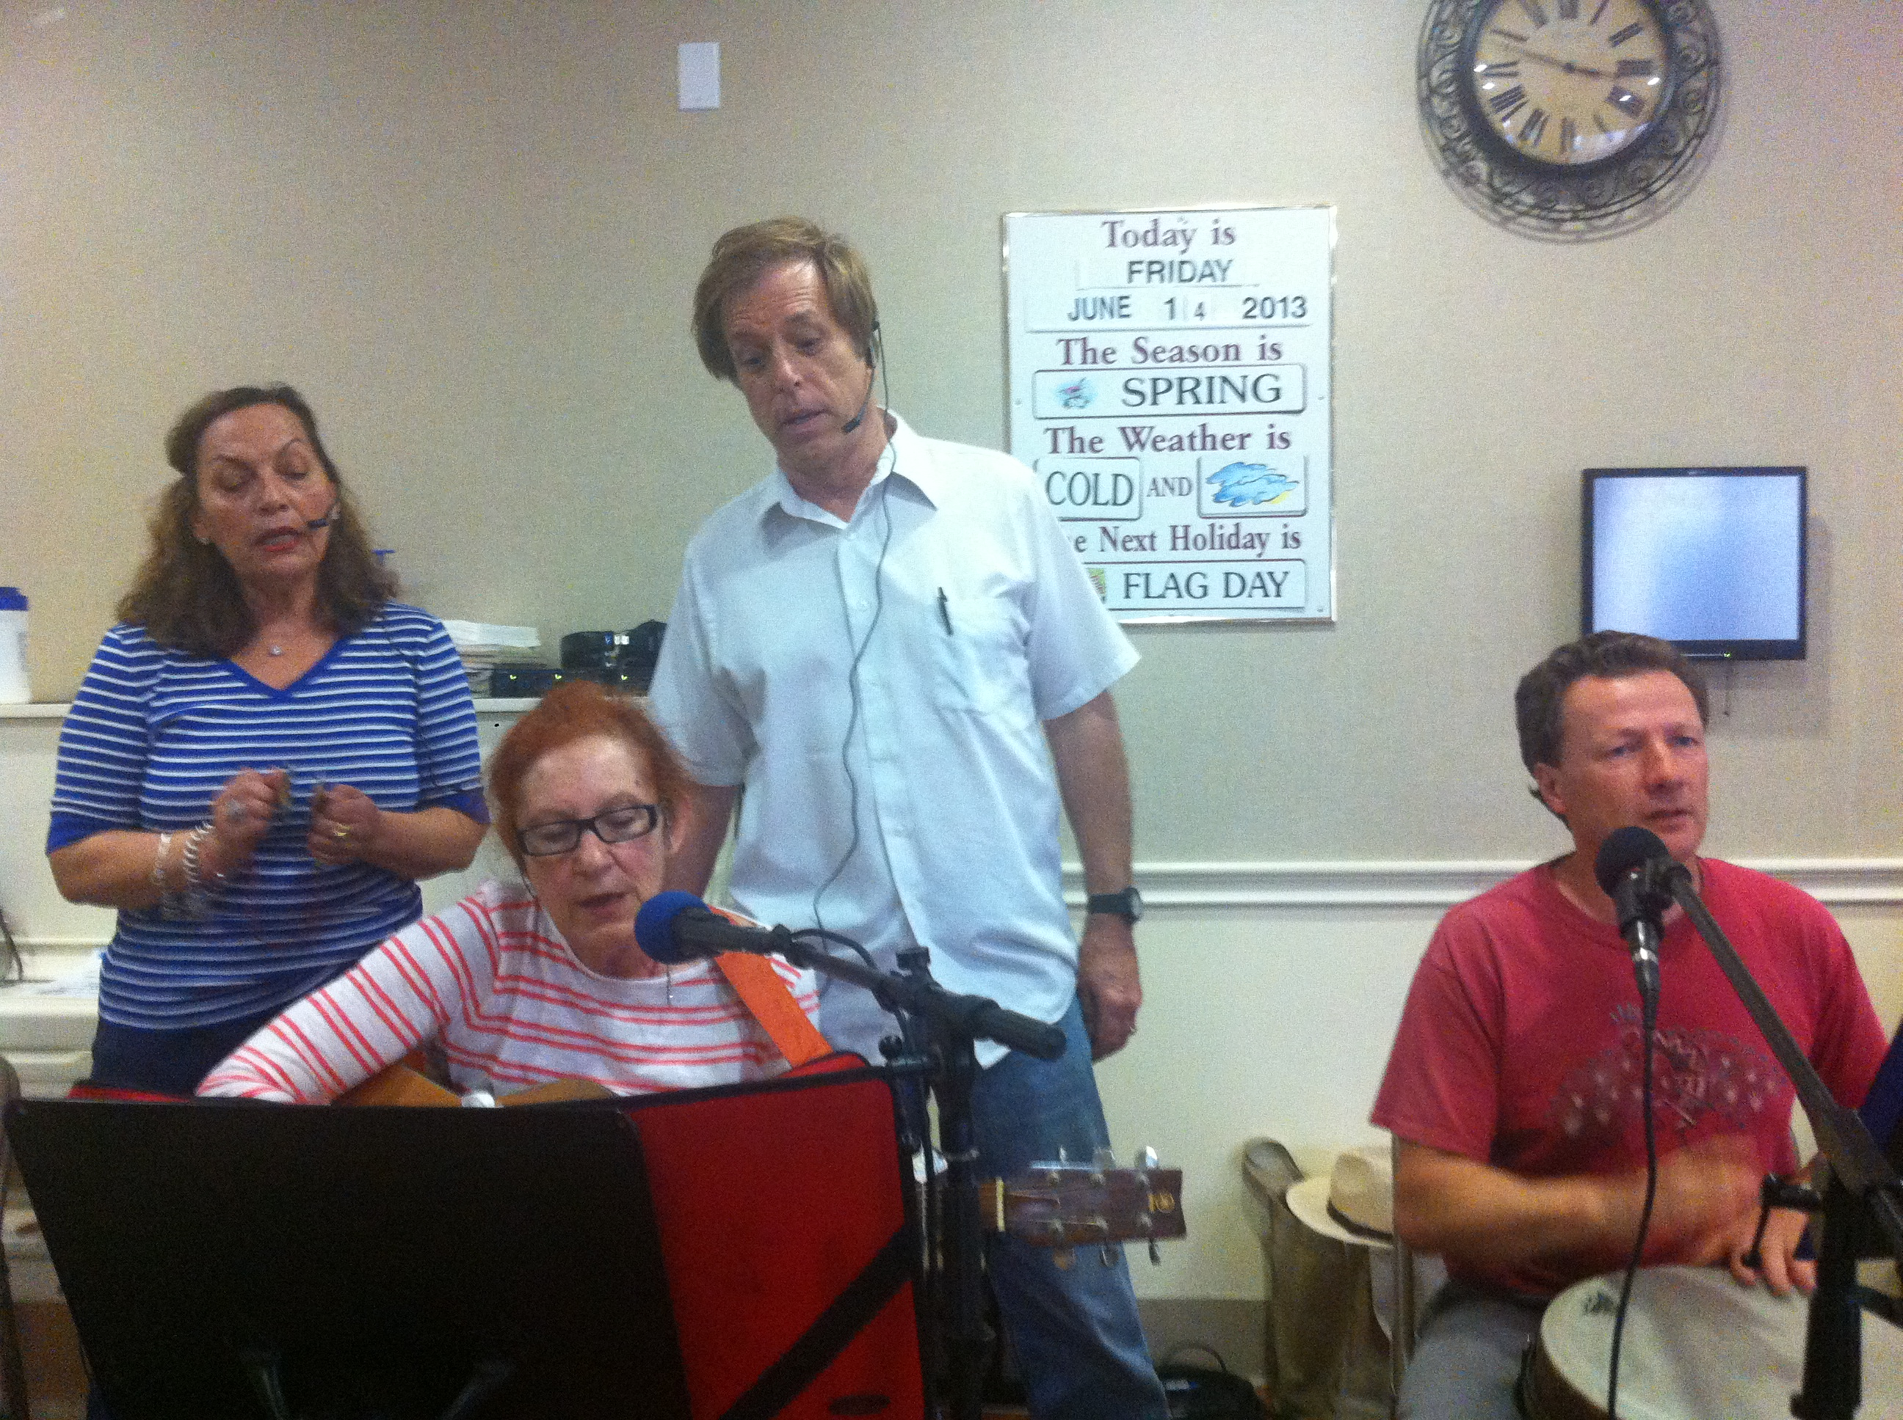
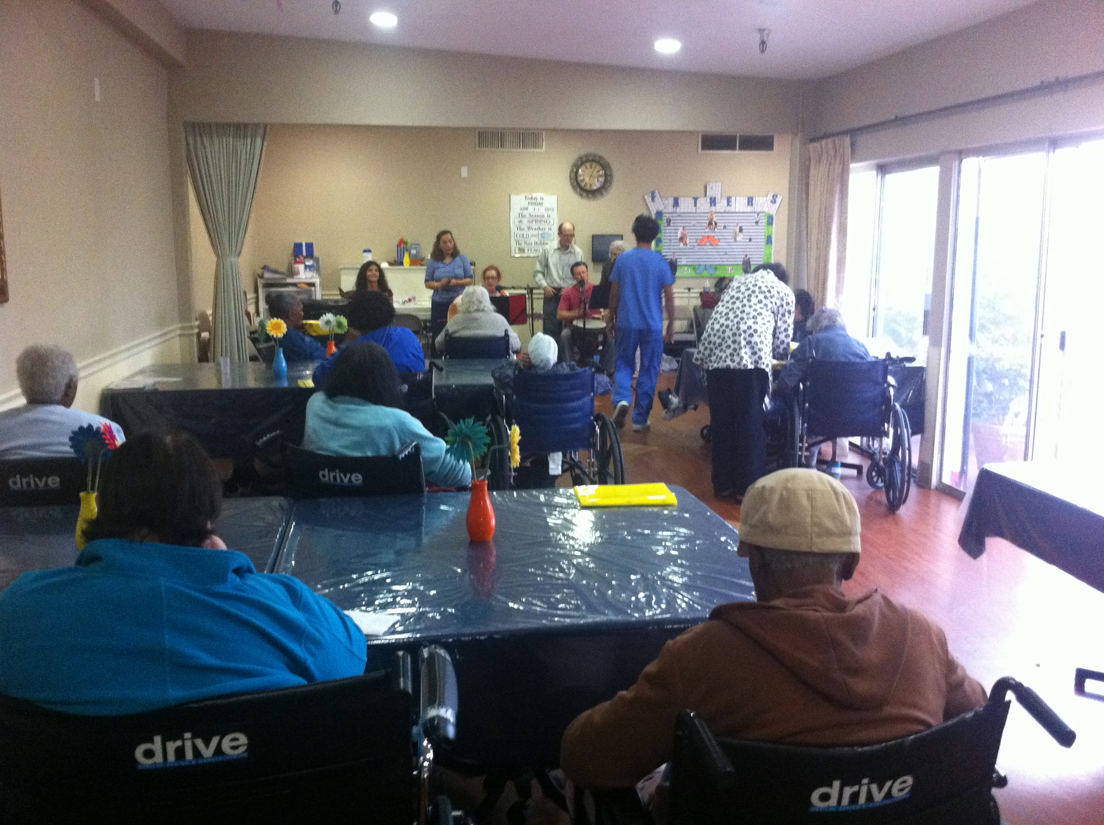

Slide 26
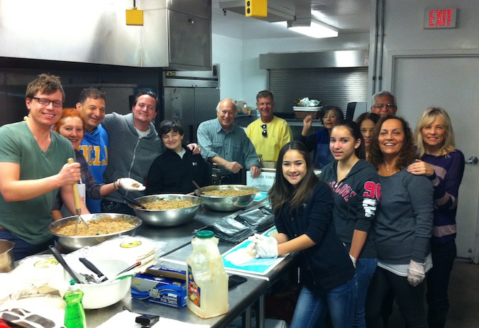

Slide 27
Do it all over again?
Find a goal sooner
USE MY TIME BETTER
Pursue more spiritual goals!
LIFE IS SHORT!

Slide 28
QUESTION AND ANSWER

