Slide 1
INTRODUCTION Dream Big
Tanya Griffin and I am 39 years old.
Interior Design from Los Angeles
Company Shaping Spaces Group Interior Design & Home Staging - 2008
Been practicing interior design since 1996 and graduated with a Bachelors of Science in Interior Design in 1999 from Woodbury University in Burbank after transferring from Cal St. Long Beach.

Slide 2
The Early Years…
Born in Inglewood, Ca and raised in Los Angeles the youngest of 3 girls.
Never a “girly girl” but didn’t play sports either.
Always loved beautiful places, hotels, museums and houses.
2nd grade

Slide 3
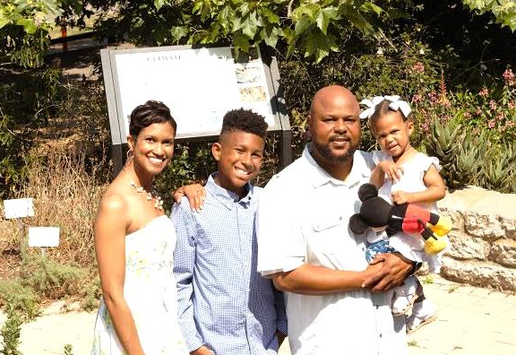
My Family…
A little about my family
We love to travel…

Slide 4
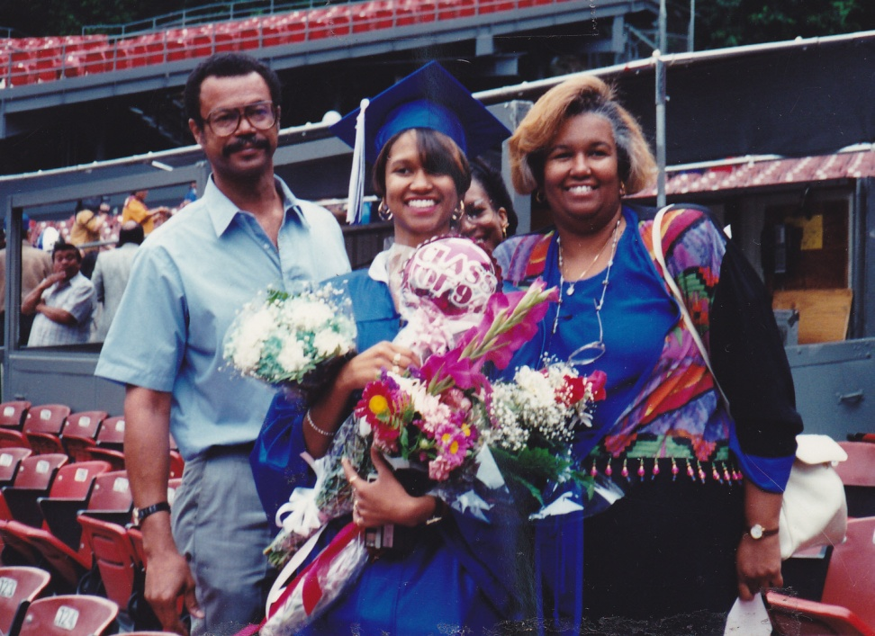
HIGH SCHOOL
I graduated from Los Angeles College Prep HS in 1994

Slide 5
HIGH SCHOOL
Activities/Athletics in HS
Jobs I worked while in HS
Leadership
Pep Squad
Work Study
Wet Seal
Music Plus
Bed Bath & Beyond
Red Lobster

Slide 6
College…Yea!
I attended Cal State Long Beach for 2 years then transferred to Woodbury University and graduated with a Degree Interior Design

Slide 7
College
Obstacles or adversity
Memories
Being comfortable in my own skin.
Often the only African American in class and at work
Working 2 jobs to help pay for school
Being able to set my own schedule for class and work
Design, Design, Design, Long Hours working on projects And loving it!
Being around a diverse group of people of all ages with new experiences
Living in the dorms, my first apt across from the beach

Slide 8
Career Path
I started as a non paid intern, and working retail…
I was promoted to a paid Jr. Designer then a senior designer
Now the Owner of Shaping Spaces Group Interior Design Home Staging with 19 yrs experience….
Notes:
You may use this chart to describe your journey to the current career

Slide 9
Career
Challenges
Being the only African American Female in the work place
Not a common major in my neighborhood, finding my voice and niche

Slide 10
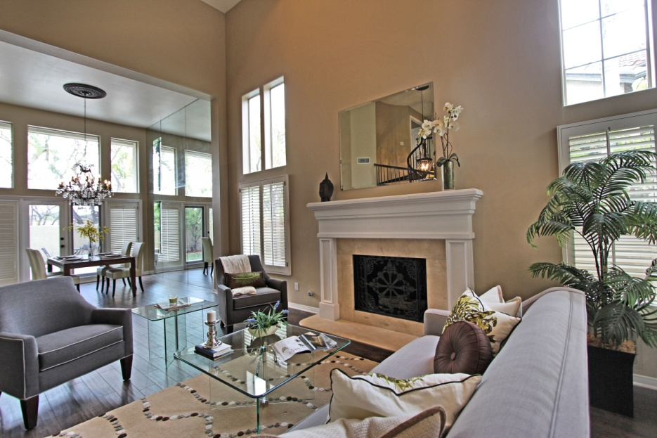
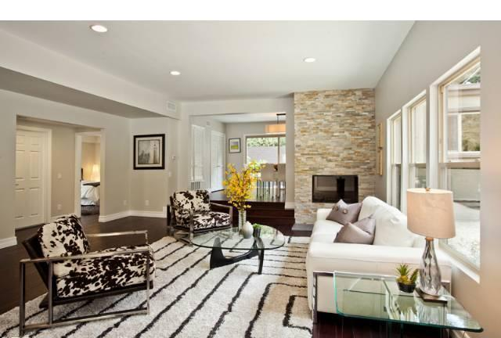
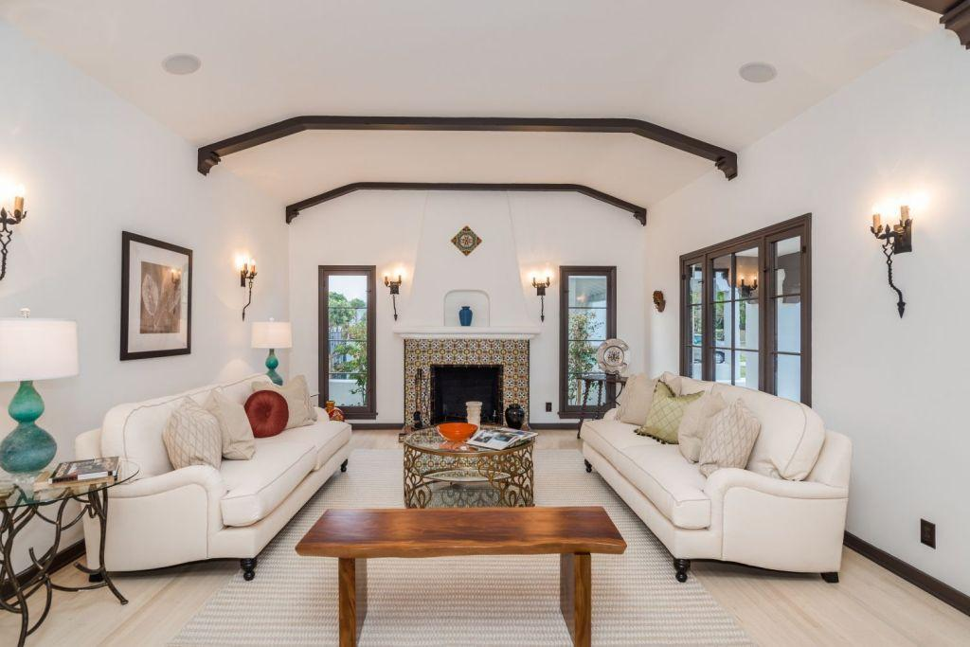
Career

Slide 11
ACADEMIC EXERCISE
Lets Design Your Dream Space

Slide 12
QUESTION AND ANSWER

