Slide 1
Marnie Schneider
Grab a Ball & Play Foundation

Slide 2
INTRODUCTION
My name is Marnie Schnider and I am 46 years old.
I am the Co-Founder of Grab a Ball and Play Foundation
A non-profit organization that raises funds to purchase brand new footballs, basketballs and soccer balls, and donates them to children and youth groups in need.
My role at Grab a Ball and Play Foundation is the Director of Communications and Public Relations.
I am responsible for managing and directing internal and external communications and most importantly fundraising.

Slide 3
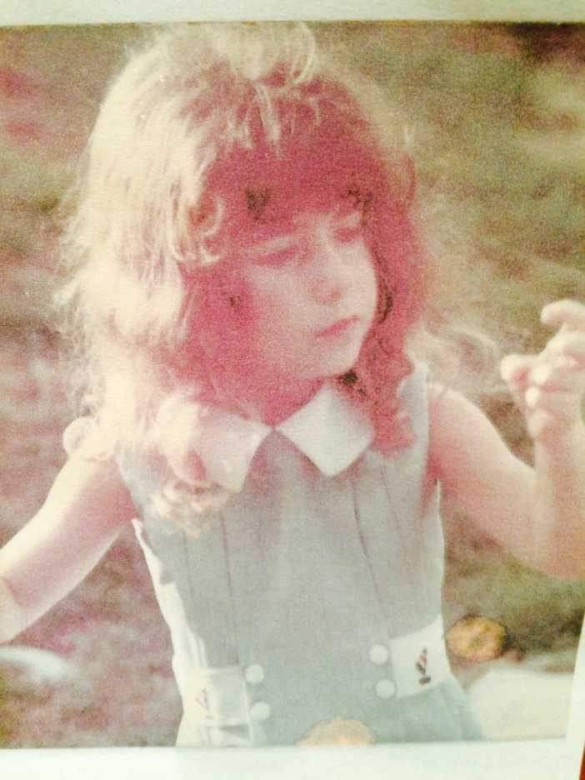
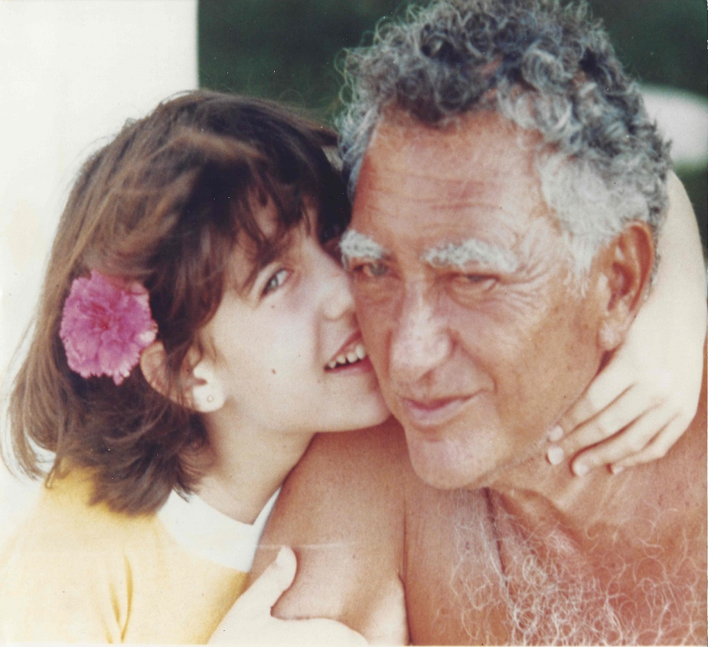
The Early Years…
I was born in New York and raised in Philadelphia
This is a picture of my grandfather and I in Mexico, when I was 12 years old.
This is a picture of me when I was 3 years old

Slide 4
More Early Years…
A little about my family…
This is a picture of me and my mother
This is a picture of me and my grandfather when I was 5 years old

Slide 5
HIGH SCHOOL
I attended Episcopal Academy in Newtown Square, Pennsylvania

Slide 6
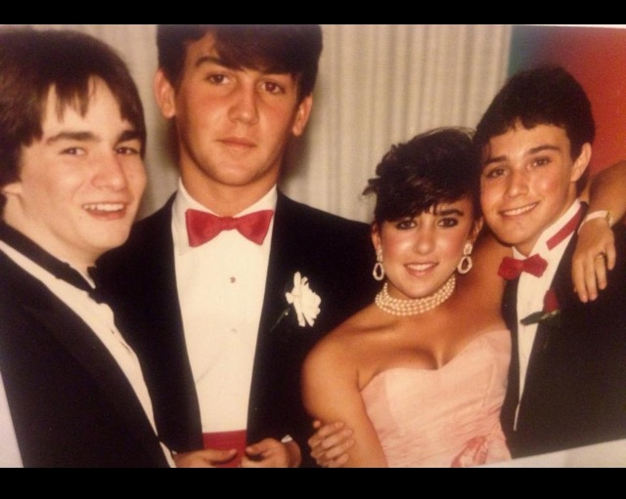
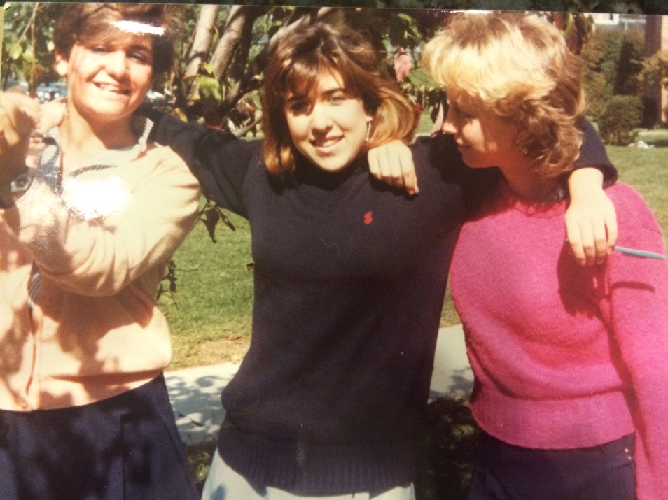
HIGH SCHOOL
As a HS student I was involved in horseback riding and a lot of community service
As a HS student I was outgoing and well liked
\
Here is a shot of me in HS for
My Junior Prom
Here is a shot of me in HS with my friends

Slide 7
HIGH SCHOOL
Things I enjoyed in HS
Things I did not enjoy in HS

Slide 8
HIGH SCHOOL
Activities/Athletics in HS
Jobs I worked while in HS

Slide 9
HIGH SCHOOL
Fondest memories from HS
Obstacles/Adversity you had to overcome in HS

Slide 10
College or Graduate School
I attended Penn State University in Pennsylvania
\

Slide 11
College or Graduate School
Activities/Athletics in College
Jobs I worked while in College

Slide 12
College or Graduate School
Favorite classes
Least favorite classes

Slide 13
College or Graduate School
Fondest memories
Obstacles or adversity that you had to overcome

Slide 14
Career Path
I started with serving my community
I began volunteering for Pediatrics Cancer Research Foundation
I am now the Co-Founder for Grab a Ball and Play Foundation
Notes:
You may use this chart to describe your journey to the current career

Slide 15
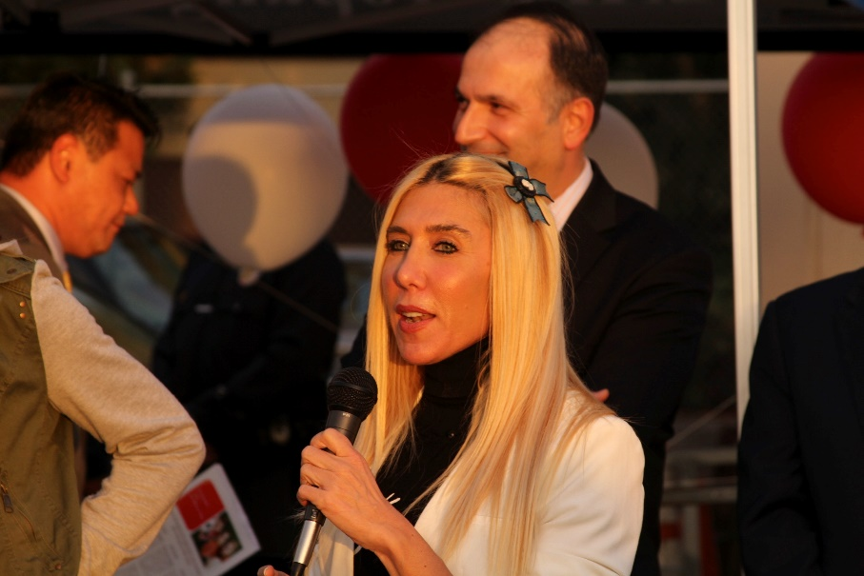
Career

Slide 16
Career
My first Job
My worst Job

Slide 17
Career
Some challenges I had to overcome in my career

Slide 18
CURRENT ROLE
History
Started in 2014
Youth athletics
Size
20 Employees
Location
Calabasas
Products
Services
Athletic Balls
Non-profit Organization
Notes:
Use this graph to give more description of your current company (history, size, location, products and services, etc.)

Slide 19
Current Role
Director of Communications & Public Relations
Fundraising
Marketing
Business Development
Sponsorship
Notes:
Use this graph to give more description of your role specifically (responsibilities, typical work week, direct reports, etc.)

Slide 20
Career Compensation
Grab a Ball & Play Foundation
Family Business
ICM, Marketing Agent
$70k
Sunglass Hut, Sales Associate
$15k
Notes:
Use this graph to show general compensation ranges for people in various roles in your company

Slide 21
QUESTION AND ANSWER

