Slide 1
The Impact of Your Life
Blake F. Richetta
May 2015

Slide 2
The Mission of My Presentation

Slide 3
A Little About Me….

Slide 4
A Brief History….

Slide 5
Family

Slide 6
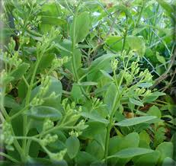
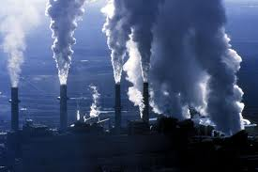
Career, Humanity & Our Planet

Slide 7
Career, Humanity & Our Planet

Slide 8
Philanthropy, Humanity

Slide 9
28,000 Days

Slide 10
Life is a Journey, NOT a Destination

Slide 11
Get Busy Living or Get Busy Dying!

Slide 12
Impact
Family
Career, Humanity
Philanthropy, Humanity
Friends, Community
The Planet

Slide 13
Life Balance

Slide 14
A Career of “Passion”

Slide 15
Excellence

Slide 16
Persistence

Slide 17
Presence

Slide 18
Risk Taking

Slide 19
Lead!

Slide 20
Go To Bed With A Plan, Wake Up With A Purpose!

Slide 21
Prior Planning Prevents Poor Performance!

Slide 22
A Plan Is Only As Good As The Execution – And Execution Is Only As Good As The Plan!

Slide 23
The “W” Strategic vs. Tactical

Slide 24
Always Follow Through!

Slide 25
Multi-Task, Manage Projects and Deadlines Develop a “System”

Slide 26
Do NOT Confuse Activity With Accomplishment

Slide 27
Proactive Work vs. Reactive Work Do NOT Spend a Dollar of Your Time To Make a Dime! Work Smarter Not Harder!

Slide 28
Do NOT Become A “Master of Minutia” Do NOT Make a Mountain Out of A Molehill

Slide 29
Analysis Paralysis! Do NOT Get Trapped Near The “Inner Circle of Thought!”

Slide 30
Worry Does NOT Take The Sorrow Out Of Tomorrow – But It Will Take The Joy Out Of Today

Slide 31
Take Responsibility NO Excuses!

Slide 32
Challenge Yourself, Never Stop Learning! If You Stop Learning, You Will Stop Growing

Slide 33
Chief Virtues
Love, Compassion
Empathy
Honesty, Integrity
Wisdom
Courage
Strength
Fortitude (Perseverance, Persistence, Passion)
Temperance

Slide 34
What Will Be The Impact of Your Life?

