Slide 1
YBA GUEST LAUREN STONE

Slide 2
INTRODUCTION
I’m Lauren Stone and I’m 30.
I work for an organization called BRITWEEK -we celebrate British culture (art, fashion, music, film) with events all over the country! I’m not British, but I spent almost 6 years working for the British government, and yes, I LOVE tea! ☺
BritWeek was founded by this guy…

Slide 3
BRITWEEK….
.
BritWeek founder….. NIGEL LYTHGOE

Slide 4
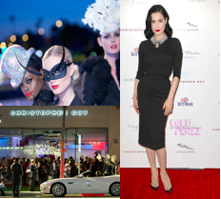
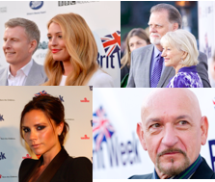
INTRODUCTION
I’m the Executive Director of BRITWEEK. I organize over 40+ events (YIKES), oversee our press and celebrity relations, and manage our website and social media.

Slide 5
The Early Years…
I was born in Philadelphia and raised there until I was 16.
This is me at 5.
And me at 15.

Slide 6
MORE EARLY YEARS
A little about my family…
This is when it was just me, my older sister, my mom and my dad
Me, my husband, my mother-in-law, and my mom & dad.

Slide 7
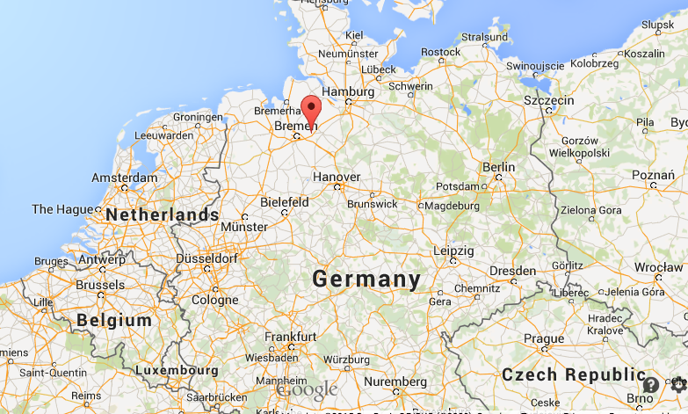
BUT, at 16 I left home
I got a scholarship from the US government and was chosen among thousands of students around the country to live, here…in Germany
\

Slide 8
GERMANY
In Germany, I lived with a German family, went to a German school, and spoke entirely ‘auf Deutsch’
This is me with my “German” brother Bijan.
We are still close friends – this is us today with my husband, too!

Slide 9
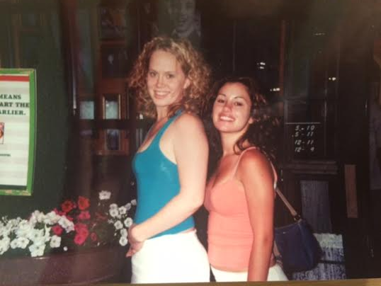
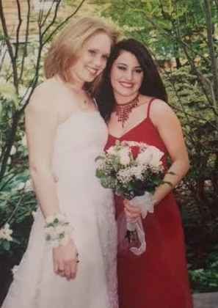
HIGH SCHOOL
As a high school student in Philadelphia, I played the flute and was part of the theatre club
In Germany, I still played the flute, but I also learned how to ski, cook German food, and of course, speak GERMAN!
\
Tenth grade of high school (15) with my best friend Savanna
As a senior in high school, right before prom with my best friend again. ☺

Slide 10
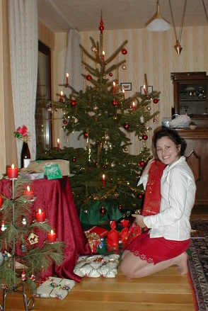
HIGH SCHOOL
Things I enjoyed in HS
Things I did not enjoy in HS
I LOVED fashion
Meeting new people & seeing new places
Theater and acting
Speaking in front of people
Languages
Cooking & food
Physics (no thank you!)

Slide 11
WHAT GERMANY TAUGHT ME
Fondest memories from HS
Obstacles/Adversity you had to overcome in HS
Going to Germany and meeting new people and seeing new places
Learning a new language and becoming more confident in all sorts of new situations.
Learning that sometimes, through challenges and obstacles, amazing things happen
Meeting my best friend Savanna and learning how to stay friends across a great distance.
Moving back to Philadelphia after being away for a year and feeling like everyone had forgotten about me
Re-connecting with friends

Slide 12
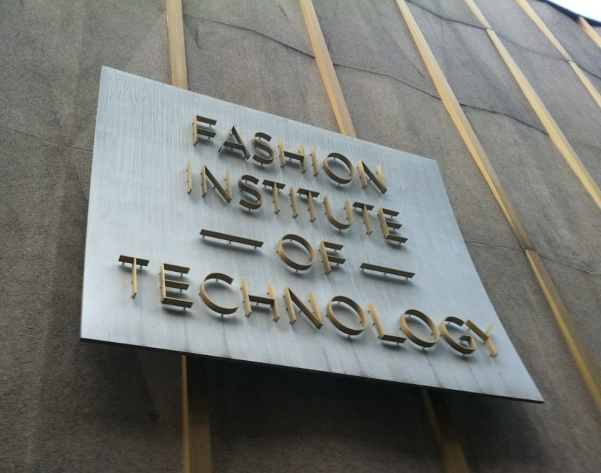
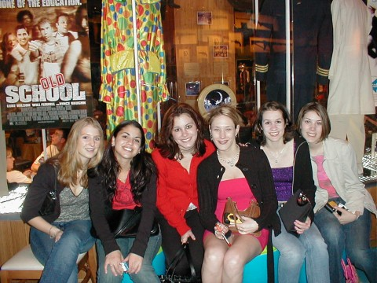
OFF TO FASHION SCHOOL
At 18, I was off to New York City to go to the Fashion Institute of Technology and study Marketing!
\
My first year of college

Slide 13
WHILE AT FIT IN NYC
Things I liked to do:
Jobs during college
Loved Marketing classes, especially Advertising and PR
I found free stuff to do all over the city – comedy shows, make-up classes, Broadway shows, and more.
I worked on campus for a professor, but I also did LOADS of internships:
I worked in music PR for a company called Funky Dumpling
I was an advertising intern for the Brides Magazine
I also worked in media and advertising for a big advertising firm – who hired me after college!!!

Slide 14
WHILE AT FIT IN NYC
Fondest memories
Obstacles or adversity that you had to overcome
Being in one of the most amazing cities ever! So many amazing experiences
Being surrounded by creativity - fashion, art and music – both at school and throughout the city
Making great friends
Being in a big city and not feeling alone
Trying to balance school, work, internships, and having fun!
Thinking about what kind of job I wanted to do after school

Slide 15
WHILE AT FIT IN NYC
I went to ROME, ITALY for 4 months
And then I went to FRANCE – Paris & Montpellier

Slide 16
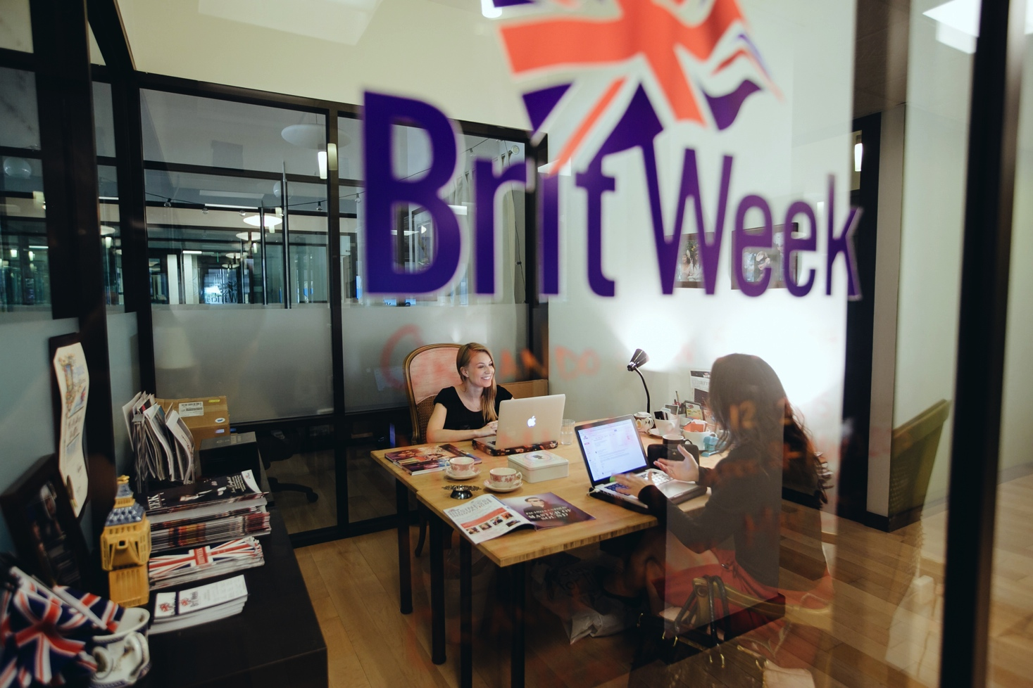
Career Path
I started as an Account Executive for an advertising agency
At 22, I got a job as Business Development Associate at the British Consulate General New York
I moved to Los Angeles and became Executive Director of BRITWEEK
At 23, I was promoted to Vice Consul of Consumer Goods for the British Consulate General New York
Notes:
You may use this chart to describe your journey to the current career

Slide 17
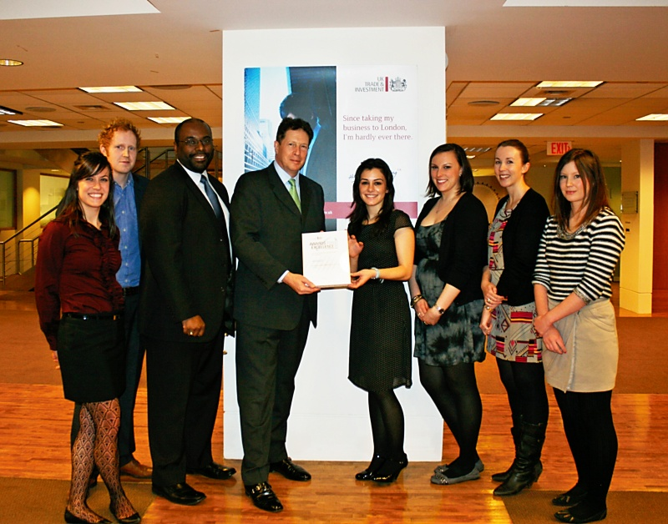
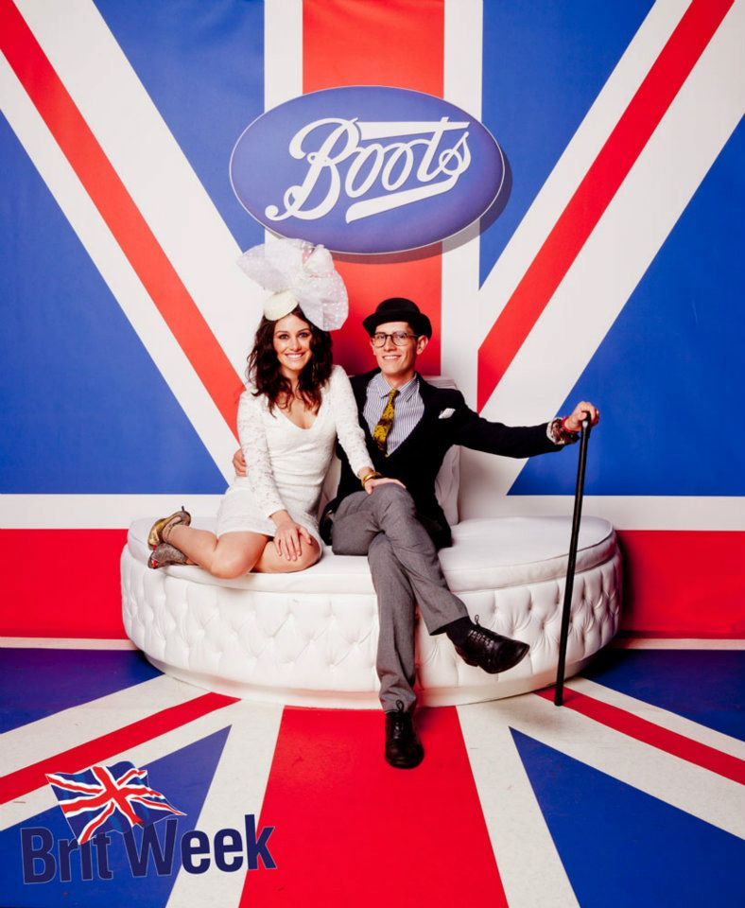
CAREER
With my team and the Ambassador, receiving an award for Team Excellence
At BritWeek with my husband

Slide 18
Career
My first Job
My worst Job
I worked at a spa, called 3000BC, booking appointments and working in their boutique
Before that, I babysat and looked after people’s houses and pets when they were away
I once worked in retail in New York and Philadelphia. I liked the job, but the girls I worked with in Philadelphia were really mean to me and accused me of stealing – YIKES!

Slide 19
Career
Some challenges I had to overcome in my career
Managing other people, especially when I was considerably younger than them.
Overcoming disagreements but staying positive and collegiate
Learning not to take things personally
Learning how to act normal, when I got to meet this guy --------→

Slide 20
BRITWEEK
History
Founded by Nigel Lythgoe and the British Consul Generl
Started in Los Angeles in 2007 with a few events
Size
Now we are 60 events each year
We are still a small team, only 2 people, but lots of volunteers!
Location
We are based in LA, but also do events in San Fran, Miami, Orlando, and OC
Products
Services
We produce events that celebrate British creativity – you would be surprised how much British people and products influence your life
We provide a platform for new British artists, bands, and businesses to gain more awareness in the US
Notes:
Use this graph to give more description of your current company (history, size, location, products and services, etc.)

Slide 21
Current Role
EXECUTIVE DIRECTOR
PLAN + EXECUTE EVENTS
FIND SPONSORS + PARTNERS
DEVELOP IDEAS
PRESS + COMM
Notes:
Use this graph to give more description of your role specifically (responsibilities, typical work week, direct reports, etc.)

Slide 22
ACADEMIC EXERCISE
We will now spend several minutes discussing the day’s academic module and how it is relevant in the ‘real world’

Slide 23
QUESTION AND ANSWER

