Slide 1
SHAILESH SACHDEVA
Director, Pricewaterhouse Coopers (PwC)
Media & Entertainment

Slide 2
INTRODUCTION
My name is SHAILESH SACHDEVA and I am 35 years old
I work for Pricewaterhouse Coopers
PwC provides services to other Fortune 500 companies:
Audit & Assurance
Consulting
Tax
I lead the Media & Entertainment Strategy Consulting group
Every day I help media companies (like Time Inc., NBC and Warner Bros.) develop and execute strategies to compete in the market

Slide 3
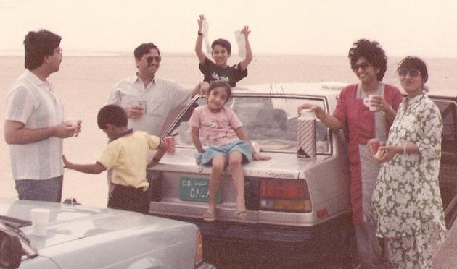
My childhood
I was born in Vietnam and raised in Saudi Arabia, Malawi, Philippines, India, Canada, and many more
This is a picture of my family on our way to Salima Beach in Malwai

Slide 4
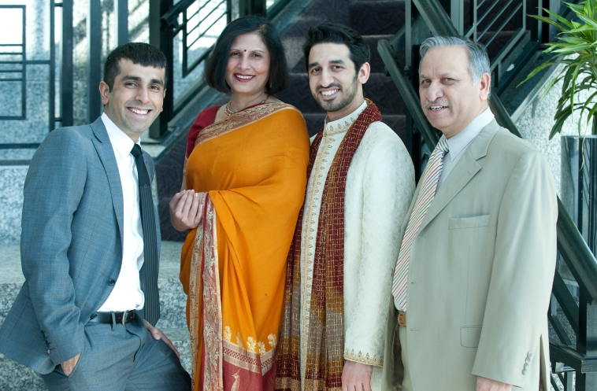
My family
A little about my family
Since childhood, we moved every 3 years to a different country, new school, and new friends
This is a picture of me, my brother (Tarun), and my parents

Slide 5
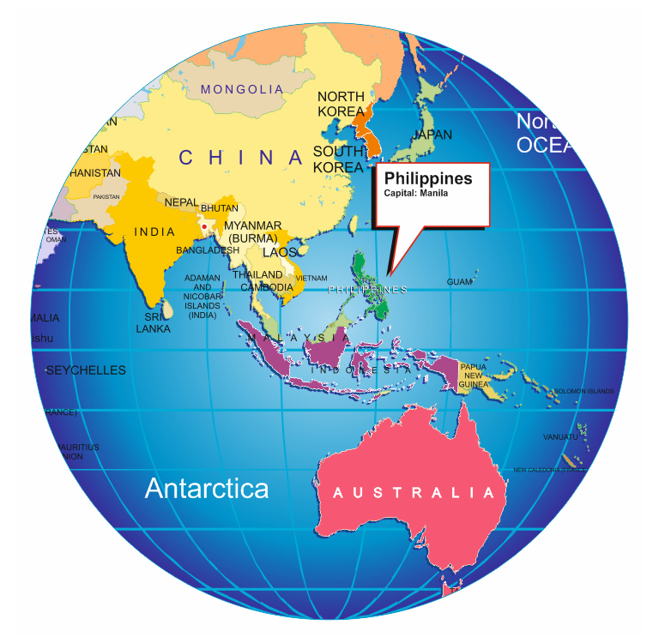
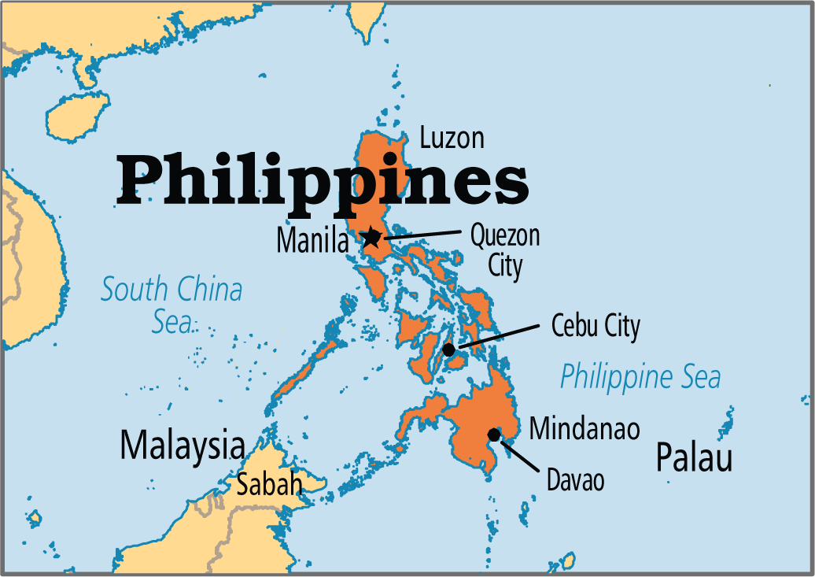
MY HIGH SCHOOL
I attended International School of Manila in the Philippines

Slide 6
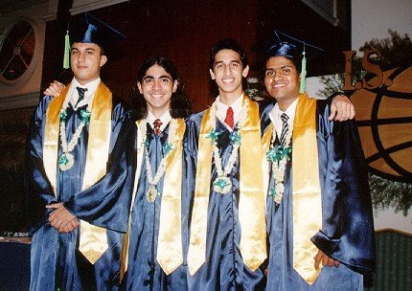
High School
As a high school student, I was shy and nerdy
Here is a picture of me and my best friends at our high school graduation

Slide 7
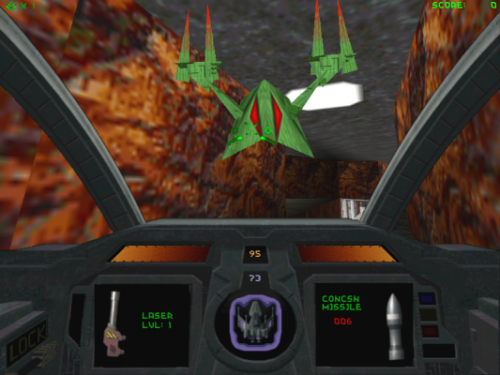
High School
Things that I really liked in High School were:
Physics
Math
Chess
Badminton
Table Tennis
Talking on the phone
Playing network Descent on a 14.4K dial-up modem

Slide 8
High School
Things that felt difficult or challenging for me while I was in High School were:
French
Gym
Not knowing what I wanted to be when I grew up

Slide 9
High School
Jobs I worked while I was in High School were:
School newspaper
Summer school office
Building and configuring computers

Slide 10
Getting in to College
The top few things I did to ensure I got into college were:
Good International Baccalaureate (IB) and SAT scores
Extracurriculars – P.R.E.P (Promoting Rural Education in the Philippines)

Slide 11
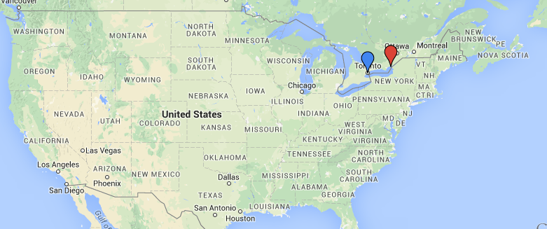
College
I attended University of Toronto (Computer Engineering) and got my MBA (Strategy & Entrepreneurship) from Queen’s University

Slide 12
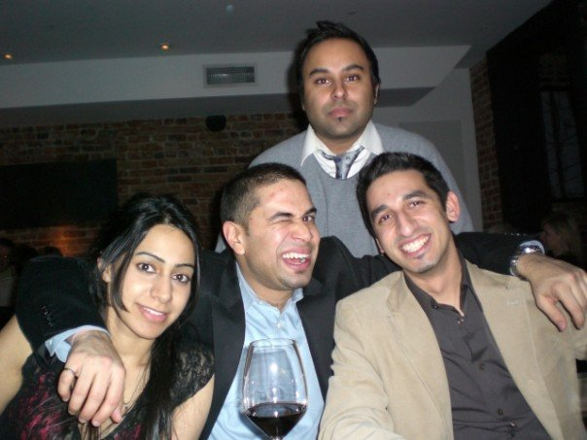
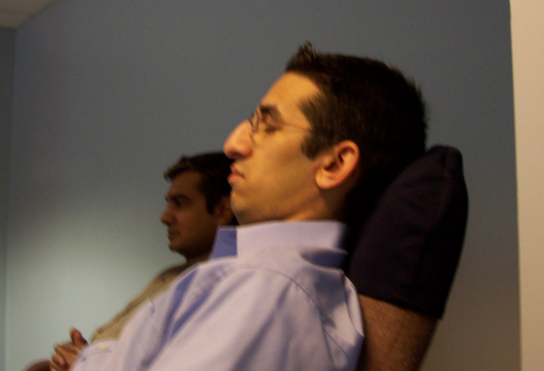
College
Things I enjoyed in College
Things I didn’t enjoy
Meeting new people, and making life-long friendships
Traveling
Classes
Exams
Preparing for interviews

Slide 13
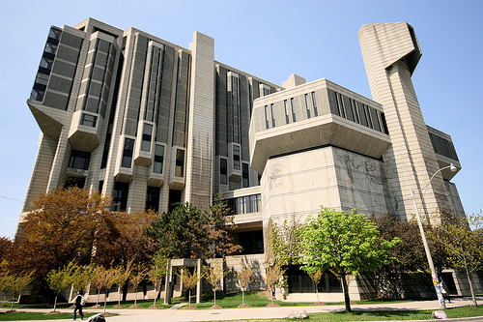
College
Jobs I worked while I was in College were:
Librarian – Microtext / Microfiche section
Software Training Material Developer
Union Negotiator
UNDP Funds Tracker (Ethiopia)

Slide 14
College
Things that felt difficult or challenging for me while I was in College were:
Not knowing what I wanted to be when I grew up
Not knowing the different options available to me after college (besides consulting and engineering)
Taking time off to enjoy myself

Slide 15
Getting a job after College
The top few things I did to ensure I got a good job after college were:
Got good grades
Perfected my resume and cover letter (sample attached)
The top few things I wish I did to ensure I got a good job after college were:
Talked to more people to understand what they did
Been more proactive vs. reactive, i.e., try to find a career that I would be interested in vs. simply applying to job postings
Developed a 3-5 year plan

Slide 16
This is My Company
Every day at my company:
I work with senior executives at large media companies
I help them understand issues their companies are facing:
How do I get my paper magazine company to go digital?
How do use social media in our news organization?
What does the film studio of the future look like?
I lead teams to assess the problem, provide a recommendation, and implement the solution
I usually travel to my client site from Monday - Thursday
PwC:
195,000 employees
Annual revenues of $34B
Operates in 157 countries
5th largest private company in the US

Slide 17
My Career Path
2008 – Promoted to Manager
2006 – Joined PRTM after my MBA
2011 – Promoted to Director
2007 – Promoted from Associate to Senior Associate
2006 – Employee # 3 at PRTM India Office
Notes:
You may use this chart to describe your journey to the current career

Slide 18
My Career
The first job I had after college was:
(insert here with a little description of what you did and how you got hired)
The worst job I have ever had was:
(give a funny anecdote and what you learned from that experience if possible)

Slide 19
My Career
Challenges I have had to overcome throughout my career are:
Stopped enjoying what I was doing, so switched from telecom consulting to media & entertainment
Traveling every week to the client was great at first, but did not leave any personal time
Very demanding hours

Slide 20
My role within organization
CEO
Partner
Director (ME)
Manager
Associate
Manager
Associate
Associate
Offshore Team
Notes:
Use this graph to give more description of your role specifically (responsibilities, typical work week, direct reports, etc.)

Slide 21
Compensation at my company
C-Suite
($500K+)
Management
($200K)
Middle Manager
($100K)
Entry Level
($60K)
Notes:
Use this graph to show general compensation ranges for people in various roles in your company

Slide 22
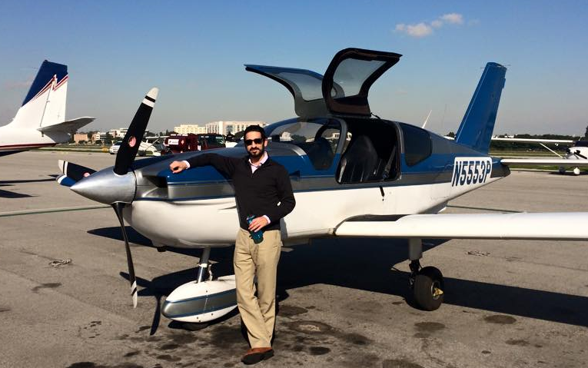
More than just work
When I am not at work I like to:
Mentor students
Work on startup ideas
Take flying lessons

Slide 23
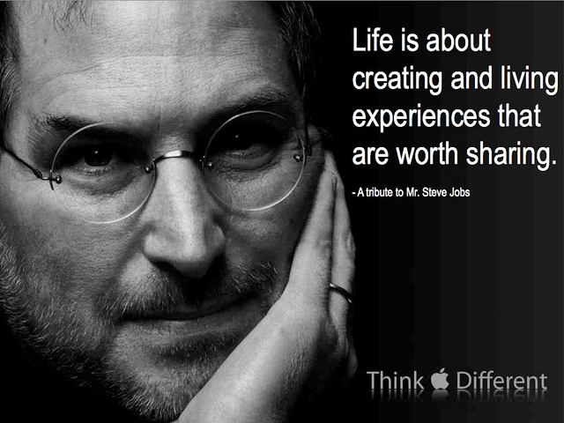
Do it all over again?
If I could talk to my high school self, what would I say?
Dream BIG and different! Step out of your comfort zone
Talk to people about your dreams – everyone loves to help others!
Life is all about relationships and experiences

Slide 24
QUESTION AND ANSWER

