Slide 1
YOUTH BUSINESS ALLIANCE PRESENTATION
Ramona Saviss
April 28, 2015

Slide 2
INTRODUCTION
My name is Ramona Saviss and I am 26 years old.
I work for Time Out Los Angeles.
Time Out is an international company that writes about cool things to do in cities around the world. I work for Time Out LA and we write about the best ways to explore Los Angeles.
My role at Time Out is Managing Editor
Every day I write, edit and build features online. I also oversee our internship program, the monthly budget and the editorial calendar of what stories are going up each day.

Slide 3
My childhood
I was born and raised in Los Angeles to immigrant parents.
My mom and dad both fled Iran as teenagers because they were Jewish and it wasn’t safe for them. They had to leave their families behind and start a new life in the U.S.
This is a picture of me and my mom at my first birthday.

Slide 4
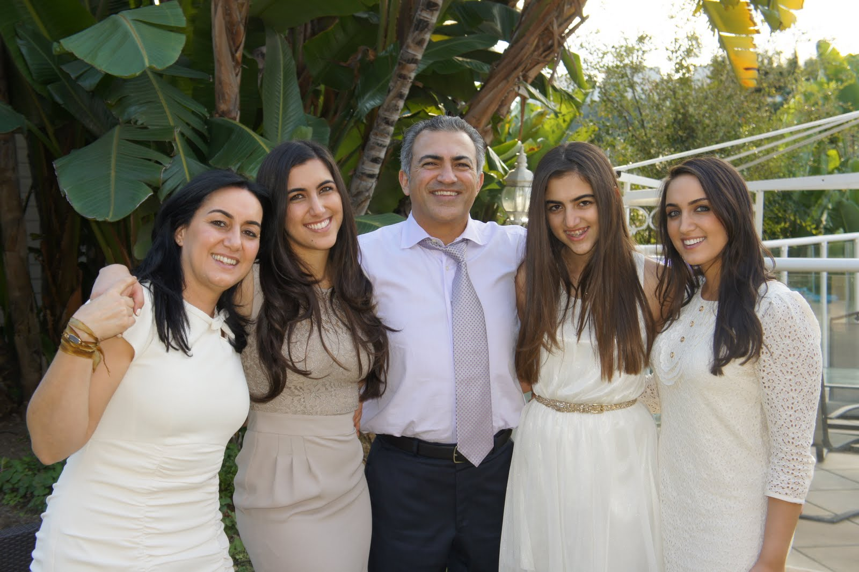
My family
A little about my family
I’m the oldest of three sisters. When I was growing up both of my parents were working and I had to take care of my two younger sisters.
My dad came to Los Angeles as a teenager with no money. His family was still back in Iran (they’re all here now). He managed to successfully start his own business.
This is a picture of me and my mom Helen, my sister Amanda, my dad Raymond, and my sister Sophie.

Slide 5
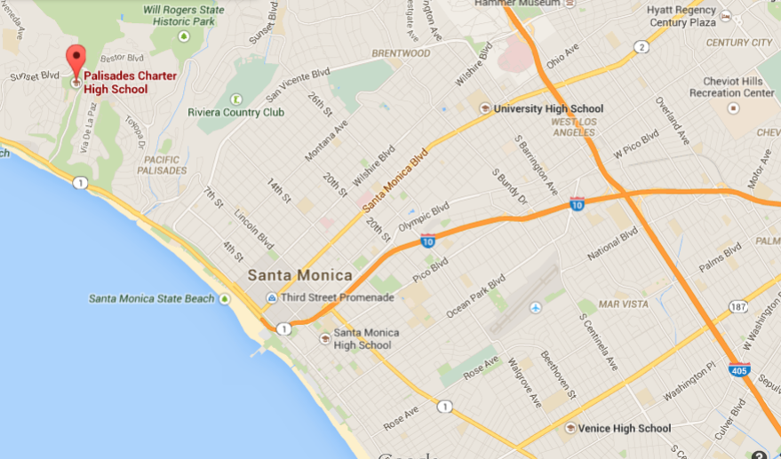
MY HIGH SCHOOL
I attended Palisades High School in Los Angeles, CA

Slide 6
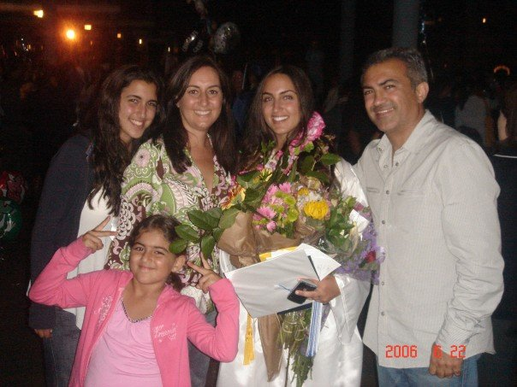
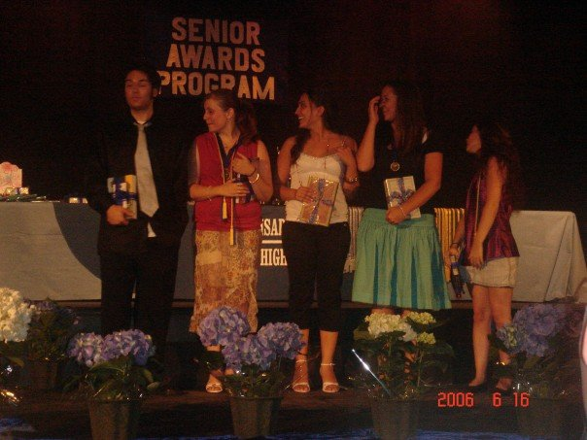
High School
As a HS student I was academic and outgoing. I didn’t have one main group of friends, but I made sure to have friends in every group.
I also was really focused on my family because my mom had just recovered from having breast cancer.
Here is a picture of me the night of graduation and on Senior Awards night.

Slide 7
High School
Things that I really liked in High School were:
Hanging out with friends
Doing group projects
Spanish: learning new languages were always fun for me
AP classes!
Yes, I actually liked hard classes and lots of reading.
I really enjoyed
AP Biology
AP Literature
Chemistry

Slide 8
High School
Things that I didn’t like in High School were:
Fights that broke out during lunch.
Math (Geometry, Calculus, Statistics—I didn’t like any of them)
P.E.
I found a way around this by volunteering during P.E. at the teacher’s office. ;)

Slide 9
High School
My high school life:
I was very busy in high school focusing on taking hard classes and getting good grades.
I would wake up around 6am and get home about 4pm. I would immediately start my homework (some days I’d take a quick nap when I got home) and work until a quick dinner at 8pm or whenever my dad got home.
After dinner, I would finish my homework and fall asleep usually with a textbook in my hand around midnight.
I am guilty of being a procrastinator and if I ever got behind on my workload, I would sometimes stay up all night doing school work. The next day I would be SO tired.

Slide 10
Getting in to College
The top few things I did to ensure that I got into college were:
Setting goals for myself
I knew I wanted to go to college, so I made that a main goal to focus on throughout high school.
This also meant that I would have to work really hard to get into challenging classes and get the best grades possible.
My mom’s motto that pushed me was: “Just do your best.”
Extra-curricular activities like volunteering at the Red Cross, Heal the Bay, Be the Match bone marrow drives
Joining school groups and applying to sit on their boards
Tutoring my peers
Being proactive and reaching out to the administration at schools I wanted to go to, in order to set up interviews with them.
On the weekends, I would wake up early and take timed prep tests for the AP exams and for the SATs. I bought a book and tested myself.

Slide 11
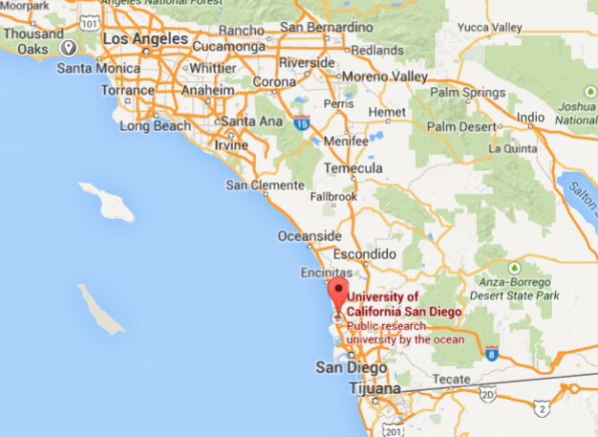
College
I attended both UCSD in San Diego (freshman and sophomore year) and UCLA in Los Angeles (junior and senior year) for college.

Slide 12
College
Things I enjoyed in College
Things I didn’t enjoy in College
Getting to create my own schedule.
Meeting new friends.
Traveling to new places near my school and studying abroad
Being independent (pro)
Having the ability to plan my days, activities, how clean my dorm was…
Having to be far from my family.
Taking mandatory “general education” classes.
Being independent (con)
Not having a lot of direction on what to study and when.

Slide 13
College
Favorite classes
Least favorite classes
Bio Chemistry
Organic Chemistry
Molecular Chemistry
Communications
History of music
History of death
French fashion
Architecture
I didn’t like any math classes, including Calculus, which I had to take at UCSD as a college requirement.
I also didn’t enjoying classes where I could not voice my personal beliefs if they were different than the professor’s views.

Slide 14
College
Jobs I worked while I was in College were:
I learned quickly that the key to getting a job that I wanted was knowing what I actually wanted to do. The best way to figure this out is signing up for internships at various companies.
As a junior in college, I started to reach out to online publications, such as PoshGlam, and asked them how I could work there as a writer. They didn’t have positions available, but needed someone to do outreach on social media, so I did it. Even though it wasn’t something I wanted to do, it was my way to get my foot in the door.
Through my school’s job board, I interned at Angeleno magazine while I was in college and for a year afterward, which led to a job at the magazine.

Slide 15
College
Things that felt difficult or challenging for me while I was in College were:
Being far from my family was hard for me during college. It was the first time I moved away from home.
I also didn’t get into my top choices for college, which was my goal in high school.
UCSD was not social enough for me. I joined a sorority and made a lot of new friends, but still missed out on school spirit.
To overcome these challenges I decided to go back to my main goal during high school, which was to get into UCLA.
I applied to transfer schools and got into both UCLA and USC. I then had to make a hard decision on whether to leave UCSD, and if so, which school would I go to?

Slide 16
Getting a job after College
The top few things I did to ensure I got a good job after college were:
Deciding what I wanted to do after I graduated based on what I always enjoyed doing, which was writing.
Figuring out where I wanted to work and applying for internships at those places.
Following up on emails to editors if they didn’t get back to me.
Having a resume that showed that I took initiative and was serious about working in journalism (I got to use my experience at PoshGlam on my resume).

Slide 17
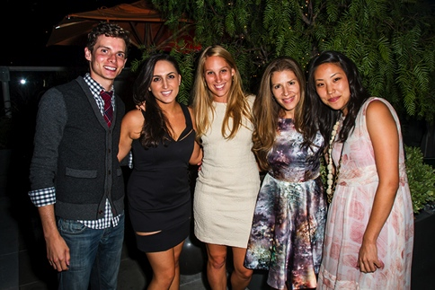
This is My Career
Every day at Time Out:
Time Out is a company that is in 87 cities across the world. The company produces city guide books, magazines and websites for tourists and locals to discover the best things to do in each city.
The five editors who helped launch Time Out in Los Angeles.
We are now a staff of eight in LA.

Slide 18
Time Out New York showing some L.A. Love

Slide 19
My Career Path
I was promoted to assistant editor (full time) from being a freelance section editor at Angeleno. I also made connections here and started to freelance at The Hollywood Reporter.
I started to get paid for overseeing a section of Angeleno magazine, after interning for a year (unpaid).
I am now the Managing Editor at Time Out Los Angeles, because of the connections I made during my first internship at Angeleno magazine.
Notes:
You may use this chart to describe your journey to the current career

Slide 20
My Career
The first job I had after college was:
Getting paid to do more at Angeleno magazine, where I interned during college. I took over the “Scene” section of the magazine, where I got to cover different events around Los Angeles.
The worst job I have ever had was:
Working at 1100 Media. It was a new magazine that was starting out in LA and I heard about them through someone I met at Angeleno. They were very unorganized and I never got to see the final versions of the articles that I wrote. However, I learned how to think on my feet, and take any opportunity that comes my way because you never know when later in your career knowing someone who you met by doing a random job will come in handy, especially when it’s in the same industry.

Slide 21
My Career
Challenges I have had to overcome throughout my career are:
My age!
I was 21 when I became an Assistant Editor at Angeleno, 22 when I started reporting on the red carpet and writing for The Hollywood Reporter, 24 when I helped launch Time Out in Los Angeles and 25 when I became a Managing Editor at Time Out.
When people in the industry (editors, writers, publicists, etc.) would find out how young I was, they sometimes wouldn’t take me as seriously due to my age. I learned to conceal it.
Feeling like I did not have enough experience
While I enjoyed writing throughout my life and even wrote the poem for our high school graduation program, I was never a part of the school paper both in high school and college. I didn’t have this experience to put on my resume and was always asked about it when interviewing early on in my career.

Slide 22
Compensation at my company
Executives ($100K)
Management
($50-80K)
Associate Editors
($35-45K)
Assistant Editors
($25-35K)
Notes:
Use this graph to show general compensation ranges for people in various roles in your company

Slide 23
More than just work
When I am not at work I like to:
Workout (I enjoy going on walks/runs with my fiancé.)
Travel (I love to travel internationally and road trips!)
Volunteering (I volunteer at bone marrow drives.)
Fundraising (I like to help fundraise for the Leukemia Lymphoma Society and was nominated as one of their Women of the Year in 2013 and raised $28k (my goal was $1000 total)!!!!!
Spend time with my friends, family and my fiancé.
Go to Lakers and Dodgers games!
If you couldn’t tell by now, I LOVE L.A.

Slide 24
Do it all over again?
If I could talk to my high school self, what would I say?
Be proactive and volunteer to take on more when possible, you never know where new doors will open for you.
Ask A LOT of questions, it’s never bad to ask too many questions.
Go after what you believe in and what you enjoy doing.
Anything you set your mind to and set as a goal, you could achieve—so dream big and work hard.
Oh, and don’t wear that purple dress to prom. ;)

Slide 25
QUESTIONS & ANSWERS

