Slide 1
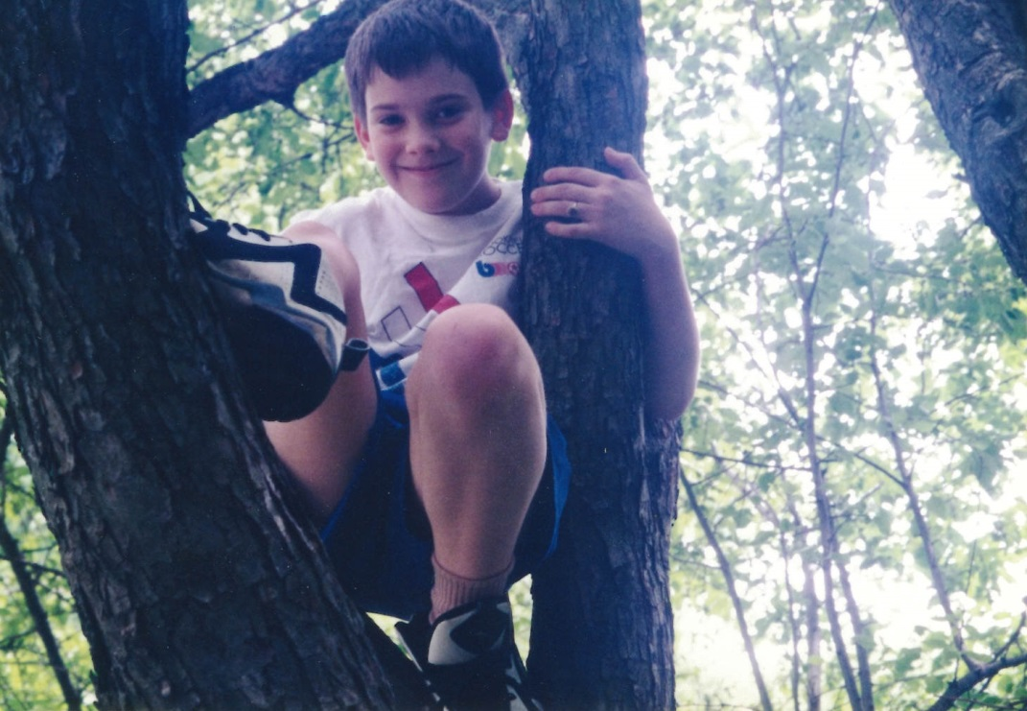
A Perspective of Growth
Galen D’Attilio

Slide 2
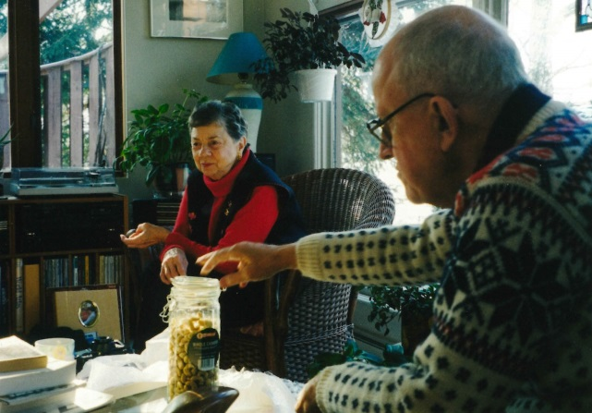
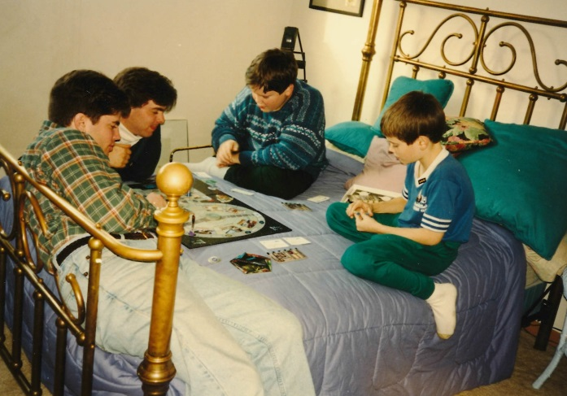
Family
Parental Units
Grandparentals
Brothers

Slide 3
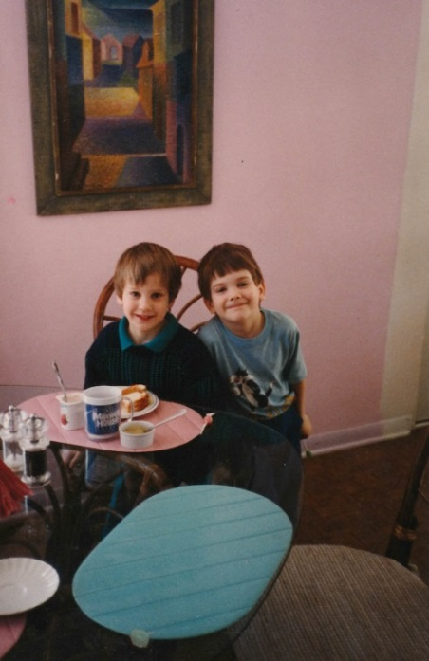
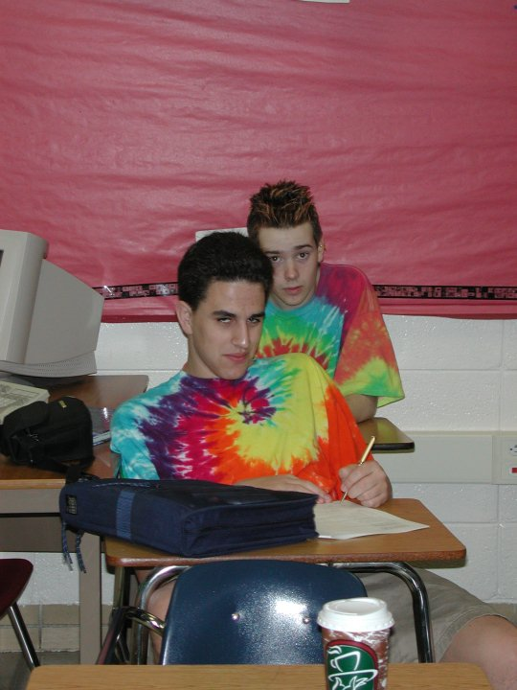
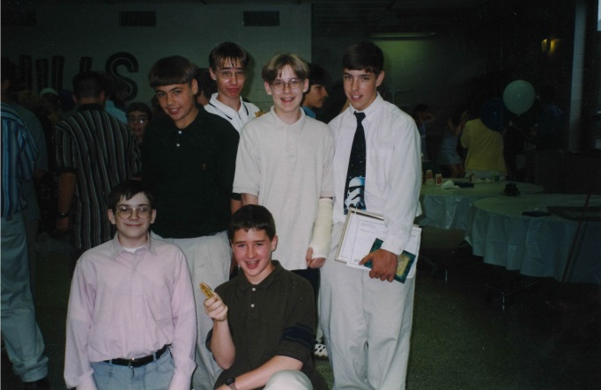
Friends and school
Elementary
Middle
High

Slide 4
And others…

Slide 5
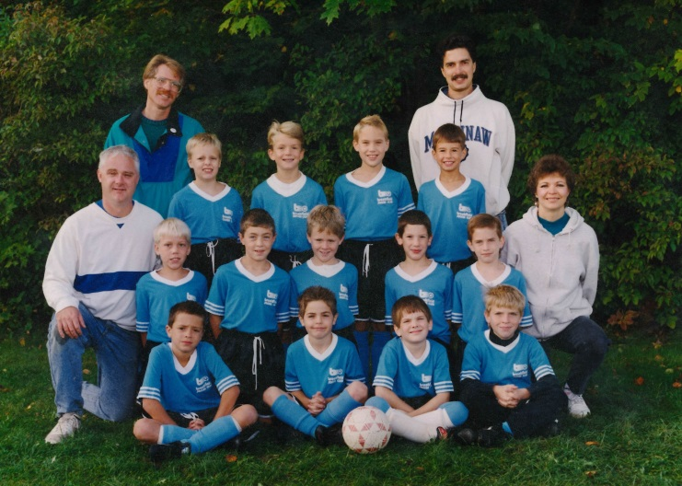
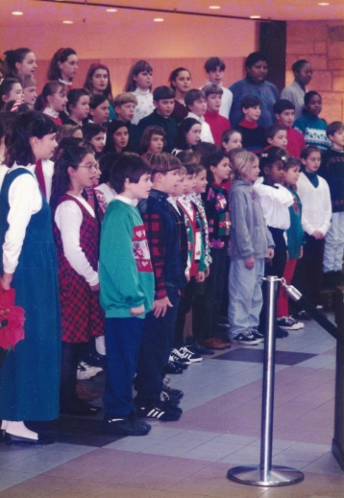
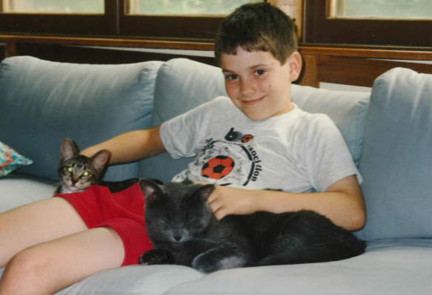
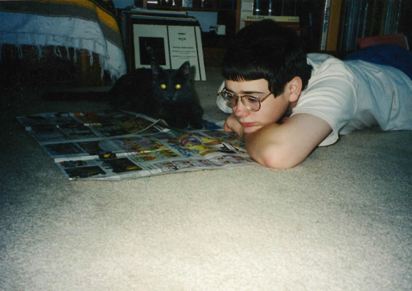
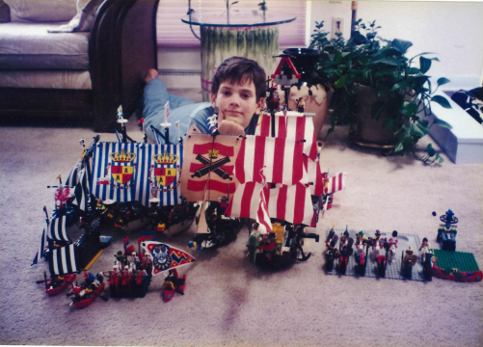
Things I liked then…
Soccer
Choir
Cats
Comics
LEGOs

Slide 6
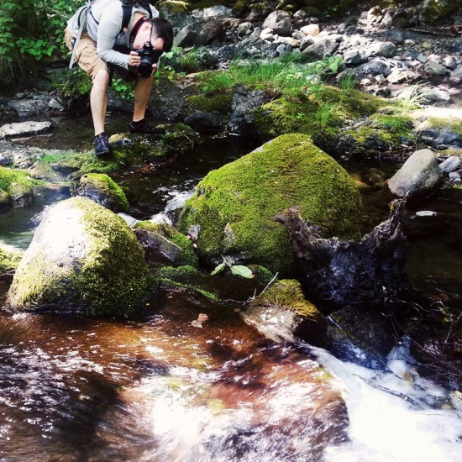
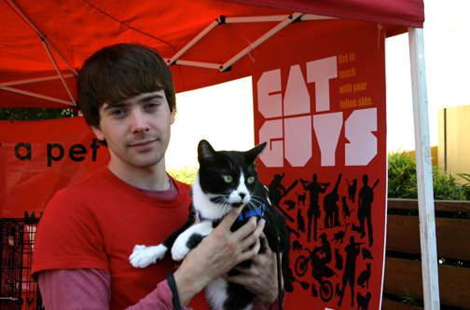
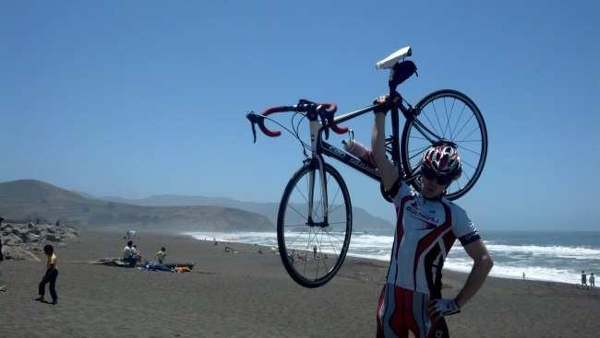
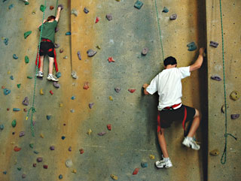
Things I like now
Hiking & Photography
Cats
Cycling
Climbing

Slide 7
Progress!
Aubrey then…
Aubrey now

Slide 8
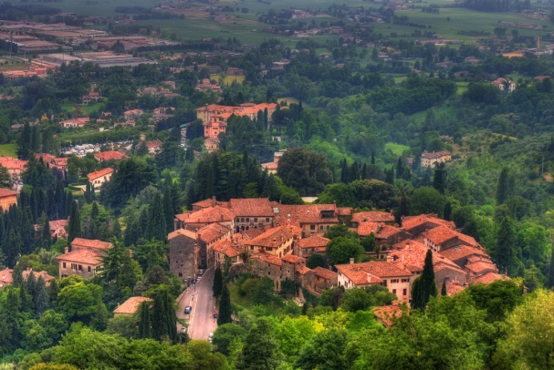
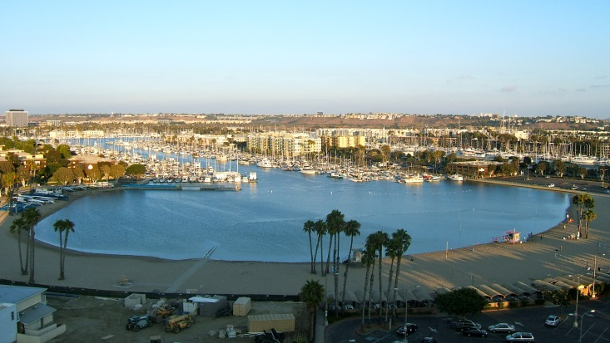
Locational progress
Milwaukee
Boston
Santa Monica
Italy
San Francisco
Marina Del Rey

Slide 9
Director, Business Development
Interactive Media Student
Director, Strategic Partnerships
Production Assistant
Strategic Partner Manager
Production Assistant
Finance Associate
Financial Analyst
Business Manager
MBA Student
2002
2005
2006
2006
2009
2011
2012
2014
2015
2017

Slide 10
Progress of happiness in a graph

Slide 11
Happiness progress straight-lined

Slide 12
The process of getting there
Create an end goal
Choose favorite hobby or deep passion
Ex: Digital content
Apply what you’re good at to it
Ex: Analysis, negotiations
Select a job title
EVP, Biz Dev
Consider a company
Ex: Sony Pictures
Fill in the gaps
Obtain education
Ex: Interactive Media, Business
Explore roles
Ex: Finance, Operations, Business Analysis
Create connections
Ex: Other Biz Dev executives
Be a leader

Slide 13
How to get noticed as a leader
Proactiveness
Skepticism
Fiery passion
Respectful irreverance
Confidence
Self-develop
Explore
Never give up
Connect, connect, connect

Slide 14
The statistical good leader
IQ
EQ
RQ

Slide 15
IQ/RQ/EQ development over time

Slide 16
Salary Over Time

Slide 17
Progress takes time
Be patient
Never give up
Burn with passion!

