Slide 1
Confidential
Youth Business Alliance
May 2015

Slide 2
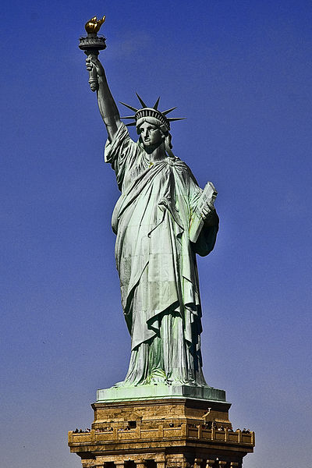
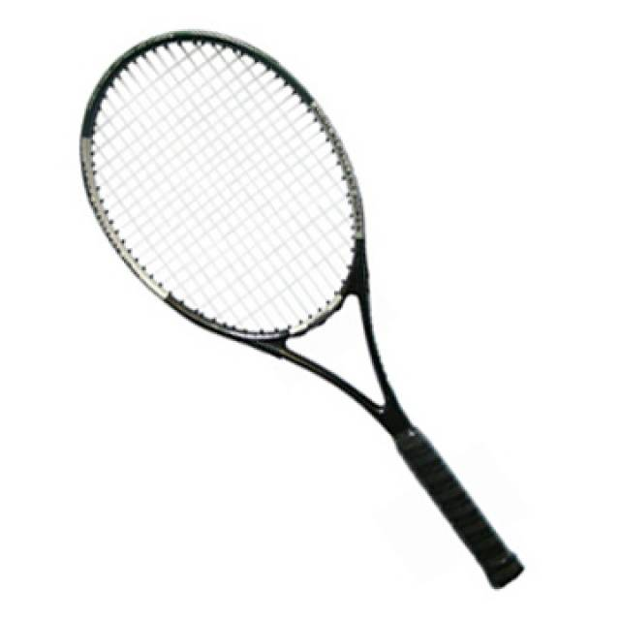
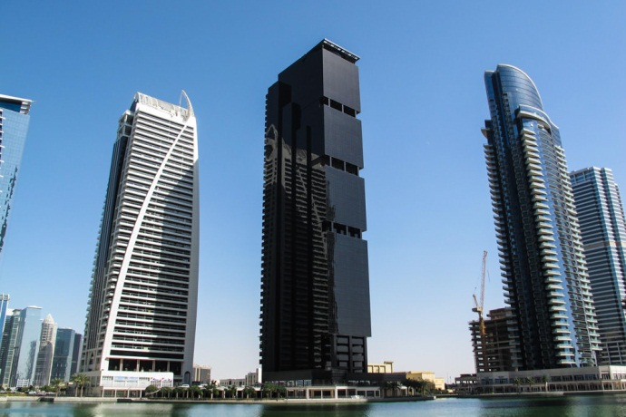
About Me
Born & raised in New York
I moved to LA last year
I am 26 years old
I work for Blackstone
Blackstone is the world’s largest private equity company in the world
What is private equity??? → We’ll get into that in a bit
My role at Blackstone is to invest in real estate and provide financing for real estate transactions

Slide 3
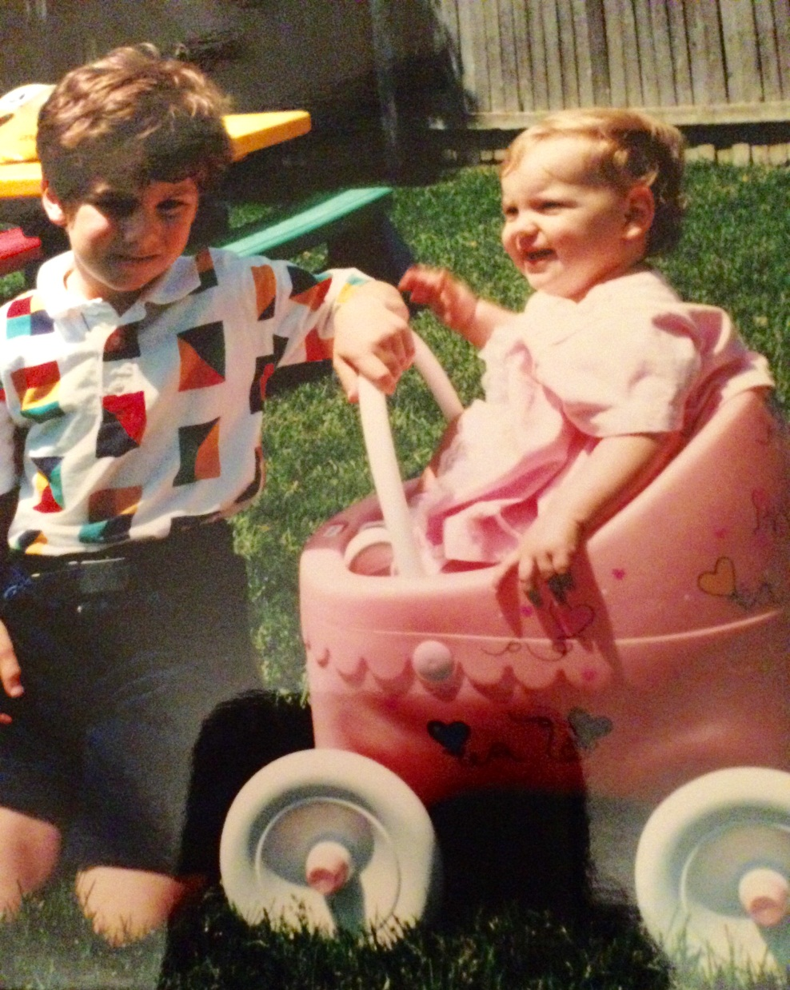
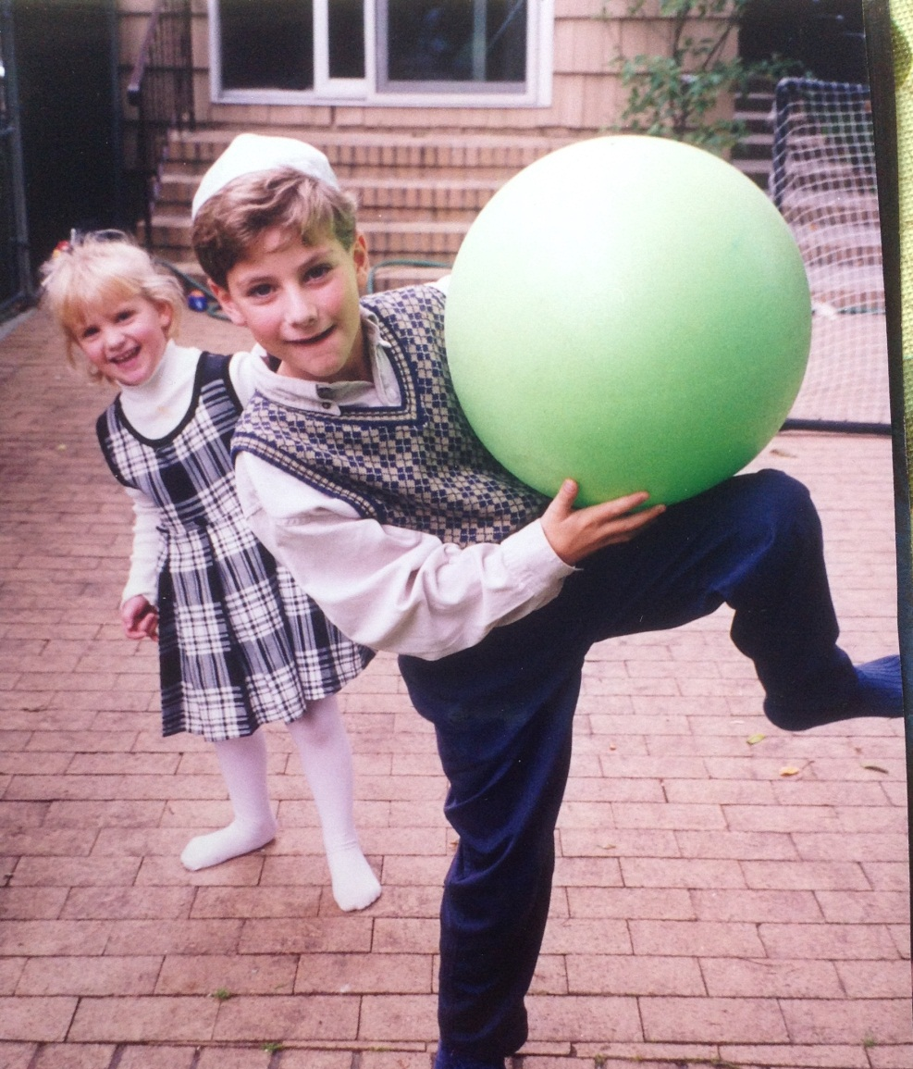
The Early Years
I was born in New York City and moved to East Rockaway when my baby sister was born

Slide 4
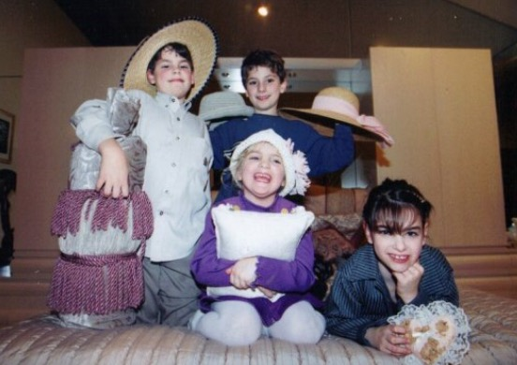
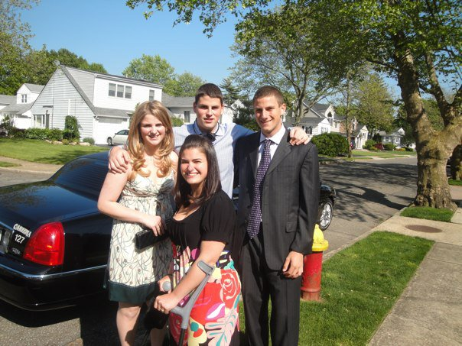
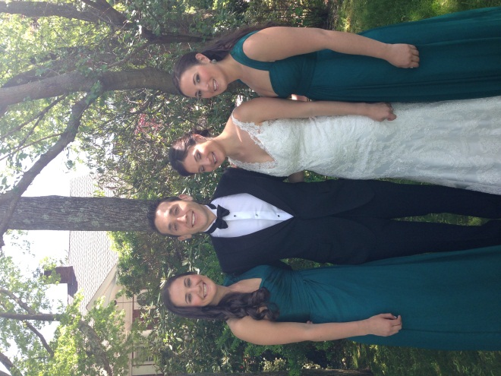
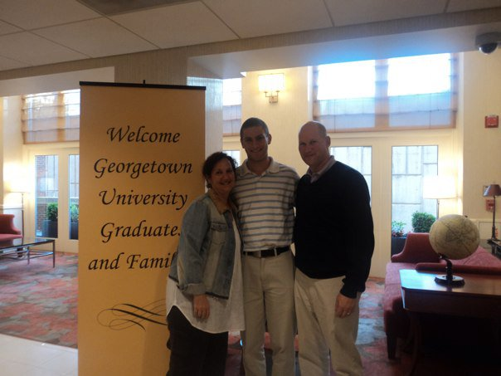
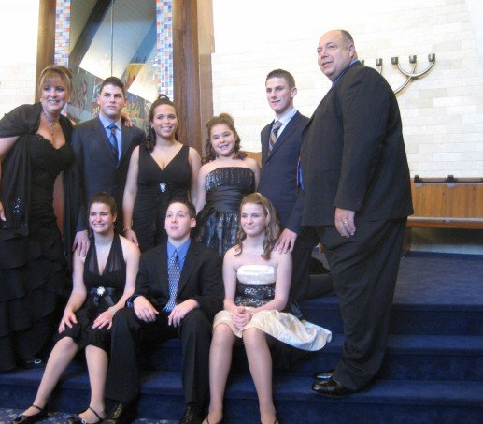
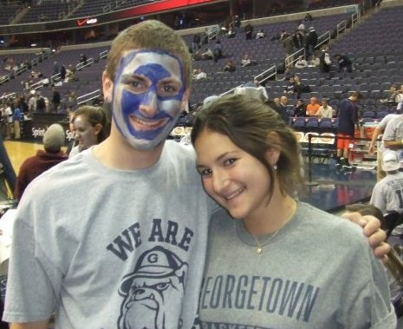
My Family
I have three full brothers and sisters; my parents both remarried when I was in high school and now I am the oldest of 10 siblings (11 if you count my sister’s husband)

Slide 5
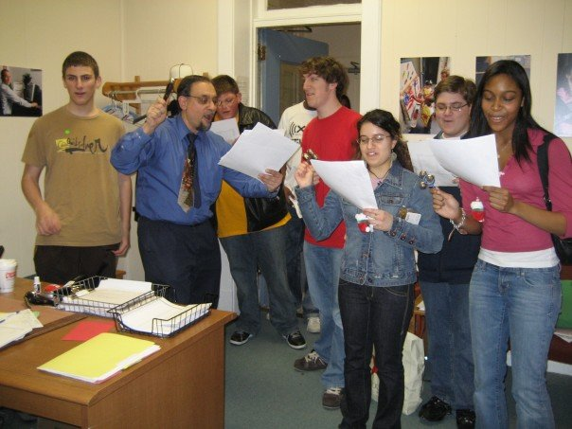
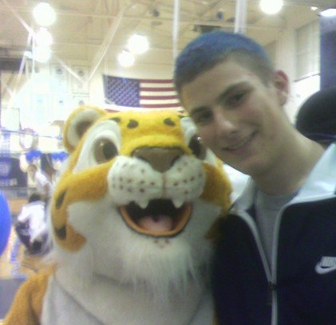
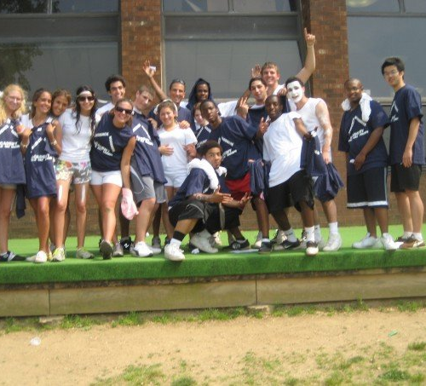
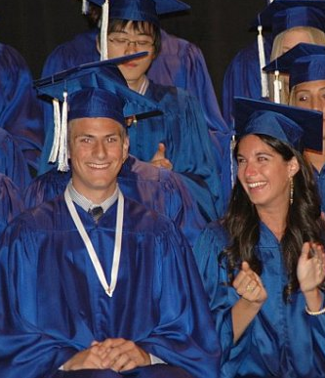
High School
I went to high school in Woodmere, NY, which is 45 minutes outside of Manhattan and 10 minutes from the beach!
Things I Loved In High School: Math, History & Science; Tennis; Drama; Student Government
Things I Hated In High School: English!!! Curfews

Slide 6
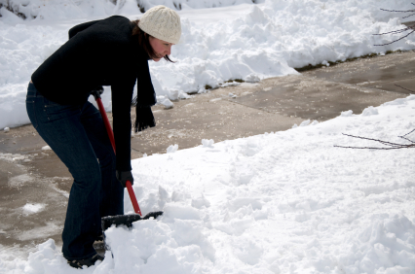
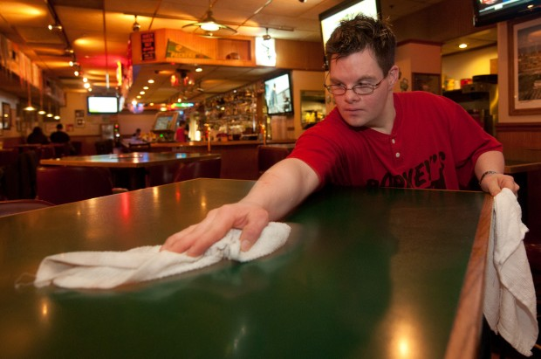
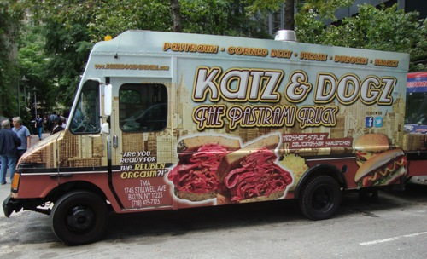
Not All Fun & Games: Working!
Elementary School
Car washes
Dog Walking
Doing Chores
Middle School
Babysitting
Snow Shoveling (it snows A LOT on the East Coast)
Dog Walking
High School
Busboy
Truck driver

Slide 7
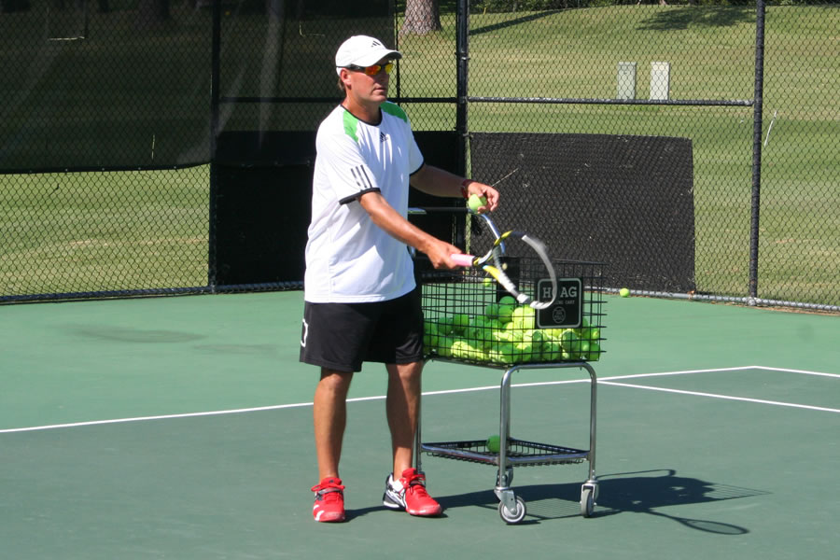
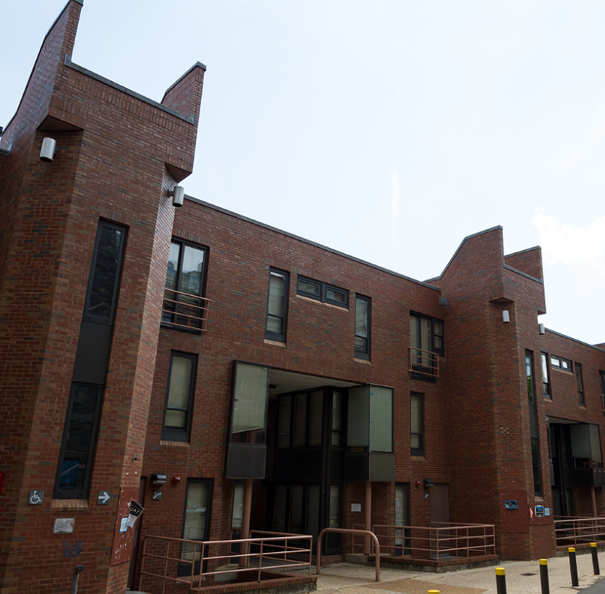
Not All Fun & Games: Working!
In College I continued working…
Tennis instructor at Yates (I once gave a lesson to the Obama girls!!!)
Resident Assistant at Henle Village
Investment Banking Summer Analyst at Morgan Stanley
(Not me but close enough)
(My job was to keep this safe)

Slide 8
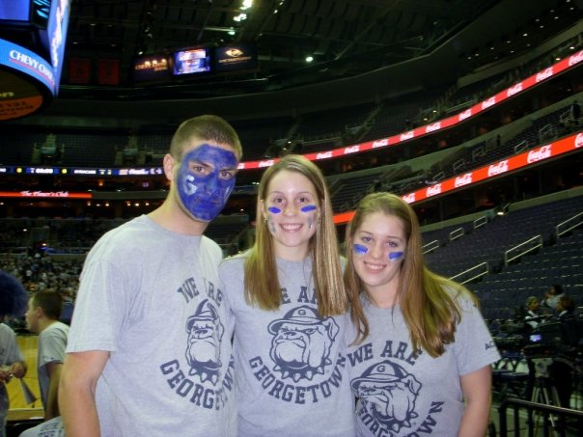
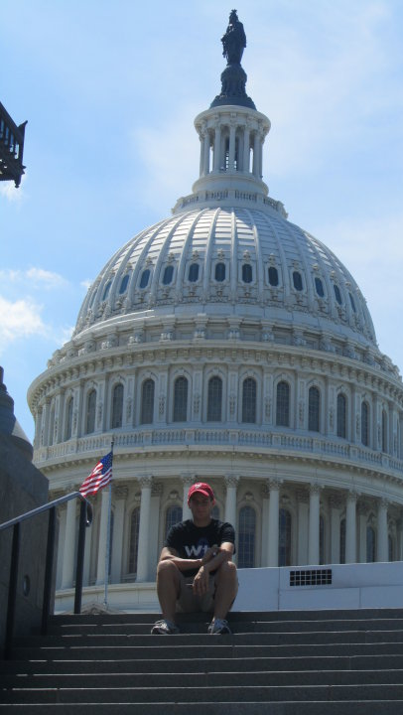
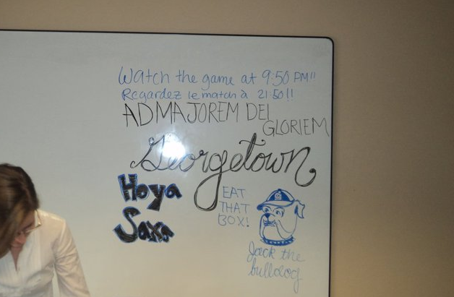
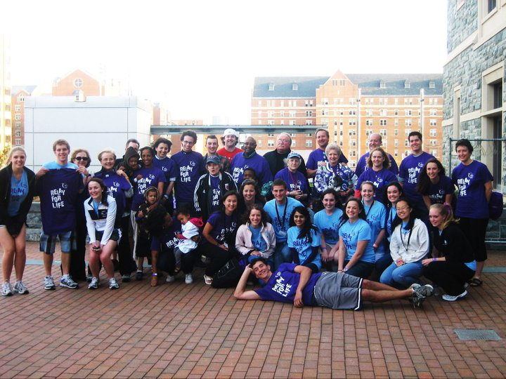
Hoya Hoya Saxa: College at Georgetown
The best day of my life was April 3, 2007 → The day I got into Georgetown
What’s awesome about college:
New friends
Georgetown basketball
Jeff Green, Roy Hibbert, Patrick Ewing
Learning to love learning and critical thinking
Freedom & responsibility
The network you build
Gaining skills and education to enter the workforce

Slide 9
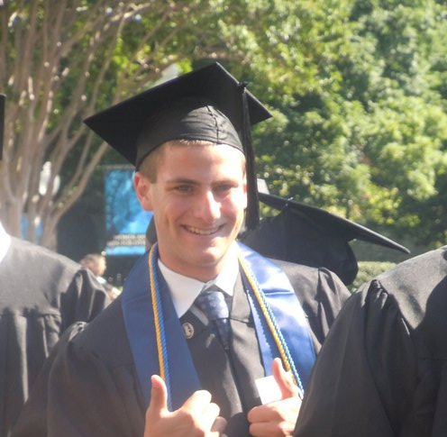
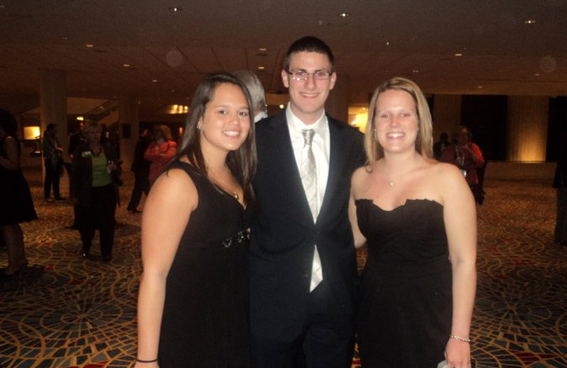
Glory Days, They Will Pass You By, In The Blink Of An Eye
Four Important Things I Learned In College:
Be a man for others → Charity and community are paramount
One person can make a difference → Relay For Life
It’s better to make 5 great friends than 50 acquaintances
If you don’t like what you’re doing then change something

Slide 10
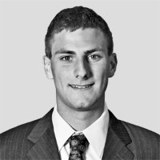
So What Comes Next…. A Career!
Blackstone took a huge risk in hiring me at 22
No prior experience, never worked in real estate
Started as an analyst
Use excel to build financial models / do market research
Made my goal to teach myself something new about the business every single day
Developed a passion for finance and real estate
DO WHAT YOU LOVE, LOVE WHAT YOU DO
Official Employee Photo

Slide 11
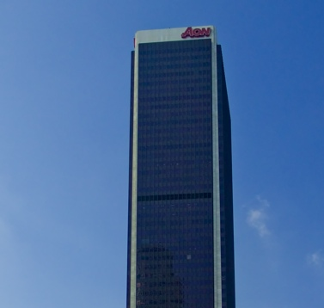
So What Is Blackstone? What Do I Do?
What Is Blackstone?
Blackstone is one of the largest “alternative asset managers” in the world with over $300bn of money under management
We invest money on behalf of our clients
Teachers
Unions
Pension Funds
Offices in New York, Los Angeles, London, Hong Kong and all over the world
What Do I Do?
I help invest capital in real estate transactions in both debt and equity

Slide 12
Career Advice
Develop a relationship with a mentor
Put yourself in the best position to succeed
Discover your passion and pursue it
Believe in yourself and trust your instincts but learn from those with experience
Make lots of mistakes but don’t make the same one twice

