Slide 1
a story of a young boy from brick city
By: Chad Thomas

Slide 2
INTRODUCTION

Slide 4
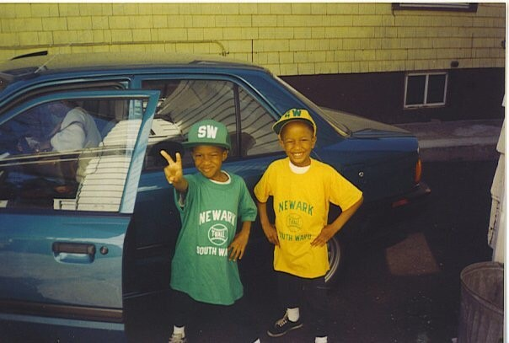
My childhood

Slide 6
MY HIGH SCHOOL

Slide 7
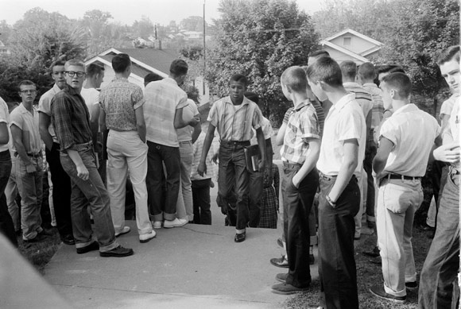

Slide 8
High School
WHY AM I HERE?
WHAT DO I HAVE TO PROVE?
WHO CAN I LEARN FROM?
WHAT ACTUALLY MATTERS?
CAN I SUCCEED ONCE I LEAVE?

Slide 9
College

Slide 10
College
WORK HARD OR PLAY HARD?
LEARN OR BE LAZY?
GROW OR STAY THE SAME?

Slide 11
College

Slide 12
Getting a job after College

Slide 13
This is My Company

Slide 14
My Career Path
Notes:
You may use this chart to describe your journey to the current career

Slide 15
Compensation at my company
C-Suite
($350K)
Management
($150K)
Middle Manager
($75K)
Entry Level
($50K)
Notes:
Use this graph to show general compensation ranges for people in various roles in your company

Slide 16
More than just work

Slide 17
Do it all over again?

Slide 18
QUESTION AND ANSWER

