Slide 1
Sarah Haufrect Youth Business Alliance
October 6th, 2017
Mendez High School

Slide 2
INTRODUCTION
My name is Sarah Haufrect and I am 35 years old.
I work for The Office of Lowell Milken.
My Position:
I support the work and philanthropy of International Businessman and Philanthropist Lowell Milken who is Chairman of the Milken Family Foundation in Santa Monica, CA.
In my role as Director of Communications
I manage Lowell Milken’s official websites, his digital reputation and serve as a project manager and office representative for external partnerships with other organizations, such as the Lowell Milken Institute for Business Law and Policy at UCLA School of Law.

Slide 3
This is My Company
As Director of Communications for The Office of Lowell Milken:
I work for the Chairman and Co-founder of several companies and non-profits

Slide 4
MY JOB NOW
Data, traffic and keyword tracking through Google
Managing my boss’s Wikipedia Page, linkedin page and all other social media sites
Web admin for www.lowellmilken.org and www.lowellmilken.com
Writing and editing press releases, article, books and even movie scripts sometimes.
Produced a documentary film.
Freelance writing and creative writing

Slide 5
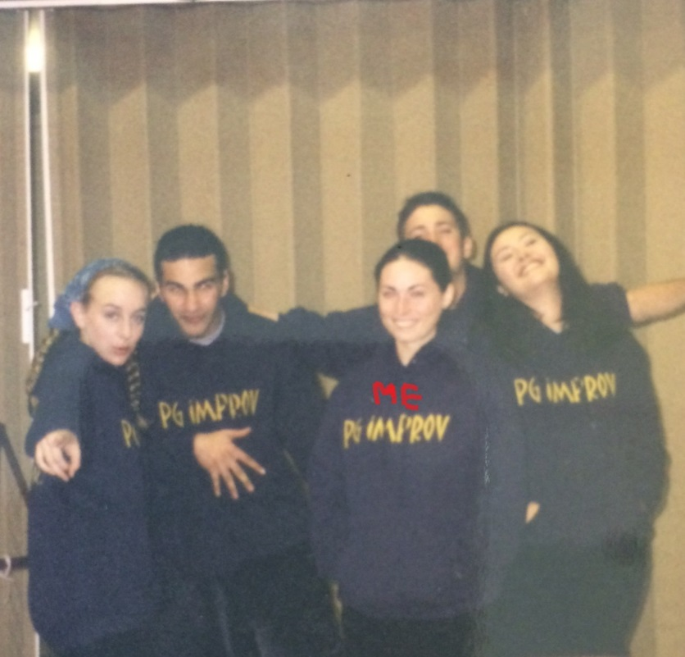
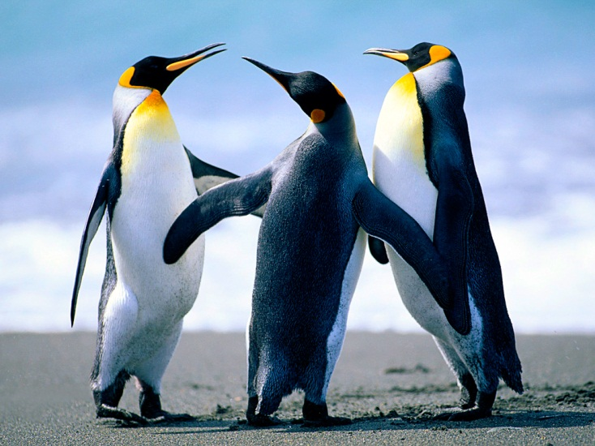
High School
As a HS student I was very studious. I had a lot of different interests that all had social cliques, but since I did a bunch of different things, I never fit into any of those groups. I was friendly with most everyone, but I had a very small group of friends.

Slide 6
Activity
Please take a few minutes to write down 5 things in the following categories:
5 things you think you are good at
5 things you like about yourself
5 things you love

Slide 7
High School
Things that I really liked in High School were:
Sports (Volleyball, Varsity Soccer, Varsity Track
Creative writing
Speech competitions
Theater (plays and an Improv troupe)
Movies
Traveling

Slide 8
Some things Never Change
Things that I really like and do NOW:
Exercise
Creative writing – Freelance writer, poet, journalist
Voice-Over and public speaking
I see theater and go to museums and love movies
Documentary Film producer
Traveling

Slide 9
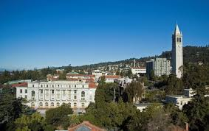
College
I attended college UC Berkeley in Berkeley, CA

Slide 10
College
Things I enjoyed
Things I didn’t enjoy
Berkeley Fiction Review
Club Soccer team
My job at the Student Learning Center as a writing tutor and workshop leader.
Being away from my parents
Spending my entire first paycheck on the cost of a speeding ticket between Freshman and Sophomore year.
A 24-hour essay final my first semester at college. SO STRESSFUL
Getting my C- ever. That was tough.

Slide 11
College
Jobs I worked while I was in College were:
I was a “drop-in” writing tutor at the Student Learning Center
I was the director for DeCal, short for Democratic Education at Cal, which supported undergraduate students who taught half-credit courses on subjects not otherwise available through normal course offering.
I taught an English writing workshop for Freshman students my Junior year.

Slide 12
Getting a job after College
The top few things I did to ensure I got a good job after college were:
After graduation, I interned for a Literary agent for the summer
I applied to jobs while I was interning.
I networked. I asked friends and family is they new companies or people looking for employees in writing and communications.
I applied to be a SAT writing tutor and was accepted.
I took a part-time job at a local independent bookstore at minimum wage while I applied to other jobs.

Slide 13
My Career Path
Editor of a lifestyle magazine, PASADENA, writing articles and hiring writers and photographers
Writing pop-up ads and skyscrapers for beauty products
Getting hired to run the website for my boss’s family foundation and getting promoted to where I am now, the Director of Communications
Notes:
You may use this chart to describe your journey to the current career

Slide 14
Compensation at my company
Chairman
(Billionaire)
Management
($100K)
Middle Manager
($75K)
Entry Level
($50-65K)
Notes:
Use this graph to show general compensation ranges for people in various roles in your company

Slide 15
Do it all over again?
If I could talk to my high school self, what would I say?
Save more money! Don’t use credit cards if you can avoid them.
Travel more!
If you want it to happen, make it happen. Go after opportunities!
It’s ok when bad things happen. They make you stronger.
Take more foreign language classes.
Build relationships with professors.
Your grades and GPA do not define you or anyone else. No one thing defines all of who you are.

Slide 16
Best advice
The Trifecta of success
1 – Be Really Good 2 – Be Punctual
3 – Be Nice
But the real secret is that you only need 2 at one time.
If you’re really good and punctual, you don’t have to be nice.
If you’re nice and really good, you don’t have to be punctual.
And if you’re punctual and nice, you don’t have to be really good!

Slide 17
QUESTION AND ANSWER

