Slide 1
YBA Guest Speaker
ELIZABETH RODRIGUEZ
The way to get started is to quit talking and begin doing –Walt Disney

Slide 2
INTRODUCTION
My name is Elizabeth Rodriguez and I am 30 years old.
I work for Prosum Technology Services.
Prosum is a technology services firm that helps clients with consulting and staffing needs.
My role at Prosum Technology Services is Manager for the Administrative Team.
I oversee the administrative team in their day to day functions and long term projects.

Slide 3
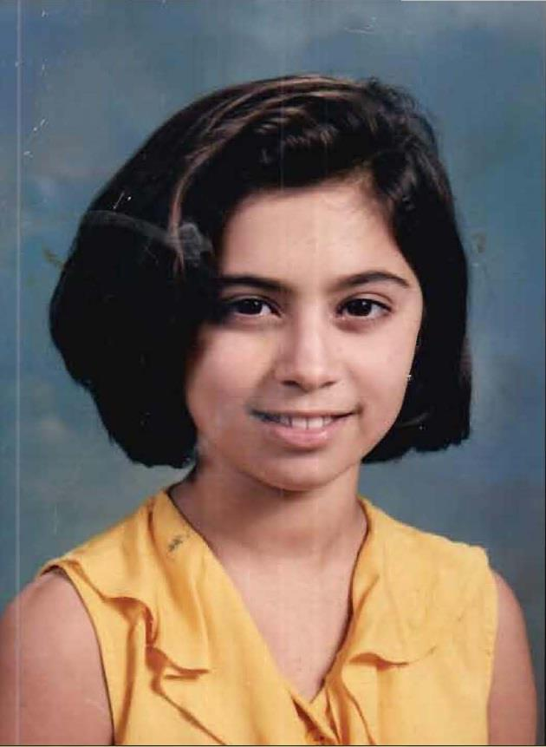
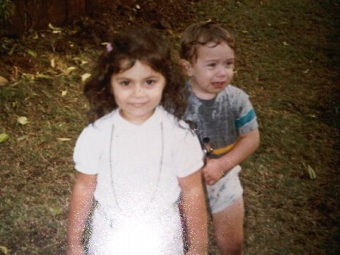
The Early Years…
I was born in Santa Monica and raised in Inglewood
This is a picture of me at age 3.
This is a picture of me at age 10.

Slide 4
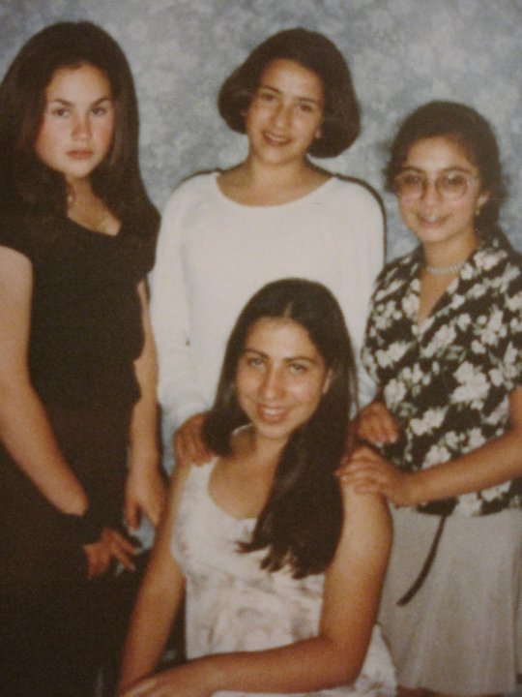
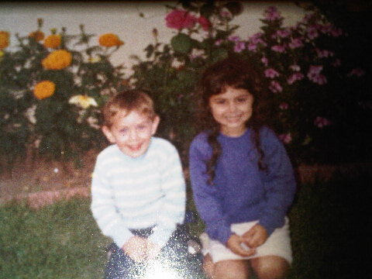
More Early Years…
A little about my family…
This is a picture of me and my brother Chris.
This is a picture of me (at an awkward age) and my cousins: Michelle, Anabel, and Nereida.

Slide 5
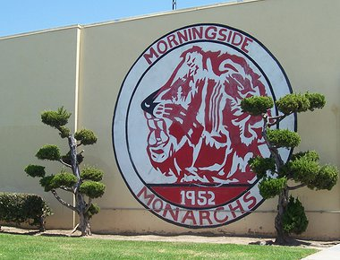
HIGH SCHOOL
I attended Morningside HS in Inglewood, CA
\

Slide 6
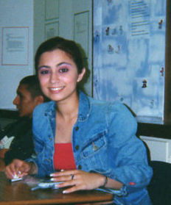
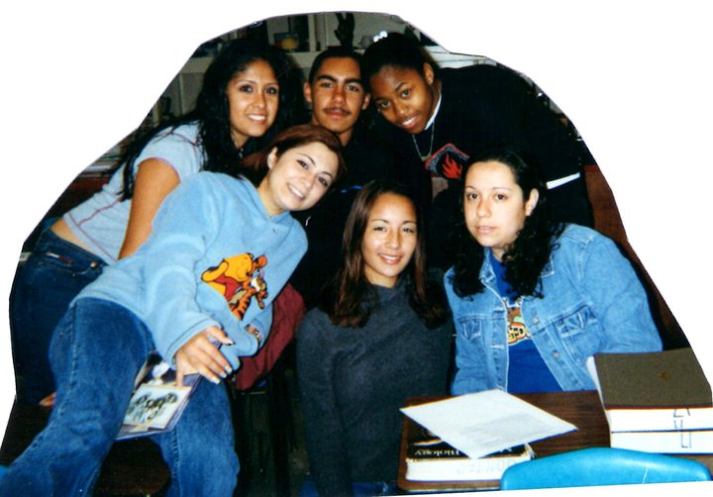
HIGH SCHOOL
As a HS student I was involved in EVERYTHING: Softball Team, G.A.T.E., French Club, Academic Decathlon, CBOP/EAOP, Student Government…
As a HS student I was outgoing (but very nerdy), popular (at least I thought I was), over-achieving, and very annoying.
\
Here is a shot of me in HS
Some friends and I in the 12th grade

Slide 7
HIGH SCHOOL
Things I enjoyed in HS
Things I did not enjoy in HS
Playing softball
Planning student body events
My afterschool job (not joking, either)
Buying and putting on makeup
Hanging out with my friends
Homework! (jk, I actually enjoyed this, but cool people don’t admit that)
Bad Grades (anything lower than an A-)
Standardized testing

Slide 8
HIGH SCHOOL
Activities/Athletics in HS
Jobs I worked while in HS
Softball
G.A.T.E.
Student Government
  Senior Class Vice President
  Senior Class Representative
French Club
CBOP/EAOP
Academic Decathlon
Clerical Aide, Inglewood Unified School District
Part-Time administrative work at an Optometrist’s Office: Inglewood Optometric Center

Slide 9
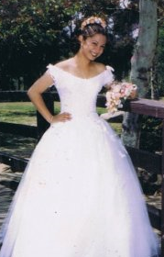
HIGH SCHOOL
Fondest memories from HS
My quinceañera
Day after Prom: went to Six Flags with my friends
Senior Year Winter Formal
Week leading up to the Academic Decathlon
  All of the teachers would excuse us from our classes so we could prepare, where my team-mates and I ate a lot of food and de-stressed

Slide 10
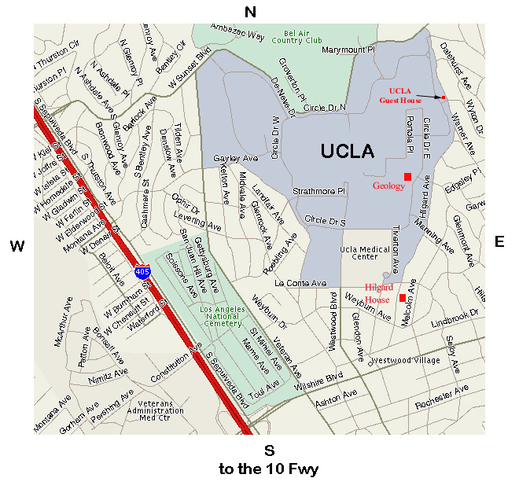
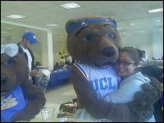
College or
Graduate School
I attended college in Los Angeles, CA (UCLA)
My senior year of college
\

Slide 11
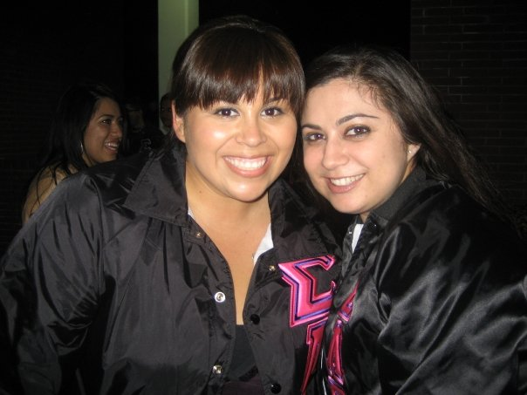
College
Activities in College
Jobs I worked while in College
Inglewood Optometric Center
ASUCLA Textbook Store –Information Counter
BearWear –Souvenir Stands at Football and Basketball Games
Dream Dinners –Associate
**and all of them at the same time!
Sigma Lambda Gamma, National Sorority, Inc.
Dream Scholarship Fund –Chair
Shine! K-12 Outreach Program
Early Academic Outreach Program

Slide 12
College
Favorite classes
Least favorite classes
All of my Linguistics classes!
Language, Culture, and Communication
Language Development
Italian/Quechua
Comparative Literature
Philosophy of Logic
Cultural Geography
Organic Chemistry
English Composition
Human Evolution
Statistics and Probability (for Life Science Majors)

Slide 13
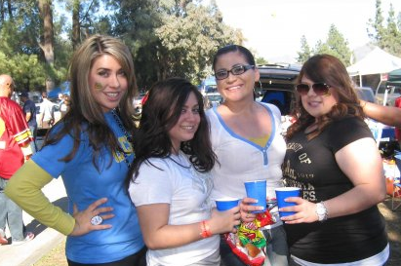
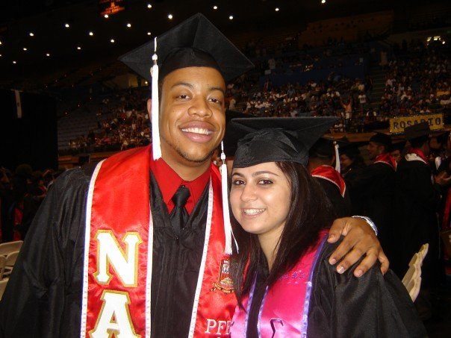
College
Fondest memories
Obstacles or adversity that you had to overcome
Tailgating football games
Graduation
My sorority
  Recruitment events
  Parties
  Dinners/bonding
Transitioning from high school rules to academics
  no one made me go to class
Learning to study
Being responsible for MYSELF

Slide 14
Career Path
I started as an administrative assistant
I was promoted to administrative team lead after a little over one year
Four and a half years in I am now the Administrative Team Manager. I’ve recently taken on managing the coordinators for other practices.
(In a few years I plan to take over the administrative world!)
Notes:
You may use this chart to describe your journey to the current career

Slide 15
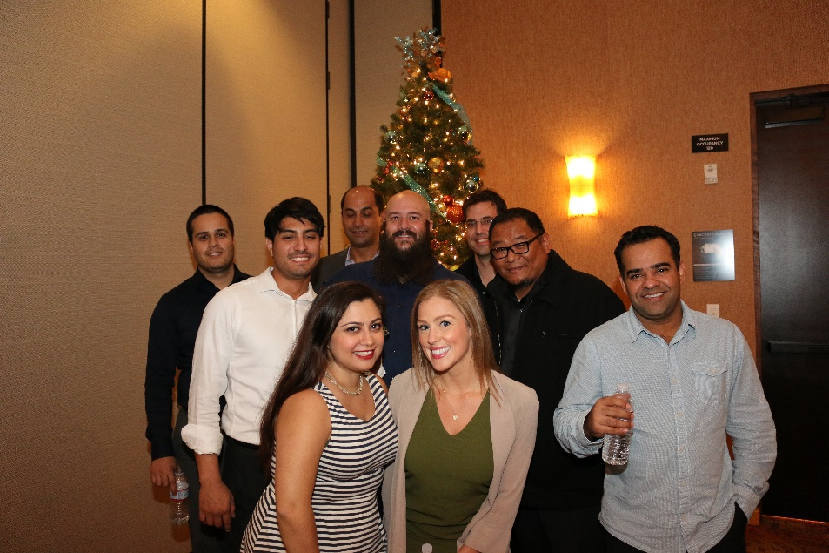
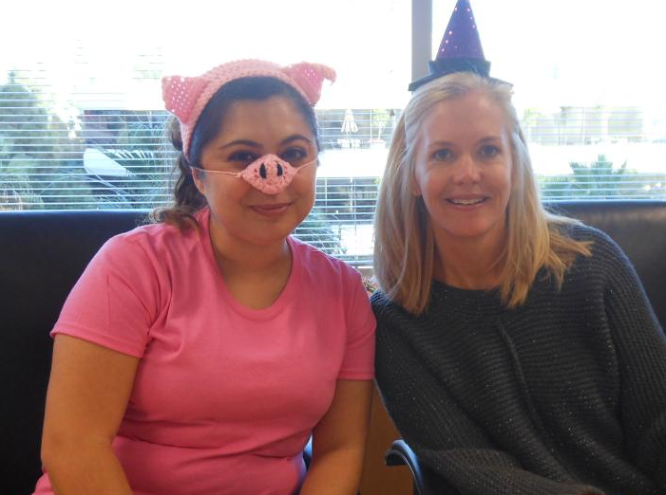
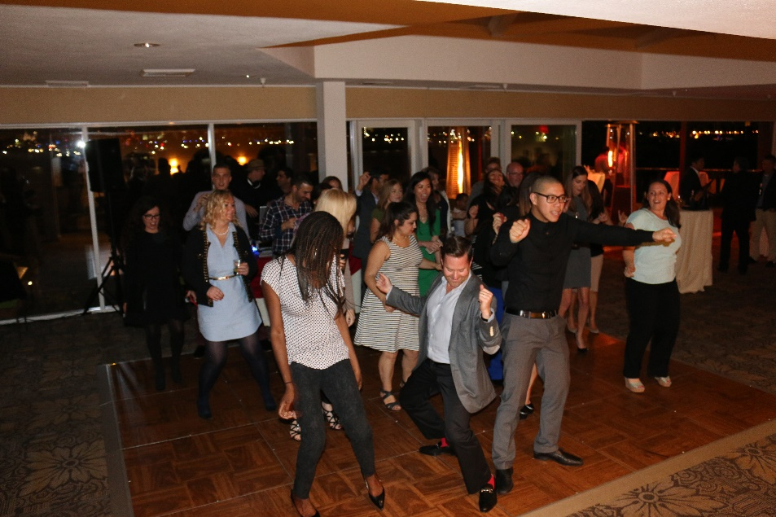
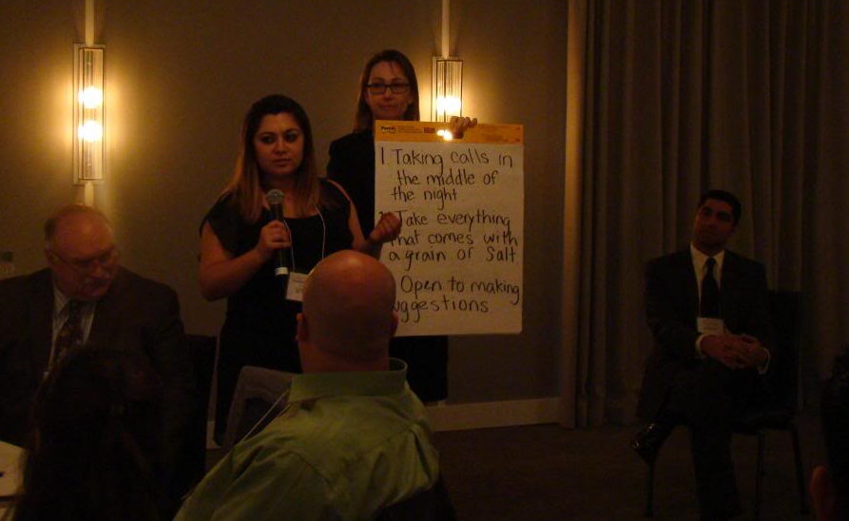
Career
Company Halloween Party
Holiday Party 2014
Speaking at our Kickoff Event

Slide 16
Career
My first Job
My worst Job
Clerical Aide at an Elementary School in Inglewood
I photocopied assignments for the teachers, worked with small groups of kids on reading assignments, and any tasks that helped out around the classroom.
Dream Dinners Associate
It was my job to prep food for guest sessions, put frozen foods in portioned bags, and then clean up after the guests at the sessions.

Slide 17
Career
Some challenges I had to overcome in my career
Figuring out what I wanted to DO!
The courage to seek out the mentorship and advice of the RIGHT people.
Challenging myself
  Easy to keep doing easy work
  Hard to purposely take a plunge into the unknown

Slide 18
CURRENT ROLE
History
Prosum Technology Services was founded in 1996
We have grown from 1 desk in our founder’s apartment to hundreds of desks in our offices
Size
281 total employees, 3 offices, 100s of offsite employees
A little under 100 “core” employees
Location
2 offices in Southern California (El Segundo & Irvine)
1 office in Hyderabad, India
Products
Services
Technology Services!
Staffing and Consulting practices
Staffing for our staffing clients and project based work with our consulting clients.
Notes:
Use this graph to give more description of your current company (history, size, location, products and services, etc.)

Slide 19
Current Role
Administrative Manager
Strategic Role within the company
Liaison between my team and entire office
Work closely and directly with Executives
Manage a team of 5
Notes:
Use this graph to give more description of your role specifically (responsibilities, typical work week, direct reports, etc.)

Slide 20
Career Compensation
One day:
Millions
Management:
$50-70K
Supervisory:
$45-50K
Administrative
Hourly: $12-15
Notes:
Use this graph to show general compensation ranges for people in various roles in your company

Slide 21
ACADEMIC EXERCISE
We will now spend several minutes discussing the day’s academic module and how it is relevant in the ‘real world’

Slide 22

QUESTION AND ANSWER

