Slide 1
YBA Presentation Tamara Shayne Kagel
March 25, 2015
Santee High School

Slide 2
INTRODUCTION
My name is Tamara Shayne Kagel and I am 32 years old.
I am a writer for The Huffington Post and just finished my first book which is called The Genius Girl’s Guide.
I am also a lawyer who used to work as a criminal prosecutor for the City of Los Angeles.
Before law school, I danced for a ballet company and I’m also a certified yoga instructor.

Slide 3
My childhood
I am also from LA. I was born in the San Fernando Valley and raised in Calabasas.
This is a picture of me and my sister.

Slide 4
Me and my friend. Me and My sister.

Slide 5
My family
My parents worked very hard and all the time.
My mom was an LAUSD teacher and my dad worked in promotional products.
This is a picture of my family at my sister’s Bat Mitzvah.

Slide 6
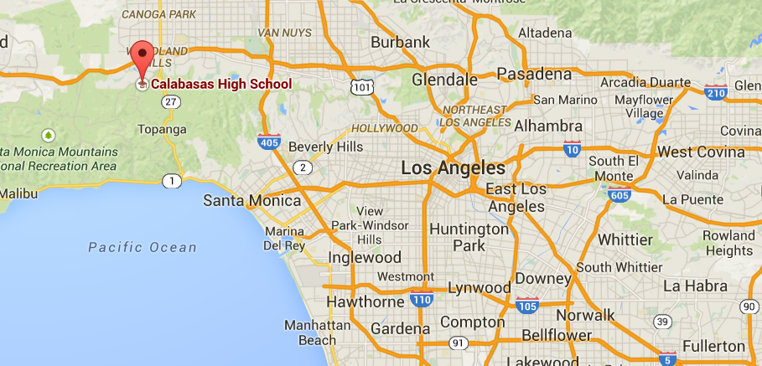
MY HIGH SCHOOL
I attended Calabasas High School, a public school in Calabasas, CA which is in the Valley near Malibu (and is also home to the Kardashians).

Slide 7
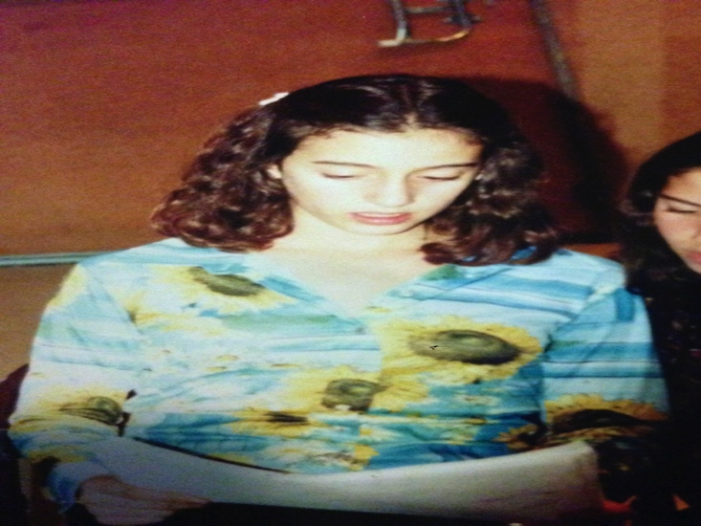
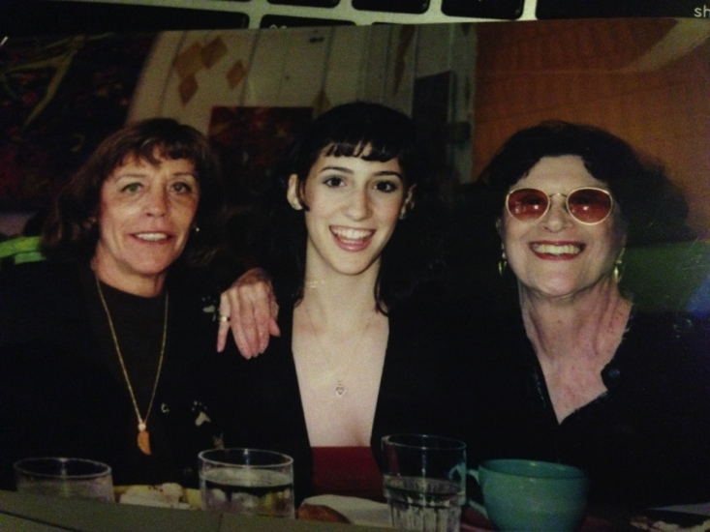
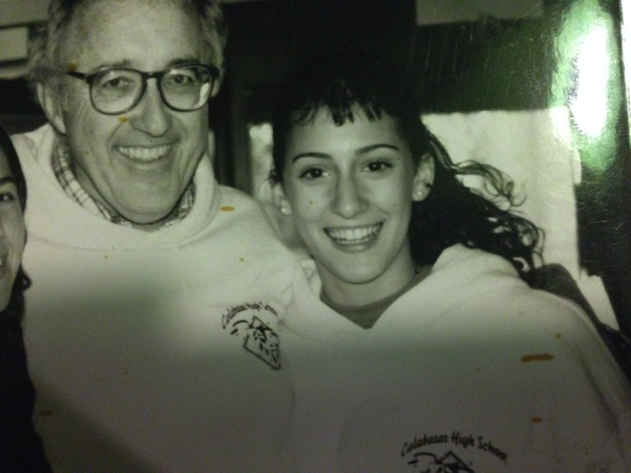
High School
As a HS student I stayed focused on getting into college and getting OUT of high school.
Me, reading lines for a play.
Me and my two Grandmothers at my Sweet 16.
Me and my favorite teacher.

Slide 8
High School
Things that I really liked in High School were:
My classes, especially English and History
My teachers; I spent many lunches with them
Reading Catcher in the Rye, Pride and Prejudice, and The Bell Jar
Dancing and performing
Junior Statesmen of America
Volunteen – civic philanthropy
Reading my bad poetry at open mics
Playing chess

Slide 9
High School
Things that felt difficult or challenging for me while I was in High School were:
Respecting authority (I got suspended for executing an unsanctioned field trip to Sacramento to learn about government)
Thinking I was smarter than everyone else.
Socializing with people who thought becoming a reality TV star was a viable option.

Slide 10
High School
Jobs I worked while I was in High School were:
Interned for Congressman Brad Sherman two days a week and got paid for working their events.
Babysat almost every weekend.
I had to go to Hebrew school two days week in order to get my allowance so not quite a job but still.
I tutored other kids.
My Dad’s company hired me to do some basic accounting.

Slide 11
Getting in to College
The top few things I did to ensure I got into college were:
Studied and prepped for the SAT. It is a learned test. You can’t study enough for it. I had a tutor for this but the most important thing the tutor did was set a deadline for my homework. If you can’t afford a tutor, make yourself accountable to someone.
Cultivate relationships with your teachers. Good letters of rec come because your teachers like you not just from your academic performance. Some of my teachers even asked me to draft my letters of rec for them.
Writing your way in. Your essays matter. Craft your narrative early. What is your story and how does college fit into it?

Slide 12
Getting into college 2
Listen to NPR
You will get smarter
You can do it while doing anything else (like riding the bus, doing laundry, exercising)
You will get familiar with how people at college talk.
Learn your local NPR stations (also great resources on events)
89.9 KCRW
89.3 KPCC
Read the New York Times (or LA Times)
You will learn SAT words (look up every word you don’t know)
PODCAST
Especially THIS AMERICAN LIFE, RADIOLAB, PLANET MONEY

Slide 13
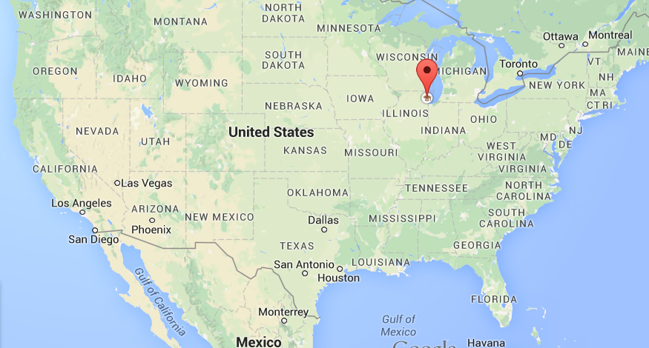
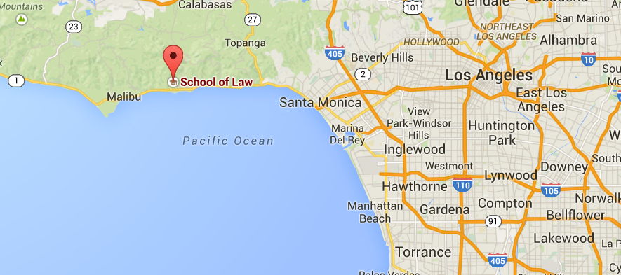
College
I attended Northwestern University in Chicago, Illinois for undergrad and then Pepperdine University School of Law for law school.

Slide 14
College is Awesome

Slide 15
Really awesome

Slide 16
College
Things I enjoyed in College
Things I didn’t enjoy in College
The people. Being around other smart kids from different backgrounds
The classes. Like poetry, dance, film, rock n roll, comic books, etc.
Becoming friends with my professors
Student government
Speakers, events
My sorority (sort of. They’re a little weird but they throw cool parties)
Dating for the first time
How much is free. Free events, concerts, speakers, services, etc.
The pressure
Learning to deal with depression

Slide 17
College
Favorite classes
Least favorite classes
Classes where you get to write a paper instead of taking a test
Fiction writing classes
Dance classes
America studies
History of Rock n roll
Public speaking
Photography
Logic – I did not have the math background to succeed in this class
I wish I had gone abroad but I didn’t. The classes are often not difficult and it’s an incredible experience.

Slide 18
College
Jobs I worked while I was in College were:
I was in student government all four years of NU. Two as a student senator, and two as Vice-President of the student body which counts as work-study
I worked as a dancer for a DJ company.
I interned for Senator Dick Durbin of Illinois.
I worked as a tour guide for NU.
Make good use of your summers.
Even if you don’t know what you want to do after you graduate, having name brands on your resume helps everything. For example, interning with a big company, big studio, big brand, big political party, are all good experience for any type of job down the road

Slide 19
College
Things that felt difficult or challenging for me while I was in College were:
Juggling it all. I wanted to do everything.
Managing my time. Overcoming procrastination.
Getting over my pride and asking for help.
Dealing with unlimited freedom.
Use your resources
If you can’t afford books, tell the library to help you get them for free.
If you are depressed, find free counseling.
If you’re behind in classes, talk to your counselor.
Take advantage of everything and make the school work for you. The school really wants you to graduate. Make them help you realize this goal.

Slide 20
College
Choose your major mindfully.
Things like engineering are proven to be more valuable. But they are going to be harder and it could mean that it makes it harder for you to graduate.
After freshman year, you can get into most classes by being persistent. Audit and harass the teacher.
Get help at every stage.
Ask your professors for help or give advice.
Tell your friends when you’re struggling.
Have fun in moderation.
Learning to say no to social opportunities is a part of maturing.
Prioritize your health.
Sleep, exercise, rest, meditation, reading, being in nature, did I mention sleep!

Slide 21
Getting a job after College
The top few things I did to ensure I got a good job after college were:
Get good grades
Not get into too much trouble. Remember, you’re no longer a minor!
Network and make connections, otherwise known as friends.
The people you know now are your best connections.
Graduate college
This will be harder than you think and you need to go into college with a safety net! Create one now.
The odds are against you so make a plan for what to do for when you fall behind.

Slide 22
My Career Path
I wrote for free for the Huffington Post and started my first job as a lawyer as a prosecutor for the City of Los Angeles.
I now have a book coming out called The Genius Girl’s Guide which I’ve already sold the TV rights for.
I danced as a ballet dancer for 4 years while waitressing
I worked for a night life magazine called 944 as an event reporter while in law school, then blogged for the Jewish Journal.
I wanted to get a Masters in Writing but couldn’t afford it so I got an academic scholarship to go to law school
Notes:
You may use this chart to describe your journey to the current career

Slide 23
My Career
The first job I had after college was:
I danced full time in a dance company and I waitressed for a fine dining restaurant (actually a few, I wasn’t a very good server.)
Tough job:
Waitressing while dancing was very hard.
Working in customer service is miserable and you have to get used to being talked down to but it’s a good lesson for every job you could have.

Slide 24
My Career
Challenges I have had to overcome throughout my career are:
Believing in myself.
You have to learn to fail and continue.
You know that you have to believe in yourself but you have to learn to do it, even after you screw up.
Just by trying again, you will succeed.
The people who succeed are the ones who believe they can even when the evidence points to the contrary.
Convincing others to believe in me.
My parents did not want me to be a writer. They wanted me to be a lawyer.

Slide 25
More than just work
When I am not at work I like to:
Yoga, hike, bike ride
Meditate
Try new restaurants
See movies
Go to museums
Throw dinner parties and visit with friends.
Read
Listen to NPR and podcasts.

Slide 26
Do it all over again?
If I could talk to my high school self, what would I say?
Personal relationships affect career success
Having a bad break-up affected my career.
Having it all for women – you can have both but it’s hardest to have it all at the same time. Delaying marriage and kids meant more time to focus on my career. I got married this past year and I would say it was the perfect age.
Network more - Ask people for advice. Ask anyone even remotely related to your industry for their card and their advice.
High school is the worst time of life for a lot of people.
Care less.
Be accountable to someone. Deadlines erase doubt.
Deal with procrastination ahead of time.

Slide 27
QUESTION AND ANSWER

