Slide 1
YBA GUEST RESOURCE TEMPLATE

Slide 2
INTRODUCTION
My name is JASON CIMENT and I am 46 years old.
I run a few companies including
LADEZIGN.COM and MAGAZINESUBSCRIPTION.COM
LADEZIGN builds websites and promotes them:
I sell magazine subscriptions to businesses and libraries
My role at both companies is mostly business development
I read and respond to hundreds of emails and phone calls.
I go to a lot of networking events to meet people.

Slide 3
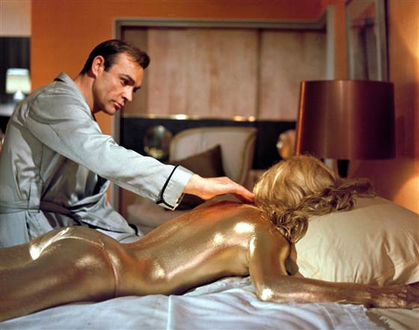
My childhood
I was born and raised in Miami Beach until I was 16.
This is a picture of James Bond at the famous Fountainbleu Hotel

Slide 4
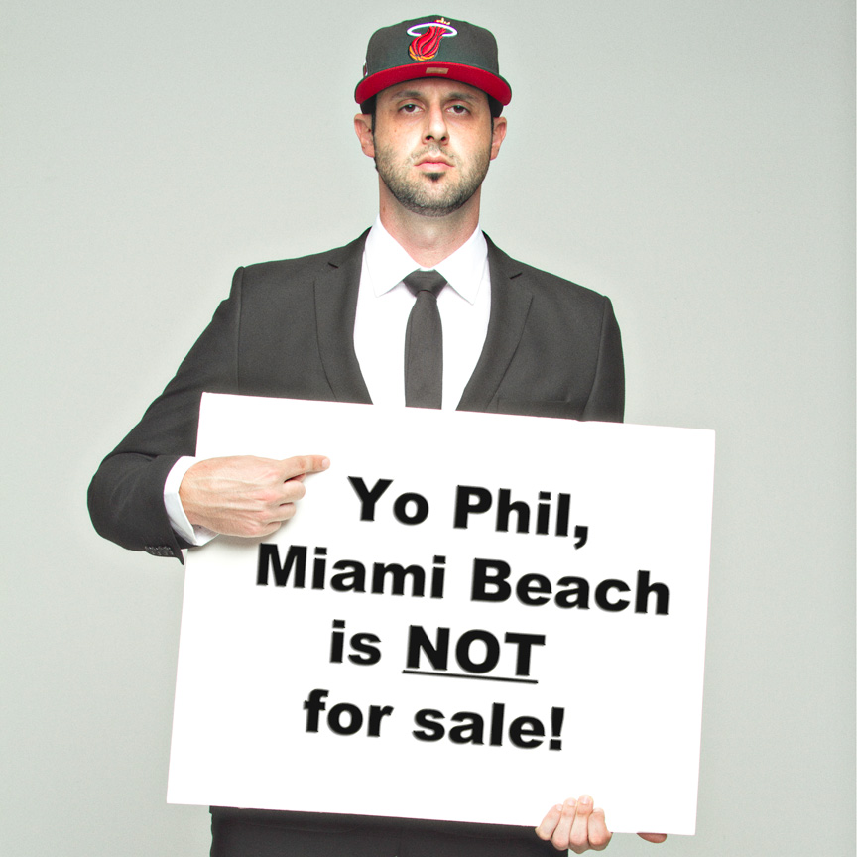
My family BACKGROUND
My dad was Mayor of Miami Beach when I was 12. He was pretty famous back then as one of the first practicing Orthodox Jews to go into politics – even if it was part time.
I am the middle of two brothers. My mom has been in business since right after I was born.

Slide 5
MY HIGH SCHOOL
I attended Hebrew Academy in Miami Beach, Florida
For 12th grade I went to study abroad in Jerusalem.
I also got a year of college credit at the same time.

Slide 6
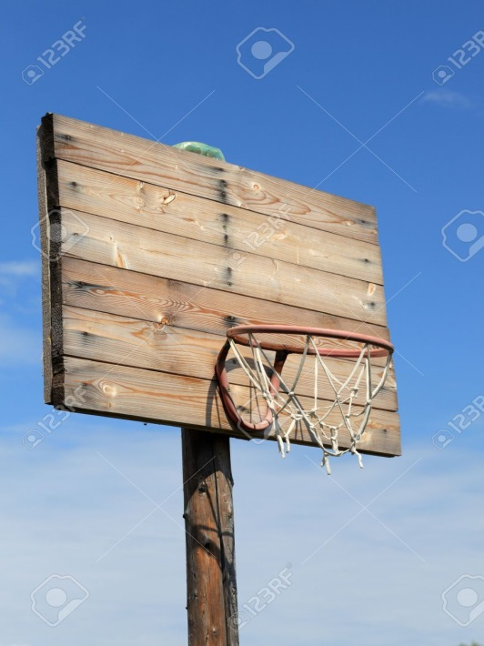
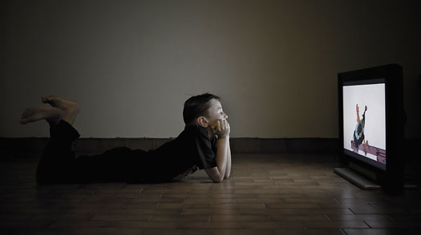
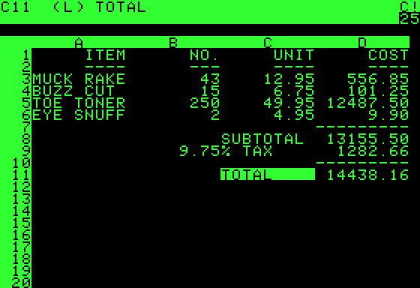
High School
As a HS student I was never bored because even without a cell phone, I had plenty of ways to stay busy.

Slide 7
High School ACTIVITIES
Things that I really liked in High School were:
Reading Hardy Boys and just getting into “thrillers”
Learned to play chess from a grandmaster from Russia
Shooting free throws
Tennis after school
After school job to make money to buy comic books

Slide 8
High School CHALLENGES
Things that felt difficult or challenging for me while I was in High School were:
I didn’t find my groove until I was 18 at the end of my first year of college.
My high school class didn’t get along. They could not even have a reunion because people didn’t care.
I learned later in life how my brain really works. I used to be jealous of the “crammers” (who were usually the troublemakers) and only now realized that if I knew how to study “for me” I would have done much better without freaking out.
I had mostly girls my age that lived near me. Of course this is supposed to be cool but there are good reasons why it wasn’t. you can all figure those reasons out. So I had to find boys of different ages to be friends with.

Slide 9
High School JOBS
Jobs I worked while I was in High School were:
I worked after school in my mom’s business cleaning her store, putting away the merchandise, filing things and answering the phone. Used to ride my bike. Get paid a quarter (for real), maybe it was fifty cents (is that name trademarked now) and go downstairs to the diner and buy a piece of toast and jelly. I also used to buy Richie Rich and Batman comics.
I used to import kosher chewing gum from New York and sell it to friends because we didn’t have a kosher store where I lived.
In 11th grade I started a magazine subscription business selling magazines to doctors and printed up 5,000 brochures for $120 (back then). The business became a real business when I was 26.

Slide 10
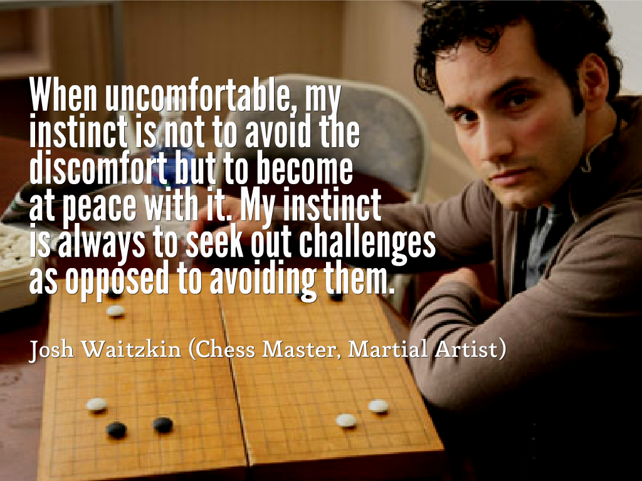
Getting in to College
I did thousands of math problems in the SAT books. I never took an SAT course. Couldn’t afford it.
Played violin from the age of 10.
Started the chess club in high school. I wasn’t ever really good but I was good enough to at least play with confidence. But I wasn’t willing to practice enough and memorize all the games that rated players were doing.

Slide 11
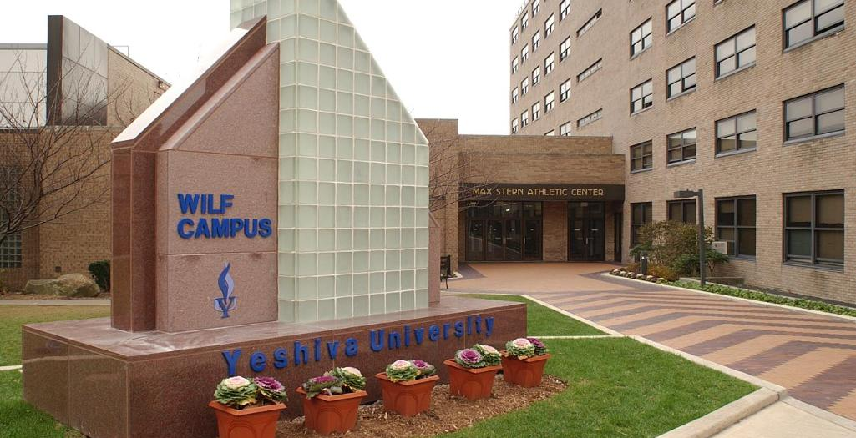
College
I attended a dual curriculum college in New York City

Slide 12
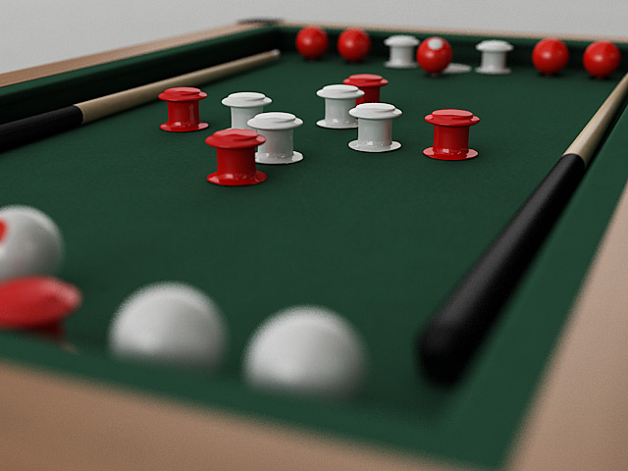
College DISTRACTIONS
I was the bumper pool champion in my college in my freshman year. Funny thing is I beat my roommate who was #2. Played a lot of ping pong and Foosball. Remember no laptops or cell phones.

Slide 13
College CLASSES
Favorite classes
Least favorite classes
Speech and Debate (even founded the debate team)
Capital Finance (this was not boring accounting stuff but lectures from Nobel prize winners each Friday for 3 hours.
Any science
The marketing class where the professor told me I could do better because she taught my older 4.0 grade average brother.

Slide 14
College
Things that felt difficult or challenging for me while I was in College were:
Hardest thing was classes that required memorization and spit back of materials. I used to create tons and tons of cribsheets hoping that the process of writing things down would help commit them to memory.
Turns out I learned that writing things down removes stress which became quite valuable in my work world.

Slide 15
EMPLOYMENT POST College
The top few things I did to ensure I got a good job after college were:
Got really good grades in my major.
Did enough extra curricular activities to have conversations points during interviews.
Made sure my “story” was different than other people interviewing. This became the source of my ability to do a good job for clients in LA Dezign.

Slide 16
This is ladezign
We design, build and promote websites for:
Law firms
Manufacturers
Online stores
Service firms
Charities

Slide 17
This is MAGAZINES
We provide subscriptions to the following types of subscribers:
Businesses
Individuals
Schools
Students
Libraries

Slide 18
My Career Path
I went to Fordham Law School and passed the Bar Exam
I worked as a CPA for 2 years
I am now the CEO of two companies started after 1996 that continue to grow.
Notes:
You may use this chart to describe your journey to the current career

Slide 19
Career HIGHS AND LOWS
The first job I had after college was:
Working as a CPA for the top accounting firm in the country with expertise in real esate.
The worst day I have ever had at that Job was:
I left work around 7:00pm one night after finishing my work for the day. Came in the next morning and got reamed for leaving without asking permission from my immediate supervisor. This took me totally by surprise.
The best day was two months later when the assistant to the Human Resources director (who hires and fires) said I don’t like rumors and I’m putting you on the most high profile gig and it will make you or break you. (I did fine).

Slide 20
Career challenges
Trusting people too much. I try too hard to give people 2nd and 3rd chances always hoping for the best.
This relates to hiring the right people.
Having a good partner in each business enterprise.
Learning how to communicate more appropriately with clients and referral partners.
Staying focuses since I want to do so many things all the time.

Slide 21
More than just work
When I am not at work I like to:
Reading at least 2 books a week. Shutting down all the electronics is a benefit.
Family stuff with my wife and 4 kids.
Charity endeavors that are also personal relationship driven.
Started a high school club for Jewish kids in public school to learn about Judaism.
Start new business ideas.
Work with high school kids on internships in the summer.
Addicted to tv shows. Do not like horror stuff. Life is scary enough.

Slide 22
Do it all over again?
If I could talk to my high school self, what would I say?
Don’t pay rent. Figure out how to buy an office building to own.
Find a good partner.
Travel after college before starting my work life.
Learn to ski at a younger age.
Use my summers to have experiences.

Slide 23
QUESTION AND ANSWER

